Slide 1

CS 224: ALGORITHMS FOR DATA SCIENCE
LECTURE 23 (11/29)
Tensor decomposition
Sum-of-squares
Robustness
Supervised learning
Computational complexity
Statistical physics
Generative modeling
APPROXIMATE MESSAGE PASSING: OPTIMALITY, PROOF OF STATE EVOLUTION

Slide 2
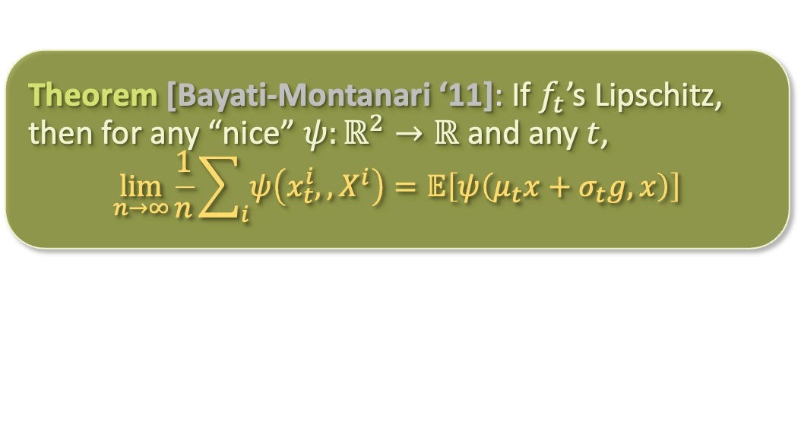
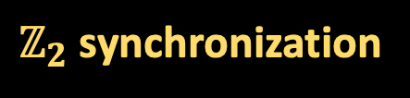
LAST TIME:
mean-field approximation
Onsager correction/
”memory term”
(estimate for marginal expectation)
$ℤ_{2}$ synchronization
approximate message passing (AMP)
Theorem [Bayati-Montanari ‘11]: If $f_{t}$’s Lipschitz, then for any “nice” $ψ:ℝ^{2}→ℝ$ and any $t$,
$$\lim_{n→∞}{\frac{1}{n}\sum_{i}{ψ\left(x_{t}^{i},,X^{i}\right)}}=𝔼\left[ψ\left(μ_{t}x+σ_{t}g,x\right)\right]$$
state evolution

Slide 3
LAST TIME:
mean-field approximation
Onsager correction/
”memory term”
(estimate for marginal expectation)
$ℤ_{2}$ synchronization
approximate message passing (AMP)
“ “
state evolution

Slide 4

LAST TIME:
“ “
We chose the nonlinearity
$$f_{t}\left(y\right)≝𝔼\left[x ∣ μ_{t}x+σ_{t}g=y\right]$$
so that
$$μ_{t+1}=\sqrt{λ}⋅𝔼\left[𝔼{\left[x ∣ μ_{t}x+σ_{t}g\right]}^{2}\right]=\sqrt{λ}⋅σ_{t+1}^{2}$$

Slide 5

LAST TIME:
“ “
We chose the nonlinearity
$$f_{t}\left(y\right)≝𝔼\left[x ∣ μ_{t}x+σ_{t}g=y\right]$$
so that
$$μ_{t+1}=\sqrt{λ}⋅𝔼\left[𝔼{\left[x ∣ μ_{t}x+σ_{t}g\right]}^{2}\right]=\sqrt{λ}⋅σ_{t+1}^{2}$$

Slide 6
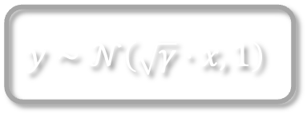


LAST TIME:
“ “
We chose the nonlinearity
$$f_{t}\left(y\right)≝𝔼\left[x ∣ μ_{t}x+σ_{t}g=y\right]$$
so that
$$μ_{t+1}=\sqrt{λ}⋅𝔼\left[𝔼{\left[x ∣ μ_{t}x+σ_{t}g\right]}^{2}\right]=\sqrt{λ}⋅σ_{t+1}^{2}$$
Additionally, we defined
i.e. the minimum mean squared error achievable for the following 1D denoising problem:
$$x∼\left\{±1\right\}$$
$$y∼𝒩\left(\sqrt{γ}⋅x,1\right)$$
“signal to noise ratio”

Slide 7
LAST TIME:
“ “
We chose the nonlinearity
$$f_{t}\left(y\right)≝𝔼\left[x ∣ μ_{t}x+σ_{t}g=y\right]$$
so that
$$μ_{t+1}=\sqrt{λ}⋅𝔼\left[𝔼{\left[x ∣ μ_{t}x+σ_{t}g\right]}^{2}\right]=\sqrt{λ}⋅σ_{t+1}^{2}$$
Additionally, we defined
so that

Slide 8

LAST TIME:
“ “
$$t$$

Slide 9
LAST TIME:
“ “
$$t$$

Slide 10
LAST TIME:
“ “
$$t$$

Slide 11
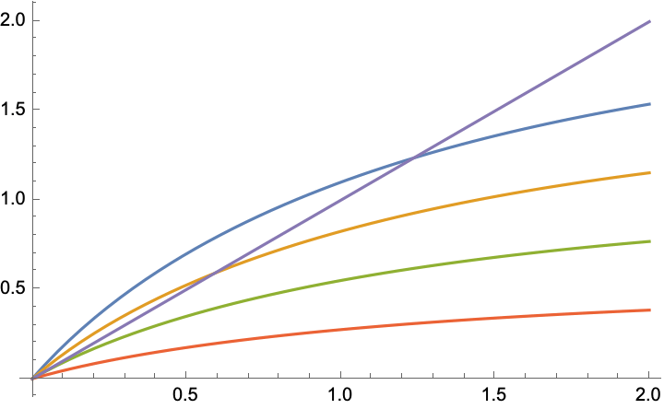






LAST TIME:
“ “
$$t$$
Iterating this results in fixed point $γ_{∗}\left(λ\right)$
$$λ=2$$
$$γ_{∗}(2)$$
$$λ=1.5$$
$$λ=1$$
$$λ=0.5$$

Slide 12
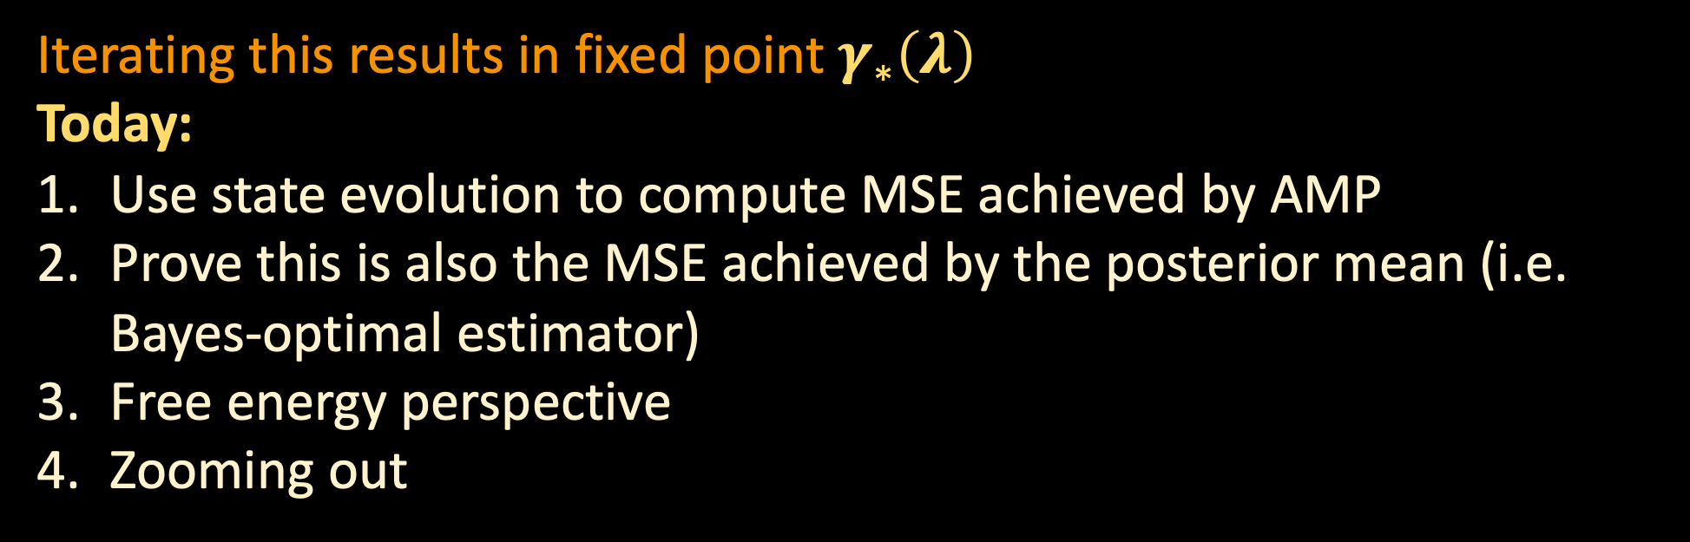
LAST TIME:
“ “
$$t$$
Iterating this results in fixed point $γ_{∗}\left(λ\right)$
Today:
Use state evolution to compute MSE achieved by AMP
Prove this is also the MSE achieved by the posterior mean (i.e. Bayes-optimal estimator)
Free energy perspective
Zooming out

Slide 13
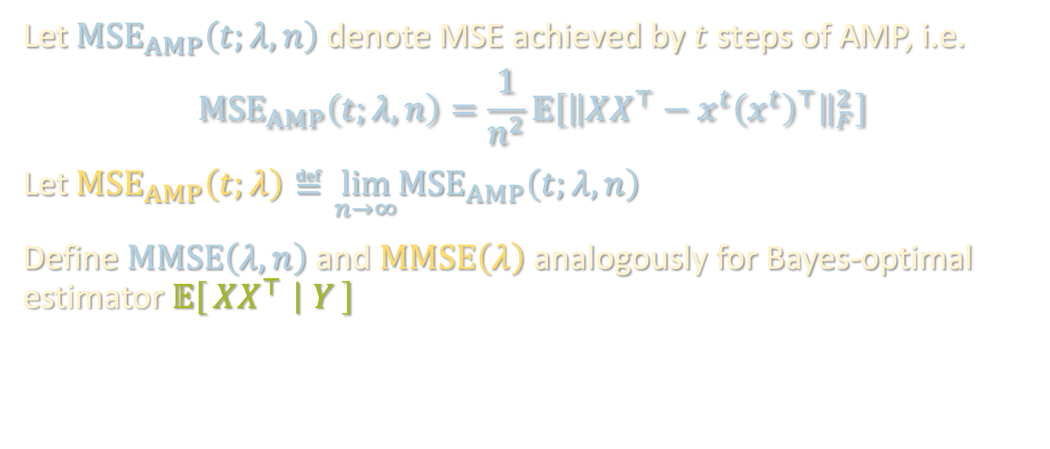
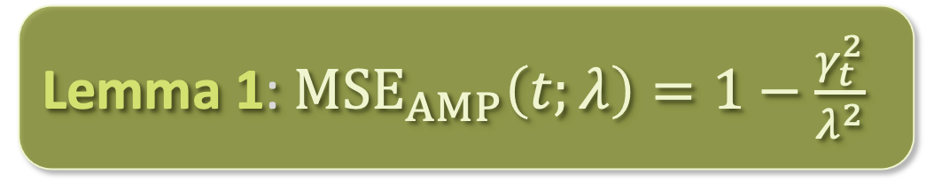
MSE FOR AMP
“ “
$$t$$
Let $MSE_{AMP}\left(t;λ,n\right)$ denote MSE achieved by $t$ steps of AMP, i.e.
$${MSE}_{AMP}\left(t;λ,n\right)=\frac{1}{n^{2}}𝔼\left[{\left\|XX^{⊤}−x^{t}{\left(x^{t}\right)}^{⊤}\right\|}_{F}^{2}\right]$$
Let $MSE_{AMP}\left(t;λ\right)≝\lim_{n→∞}{MSE}_{AMP}\left(t;λ,n\right)$
Define $MMSE\left(λ,n\right)$ and $MMSE\left(λ\right)$ analogously for Bayes-optimal estimator $𝔼\left[XX^{⊤} ∣ Y\right]$
Lemma 1: $MSE_{AMP}\left(t;λ\right)=1−\frac{γ_{t}^{2}}{λ^{2}}$
Proof: Just plug into state evolution (see board)

Slide 14
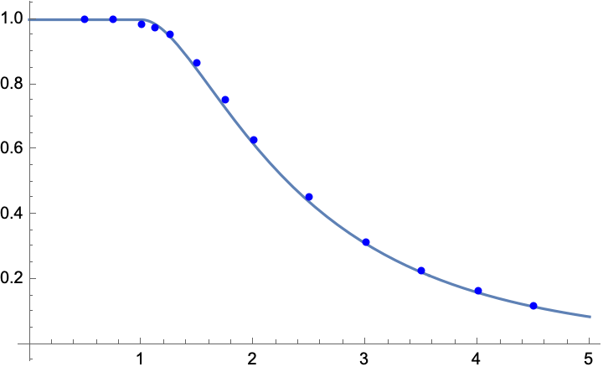


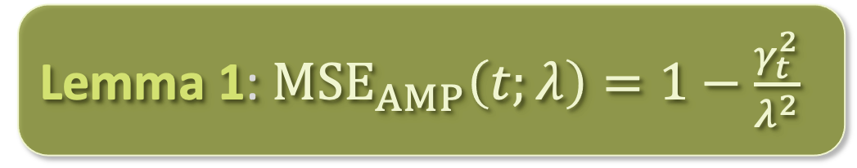
MSE FOR AMP
“ “
$$t$$
Lemma 1: $MSE_{AMP}\left(t;λ\right)=1−\frac{γ_{t}^{2}}{λ^{2}}$
$$MSE_{AMP}\left(λ\right)$$
$$λ$$

Slide 15


MSE FOR AMP
“ “
$$t$$
Lemma 1: $MSE_{AMP}\left(t;λ\right)=1−\frac{γ_{t}^{2}}{λ^{2}}$
Statistical physics-based methods give very accurate predictions of algorithm behavior!
$$MSE_{AMP}\left(λ\right)$$
$$λ$$

Slide 16
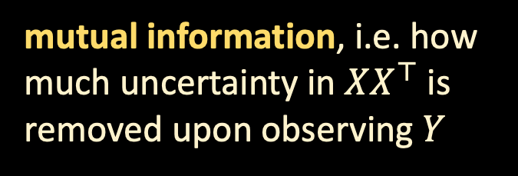
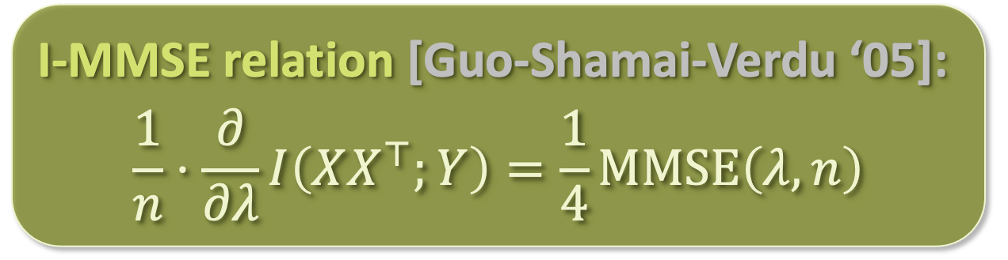
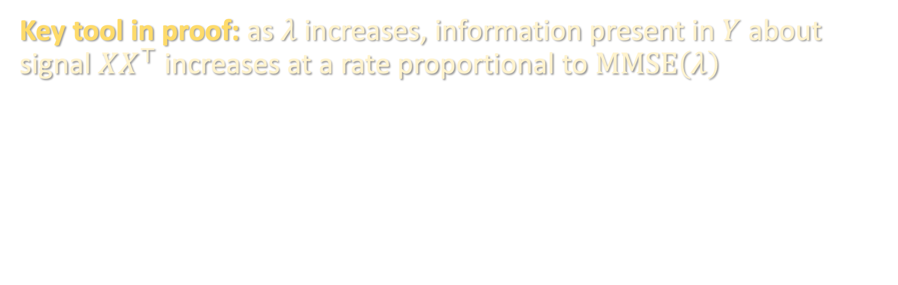

AMP IS OPTIMAL
“ “
$$t$$
Lemma 2: $MMSE\left(λ\right)=\lim_{t→∞}{MSE_{AMP}}\left(t;λ\right)$
Key tool in proof: as $λ$ increases, information present in $Y$ about signal $XX^{⊤}$ increases at a rate proportional to $MMSE\left(λ\right)$
I-MMSE relation [Guo-Shamai-Verdu ‘05]:
$$\frac{1}{n}⋅\frac{∂}{∂λ}I\left(XX^{⊤};Y\right)=\frac{1}{4}MMSE\left(λ,n\right)$$
mutual information, i.e. how much uncertainty in $XX^{⊤}$ is removed upon observing $Y$

Slide 17

AMP IS OPTIMAL
“ “
$$t$$
Lemma 2: $MMSE\left(λ\right)=\lim_{t→∞}{MSE_{AMP}}\left(t;λ\right)$
Key tool in proof: as $λ$ increases, information present in $Y$ about signal $XX^{⊤}$ increases at a rate proportional to $MMSE\left(λ\right)$
$$≤$$
(see board)

Slide 18
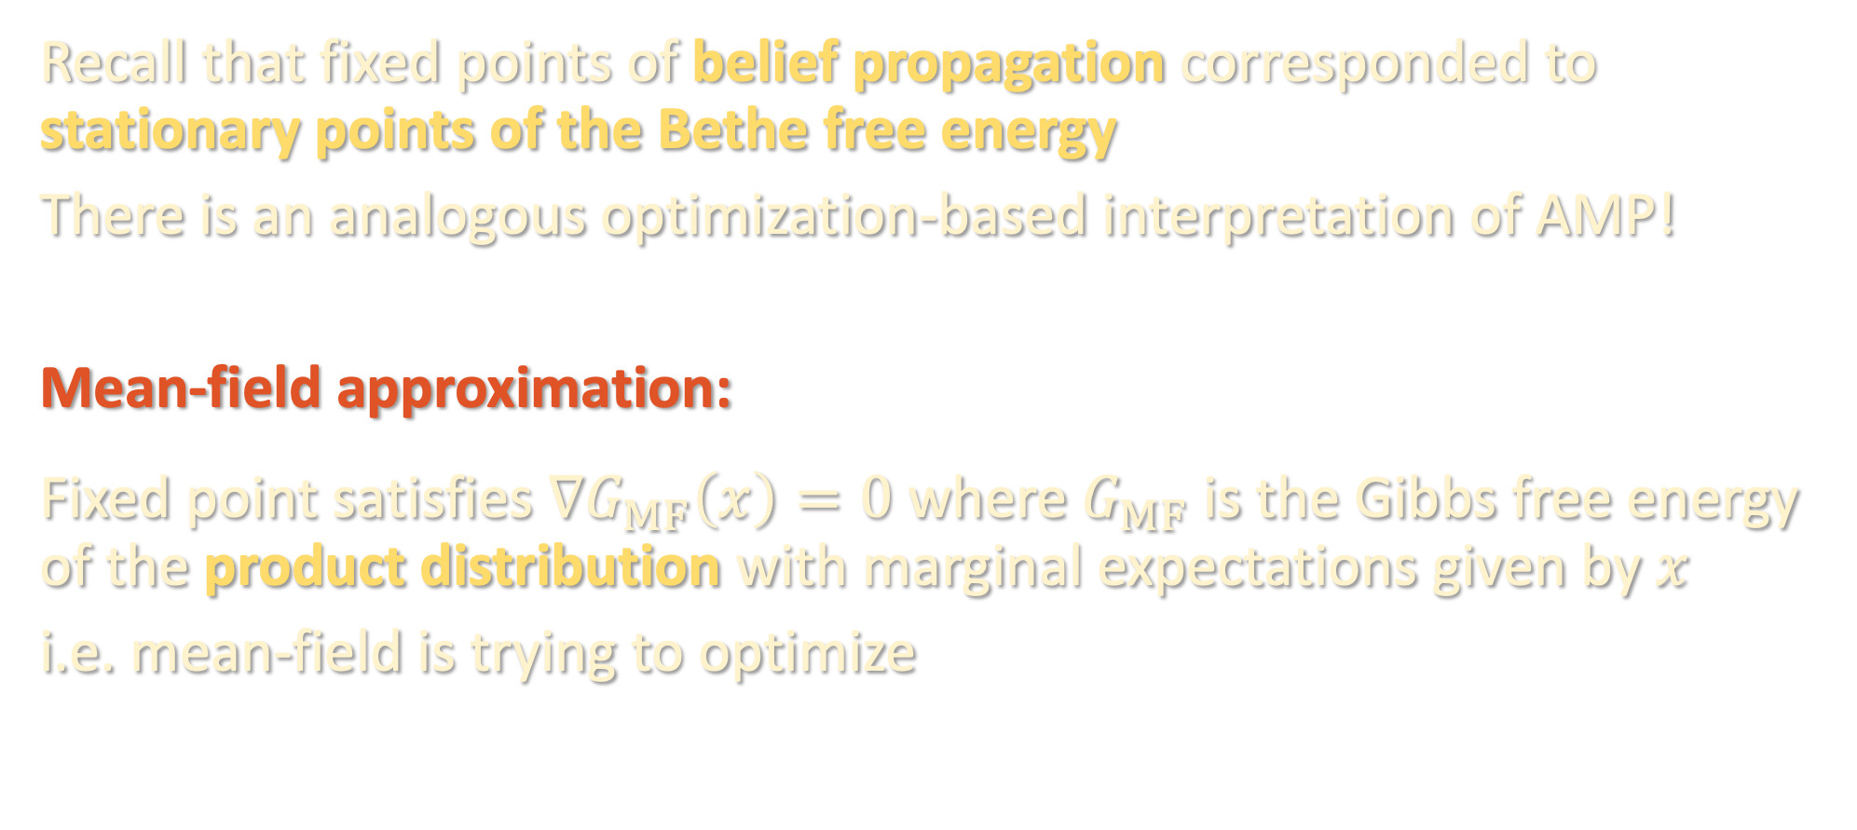
FREE ENERGY PERSPECTIVE
Recall that fixed points of belief propagation corresponded to stationary points of the Bethe free energy
There is an analogous optimization-based interpretation of AMP!
Mean-field approximation:
Fixed point satisfies $∇G_{MF}\left(x\right)=0$ where $G_{MF}$ is the Gibbs free energy of the product distribution with marginal expectations given by $x$
i.e. mean-field is trying to optimize

Slide 19
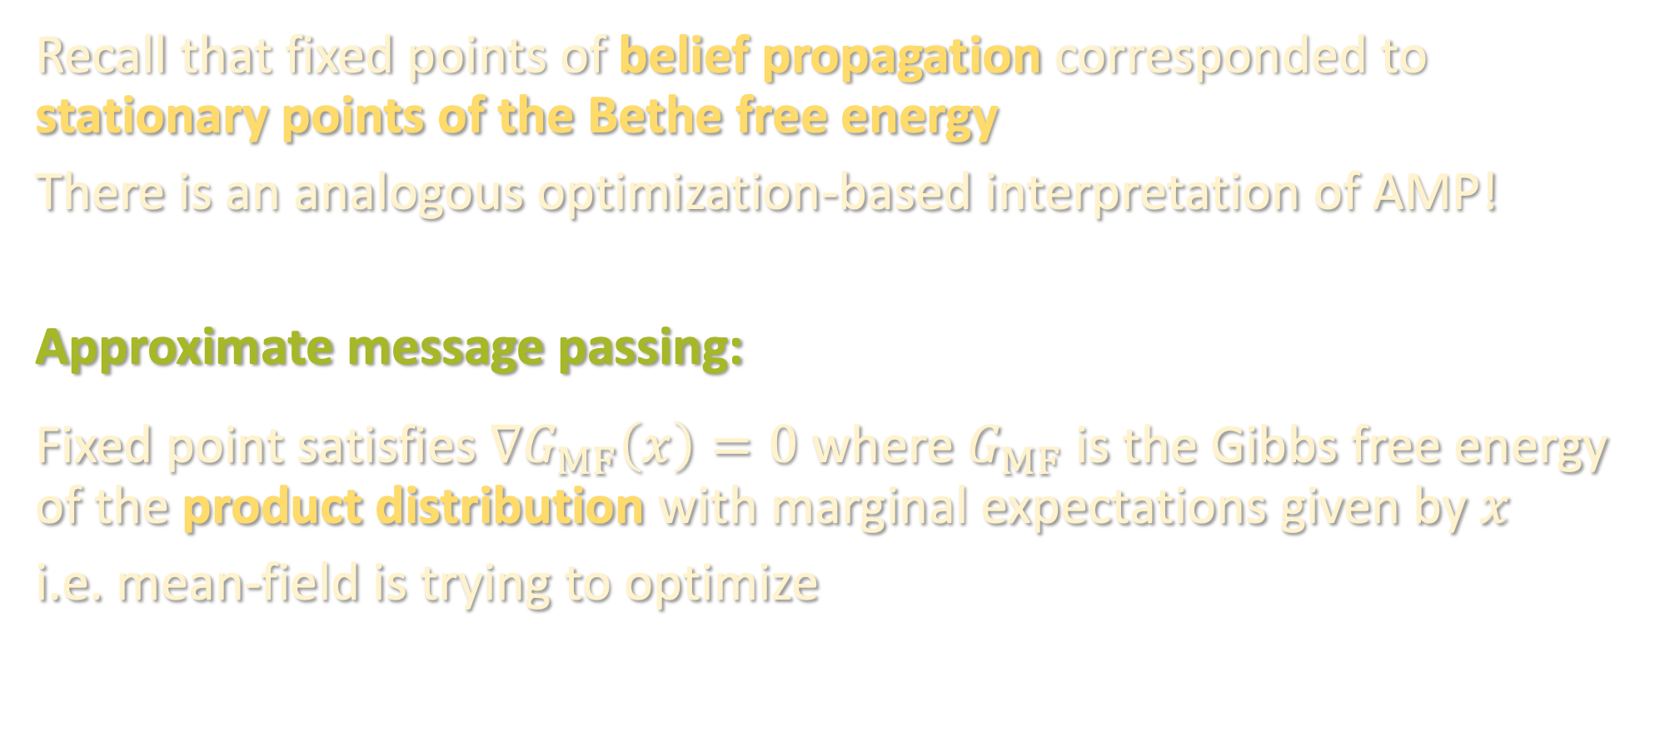
FREE ENERGY PERSPECTIVE
Recall that fixed points of belief propagation corresponded to stationary points of the Bethe free energy
There is an analogous optimization-based interpretation of AMP!
Approximate message passing:
Fixed point satisfies $∇G_{MF}\left(x\right)=0$ where $G_{MF}$ is the Gibbs free energy of the product distribution with marginal expectations given by $x$
i.e. mean-field is trying to optimize

Slide 20
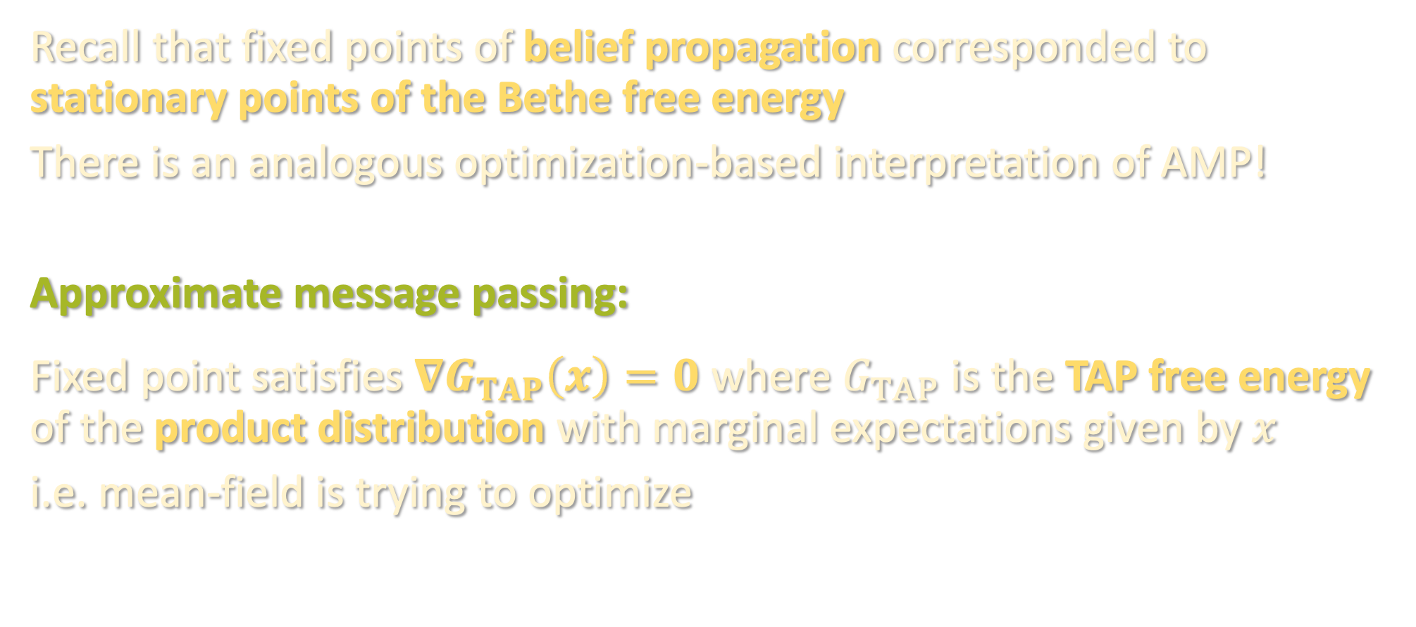
FREE ENERGY PERSPECTIVE
Recall that fixed points of belief propagation corresponded to stationary points of the Bethe free energy
There is an analogous optimization-based interpretation of AMP!
Approximate message passing:
Fixed point satisfies $∇G_{TAP}\left(x\right)=0$ where $G_{TAP}$ is the TAP free energy of the product distribution with marginal expectations given by $x$
i.e. mean-field is trying to optimize

Slide 21

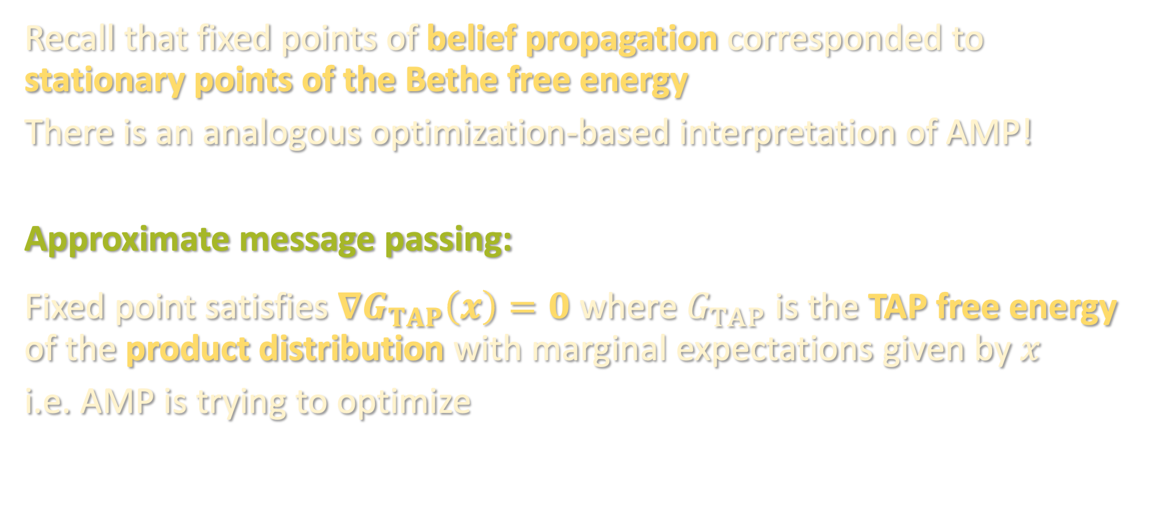
FREE ENERGY PERSPECTIVE
Recall that fixed points of belief propagation corresponded to stationary points of the Bethe free energy
There is an analogous optimization-based interpretation of AMP!
Approximate message passing:
Fixed point satisfies $∇G_{TAP}\left(x\right)=0$ where $G_{TAP}$ is the TAP free energy of the product distribution with marginal expectations given by $x$
i.e. AMP is trying to optimize
$$Q\left(v\right)=\frac{1}{n}{\left\|v\right\|}^{2}$$

Slide 22
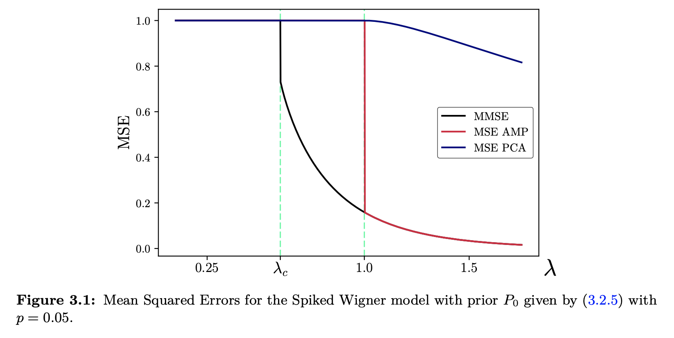


BEYOND $ℤ_{2}$ SYNCHRONIZATION
If the prior on $X$ is not uniform over ${\left\{±1\right\}}^{n}$, e.g. if each coordinate is drawn from $Ber(p)$ for $p≠1/2$, then AMP need not achieve Bayes-optimal error:
[Miolane ‘18, Figure 3.1]
In these cases, AMP still conjectured to be optimal among poly-time algorithms!
Physics approach to computational hardness: free energy landscapes, failure of specific algorithms (BP, AMP, etc.)

Slide 23
BEYOND LOW RANK MATRIX ESTIMATION
Many rigorous applications of AMP:
Compressed sensing [Donoho et al. ‘09], [Bayati-Montanari ‘11], …
Generalized linear models [Rangan ’11, Schniter-Rangan ‘14], …
Mixed linear regression [Tan-Venkataramanan ‘23]
Planted clique [Deshpande-Montanari ‘15]
Group synchronization [Perry-Wein-Bandeira-Moitra ‘16]
Nonnegative PCA, sparse PCA, etc. [Montanari-Richard ‘16], [Deshpande-Montanari ‘14], …
Random polynomial optimization [Subag ‘21], [Montanari ‘19], [El Alaoui-Montanari-Sellke ‘21], …

Slide 24
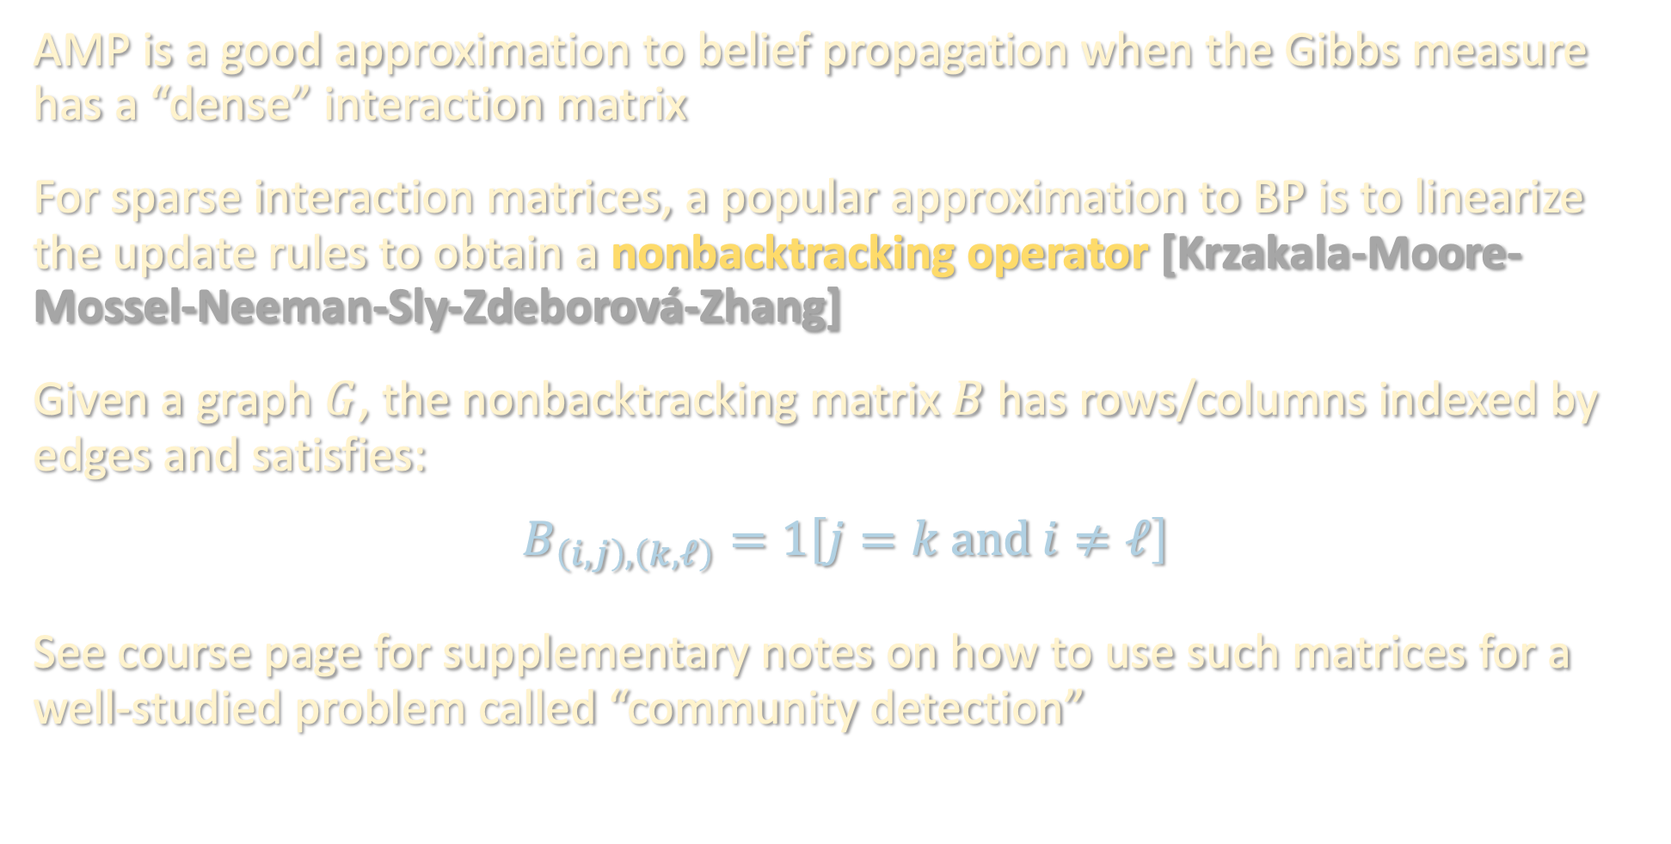
OTHER BP-INSPIRED ALGORITHMS
AMP is a good approximation to belief propagation when the Gibbs measure has a “dense” interaction matrix
For sparse interaction matrices, a popular approximation to BP is to linearize the update rules to obtain a nonbacktracking operator [Krzakala-Moore-Mossel-Neeman-Sly-Zdeborová-Zhang]
Given a graph $G$, the nonbacktracking matrix $B$ has rows/columns indexed by edges and satisfies:
$$B_{\left(i,j\right),\left(k,ℓ\right)}=1\left[j=k and i≠ℓ\right]$$
See course page for supplementary notes on how to use such matrices for a well-studied problem called “community detection”

Slide 25

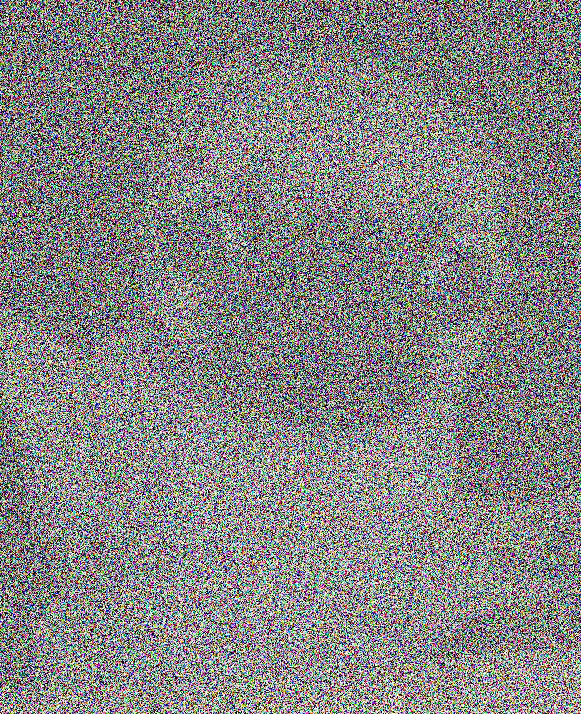
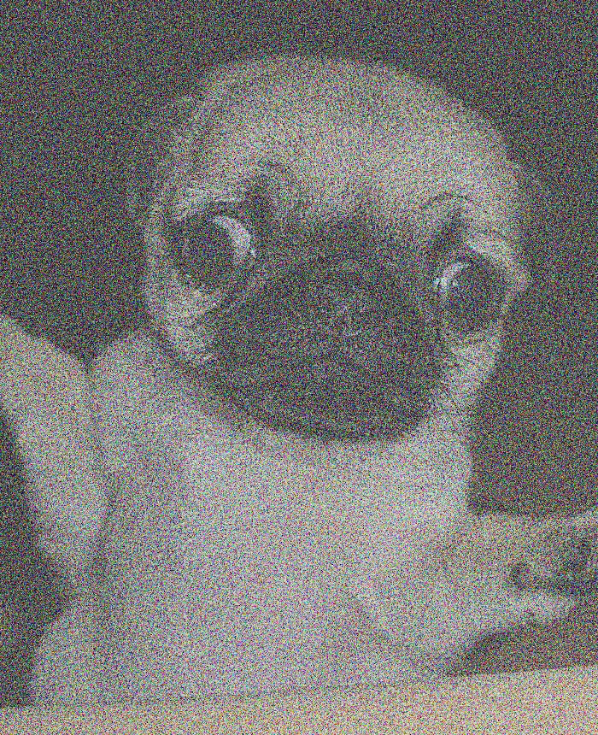
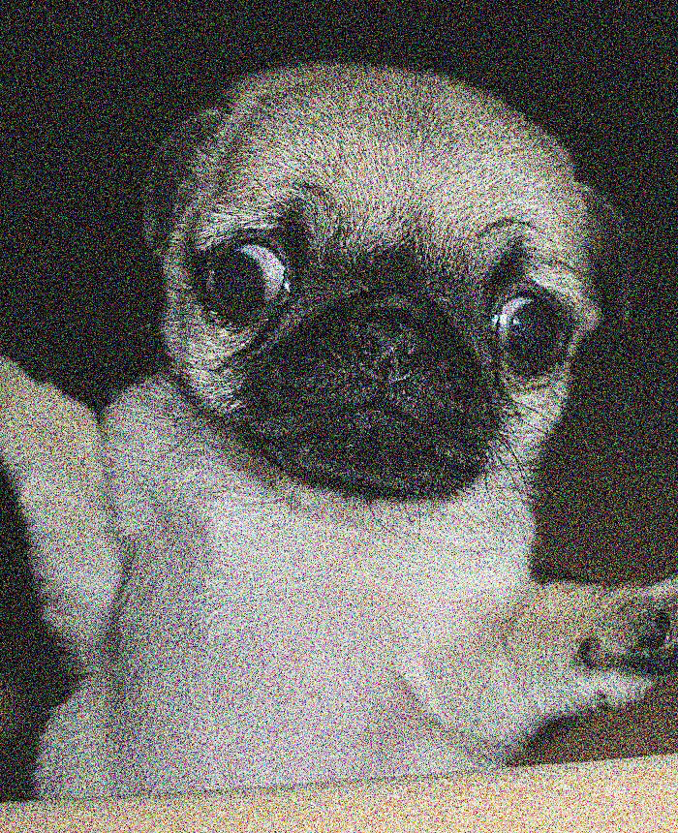

NEXT TIME
How does this all fit into the context of the course?
In the last lecture of the semester, we’ll see how to use Bayes-optimal denoising algorithms to get powerful distribution learning guarantees via diffusion generative modeling!

