Slide 1


CS 2243: ALGORITHMS FOR DATA SCIENCE
LECTURE 19 (11/11)
Tensor decomposition
Sum-of-squares
Supervised learning
Computational complexity
Statistical physics
Generative modeling
APPROXIMATE MESSAGE PASSING: DERIVATION AND OPTIMALITY FOR $ℤ_{2}$ SYNCHRONIZATION

Slide 2
PLAN FOR TODAY
Last time, we derived a powerful heuristic, belief propagation (BP), for inference. Unfortunately, notoriously open how to prove rigorous, general-purpose guarantees for BP on non-acyclic graphs
Next two lectures: approximate message passing, a BP-inspired algorithm with provable guarantees that is conjectured to be optimal for a wide range of inference problems
Broadly applicable, but for concreteness, will focus on a specific application to denoising low-rank matrices
Warning: today’s slides have a lot of equations, so please don’t hesitate to stop me and ask questions!

Slide 3
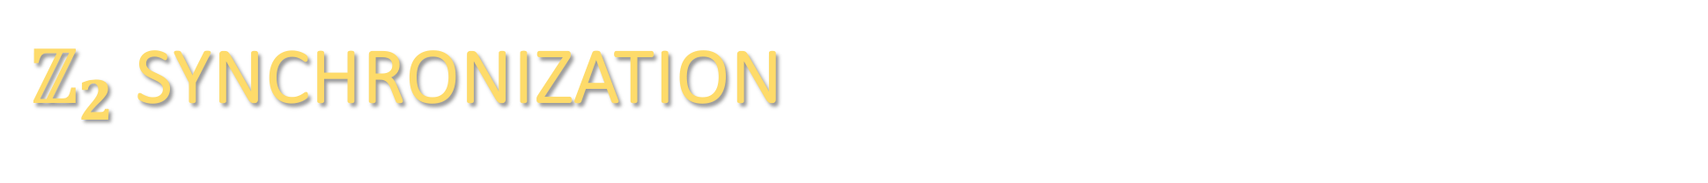
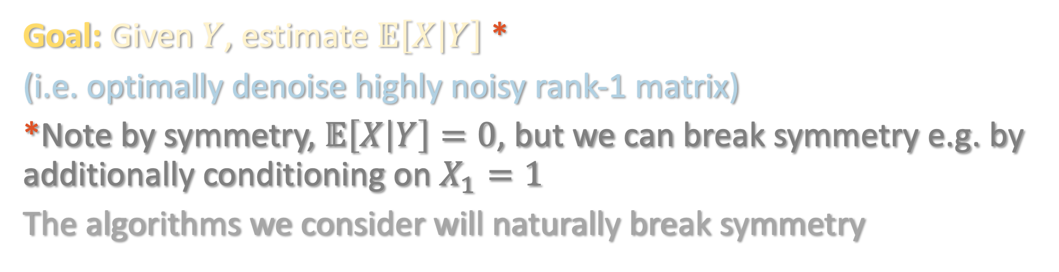
$ℤ_{2}$ SYNCHRONIZATION
Powerful testbed for provable methods for variational inference:
Goal: Given $Y$, estimate $𝔼\left[X | Y\right]$ *
(i.e. optimally denoise highly noisy rank-1 matrix)
*Note by symmetry, $𝔼\left[X | Y\right]=0$, but we can break symmetry e.g. by additionally conditioning on $X_{1}=1$
The algorithms we consider will naturally break symmetry

Slide 4
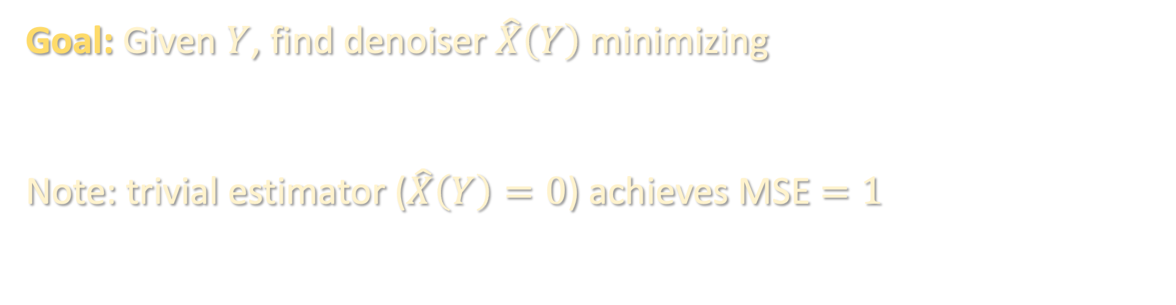
$ℤ_{2}$ SYNCHRONIZATION
Powerful testbed for provable methods for variational inference:
Goal: Given $Y$, find denoiser $\hat{X}\left(Y\right)$ minimizing
Note: trivial estimator ($\hat{X}\left(Y\right)=0$) achieves MSE $=1$

Slide 5
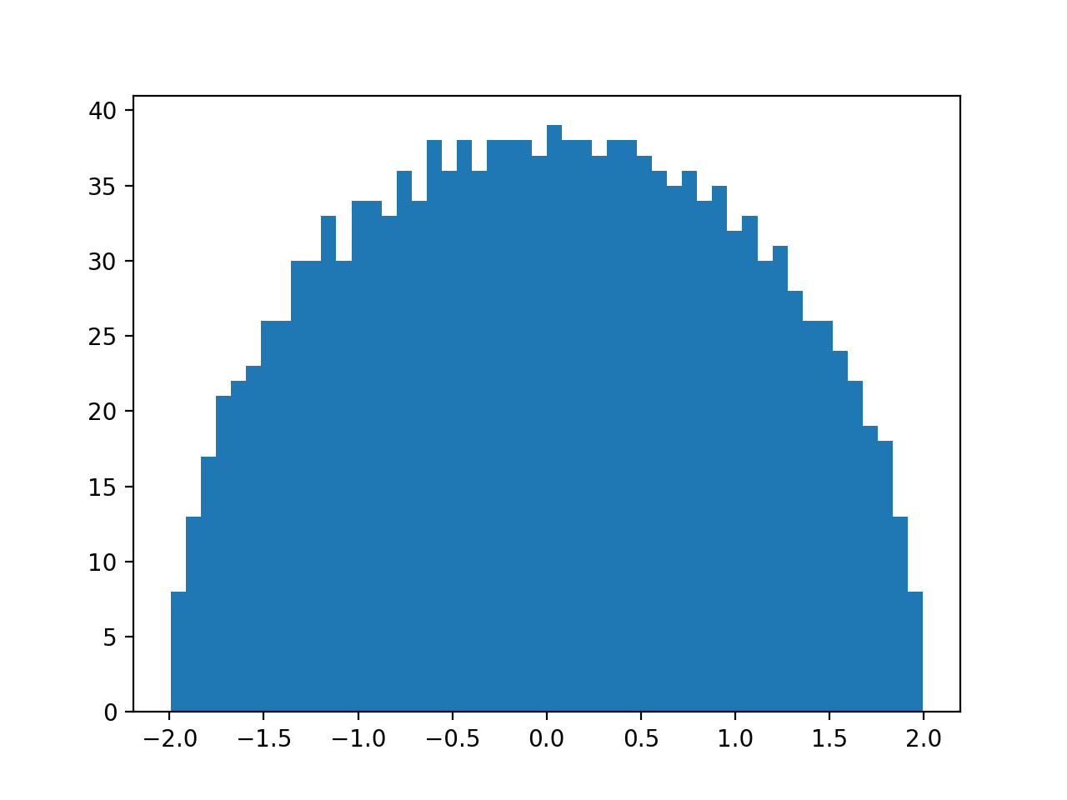



SPECTRAL METHOD BASELINE
Naïve attempt: take top eigenvector $v$ of $Y$
[Baik-Ben Arous-Peche ’04]: “BBP transition” – the top eigenvalue of $Y$ escapes from the “bulk” when $λ>1$
Histogram of eigenvalues
of $\frac{1}{\sqrt{n}}Y$
$$λ=0$$
(Wigner semicircle law)

Slide 6
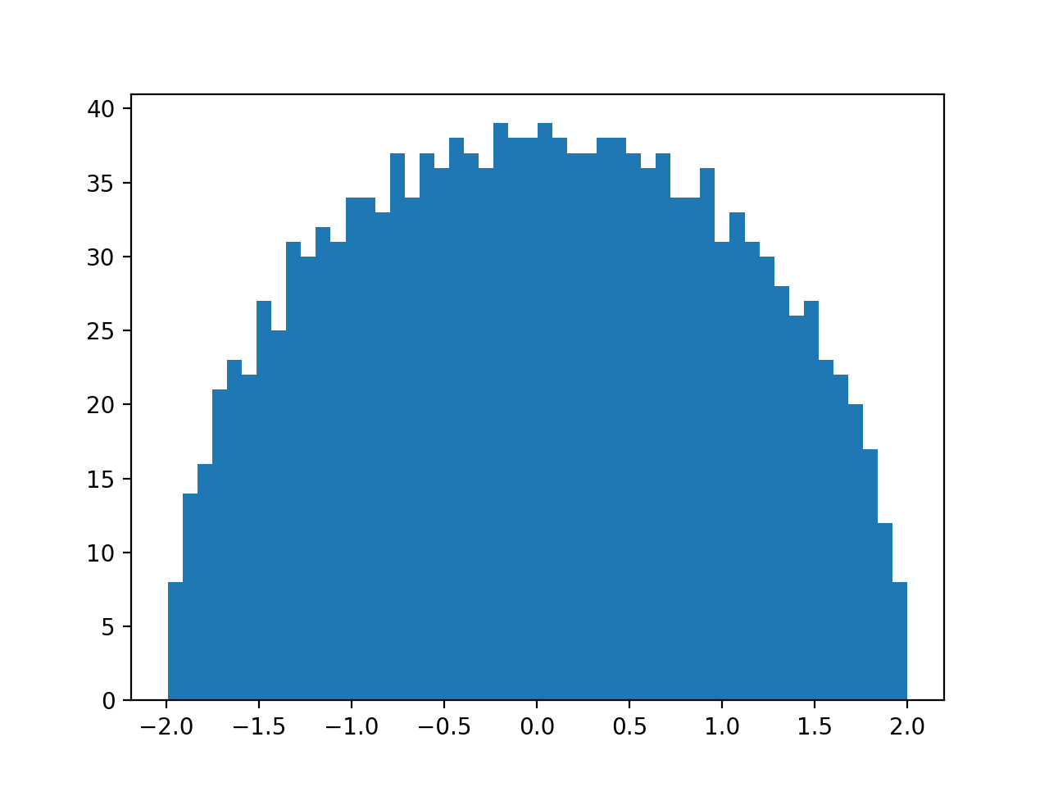

SPECTRAL METHOD BASELINE
Naïve attempt: take top eigenvector $v$ of $Y$
[Baik-Ben Arous-Peche ’04]: “BBP transition” – the top eigenvalue of $Y$ escapes from the “bulk” when $λ>1$
Histogram of eigenvalues
of $\frac{1}{\sqrt{n}}Y$
$$λ=1$$

Slide 7
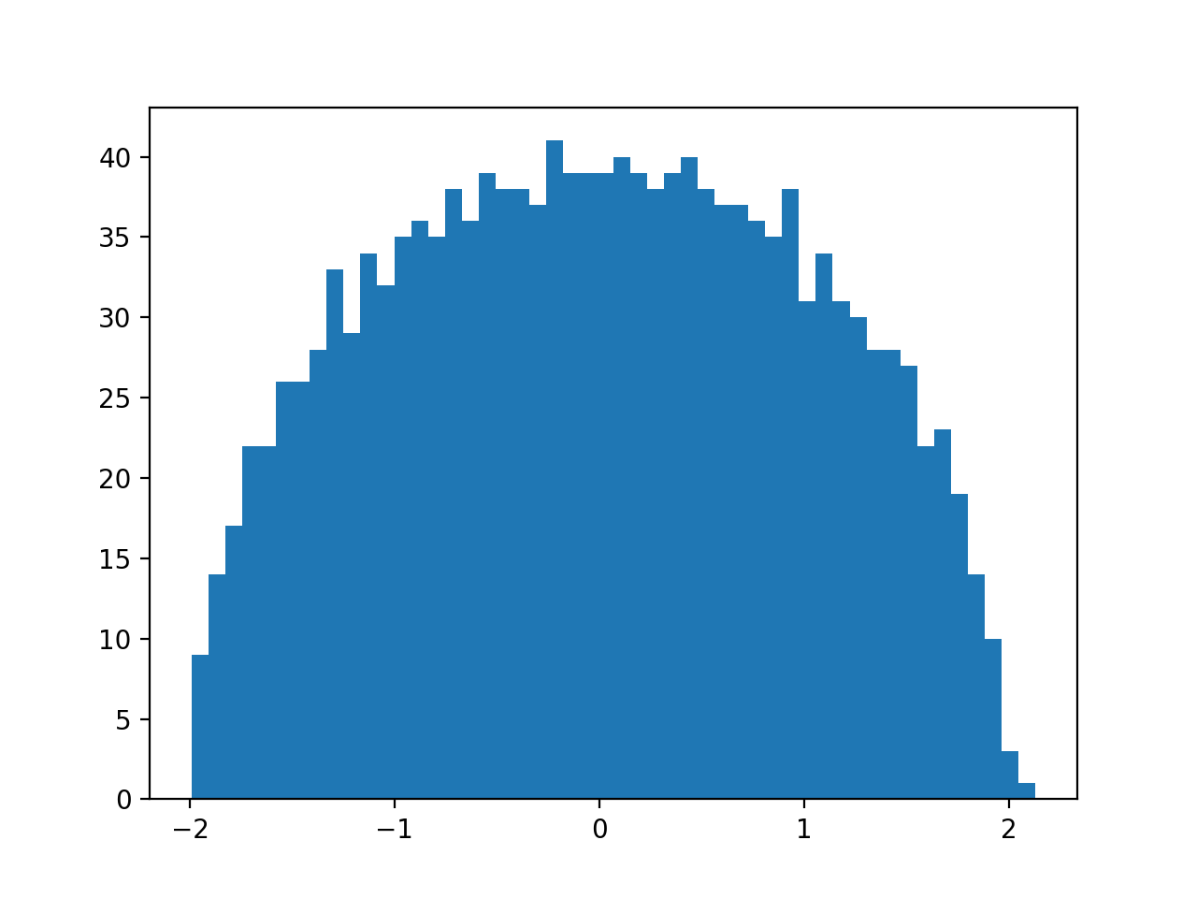

SPECTRAL METHOD BASELINE
Naïve attempt: take top eigenvector $v$ of $Y$
[Baik-Ben Arous-Peche ’04]: “BBP transition” – the top eigenvalue of $Y$ escapes from the “bulk” when $λ>1$
Histogram of eigenvalues
of $\frac{1}{\sqrt{n}}Y$
$$λ=2$$

Slide 8
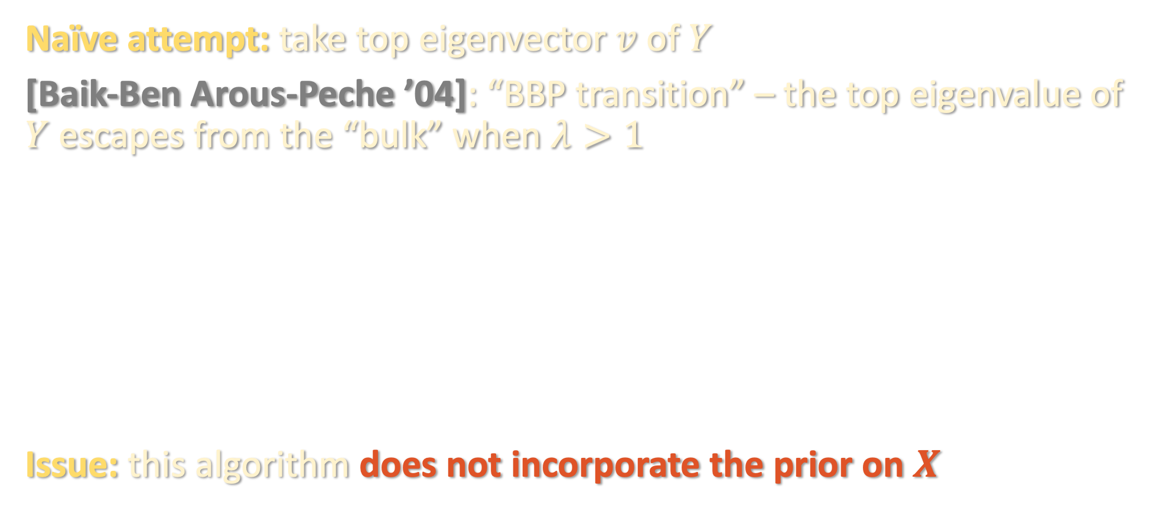
SPECTRAL METHOD BASELINE
Naïve attempt: take top eigenvector $v$ of $Y$
[Baik-Ben Arous-Peche ’04]: “BBP transition” – the top eigenvalue of $Y$ escapes from the “bulk” when $λ>1$
Issue: this algorithm does not incorporate the prior on $X$

Slide 9

BELIEF PROPAGATION
Let us compute the Gibbs measure $μ\left(x\right)≝ ℙ\left[X=x | Y\right]$
i.e. Gibbs measure is an Ising model with random interaction matrix

Slide 10

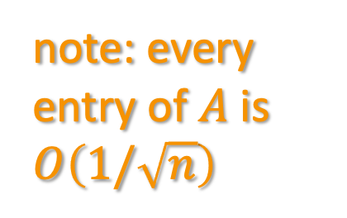
BELIEF PROPAGATION
Compatibility functions: for all $i<j$,
Belief propagation update rules:
note: every entry of $A$ is $O\left(1/\sqrt{n}\right)$

Slide 11
BELIEF PROPAGATION
Compatibility functions: for all $i<j$,
Belief propagation update rules:
note: every entry of $A$ is $O\left(1/\sqrt{n}\right)$

Slide 12
BELIEF PROPAGATION
Compatibility functions: for all $i<j$,
Belief propagation update rules:
note: every entry of $A$ is $O\left(1/\sqrt{n}\right)$

Slide 13
BELIEF PROPAGATION
Instead of marginal probabilities, can equivalently parametrize in terms of marginal expectations:

Slide 14
BELIEF PROPAGATION
Instead of marginal probabilities, can equivalently parametrize in terms of marginal expectations:

Slide 15

BELIEF PROPAGATION
Instead of marginal probabilities, can equivalently parametrize in terms of marginal expectations:
$$⇒$$

Slide 16
BELIEF PROPAGATION
Instead of marginal probabilities, can equivalently parametrize in terms of marginal expectations:
$$⇒$$

Slide 17
BELIEF PROPAGATION
Instead of marginal probabilities, can equivalently parametrize in terms of marginal expectations:
$$⇒$$

Slide 18
BELIEF PROPAGATION

Slide 19
BELIEF PROPAGATION

Slide 20
BELIEF PROPAGATION

Slide 21
BELIEF PROPAGATION

Slide 22
BELIEF PROPAGATION

Slide 23
BELIEF PROPAGATION

Slide 24
BELIEF PROPAGATION

Slide 25
BELIEF PROPAGATION

Slide 26
BELIEF PROPAGATION

Slide 27
BELIEF PROPAGATION

Slide 28
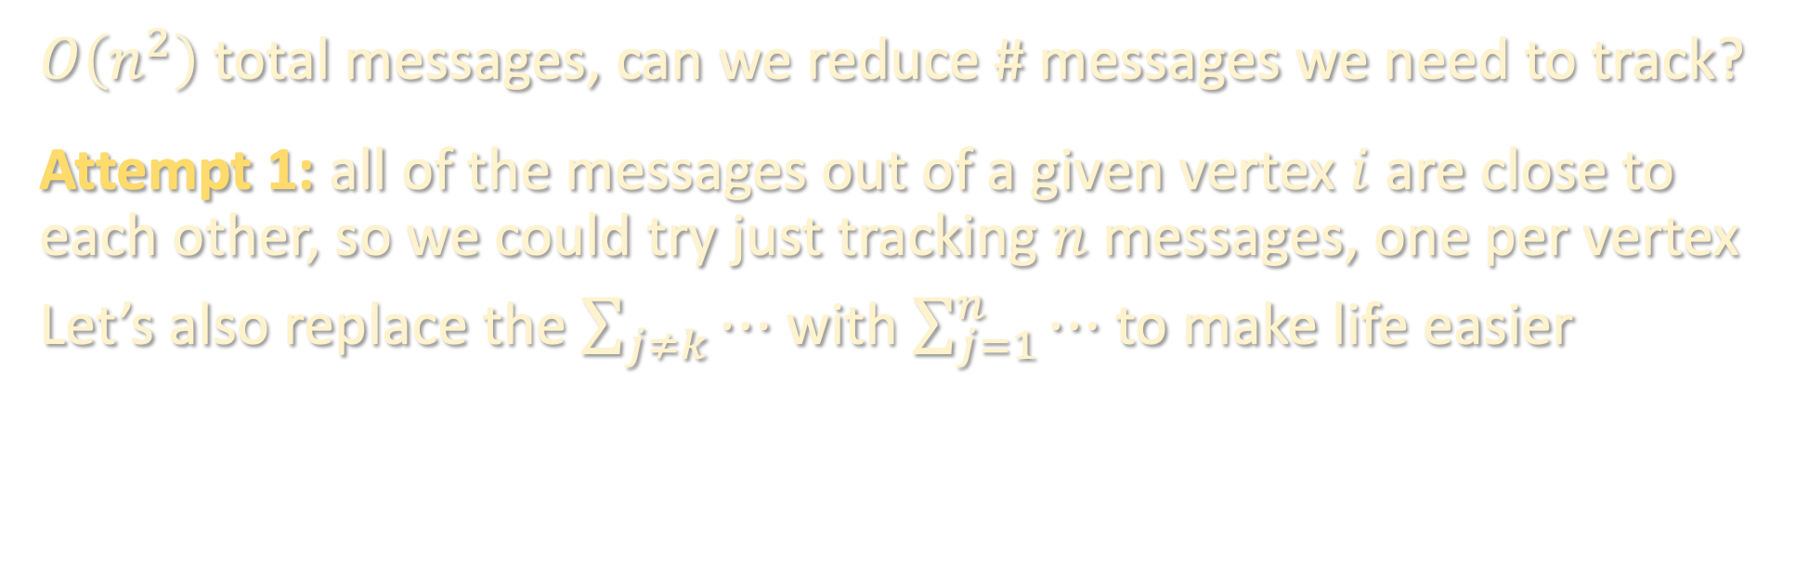
APPROXIMATE MESSAGE PASSING
$O\left(n^{2}\right)$ total messages, can we reduce # messages we need to track?
Attempt 1: all of the messages out of a given vertex $i$ are close to each other, so we could try just tracking $n$ messages, one per vertex
Let’s also replace the $\sum_{j≠k}{⋯}$ with $\sum_{j=1}^{n}{⋯}$ to make life easier

Slide 29
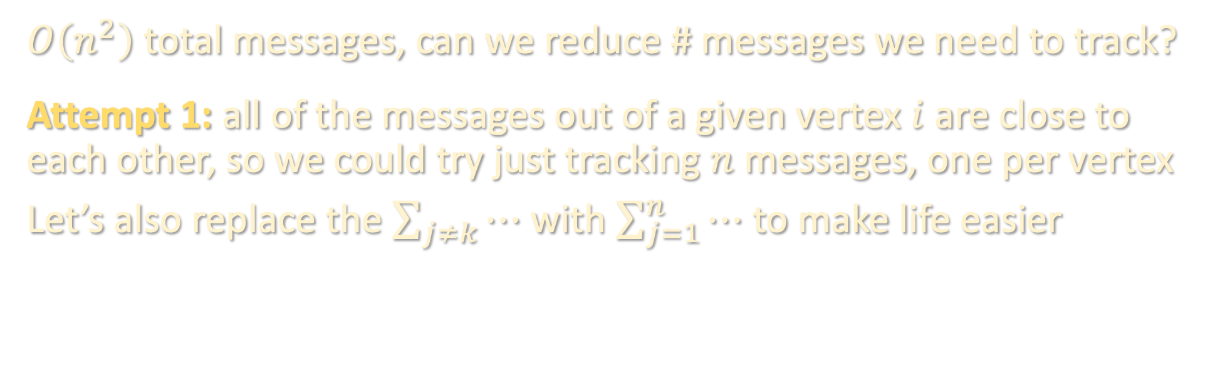
APPROXIMATE MESSAGE PASSING
$O\left(n^{2}\right)$ total messages, can we reduce # messages we need to track?
Attempt 1: all of the messages out of a given vertex $i$ are close to each other, so we could try just tracking $n$ messages, one per vertex
Let’s also replace the $\sum_{j≠k}{⋯}$ with $\sum_{j=1}^{n}{⋯}$ to make life easier
mean field approximation
(resembles power method)
(vector form)
(not accurate enough)
(applied entrywise)

Slide 30
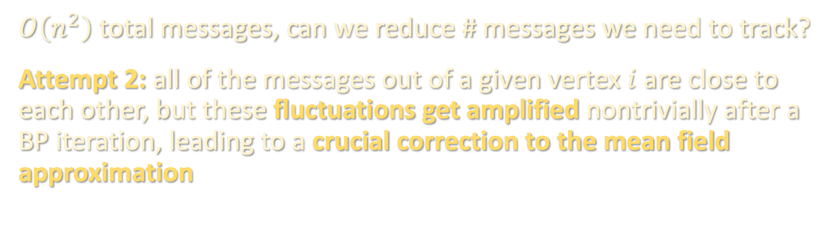
APPROXIMATE MESSAGE PASSING
$O\left(n^{2}\right)$ total messages, can we reduce # messages we need to track?
Attempt 2: all of the messages out of a given vertex $i$ are close to each other, but these fluctuations get amplified nontrivially after a BP iteration, leading to a crucial correction to the mean field approximation

Slide 31

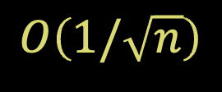
APPROXIMATE MESSAGE PASSING
$$=$$
$$O\left(1/\sqrt{n}\right)$$

Slide 32
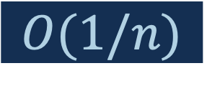
APPROXIMATE MESSAGE PASSING
$$O(1/n)$$

Slide 33
APPROXIMATE MESSAGE PASSING
$$O(1/n)$$

Slide 34

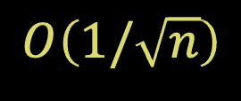

APPROXIMATE MESSAGE PASSING
$$[ ]$$
$$O\left(1/\sqrt{n}\right)$$
$$±$$
$$O(1/n)$$

Slide 35

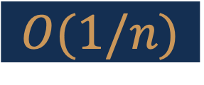
APPROXIMATE MESSAGE PASSING
$$[ ]$$
$$O\left(1/\sqrt{n}\right)$$
$$±$$
$$O(1/n)$$
$$O(1/n)$$

Slide 36

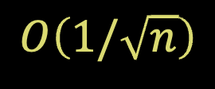
APPROXIMATE MESSAGE PASSING
$$[ ]$$
$$O\left(1/\sqrt{n}\right)$$
$$±$$
$$O(1/n)$$
$$±$$
$$O\left(1/\sqrt{n}\right)$$

Slide 37
APPROXIMATE MESSAGE PASSING
$$[ ]$$
$$O\left(1/\sqrt{n}\right)$$
$$±$$
$$O(1/n)$$
$$±$$
$$O\left(1/\sqrt{n}\right)$$

Slide 38
APPROXIMATE MESSAGE PASSING

Slide 39
APPROXIMATE MESSAGE PASSING
(vector form)
(applied entrywise)

Slide 40
APPROXIMATE MESSAGE PASSING
(estimate for marginal expectation)

Slide 41
APPROXIMATE MESSAGE PASSING
mean-field approximation
Onsager correction/
”memory term”
(estimate for marginal expectation)
approximate message passing (AMP)
can consider, e.g., random or spectral initialization

Slide 42
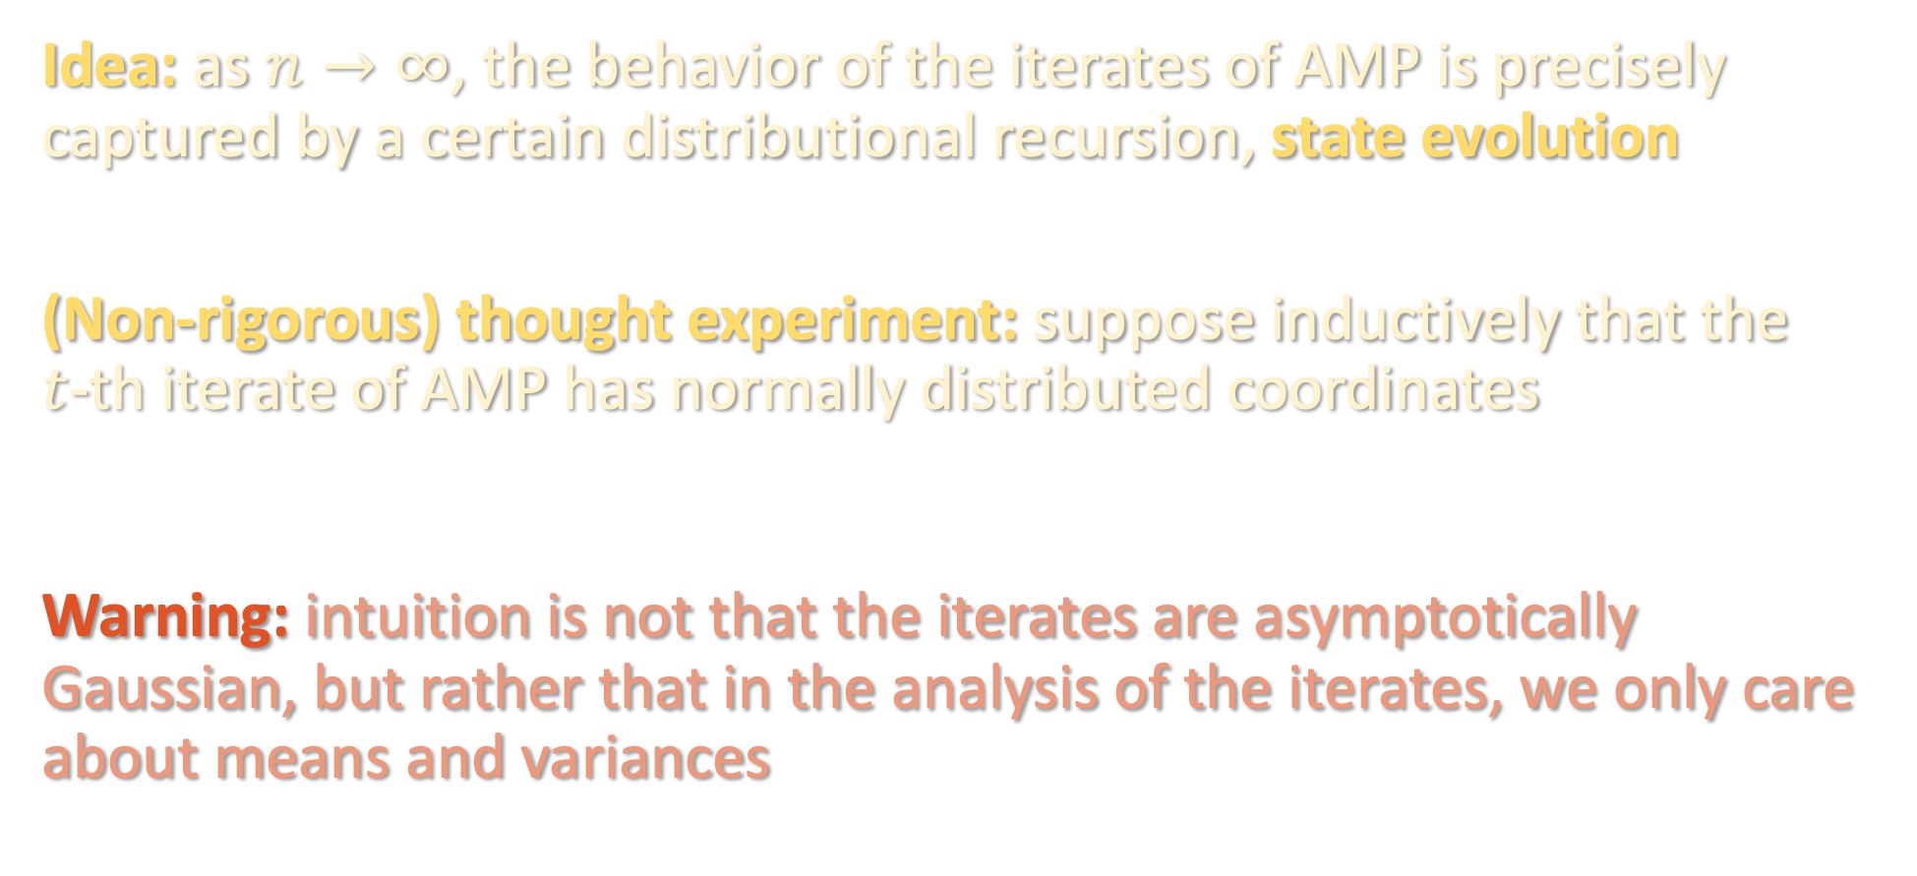
STATE EVOLUTION
Idea: as $n→∞$, the behavior of the iterates of AMP is precisely captured by a certain distributional recursion, state evolution
(Non-rigorous) thought experiment: suppose inductively that the $t$-th iterate of AMP has normally distributed coordinates
Warning: intuition is not that the iterates are asymptotically Gaussian, but rather that in the analysis of the iterates, we only care about means and variances

Slide 43
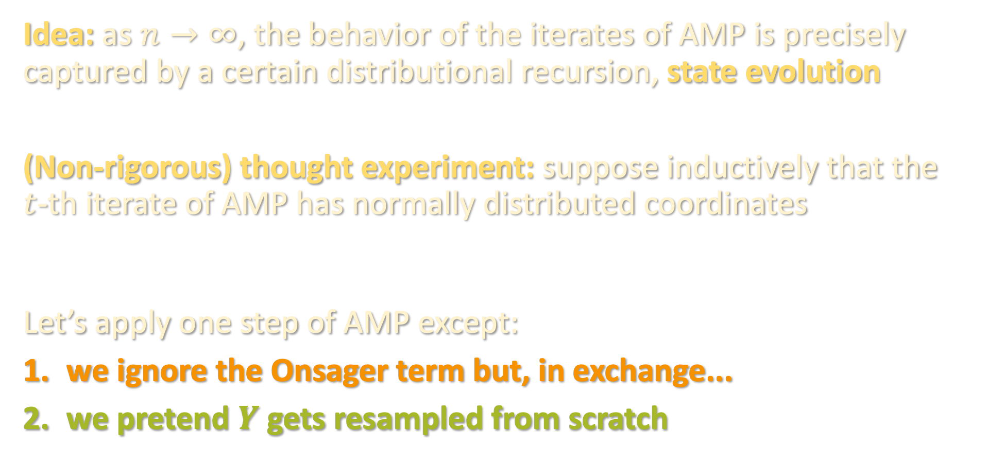
STATE EVOLUTION
Idea: as $n→∞$, the behavior of the iterates of AMP is precisely captured by a certain distributional recursion, state evolution
(Non-rigorous) thought experiment: suppose inductively that the $t$-th iterate of AMP has normally distributed coordinates
Let’s apply one step of AMP except:
we ignore the Onsager term but, in exchange...
we pretend $Y$ gets resampled from scratch

Slide 44
STATE EVOLUTION

Slide 45
STATE EVOLUTION

Slide 46
STATE EVOLUTION

Slide 47
STATE EVOLUTION

Slide 48
STATE EVOLUTION

Slide 49
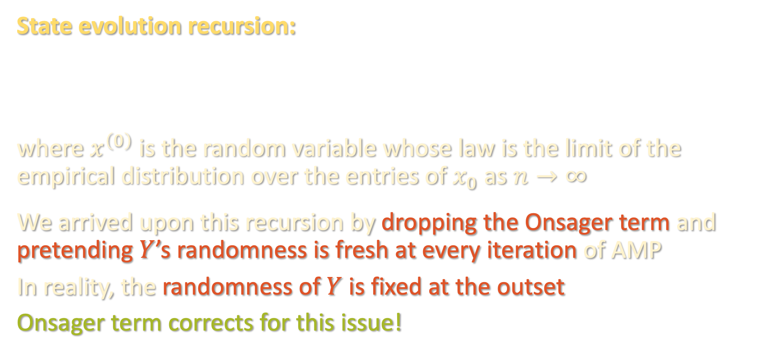
STATE EVOLUTION
State evolution recursion:
where $x^{\left(0\right)}$is the random variable whose law is the limit of the empirical distribution over the entries of $x_{0}$ as $n→∞$
We arrived upon this recursion by dropping the Onsager term and pretending $Y$’s randomness is fresh at every iteration of AMP
In reality, the randomness of $Y$ is fixed at the outset
Onsager term corrects for this issue!

Slide 50

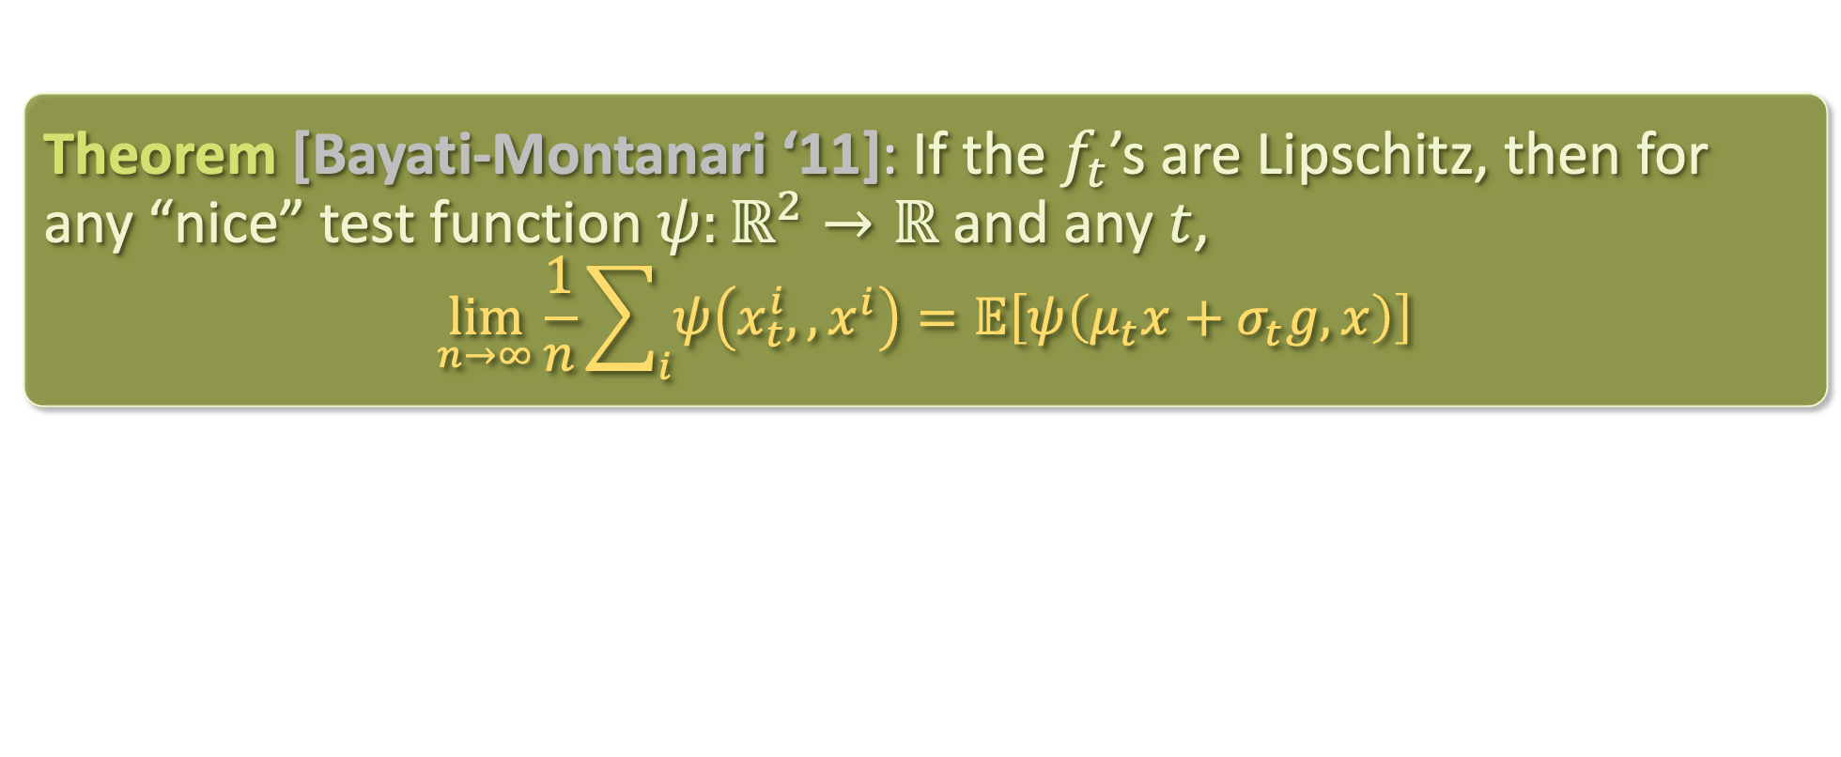
STATE EVOLUTION
State evolution recursion:
where $x^{\left(0\right)}$is the random variable whose law is the limit of the empirical distribution over the entries of $x_{0}$ as $n→∞$
Theorem [Bayati-Montanari ‘11]: If the $f_{t}$’s are Lipschitz, then for any “nice” test function $ψ:ℝ^{2}→ℝ$ and any $t$,
$$\lim_{n→∞}{\frac{1}{n}\sum_{i}{ψ\left(x_{t}^{i},,x^{i}\right)}}=𝔼\left[ψ\left(μ_{t}x+σ_{t}g,x\right)\right]$$

Slide 51

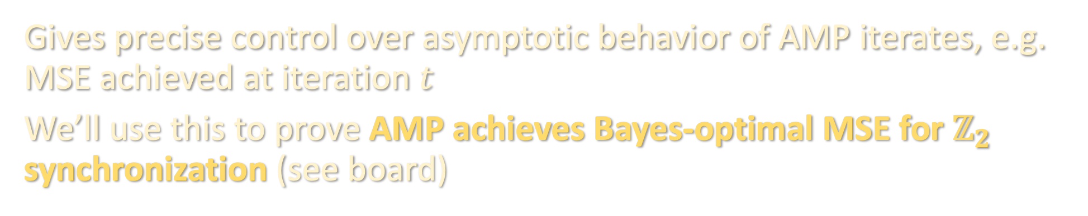
STATE EVOLUTION
Theorem [Bayati-Montanari ‘11]: If the $f_{t}$’s are Lipschitz, then for any “nice” test function $ψ:ℝ^{2}→ℝ$ and any $t$,
$$\lim_{n→∞}{\frac{1}{n}\sum_{i}{ψ\left(x_{t}^{i},,x^{i}\right)}}=𝔼\left[ψ\left(μ_{t}x+σ_{t}g,x\right)\right]$$
Gives precise control over asymptotic behavior of AMP iterates, e.g. MSE achieved at iteration $t$
We’ll use this to prove AMP achieves Bayes-optimal MSE for $ℤ_{2}$ synchronization (see board)

