Slide 1

CS 2243: ALGORITHMS FOR DATA SCIENCE
LECTURE 15 (10/28)
Tensor decomposition
Sum-of-squares
Supervised learning
Computational complexity
Statistical physics
Generative modeling
CRYPTOGRAPHIC REDUCTIONS AND LEARNING

Slide 2
ANNOUNCEMENTS
Pset 3 due tomorrow
Pset 2 grades will be released tomorrow
Project proposal due this Friday
Bulk of today’s lecture on new material

Slide 3
Early connections to cryptography
(pseudorandom functions, public-key crypto, agnostic noise)
Crypto lower bounds for learning MLPs and Gaussian mixtures
(Continuous LWE)
Outlook
Disclaimer: I’m not a cryptographer, take Prof. Barak’s CS 127 if you want to learn the crypto fundamentals for real!

Slide 4
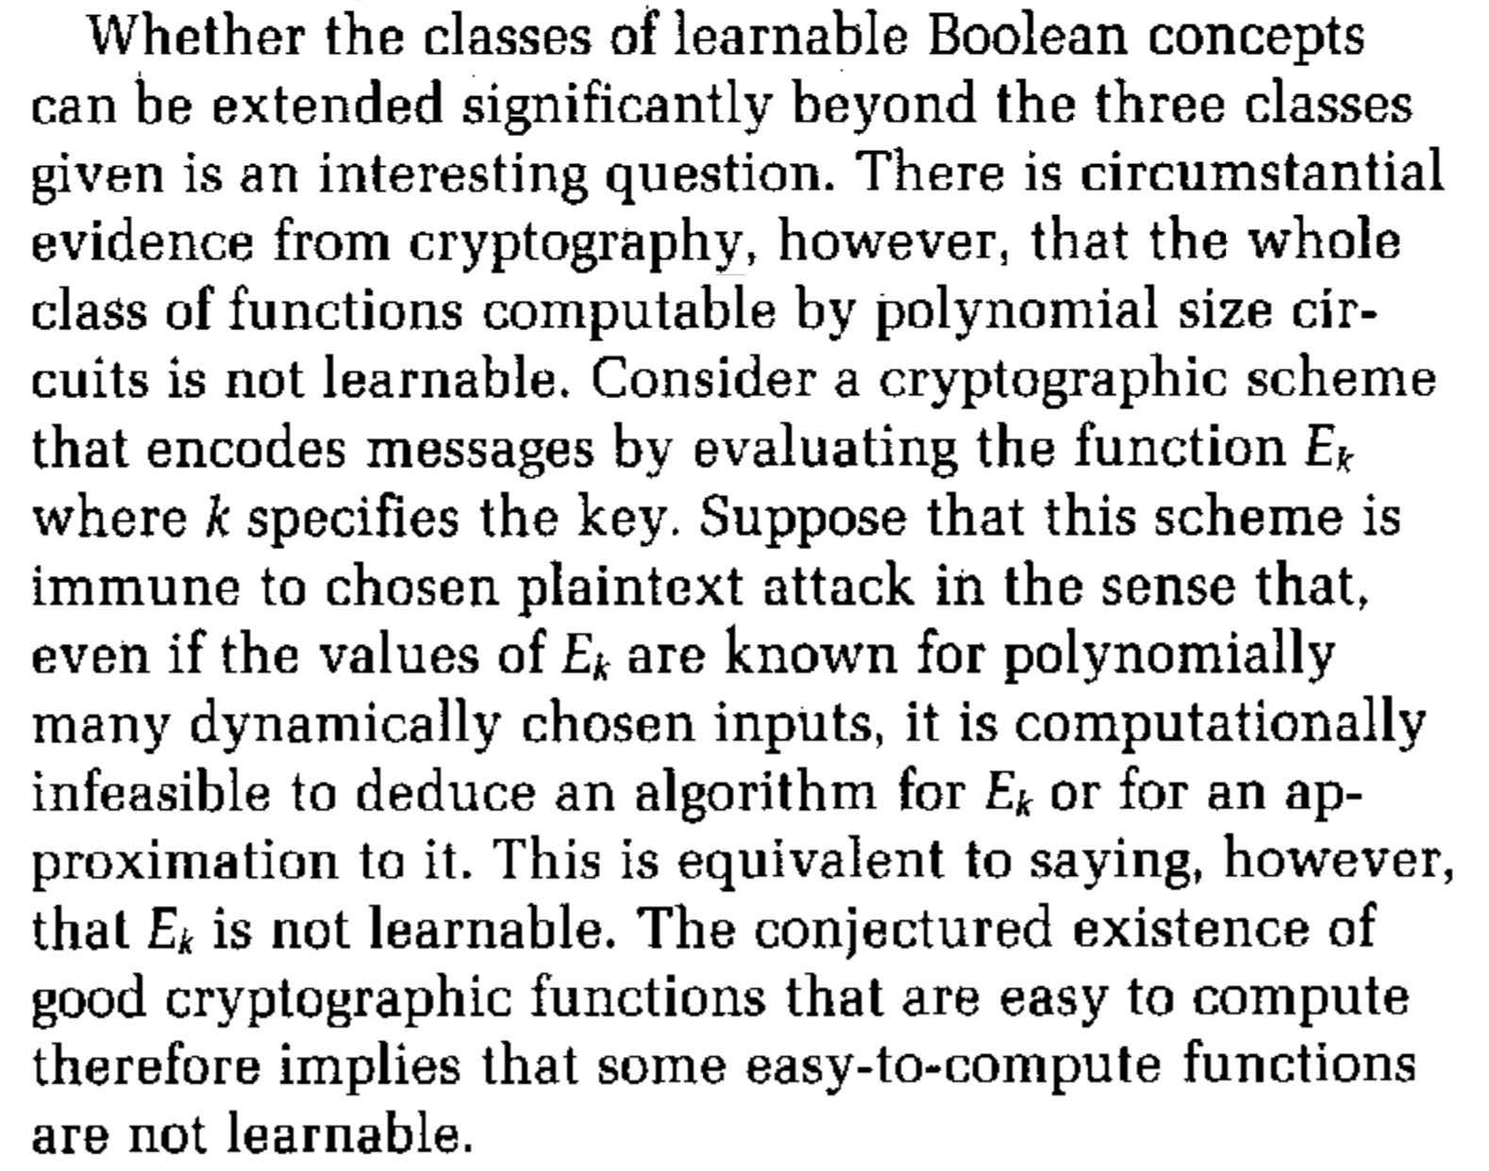
CRYPTOGRAPHY AND LEARNING
From Valiant’s “A theory for the learnable”

Slide 5
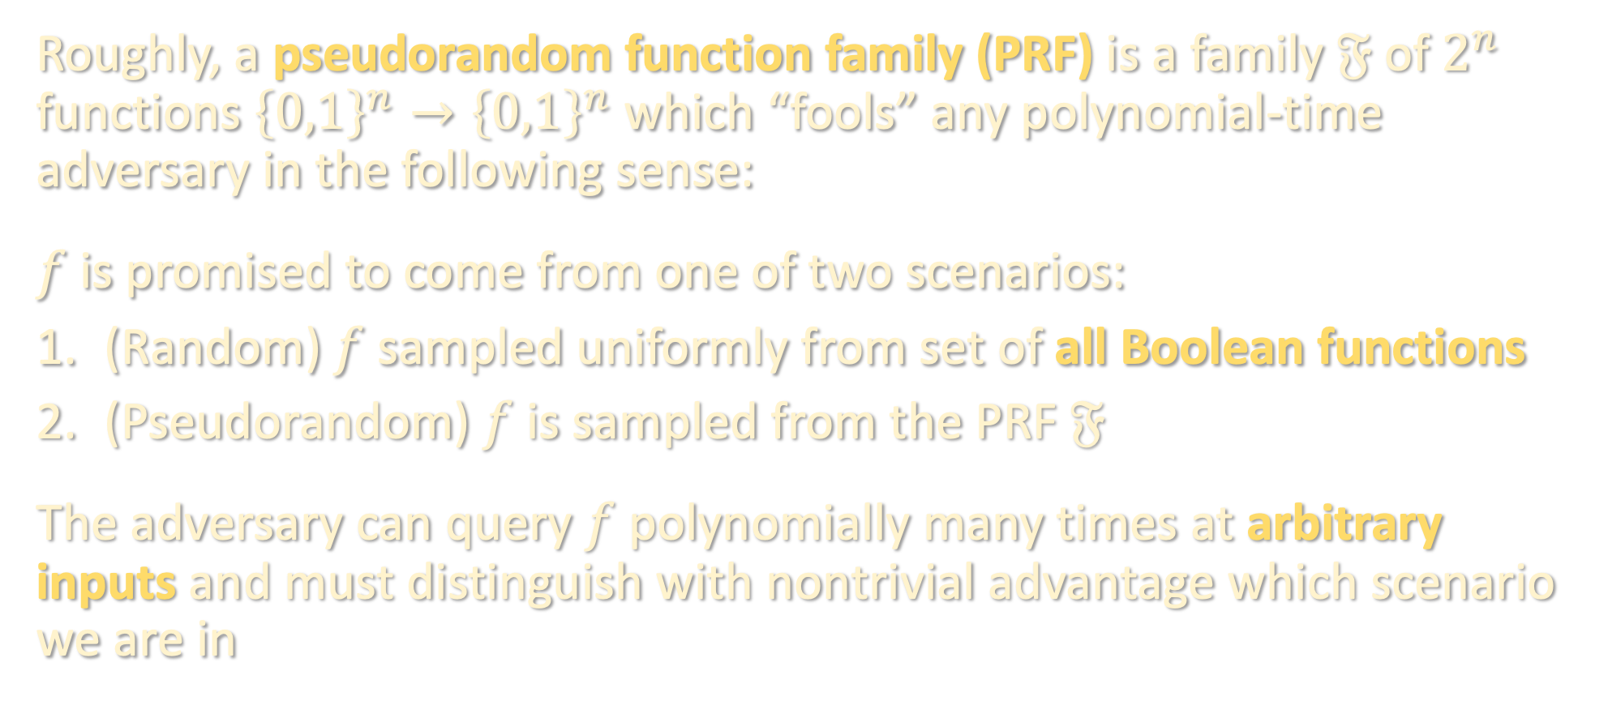
PSEUDORANDOM FUNCTION FAMILIES (PRF)
Roughly, a pseudorandom function family (PRF) is a family $𝔉$ of $2^{n}$ functions ${\left\{0,1\right\}}^{n}→{\left\{0,1\right\}}^{n}$ which “fools” any polynomial-time adversary in the following sense:
$f$ is promised to come from one of two scenarios:
(Random) $f$ sampled uniformly from set of all Boolean functions
(Pseudorandom) $f$ is sampled from the PRF $𝔉$
The adversary can query $f$ polynomially many times at arbitrary inputs and must distinguish with nontrivial advantage which scenario we are in

Slide 6

PRFS FROM ONE-WAY FUNCTIONS
A one-way function (OWF) is a function ${f:\left\{0,1\right\}}^{n}→{\left\{0,1\right\}}^{m}$ which is efficiently computable but hard to invert, i.e. given $y=f\left(x\right)$ for a random $x$, it is computationally hard to find $x′$ such that $f\left(x^{′}\right)=y$
“minimal” assumption necessary for cryptography to be possible
Thm [Goldreich-Goldwasser-Micali ‘84]: Pseudorandom function families exist if one-way functions exist.
Corollary [Valiant ‘84]: Poly-sized circuits are hard to PAC learn, even given the ability to query them at arbitrary inputs (“learning from membership queries”)

Slide 7
PRFS FROM ONE-WAY FUNCTIONS
Corollary [Valiant ‘84]: Poly-sized circuits are hard to PAC learn, even given the ability to query them at arbitrary inputs (“learning from membership queries”)
Proof: a polynomial-time PAC learning algorithm would yield a polynomial-time adversary for distinguishing whether the underlying function is truly random or from a PRF
Pros:
Assumption is very mild
Learner is very powerful
Cons:
worst-case lower bound
class of functions too powerful

Slide 8
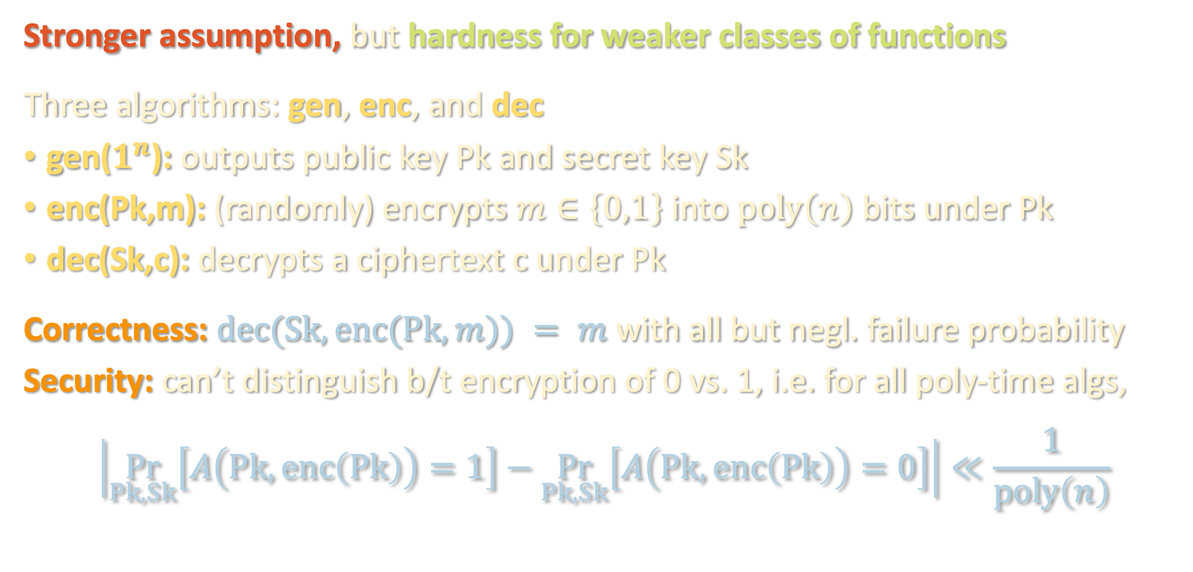
PUBLIC-KEY ENCRYPTION
Stronger assumption, but hardness for weaker classes of functions
Three algorithms: gen, enc, and dec
gen($1^{n}$): outputs public key Pk and secret key Sk
enc(Pk,m): (randomly) encrypts $m∈\left\{0,1\right\}$ into $poly\left(n\right)$ bits under Pk
dec(Sk,c): decrypts a ciphertext c under Pk
Correctness: $dec(Sk,enc(Pk,m)) = m$ with all but negl. failure probability
Security: can’t distinguish b/t encryption of 0 vs. 1, i.e. for all poly-time algs,
$$\left|\underset{Pk,Sk}{Pr}\left[A\left(Pk,enc\left(Pk\right)\right)=1\right]−\underset{Pk,Sk}{Pr}\left[A\left(Pk,enc\left(Pk\right)\right)=0\right]\right|≪\frac{1}{poly\left(n\right)}$$

Slide 9
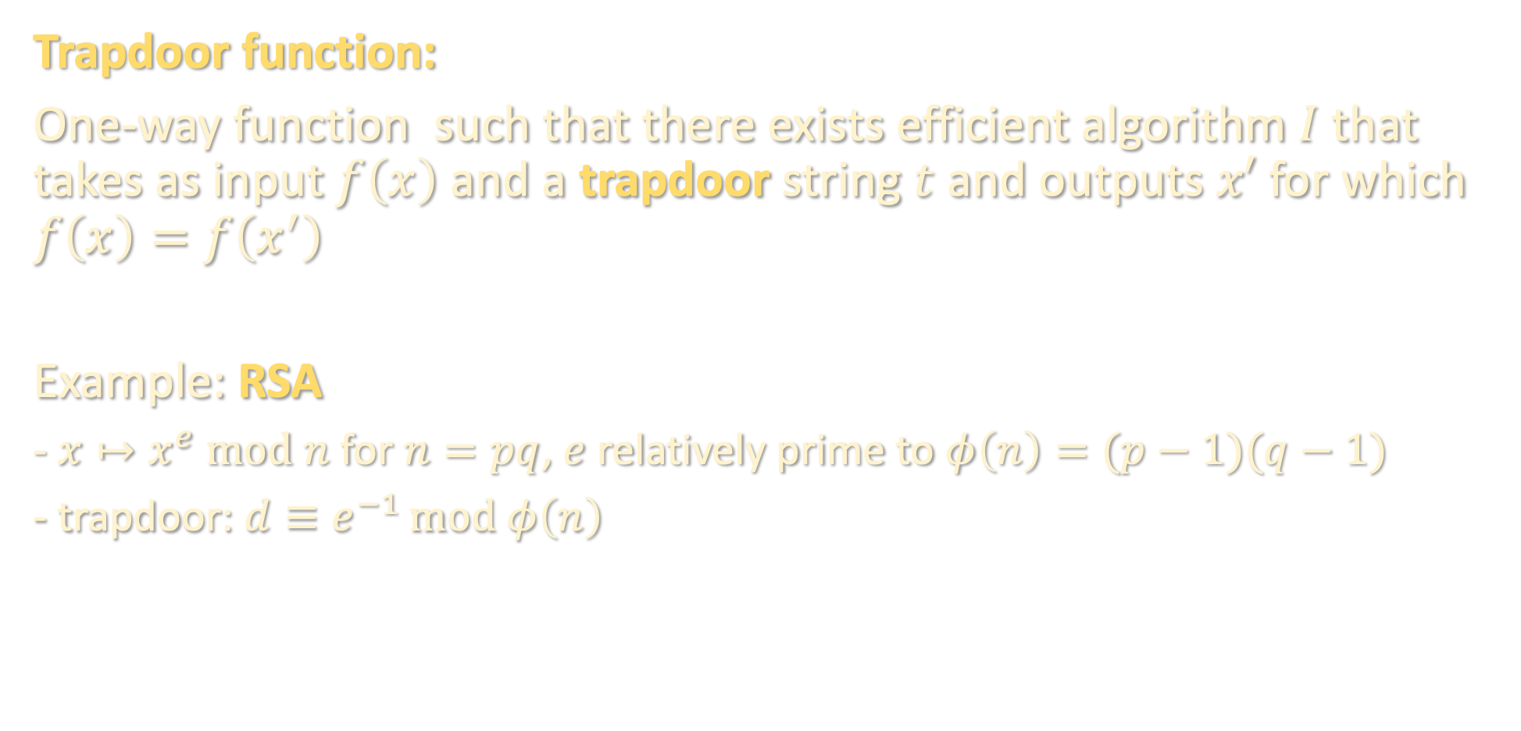
PUBLIC-KEY ENCRYPTION (EXAMPLES)
Trapdoor function:
One-way function such that there exists efficient algorithm $I$ that takes as input $f\left(x\right)$ and a trapdoor string $t$ and outputs $x′$ for which $f\left(x\right)=f\left(x^{′}\right)$
Example: RSA
- $x↦x^{e} mod n$ for $n=pq$, $e$ relatively prime to $φ\left(n\right)=(p−1)(q−1)$
- trapdoor: $d≡e^{−1 }mod φ\left(n\right)$

Slide 10
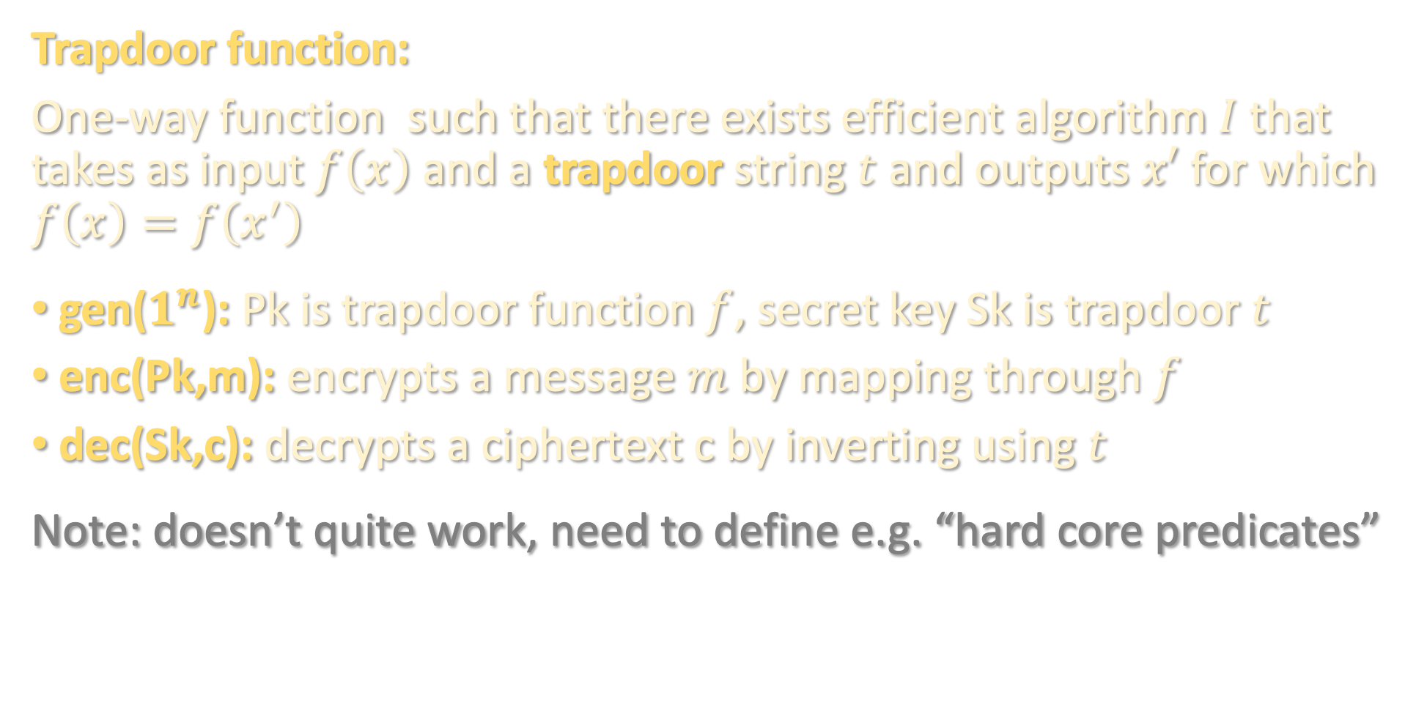
PUBLIC-KEY ENCRYPTION (EXAMPLES)
Trapdoor function:
One-way function such that there exists efficient algorithm $I$ that takes as input $f\left(x\right)$ and a trapdoor string $t$ and outputs $x′$ for which $f\left(x\right)=f\left(x^{′}\right)$
gen($1^{n}$): Pk is trapdoor function $f$, secret key Sk is trapdoor $t$
enc(Pk,m): encrypts a message $m$ by mapping through $f$
dec(Sk,c): decrypts a ciphertext c by inverting using $t$
Note: doesn’t quite work, need to define e.g. “hard core predicates”

Slide 11
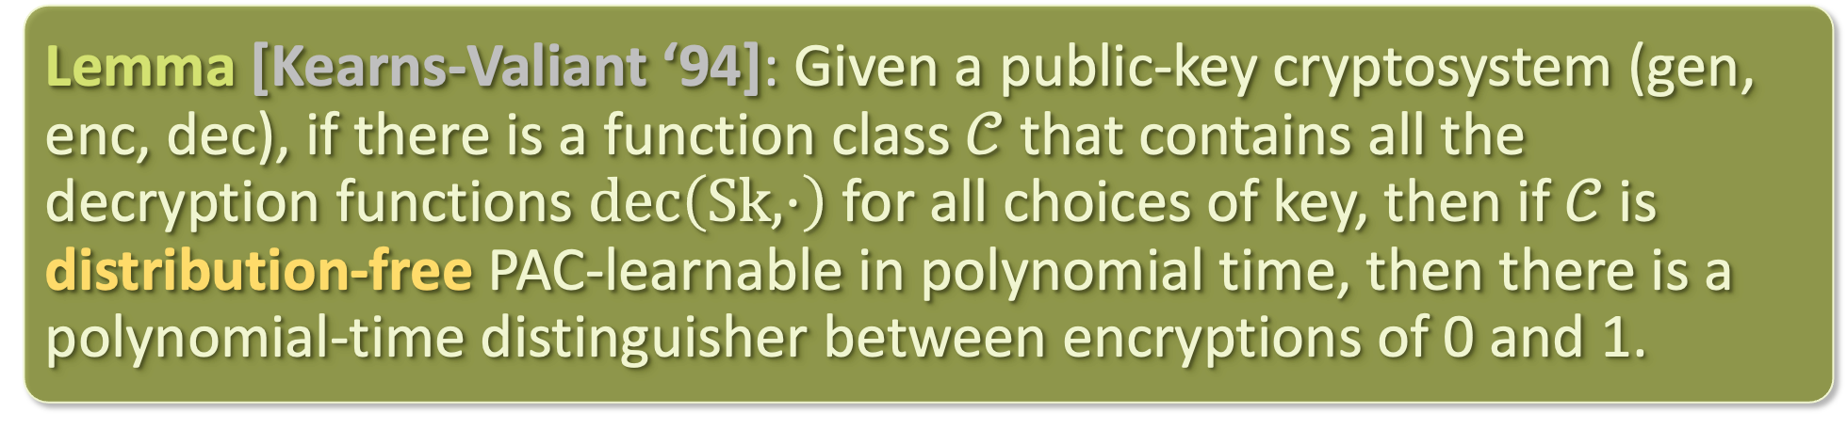
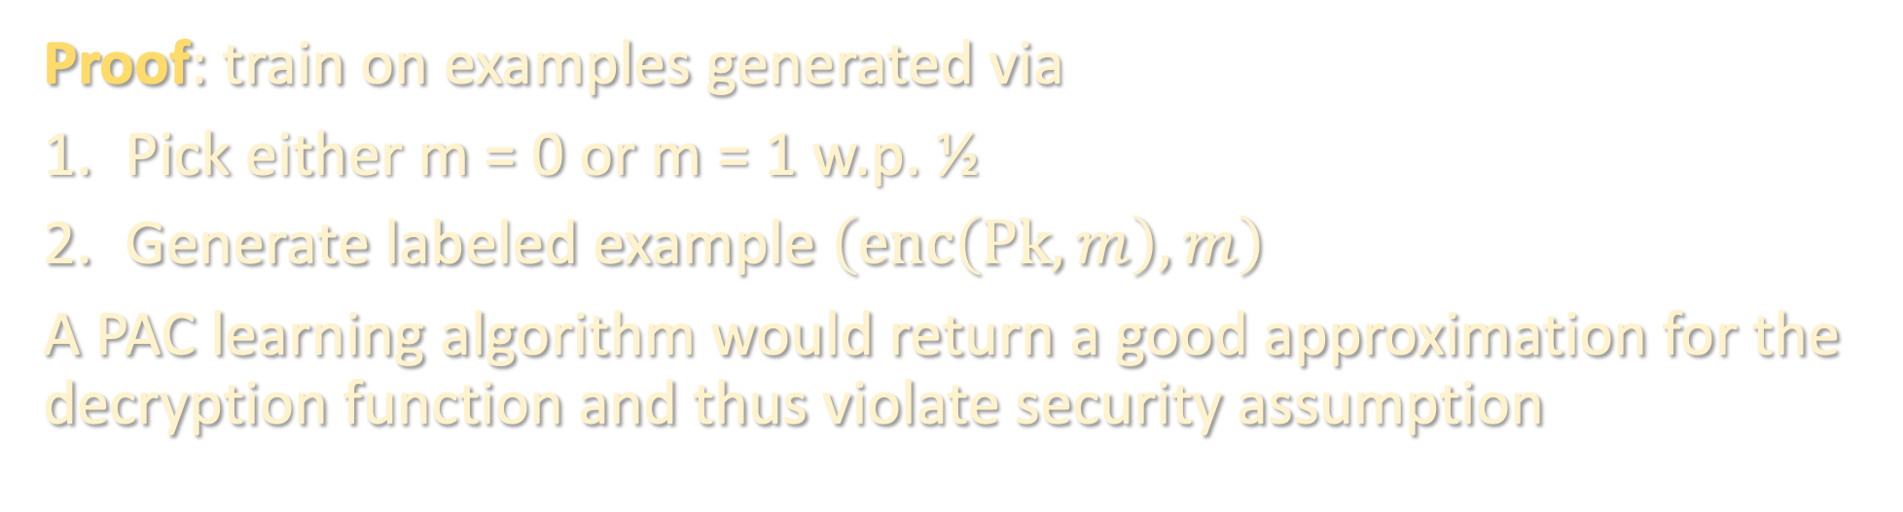
PUBLIC-KEY ENCRYPTION + HARDNESS OF LEARNING
Lemma [Kearns-Valiant ‘94]: Given a public-key cryptosystem (gen, enc, dec), if there is a function class $𝒞$ that contains all the decryption functions $dec\left(Sk,⋅\right)$ for all choices of key, then if $𝒞$ is distribution-free PAC-learnable in polynomial time, then there is a polynomial-time distinguisher between encryptions of 0 and 1.
Proof: train on examples generated via
Pick either m = 0 or m = 1 w.p. ½
Generate labeled example $\left(enc\left(Pk,m\right),m\right)$
A PAC learning algorithm would return a good approximation for the decryption function and thus violate security assumption

Slide 12
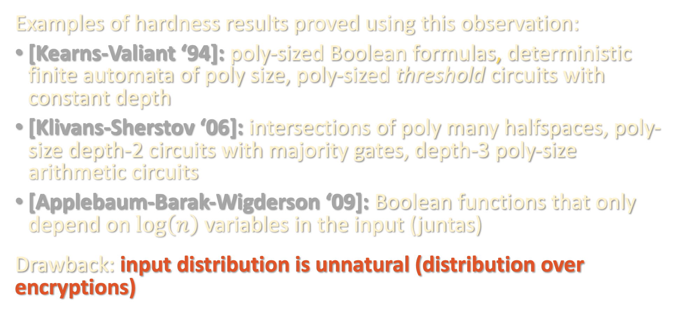
PUBLIC-KEY ENCRYPTION + HARDNESS OF LEARNING
Examples of hardness results proved using this observation:
[Kearns-Valiant ‘94]: poly-sized Boolean formulas, deterministic finite automata of poly size, poly-sized threshold circuits with constant depth
[Klivans-Sherstov ‘06]: intersections of poly many halfspaces, poly-size depth-2 circuits with majority gates, depth-3 poly-size arithmetic circuits
[Applebaum-Barak-Wigderson ‘09]: Boolean functions that only depend on $\log\left(n\right)$ variables in the input (juntas)
Drawback: input distribution is unnatural (distribution over encryptions)

Slide 13
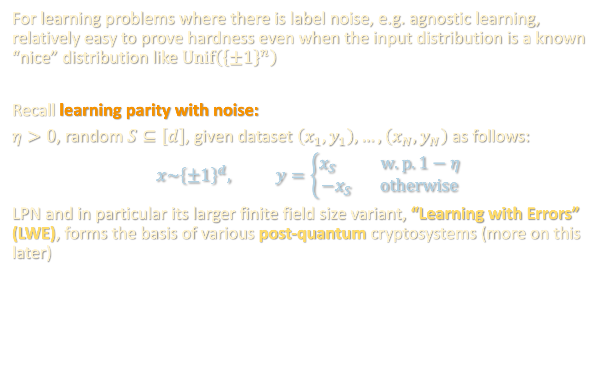
DISTRIBUTION-SPECIFIC HARDNESS: NOISE HELPS
For learning problems where there is label noise, e.g. agnostic learning, relatively easy to prove hardness even when the input distribution is a known “nice” distribution like $Unif\left({\left\{±1\right\}}^{n}\right)$
Recall learning parity with noise:
$η>0$, random $S⊆\left[d\right]$, given dataset $\left(x_{1},y_{1}\right),…,\left(x_{N},y_{N}\right)$ as follows:
$$x\sim {\left\{±1\right\}}^{d}, y=\left\{\begin{aligned}x_{S} w.p. 1−η \\ −x_{S} otherwise\end{aligned}\right.$$
LPN and in particular its larger finite field size variant, “Learning with Errors” (LWE), forms the basis of various post-quantum cryptosystems (more on this later)

Slide 14
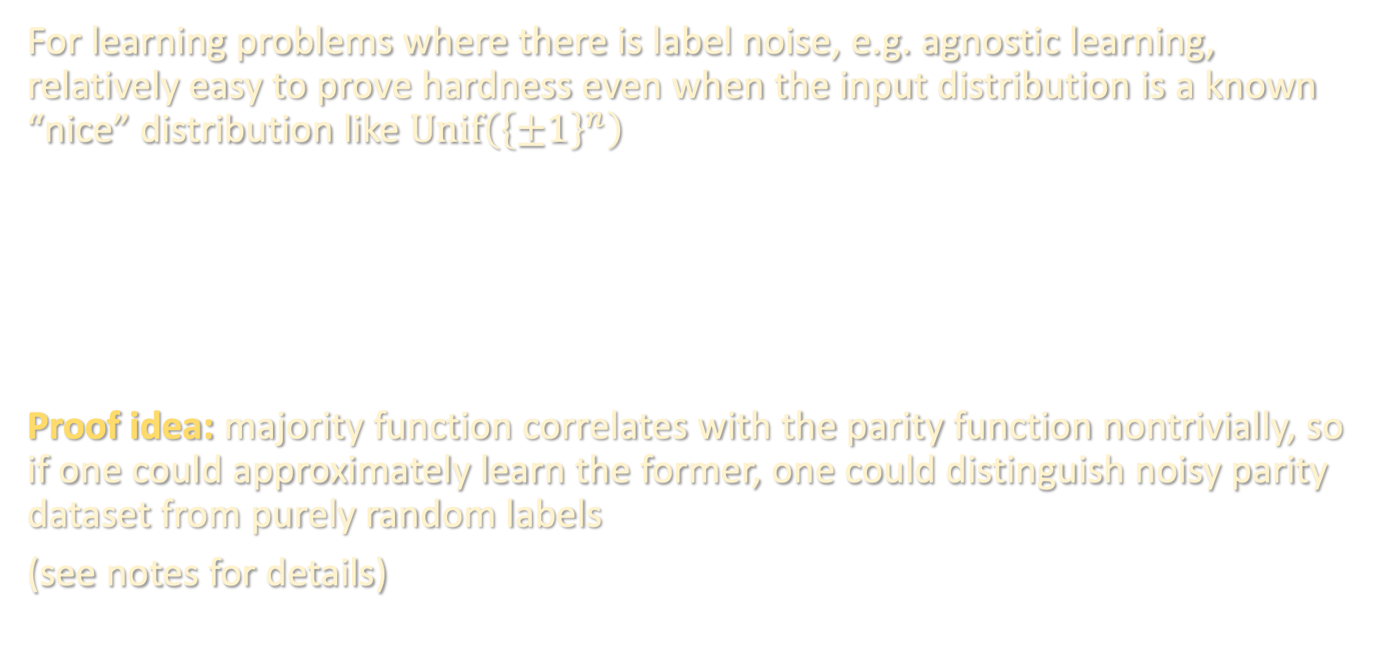
DISTRIBUTION-SPECIFIC HARDNESS: NOISE HELPS
For learning problems where there is label noise, e.g. agnostic learning, relatively easy to prove hardness even when the input distribution is a known “nice” distribution like $Unif\left({\left\{±1\right\}}^{n}\right)$
Proof idea: majority function correlates with the parity function nontrivially, so if one could approximately learn the former, one could distinguish noisy parity dataset from purely random labels
(see notes for details)
Lemma [Kalai-Klivans-Mansour-Servedio ‘06]: A polynomial-time algorithm for agnostically learning halfspaces over the uniform distribution implies a polynomial-time algorithm for learning parity with noise.

Slide 15
TAKEAWAYS SO FAR
Typically in the past, cryptographic assumptions have been great for proving lower bounds for learning worst-case functions either over worst-case input distributions, or over benign input distribution but in agnostic setting
Additionally, the settings are all discrete in nature!
Rest of lecture: cryptographic lower bounds for learning neural networks over Gaussian inputs with benign noise, and for learning mixtures of Gaussians

Slide 16
Early connections to cryptography
(pseudorandom functions, public-key crypto, agnostic noise)
Crypto lower bounds for learning MLPs and Gaussian mixtures
(Continuous LWE)
Outlook

Slide 17
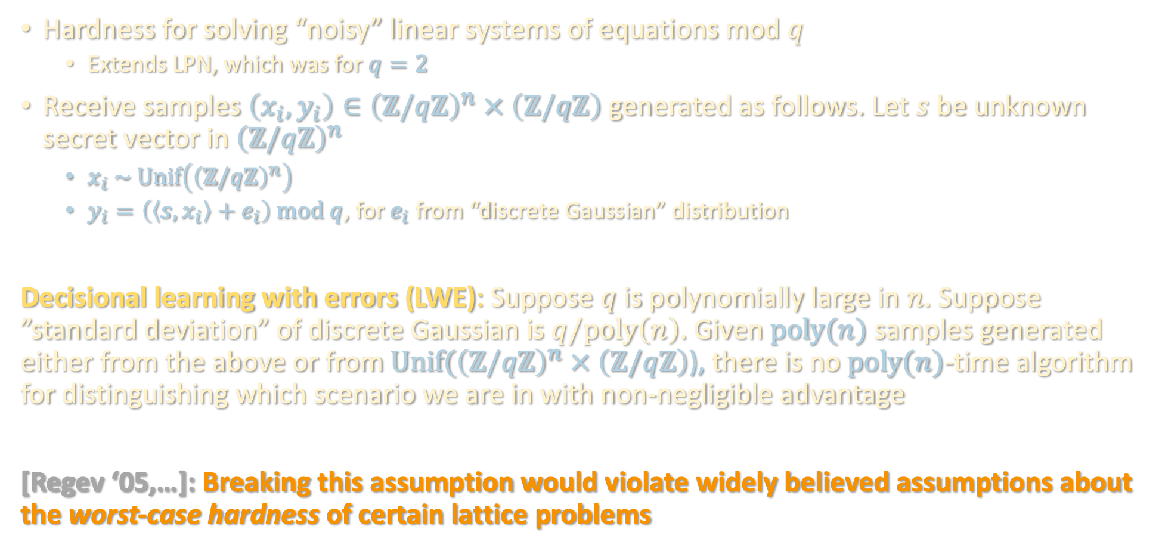
LEARNING WITH ERRORS
Hardness for solving “noisy” linear systems of equations mod $q$
  Extends LPN, which was for $q=2$
Receive samples $\left(x_{i},y_{i}\right)∈{\left(ℤ/qℤ\right)}^{n} × \left(ℤ/qℤ\right)$ generated as follows. Let $s$ be unknown secret vector in ${\left(ℤ/qℤ\right)}^{n}$
  $x_{i} \sim Unif\left({\left(ℤ/qℤ\right)}^{n}\right)$
  $y_{i}=\left(\left\langle s,x_{i}\right\rangle +e_{i}\right) mod q$, for $e_{i}$ from “discrete Gaussian” distribution
Decisional learning with errors (LWE): Suppose $q$ is polynomially large in $n$. Suppose ”standard deviation” of discrete Gaussian is $q/poly\left(n\right)$. Given $poly(n)$ samples generated either from the above or from $Unif({\left(ℤ/qℤ\right)}^{n} × \left(ℤ/qℤ\right)$), there is no $poly(n)$-time algorithm for distinguishing which scenario we are in with non-negligible advantage
[Regev ‘05,…]: Breaking this assumption would violate widely believed assumptions about the worst-case hardness of certain lattice problems

Slide 18
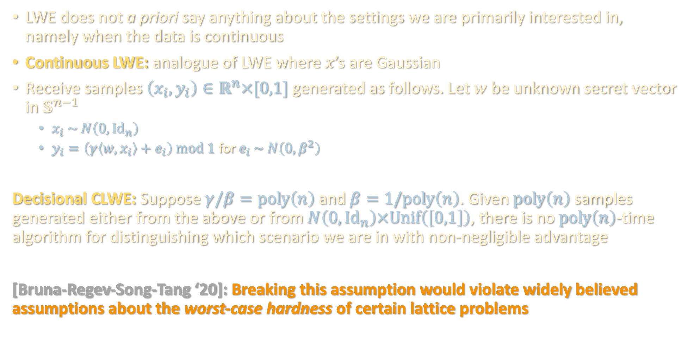
CONTINUOUS LEARNING WITH ERRORS
LWE does not a priori say anything about the settings we are primarily interested in, namely when the data is continuous
Continuous LWE: analogue of LWE where $x$’s are Gaussian
Receive samples $\left(x_{i},y_{i}\right)∈ℝ^{n}×[0,1]$ generated as follows. Let $w$ be unknown secret vector in $𝕊^{n−1}$
  $x_{i} \sim N\left(0,Id_{n}\right)$
  $y_{i}=\left(γ\left\langle w,x_{i}\right\rangle +e_{i}\right) mod 1$ for $e_{i} \sim N\left(0,β^{2}\right)$
Decisional CLWE: Suppose $γ/β=poly\left(n\right)$ and $β=1/poly\left(n\right)$. Given $poly\left(n\right)$ samples generated either from the above or from $N\left(0,Id_{n}\right)×Unif\left(\left[0,1\right]\right)$, there is no $poly\left(n\right)$-time algorithm for distinguishing which scenario we are in with non-negligible advantage
[Bruna-Regev-Song-Tang ‘20]: Breaking this assumption would violate widely believed assumptions about the worst-case hardness of certain lattice problems

Slide 19
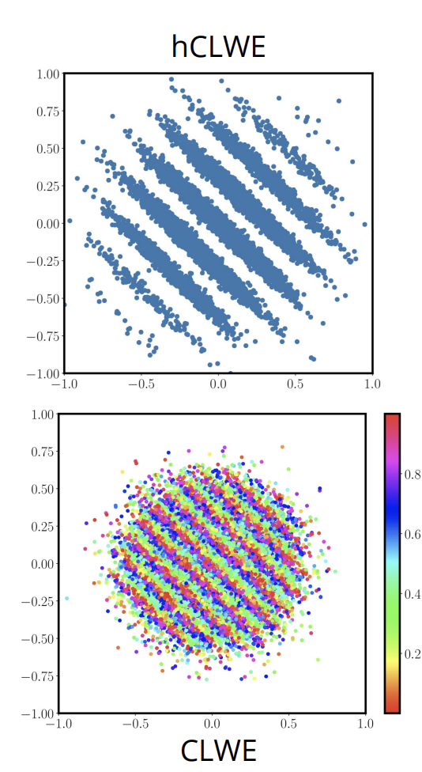
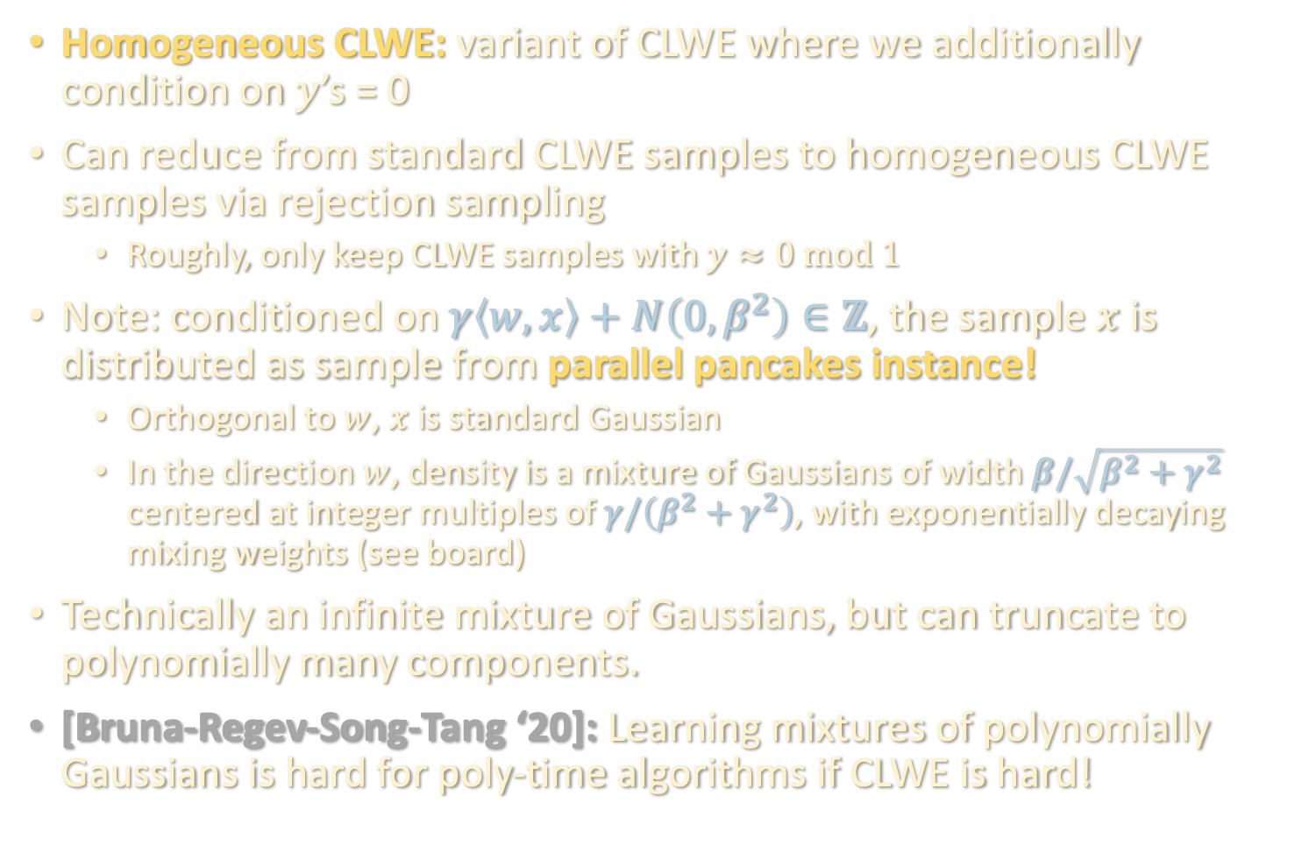
IMPLICATION 1: GAUSSIAN MIXTURES
Homogeneous CLWE: variant of CLWE where we additionally condition on $y$’s = 0
Can reduce from standard CLWE samples to homogeneous CLWE samples via rejection sampling
  Roughly, only keep CLWE samples with $y≈0 mod 1$
Note: conditioned on $γ\left\langle w,x\right\rangle +N\left(0,β^{2}\right)∈ℤ$, the sample $x$ is distributed as sample from parallel pancakes instance!
  Orthogonal to $w$, $x$ is standard Gaussian
  In the direction $w$, density is a mixture of Gaussians of width $β/\sqrt{β^{2}+γ^{2}}$ centered at integer multiples of $γ/\left(β^{2}+γ^{2}\right)$, with exponentially decaying mixing weights (see board)
Technically an infinite mixture of Gaussians, but can truncate to polynomially many components.
[Bruna-Regev-Song-Tang ‘20]: Learning mixtures of polynomially Gaussians is hard for poly-time algorithms if CLWE is hard!

Slide 20
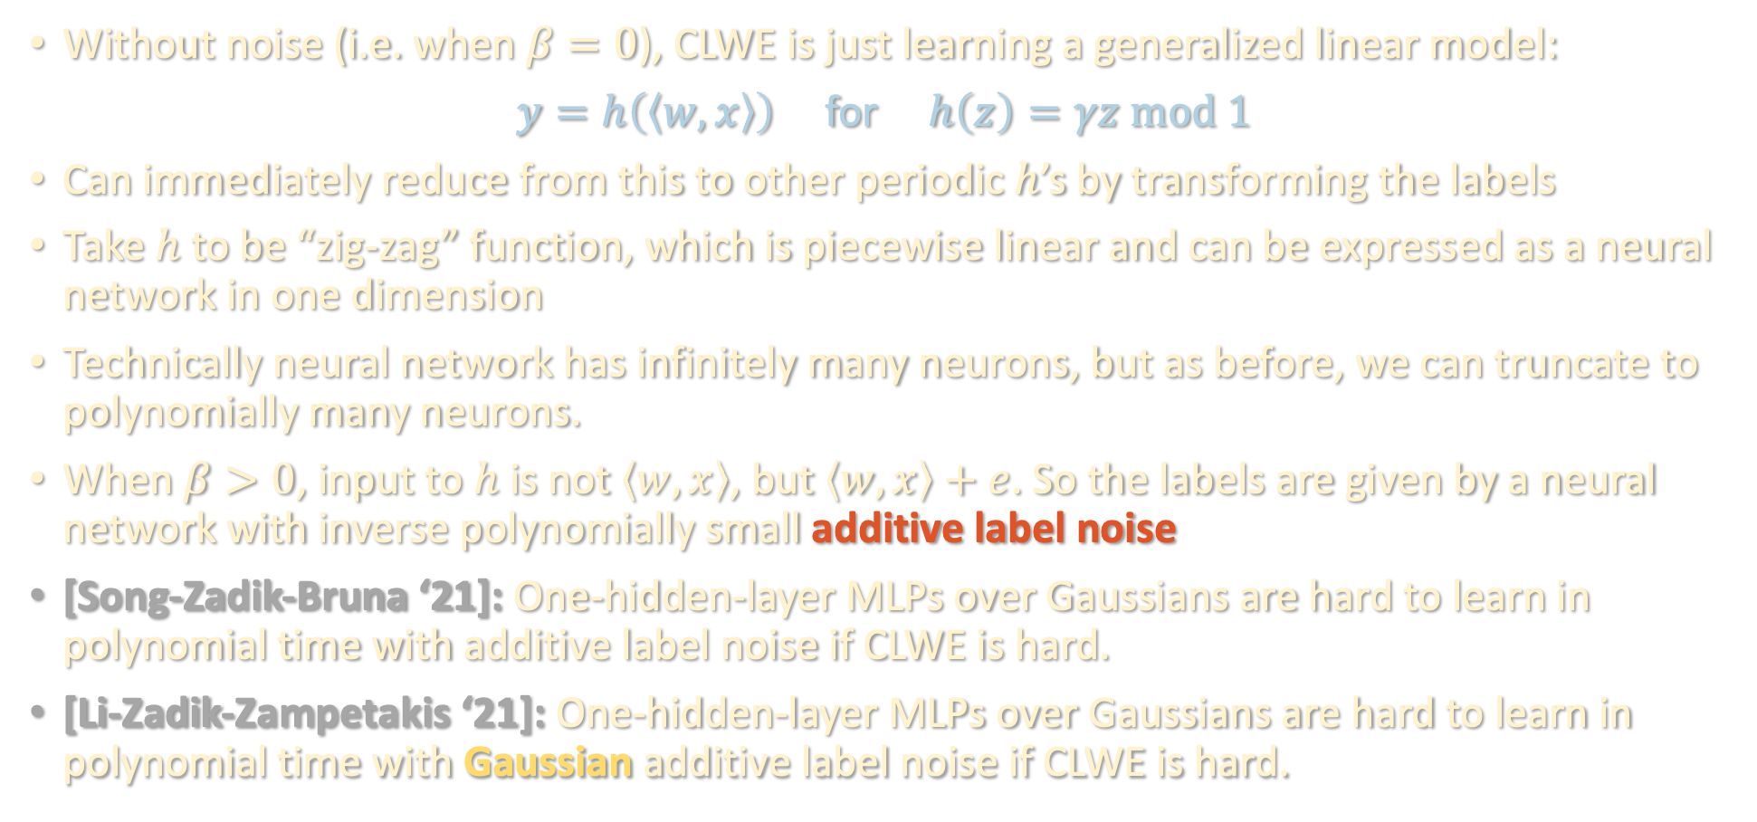
IMPLICATION 2: LEARNING NEURAL NETS
Without noise (i.e. when $β=0$), CLWE is just learning a generalized linear model:
$y=h\left(\left\langle w,x\right\rangle \right)$ for $h\left(z\right)=γz mod 1$
Can immediately reduce from this to other periodic $h$’s by transforming the labels
Take $h$ to be “zig-zag” function, which is piecewise linear and can be expressed as a neural network in one dimension
Technically neural network has infinitely many neurons, but as before, we can truncate to polynomially many neurons.
When $β>0$, input to $h$ is not $\left\langle w,x\right\rangle$, but $\left\langle w,x\right\rangle +e$. So the labels are given by a neural network with inverse polynomially small additive label noise
[Song-Zadik-Bruna ‘21]: One-hidden-layer MLPs over Gaussians are hard to learn in polynomial time with additive label noise if CLWE is hard.
[Li-Zadik-Zampetakis ‘21]: One-hidden-layer MLPs over Gaussians are hard to learn in polynomial time with Gaussian additive label noise if CLWE is hard.

Slide 21
OTHER HARDNESS RESULTS FOR NEURAL NETS
[Daniely-Vardi ‘20, C-Gollakota-Klivans-Meka ‘22]: Hardness for learning two-hidden-layer MLPs over Gaussian data without label noise, under a different crypto assumption (see last year’s lecture 19 notes)
[Daniely-Srebro-Vardi ‘23]: Modification of the reduction above shows that even in the smoothed complexity setting, depth-4 MLPs are hard to learn over Gaussian inputs

Slide 22
FROM DISCRETE TO CONTINUOUS
Perhaps the least obvious aspect of all of these results is how one can derive hardness for problems over continuous domains, given the vast toolbox of continuous algorithms (gradient descent, method of moments, etc.)
Hardness of CLWE from hardness of lattice problems closely tracks Regev’s original proof strategy for LWE. Superficially, a little mysterious from this why continuous inputs provably don’t help
Can we get better intuition by directly relating CLWE back to LWE?
[Gupte-Vafa-Vaikuntanathan ‘22]: Yes! Direct reduction from LWE to CLWE.
  Intuition: continuity doesn’t help because can approximately simulate continuous data by carefully adding noise to discrete data
  Proof: see board

Slide 23
Early connections to cryptography
(pseudorandom functions, public-key crypto, agnostic noise)
Crypto lower bounds for learning MLPs and Gaussian mixtures
(Continuous LWE)
Outlook

Slide 24
COMPLEXITY RECAP
Strong connections between cryptography / average-case complexity and ML theory, but practically relevant reductions tricky because the former are typically discrete and either correspond to unnatural input distributions or require agnostic noise to simulate
Bulk of work on lower bounds has been in restricted models like SQ (surprisingly robust, main exception is Gaussian elimination)
hardness is based on engineering instances with structural features that preclude certain algorithms. convenient by virtue of recipes
E.g. parity <-> low-degree approximation, Gaussian mixtures <-> moment methods / dimensionality reduction
These instances show (surprisingly!) that not only do those algorithms fail, but any algorithm will fail

Slide 25
COMPLEXITY RECAP
Lower bounds are a powerful way of introspecting about modeling choices
e.g. once upon a time distribution-free agnostic learning was a great target to shoot for, but turned out to be too good to be true
Realizing a model is too general often requires requires taking a computational, rather than a statistical, lens
Even seemingly benign settings (continuous functions, Gaussian inputs, smoothed MLP weights) can be computationally hard!

Slide 26

COMING UP
sum-of-squares
optimization
statistical physics
tensors
supervised
learning
computational complexity

