Slide 1

CS 2243: ALGORITHMS FOR DATA SCIENCE
LECTURE 12 (10/16)
Tensor decomposition
Sum-of-squares
Supervised learning
Computational complexity
Statistical physics
Generative modeling
BEYOND LINEARIZED NETWORKS: MEAN-FIELD LIMIT

Slide 2
ANNOUNCEMENTS
Pset 3 is out, due Tuesday Oct 29
Final project information / signup link posted in Canvas announcement

Slide 3
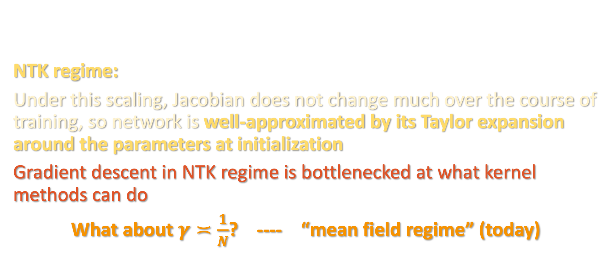
WHAT WE KNOW SO FAR ABOUT GD
NTK regime:
Under this scaling, Jacobian does not change much over the course of training, so network is well-approximated by its Taylor expansion around the parameters at initialization
Gradient descent in NTK regime is bottlenecked at what kernel methods can do
What about $γ≍\frac{1}{N}$? ---- “mean field regime” (today)

Slide 4
MEAN FIELD LIMIT
It will be convenient to denote this by
We will consider population gradient descent:
where is the test loss (can approximate
using online gradient descent)

Slide 5

MEAN FIELD LIMIT
We can decompose the loss as
$$N$$

Slide 6
MEAN FIELD LIMIT
We can decompose the loss as
$$N$$
”external field”

Slide 7
MEAN FIELD LIMIT
We can decompose the loss as
$$N$$
”external field”
”pairwise interactions”

Slide 8
MEAN FIELD LIMIT
We can decompose the loss as
$$N$$
”external field”
”pairwise interactions”
for

Slide 9
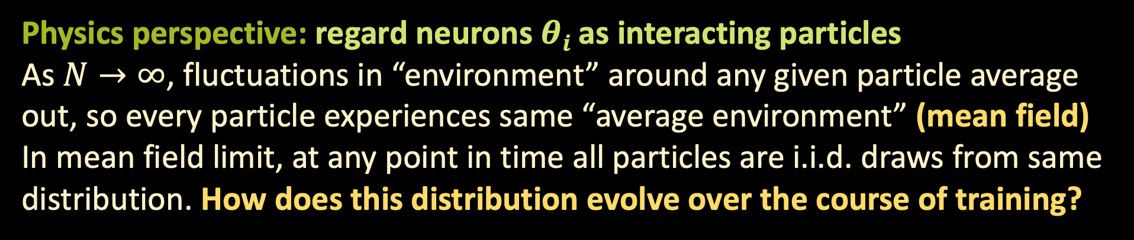
MEAN FIELD LIMIT
for
We can decompose the loss as
$$N$$
”external field”
”pairwise interactions”
Physics perspective: regard neurons $θi$ as interacting particles
As $N→∞$, fluctuations in “environment” around any given particle average out, so every particle experiences same “average environment” (mean field)
In mean field limit, at any point in time all particles are i.i.d. draws from same distribution. How does this distribution evolve over the course of training?

Slide 10

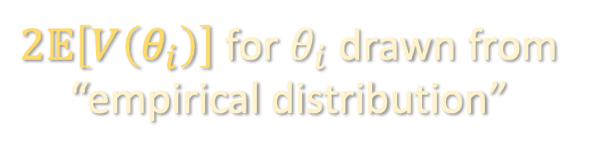
MEAN FIELD LIMIT
for
$$N$$
Instead of parametrizing in terms of $θ=\left(θ_{1},…,θ_{N}\right)$, parametrize in terms of a probability distribution $ρ$ over $ℝ^{d}$. Then $L$ becomes
$2𝔼\left[V\left(θ_{i}\right)\right]$ for $θ_{i}$drawn from “empirical distribution”

Slide 11

MEAN FIELD LIMIT
for
Finite N Mean-field limit
$$N$$

Slide 12
MEAN FIELD LIMIT
Finite N Mean-field limit
$$N$$
,

Slide 13
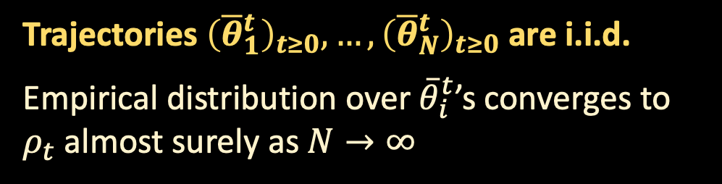
MEAN FIELD LIMIT
Finite N Mean-field limit
$$N$$
,
Trajectories ${\left({\overline{θ}}_{1}^{t}\right)}_{t≥0},…,{\left({\overline{θ}}_{N}^{t}\right)}_{t≥0}$ are i.i.d.
Empirical distribution over ${\overline{θ}}_{i}^{t}$’s converges to $ρ_{t}$ almost surely as $N→∞$

Slide 14
MEAN FIELD LIMIT
Finite N Mean-field limit
$$N$$
,
continuity PDE
holds in “weak sense” (see board)

Slide 15
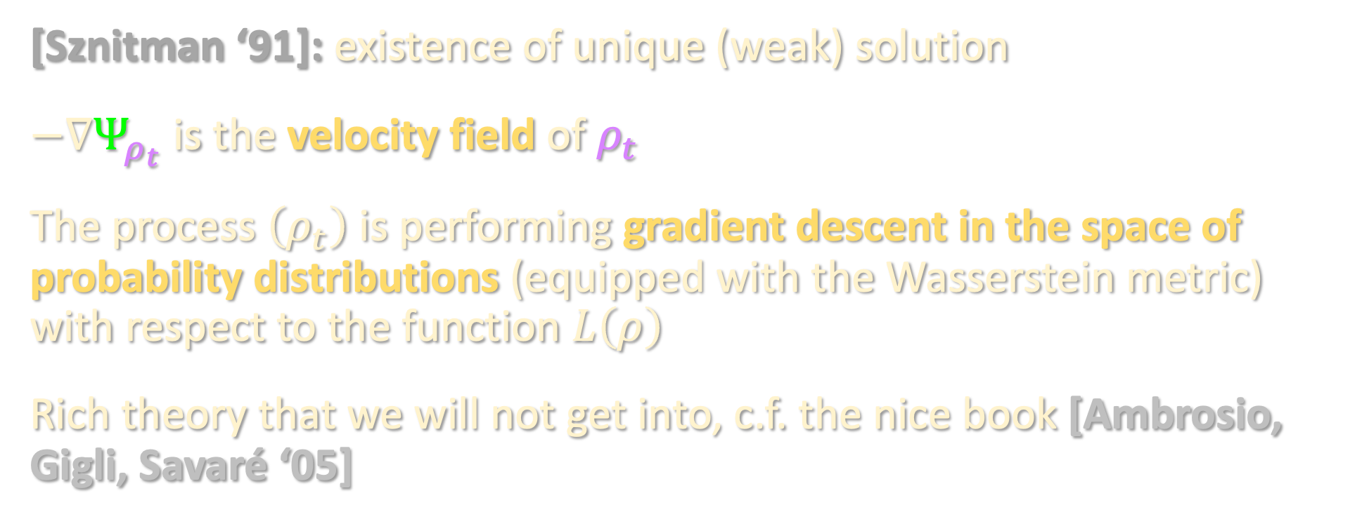
WASSERSTEIN GRADIENT FLOWS
[Sznitman ‘91]: existence of unique (weak) solution
$−∇Ψ_{ρ_{t}}$ is the velocity field of $ρ_{t}$
The process $\left(ρ_{t}\right)$ is performing gradient descent in the space of probability distributions (equipped with the Wasserstein metric) with respect to the function $L\left(ρ\right)$
Rich theory that we will not get into, c.f. the nice book [Ambrosio, Gigli, Savaré ‘05]

Slide 16
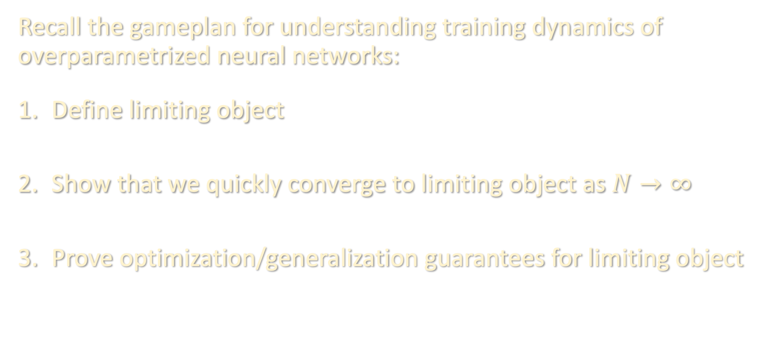
RECIPE
Recall the gameplan for understanding training dynamics of overparametrized neural networks:
Define limiting object
Show that we quickly converge to limiting object as $N→∞$
Prove optimization/generalization guarantees for limiting object

Slide 17
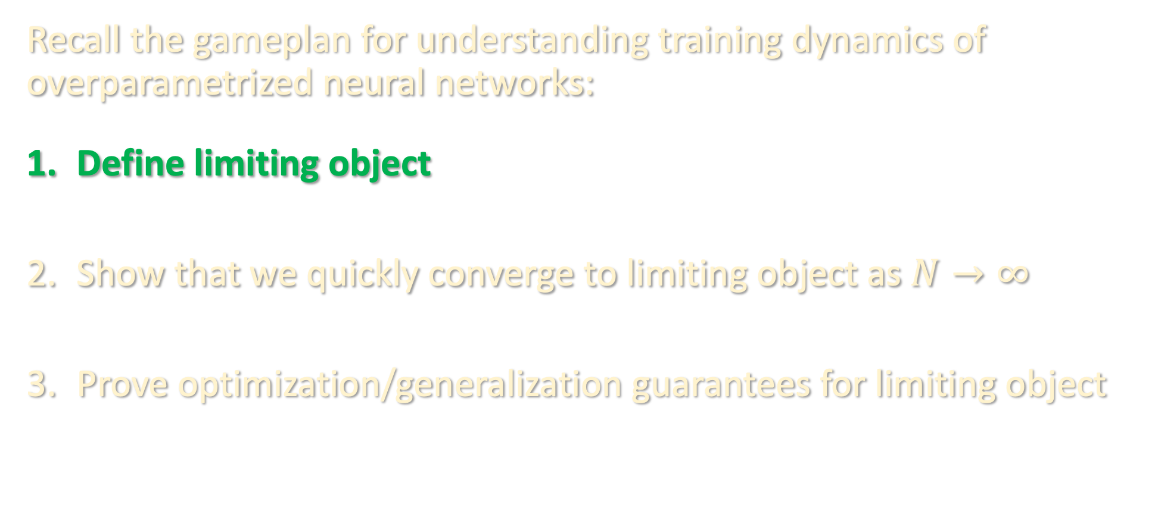
RECIPE
Recall the gameplan for understanding training dynamics of overparametrized neural networks:
Define limiting object
Show that we quickly converge to limiting object as $N→∞$
Prove optimization/generalization guarantees for limiting object

Slide 18
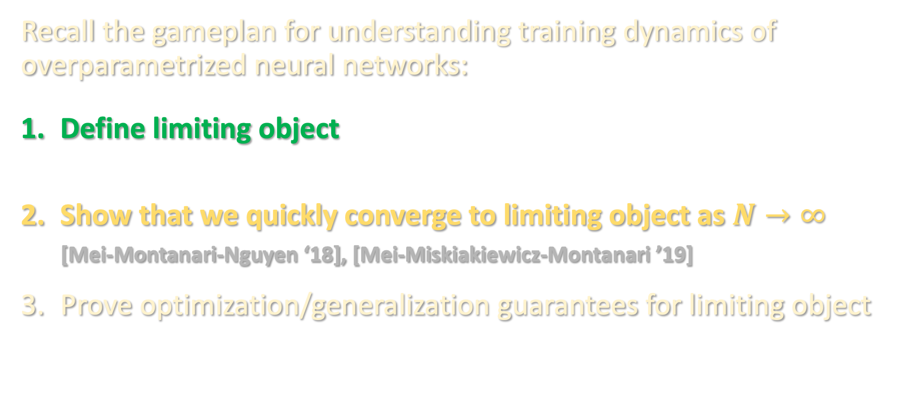
RECIPE
Recall the gameplan for understanding training dynamics of overparametrized neural networks:
Define limiting object
Show that we quickly converge to limiting object as $N→∞$
[Mei-Montanari-Nguyen ‘18], [Mei-Miskiakiewicz-Montanari ’19]
Prove optimization/generalization guarantees for limiting object

Slide 19

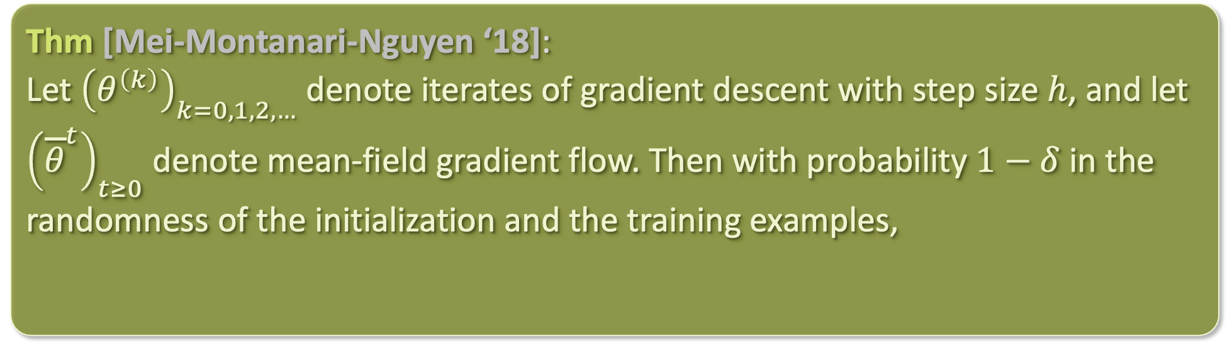
NON-ASYMPTOTIC CONVERGENCE
Assume:
1. $∇V,∇U$ bounded Lipschitz, 2. $σ$ bounded, 3. $∇_{θ}σ\left(x;θ\right)$ has sub-Gaussian tails
Proof sketch: see board
Thm [Mei-Montanari-Nguyen ‘18]:
Let ${\left(θ^{\left(k\right)}\right)}_{k=0,1,2,…}$ denote iterates of gradient descent with step size $h$, and let ${\left({\overline{θ}}^{t}\right)}_{t≥0}$ denote mean-field gradient flow. Then with probability $1−δ$ in the randomness of the initialization and the training examples,

Slide 20
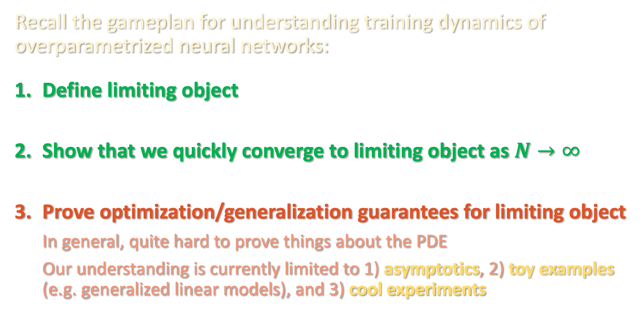
RECIPE
Recall the gameplan for understanding training dynamics of overparametrized neural networks:
Define limiting object
Show that we quickly converge to limiting object as $N→∞$
Prove optimization/generalization guarantees for limiting object
In general, quite hard to prove things about the PDE
Our understanding is currently limited to 1) asymptotics, 2) toy examples (e.g. generalized linear models), and 3) cool experiments

Slide 21

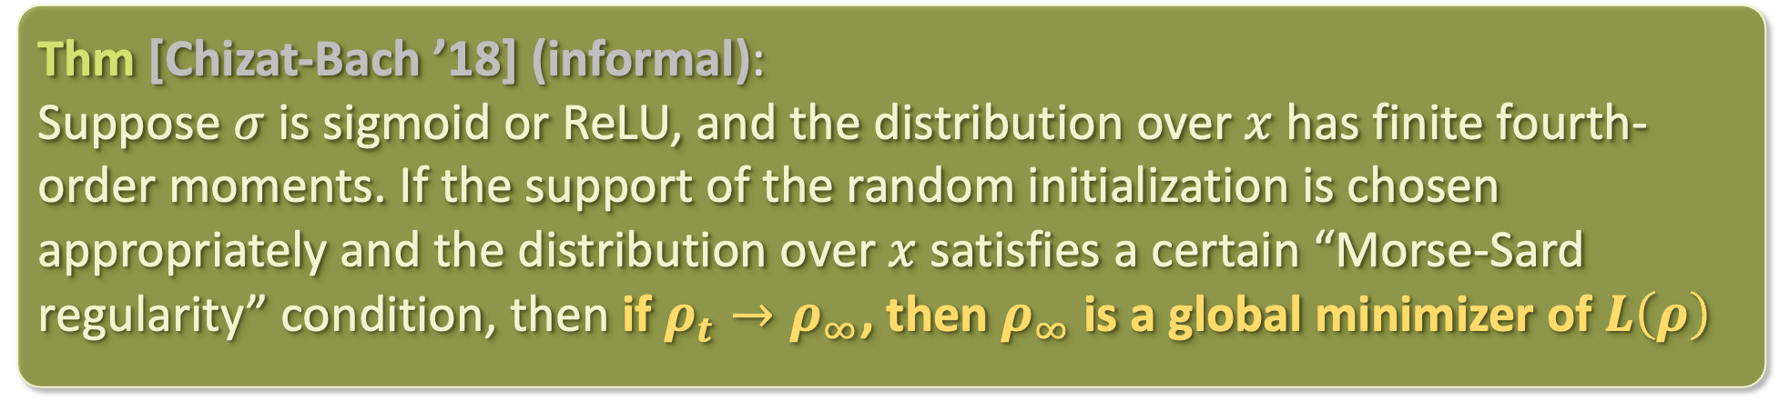
ASYMPTOTICS – NOISELESS GD
Want to understand the evolution of $L\left(ρ_{t}\right)$
Proof crucially exploits the Wasserstein gradient flow perspective, as well as homogeneity / partial homogeneity of the activation function
Follow-ups: [Wojtowytsch ‘20], [Nguyen-Pham ‘20]
Thm [Chizat-Bach ’18] (informal):
Suppose $σ$ is sigmoid or ReLU, and the distribution over $x$ has finite fourth-order moments. If the support of the random initialization is chosen appropriately and the distribution over $x$ satisfies a certain “Morse-Sard regularity” condition, then if $ρ_{t}→ρ_{∞}$, then $ρ_{∞}$ is a global minimizer of $L\left(ρ\right)$

Slide 22


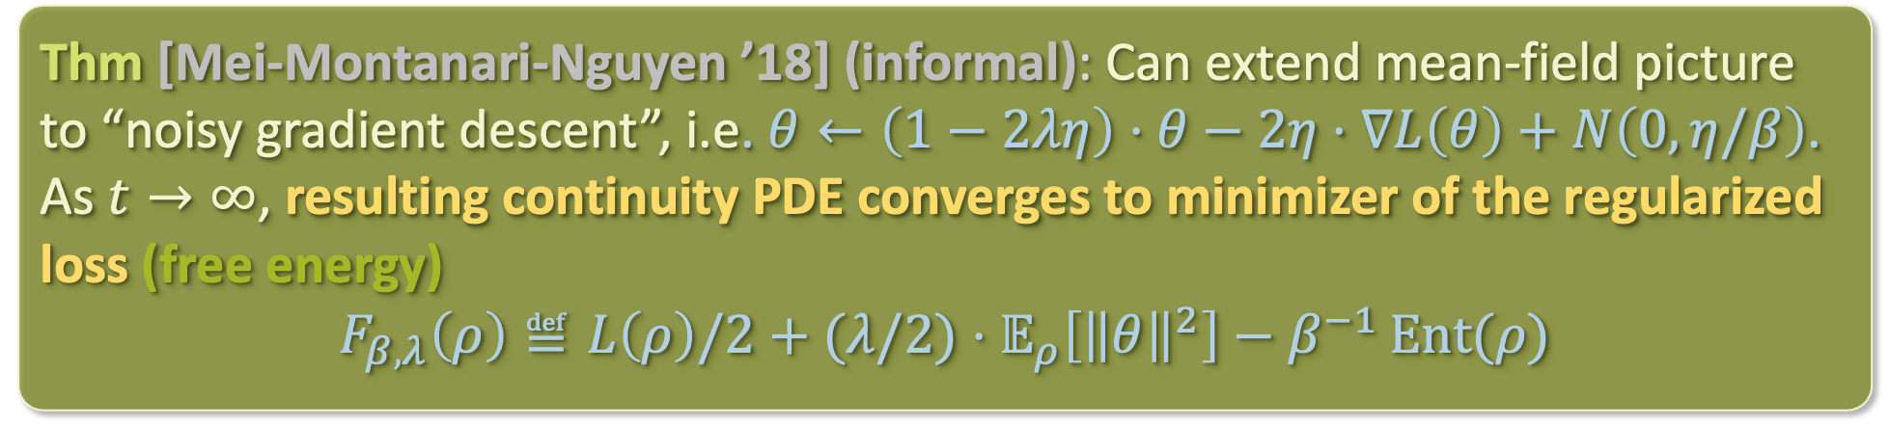
ASYMPTOTICS – NOISY GD
Want to understand the evolution of $L\left(ρ_{t}\right)$
Thm [Mei-Montanari-Nguyen ’18] (informal): Can extend mean-field picture to “noisy gradient descent”, i.e. $θ←\left(1−2λη\right)⋅θ−2η⋅∇L\left(θ\right)+N\left(0,η/β\right)$. As $t→∞$, resulting continuity PDE converges to minimizer of the regularized loss (free energy)
$$F_{β,λ}\left(ρ\right)≝L\left(ρ\right)/2+(λ/2)⋅𝔼_{ρ}\left[{\left\|θ\right\|}^{2}\right]−β^{−1 }Ent(ρ)$$
In fact, limit distribution satisfies
$$ρ_{∞}\left(θ\right)∝\exp\left(−βΨ_{ρ_{∞}}^{\left(λ\right)}\left(θ\right)\right)$$

Slide 23
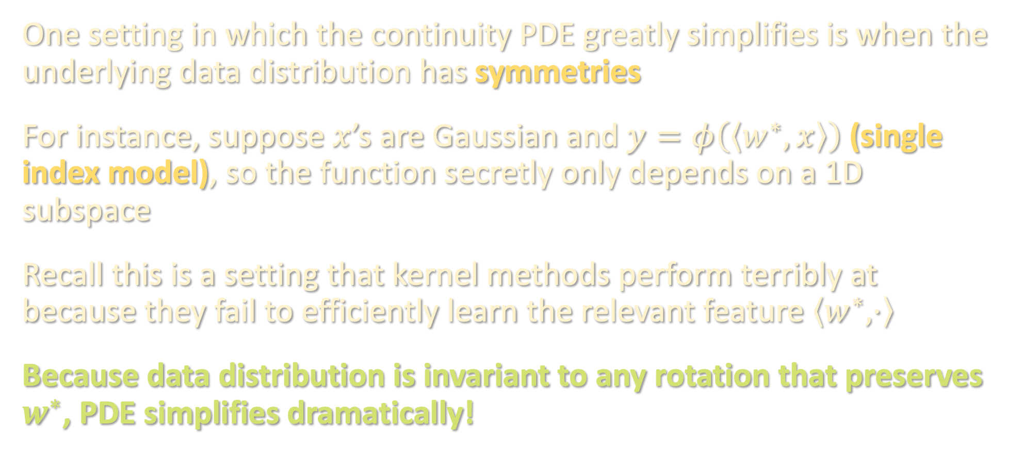
TOY MODELS
One setting in which the continuity PDE greatly simplifies is when the underlying data distribution has symmetries
For instance, suppose $x$’s are Gaussian and $y=φ\left(\left\langle w^{∗},x\right\rangle \right)$ (single index model), so the function secretly only depends on a 1D subspace
Recall this is a setting that kernel methods perform terribly at because they fail to efficiently learn the relevant feature $\left\langle w^{∗},⋅\right\rangle$
Because data distribution is invariant to any rotation that preserves $w^{∗}$, PDE simplifies dramatically!

Slide 24
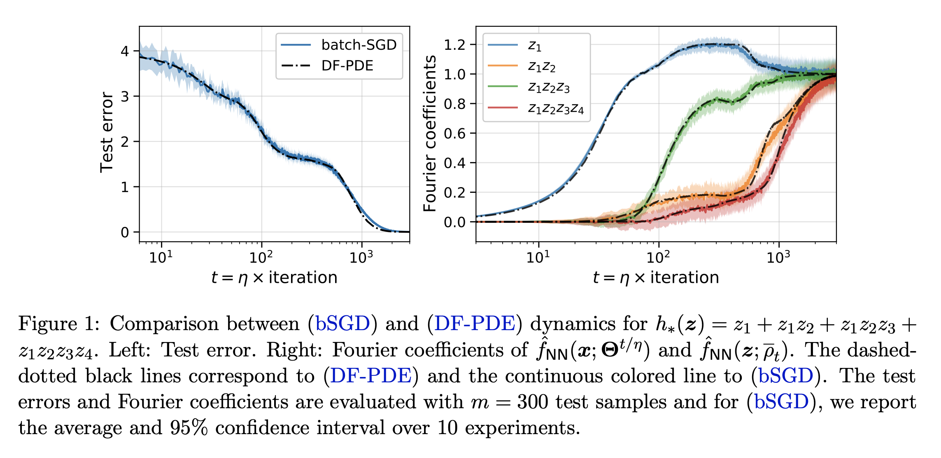
TOY MODELS
In such settings where symmetries drastically reduce the dimension of the PDE, we can numerically solve it and obtain sharp predictions
Although a finite-dimensional problem, to get rigorous guarantees they still need to modify the training algorithm (e.g. do layerwise training) to get end-to-end provable guarantees
from [Abbe-Boix-Adsera-Misiakiewicz ‘22]

Slide 25
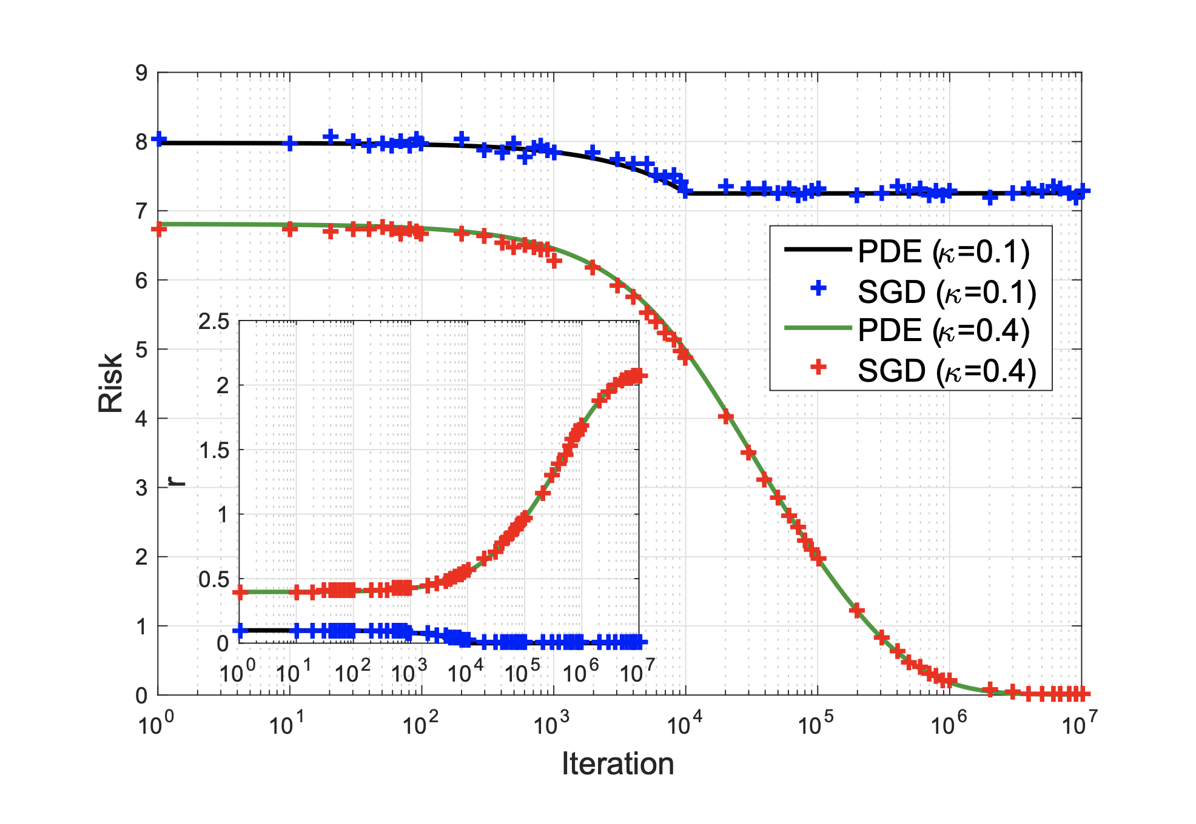

TOY MODELS
In such settings where symmetries drastically reduce the dimension of the PDE, we can numerically solve it and obtain sharp predictions
Classifying isotropic Gaussians:
Data is a mixture of
$x∼N\left(0,{\left(1+Δ\right)}^{2}⋅Id_{d}\right)$, $y=1$
$x∼N\left(0,{\left(1−Δ\right)}^{2}⋅Id_{d}\right)$, $y=−1$
Reduced PDE is 1-dimensional (only need to track distribution of ${\left\|θ\right\|}_{2}$)
They obtain rigorous end-to-end guarantees for this problem
from [Mei-Montanari-Nguyen ‘18]

Slide 26
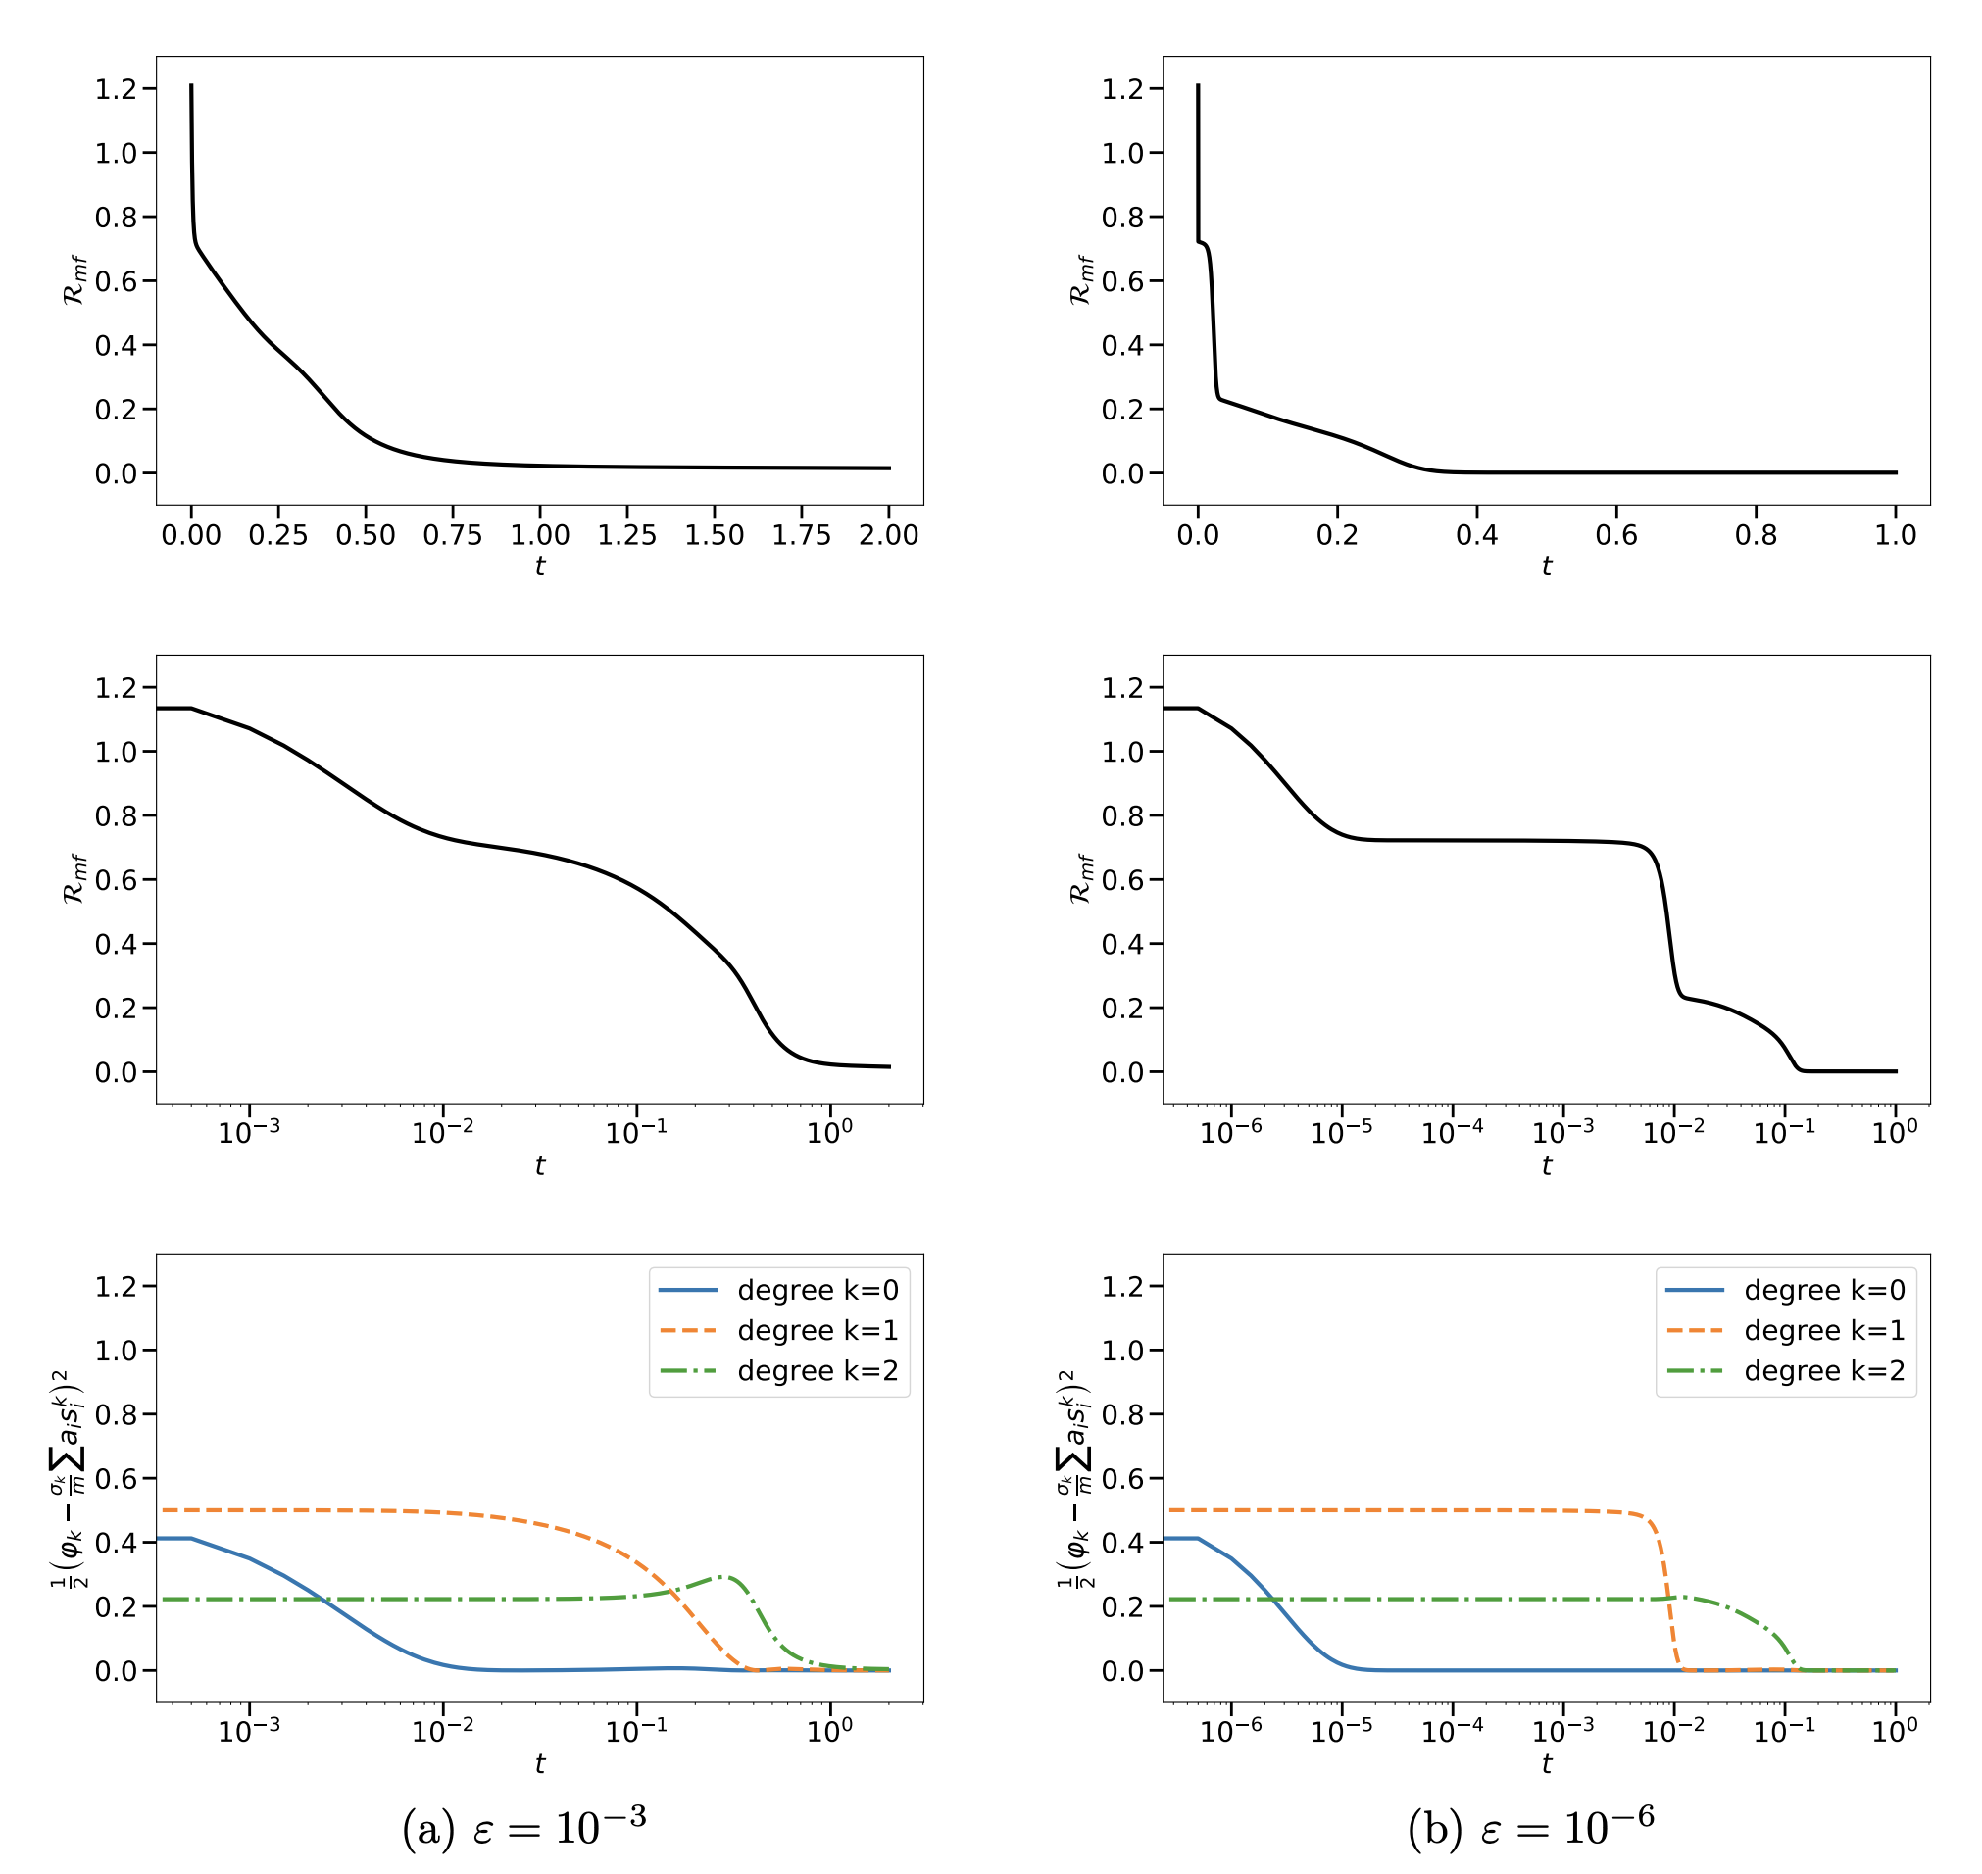

TOY MODELS
In such settings where symmetries drastically reduce the dimension of the PDE, we can numerically solve it and obtain sharp predictions
Continuity PDE for learning $f\left(x\right)=φ\left(\left\langle w^{∗},x\right\rangle \right)$ for
$$φ\left(z\right)=He_{0}\left(z\right)−He_{1}\left(z\right)+\frac{2}{3}He_{2}\left(z\right)$$
using a one-hidden-layer ReLU network over Gaussian examples
Demonstrates two empirically observed phenomena:
Plateaus in the loss curve, interspersed with sharp drops
Longer and longer time scales
Key (partially rigorous) finding: mean field gradient flow incrementally learns low-degree Hermite components of single index models
from [Berthier-Montanari-Zhou ‘23]

Slide 27
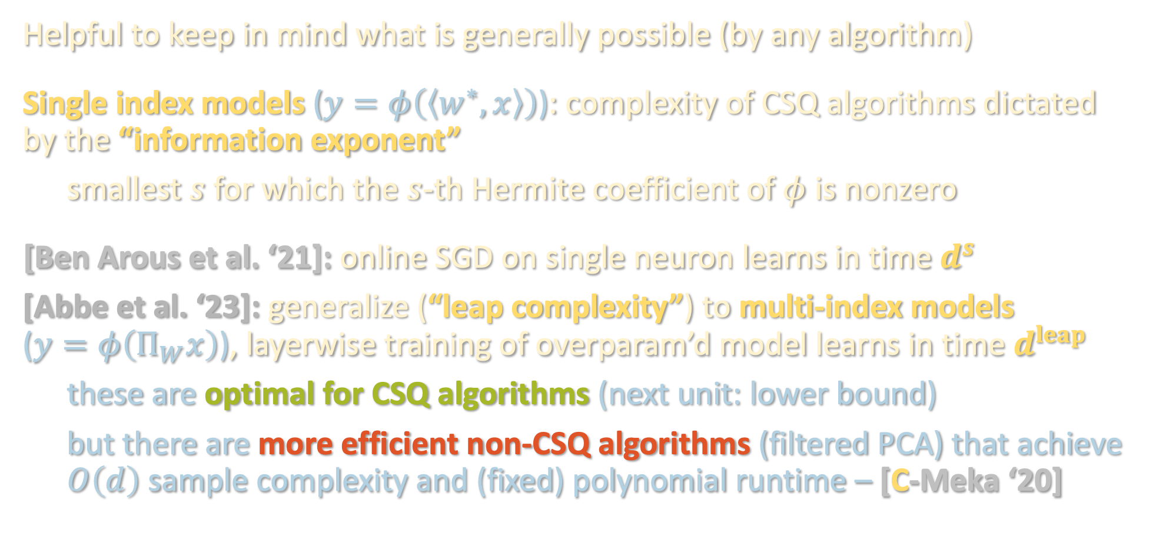
CSQ REVISITED
Helpful to keep in mind what is generally possible (by any algorithm)
Single index models ($y=φ\left(\left\langle w^{∗},x\right\rangle \right)$): complexity of CSQ algorithms dictated by the “information exponent”
smallest $s$ for which the $s$-th Hermite coefficient of $φ$ is nonzero
[Ben Arous et al. ‘21]: online SGD on single neuron learns in time $d^{s}$
[Abbe et al. ‘23]: generalize (“leap complexity”) to multi-index models ($y=φ\left(Π_{W}x\right)$), layerwise training of overparam’d model learns in time $d^{leap}$
these are optimal for CSQ algorithms (next unit: lower bound)
but there are more efficient non-CSQ algorithms (filtered PCA) that achieve $O\left(d\right)$ sample complexity and (fixed) polynomial runtime – [C-Meka ‘20]

Slide 28
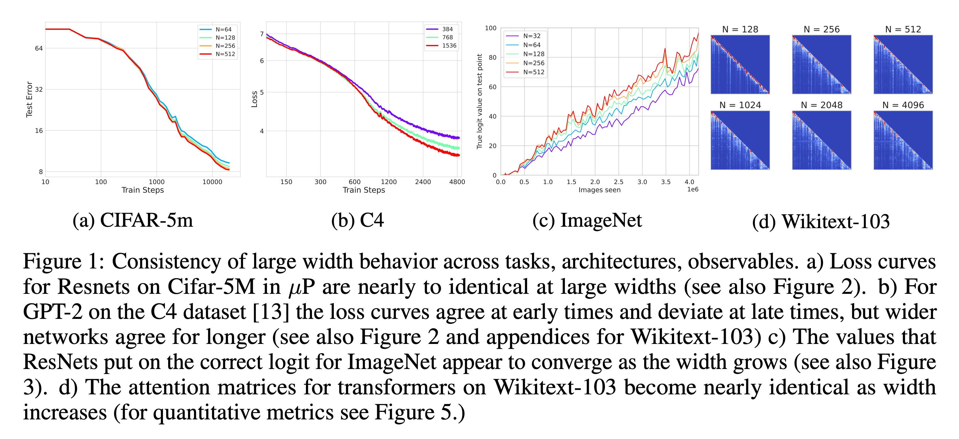
PRACTICAL IMPLICATIONS BEYOND TOY SETTINGS
How predictive is the mean field limit of practically observed phenomena?
from [Vyas-Atanasov-Bordelon-Morwani-Sainathan-Pehlevan ‘23]

Slide 29
SUPERVISED LEARNING RECAP- ALGORITHMS
30 years after [Linial-Mansour-Nisan ‘93]’s low-degree algorithm, (almost) everything in PAC is still about low-degree polynomials
But there are two distinct flavors:
⚠️
⚠️
 | What is the smallest degree for which there is a polynomial that approximates the ground truth? | What is the smallest degree at which the ground truth has a nonzero polynomial component?

Slide 30
SUPERVISED LEARNING RECAP- ALGORITHMS
30 years after [Linial-Mansour-Nisan ‘93]’s low-degree algorithm, (almost) everything in PAC is still about low-degree polynomials
But there are two distinct flavors:
⚠️
⚠️
 | What is the smallest degree for which there is a polynomial that approximates the ground truth? | What is the smallest degree at which the ground truth has a nonzero polynomial component?
Structure being exploited | Fourier/Hermite concentration | information exponent / leap

Slide 31
SUPERVISED LEARNING RECAP- ALGORITHMS
30 years after [Linial-Mansour-Nisan ‘93]’s low-degree algorithm, (almost) everything in PAC is still about low-degree polynomials
But there are two distinct flavors:
⚠️
⚠️
 | What is the smallest degree for which there is a polynomial that approximates the ground truth? | What is the smallest degree at which the ground truth has a nonzero polynomial component?
Structure being exploited | Fourier/Hermite concentration | information exponent / leap
Algorithms | low-degree algorithm, polynomial regression, kernel methods | tensor methods, feature learning / GD beyond NTK

Slide 32
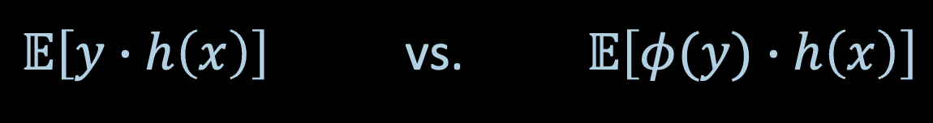
SUPERVISED LEARNING RECAP- ALGORITHMS
30 years after [Linial-Mansour-Nisan ‘93]’s low-degree algorithm, (almost) everything in PAC is still about low-degree polynomials
Algorithms in practice largely captured by the CSQ model, but the theory suggests that even slight deviations from this model can lead to improvements in time/data efficiency (e.g. filtered PCA)
$𝔼\left[y∙h\left(x\right)\right]$ vs. $𝔼\left[φ(y)∙h\left(x\right)\right]$

Slide 33
SUPERVISED LEARNING RECAP- ALGORITHMS
30 years after [Linial-Mansour-Nisan ‘93]’s low-degree algorithm, (almost) everything in PAC is still about low-degree polynomials
Algorithms in practice largely captured by the CSQ model, but the theory suggests that even slight deviations from this model can lead to improvements in time/data efficiency (e.g. filtered PCA)
Last two lectures: to understand why training overparametrized models helps, pass to a limiting object:
If not careful about scaling, “easy” to prove convergence / generalization because dynamics are linear
With critical scaling, limiting object quite predictive, but remains hard to analyze except in toy settings

Slide 34

SUPERVISED LEARNING RECAP- MODELING
Still in the early stages of navigating tradeoff between distributional assumptions and algorithmic guarantees:
Distribution-free with Massart noise
Known
Truth?
generality of
distributional
assumption
Gaussian/
uniform over ${\left\{±1\right\}}^{n}$
*
Halfspaces
Neural networks
expressivity of function class

Slide 35
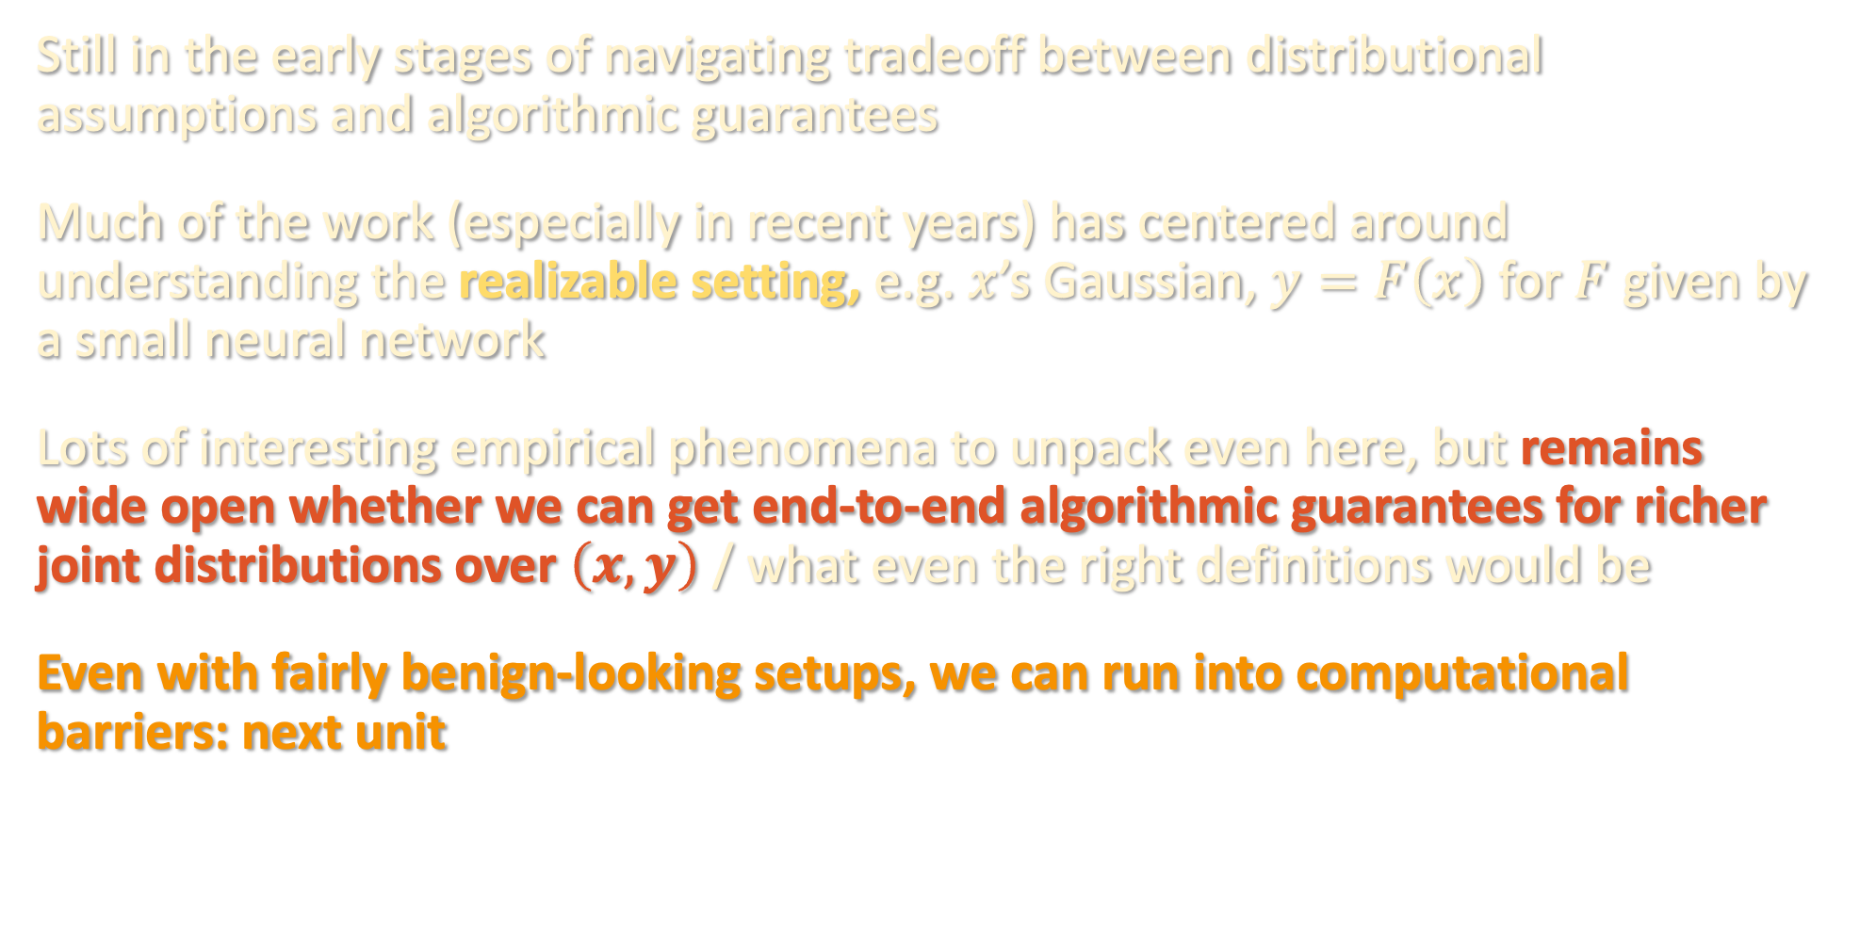
SUPERVISED LEARNING RECAP- MODELING
Still in the early stages of navigating tradeoff between distributional assumptions and algorithmic guarantees
Much of the work (especially in recent years) has centered around understanding the realizable setting, e.g. $x$’s Gaussian, $y=F\left(x\right)$ for $F$ given by a small neural network
Lots of interesting empirical phenomena to unpack even here, but remains wide open whether we can get end-to-end algorithmic guarantees for richer joint distributions over $\left(x,y\right)$ / what even the right definitions would be
Even with fairly benign-looking setups, we can run into computational barriers: next unit

Slide 36

UP NEXT
sum-of-squares
optimization
tensors
supervised
learning
computational complexity

