Slide 1

CS 2243: ALGORITHMS FOR DATA SCIENCE
LECTURE 11 (10/8)
Tensor decomposition
Sum-of-squares
Supervised learning
Computational complexity
Statistical physics
Generative modeling
TRAINING DYNAMICS FOR LINEARIZED NETWORKS

Slide 2

ANNOUNCEMENTS
Final project topics will be posted next week
Talk by Costis Daskalakis (MIT) at the CS Colloquium tomorrow!

Slide 3
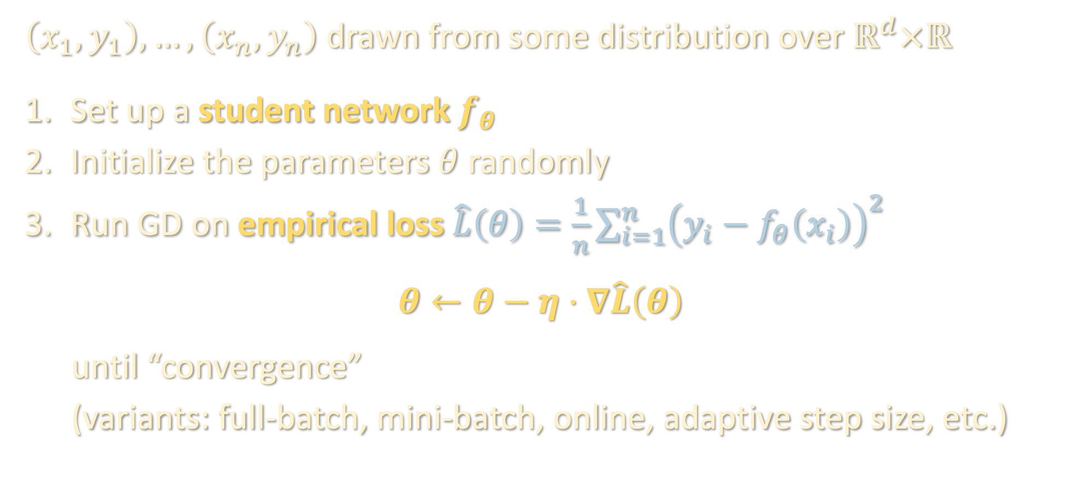
GRADIENT DESCENT (GD)
$\left(x_{1},y_{1}\right),…,\left(x_{n},y_{n}\right)$ drawn from some distribution over $ℝ^{d}×ℝ$
Set up a student network $f_{θ}$
Initialize the parameters $θ$ randomly
Run GD on empirical loss $\hat{L}\left(θ\right)=\frac{1}{n}\sum_{i=1}^{n}{{\left(y_{i}−f_{θ}\left(x_{i}\right)\right)}^{2}}$
$$θ←θ−η⋅∇\hat{L}\left(θ\right)$$
until “convergence”
(variants: full-batch, mini-batch, online, adaptive step size, etc.)

Slide 4
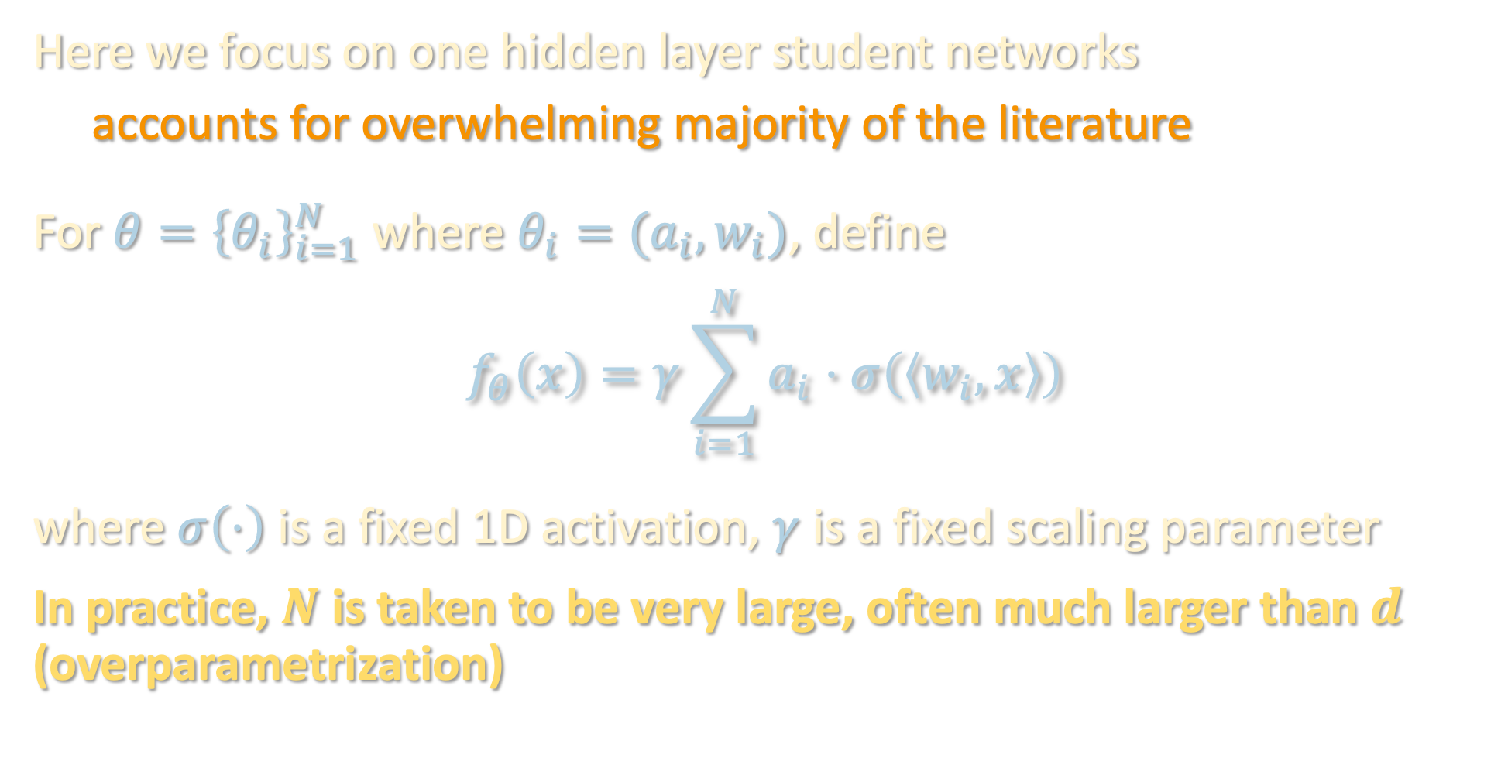
GRADIENT DESCENT (GD)
Here we focus on one hidden layer student networks
accounts for overwhelming majority of the literature
For $θ={\left\{θ_{i}\right\}}_{i=1}^{N}$ where $θ_{i}=(a_{i},w_{i})$, define
$$f_{θ}\left(x\right)=γ\sum_{i=1}^{N}{a_{i}⋅σ\left(\left\langle w_{i},x\right\rangle \right)}$$
where $σ\left(⋅\right)$ is a fixed 1D activation, $γ$ is a fixed scaling parameter
In practice, $N$ is taken to be very large, often much larger than $d$ (overparametrization)

Slide 5
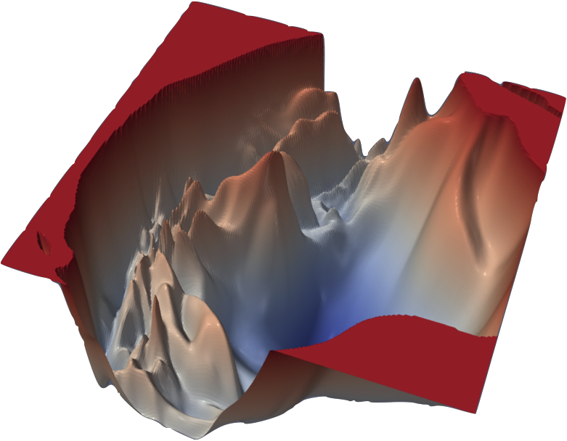
TWO MYSTERIES FROM PRACTICE
Optimization: Empirical loss is a (highly) nonconvex function
… yet we are able to efficiently converge to zero empirical loss (i.e. perfectly fit all the training data)

Slide 6
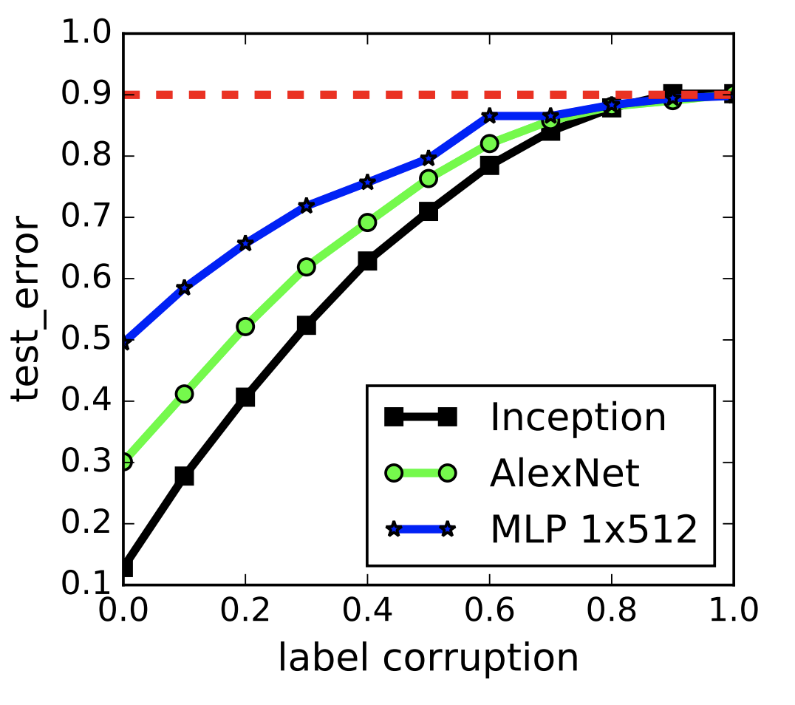
TWO MYSTERIES FROM PRACTICE
Generalization: Highly overparametrized models trained to achieve zero empirical loss also achieve small test loss, i.e. they do not overfit!
from Zhang-Bengio-Hardt-Recht-Vinyals ‘17

Slide 7

EXPLOITING OVERPARAMETRIZATION IN THE ANALYSIS
Empirically, “the more parameters the better.” A hypothesis:
As # params $N→∞$, training dynamics converge to a limiting process with the desired optimization / generalization properties
Only role of overparametrization is to bring us closer and closer to this limiting process
For provable guarantees, suffices to:
Bound error in approximating limiting process in terms of $N$
Prove limiting process converges quickly to small train/test error

Slide 8
EXPLOITING OVERPARAMETRIZATION IN THE ANALYSIS
This week, we’ll see two regimes in which people have tried implementing this recipe:
Lazy training / linearized neural networks/ kernel limit:
Network is well-approximated by its first-order Taylor expansion around the parameters at initialization. Bottlenecked at kernel methods
Non-lazy training / feature learning regime / mean field limit:
Training dynamics are highly nonlinear. Features (i.e. first-layer weights) very different from those at initialization

Slide 9
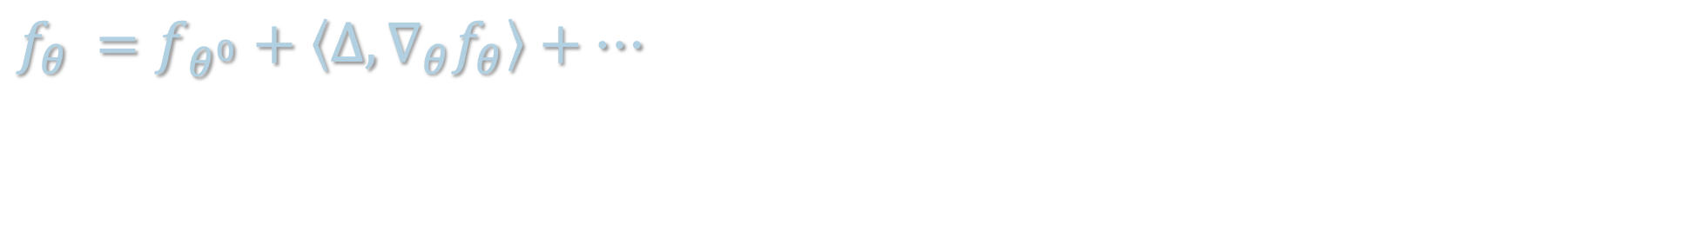

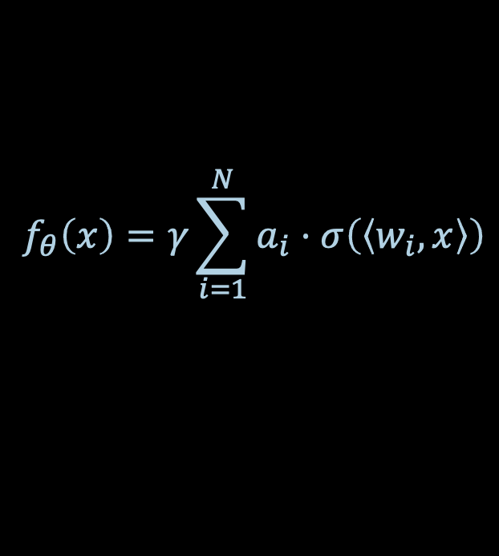
LINEARIZED NETWORKS
$$f_{θ}\left(x\right)=γ\sum_{i=1}^{N}{a_{i}⋅σ\left(\left\langle w_{i},x\right\rangle \right)}$$
Suppose parameters at initialization are given by $θ_{i}^{0}=\left(a_{i}^{0},w_{i}^{0}\right)$
Taylor expansion of $f_{θ}$ around $θ^{0}$:
Take $θ_{i}=\left(a_{i}^{0}+\left[Δa_{i}\right], w_{i}^{0}+\left[Δw_{i}\right]\right)$. Then
$$f_{θ}$$ | $$=f_{θ^{0}}+\left\langle Δ,∇_{θ}f_{θ}\right\rangle +…$$

Slide 10
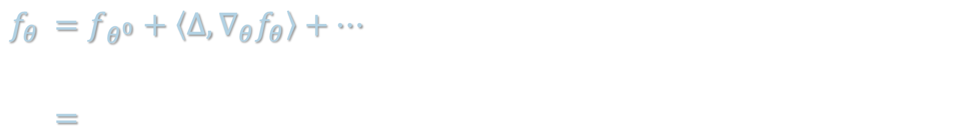


LINEARIZED NETWORKS
$$f_{θ}\left(x\right)=γ\sum_{i=1}^{N}{a_{i}⋅σ\left(\left\langle w_{i},x\right\rangle \right)}$$
Suppose parameters at initialization are given by $θ_{i}^{0}=\left(a_{i}^{0},w_{i}^{0}\right)$
Taylor expansion of $f_{θ}$ around $θ^{0}$:
Take $θ_{i}=\left(a_{i}^{0}+\left[Δa_{i}\right], w_{i}^{0}+\left[Δw_{i}\right]\right)$. Then
$$f_{θ}$$ | $$=f_{θ^{0}}+\left\langle Δ,∇_{θ}f_{θ}\right\rangle +…$$
 | $$=$$
$$f_{θ^{0}}+γ\sum_{i=1}^{N}{\left[Δa_{i}\right]⋅σ\left(\left\langle w_{i}^{0},⋅\right\rangle \right)}+γ\sum_{i=1}^{N}{a_{i}^{0}\left\langle \left[Δw_{i}\right],⋅\right\rangle ⋅σ^{′}\left(\left\langle w_{i}^{0},⋅\right\rangle \right)}+⋯$$
“random features model”
“neural tangent model”

Slide 11
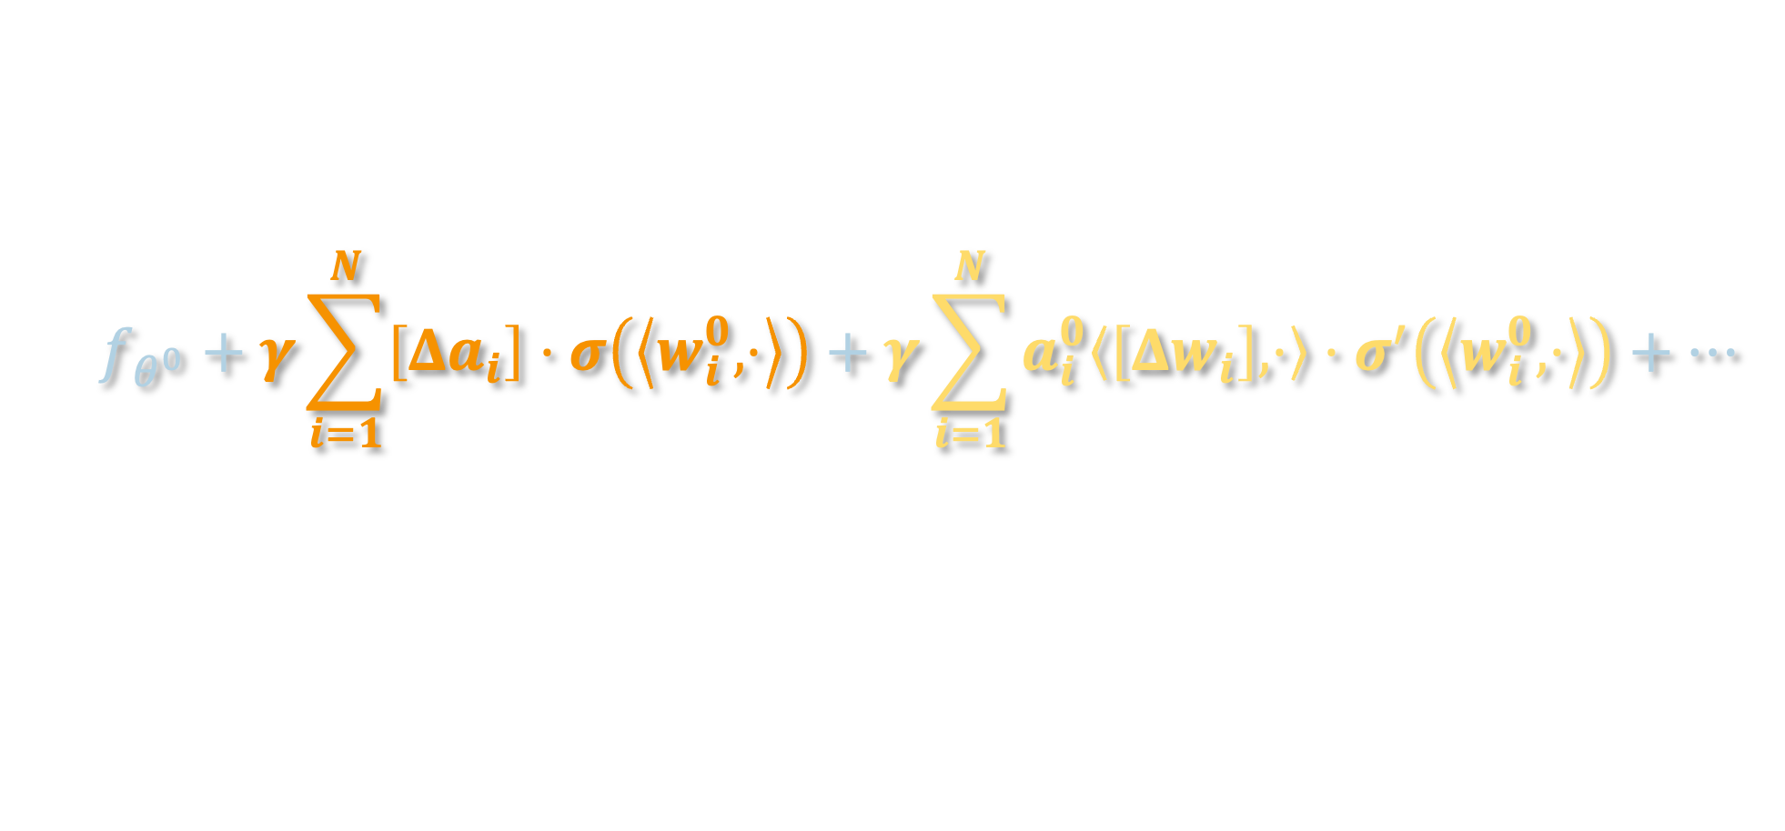
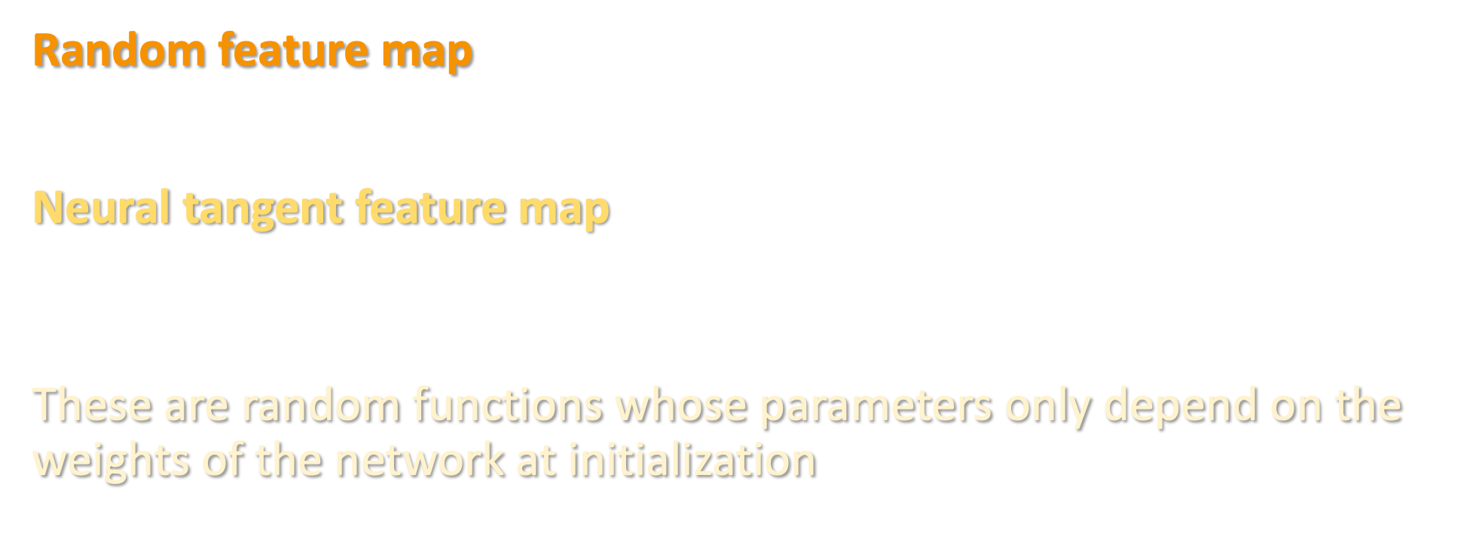
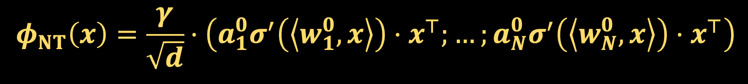

LINEARIZED NETWORKS
$$f_{θ^{0}}+γ\sum_{i=1}^{N}{\left[Δa_{i}\right]⋅σ\left(\left\langle w_{i}^{0},⋅\right\rangle \right)}+γ\sum_{i=1}^{N}{a_{i}^{0}\left\langle \left[Δw_{i}\right],⋅\right\rangle ⋅σ^{′}\left(\left\langle w_{i}^{0},⋅\right\rangle \right)}+⋯$$
Random feature map
$$φ_{RF}\left(x\right)=γ⋅\left(σ\left(\left\langle w_{1},x\right\rangle \right);…;σ\left(\left\langle w_{N},x\right\rangle \right)\right)$$
Neural tangent feature map
$$φ_{NT}\left(x\right)=\frac{γ}{\sqrt{d}}⋅\left(σ^{′}\left(\left\langle w_{1},x\right\rangle \right)⋅x^{⊤};…;σ^{′}\left(\left\langle w_{N},x\right\rangle \right)⋅x^{⊤}\right)$$
These are random functions whose parameters only depend on the weights of the network at initialization
$$φ_{RF}\left(x\right)=γ⋅\left(σ\left(\left\langle w_{1}^{0},x\right\rangle \right);…;σ\left(\left\langle w_{N}^{0},x\right\rangle \right)\right)$$
$$φ_{NT}\left(x\right)=\frac{γ}{\sqrt{d}}⋅\left(a_{1}^{0}σ^{′}\left(\left\langle w_{1}^{0},x\right\rangle \right)⋅x^{⊤};…;a_{N}^{0}σ^{′}\left(\left\langle w_{N}^{0},x\right\rangle \right)⋅x^{⊤}\right)$$

Slide 12
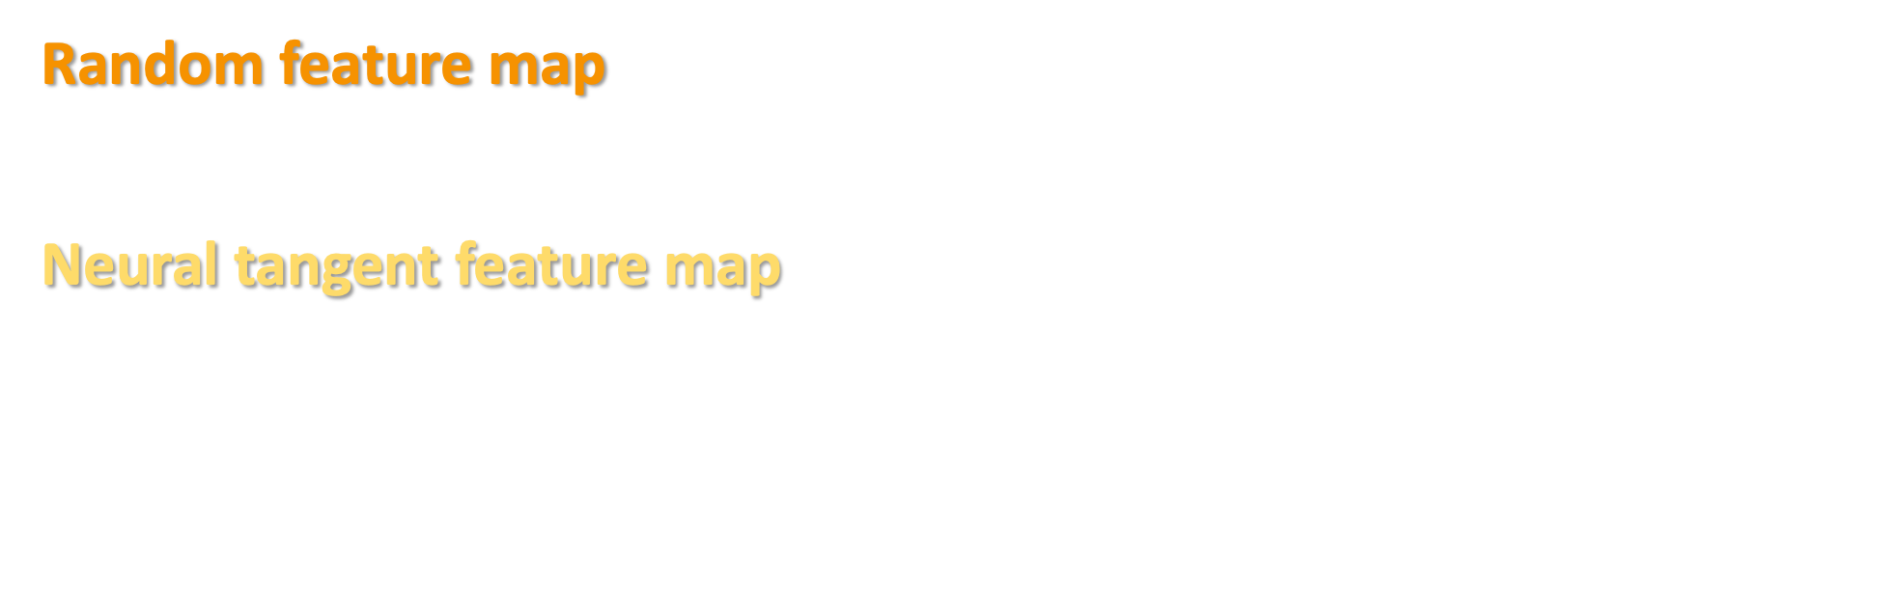
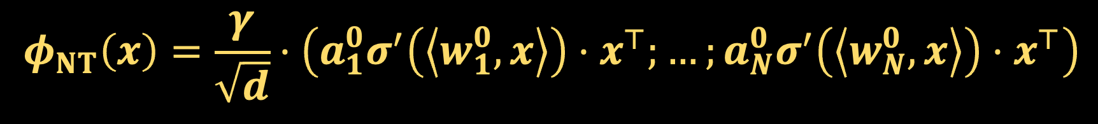
LINEARIZED NETWORKS
$$f_{θ^{0}}+γ\sum_{i=1}^{N}{\left[Δa_{i}\right]⋅σ\left(\left\langle w_{i}^{0},⋅\right\rangle \right)}+γ\sum_{i=1}^{N}{a_{i}^{0}\left\langle \left[Δw_{i}\right],⋅\right\rangle ⋅σ^{′}\left(\left\langle w_{i}^{0},⋅\right\rangle \right)}+⋯$$
Random feature map
$$φ_{RF}\left(x\right)=γ⋅\left(σ\left(\left\langle w_{1},x\right\rangle \right);…;σ\left(\left\langle w_{N},x\right\rangle \right)\right)$$
Neural tangent feature map
$$φ_{NT}\left(x\right)=\frac{γ}{\sqrt{d}}⋅\left(σ^{′}\left(\left\langle w_{1},x\right\rangle \right)⋅x^{⊤};…;σ^{′}\left(\left\langle w_{N},x\right\rangle \right)⋅x^{⊤}\right)$$
$$φ_{RF}\left(x\right)=γ⋅\left(σ\left(\left\langle w_{1}^{0},x\right\rangle \right);…;σ\left(\left\langle w_{N}^{0},x\right\rangle \right)\right)$$
$$φ_{NT}\left(x\right)=\frac{γ}{\sqrt{d}}⋅\left(a_{1}^{0}σ^{′}\left(\left\langle w_{1}^{0},x\right\rangle \right)⋅x^{⊤};…;a_{N}^{0}σ^{′}\left(\left\langle w_{N}^{0},x\right\rangle \right)⋅x^{⊤}\right)$$
$$f_{θ^{0}+Δ}\left(x\right)=f_{θ^{0}}\left(x\right)+\left\langle φ_{RF}\left(x\right),\left[Δa\right]\right\rangle +\sqrt{d}⋅\left\langle φ_{NT}\left(x\right),\left[Δw\right]\right\rangle$$

Slide 13
LINEARIZED NETWORKS
$$f_{θ^{0}}+γ\sum_{i=1}^{N}{\left[Δa_{i}\right]⋅σ\left(\left\langle w_{i}^{0},⋅\right\rangle \right)}+γ\sum_{i=1}^{N}{a_{i}^{0}\left\langle \left[Δw_{i}\right],⋅\right\rangle ⋅σ^{′}\left(\left\langle w_{i}^{0},⋅\right\rangle \right)}+⋯$$
Random feature map
$$φ_{RF}\left(x\right)=γ⋅\left(σ\left(\left\langle w_{1},x\right\rangle \right);…;σ\left(\left\langle w_{N},x\right\rangle \right)\right)$$
Neural tangent feature map
$$φ_{NT}\left(x\right)=\frac{γ}{\sqrt{d}}⋅\left(σ^{′}\left(\left\langle w_{1},x\right\rangle \right)⋅x^{⊤};…;σ^{′}\left(\left\langle w_{N},x\right\rangle \right)⋅x^{⊤}\right)$$
$$φ_{RF}\left(x\right)=γ⋅\left(σ\left(\left\langle w_{1}^{0},x\right\rangle \right);…;σ\left(\left\langle w_{N}^{0},x\right\rangle \right)\right)$$
$$φ_{NT}\left(x\right)=\frac{γ}{\sqrt{d}}⋅\left(a_{1}^{0}σ^{′}\left(\left\langle w_{1}^{0},x\right\rangle \right)⋅x^{⊤};…;a_{N}^{0}σ^{′}\left(\left\langle w_{N}^{0},x\right\rangle \right)⋅x^{⊤}\right)$$
$$f_{θ^{0}+Δ}\left(x\right)=f_{θ^{0}}\left(x\right)+\left\langle φ_{RF}\left(x\right),\left[Δa\right]\right\rangle +\sqrt{d}⋅\left\langle φ_{NT}\left(x\right),\left[Δw\right]\right\rangle$$

Slide 14

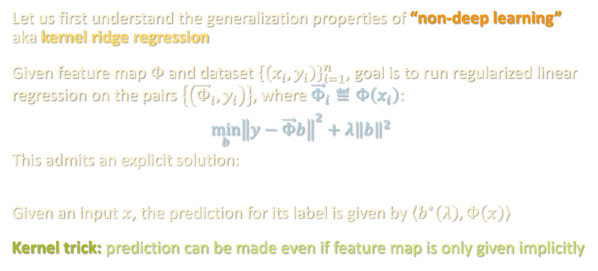
INTERLUDE: KERNEL METHODS
Let us first understand the generalization properties of “non-deep learning” aka kernel ridge regression
Given feature map $Φ$ and dataset ${\left\{\left(x_{i},y_{i}\right)\right\}}_{i=1}^{n}$, goal is to run regularized linear regression on the pairs $\left\{\left({\vec{Φ}}_{i},y_{i}\right)\right\}$, where ${\vec{Φ}}_{i}≝Φ\left(x_{i}\right)$:
$$\min_{b}{{\left\|y−\vec{Φ}b\right\|}^{2}+λ{\left\|b\right\|}^{2}}$$
This admits an explicit solution:
$$b^{∗}\left(λ\right)≝{\vec{Φ}}^{⊤}{\left(λ Id_{n}+\vec{Φ}{\vec{Φ}}^{⊤}\right)}^{−1 }y$$
Given an input $x$, the prediction for its label is given by $\left\langle b^{∗}\left(λ\right),Φ\left(x\right)\right\rangle$
Kernel trick: prediction can be made even if feature map is only given implicitly
$$b^{∗}\left(λ\right)≝{\vec{Φ}}^{⊤}{\left(λ Id_{n}+\vec{Φ}{\vec{Φ}}^{⊤}\right)}^{−1 }y$$

Slide 15

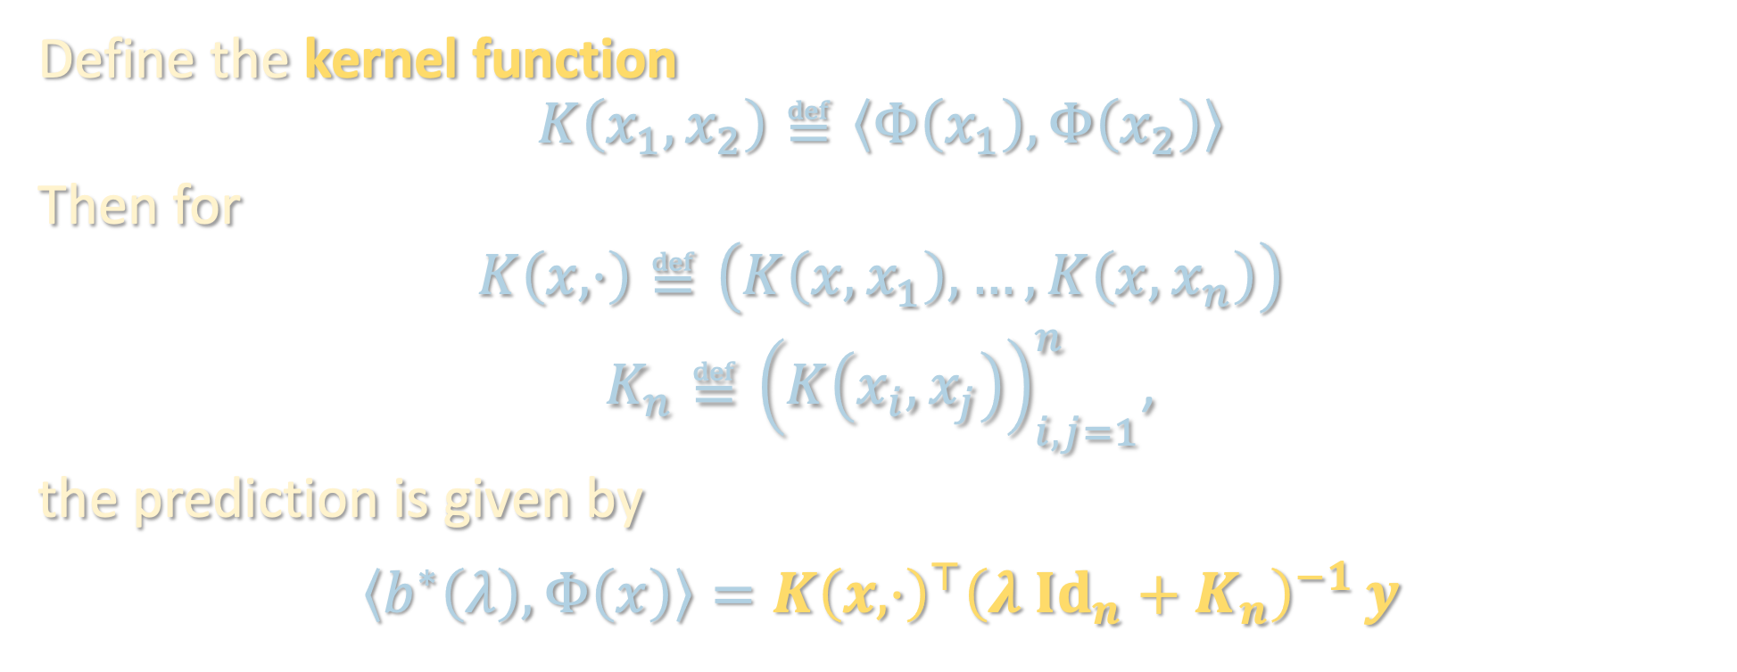

INTERLUDE: KERNEL METHODS
only need to know $K\left(⋅,⋅\right)$, i.e. how to compute inner products in feature space!
$$b^{∗}\left(λ\right)≝{\vec{Φ}}^{⊤}{\left(λ Id_{n}+\vec{Φ}{\vec{Φ}}^{⊤}\right)}^{−1 }y$$
Define the kernel function
$$K\left(x_{1},x_{2}\right)≝\left\langle Φ\left(x_{1}\right),Φ\left(x_{2}\right)\right\rangle$$
Then for
$$K\left(x,⋅\right)≝\left(K\left(x,x_{1}\right),…,K\left(x,x_{n}\right)\right)$$
$K_{n}≝{\left(K\left(x_{i},x_{j}\right)\right)}_{i,j=1}^{n}$,
the prediction is given by
$$\left\langle b^{∗}\left(λ\right),Φ\left(x\right)\right\rangle =K{\left(x,⋅\right)}^{⊤}{\left(λ Id_{n}+K_{n}\right)}^{−1 }y$$
empirical kernel matrix

Slide 16
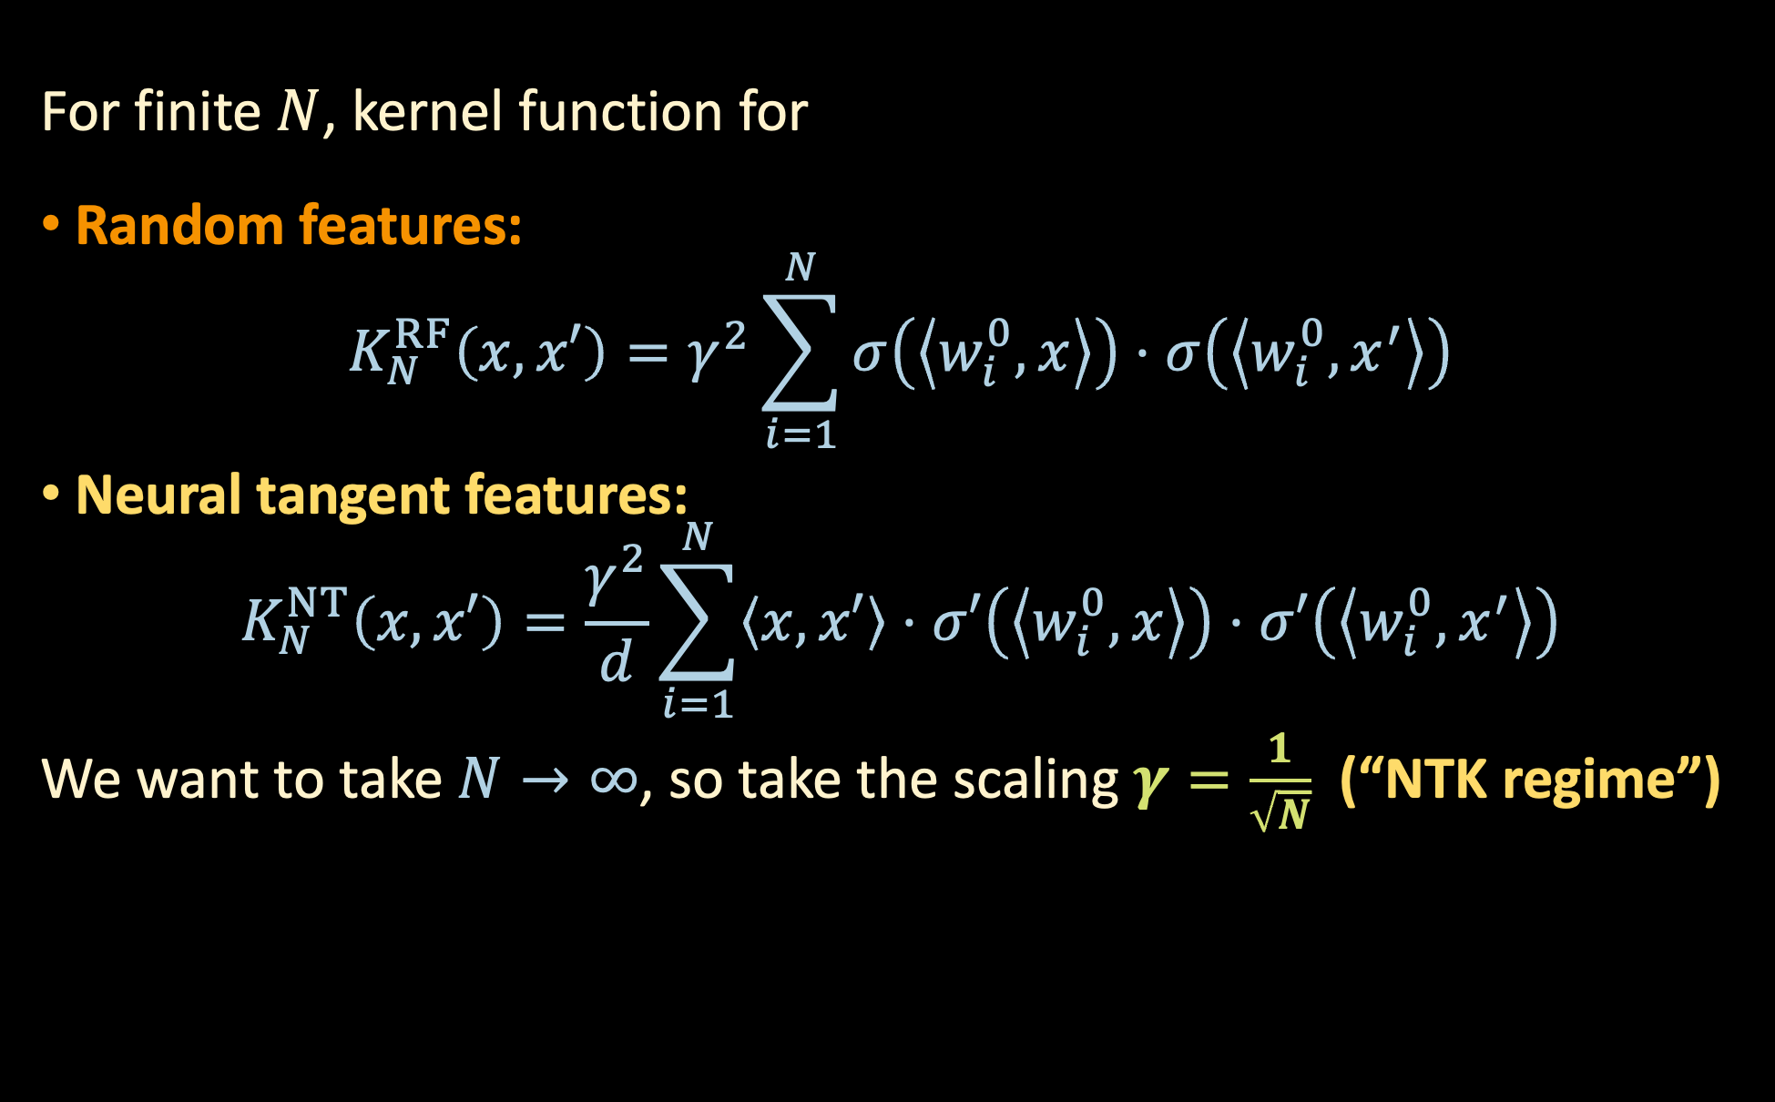
LIMITING OBJECT FOR KERNEL METHODS
For finite $N$, kernel function for
Random features:
$$K_{N}^{RF}\left(x,x′\right)=γ^{2}\sum_{i=1}^{N}{σ\left(\left\langle w_{i}^{0},x\right\rangle \right)⋅σ\left(\left\langle w_{i}^{0},x^{′}\right\rangle \right)}$$
Neural tangent features:
$$K_{N}^{NT}\left(x,x′\right)=\frac{γ^{2}}{d}\sum_{i=1}^{N}{\left\langle x,x′\right\rangle ⋅σ′\left(\left\langle w_{i}^{0},x\right\rangle \right)⋅σ′\left(\left\langle w_{i}^{0},x^{′}\right\rangle \right)}$$
We want to take $N→∞$, so take the scaling $γ=\frac{1}{\sqrt{N}}$ (“NTK regime”)
$$φ_{RF}\left(x\right)=γ⋅\left(σ\left(\left\langle w_{1}^{0},x\right\rangle \right);…;σ\left(\left\langle w_{N}^{0},x\right\rangle \right)\right)$$
$$φ_{NT}\left(x\right)=\frac{γ}{\sqrt{d}}⋅\left(a_{1}^{0}σ^{′}\left(\left\langle w_{1}^{0},x\right\rangle \right)⋅x^{⊤};…;a_{N}^{0}σ^{′}\left(\left\langle w_{N}^{0},x\right\rangle \right)⋅x^{⊤}\right)$$

Slide 17
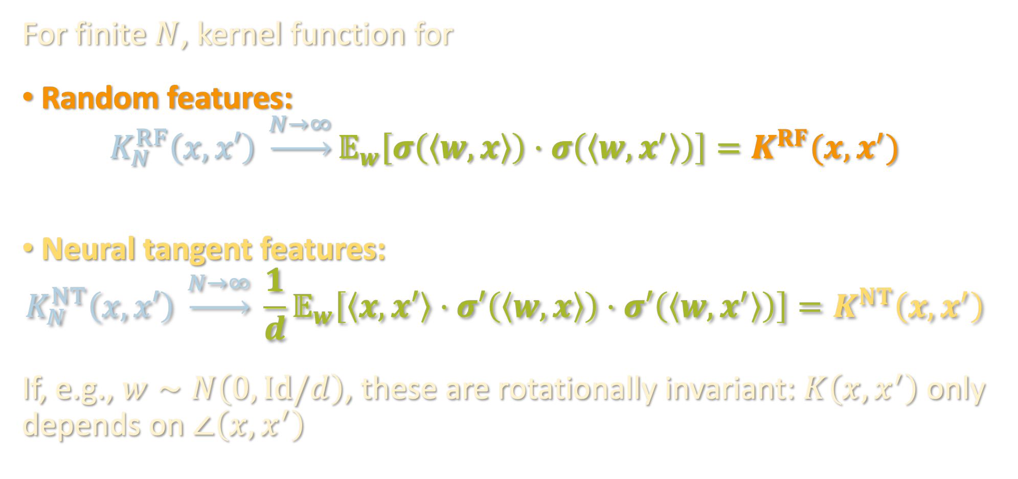
LIMITING OBJECT FOR KERNEL METHODS
For finite $N$, kernel function for
Random features:
$$K_{N}^{RF}\left(x,x′\right) \underset{→}{N→∞}𝔼_{w}\left[σ\left(\left\langle w,x\right\rangle \right)⋅σ\left(\left\langle w,x^{′}\right\rangle \right)\right]=K^{RF}(x,x^{′})$$
Neural tangent features:
$$K_{N}^{NT}\left(x,x′\right) \underset{→}{N→∞} \frac{1}{d}𝔼_{w}\left[\left\langle x,x′\right\rangle ⋅σ′\left(\left\langle w,x\right\rangle \right)⋅σ′\left(\left\langle w,x^{′}\right\rangle \right)\right]=K^{NT}\left(x,x^{′}\right)$$
If, e.g., $w∼N\left(0,Id/d\right)$, these are rotationally invariant: $K\left(x,x^{′}\right)$ only depends on $∠\left(x,x^{′}\right)$
$$φ_{RF}\left(x\right)=γ⋅\left(σ\left(\left\langle w_{1}^{0},x\right\rangle \right);…;σ\left(\left\langle w_{N}^{0},x\right\rangle \right)\right)$$
$$φ_{NT}\left(x\right)=\frac{γ}{\sqrt{d}}⋅\left(a_{1}^{0}σ^{′}\left(\left\langle w_{1}^{0},x\right\rangle \right)⋅x^{⊤};…;a_{N}^{0}σ^{′}\left(\left\langle w_{N}^{0},x\right\rangle \right)⋅x^{⊤}\right)$$
“neural tangent kernel (NTK)”
[Jacot-Gabriel-Hongler ‘18]

Slide 18
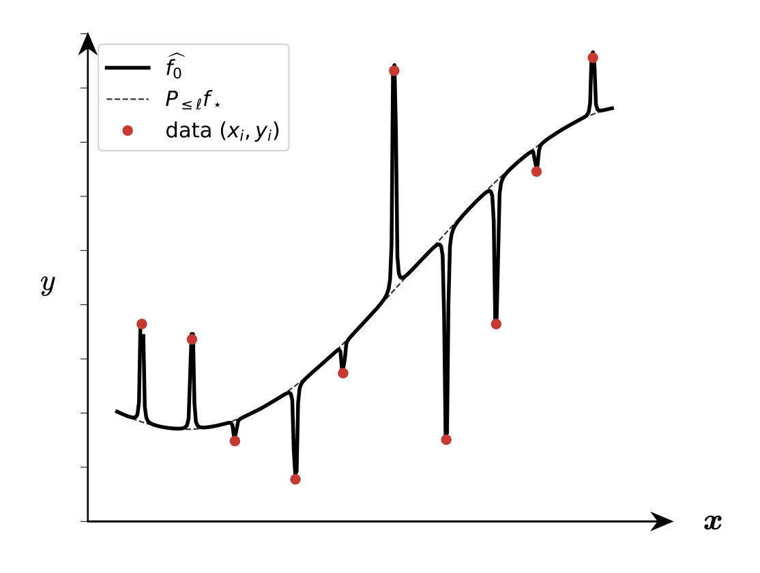
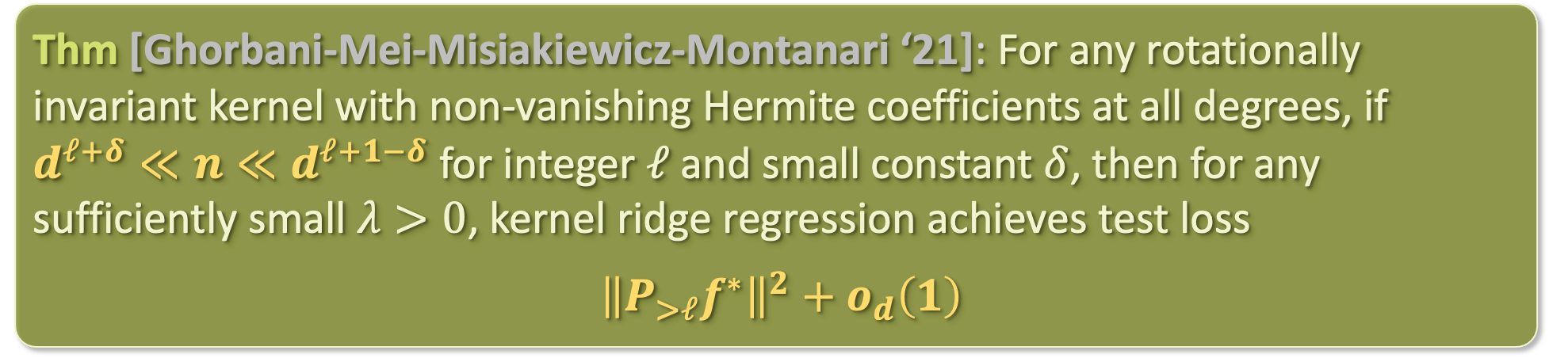


PROPERTIES OF LIMITING KERNEL
Example of a generalization bound one can prove:
Suppose $x_{i}∼\sqrt{d}⋅𝕊^{d−1}, y_{i}=f\left(x_{i}\right)$ for arbitrary $f$ s.t. ${\left\|f\right\|}_{L^{2}}=1$,
Thm [Ghorbani-Mei-Misiakiewicz-Montanari ‘21]: For any rotationally invariant kernel with non-vanishing Hermite coefficients at all degrees, if $d^{ℓ+δ}≪n≪d^{ℓ+1−δ}$ for integer $ℓ$ and small constant $δ$, then for any sufficiently small $λ>0$, kernel ridge regression achieves test loss
${\left\|P_{>ℓ}f^{∗}\right\|}^{2}+o_{d}\left(1\right)$
projection to orthogonal complement of subspace of degree-$≤ℓ$ polynomials

Slide 19
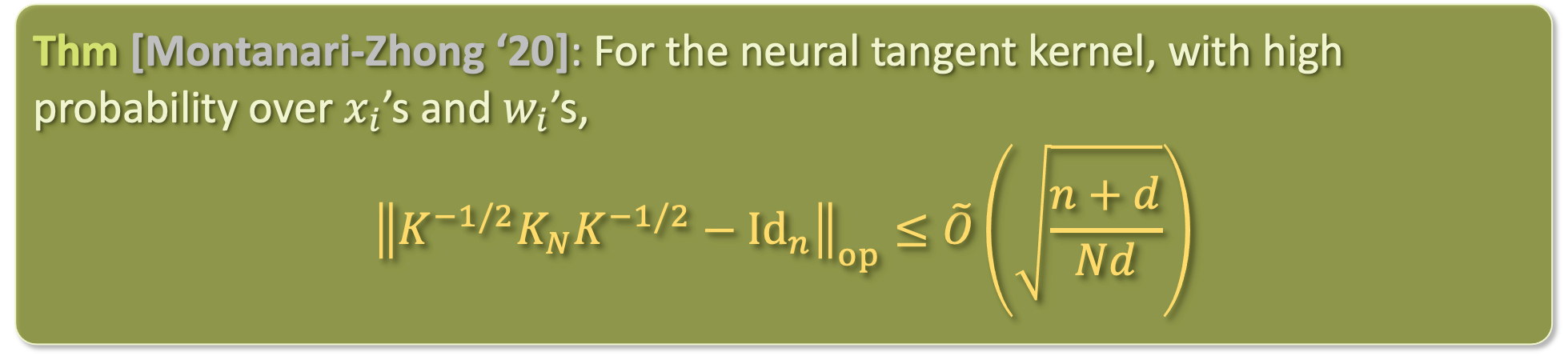

FINITE-N KERNEL APPROXIMATION ERROR
Can use off-the-shelf matrix concentration inequalities to quantify convergence of empirical kernel to limiting kernel
As soon as #parameters $Nd≫$ #samples $n$, limiting object is accurate. Similar picture holds for random features
Proof: apply matrix Bernstein
Thm [Montanari-Zhong ‘20]: For the neural tangent kernel, with high probability over $x_{i}$’s and $w_{i}$’s,
$${\left\|K^{−1/2}K_{N}K^{−1/2}−Id_{n}\right\|}_{op}≤\tilde{O}\left(\sqrt{\frac{n+d}{Nd}}\right)$$

Slide 20
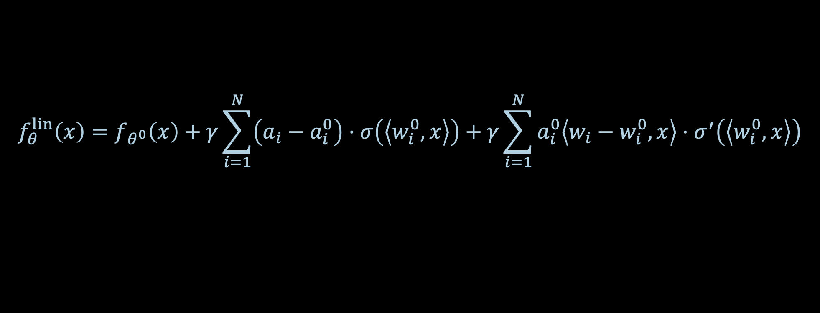
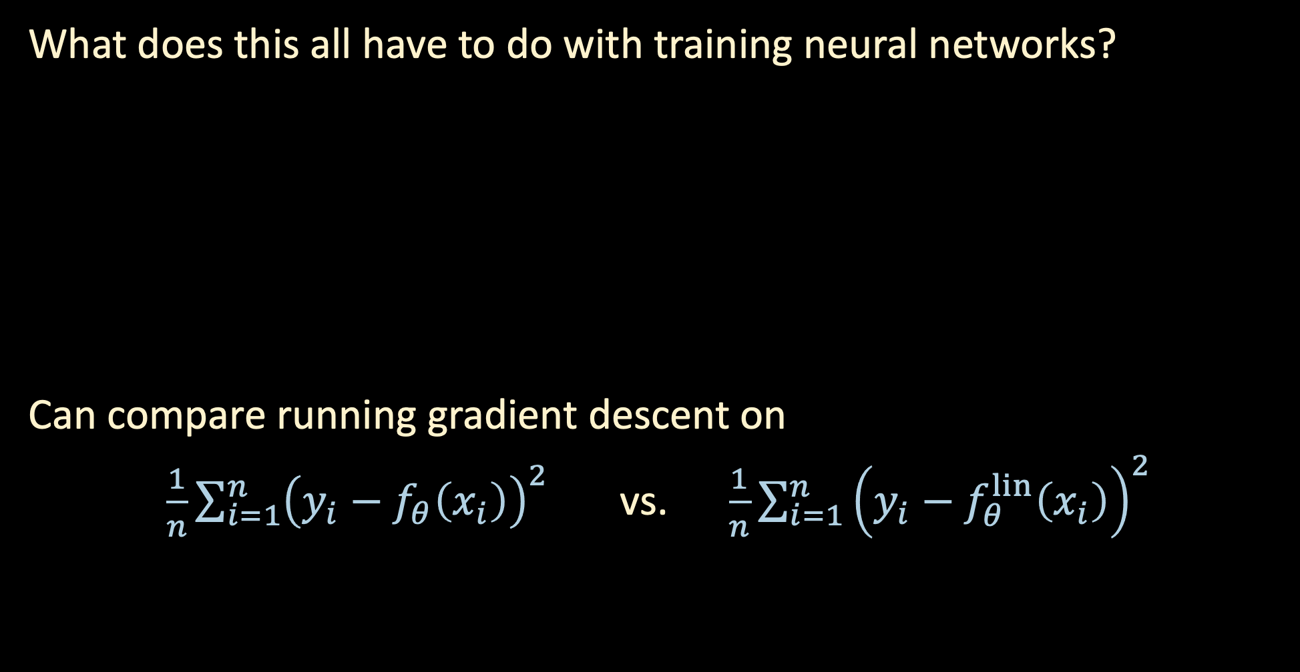
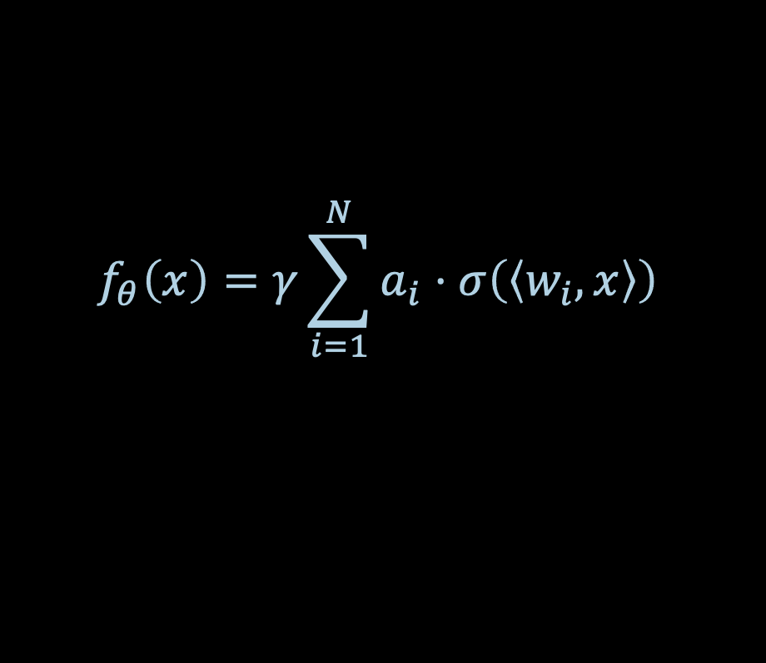
BACK TO GRADIENT DESCENT
What does this all have to do with training neural networks?
Can compare running gradient descent on
$\frac{1}{n}\sum_{i=1}^{n}{{\left(y_{i}−f_{θ}\left(x_{i}\right)\right)}^{2}}$ vs. $\frac{1}{n}\sum_{i=1}^{n}{{\left(y_{i}−f_{θ}^{lin}\left(x_{i}\right)\right)}^{2}}$
$$f_{θ}\left(x\right)=γ\sum_{i=1}^{N}{a_{i}⋅σ\left(\left\langle w_{i},x\right\rangle \right)}$$
$$f_{θ}^{lin}\left(x\right)=f_{θ^{0}}\left(x\right)+γ\sum_{i=1}^{N}{\left(a_{i}−a_{i}^{0}\right)⋅σ\left(\left\langle w_{i}^{0},x\right\rangle \right)}+γ\sum_{i=1}^{N}{a_{i}^{0}\left\langle w_{i}−w_{i}^{0},x\right\rangle ⋅σ^{′}\left(\left\langle w_{i}^{0},x\right\rangle \right)}$$
deep learning
linear regression

Slide 21

BACK TO GRADIENT DESCENT
What does this all have to do with training neural networks?
$$f_{θ}\left(x\right)=γ\sum_{i=1}^{N}{a_{i}⋅σ\left(\left\langle w_{i},x\right\rangle \right)}$$
$$f_{θ}^{lin}\left(x\right)=f_{θ^{0}}\left(x\right)+γ\sum_{i=1}^{N}{\left(a_{i}−a_{i}^{0}\right)⋅σ\left(\left\langle w_{i}^{0},x\right\rangle \right)}+γ\sum_{i=1}^{N}{a_{i}^{0}\left\langle w_{i}−w_{i}^{0},x\right\rangle ⋅σ^{′}\left(\left\langle w_{i}^{0},x\right\rangle \right)}$$
Thm [Du et al. ’19a/b, Li-Liang ’18, Allen-Zhu-Li-Song ‘19, Zou et al. ‘19, Chizat-Oyallon-Bach ’18, …] (informal): When $γ≫1/N$, the trajectories of gradient flow for training $f_{θ}$ versus $f_{θ}^{lin}$ are vanishingly close as $N→∞$
(See board)

Slide 22

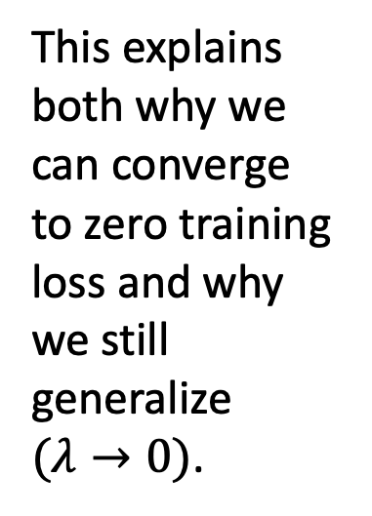
DOES THIS SOLVE DEEP LEARNING?
This explains both why we can converge to zero training loss and why we still generalize $(λ→0)$.

Slide 23
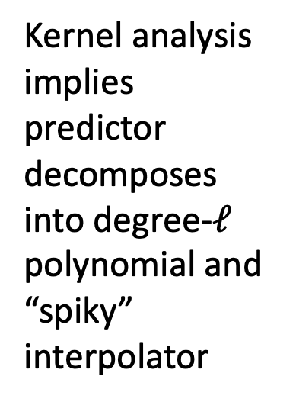
DOES THIS SOLVE DEEP LEARNING?
Kernel analysis implies predictor decomposes into degree-$ℓ$ polynomial and “spiky” interpolator

Slide 24

DOES THIS SOLVE DEEP LEARNING?
In NTK regime ($γ≫1/N$), gradient flow generalizes as well as polynomial regression!

Slide 25
DOES THIS SOLVE DEEP LEARNING?
In NTK regime ($γ≫1/N$), gradient flow generalizes as well as polynomial regression!
In the NTK regime, GD cannot outperform kernel methods…

Slide 26
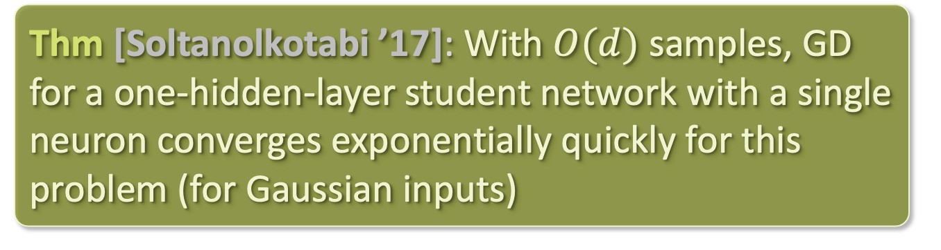





SIMPLE NEGATIVE EXAMPLE
Consider labels generated by
$$f\left(x\right)=ReLU\left(\left\langle w^{∗},x\right\rangle \right)$$
Polynomial regression (and by extension any kernel method, as well as GD in NTK regime) requires $d^{poly\left(1/ε\right)}$ samples to learn to error $ε$
$${\hat{ReLU}}_{ℓ}^{2}$$
Thm [Soltanolkotabi ’17]: With $O(d)$ samples, GD for a one-hidden-layer student network with a single neuron converges exponentially quickly for this problem (for Gaussian inputs)
$$∼1/ℓ^{5/2}$$
Degree $ℓ$

Slide 27
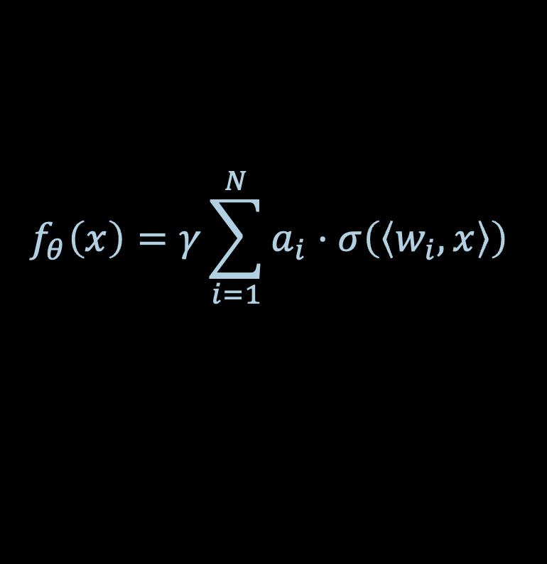
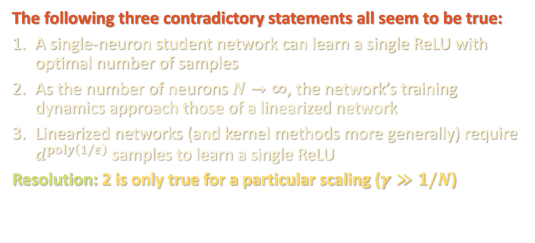
DOES OVERPARAMETRIZATION HURT OR HELP?
The following three contradictory statements all seem to be true:
A single-neuron student network can learn a single ReLU with optimal number of samples
As the number of neurons $N→∞$, the network’s training dynamics approach those of a linearized network
Linearized networks (and kernel methods more generally) require $d^{poly\left(1/ε\right)}$ samples to learn a single ReLU
Resolution: 2 is only true for a particular scaling ($γ≫1/N$)
$$f_{θ}\left(x\right)=γ\sum_{i=1}^{N}{a_{i}⋅σ\left(\left\langle w_{i},x\right\rangle \right)}$$

Slide 28
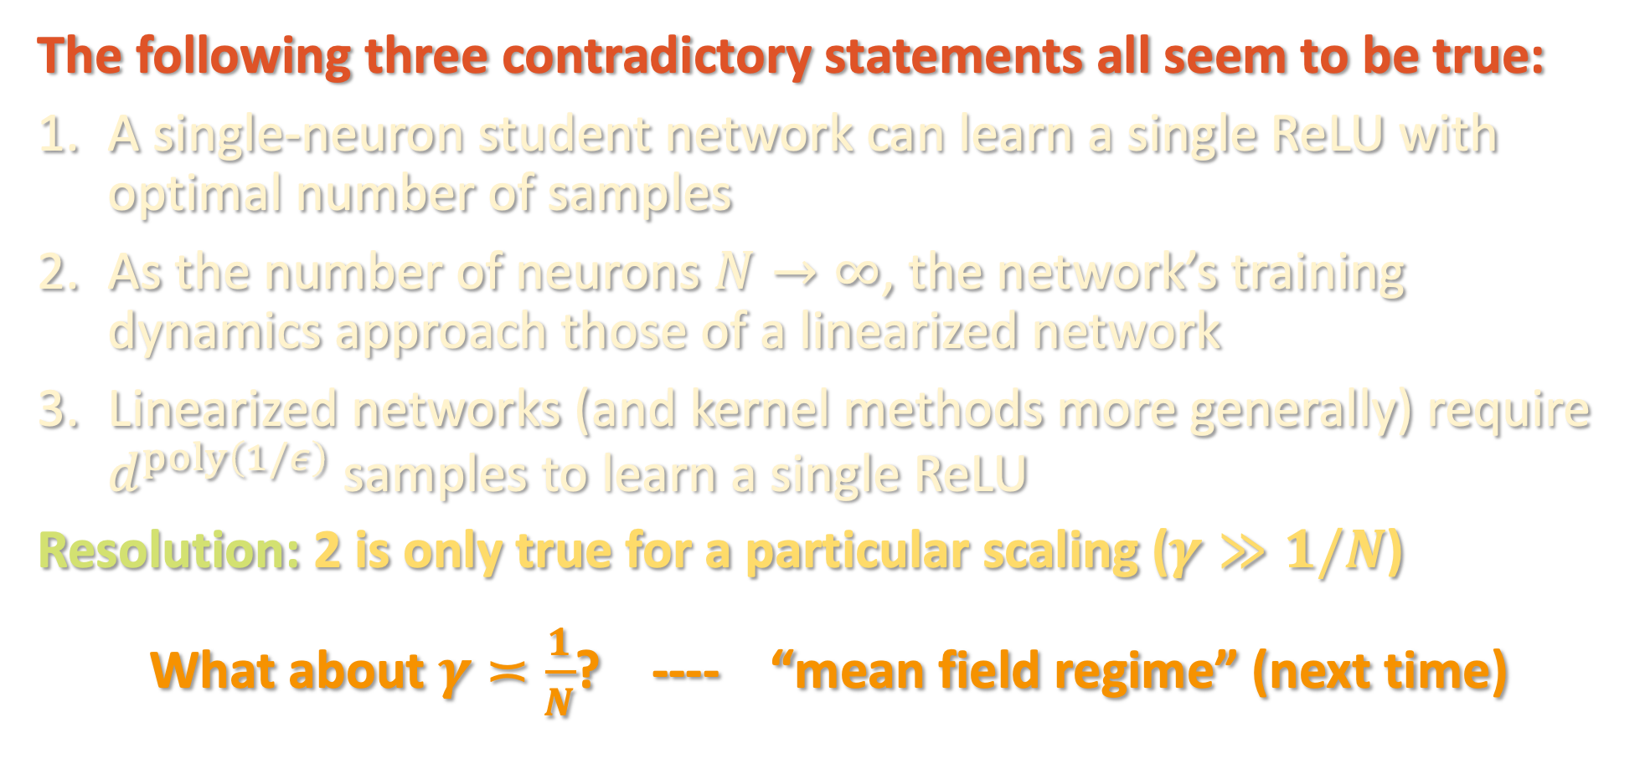
DOES OVERPARAMETRIZATION HURT OR HELP?
The following three contradictory statements all seem to be true:
A single-neuron student network can learn a single ReLU with optimal number of samples
As the number of neurons $N→∞$, the network’s training dynamics approach those of a linearized network
Linearized networks (and kernel methods more generally) require $d^{poly\left(1/ε\right)}$ samples to learn a single ReLU
Resolution: 2 is only true for a particular scaling ($γ≫1/N$)
What about $γ≍\frac{1}{N}$? ---- “mean field regime” (next time)

