Slide 1

CS 224: ALGORITHMS FOR DATA SCIENCE
LECTURE 10 (10/7)
Tensor decomposition
Sum-of-squares
Supervised learning
Computational complexity
Statistical physics
Generative modeling
CSQ LOWER BOUNDS, FILTERED PCA

Slide 2
ANNOUNCEMENTS
Pset 2 due this Wednesday, 10/8
Mid-semester course reviews due Thursday, 10/9

Slide 3
CSQ lower bounds and beyond
Finding a relevant direction
Finding another relevant direction
Technical subtleties

Slide 4
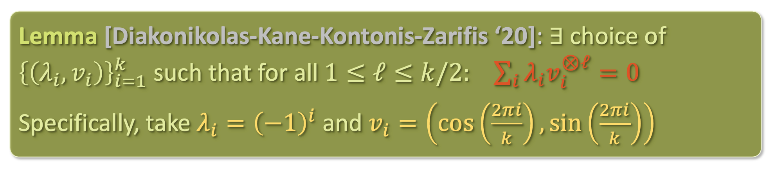
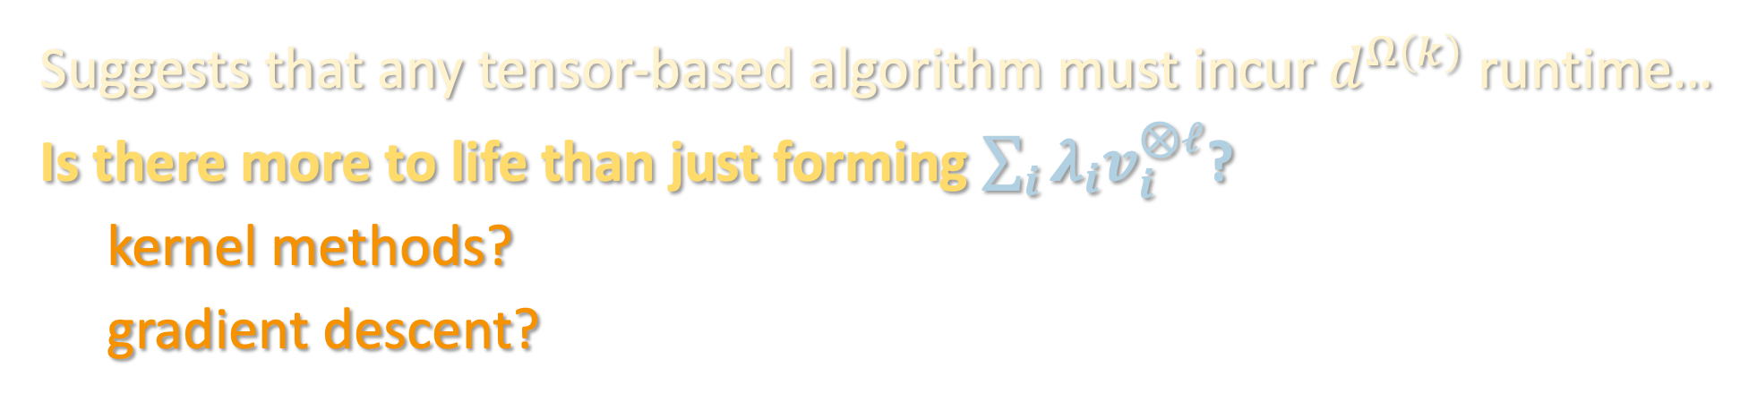
OBSTRUCTION FOR TENSOR METHODS
Lemma [Diakonikolas-Kane-Kontonis-Zarifis ‘20]: $∃$choice of ${\left\{\left(λ_{i},v_{i}\right)\right\}}_{i=1}^{k}$ such that for all $1≤ℓ≤k/2:$ $\sum_{i}{λ_{i}v_{i}^{⊗ℓ}}=0$
Specifically, take $λ_{i}={\left(−1\right)}^{i}$ and $v_{i}=\left(\cos\left(\frac{2πi}{k}\right),\sin\left(\frac{2πi}{k}\right)\right)$
Suggests that any tensor-based algorithm must incur $d^{Ω\left(k\right)}$ runtime…
Is there more to life than just forming $\sum_{i}{λ_{i}v_{i}^{⊗ℓ}}$?
kernel methods?
gradient descent?

Slide 5
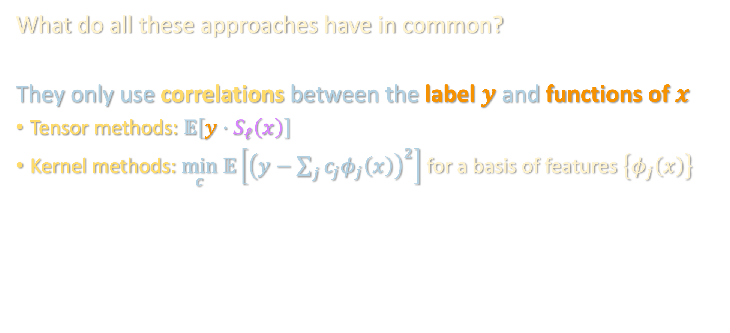
OBSTRUCTION FOR “CORRELATIONAL” METHODS
What do all these approaches have in common?
They only use correlations between the label $y$ and functions of $x$
Tensor methods: $𝔼\left[y⋅S_{ℓ}\left(x\right)\right]$
Kernel methods: $\min_{c} 𝔼\left[{\left(y−\sum_{j}{c_{j}φ_{j}\left(x\right)}\right)}^{2}\right]$ for a basis of features $\left\{φ_{j}\left(x\right)\right\}$

Slide 6
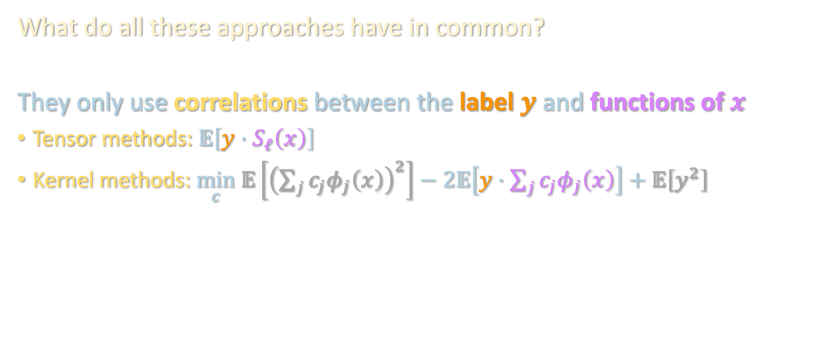
OBSTRUCTION FOR “CORRELATIONAL” METHODS
What do all these approaches have in common?
They only use correlations between the label $y$ and functions of $x$
Tensor methods: $𝔼\left[y⋅S_{ℓ}\left(x\right)\right]$
Kernel methods: $\min_{c} 𝔼\left[{\left(\sum_{j}{c_{j}φ_{j}\left(x\right)}\right)}^{2}\right]−2𝔼\left[y⋅\sum_{j}{c_{j}φ_{j}\left(x\right)}\right]+𝔼\left[y^{2}\right]$

Slide 7
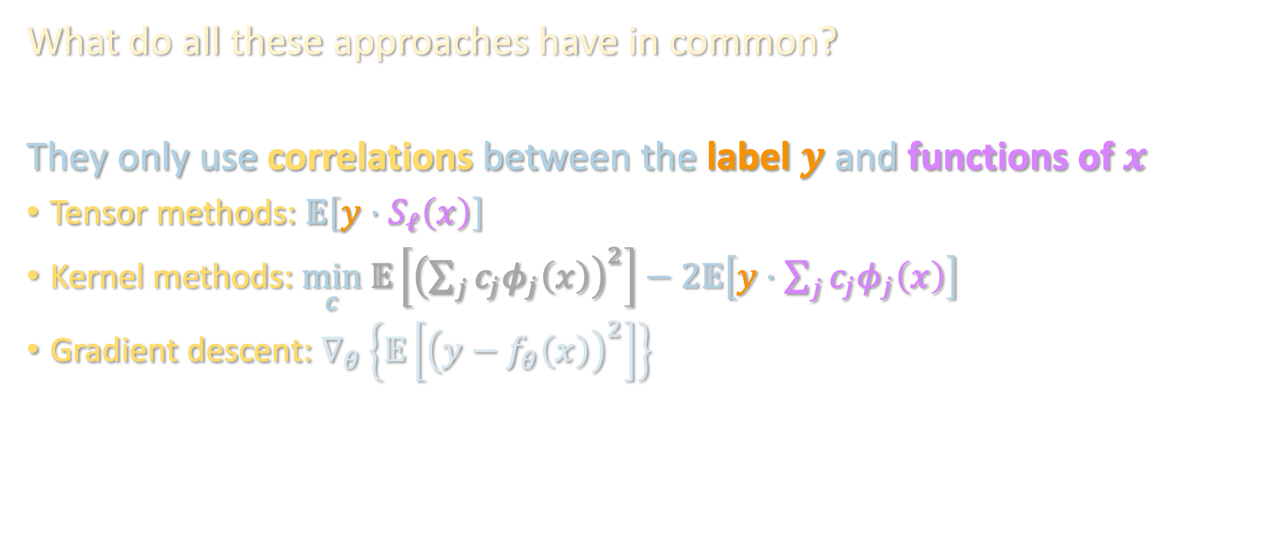
OBSTRUCTION FOR “CORRELATIONAL” METHODS
What do all these approaches have in common?
They only use correlations between the label $y$ and functions of $x$
Tensor methods: $𝔼\left[y⋅S_{ℓ}\left(x\right)\right]$
Kernel methods: $\min_{c} 𝔼\left[{\left(\sum_{j}{c_{j}φ_{j}\left(x\right)}\right)}^{2}\right]−2𝔼\left[y⋅\sum_{j}{c_{j}φ_{j}\left(x\right)}\right]$
Gradient descent: $∇_{θ}\left\{𝔼\left[{\left(y−f_{θ}\left(x\right)\right)}^{2}\right]\right\}$

Slide 8
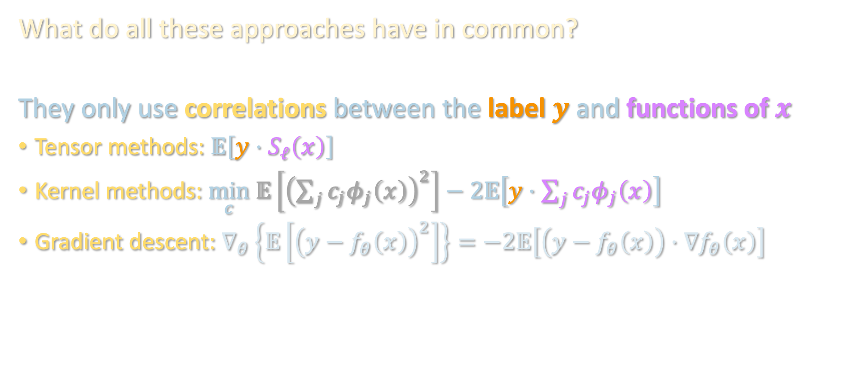
OBSTRUCTION FOR “CORRELATIONAL” METHODS
What do all these approaches have in common?
They only use correlations between the label $y$ and functions of $x$
Tensor methods: $𝔼\left[y⋅S_{ℓ}\left(x\right)\right]$
Kernel methods: $\min_{c} 𝔼\left[{\left(\sum_{j}{c_{j}φ_{j}\left(x\right)}\right)}^{2}\right]−2𝔼\left[y⋅\sum_{j}{c_{j}φ_{j}\left(x\right)}\right]$
Gradient descent: $∇_{θ}\left\{𝔼\left[{\left(y−f_{θ}\left(x\right)\right)}^{2}\right]\right\}=−2𝔼\left[\left(y−f_{θ}\left(x\right)\right)⋅∇f_{θ}\left(x\right)\right]$

Slide 9
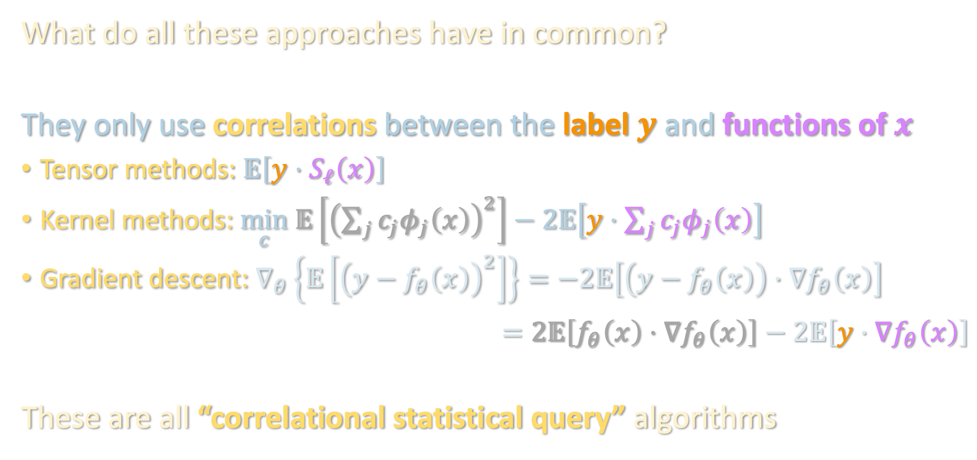
OBSTRUCTION FOR “CORRELATIONAL” METHODS
What do all these approaches have in common?
They only use correlations between the label $y$ and functions of $x$
Tensor methods: $𝔼\left[y⋅S_{ℓ}\left(x\right)\right]$
Kernel methods: $\min_{c} 𝔼\left[{\left(\sum_{j}{c_{j}φ_{j}\left(x\right)}\right)}^{2}\right]−2𝔼\left[y⋅\sum_{j}{c_{j}φ_{j}\left(x\right)}\right]$
Gradient descent: $∇_{θ}\left\{𝔼\left[{\left(y−f_{θ}\left(x\right)\right)}^{2}\right]\right\}=−2𝔼\left[\left(y−f_{θ}\left(x\right)\right)⋅∇f_{θ}\left(x\right)\right]$
$$=2𝔼\left[f_{θ}\left(x\right)⋅∇f_{θ}\left(x\right)\right]−2𝔼\left[y⋅∇f_{θ}\left(x\right)\right]$$
These are all “correlational statistical query” algorithms

Slide 10





OBSTRUCTION FOR “CORRELATIONAL” METHODS
Correlational statistical query (CSQ) model: algorithm only interacts with the dataset through queries of the form
where $\left|noise\right|≤τ$ for tolerance $τ$ (corresponds to $\sqrt{1/\#samples}$)
Proof: computational complexity unit next week
Strong evidence that tensor/kernel/gradient methods can’t beat $d^{k}$
$$𝔼\left[y⋅ψ\left(x\right)\right]+noise$$
$$ψ:ℝ^{d}→ℝ$$
Thm [Diakonikolas et al. ‘20]: In CSQ, learning one-hidden-layer MLP’s over Gaussians, even to constant error, requires $2^{d^{Θ\left(1\right)}}$ queries or tolerance $d^{−Ω\left(k\right)}$

Slide 11

TAKING STOCK
Recall our guiding questions:
For one-hidden-layer MLP’s, low-degree approx got $d^{poly({\left\|λ\right\|}_{1}/ε)}$
Can we improve the $ε$ dependence?
Can we improve the ${\left\|λ\right\|}_{1}$ dependence?

Slide 12

TAKING STOCK
Recall our guiding questions:
For one-hidden-layer MLP’s, low-degree approx got $d^{poly({\left\|λ\right\|}_{1}/ε)}$
Can we improve the $ε$ dependence?
Can we improve the ${\left\|λ\right\|}_{1}$ dependence?
Next, we will see how to improve on 2 by going beyond CSQ. In the process, will also answer:
Can we handle more layers?

Slide 13
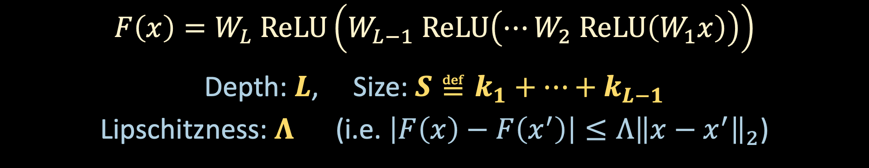
MULTI-LAYER PERCEPTRONS
$$x$$
$$W_{1}^{T}$$
$$W_{L−1}^{T}$$
$$W_{L}^{T}$$
$$W_{2}^{T}$$
…
$$ReLU$$
$$ReLU$$
$$ReLU$$
$$y$$
$$1×k_{L−1}$$
$$k_{L−1}×k_{L−2}$$
$$k_{2}×k_{1}$$
$$k_{1}×d$$
$$F\left(x\right)=W_{L} ReLU\left(W_{L−1} ReLU\left(⋯W_{2} ReLU\left(W_{1}x\right)\right)\right)$$
Depth: $L$, Size: $S≝k_{1}+⋯+k_{L−1}$
Lipschitzness: $Λ$ (i.e. $\left|F\left(x\right)−F\left(x^{′}\right)\right|≤Λ{\left\|x−x^{′}\right\|}_{2}$)

Slide 14
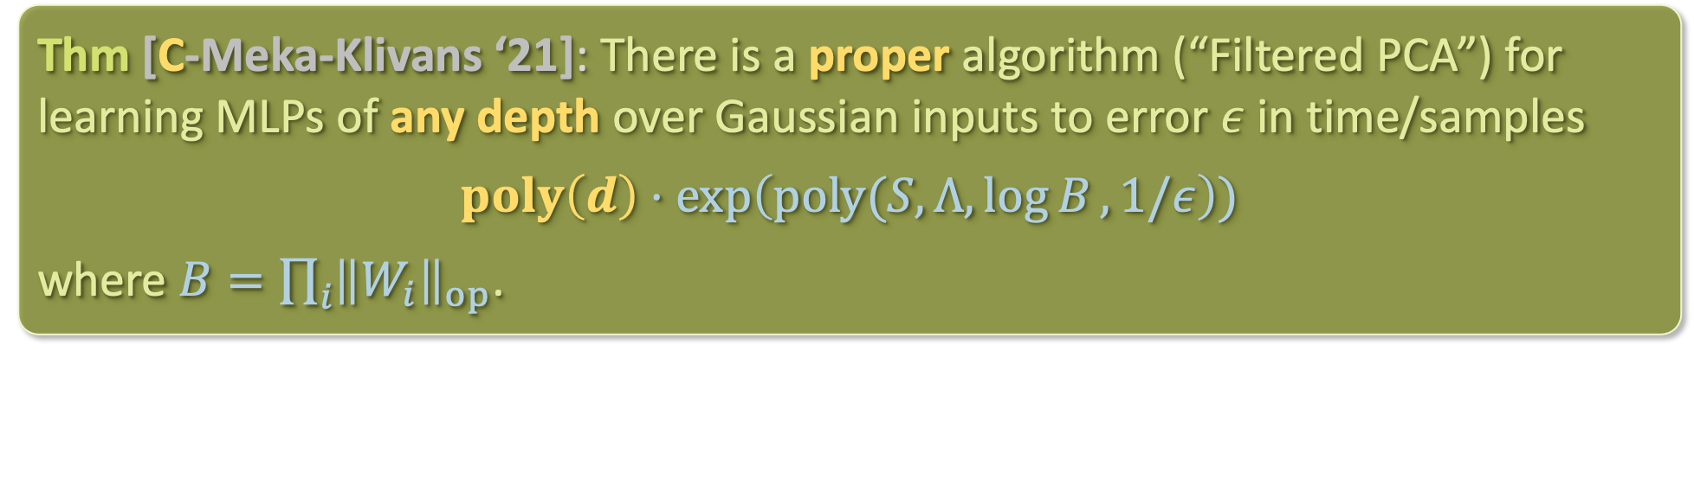
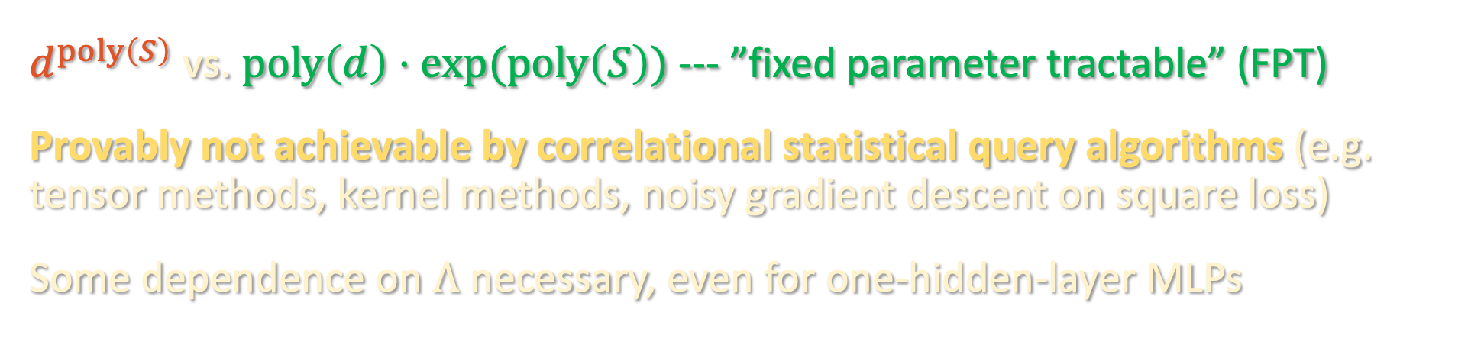
BEYOND CSQ: FILTERED PCA
Thm [C-Meka-Klivans ‘21]: There is a proper algorithm (“Filtered PCA”) for learning MLPs of any depth over Gaussian inputs to error $ε$ in time/samples
$$poly\left(d\right)⋅\exp\left(poly(S,Λ,\log{B},1/ε\right))$$
where $B=\prod_{i}{{\left\|W_{i}\right\|}_{op}}$.
$d^{poly\left(S\right)}$ vs. $poly\left(d\right)⋅exp⁡(poly\left(S\right))$ --- ”fixed parameter tractable” (FPT)
Provably not achievable by correlational statistical query algorithms (e.g. tensor methods, kernel methods, noisy gradient descent on square loss)
Some dependence on $Λ$ necessary, even for one-hidden-layer MLPs

Slide 15
CSQ lower bounds and beyond
Finding a relevant direction
Finding another relevant direction
Technical subtleties

Slide 16
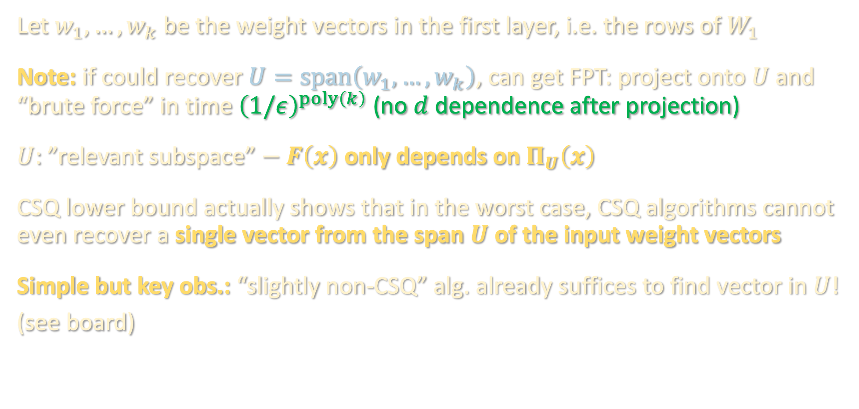
WARMUP: FINDING A RELEVANT DIRECTION
Let $w_{1},…,w_{k}$ be the weight vectors in the first layer, i.e. the rows of $W_{1}$
Note: if could recover $U=span\left(w_{1},…,w_{k}\right)$, can get FPT: project onto $U$ and “brute force” in time ${\left(1/ε\right)}^{poly\left(k\right)}$ (no $d$ dependence after projection)
$U$: ”relevant subspace” $− F\left(x\right)$ only depends on $Π_{U}\left(x\right)$
CSQ lower bound actually shows that in the worst case, CSQ algorithms cannot even recover a single vector from the span $U$ of the input weight vectors
Simple but key obs.: “slightly non-CSQ” alg. already suffices to find vector in $U$!
(see board)

Slide 17
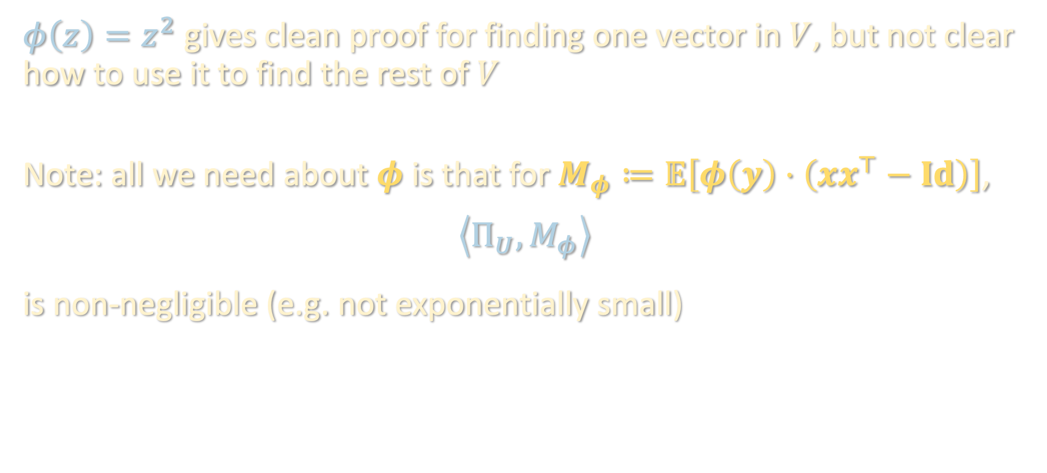
A DIFFERENT FILTER FUNCTION
$φ\left(z\right)=z^{2}$ gives clean proof for finding one vector in $V$, but not clear how to use it to find the rest of $V$
Note: all we need about $φ$ is that for $M_{φ}≔𝔼\left[φ\left(y\right)⋅\left(xx^{⊤}−Id\right)\right]$,
$$\left\langle Π_{U},M_{φ}\right\rangle$$
is non-negligible (e.g. not exponentially small)

Slide 18
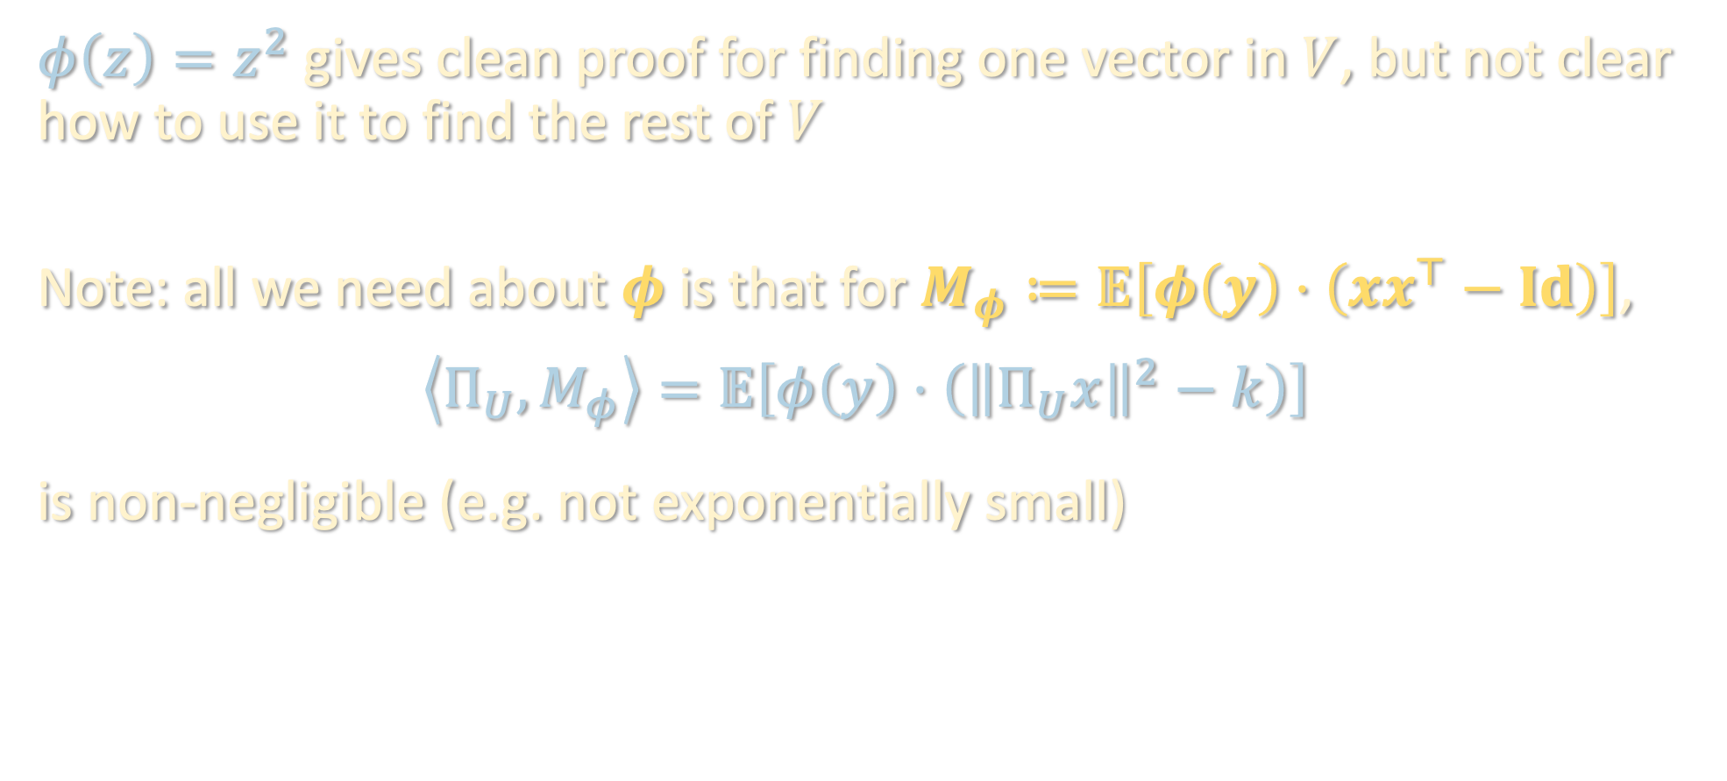
A DIFFERENT FILTER FUNCTION
$φ\left(z\right)=z^{2}$ gives clean proof for finding one vector in $V$, but not clear how to use it to find the rest of $V$
Note: all we need about $φ$ is that for $M_{φ}≔𝔼\left[φ\left(y\right)⋅\left(xx^{⊤}−Id\right)\right]$,
$$\left\langle Π_{U},M_{φ}\right\rangle =𝔼\left[φ\left(y\right)⋅\left({\left\|Π_{U}x\right\|}^{2}−k\right)\right]$$
is non-negligible (e.g. not exponentially small)

Slide 19

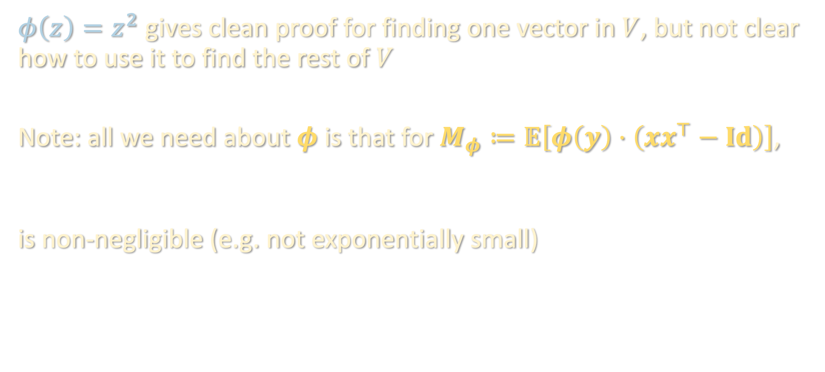
A DIFFERENT FILTER FUNCTION
$φ\left(z\right)=z^{2}$ gives clean proof for finding one vector in $V$, but not clear how to use it to find the rest of $V$
Note: all we need about $φ$ is that for $M_{φ}≔𝔼\left[φ\left(y\right)⋅\left(xx^{⊤}−Id\right)\right]$,
$$\left\langle Π_{V},M_{φ}\right\rangle =𝔼\left[φ\left(y\right)⋅\left({\left\|Π_{V}x\right\|}^{2}−k\right)\right]$$
is non-negligible (e.g. not exponentially small)
$$\left\langle Π_{U},M_{φ}\right\rangle =𝔼\left[φ\left(y\right)⋅\left({\left\|Π_{U}x\right\|}^{2}−k\right)\right]$$

Slide 20

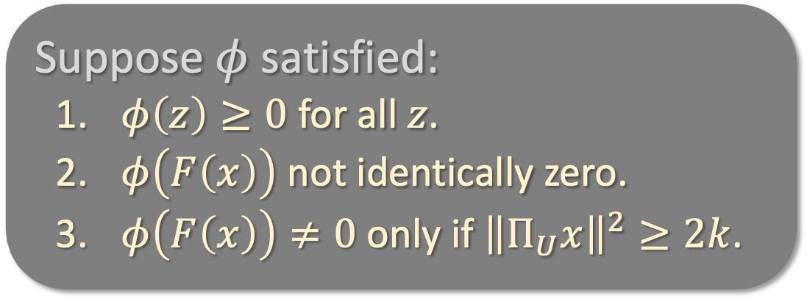



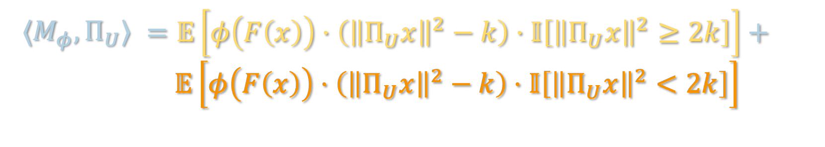
A DIFFERENT FILTER FUNCTION
$$\left\langle Π_{U},M_{φ}\right\rangle =𝔼\left[φ\left(y\right)⋅\left({\left\|Π_{U}x\right\|}^{2}−k\right)\right]$$
$$φ\left(F\left(x\right)\right)$$
Suppose $φ$ satisfied:
  $φ\left(z\right)≥0$ for all $z$.
  $φ\left(F\left(x\right)\right)$ not identically zero.
  $φ\left(F\left(x\right)\right)≠0$ only if ${\left\|Π_{U}x\right\|}^{2}≥2k$.
$${\left\|Π_{U}x\right\|}^{2}$$
$$2k$$
$⟨M_{φ},Π_{U}⟩$ | $$=𝔼\left[φ\left(F\left(x\right)\right)⋅\left({\left\|Π_{U}x\right\|}^{2}−k\right)⋅𝕀\left[{\left\|Π_{U}x\right\|}^{2}≥2k\right]\right]+$$ $$𝔼\left[φ\left(F\left(x\right)\right)⋅\left({\left\|Π_{U}x\right\|}^{2}−k\right)⋅𝕀\left[{\left\|Π_{U}x\right\|}^{2}<2k\right]\right]$$
Then:

Slide 21
A DIFFERENT FILTER FUNCTION
$$\left\langle Π_{U},M_{φ}\right\rangle =𝔼\left[φ\left(y\right)⋅\left({\left\|Π_{U}x\right\|}^{2}−k\right)\right]$$
$$φ\left(F\left(x\right)\right)$$
Suppose $φ$ satisfied:
  $φ\left(z\right)≥0$ for all $z$.
  $φ\left(F\left(x\right)\right)$ not identically zero.
  $φ\left(F\left(x\right)\right)≠0$ only if ${\left\|Π_{U}x\right\|}^{2}≥2k$.
$${\left\|Π_{U}x\right\|}^{2}$$
$$2k$$
$⟨M_{φ},Π_{U}⟩$ | $$=𝔼\left[φ\left(F\left(x\right)\right)⋅\left({\left\|Π_{U}x\right\|}^{2}−k\right)⋅𝕀\left[{\left\|Π_{U}x\right\|}^{2}≥2k\right]\right]$$
Then:

Slide 22
A DIFFERENT FILTER FUNCTION
$$\left\langle Π_{U},M_{φ}\right\rangle =𝔼\left[φ\left(y\right)⋅\left({\left\|Π_{U}x\right\|}^{2}−k\right)\right]$$
$$φ\left(F\left(x\right)\right)$$
Suppose $φ$ satisfied:
  $φ\left(z\right)≥0$ for all $z$.
  $φ\left(F\left(x\right)\right)$ not identically zero.
  $φ\left(F\left(x\right)\right)≠0$ only if ${\left\|Π_{U}x\right\|}^{2}≥2k$.
$${\left\|Π_{U}x\right\|}^{2}$$
$$2k$$
$⟨M_{φ},Π_{U}⟩$ | $$≥𝔼\left[φ\left(F\left(x\right)\right)⋅k⋅𝕀\left[{\left\|Π_{U}x\right\|}^{2}≥2k\right]\right]>0$$
Then:
so top eigenvector of $M$ would lie in relevant subspace $U$.

Slide 23
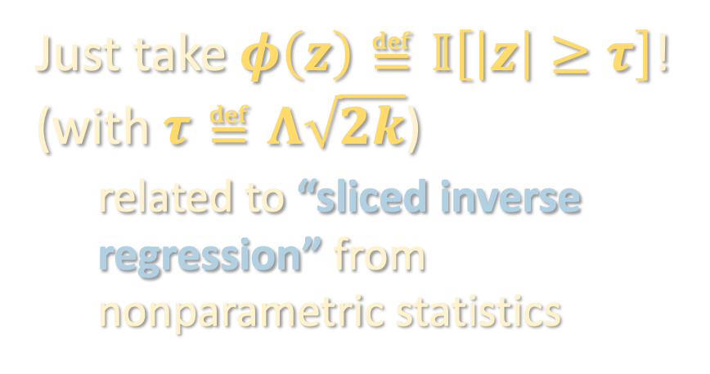




A DIFFERENT FILTER FUNCTION
Suppose $φ$ satisfied:
  $φ\left(z\right)≥0$ for all $z$.
  $φ\left(F\left(x\right)\right)$ not identically zero.
  $φ\left(F\left(x\right)\right)≠0$ only if ${\left\|Π_{U}x\right\|}^{2}≥2k$.
Just take $φ\left(z\right)≝𝕀\left[\left|z\right|≥τ\right]$!
(with $τ≝Λ\sqrt{2k}$)
related to “sliced inverse regression” from nonparametric statistics
$$φ\left(F\left(x\right)\right)$$
$${\left\|Π_{U}x\right\|}^{2}$$
$$2k$$

Slide 24
A DIFFERENT FILTER FUNCTION
Suppose $φ$ satisfied:
  $φ\left(z\right)≥0$ for all $z$.
  $φ\left(F\left(x\right)\right)$ not identically zero.
  $φ\left(F\left(x\right)\right)≠0$ only if ${\left\|Π_{U}x\right\|}^{2}≥2k$.
Just take $φ\left(z\right)≝𝕀\left[\left|z\right|≥τ\right]$!
(with $τ≝Λ\sqrt{2k}$)
related to “sliced inverse regression” from nonparametric statistics
$$φ\left(F\left(x\right)\right)$$
$\left\langle M_{φ},Π_{U}\right\rangle$ | $$≥k⋅𝔼\left[φ\left(F\left(x\right)\right)⋅𝕀\left[{\left\|Π_{U}x\right\|}^{2}≥2k\right]\right]$$
$${\left\|Π_{U}x\right\|}^{2}$$
$$2k$$

Slide 25
A DIFFERENT FILTER FUNCTION
Suppose $φ$ satisfied:
  $φ\left(z\right)≥0$ for all $z$.
  $φ\left(F\left(x\right)\right)$ not identically zero.
  $φ\left(F\left(x\right)\right)≠0$ only if ${\left\|Π_{U}x\right\|}^{2}≥2k$.
Just take $φ\left(z\right)≝𝕀\left[\left|z\right|≥τ\right]$!
(with $τ≝Λ\sqrt{2k}$)
related to “sliced inverse regression” from nonparametric statistics
$$φ\left(F\left(x\right)\right)$$
$\left\langle M_{φ},Π_{U}\right\rangle$ | $$≥k⋅𝔼\left[𝕀\left[\left|F\left(x\right)\right|≥τ\right]\right]$$
$${\left\|Π_{U}x\right\|}^{2}$$
$$2k$$

Slide 26

A DIFFERENT FILTER FUNCTION
Suppose $φ$ satisfied:
  $φ\left(z\right)≥0$ for all $z$.
  $φ\left(F\left(x\right)\right)$ not identically zero.
  $φ\left(F\left(x\right)\right)≠0$ only if ${\left\|Π_{U}x\right\|}^{2}≥2k$.
Just take $φ\left(z\right)≝𝕀\left[\left|z\right|≥τ\right]$!
(with $τ≝Λ\sqrt{2k}$)
related to “sliced inverse regression” from nonparametric statistics
$$φ\left(F\left(x\right)\right)$$
$$\left\{x:{\left\|Π_{U}x\right\|}^{2}<2k\right\}$$
$\left\langle M_{φ},Π_{U}\right\rangle$ | $$≥k⋅ℙ\left[\left|F\left(x\right)\right|≥τ\right]$$
$${\left\|Π_{U}x\right\|}^{2}$$
$$2k$$

Slide 27
A DIFFERENT FILTER FUNCTION
Suppose $φ$ satisfied:
  $φ\left(z\right)≥0$ for all $z$.
  $φ\left(F\left(x\right)\right)$ not identically zero.
  $φ\left(F\left(x\right)\right)≠0$ only if ${\left\|Π_{U}x\right\|}^{2}≥2k$.
Just take $φ\left(z\right)≝𝕀\left[\left|z\right|≥τ\right]$!
(with $τ≝Λ\sqrt{2k}$)
related to “sliced inverse regression” from nonparametric statistics
$$φ\left(F\left(x\right)\right)$$
$\left\langle M_{φ},Π_{U}\right\rangle$ | $$≥k⋅ℙ\left[\left|F\left(x\right)\right|≥τ\right]$$
$${\left\|Π_{U}x\right\|}^{2}$$
$$2k$$

Slide 28




A DIFFERENT FILTER FUNCTION
Just take $φ\left(z\right)≝𝕀\left[\left|z\right|≥τ\right]$!
(with $τ≝Λ\sqrt{2k}$)
$φ\left(F\left(x\right)\right)≠0$ only if ${\left\|Π_{U}x\right\|}^{2}≥2k$.
If ${\left\|Π_{U}x\right\|}^{2}<2k$, then $|F\left(x\right)|<Λ\sqrt{2k}$:
so Property 3 holds.
$$\left|F\left(x\right)\right|=\left|F\left(Π_{U}x\right)\right|$$
$≤\left|F\left(0\right)\right|+Λ\left\|Π_{U}x\right\|$
$<Λ\sqrt{2k}$

Slide 29

A DIFFERENT FILTER FUNCTION
Just take $φ\left(z\right)≝𝕀\left[\left|z\right|≥τ\right]$!
(with $τ≝Λ\sqrt{2k}$)
$φ\left(F\left(x\right)\right)$ not identically zero.

Slide 30

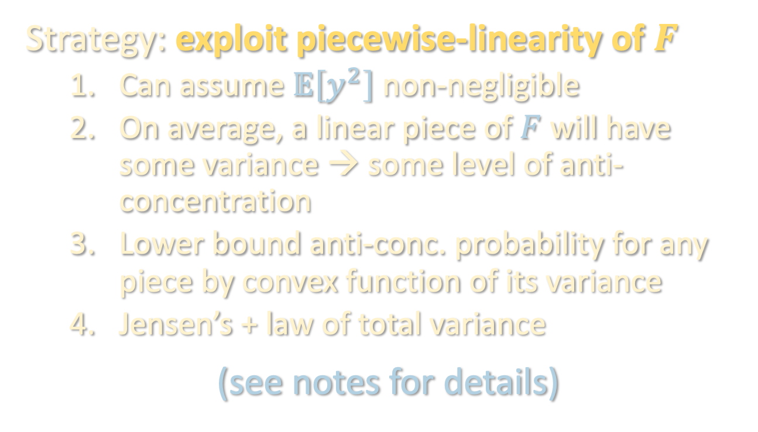
A DIFFERENT FILTER FUNCTION
Just take $φ\left(z\right)≝𝕀\left[\left|z\right|≥τ\right]$!
(with $τ≝Λ\sqrt{2k}$)
$ℙ\left[\left|F\left(x\right)\right|≥τ\right]$ is large.
Strategy: exploit piecewise-linearity of $F$
  Can assume $𝔼\left[y^{2}\right]$ non-negligible
  On average, a linear piece of $F$ will have some variance → some level of anti-concentration
  Lower bound anti-conc. probability for any piece by convex function of its variance
  Jensen’s + law of total variance
  (see notes for details)

Slide 31
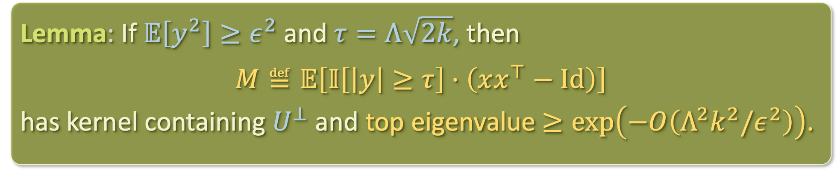

FINDING A RELEVANT FUNCTION
Lemma: If $𝔼\left[y^{2}\right]≥ε^{2}$ and $τ=Λ\sqrt{2k}$, then
$$M≝𝔼\left[𝕀\left[\left|y\right|≥τ\right]⋅\left(xx^{⊤}−Id\right)\right]$$
has kernel containing $U^{⊥}$ and top eigenvalue $≥\exp\left(−O\left(Λ^{2}k^{2}/ε^{2}\right)\right)$.
If we form an empirical estimate of $M$ from enough samples and take its top eigenvector, will be close to relevant subspace $U$
The full spectrum of $M$ need not reveal the full subspace $U$…
How do we learn the rest of the relevant subspace?

Slide 32
CSQ lower bounds and beyond
Finding a relevant direction
Finding another relevant direction
Technical subtleties

Slide 33

FINDING ANOTHER RELEVANT DIRECTION
Given $v∈U$, how do we find another vector $v^{′}∈U ∖span\left(v\right)$?
$$𝔼\left[𝕀\left[\left|y\right|≥τ\right]⋅\left(xx^{⊤}−Id\right)\right]$$

Slide 34

FINDING ANOTHER RELEVANT DIRECTION
Given $v∈U$, how do we find another vector $v^{′}∈U ∖span\left(v\right)$?
$$Π_{v}^{⊥}⋅𝔼\left[𝕀\left[\left|y\right|≥τ\right]⋅\left(xx^{⊤}−Id\right)\right]⋅Π_{v}^{⊥}$$

Slide 35

FINDING ANOTHER RELEVANT DIRECTION
Given $v∈U$, how do we find another vector $v^{′}∈U ∖span\left(v\right)$?
$$Π_{v}^{⊥}⋅𝔼\left[𝕀\left[\left|y\right|≥τ\right]⋅\left(xx^{⊤}−Id\right)\right]⋅Π_{v}^{⊥}$$

Slide 36

FINDING ANOTHER RELEVANT DIRECTION
Given $v∈U$, how do we find another vector $v^{′}∈U ∖span\left(v\right)$?
$$M^{′}≝Π_{v}^{⊥}⋅𝔼\left[𝕀\left[\left|y−F\left(Π_{v}x\right)\right|≥τ\right]⋅\left(xx^{⊤}−Id\right)\right]⋅Π_{v}^{⊥}$$
For now, pretend we have access to this

Slide 37
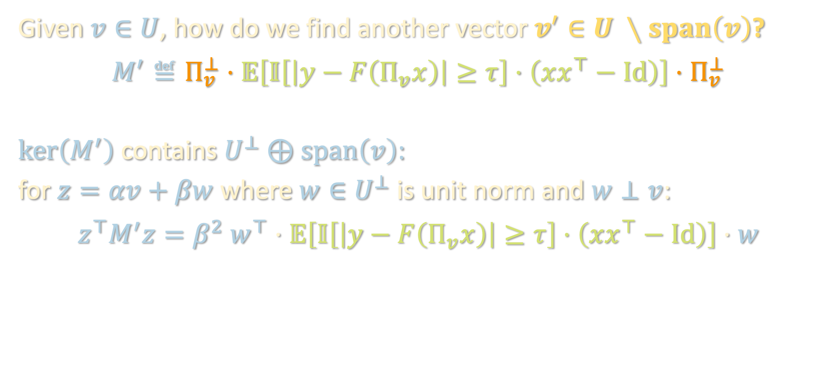
FINDING ANOTHER RELEVANT DIRECTION
Given $v∈U$, how do we find another vector $v^{′}∈U ∖span\left(v\right)$?
$$M^{′}≝Π_{v}^{⊥}⋅𝔼\left[𝕀\left[\left|y−F\left(Π_{v}x\right)\right|≥τ\right]⋅\left(xx^{⊤}−Id\right)\right]⋅Π_{v}^{⊥}$$
$ker\left(M^{′}\right)$ contains $U^{⊥}⊕span\left(v\right)$:
for $z=αv+βw$ where $w∈U^{⊥}$ is unit norm and $w⊥v$:
$$z^{⊤}M^{′}z=β^{2} w^{⊤}⋅𝔼\left[𝕀\left[\left|y−F\left(Π_{v}x\right)\right|≥τ\right]⋅\left(xx^{⊤}−Id\right)\right]⋅w$$

Slide 38


FINDING ANOTHER RELEVANT DIRECTION
Given $v∈U$, how do we find another vector $v^{′}∈U ∖span\left(v\right)$?
$$M^{′}≝Π_{v}^{⊥}⋅𝔼\left[𝕀\left[\left|y−F\left(Π_{v}x\right)\right|≥τ\right]⋅\left(xx^{⊤}−Id\right)\right]⋅Π_{v}^{⊥}$$
$ker\left(M^{′}\right)$ contains $U^{⊥}⊕span\left(v\right)$:
for $z=αv+βw$ where $w∈U^{⊥}$ is unit norm and $w⊥v$:
$$z^{⊤}M^{′}z=β^{2} w^{⊤}⋅𝔼\left[𝕀\left[\left|y−F\left(Π_{v}x\right)\right|≥τ\right]⋅\left(xx^{⊤}−Id\right)\right]⋅w$$
$$=β^{2} 𝔼\left[𝕀\left[\left|y−F\left(Π_{v}x\right)\right|≥τ\right]⋅\left({\left\langle w,x\right\rangle }^{2}−1\right)\right]$$
depends on $U$
depends on $w$ (orthogonal to $U$)

Slide 39
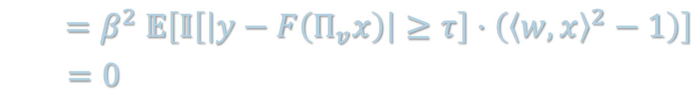
FINDING ANOTHER RELEVANT DIRECTION
Given $v∈U$, how do we find another vector $v^{′}∈U ∖span\left(v\right)$?
$$M^{′}≝Π_{v}^{⊥}⋅𝔼\left[𝕀\left[\left|y−F\left(Π_{v}x\right)\right|≥τ\right]⋅\left(xx^{⊤}−Id\right)\right]⋅Π_{v}^{⊥}$$
$ker\left(M^{′}\right)$ contains $U^{⊥}⊕span\left(v\right)$:
for $z=αv+βw$ where $w∈U^{⊥}$ is unit norm and $w⊥v$:
$$z^{⊤}M^{′}z=β^{2} w^{⊤}⋅𝔼\left[𝕀\left[\left|y−F\left(Π_{v}x\right)\right|≥τ\right]⋅\left(xx^{⊤}−Id\right)\right]⋅w$$
$$=β^{2} 𝔼\left[𝕀\left[\left|y−F\left(Π_{v}x\right)\right|≥τ\right]⋅\left({\left\langle w,x\right\rangle }^{2}−1\right)\right]$$
$$=0$$

Slide 40
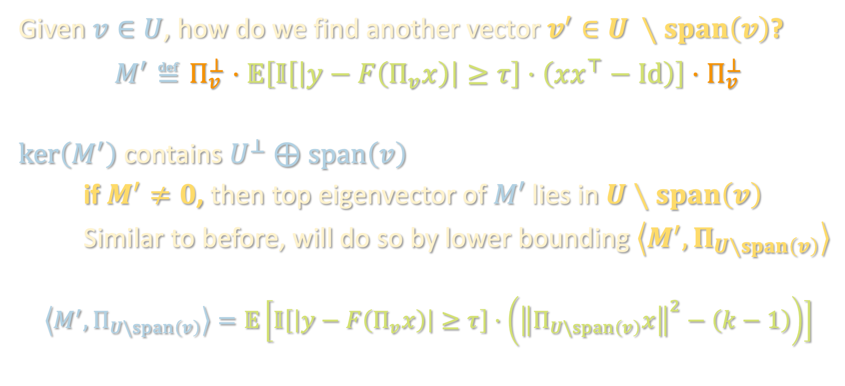
FINDING ANOTHER RELEVANT DIRECTION
Given $v∈U$, how do we find another vector $v^{′}∈U ∖span\left(v\right)$?
$$M^{′}≝Π_{v}^{⊥}⋅𝔼\left[𝕀\left[\left|y−F\left(Π_{v}x\right)\right|≥τ\right]⋅\left(xx^{⊤}−Id\right)\right]⋅Π_{v}^{⊥}$$
$ker\left(M^{′}\right)$ contains $U^{⊥}⊕span\left(v\right)$
if $M^{′}≠0$, then top eigenvector of $M′$ lies in $U∖span\left(v\right)$
Similar to before, will do so by lower bounding $\left\langle M^{′},Π_{U∖span\left(v\right)}\right\rangle$
$$\left\langle M^{′},Π_{U\backslash span\left(v\right)}\right\rangle =𝔼\left[𝕀\left[\left|y−F\left(Π_{v}x\right)\right|≥τ\right]⋅\left({\left\|Π_{U\backslash span\left(v\right)}x\right\|}^{2}−\left(k−1\right)\right)\right]$$

Slide 41


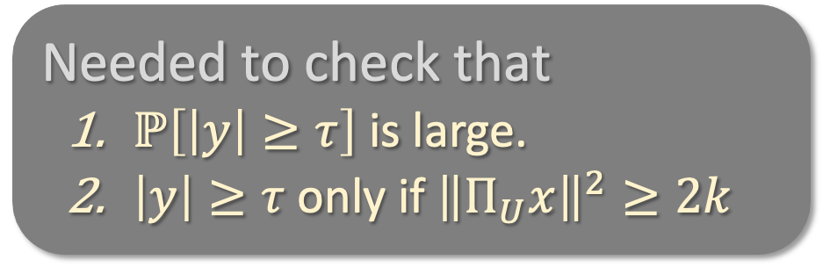




FINDING ANOTHER RELEVANT DIRECTION
Previously…
$$\left\langle M,Π_{U}\right\rangle =𝔼\left[𝕀\left[\left|y\right|≥τ\right]⋅\left({\left\|Π_{U}x\right\|}^{2}−k\right)\right]$$
Needed to check that
  $ℙ\left[\left|y\right|≥τ\right]$ is large.
  $\left|y\right|≥τ$only if ${\left\|Π_{U}x\right\|}^{2}≥2k$
$$𝕀\left[\left|y\right|≥τ\right]$$
$${\left\|Π_{U}x\right\|}^{2}$$
$$2k$$
Then:
so top eigenvector of $M$ would lie in $U$.
$⟨M,Π_{U}⟩$ | $$≥k⋅ℙ\left[\left|y\right|≥τ\right]>0$$

Slide 42

FINDING ANOTHER RELEVANT DIRECTION
$$\left\langle M′,Π_{U\backslash span\left(v\right)}\right\rangle =𝔼\left[𝕀\left[\left|y−F\left(Π_{v}x\right)\right|≥τ\right]⋅\left({\left\|Π_{U\backslash span\left(v\right)}x\right\|}^{2}−(k−1)\right)\right]$$
Needed to check that
  $ℙ\left[\left|y\right|≥τ\right]$ is large.
  $\left|y\right|≥τ$only if ${\left\|Π_{U}x\right\|}^{2}≥2k$
$$𝕀\left[\left|y\right|≥τ\right]$$
$${\left\|Π_{U}x\right\|}^{2}$$
$$2k$$
Then:
so top eigenvector of $M$ would lie in $U$.
$⟨M,Π_{U}⟩$ | $$≥k⋅ℙ\left[\left|y\right|≥τ\right]>0$$

Slide 43
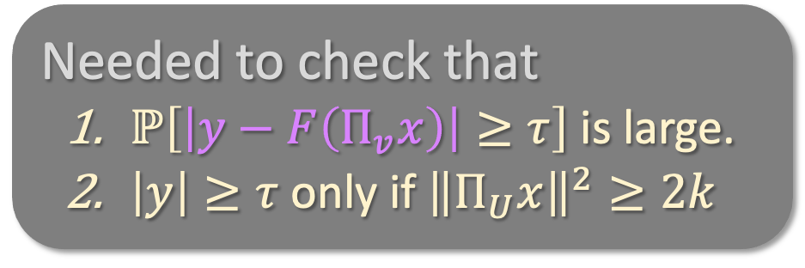
FINDING ANOTHER RELEVANT DIRECTION
$$\left\langle M′,Π_{U\backslash span\left(v\right)}\right\rangle =𝔼\left[𝕀\left[\left|y−F\left(Π_{v}x\right)\right|≥τ\right]⋅\left({\left\|Π_{U\backslash span\left(v\right)}x\right\|}^{2}−(k−1)\right)\right]$$
Needed to check that
  $ℙ\left[\left|y−F\left(Π_{v}x\right)\right|≥τ\right]$ is large.
  $\left|y\right|≥τ$only if ${\left\|Π_{U}x\right\|}^{2}≥2k$
$$𝕀\left[\left|y\right|≥τ\right]$$
$${\left\|Π_{U}x\right\|}^{2}$$
$$2k$$
Then:
so top eigenvector of $M$ would lie in $U$.
$⟨M,Π_{U}⟩$ | $$≥k⋅ℙ\left[\left|y\right|≥τ\right]>0$$

Slide 44
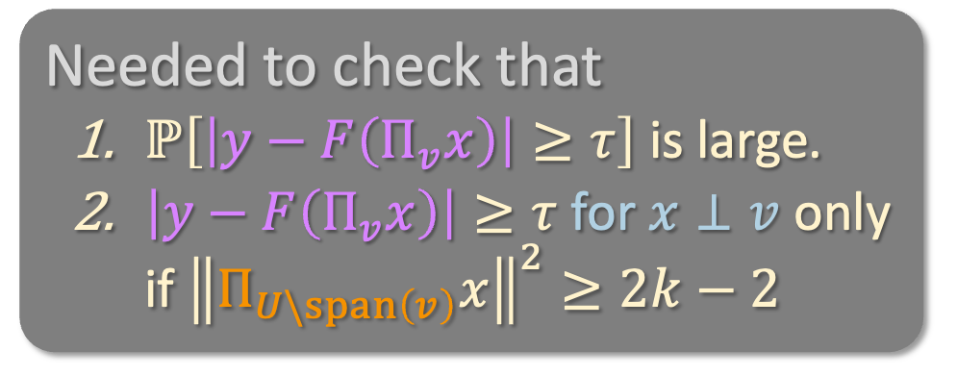
FINDING ANOTHER RELEVANT DIRECTION
$$\left\langle M′,Π_{U\backslash span\left(v\right)}\right\rangle =𝔼\left[𝕀\left[\left|y−F\left(Π_{v}x\right)\right|≥τ\right]⋅\left({\left\|Π_{U\backslash span\left(v\right)}x\right\|}^{2}−(k−1)\right)\right]$$
Needed to check that
  $ℙ\left[\left|y−F\left(Π_{v}x\right)\right|≥τ\right]$ is large.
  $\left|y−F\left(Π_{v}x\right)\right|≥τ$ for $x⊥v$ only if ${\left\|Π_{U\backslash span\left(v\right)}x\right\|}^{2}≥2k−2$
$$𝕀\left[\left|y\right|≥τ\right]$$
$${\left\|Π_{U}x\right\|}^{2}$$
$$2k$$
Then:
so top eigenvector of $M$ would lie in $U$.
$⟨M,Π_{U}⟩$ | $$≥k⋅ℙ\left[\left|y\right|≥τ\right]>0$$

Slide 45



FINDING ANOTHER RELEVANT DIRECTION
$$\left\langle M′,Π_{U\backslash span\left(v\right)}\right\rangle =𝔼\left[𝕀\left[\left|y−F\left(Π_{v}x\right)\right|≥τ\right]⋅\left({\left\|Π_{U\backslash span\left(v\right)}x\right\|}^{2}−(k−1)\right)\right]$$
Needed to check that
  $ℙ\left[\left|y−F\left(Π_{v}x\right)\right|≥τ\right]$ is large.
  $\left|y−F\left(Π_{v}x\right)\right|≥τ$ for $x⊥v$ only if ${\left\|Π_{U\backslash span\left(v\right)}x\right\|}^{2}≥2k−2$
$$𝕀\left[\left|y−F\left(Π_{v}x\right)\right|≥τ\right]$$
$${\left\|Π_{U\backslash span\left(v\right)}x\right\|}^{2}$$
$$2k−2$$
Then:
so top eigenvector of $M$ would lie in $U$.
$⟨M,Π_{U}⟩$ | $$≥k⋅ℙ\left[\left|y\right|≥τ\right]>0$$

Slide 46

FINDING ANOTHER RELEVANT DIRECTION
$$\left\langle M′,Π_{U\backslash span\left(v\right)}\right\rangle =𝔼\left[𝕀\left[\left|y−F\left(Π_{v}x\right)\right|≥τ\right]⋅\left({\left\|Π_{U\backslash span\left(v\right)}x\right\|}^{2}−(k−1)\right)\right]$$
Needed to check that
  $ℙ\left[\left|y−F\left(Π_{v}x\right)\right|≥τ\right]$ is large.
  $\left|y−F\left(Π_{v}x\right)\right|≥τ$ for $x⊥v$ only if ${\left\|Π_{U\backslash span\left(v\right)}x\right\|}^{2}≥2k−2$
$$𝕀\left[\left|y−F\left(Π_{v}x\right)\right|≥τ\right]$$
$${\left\|Π_{U\backslash span\left(v\right)}x\right\|}^{2}$$
$$2k−2$$
Then:
so top eigenvector of $M$ would lie in $U$.
$⟨M′,Π_{U\backslash span\left(v\right)}⟩$ | $$≥k⋅ℙ\left[\left|y\right|≥τ\right]>0$$

Slide 47
FINDING ANOTHER RELEVANT DIRECTION
$$\left\langle M′,Π_{U\backslash span\left(v\right)}\right\rangle =𝔼\left[𝕀\left[\left|y−F\left(Π_{v}x\right)\right|≥τ\right]⋅\left({\left\|Π_{U\backslash span\left(v\right)}x\right\|}^{2}−(k−1)\right)\right]$$
Needed to check that
  $ℙ\left[\left|y−F\left(Π_{v}x\right)\right|≥τ\right]$ is large.
  $\left|y−F\left(Π_{v}x\right)\right|≥τ$ for $x⊥v$ only if ${\left\|Π_{U\backslash span\left(v\right)}x\right\|}^{2}≥2k−2$
$$𝕀\left[\left|y−F\left(Π_{v}x\right)\right|≥τ\right]$$
$${\left\|Π_{U\backslash span\left(v\right)}x\right\|}^{2}$$
$$2k−2$$
Then:
so top eigenvector of $M$ would lie in $U$.
$⟨M′,Π_{U\backslash span\left(v\right)}⟩$ | $$≥\left(k−1\right)⋅ℙ\left[\left|y−F\left(Π_{v}x\right)\right|≥τ\right]>0$$

Slide 48

FINDING ANOTHER RELEVANT DIRECTION
$$\left\langle M′,Π_{U\backslash span\left(v\right)}\right\rangle =𝔼\left[𝕀\left[\left|y−F\left(Π_{v}x\right)\right|≥τ\right]⋅\left({\left\|Π_{U\backslash span\left(v\right)}x\right\|}^{2}−(k−1)\right)\right]$$
Needed to check that
  $ℙ\left[\left|y−F\left(Π_{v}x\right)\right|≥τ\right]$ is large.
  $\left|y−F\left(Π_{v}x\right)\right|≥τ$ for $x⊥v$ only if ${\left\|Π_{U\backslash span\left(v\right)}x\right\|}^{2}≥2k−2$
$$𝕀\left[\left|y−F\left(Π_{v}x\right)\right|≥τ\right]$$
$${\left\|Π_{U\backslash span\left(v\right)}x\right\|}^{2}$$
$$2k−2$$
Then:
so top eigenvector of $M′$ would lie in $U\backslash span\left(v\right)$.
$⟨M′,Π_{U\backslash span\left(v\right)}⟩$ | $$≥\left(k−1\right)⋅ℙ\left[\left|y−F\left(Π_{v}x\right)\right|≥τ\right]>0$$

Slide 49


FINDING ANOTHER RELEVANT DIRECTION
  2. $\left|y−F\left(Π_{v}x\right)\right|≥τ$ for $x⊥v$ only if ${\left\|Π_{U\backslash span\left(v\right)}x\right\|}^{2}≥2k−2$
Take any $x⊥v$
If ${\left\|Π_{U\backslash span\left(v\right)}x\right\|}^{2}<2k−2$, then $|F(x)−F\left(Π_{v}x\right)|<Λ\sqrt{2k−2}$:
$$\left|F\left(x\right)−F\left(Π_{v}x\right)\right|=\left|F\left(Π_{U}x\right)−F(Π_{v}x)\right|$$

Slide 50

FINDING ANOTHER RELEVANT DIRECTION
  2. $\left|y−F\left(Π_{v}x\right)\right|≥τ$ for $x⊥v$ only if ${\left\|Π_{U\backslash span\left(v\right)}x\right\|}^{2}≥2k−2$
Take any $x⊥v$
If ${\left\|Π_{U\backslash span\left(v\right)}x\right\|}^{2}<2k−2$, then $|F(x)−F\left(Π_{v}x\right)|<Λ\sqrt{2k−2}$:
$$\left|F\left(x\right)−F\left(Π_{v}x\right)\right|=\left|F\left(Π_{U}x\right)−F(Π_{v}x)\right|$$
$≤Λ \left\|Π_{U\backslash span\left(v\right)}x\right\|$

Slide 51
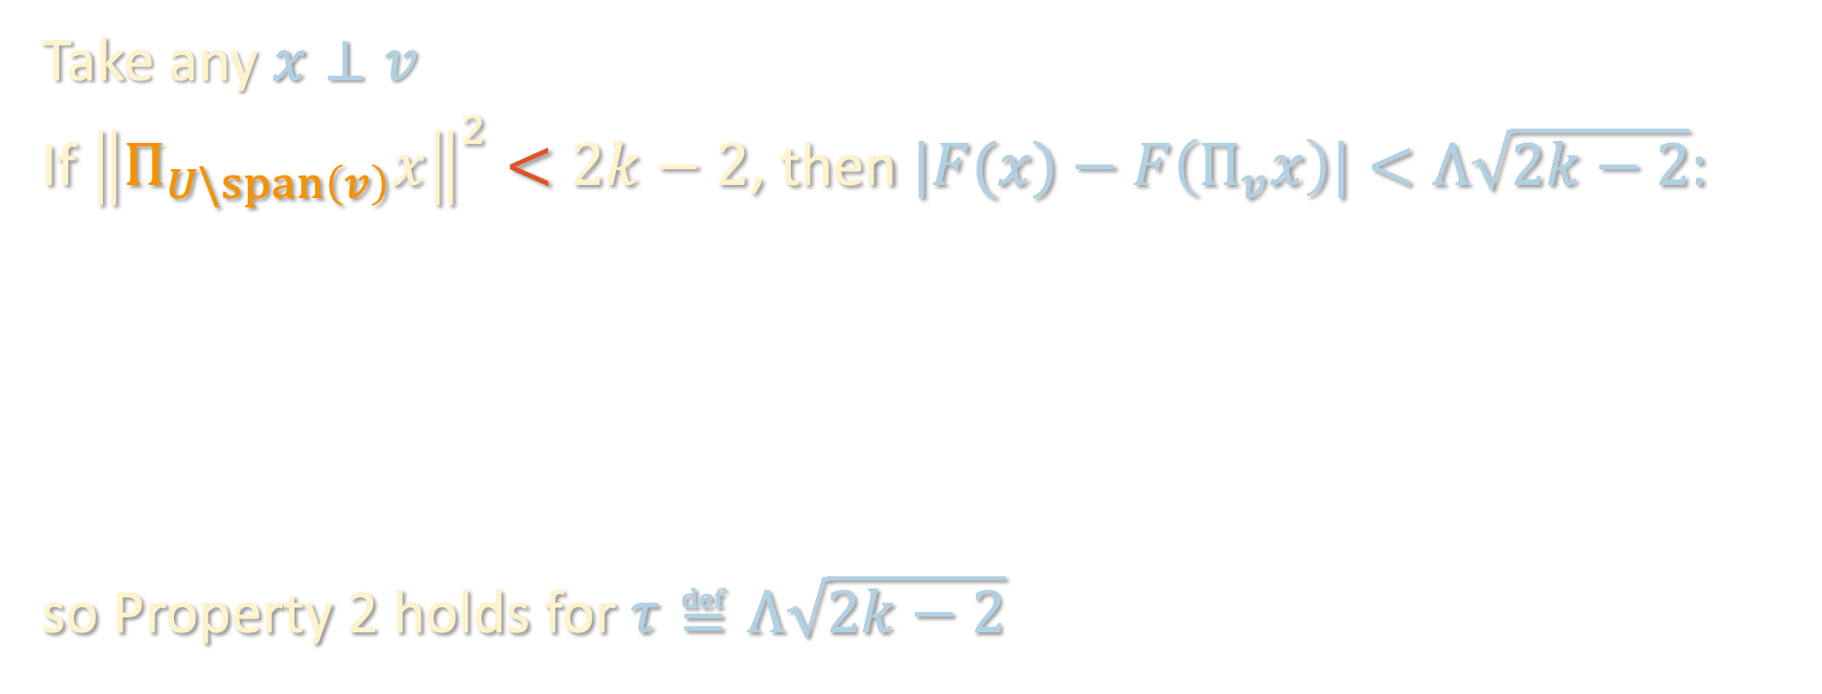
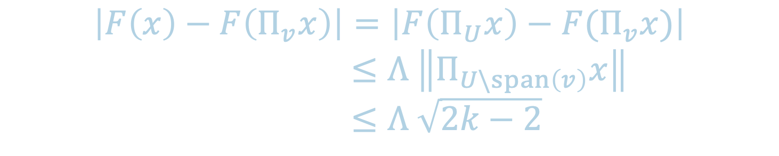
FINDING ANOTHER RELEVANT DIRECTION
  2. $\left|y−F\left(Π_{v}x\right)\right|≥τ$ for $x⊥v$ only if ${\left\|Π_{U\backslash span\left(v\right)}x\right\|}^{2}≥2k−2$
Take any $x⊥v$
If ${\left\|Π_{U\backslash span\left(v\right)}x\right\|}^{2}<2k−2$, then $|F(x)−F\left(Π_{v}x\right)|<Λ\sqrt{2k−2}$:
so Property 2 holds for $τ≝Λ\sqrt{2k−2}$
$$\left|F\left(x\right)−F\left(Π_{v}x\right)\right|=\left|F\left(Π_{U}x\right)−F(Π_{v}x)\right|$$
$≤Λ \left\|Π_{U\backslash span\left(v\right)}x\right\|$
$≤Λ \sqrt{2k−2}$

Slide 52
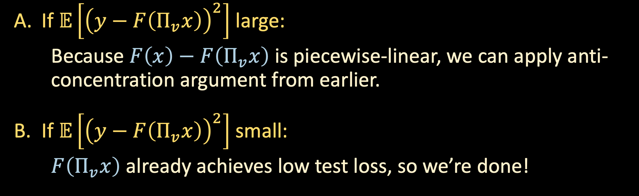
FINDING ANOTHER RELEVANT DIRECTION
  1. $ℙ\left[\left|y−F\left(Π_{v}x\right)\right|≥τ\right]$ is large (anti-concentration of $F\left(x\right)−F\left(Π_{v}x\right)$)
If $𝔼\left[{\left(y−F\left(Π_{v}x\right)\right)}^{2}\right]$ large:
  Because $F\left(x\right)−F\left(Π_{v}x\right)$ is piecewise-linear, we can apply anti-concentration argument from earlier.
If $𝔼\left[{\left(y−F\left(Π_{v}x\right)\right)}^{2}\right]$ small:
  $F\left(Π_{v}x\right)$ already achieves low test loss, so we’re done!

Slide 53
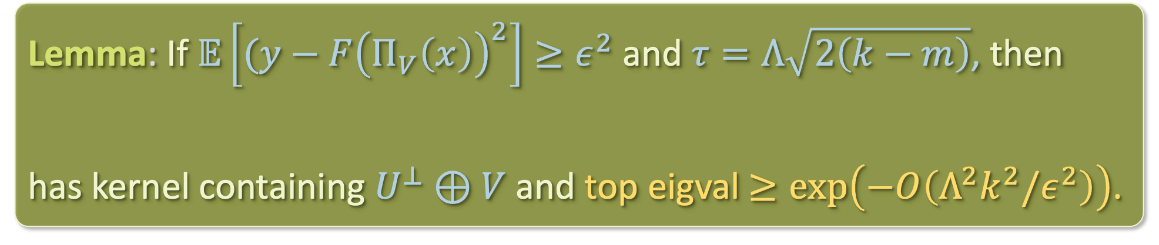

FINDING ANOTHER RELEVANT DIRECTION
Say we’ve found orthogonal vectors $v_{1},…,v_{m}∈U$ so far. Let $V$ denote their span.
If we form an empirical estimate of $M′$ from enough samples and take its top eigenvector, we recover a new direction in $U$.
Lemma: If $𝔼\left[{(y−F\left(Π_{V}\left(x\right)\right)}^{2}\right]≥ε^{2}$ and $τ=Λ\sqrt{2\left(k−m\right)}$, then
$$M^{′}≝Π_{V}^{⊥}⋅𝔼\left[𝕀\left[\left|y−F\left(Π_{V}x\right)\right|≥τ\right]⋅\left(xx^{⊤}−Id\right)\right]⋅Π_{V}^{⊥}$$
has kernel containing $U^{⊥}⊕V$ and top eigval $≥\exp\left(−O\left(Λ^{2}k^{2}/ε^{2}\right)\right)$.
$$M^{′}≝Π_{V}^{⊥}⋅𝔼\left[𝕀\left[\left|y−F\left(Π_{V}x\right)\right|≥τ\right]⋅\left(xx^{⊤}−Id\right)\right]⋅Π_{V}^{⊥}$$

Slide 54
CHICKEN AND EGG PROBLEM?
$$M^{′}≝Π_{V}^{⊥}⋅𝔼\left[𝕀\left[\left|y−F\left(Π_{V}x\right)\right|≥τ\right]⋅\left(xx^{⊤}−Id\right)\right]⋅Π_{V}^{⊥}$$

Slide 55
CSQ lower bounds and beyond
Finding a relevant direction
Finding another relevant direction
Technical subtleties

Slide 56
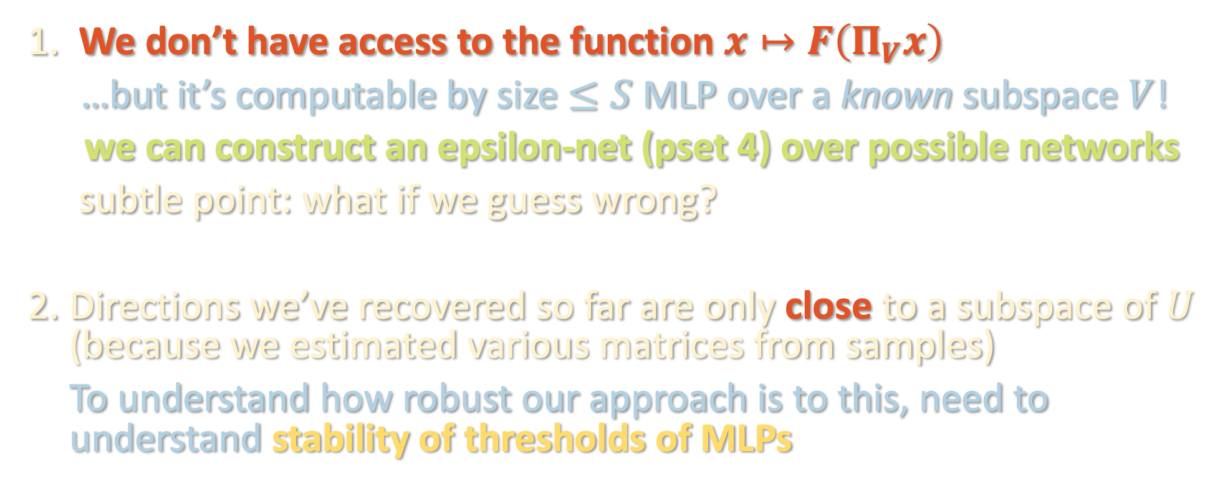
CHICKEN AND EGG PROBLEM?
$$M^{′}≝Π_{V}^{⊥}⋅𝔼\left[𝕀\left[\left|y−F\left(Π_{V}x\right)\right|≥τ\right]⋅\left(xx^{⊤}−Id\right)\right]⋅Π_{V}^{⊥}$$
We don’t have access to the function $x↦F\left(Π_{V}x\right)$
…but it’s computable by size $≤S$ MLP over a known subspace $V$!
we can construct an epsilon-net (pset 4) over possible networks
subtle point: what if we guess wrong?
Directions we’ve recovered so far are only close to a subspace of $U$ (because we estimated various matrices from samples)
To understand how robust our approach is to this, need to understand stability of thresholds of MLPs

Slide 57
KEY STABILITY RESULT

Slide 58
KEY STABILITY RESULT

Slide 59
KEY STABILITY RESULT
Want to bound the (Gaussian volume of this area of disagreement.

Slide 60

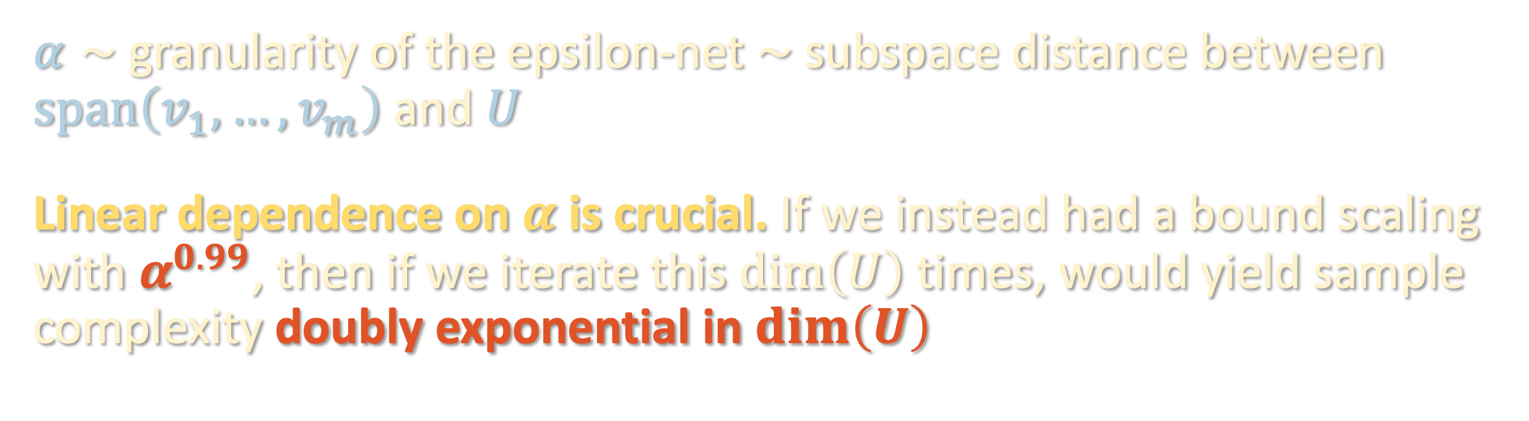

KEY STABILITY RESULT
$$\prod_{i}{{\left\|W_{i}\right\|}_{op}}≤B$$
Lemma: For depth-$L$ MLPs $F$ and $F′$ with the same architecture and whose weight matrices are $α$-close in operator norm,
$$ℙ\left[\left|F\left(x\right)\right|>τ and \left|F^{′}\left(x\right)\right|≤τ\right]≤2^{O\left(S\right)}Bα/τ$$
$α∼$granularity of the epsilon-net $∼$ subspace distance between $span\left(v_{1},…,v_{m}\right)$ and $U$
Linear dependence on $α$ is crucial. If we instead had a bound scaling with $α^{0.99}$, then if we iterate this $\dim\left(U\right)$ times, would yield sample complexity doubly exponential in $\dim\left(U\right)$

Slide 61






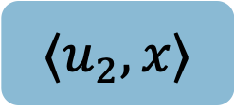

KEY STABILITY RESULT – DEPTH REDUCTION
Theorem [Ovchinnikov ‘03]: Any continuous piecewise-linear function $F$ can be written as a depth-2 max-min formula.
$max$
……
$min$
$$min$$
$$min$$
…………
$$⟨u_{1},x⟩$$
$$⟨u_{2},x⟩$$
$$⟨u_{N},x⟩$$

Slide 62

















KEY STABILITY RESULT – PROOF SKETCH
Lemma: For depth-$L$ MLPs $F$ and $F′$ with the same architecture and whose weight matrices are $α$-close in operator norm,
$$ℙ\left[\left|F\left(x\right)\right|>τ and \left|F^{′}\left(x\right)\right|≤τ\right]≤2^{O\left(S\right)}Bα/τ$$
Consider max-min formulas $Φ, Φ′$ for $F, F′$
$max$
$$Φ$$
……
$min$
$$min$$
$$min$$
…………
$$⟨u_{1},x⟩$$
$$⟨u_{2},x⟩$$
$$⟨u_{N},x⟩$$
$max$
$$Φ′$$
……
$min$
$$min$$
$$min$$
…………
$$⟨w_{1},x⟩$$
$$⟨w_{2},x⟩$$
$$⟨w_{N},x⟩$$

Slide 63





KEY STABILITY RESULT – PROOF SKETCH
Lemma: For depth-$L$ MLPs $F$ and $F′$ with the same architecture and whose weight matrices are $α$-close in operator norm,
$$ℙ\left[\left|F\left(x\right)\right|>τ and \left|F^{′}\left(x\right)\right|≤τ\right]≤2^{O\left(S\right)}Bα/τ$$
Consider max-min formulas $Φ, Φ′$ for $F, F′$
MLPS have same architecture → $Φ,Φ′$ have same clause structure
$max$
$$Φ$$
……
$min$
$$min$$
$$min$$
…………
$$⟨u_{1},x⟩$$
$$⟨u_{2},x⟩$$
$$⟨u_{N},x⟩$$
$max$
$$Φ′$$
……
$min$
$$min$$
$$min$$
…………
$$⟨w_{1},x⟩$$
$$⟨w_{2},x⟩$$
$$⟨w_{N},x⟩$$

Slide 64
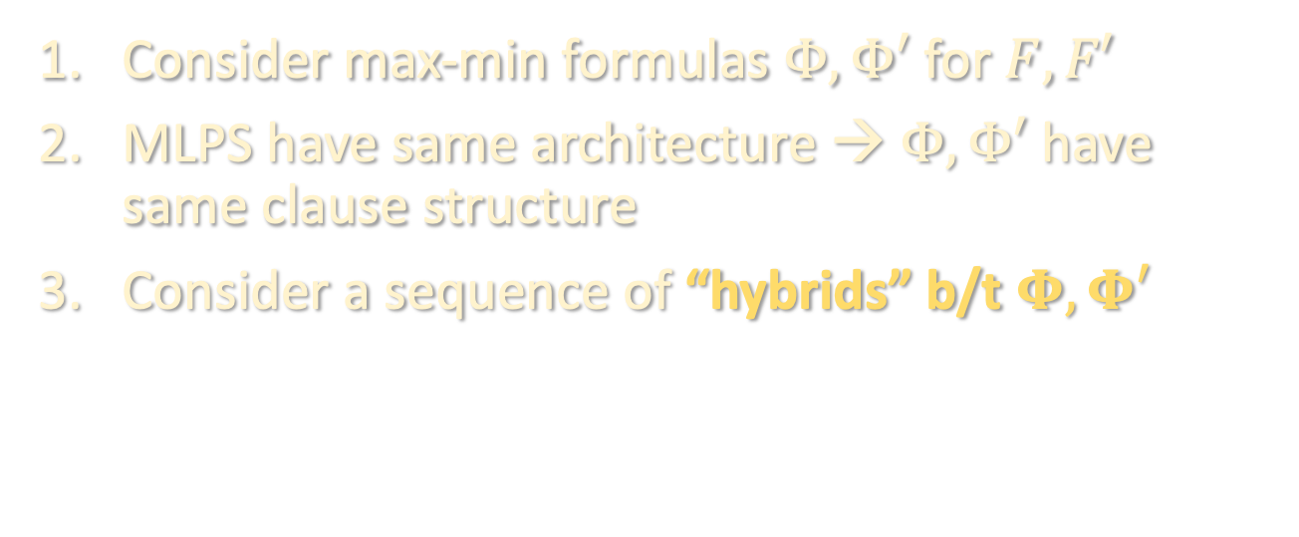
KEY STABILITY RESULT – PROOF SKETCH
Lemma: For depth-$L$ MLPs $F$ and $F′$ with the same architecture and whose weight matrices are $α$-close in operator norm,
$$ℙ\left[\left|F\left(x\right)\right|>τ and \left|F^{′}\left(x\right)\right|≤τ\right]≤2^{O\left(S\right)}Bα/τ$$
Consider max-min formulas $Φ, Φ′$ for $F, F′$
MLPS have same architecture → $Φ,Φ′$ have same clause structure
Consider a sequence of “hybrids” b/t $Φ, Φ′$
$max$
$$Φ$$
……
$min$
$$min$$
$$min$$
…………
$$⟨u_{1},x⟩$$
$$⟨u_{2},x⟩$$
$$⟨u_{N},x⟩$$
$max$
$$Φ′$$
……
$min$
$$min$$
$$min$$
…………
$$⟨w_{1},x⟩$$
$$⟨w_{2},x⟩$$
$$⟨w_{N},x⟩$$

Slide 65


KEY STABILITY RESULT – PROOF SKETCH
Lemma: For depth-$L$ MLPs $F$ and $F′$ with the same architecture and whose weight matrices are $α$-close in operator norm,
$$ℙ\left[\left|F\left(x\right)\right|>τ and \left|F^{′}\left(x\right)\right|≤τ\right]≤2^{O\left(S\right)}Bα/τ$$
Consider max-min formulas $Φ, Φ′$ for $F, F′$
MLPS have same architecture → $Φ,Φ′$ have same clause structure
Consider a sequence of “hybrids” b/t $Φ, Φ′$
$max$
$$Φ^{\left(1\right)}$$
……
$min$
$$min$$
$$min$$
…………
$$⟨w_{1},x⟩$$
$$⟨u_{2},x⟩$$
$$⟨u_{N},x⟩$$
$max$
$$Φ′$$
……
$min$
$$min$$
$$min$$
…………
$$⟨w_{1},x⟩$$
$$⟨w_{2},x⟩$$
$$⟨w_{N},x⟩$$

Slide 66


KEY STABILITY RESULT – PROOF SKETCH
Lemma: For depth-$L$ MLPs $F$ and $F′$ with the same architecture and whose weight matrices are $α$-close in operator norm,
$$ℙ\left[\left|F\left(x\right)\right|>τ and \left|F^{′}\left(x\right)\right|≤τ\right]≤2^{O\left(S\right)}Bα/τ$$
Consider max-min formulas $Φ, Φ′$ for $F, F′$
MLPS have same architecture → $Φ,Φ′$ have same clause structure
Consider a sequence of “hybrids” b/t $Φ, Φ′$
$max$
$$Φ^{\left(2\right)}$$
……
$min$
$$min$$
$$min$$
…………
$$⟨w_{1},x⟩$$
$$⟨w_{2},x⟩$$
$$⟨u_{N},x⟩$$
$max$
$$Φ′$$
……
$min$
$$min$$
$$min$$
…………
$$⟨w_{1},x⟩$$
$$⟨w_{2},x⟩$$
$$⟨w_{N},x⟩$$

Slide 67


KEY STABILITY RESULT – PROOF SKETCH
Lemma: For depth-$L$ MLPs $F$ and $F′$ with the same architecture and whose weight matrices are $α$-close in operator norm,
$$ℙ\left[\left|F\left(x\right)\right|>τ and \left|F^{′}\left(x\right)\right|≤τ\right]≤2^{O\left(S\right)}Bα/τ$$
Consider max-min formulas $Φ, Φ′$ for $F, F′$
MLPS have same architecture → $Φ,Φ′$ have same clause structure
Consider a sequence of “hybrids” b/t $Φ, Φ′$
$max$
$$Φ^{\left(N\right)}$$
……
$min$
$$min$$
$$min$$
…………
$$⟨w_{1},x⟩$$
$$⟨w_{2},x⟩$$
$$⟨u_{N},x⟩$$
$max$
$$Φ′$$
……
$min$
$$min$$
$$min$$
…………
$$⟨w_{1},x⟩$$
$$⟨w_{2},x⟩$$
$$⟨w_{N},x⟩$$

Slide 68

KEY STABILITY RESULT – PROOF SKETCH
Lemma: For depth-$L$ MLPs $F$ and $F′$ with the same architecture and whose weight matrices are $α$-close in operator norm,
$$ℙ\left[\left|F\left(x\right)\right|>τ and \left|F^{′}\left(x\right)\right|≤τ\right]≤2^{O\left(S\right)}Bα/τ$$
Consider max-min formulas $Φ, Φ′$ for $F, F′$
MLPS have same architecture → $Φ,Φ′$ have same clause structure
Consider a sequence of “hybrids” b/t $Φ, Φ′$
$max$
$$Φ^{′}=Φ^{\left(N\right)}$$
……
$min$
$$min$$
$$min$$
…………
$$⟨w_{1},x⟩$$
$$⟨w_{2},x⟩$$
$$⟨u_{N},x⟩$$
$max$
$$Φ′$$
……
$min$
$$min$$
$$min$$
…………
$$⟨w_{1},x⟩$$
$$⟨w_{2},x⟩$$
$$⟨w_{N},x⟩$$

Slide 69
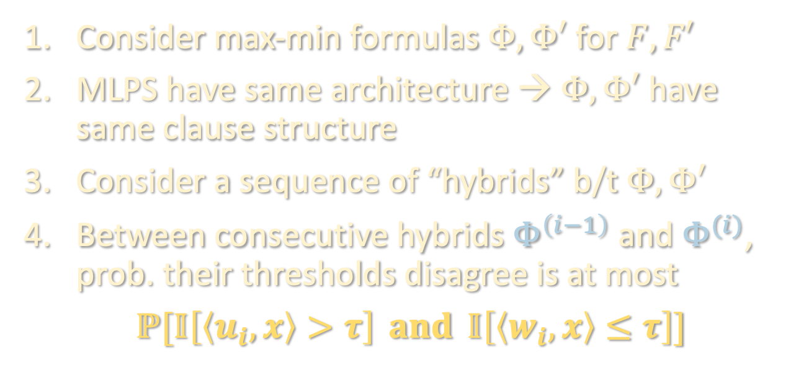
KEY STABILITY RESULT – PROOF SKETCH
Lemma: For depth-$L$ MLPs $F$ and $F′$ with the same architecture and whose weight matrices are $α$-close in operator norm,
$$ℙ\left[\left|F\left(x\right)\right|>τ and \left|F^{′}\left(x\right)\right|≤τ\right]≤2^{O\left(S\right)}Bα/τ$$
Consider max-min formulas $Φ, Φ′$ for $F, F′$
MLPS have same architecture → $Φ,Φ′$ have same clause structure
Consider a sequence of “hybrids” b/t $Φ, Φ′$
Between consecutive hybrids $Φ^{\left(i−1\right)}$ and $Φ^{(i)}$, prob. their thresholds disagree is at most
$$ℙ[𝕀\left[\left\langle u_{i},x\right\rangle >τ\right] and 𝕀\left[\left\langle w_{i},x\right\rangle ≤τ\right]]$$
$max$
$$Φ^{′}=Φ^{\left(N\right)}$$
……
$min$
$$min$$
$$min$$
…………
$$⟨w_{1},x⟩$$
$$⟨w_{2},x⟩$$
$$⟨u_{N},x⟩$$
$max$
$$Φ′$$
……
$min$
$$min$$
$$min$$
…………
$$⟨w_{1},x⟩$$
$$⟨w_{2},x⟩$$
$$⟨w_{N},x⟩$$

Slide 70
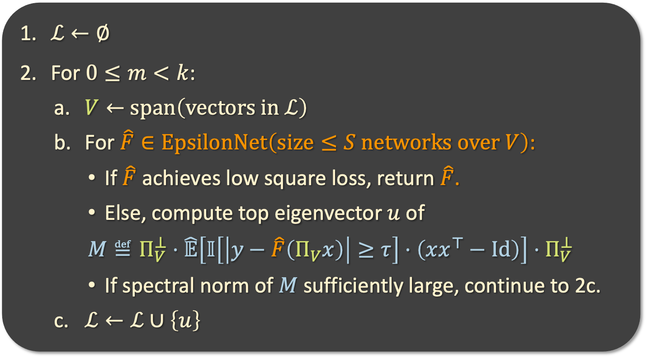
THE ALGORITHM
Filtered PCA
$ℒ←∅$
For $0≤m<k$:
  $V←$ $span\left(vectors in ℒ\right)$
  For $\hat{F}∈EpsilonNet\left(size≤S networks over V\right)$:
    If $\hat{F}$ achieves low square loss, return $\hat{F}$.
    Else, compute top eigenvector $u$ of
    $M≝Π_{V}^{⊥}⋅\hat{𝔼}\left[𝕀\left[\left|y−\hat{F}\left(Π_{V}x\right)\right|≥τ\right]⋅\left(xx^{⊤}−Id\right)\right]⋅Π_{V}^{⊥}$
    If spectral norm of $M$ sufficiently large, continue to 2c.
  $ℒ←ℒ∪\left\{u\right\}$

Slide 71
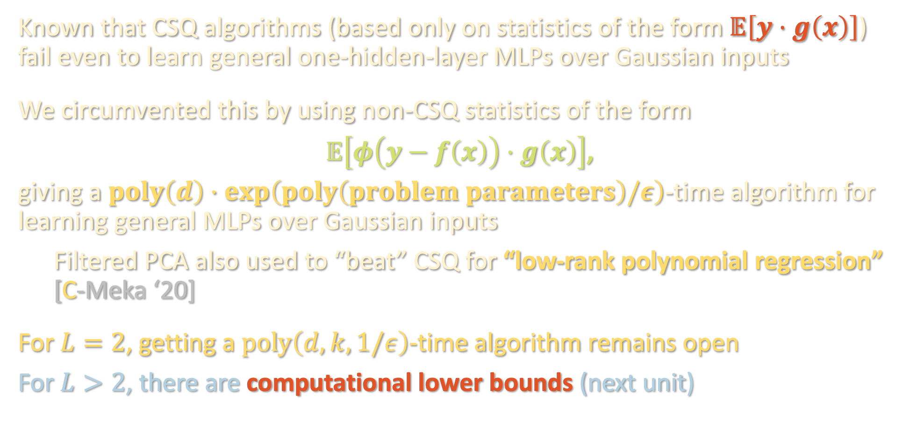
TAKEAWAYS
Known that CSQ algorithms (based only on statistics of the form $𝔼\left[y⋅g\left(x\right)\right]$) fail even to learn general one-hidden-layer MLPs over Gaussian inputs
We circumvented this by using non-CSQ statistics of the form
$𝔼\left[φ\left(y−f\left(x\right)\right)⋅g\left(x\right)\right]$,
giving a $poly\left(d\right)⋅\exp\left(poly\left(problem parameters\right)/ε\right)$-time algorithm for learning general MLPs over Gaussian inputs
Filtered PCA also used to “beat” CSQ for “low-rank polynomial regression” [C-Meka ‘20]
For $L=2$, getting a $poly\left(d,k,1/ε\right)$-time algorithm remains open
For $L>2$, there are computational lower bounds (next unit)

Slide 72
NEXT TIME
What can we actually prove about gradient descent?
Two regimes where we can say something:
Neural tangent kernel
Mean-field

