Slide 1

CS 224: ALGORITHMS FOR DATA SCIENCE
LECTURE 9 (10/4)
Tensor decomposition
Sum-of-squares
Robustness
Supervised learning
Computational complexity
Statistical physics
Generative modeling
ROBUST STATISTICS, ITERATIVE FILTERING

Slide 2
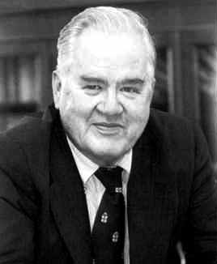
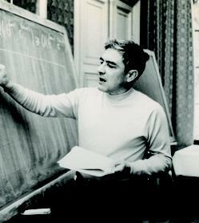
ROBUST STATISTICS
John Tukey
(1915-2000)
Peter Huber
(1934-)
Disconnect between
setting where you know your ML system works (provably or empirically)
setting where you want to deploy your ML system
the “spec”
reality

Slide 3


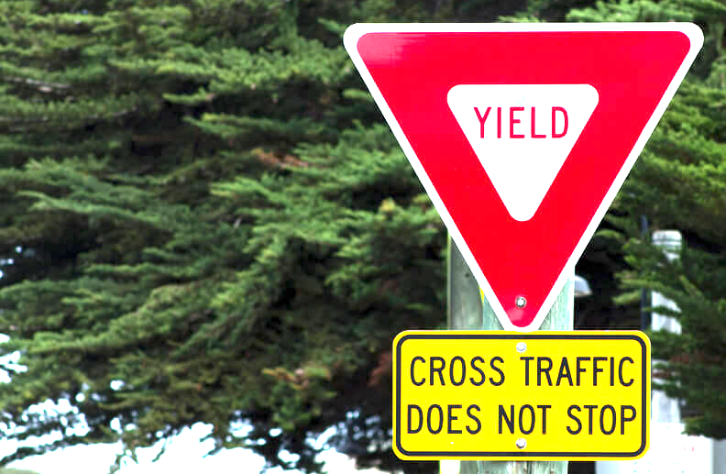
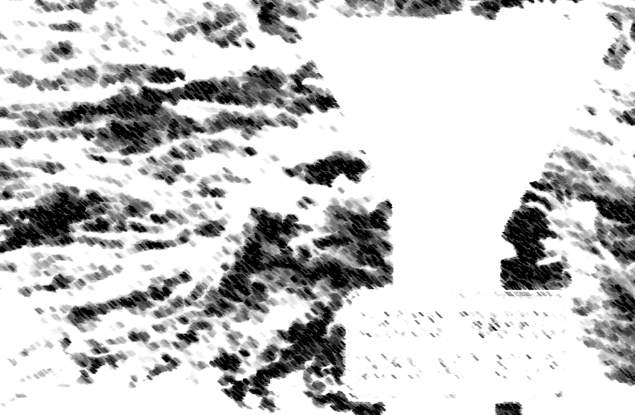
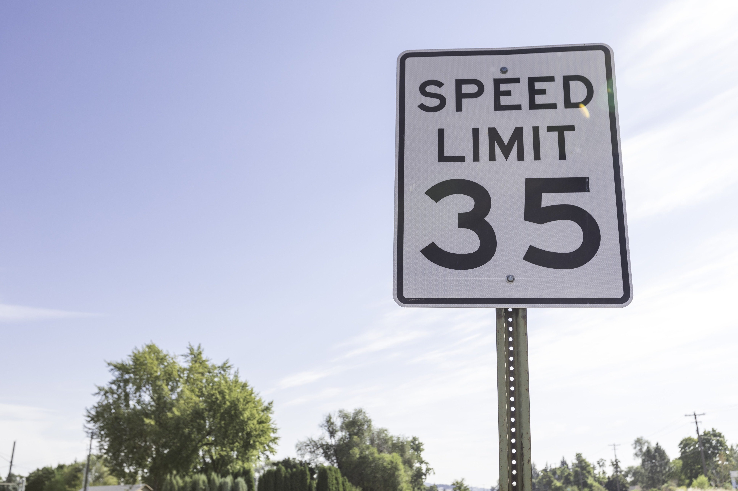
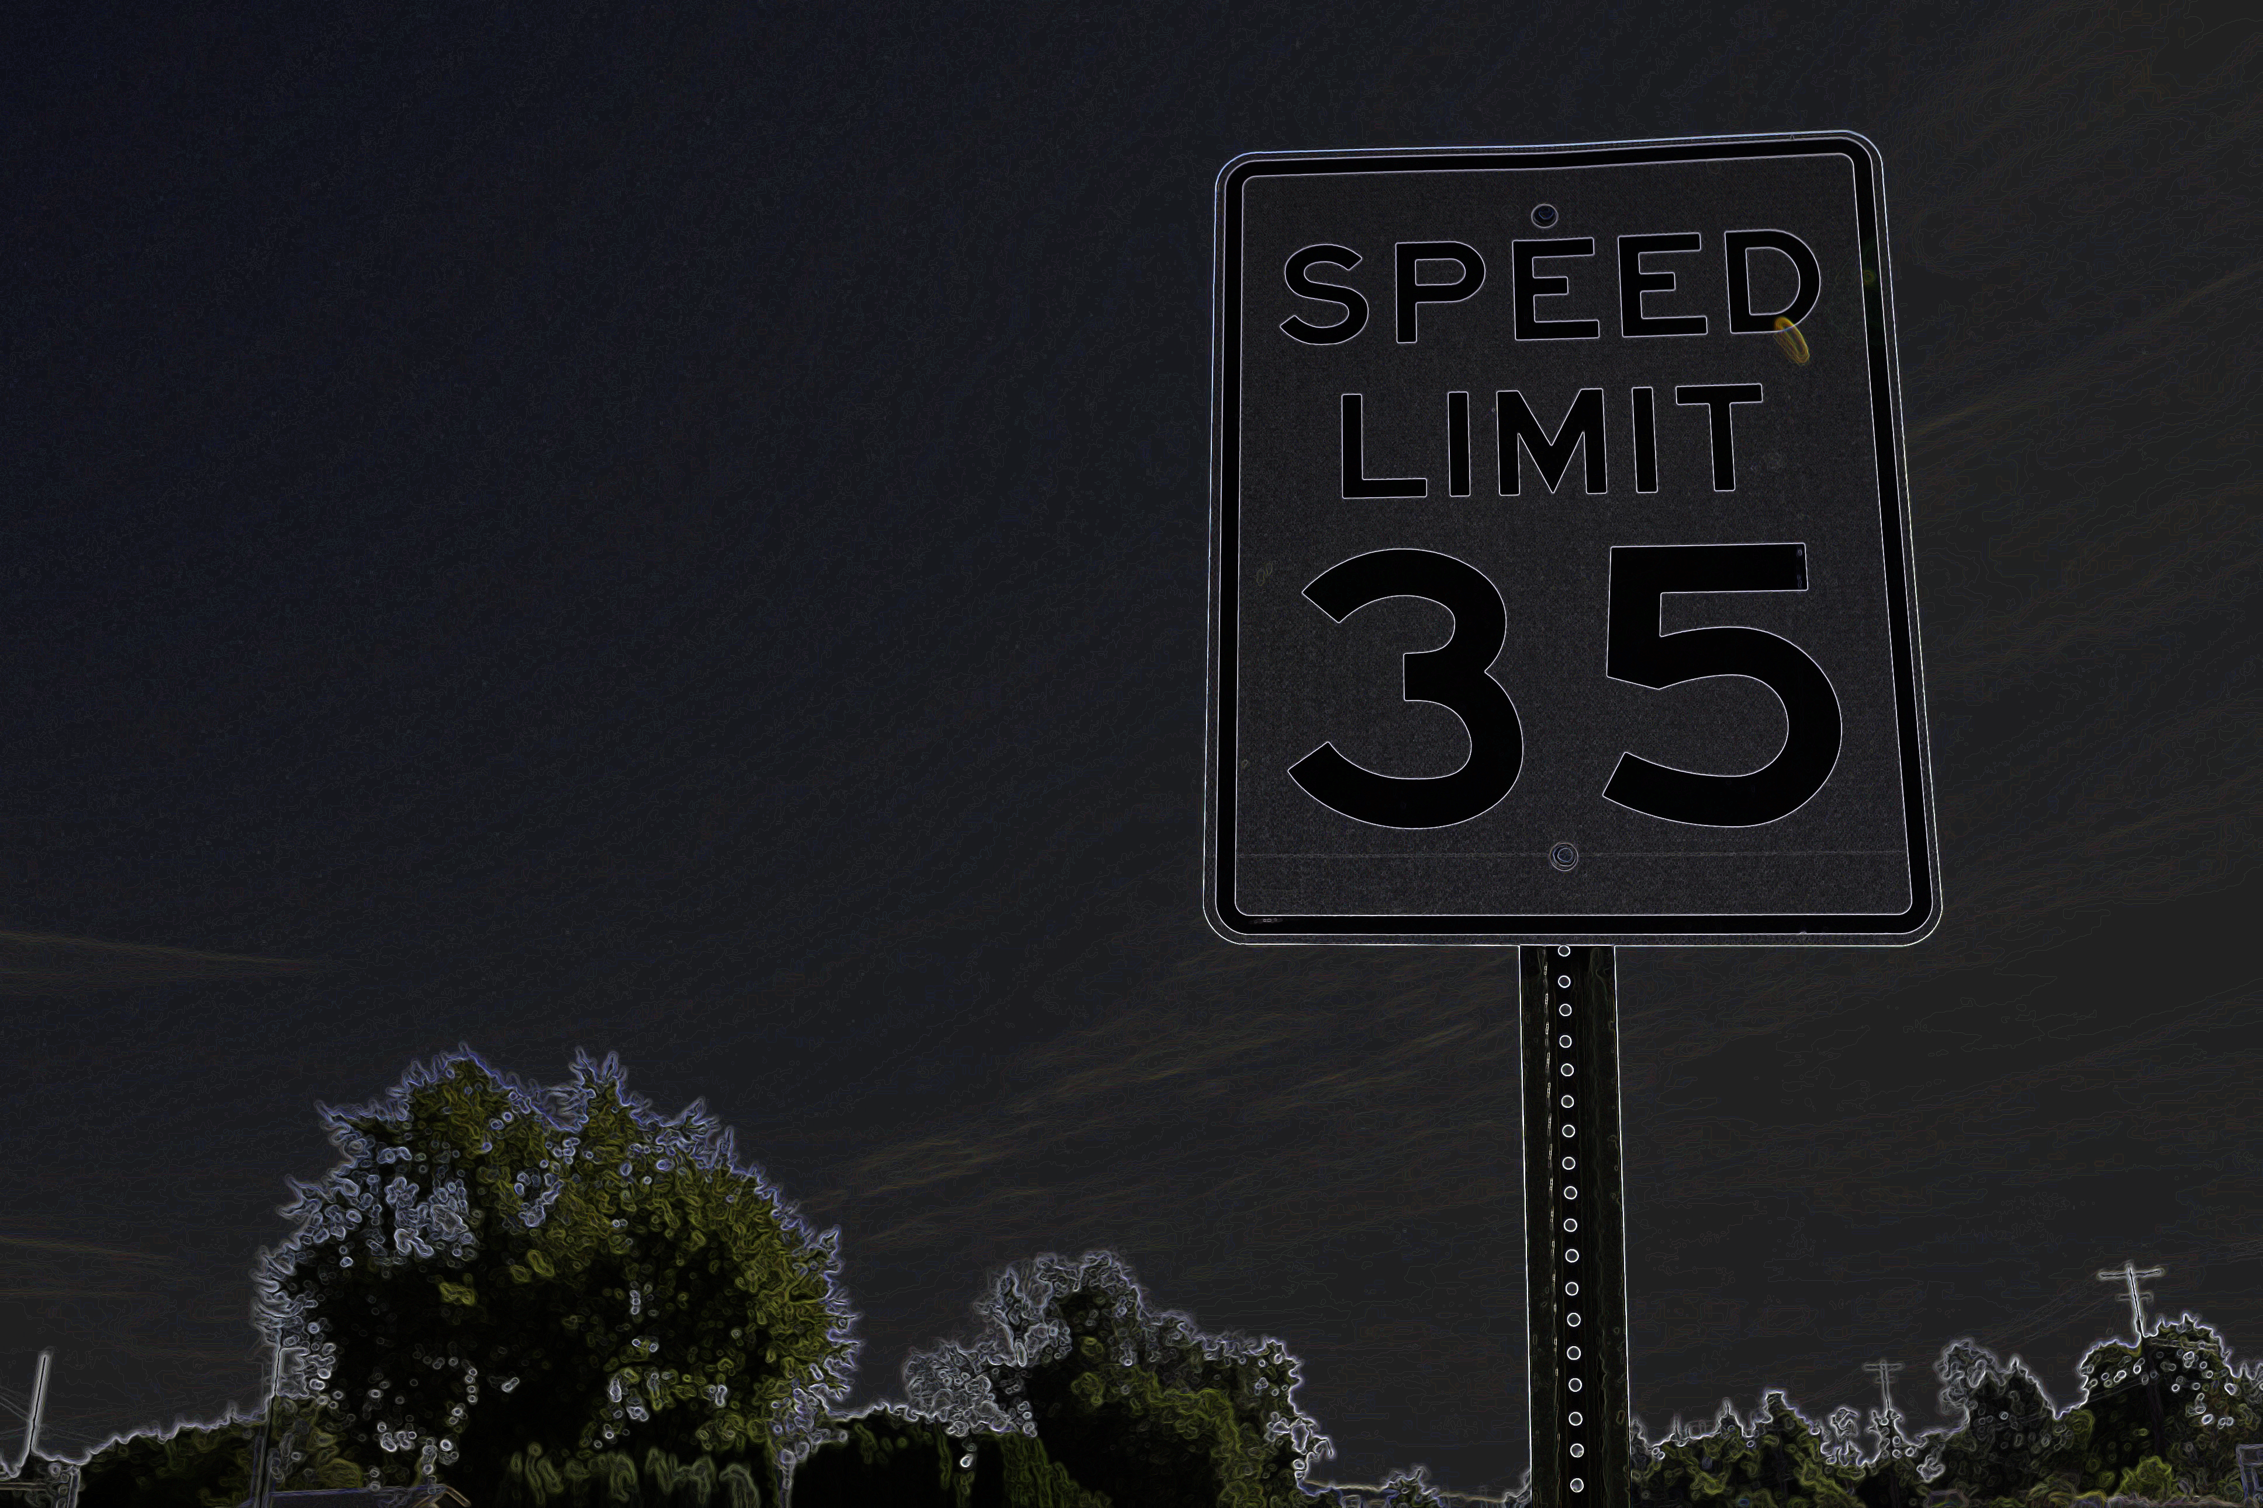
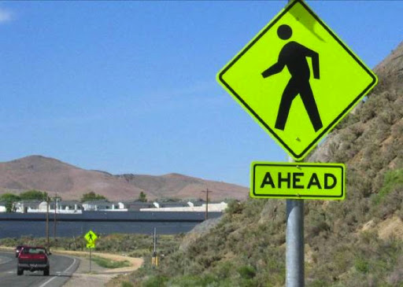
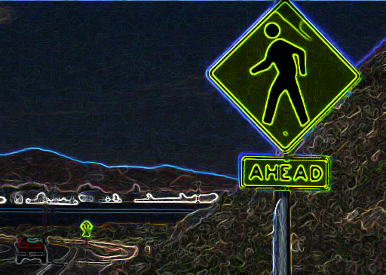



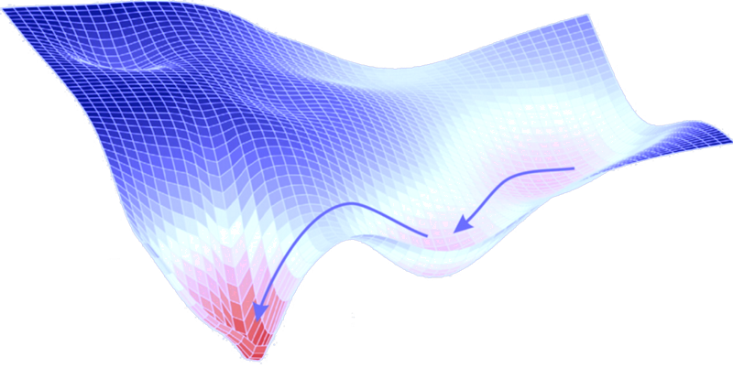
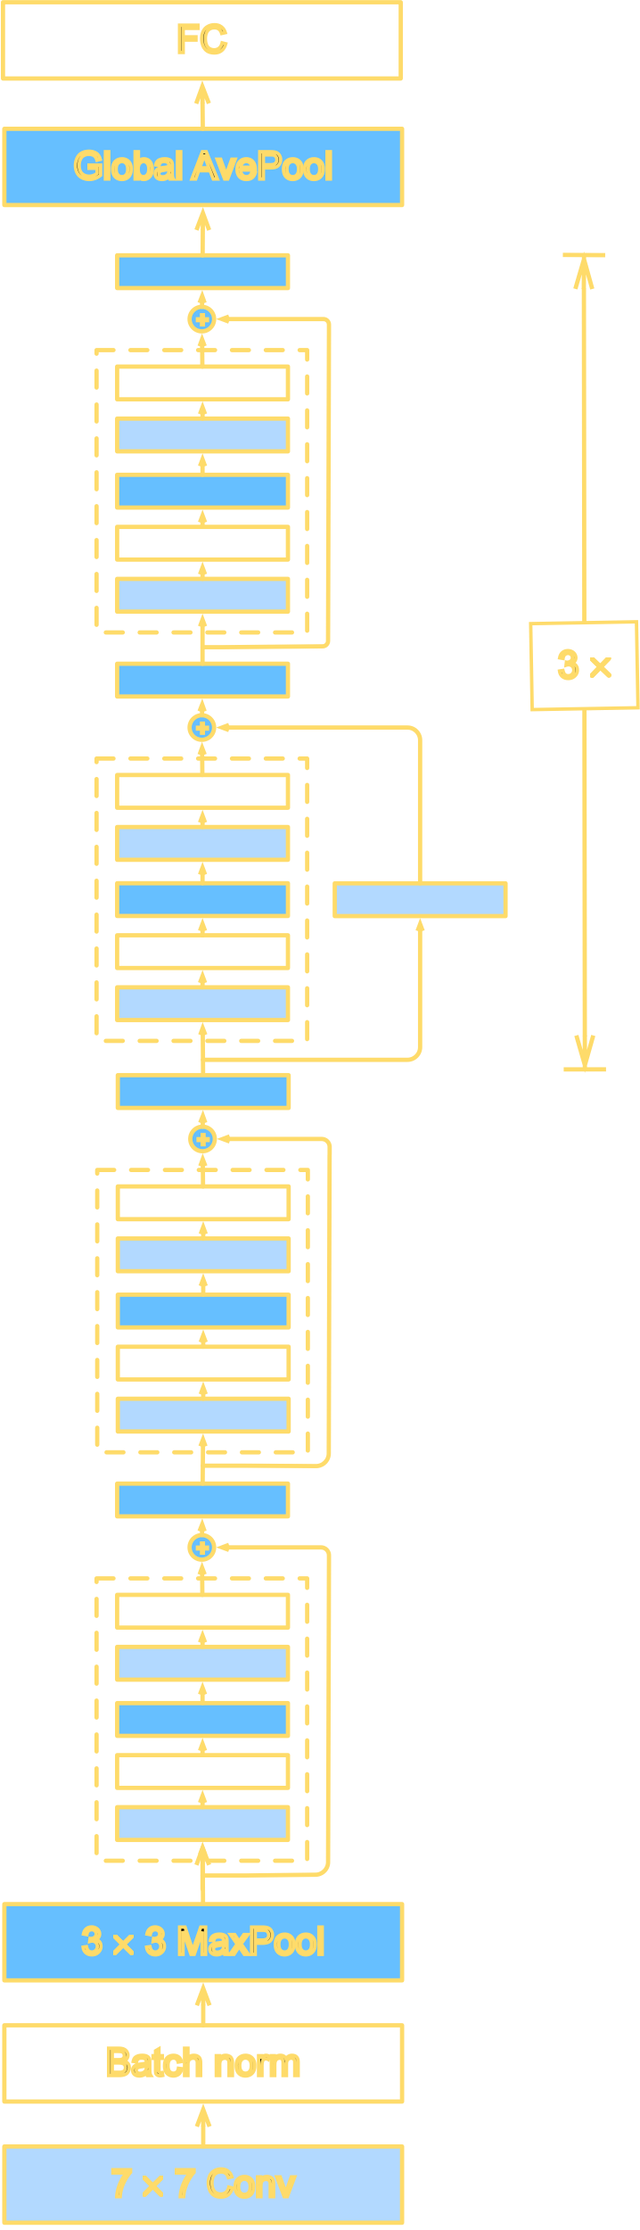
ROBUST STATISTICS
training set
training set
learning algorithm
learning algorithm
classifier
classifier
test set
test set
the “spec”
reality

Slide 4

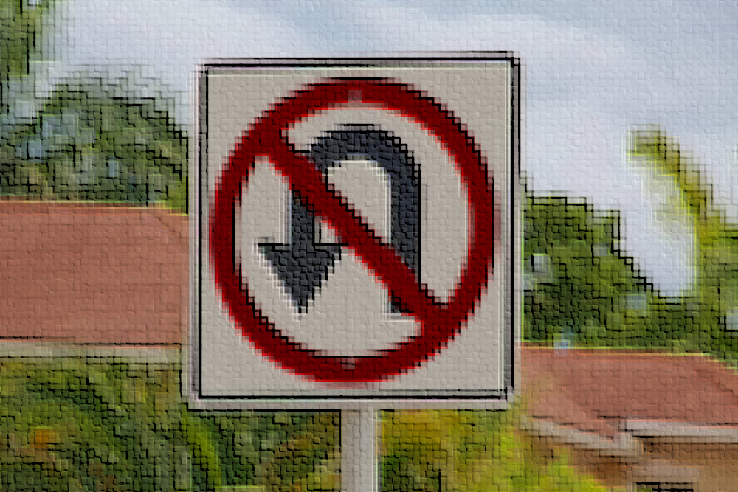
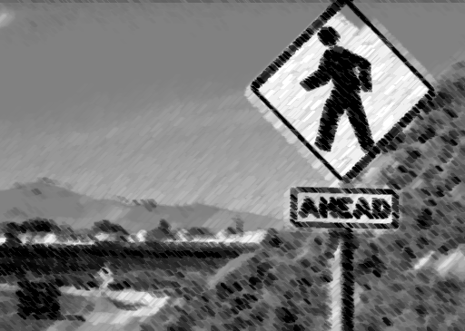
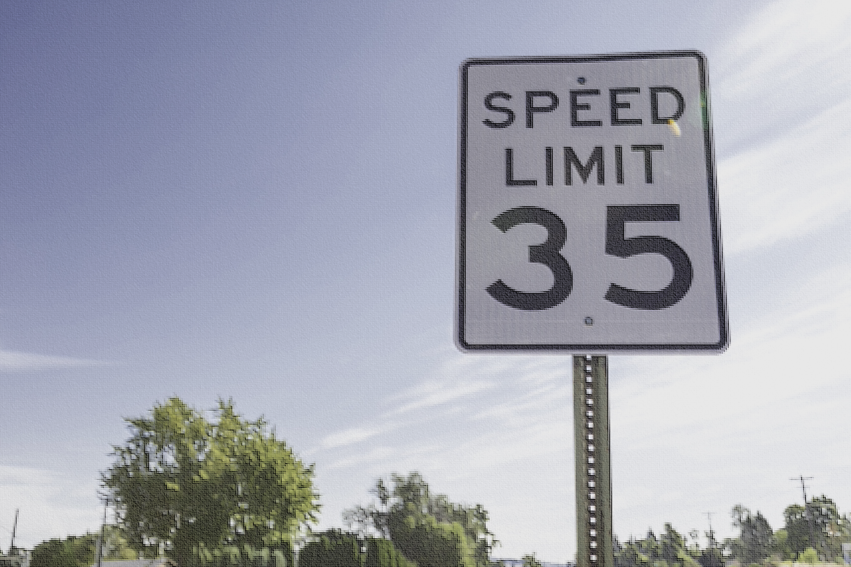
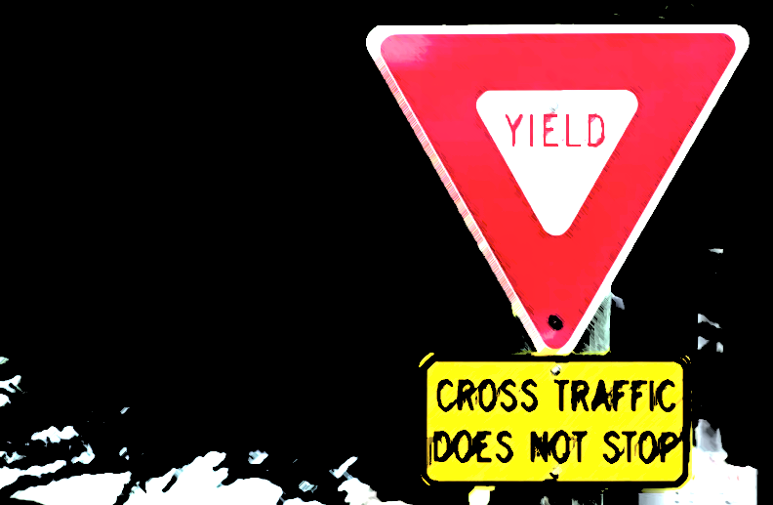
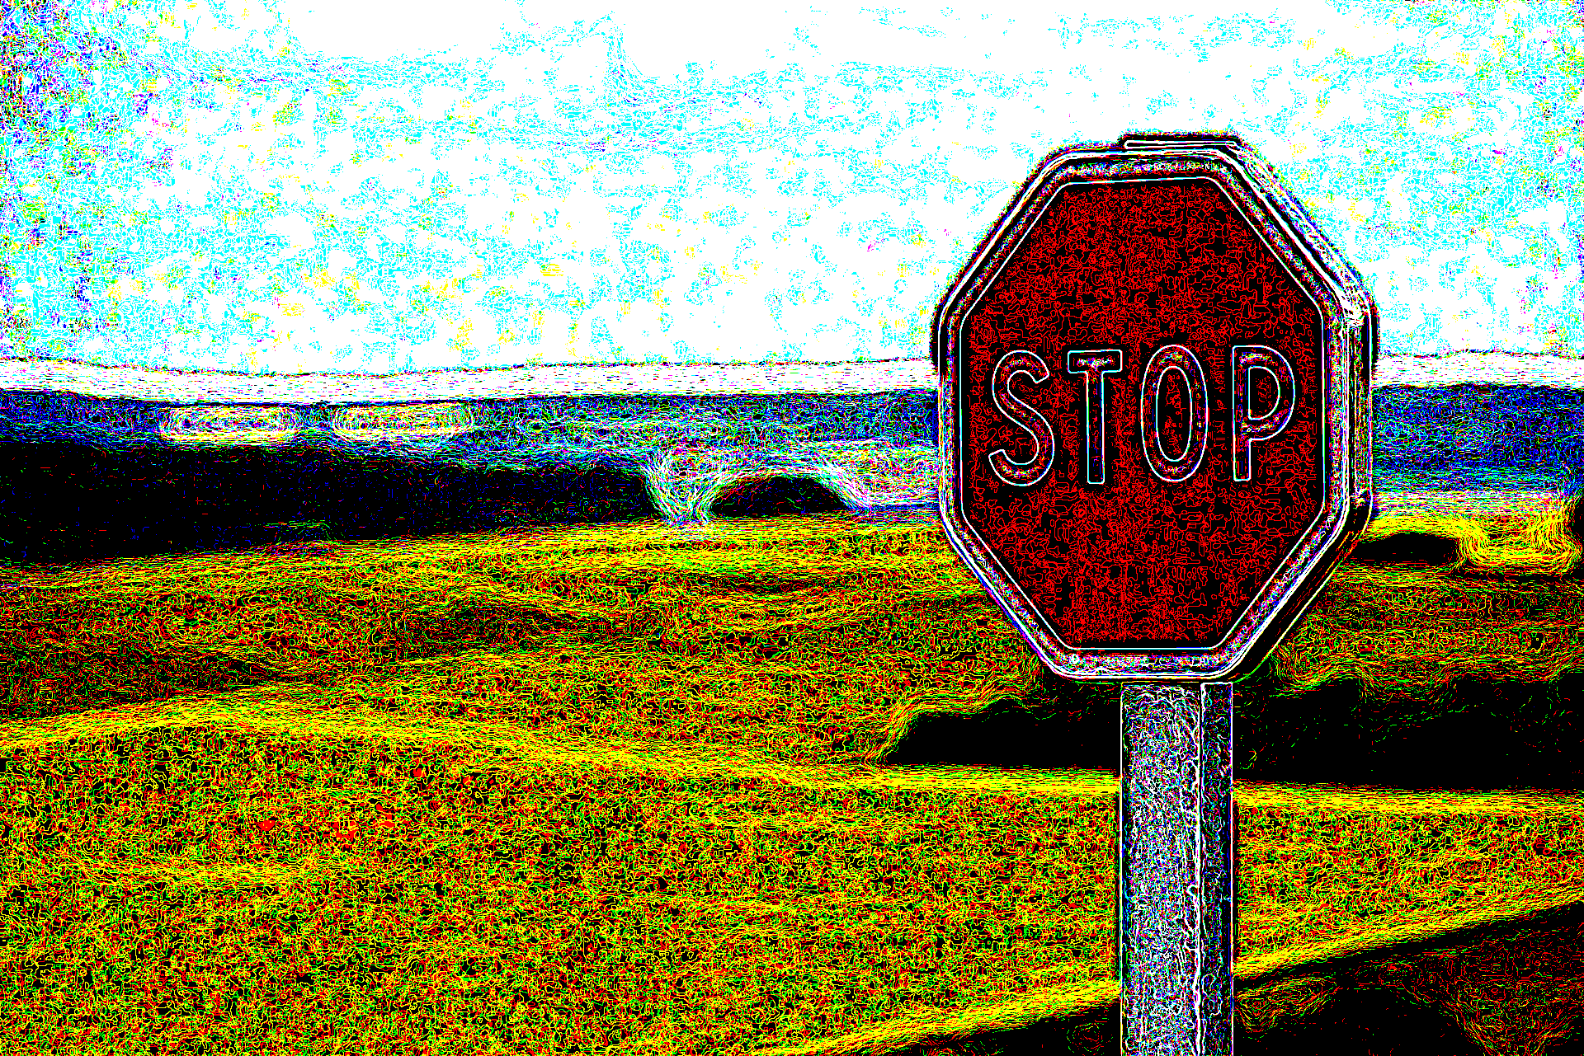
ROBUST STATISTICS
We will think of misspecification as coming from corruptions by an adversary
Flexible abstraction for stress-testing our algorithmic toolbox against all kinds of real-world deviations
training set
training set
learning algorithm
learning algorithm
(even ones without an actual adversary!)
classifier
classifier
test set
test set
the “spec”
reality

Slide 5
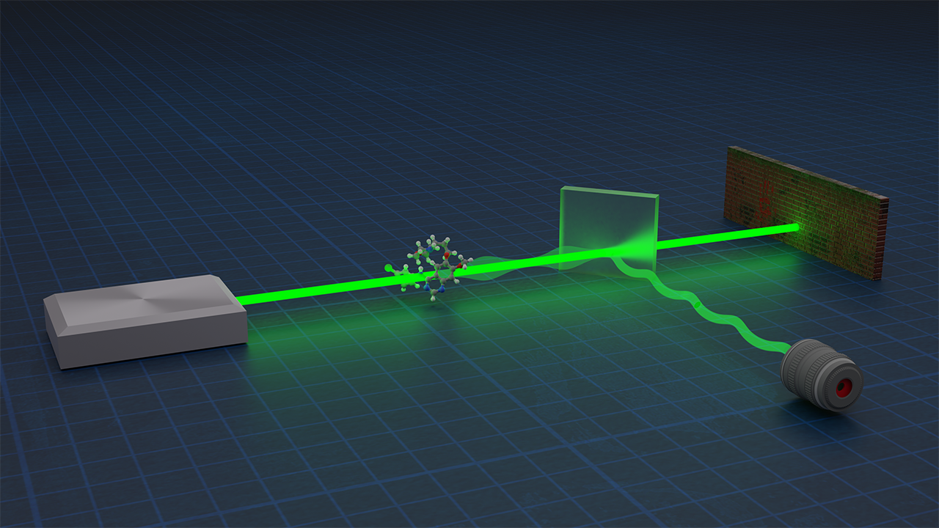
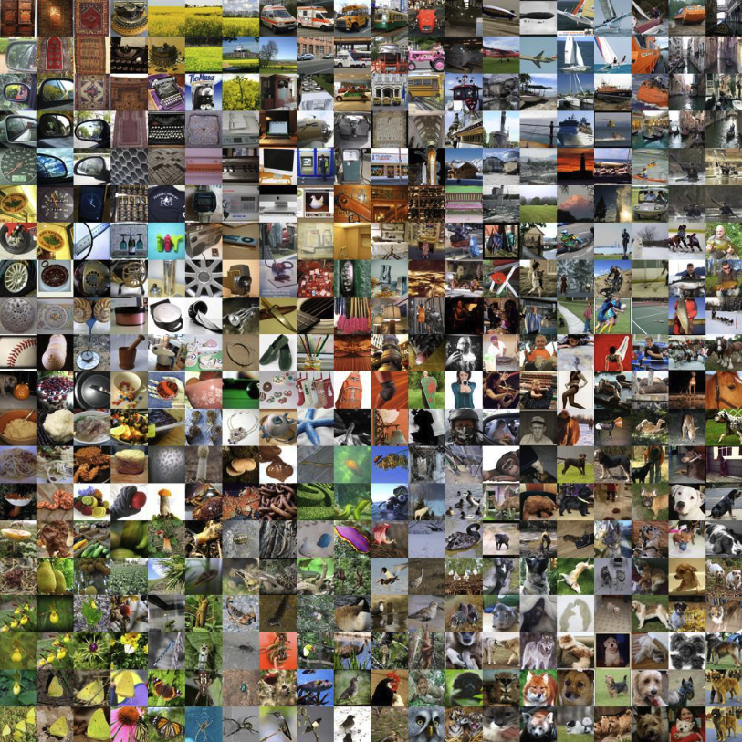




ROBUST STATISTICS
General setup: unknown distribution $q$...
...but instead of getting i.i.d. samples from $q$, we get samples from $q$ that have been corrupted
Goal: compete with OPT which knows which samples were corrupted

Slide 6
ROBUST STATISTICS
Many different ways of modeling that vary in how “adversarial” the corruptions are
  Huber contamination
  Additive contamination
  TV contamination
  Strong contamination
Sometimes have to be careful which model to work in, because the most adversarial settings may be computationally intractable or information-theoretically impossible
strength of
algorithmic
guarantees
generality of model

Slide 7
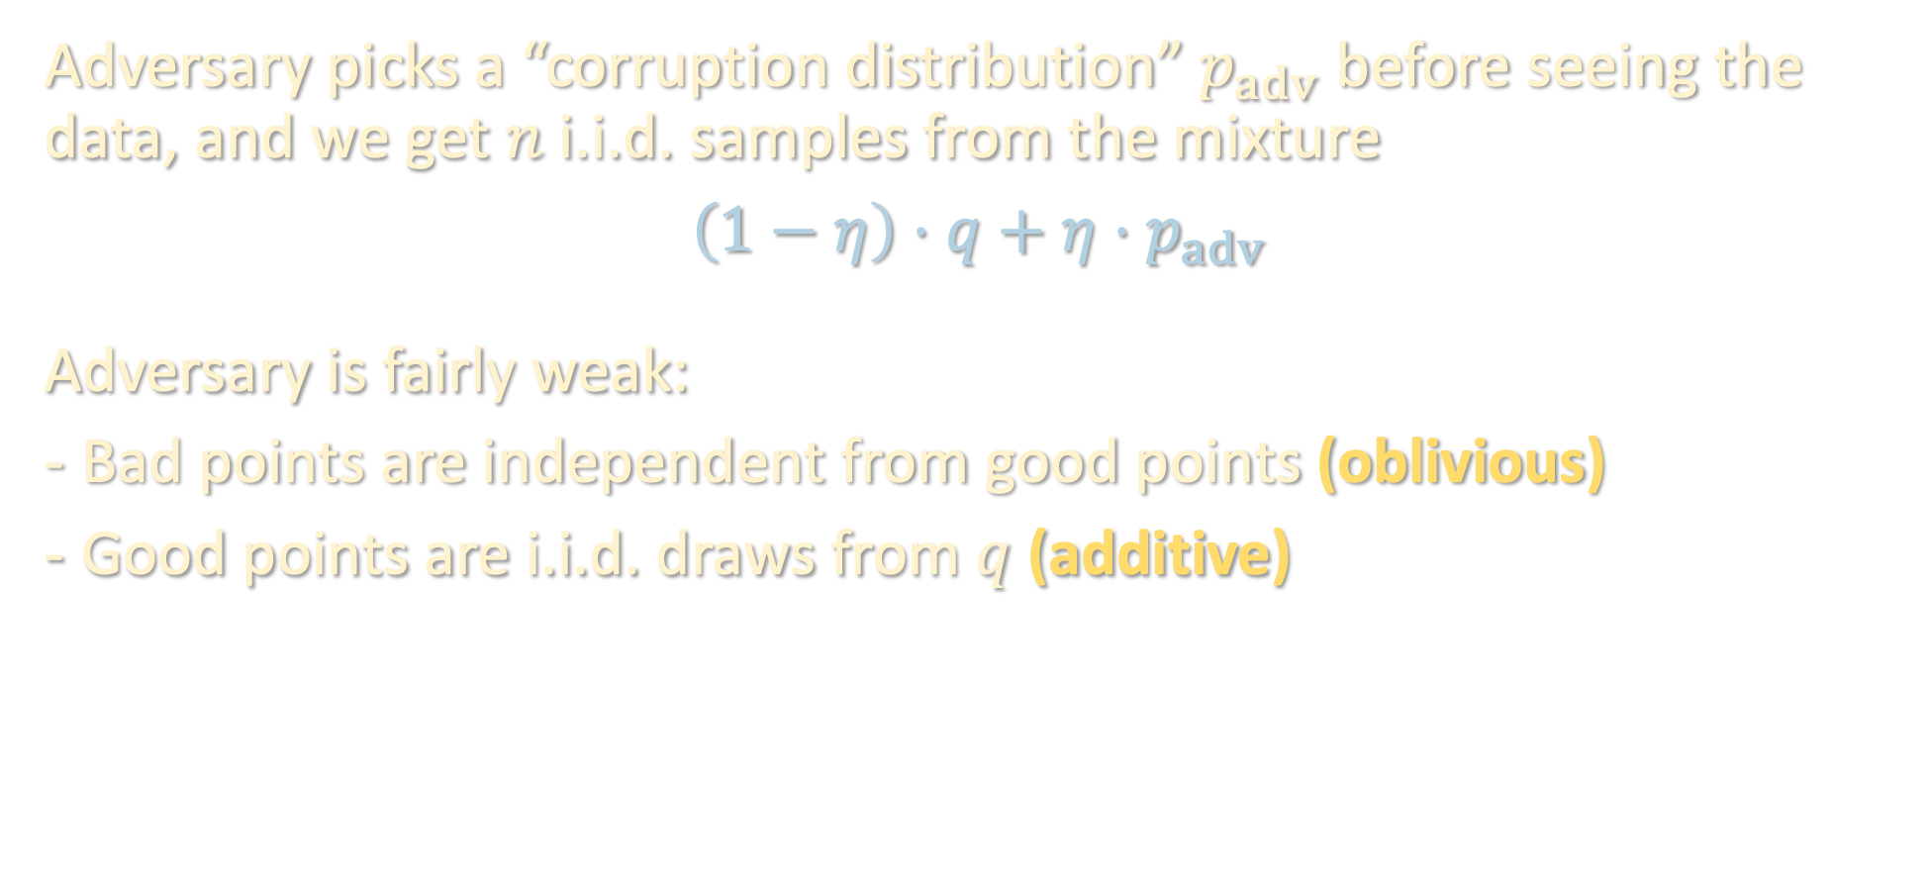
1. HUBER CONTAMINATION
Adversary picks a “corruption distribution” $p_{adv}$ before seeing the data, and we get $n$ i.i.d. samples from the mixture
$$\left(1−η\right)⋅q+η⋅p_{adv}$$
Adversary is fairly weak:
Bad points are independent from good points (oblivious)
Good points are i.i.d. draws from $q$ (additive)
 | Oblivious | Adaptive
Additive
Non-additive

Slide 8
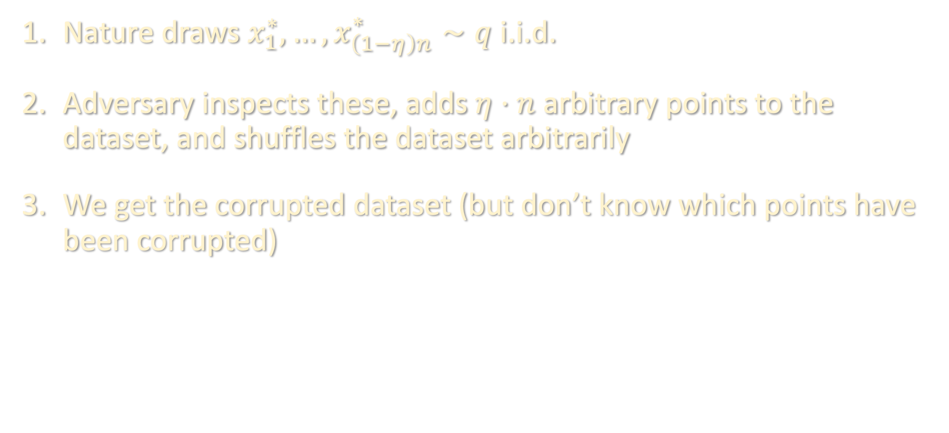
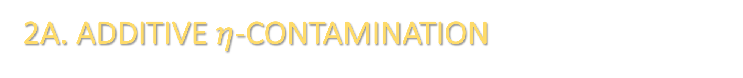
2A. ADDITIVE $η$-CONTAMINATION
Nature draws $x_{1}^{∗},…,x_{\left(1−η\right)n}^{∗}∼q$ i.i.d.
Adversary inspects these, adds $η⋅n$ arbitrary points to the dataset, and shuffles the dataset arbitrarily
We get the corrupted dataset (but don’t know which points have been corrupted)
 | Oblivious | Adaptive
Additive | Huber
Non-additive

Slide 9
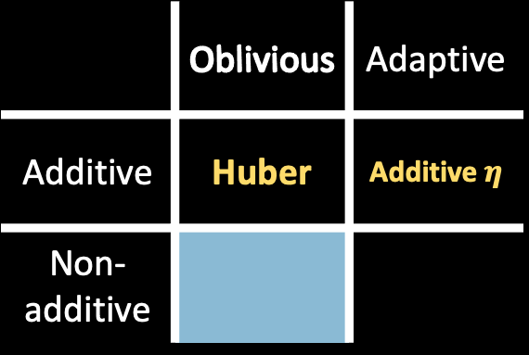
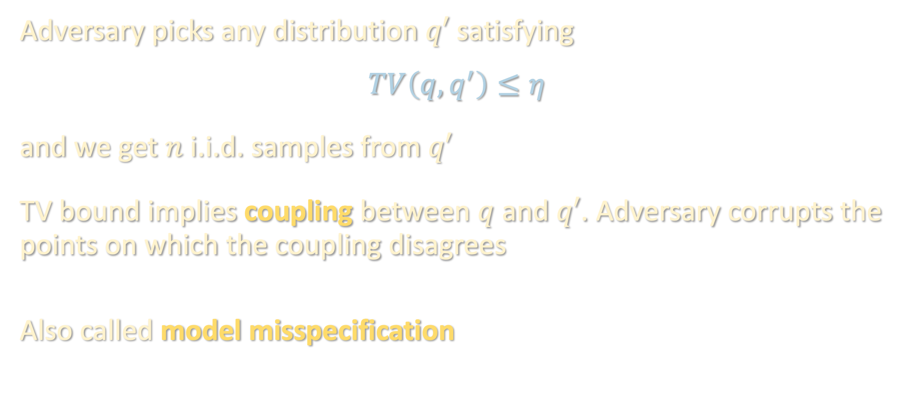
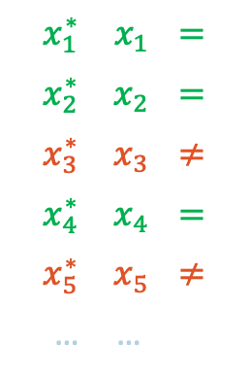
2B. TV CONTAMINATION
$$x_{1}^{∗}$$ | $$x_{1}$$ | $$=$$
$$x_{2}^{∗}$$ | $$x_{2}$$ | $$=$$
$$x_{3}^{∗}$$ | $$x_{3}$$ | $$≠$$
$$x_{4}^{∗}$$ | $$x_{4}$$ | $$=$$
$$x_{5}^{∗}$$ | $$x_{5}$$ | $$≠$$
… | …
Adversary picks any distribution $q′$ satisfying
$$TV\left(q,q^{′}\right)≤η$$
and we get $n$ i.i.d. samples from $q′$
TV bound implies coupling between $q$ and $q′$. Adversary corrupts the points on which the coupling disagrees
Also called model misspecification
 | Oblivious | Adaptive
Additive | Huber | Additive $η$
Non-additive

Slide 10
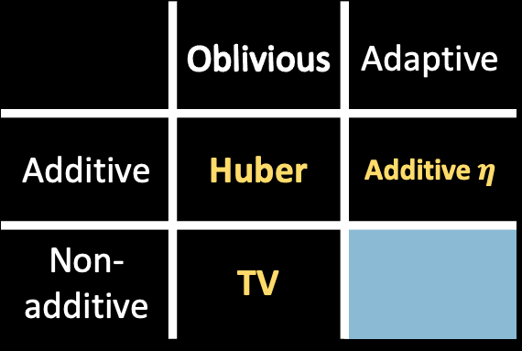
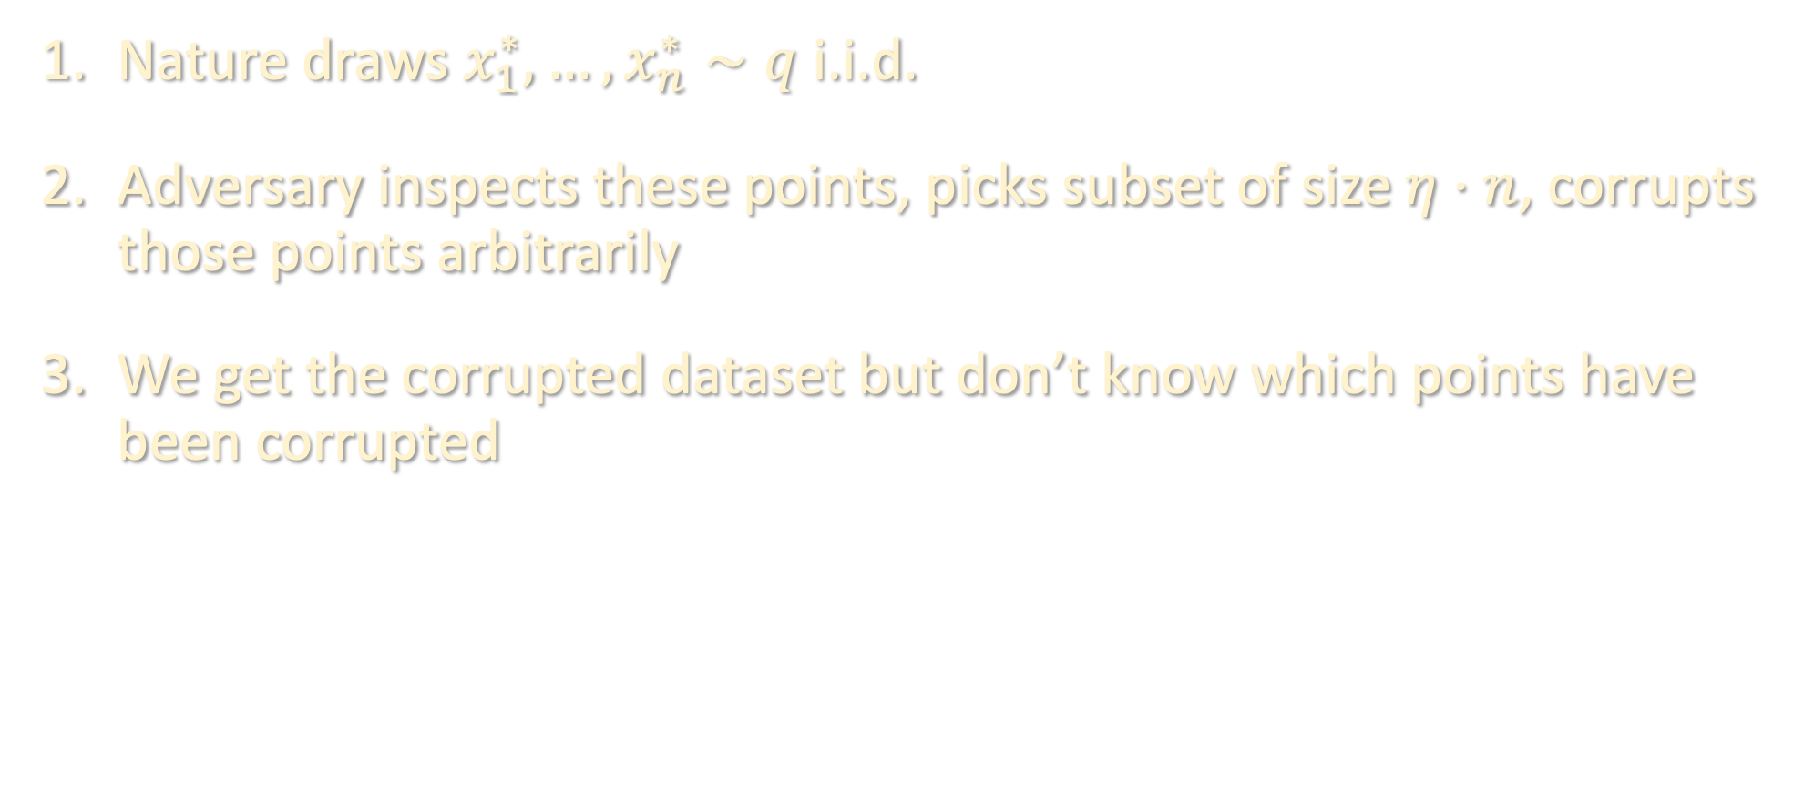
3. STRONG CONTAMINATION
Nature draws $x_{1}^{∗},…,x_{n}^{∗}∼q$ i.i.d.
Adversary inspects these points, picks subset of size $η⋅n$, corrupts those points arbitrarily
We get the corrupted dataset but don’t know which points have been corrupted
 | Oblivious | Adaptive
Additive | Huber | Additive $η$
Non-additive | TV

Slide 11
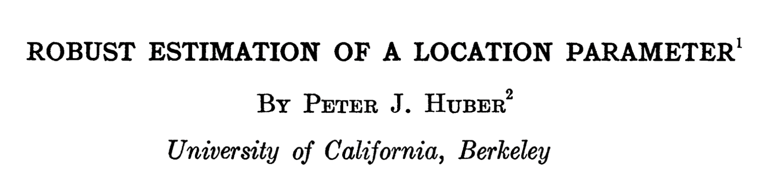
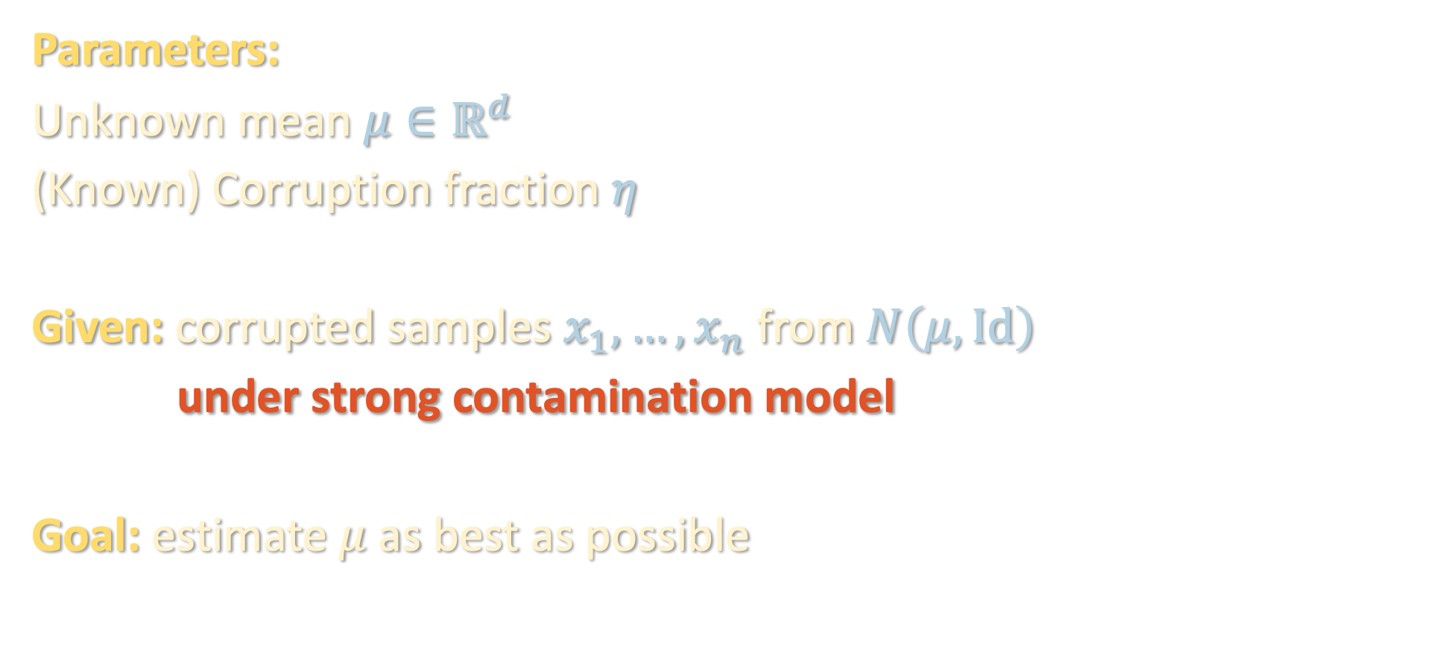
THIS LECTURE: ROBUST MEAN ESTIMATION
Parameters:
Unknown mean $μ∈ℝ^{d}$
(Known) Corruption fraction $η$
Given: corrupted samples $x_{1},…,x_{n}$ from $N\left(μ,Id\right)$
under strong contamination model
Goal: estimate $μ$ as best as possible

Slide 12
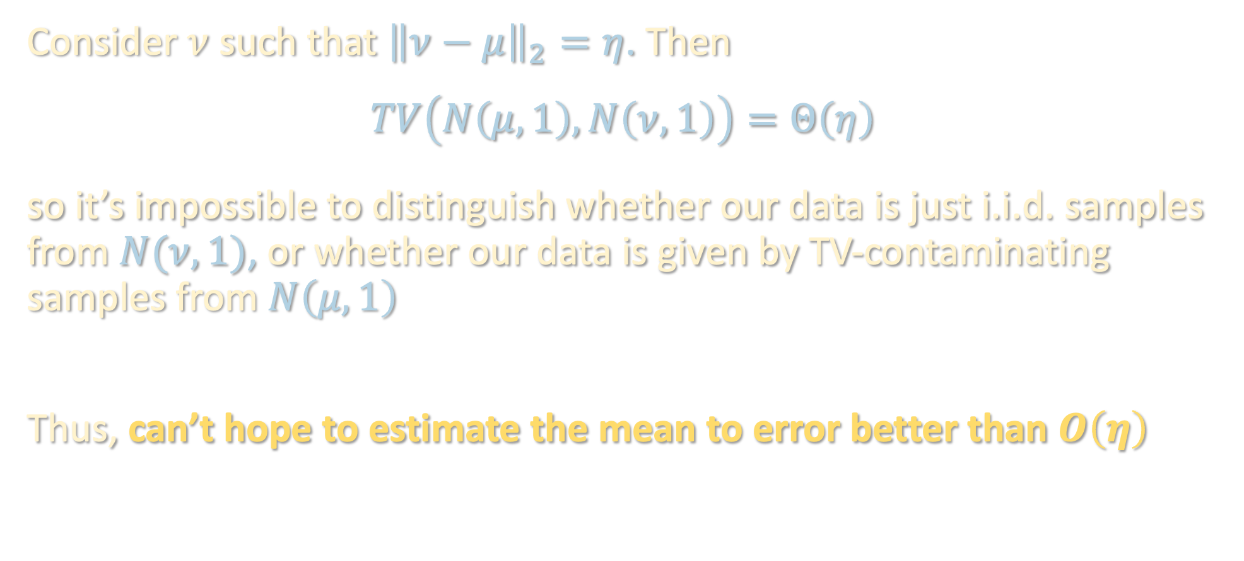
WHAT IS “AS BEST AS POSSIBLE”?
Consider $ν$ such that ${\left\|ν−μ\right\|}_{2}=η$. Then
$$TV\left(N\left(μ,1\right),N\left(ν,1\right)\right)=Θ\left(η\right)$$
so it’s impossible to distinguish whether our data is just i.i.d. samples from $N(ν,1)$, or whether our data is given by TV-contaminating samples from $N\left(μ,1\right)$
Thus, can’t hope to estimate the mean to error better than $O\left(η\right)$

Slide 13
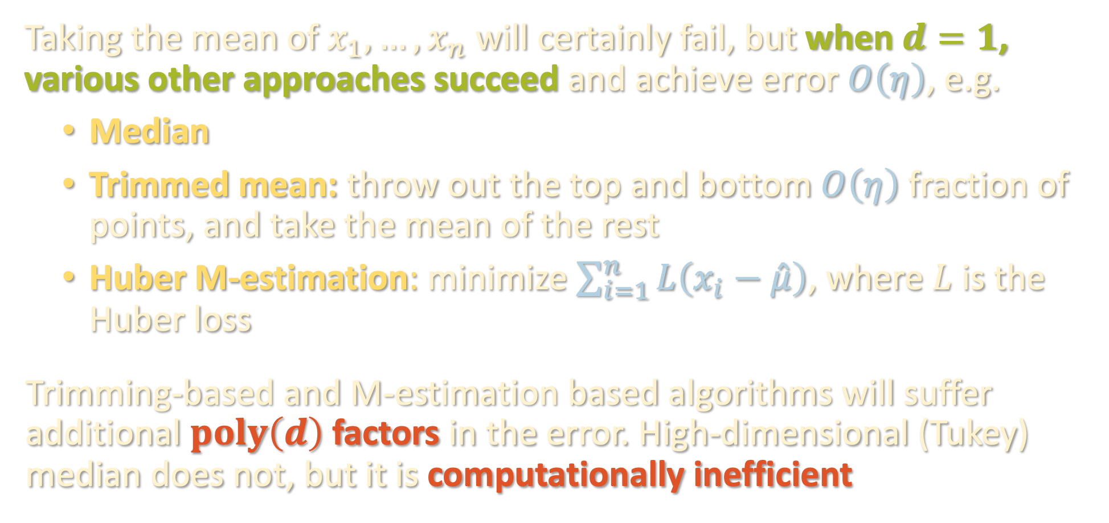
1-DIMENSIONAL PROBLEM IS EASY
Taking the mean of $x_{1},…,x_{n}$ will certainly fail, but when $d=1$, various other approaches succeed and achieve error $O\left(η\right)$, e.g.
Median
Trimmed mean: throw out the top and bottom $O\left(η\right)$ fraction of points, and take the mean of the rest
Huber M-estimation: minimize $\sum_{i=1}^{n}{L\left(x_{i}−\hat{μ}\right)}$, where $L$ is the Huber loss
Trimming-based and M-estimation based algorithms will suffer additional $poly\left(d\right)$ factors in the error. High-dimensional (Tukey) median does not, but it is computationally inefficient

Slide 14
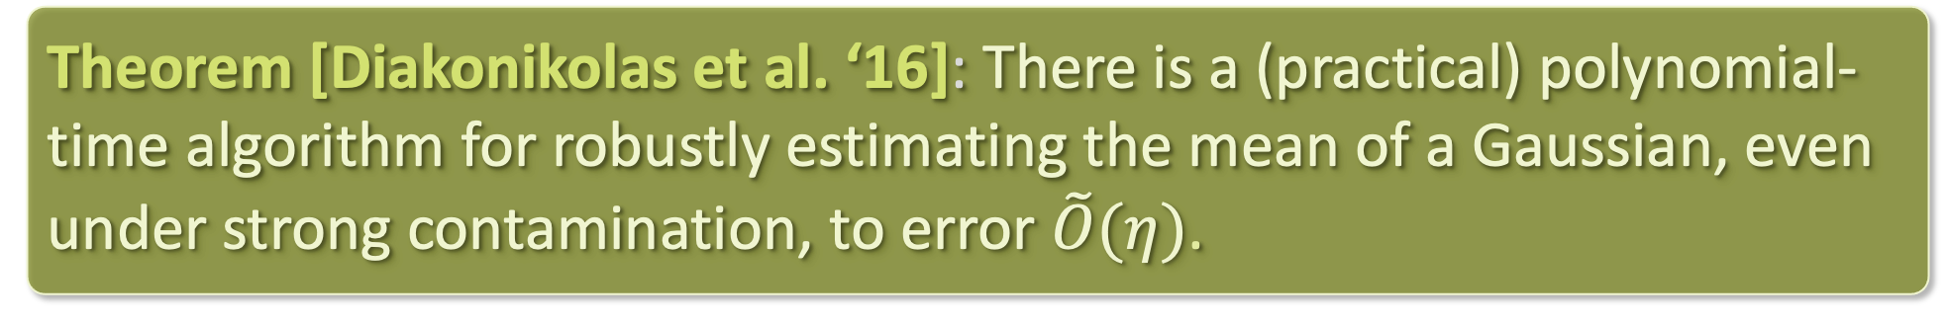
ROBUSTNESS IN HIGH DIMENSIONS
Prior to 2016, not known how to robustly estimate the mean of a high-dimensional Gaussian, even under the Huber contamination model, in polynomial time
Today we will see a proof of this based on a framework called iterative filtering that was developed by these and other authors
Theorem [Diakonikolas et al. ‘16]: There is a (practical) polynomial-time algorithm for robustly estimating the mean of a Gaussian, even under strong contamination, to error $\tilde{O}(η)$.

