Slide 1
CS 224: ALGORITHMS FOR DATA SCIENCE LECTURE 8 (10/2)
Tensor decomposition
Sum-of-squares
Robustness
Supervised learning
Computational complexity
Statistical physics
Generative modeling
SoS FOR TENSOR DECOMPOSITION - CONCLUSION

Slide 2
ANNOUNCEMENTS
Final project information up (see Canvas announcement)
Time-sensitive: sign up on Google Sheet (link in doc) by Oct 13, suggested topics/papers are first come first serve
My office hour: Thursday 3 – 4 to accommodate pset office hour at 4
Grades and solutions for pset 1 posted over next day or so

Slide 3
PLAN
Recap / wrap up SoS for noisy orthogonal tensor decomposition
Extension to overcomplete setting
Retrospective on SoS

Slide 4
NOISY ORTHOGONAL TENSOR DECOMPOSITION
$$T=\sum_{i=1}^{d}{u_{i}^{⊗3}+E}$$
where $u_{1},…,u_{k}$ are orthonormal
Last time: polynomial-time algorithm that can recover $u_{i}$’s up to small error as long as ${\left\|E\right\|}_{SOS_{6}}=o\left(1\right)$
Key idea: high-entropy constraints

Slide 5
NOISY ORTHOGONAL TENSOR DECOMPOSITION
Algorithm:
1. $\max_{\tilde{𝔼}}{\tilde{𝔼} \left\langle T, x^{⊗3}\right\rangle }$ over degree-6 pseudo-expectations $\tilde{𝔼}$ over $x$ s.t.
- $\tilde{𝔼}$ satisfies the constraint $\left\{{\left\|x\right\|}_{2}^{2}=1\right\}$
- High entropy: ${\left\|\tilde{𝔼}\left[xx^{⊤}\right]\right\|}_{op}≤\frac{1}{d}{,\left\|\tilde{𝔼}\left[\left(x⊗x\right){\left(x⊗x\right)}^{⊤}\right]\right\|}_{op}≤\frac{1}{d}$,
${\left\|\tilde{𝔼}\left[\left(x⊗x⊗x\right){\left(x⊗x⊗x\right)}^{⊤}\right]\right\|}_{op}≤\frac{1}{d}$
2. Let $\tilde{T}=\tilde{𝔼}\left[x^{⊗4}\right]$
3. Apply Jennrich’s to $\tilde{T}$ many times, i.e. take top eigenvector of
$$\tilde{T}\left(g,:,:\right)=\tilde{𝔼}\left[\left\langle g,x⊗x\right\rangle xx^{⊤}\right]$$
for $poly(d)$ many samples $g∼N\left(0,{Id}_{d^{2}}\right)$

Slide 6
NOISY ORTHOGONAL TENSOR DECOMPOSITION
Lemma: For any optimal $\tilde{𝔼}$, for $1−o\left(1\right)$ fraction of $i∈\left[d\right]$,
$$\tilde{𝔼}\left[{\left\langle u_{i},x\right\rangle }^{4}\right]≥\frac{1}{d}\left(1−o\left(1\right)\right)$$
Recall proof:
Because we’re maximizing $\tilde{𝔼}\left[\left\langle T,x^{⊗3}\right\rangle \right]$, and uniform distribution over $u_{1},…,u_{d}$ is valid pseudo-exp., $\tilde{𝔼}\left[{\sum_{i}{\left\langle u_{i},x\right\rangle }}^{3}\right]≥1 −o\left(1\right)$
Can prove ${\sum_{i}{\left\langle u_{i},x\right\rangle }}^{4}≥1 −o\left(1\right)$ using ${\sum_{i}{\left\langle u_{i},x\right\rangle }}^{3}≥1−o\left(1\right)$ and Cauchy-Schwarz (low-degree SoS proof)
Entropy constraints + averaging argument imply the lemma

Slide 7
NOISY ORTHOGONAL TENSOR DECOMPOSITION
Theorem: For any optimal $\tilde{𝔼}$ and any $a∈ℝ^{d}$ satisfying $\tilde{𝔼}\left[{\left\langle a,x\right\rangle }^{4}\right]≥\frac{1}{d}\left(1−o\left(1\right)\right)$, if $g∼N\left(0, {Id}_{d^{2}}\right)$ then with prob. at least $1/poly\left(d\right)$, the top eigenvector $v$ of $\tilde{𝔼}\left[\left\langle g,x⊗x\right\rangle xx^{⊤}\right]$ satisfies ${\left\langle a,v\right\rangle }^{2}≥0.99$
(See board)

Slide 8
SoS RETROSPECTIVE
In the past four lectures and the pset, we saw applications of SoS to
Robust mean estimation
Robust regression [Klivans-Kothari-Meka ‘18]
Learning mixtures of Gaussians down to the optimal separation threshold [Kothari-Steinhardt-Steurer ‘17], [Hopkins-Li ‘17]
Tensor decomposition w/ “maximal” noise [Ge-Ma ‘15], [Ma-Shi-Steurer ‘16]
Overcomplete tensor decomposition with (conjectured) optimal # random components [Ge-Ma ‘15], [Ma-Shi-Steurer ‘16]
Each of these was a significant breakthrough at the time
Elephant in the room: provably correct, but totally impractical

Slide 9
SoS RETROSPECTIVE
In the past four lectures and the pset, we saw applications of SoS to
Robust mean estimation
Robust regression [Klivans-Kothari-Meka ‘18]
Learning mixtures of Gaussians down to the optimal separation threshold [Kothari-Steinhardt-Steurer ‘17], [Hopkins-Li ‘17]
Tensor decomposition w/ “maximal” noise [Ge-Ma ‘15], [Ma-Shi-Steurer ‘16]
Overcomplete tensor decomposition with (conjectured) optimal # random components [Ge-Ma ‘15], [Ma-Shi-Steurer ‘16]
Each of these was a significant breakthrough at the time
Elephant in the room: provably correct, but totally impractical
Next unit: fast, practical algorithms for robust statistics
[Li-Liu ‘21]: more efficient algorithm that only implicitly works with moment tensor
[Hopkins et al. ‘15], [Ding et al. ’22]: fast spectral algorithms “inspired” by SoS

Slide 10
EXTRACTING FASTER ALGORITHMS
[Hopkins-Schramm-Shi-Steurer ‘15]: $k≪d^{4/3}$
Key step in the SoS analysis was to bound
$$“junk”=\sum_{i≠j}{\left\langle u_{i},u_{j}\right\rangle ⋅\left(u_{i}⊗u_{j}\right){\left(u_{i}⊗u_{j}\right)}^{⊤}}$$
This looks very similar to the “off-diagonal” terms in the reshaping of $T^{⊗2}$:
$$S≝\sum_{i,j}{\left(u_{i}⊗u_{j}\right)⊗\left(u_{i}⊗u_{j}\right)⊗\left(u_{i}⊗u_{j}\right)}$$
They show an appropriate random contraction of $S$ (against another copy of $T$) has top eigenvector close to a component
$$=\sum_{i}{u_{i}^{⊗2}⊗u_{i}^{⊗2}⊗u_{i}^{⊗2}}+\sum_{i≠j}{\left(u_{i}⊗u_{j}\right)⊗\left(u_{i}⊗u_{j}\right)⊗\left(u_{i}⊗u_{j}\right)}$$

Slide 11
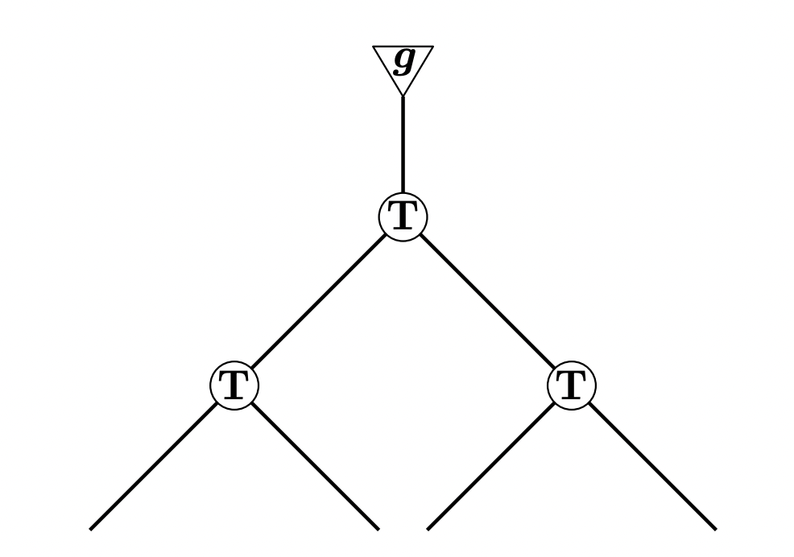
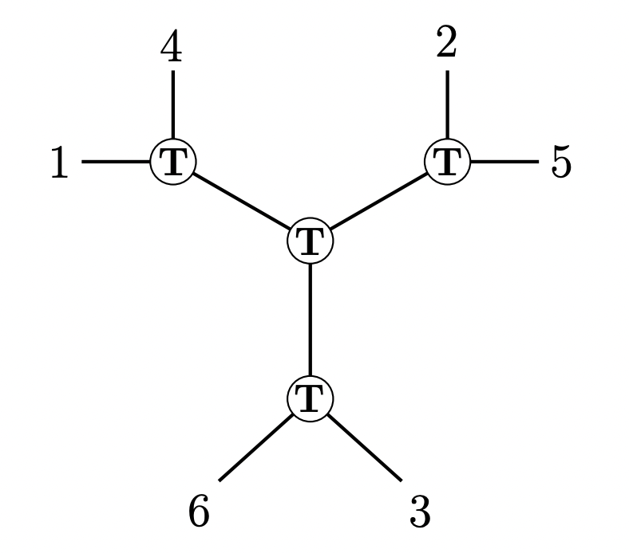
EXTRACTING FASTER ALGORITHMS
[Ding-D’Orsi-Liu-Steurer-Tiegel ‘22]: $k≪d^{3/2}$
Designed more sophisticated tensor network for which an appropriate random contraction has top eigenvector aligned with a component

Slide 12
PROVING UPPER BOUNDS
Disclaimer: goal not necessarily to invent or analyze algorithms meant for immediate practical deployment
Goals:
Find signatures of tractability: identify properties of data-generating process that algorithms can “latch onto”
Map the frontier: identify tasks on the edge of being provably possible (popular algorithms in practice often don’t suffice)
Develop frameworks: meta-algorithms that could become practically useful heuristics
$n^{1000}$ time and samples
optimal sample complexity, near-linear runtime, parallelizable
SoS
Notes:
These might appear a little abstract right now, but this may be a good framing to keep in mind as you progress through the course.

Slide 13
PROVING UPPER BOUNDS
Disclaimer: goal not necessarily to invent or analyze algorithms meant for immediate practical deployment
Goals:
In heterogeneous / corrupted data, true clusters / clean points uniquely ID’d by "moment bounds”
Benign nonconvex optimization landscapes unaffected by vanishing “low-degree noise”
Find signatures of tractability: identify properties of data-generating process that algorithms can “latch onto”
Map the frontier: identify tasks on the edge of being provably possible (popular algorithms in practice often don’t suffice)
Develop frameworks: meta-algorithms that could become practically useful heuristics
Two examples (Gaussian mixtures and noisy/overcomplete tensor decomposition) reaching optimal statistical/computational thresholds
$n^{1000}$ time and samples
optimal sample complexity, near-linear runtime, parallelizable
SoS
Notes:
These might appear a little abstract right now, but this may be a good framing to keep in mind as you progress through the course.

Slide 14
TAKEAWAYS
SoS is a powerful “programming language” for focusing most of the difficulty of algorithm design into the analysis
“Low-degree” proof for inefficient algorithm usually implies an efficient algorithm.
Sometimes requires a little careful massaging to get the right rounding algorithm (e.g. entropy maximization, Jennrich’s + high-entropy constraints, etc.)
While not practical, gives hint of tractability. Follow-up works often extract faster algorithms from features of the SoS analysis
Notes:
These might appear a little abstract right now, but this may be a good framing to keep in mind as you progress through the course.

Slide 15
LOOKING AHEAD
sum-of-squares
optimization
robust statistics
tensors
Notes:
These might appear a little abstract right now, but this may be a good framing to keep in mind as you progress through the course.

