Slide 1

CS 224: ALGORITHMS FOR DATA SCIENCE
LECTURE 4 (9/18)
Tensor decomposition
Sum-of-squares
Robustness
Supervised learning
Computational complexity
Statistical physics
Generative modeling
SMOOTHED ANALYSIS AND OVERCOMPLETE TENSORS

Slide 2
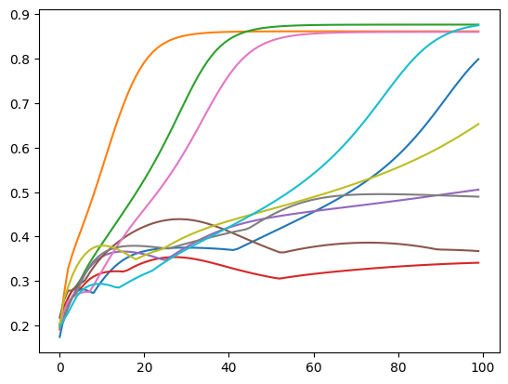



OVERCOMPLETE TENSOR DECOMPOSITION
Last time we saw several shortcomings of Jennrich’s
Practical: noise robustness, runtime
Practical + theoretical: cannot handle $k>d$
“overcomplete setting”
dimensions
e.g. # components in mixture model
$$d=400$$
$$k=8000$$

Slide 3
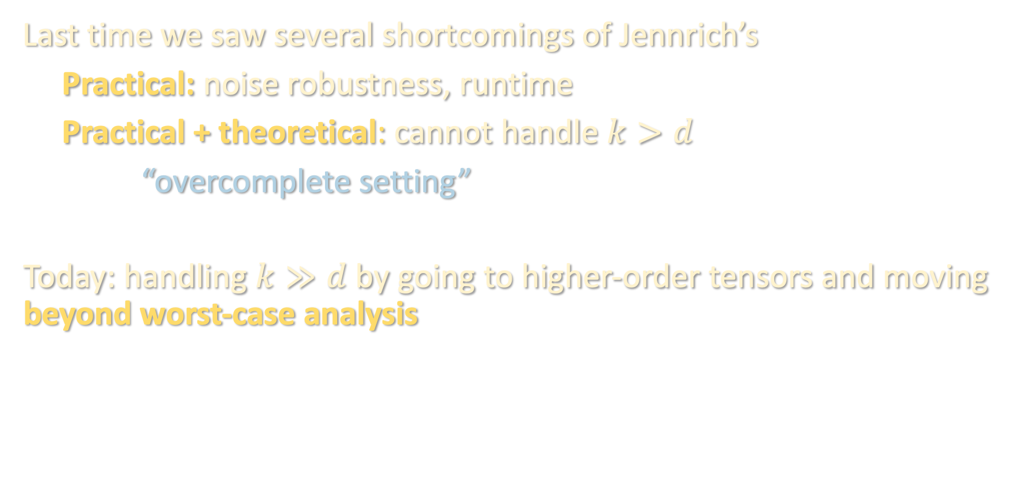
OVERCOMPLETE TENSOR DECOMPOSITION
Last time we saw several shortcomings of Jennrich’s
Practical: noise robustness, runtime
Practical + theoretical: cannot handle $k>d$
“overcomplete setting”
Today: handling $k≫d$ by going to higher-order tensors and moving beyond worst-case analysis
dimensions
e.g. # components in mixture model

Slide 4
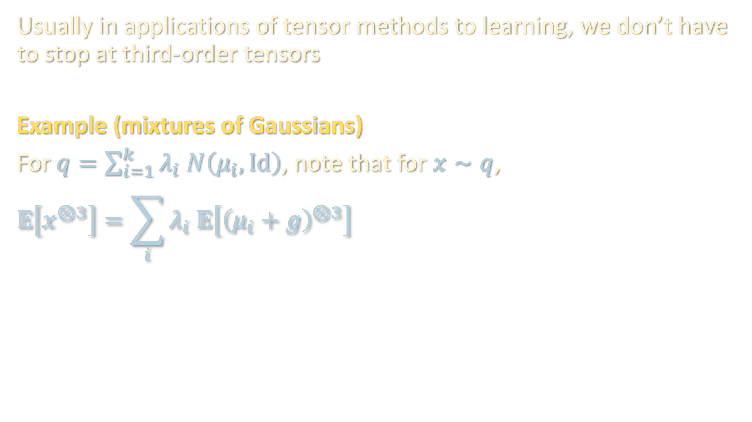
USING HIGHER ORDER TENSORS
Usually in applications of tensor methods to learning, we don’t have to stop at third-order tensors
Example (mixtures of Gaussians)
For $q=\sum_{i=1}^{k}{λ_{i} N\left(μ_{i},Id\right)}$, note that for $x∼q$,
$$𝔼\left[x^{⊗3}\right]=\sum_{i}{λ_{i} 𝔼\left[{\left(μ_{i}+g\right)}^{⊗3}\right]}$$

Slide 5
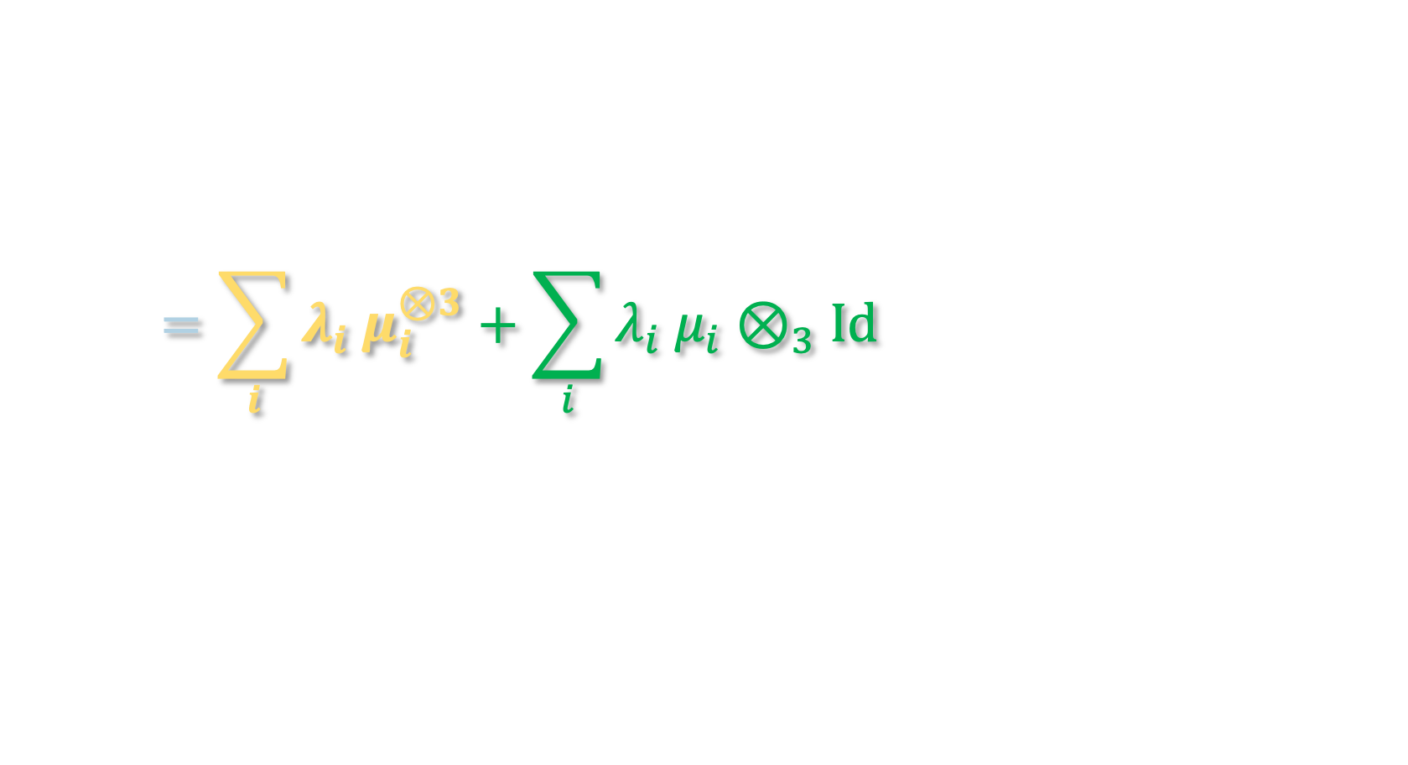
USING HIGHER ORDER TENSORS
Usually in applications of tensor methods to learning, we don’t have to stop at third-order tensors
Example (mixtures of Gaussians)
For $q=\sum_{i=1}^{k}{λ_{i} N\left(μ_{i},Id\right)}$, note that for $x∼q$,
$$𝔼\left[x^{⊗3}\right]=\sum_{i}{λ_{i} 𝔼\left[{\left(μ_{i}+g\right)}^{⊗3}\right]}$$
$$=\sum_{i}{λ_{i} μ_{i}^{⊗3}}+\sum_{i}{λ_{i} μ_{i}⊗_{3}Id}$$

Slide 6
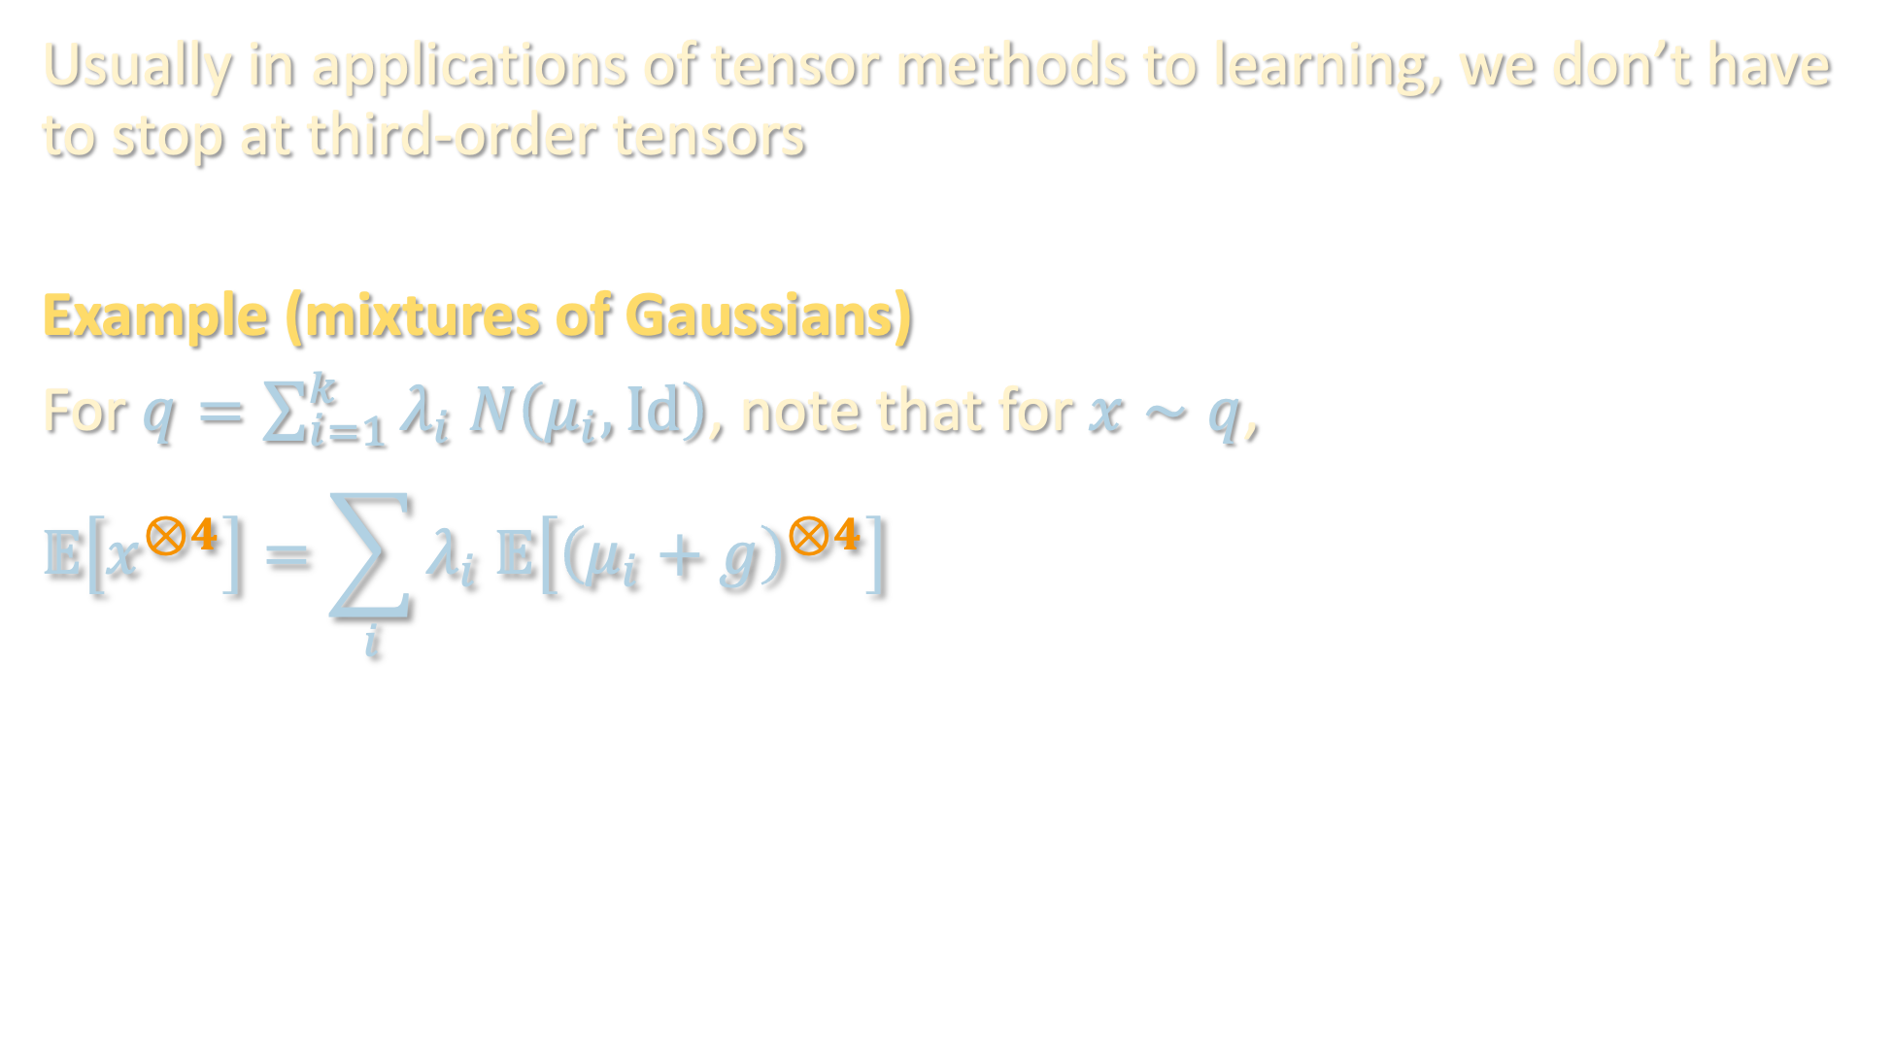
USING HIGHER ORDER TENSORS
Usually in applications of tensor methods to learning, we don’t have to stop at third-order tensors
Example (mixtures of Gaussians)
For $q=\sum_{i=1}^{k}{λ_{i} N\left(μ_{i},Id\right)}$, note that for $x∼q$,
$$𝔼\left[x^{⊗4}\right]=\sum_{i}{λ_{i} 𝔼\left[{\left(μ_{i}+g\right)}^{⊗4}\right]}$$

Slide 7
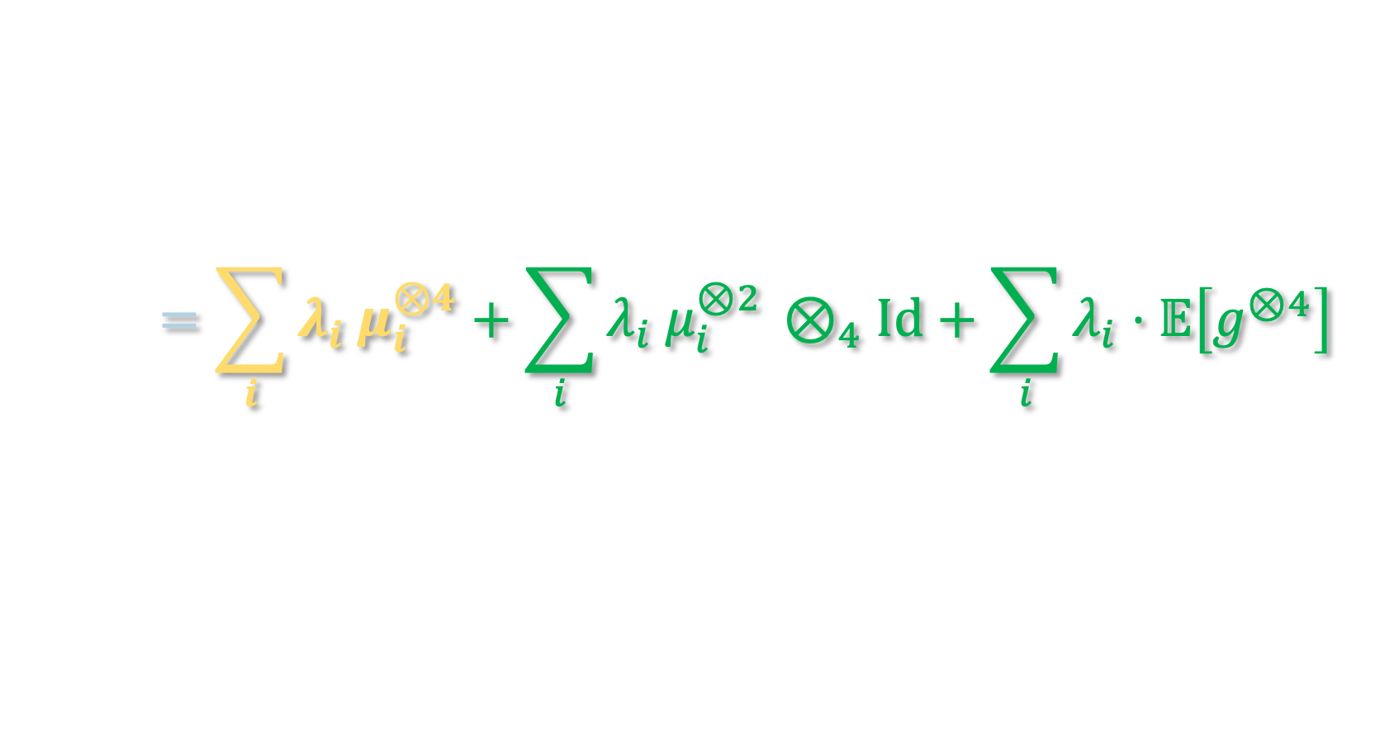
USING HIGHER ORDER TENSORS
Usually in applications of tensor methods to learning, we don’t have to stop at third-order tensors
Example (mixtures of Gaussians)
For $q=\sum_{i=1}^{k}{λ_{i} N\left(μ_{i},Id\right)}$, note that for $x∼q$,
$$𝔼\left[x^{⊗4}\right]=\sum_{i}{λ_{i} 𝔼\left[{\left(μ_{i}+g\right)}^{⊗4}\right]}$$
i.e. by looking at higher moments of the data, can access higher-order tensors!
$$=\sum_{i}{λ_{i} μ_{i}^{⊗4}}+\sum_{i}{λ_{i} μ_{i}^{⊗2 }⊗_{4}Id}+\sum_{i}{λ_{i}⋅𝔼\left[g^{⊗4}\right]}$$

Slide 8
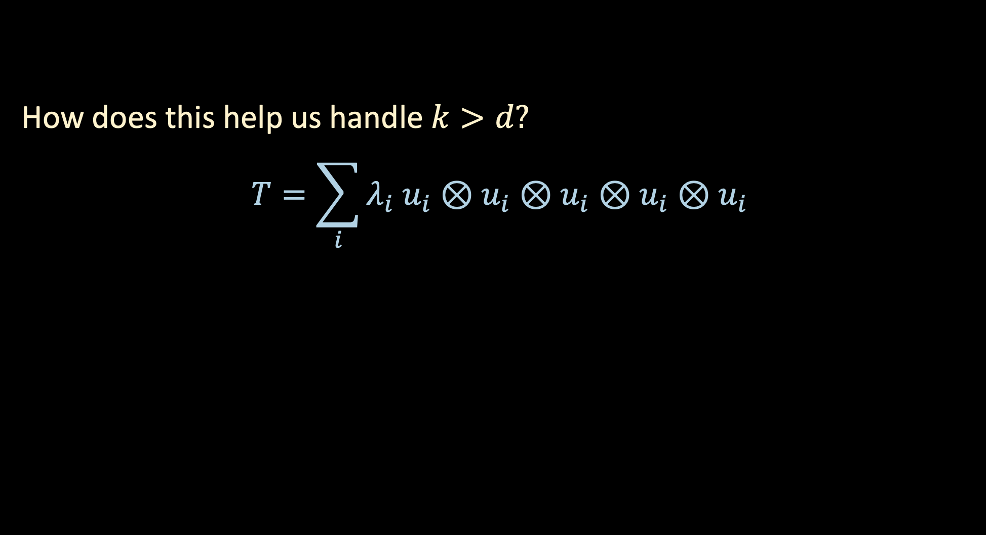
USING HIGHER ORDER TENSORS
How does this help us handle $k>d?$
$$T=\sum_{i}{λ_{i} u_{i}⊗u_{i}⊗u_{i}⊗u_{i}⊗u_{i}}$$

Slide 9
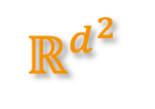
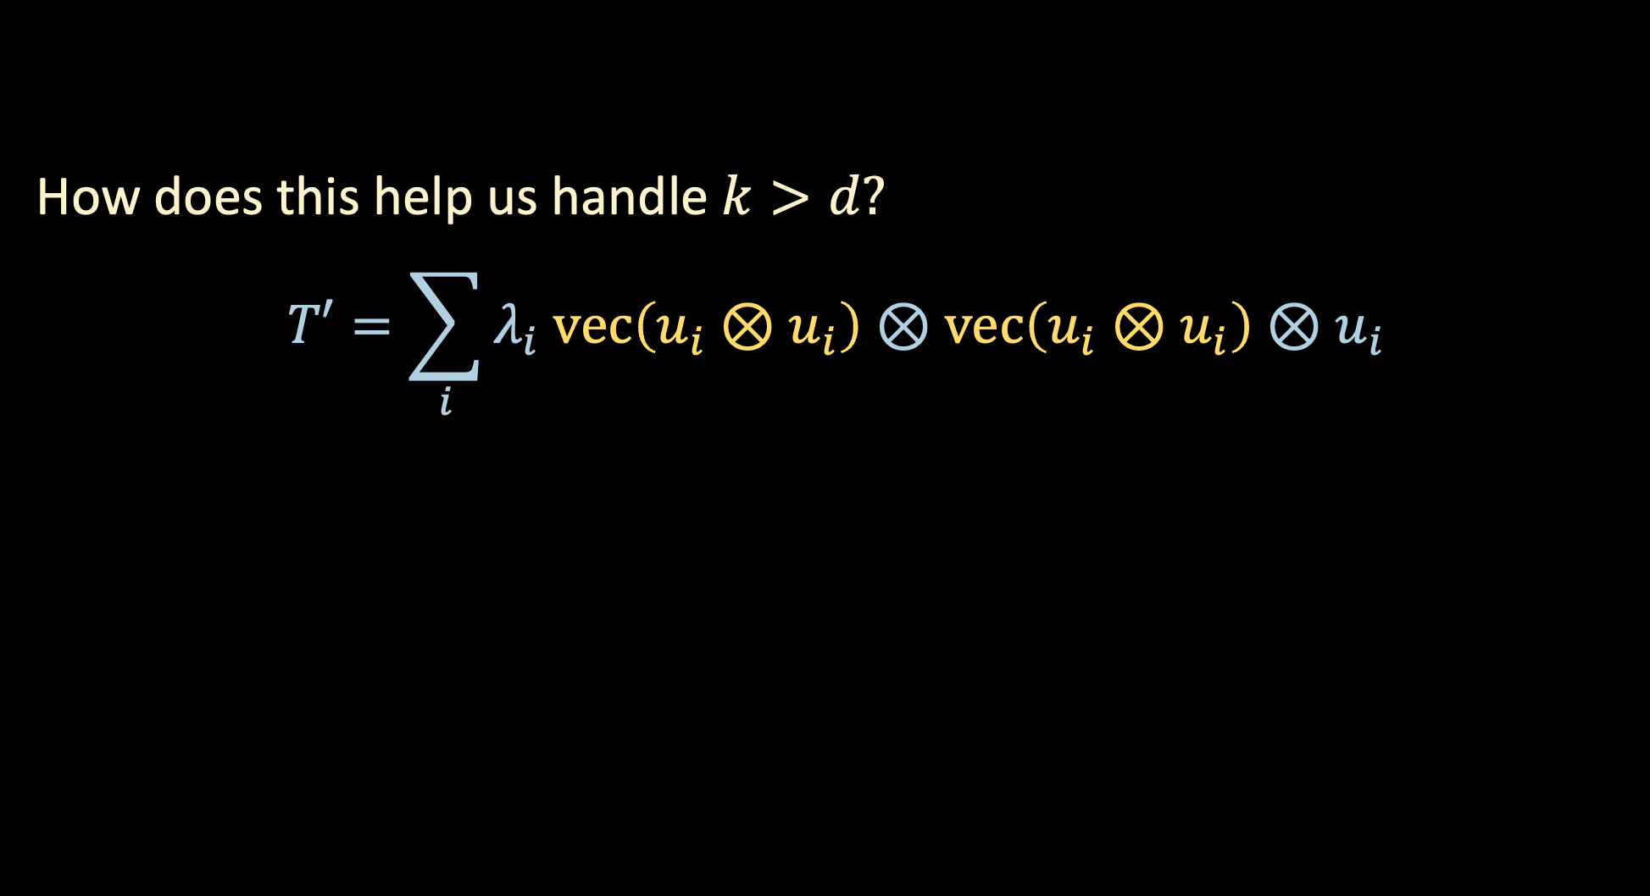

USING HIGHER ORDER TENSORS
How does this help us handle $k>d?$
$$T′=\sum_{i}{λ_{i} vec\left(u_{i}⊗u_{i}\right)⊗vec\left(u_{i}⊗u_{i}\right)⊗u_{i}}$$
$$ℝ^{d^{2}}$$
$$ℝ^{d^{2}}$$

Slide 10
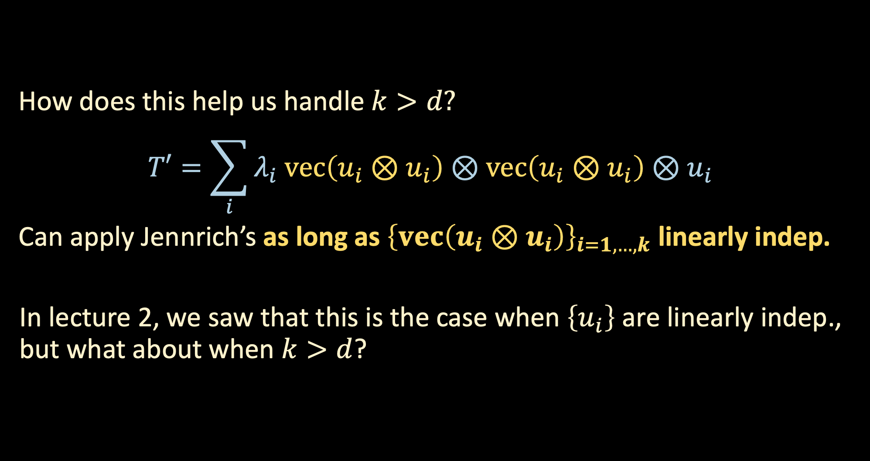
USING HIGHER ORDER TENSORS
How does this help us handle $k>d?$
$$T′=\sum_{i}{λ_{i} vec\left(u_{i}⊗u_{i}\right)⊗vec\left(u_{i}⊗u_{i}\right)⊗u_{i}}$$
Can apply Jennrich’s as long as ${\left\{vec\left(u_{i}⊗u_{i}\right)\right\}}_{i=1,…,k}$ linearly indep.
In lecture 2, we saw that this is the case when $\left\{u_{i}\right\}$ are linearly indep., but what about when $k>d$?
Hope: $vec\left(u_{i}⊗u_{i}\right)$’s $d^{2}$-dimensional, so can even handle $k∼d^{2}$

Slide 11
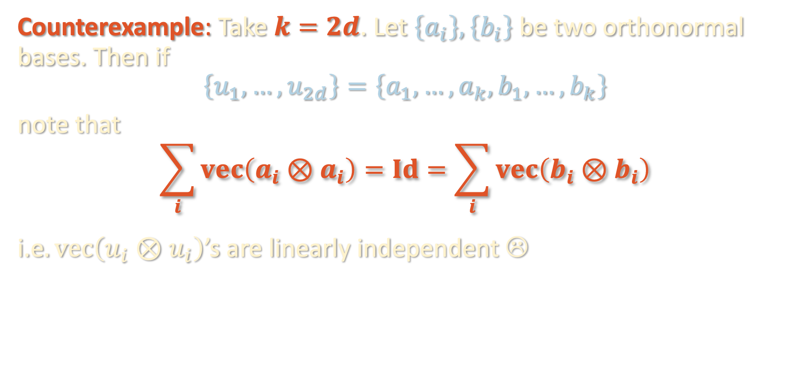
USING HIGHER ORDER TENSORS
Hope: $vec\left(u_{i}⊗u_{i}\right)$’s $d^{2}$-dimensional, so can even handle $k∼d^{2}$
Counterexample: Take $k=2d$. Let $\left\{a_{i}\right\}, \left\{b_{i}\right\}$ be two orthonormal bases. Then if
$$\left\{u_{1},…,u_{2d}\right\}=\left\{a_{1},…,a_{k},b_{1},…, b_{k}\right\}$$
note that
$$\sum_{i}{vec\left(a_{i}⊗a_{i}\right)}=Id=\sum_{i}{vec\left(b_{i}⊗b_{i}\right)}$$
i.e$. vec\left(u_{i}⊗u_{i}\right)$’s are linearly independent ☹

Slide 12
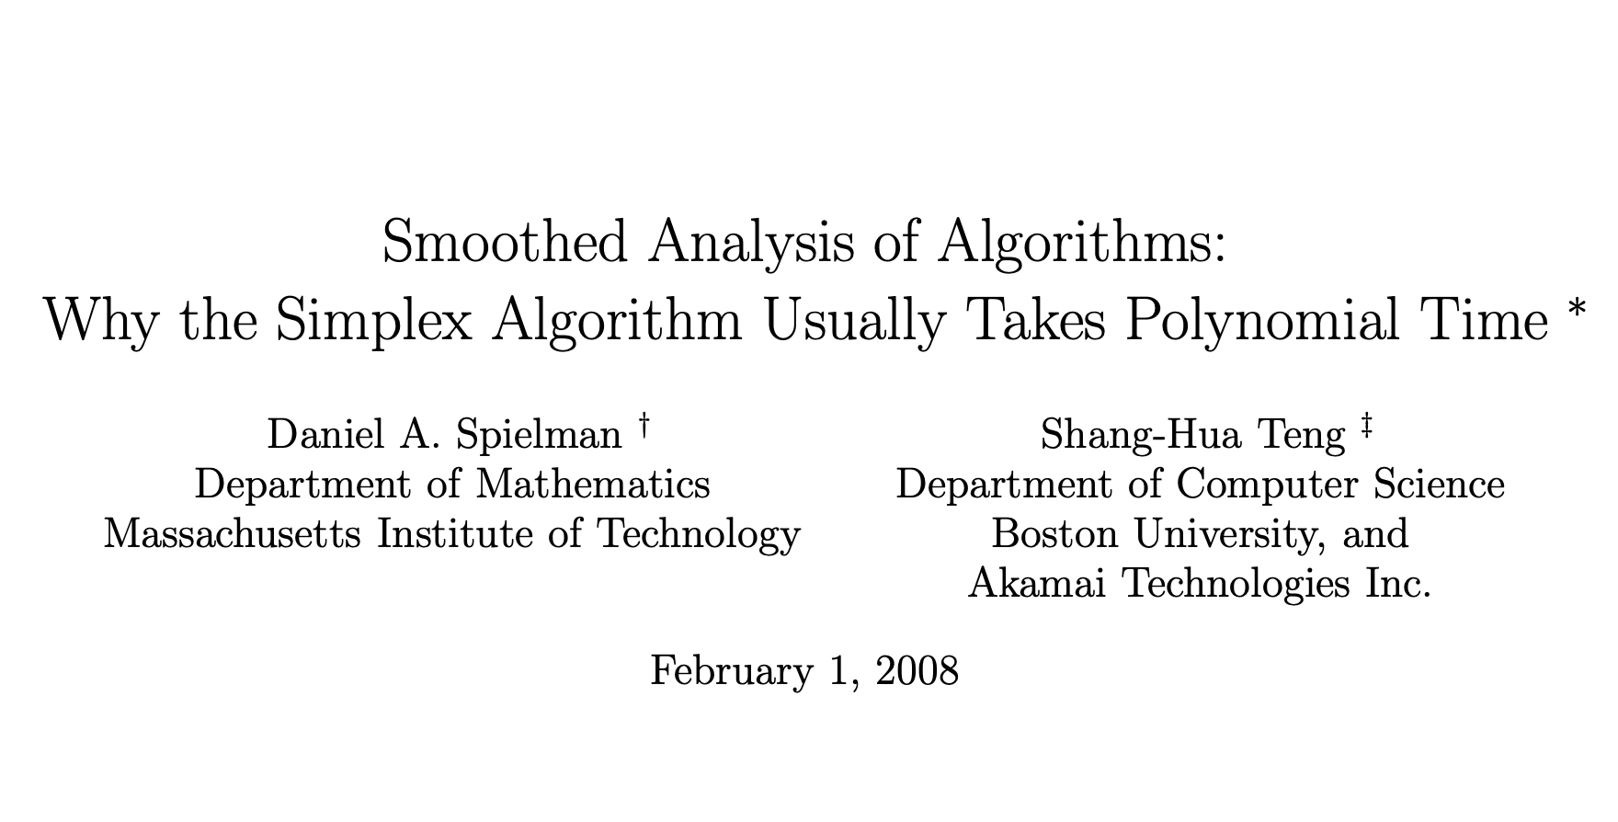
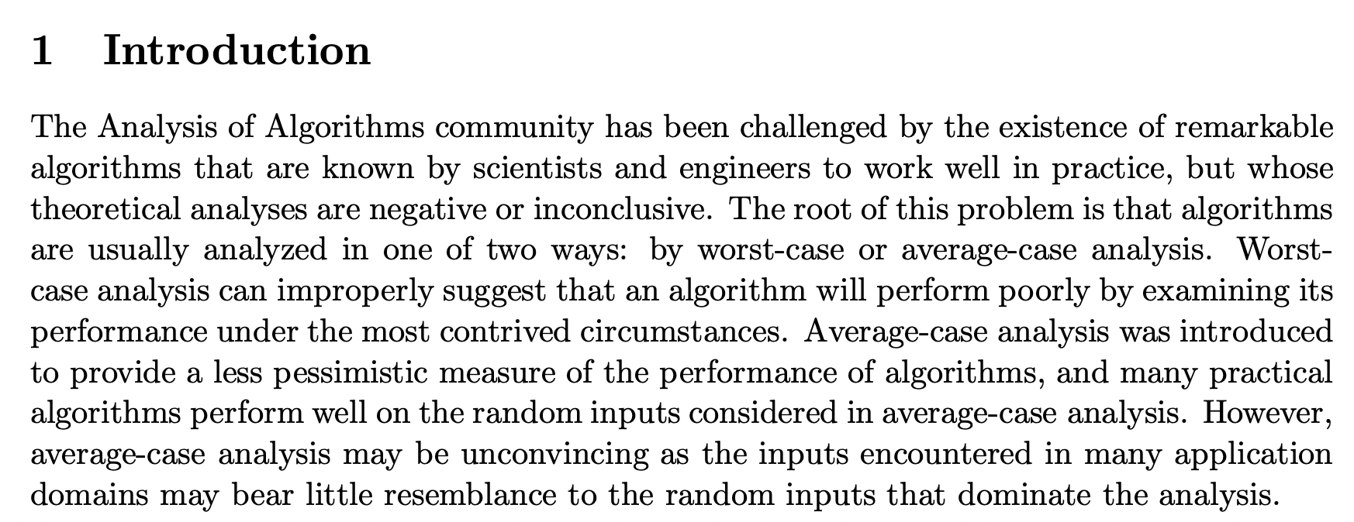
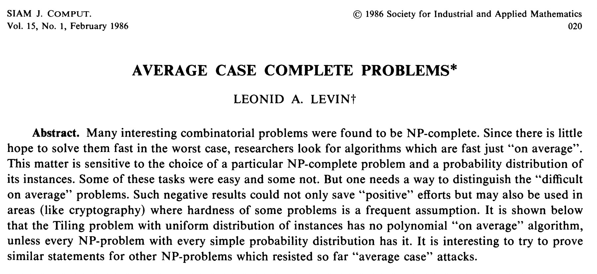
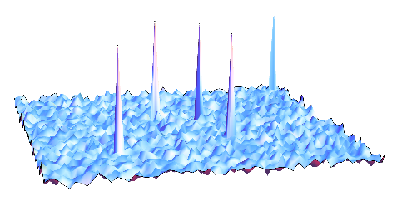

BEYOND WORST-CASE ANALYSIS
In reality, the unknown components of a tensor problem will not have such delicate structure (union of two orthonormal bases)
Perspective 1: For “random” problem instances, $ℙ$[hard instance] small
“Average-case analysis”
hardness

Slide 13

BEYOND WORST-CASE ANALYSIS
In reality, the unknown components of a tensor problem will not have such delicate structure (union of two orthonormal bases)
Perspective 2: For arbitrary problem instance, if we add small amount of noise to the instance, $ℙ$[{instance + noise} still hard] small
“Smoothed analysis” – meant to better model “real-world” instances
hardness

Slide 14
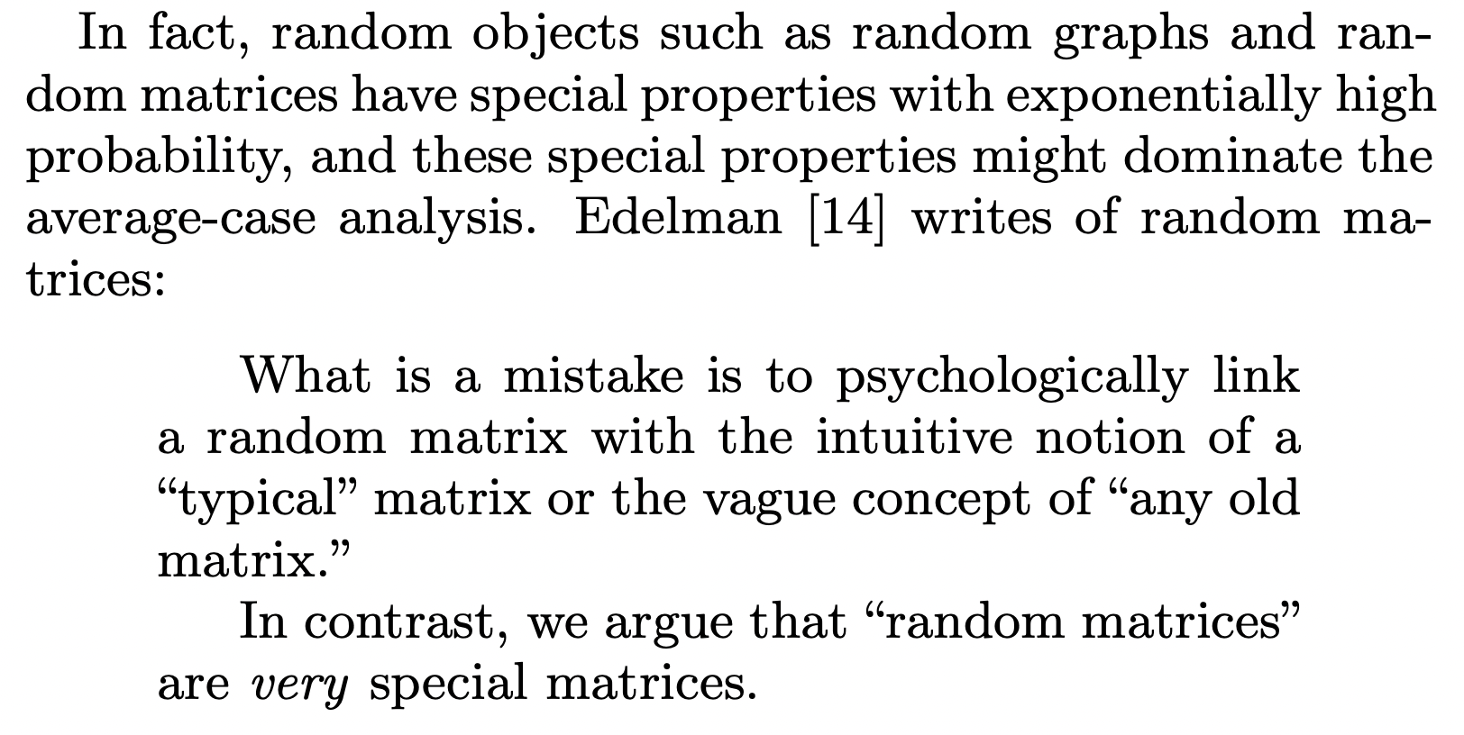
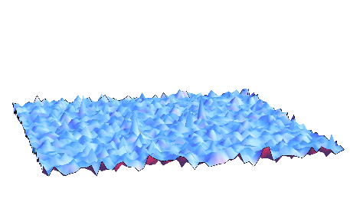
BEYOND WORST-CASE ANALYSIS
In reality, the unknown components of a tensor problem will not have such delicate structure (union of two orthonormal bases)
Perspective 2: For arbitrary problem instance, if we add small amount of noise to the instance, $ℙ$[{instance + noise} still hard] small
“Smoothed analysis” – meant to better model “real-world” instances
hardness

Slide 15
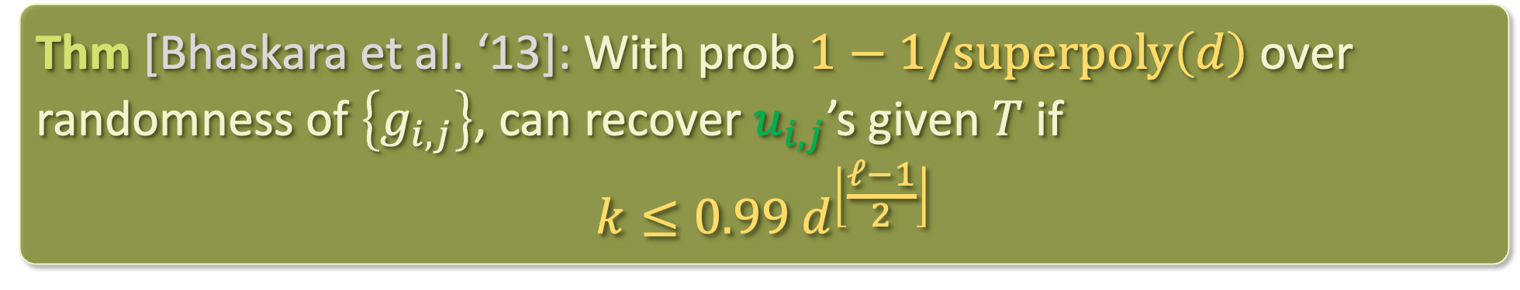

SMOOTHED ANALYSIS OF TENSOR DECOMPOSITION
Model:
$ρ>0$ “smoothing parameter”, $k=$ # components, $ℓ=$ order of tensor
Nature picks arbitrary vectors $\left\{u_{i,j}^{′}\right\}$ for $i∈\left[k\right], j∈[ℓ]$
Nature samples $u_{i,j}=u_{i,j}^{′}+\frac{ρ}{\sqrt{d}}⋅g_{i,j}$ for $g_{i,j}∼N\left(0,Id\right)$
We observe $T=\sum_{i}{u_{i,1}⊗⋯⊗u_{i,ℓ}}$
Thm [Bhaskara et al. ‘13]: With prob $1−1/superpoly\left(d\right)$ over randomness of $\left\{g_{i,j}\right\}$, can recover $u_{i,j}$’s given $T$ if
$$k≤0.99 d^{\left\lfloor \frac{ℓ−1}{2}\right\rfloor }$$

Slide 16
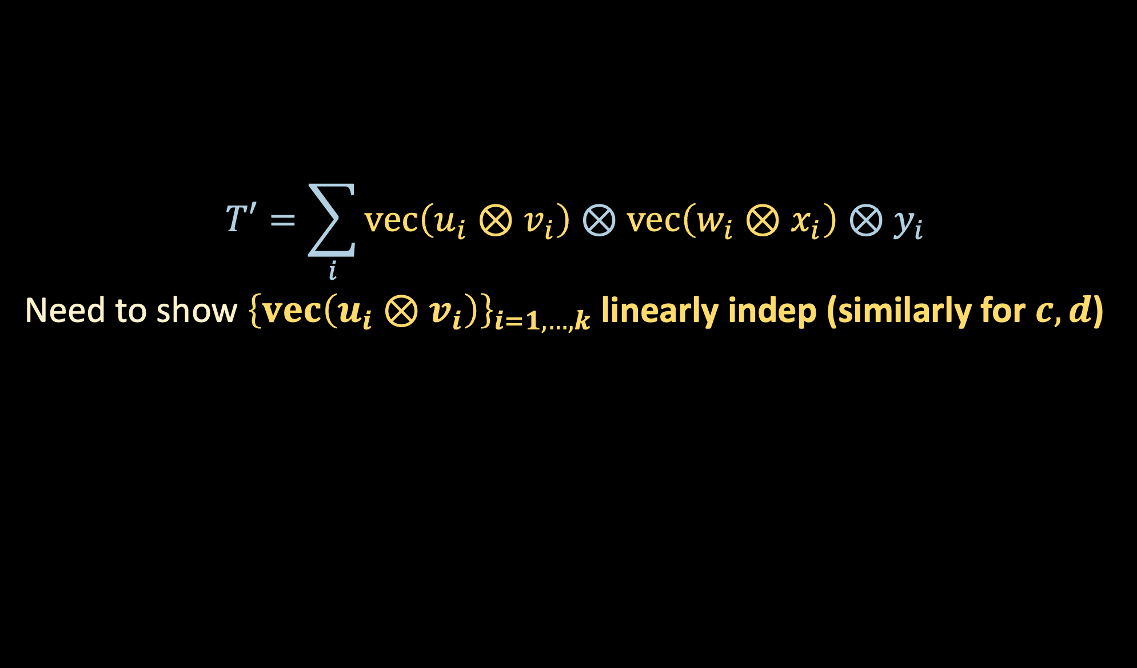
USING HIGHER ORDER TENSORS
$$T′=\sum_{i}{vec\left(u_{i}⊗v_{i}\right)⊗vec\left(w_{i}⊗x_{i}\right)⊗y_{i}}$$
Need to show ${\left\{vec\left(u_{i}⊗v_{i}\right)\right\}}_{i=1,…,k}$ linearly indep (similarly for $c,d$)

Slide 17
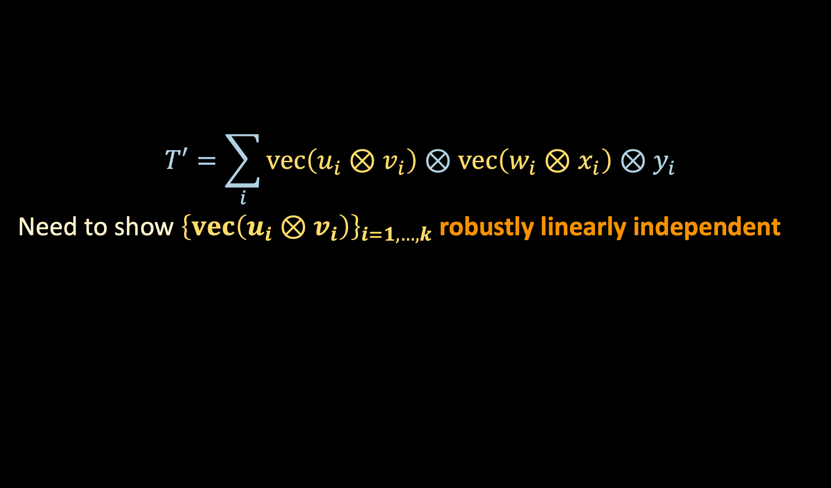
USING HIGHER ORDER TENSORS
$$T′=\sum_{i}{vec\left(u_{i}⊗v_{i}\right)⊗vec\left(w_{i}⊗x_{i}\right)⊗y_{i}}$$
Need to show ${\left\{vec\left(u_{i}⊗v_{i}\right)\right\}}_{i=1,…,k}$ robustly linearly independent

Slide 18




USING HIGHER ORDER TENSORS
$$U⊙V≝$$
$$vec\left(u_{1}⊗v_{1}\right)$$
$$⋯$$
$$vec\left(u_{k}⊗v_{k}\right)$$
“Khatri-Rao product”

Slide 19
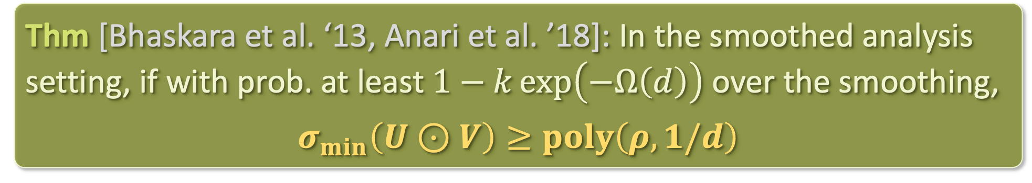
MAIN STEP
Thm [Bhaskara et al. ‘13, Anari et al. ’18]: In the smoothed analysis setting, if with prob. at least $1−k\exp\left(−Ω\left(d\right)\right)$ over the smoothing,
$$σ_{min}\left(U⊙V\right)≥poly\left(ρ,1/d\right)$$
Proof: see board

Slide 20
TAKEAWAYS
To handle # components > # dimensions, go to higher order tensors by taking higher order moments
Can get a lot of mileage out of going beyond worst-case analysis
Warning about average-case analysis: “random instances” are not a good proxy for “real-world instances”
Anti-concentration is a powerful tool for exploiting the randomness of the smoothing in smoothed analysis

Slide 21

LOOKING AHEAD
sum-of-squares
optimization
tensors

