Slide 1

CS 224: ALGORITHMS FOR DATA SCIENCE
LECTURE 3 (9/13)
Tensor decomposition
Sum-of-squares
Robustness
Supervised learning
Computational complexity
Statistical physics
Generative modeling
ITERATIVE METHODS FOR TENSOR DECOMPOSITION

Slide 2
ANNOUNCEMENTS
Pset 1 out, due Friday Sep 22 3:59pm
Weekly office hours:
  Rosie: Monday 11-12, SEC 2.330
  David: Tuesday 2:15-3:30, Maxwell-Dworkin 123
  Depen: Wednesday 11-12, SEC 1.404
Pset office hour:
  SEC 3.314, Thursday 4-6 on weeks of deadlines (next: Sep 21)

Slide 3
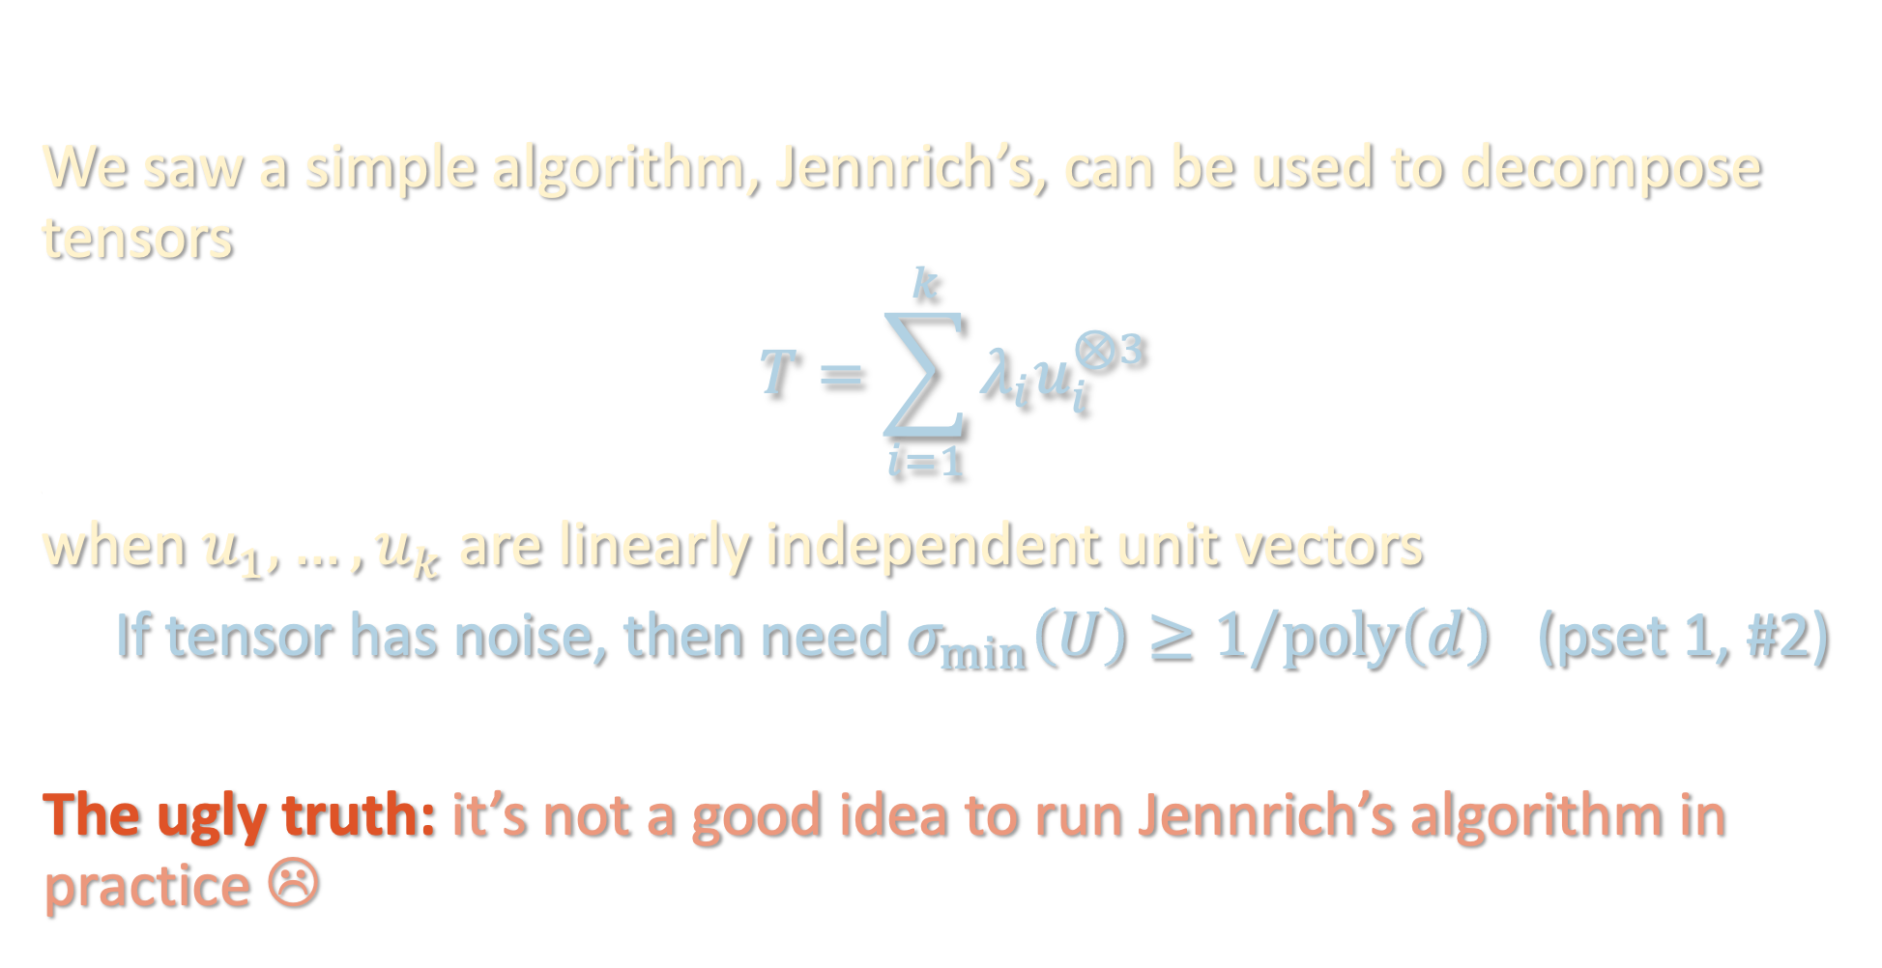
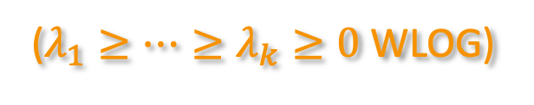
LAST TIME
We saw a simple algorithm, Jennrich’s, can be used to decompose tensors
$$T=\sum_{i=1}^{k}{λ_{i}u_{i}^{⊗3}}$$
,
when $u_{1},…,u_{k}$ are linearly independent unit vectors
If tensor has noise, then need $σ_{min}\left(U\right)≥1/poly\left(d\right)$ (pset 1, #2)
The ugly truth: it’s not a good idea to run Jennrich’s algorithm in practice ☹
($λ_{1}≥⋯≥λ_{k}≥0$ WLOG)

Slide 4
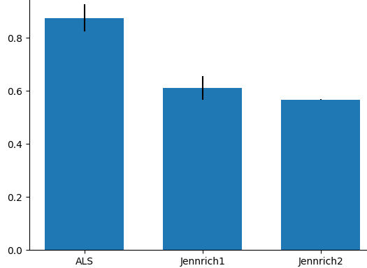
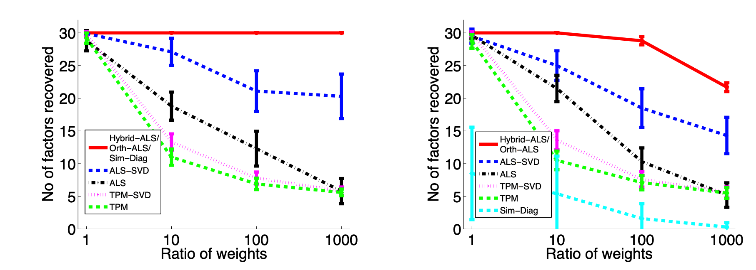
PRACTICAL CONSIDERATIONS
Not very noise robust compared to other algorithms<
https://www.mathsci.ai/post/jennrich/
https://arxiv.org/pdf/1703.01804.pdf [Sharan-Valiant ‘17]

Slide 5
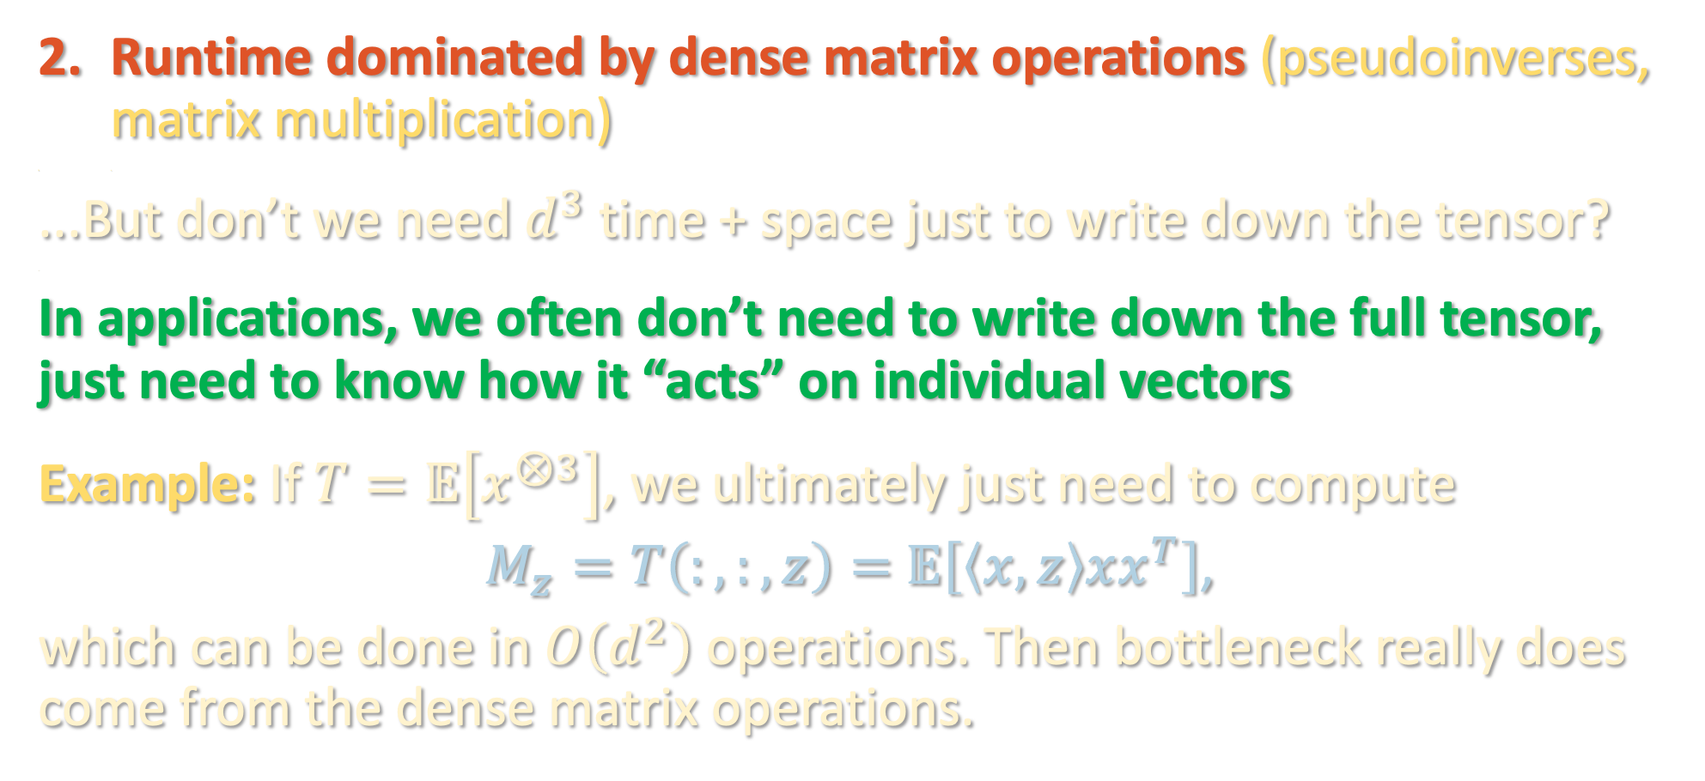
PRACTICAL CONSIDERATIONS
Runtime dominated by dense matrix operations (pseudoinverses, matrix multiplication)
<
...But don’t we need $d^{3}$ time + space just to write down the tensor?
<
In applications, we often don’t need to write down the full tensor, just need to know how it “acts” on individual vectors
Example: If $T=𝔼\left[x^{⊗3}\right]$, we ultimately just need to compute
$M_{z}=T\left(:,:,z\right)=$ $𝔼\left[\left\langle x,z\right\rangle xx^{T}\right]$,
which can be done in $O\left(d^{2}\right)$ operations. Then bottleneck really does come from the dense matrix operations.

Slide 6
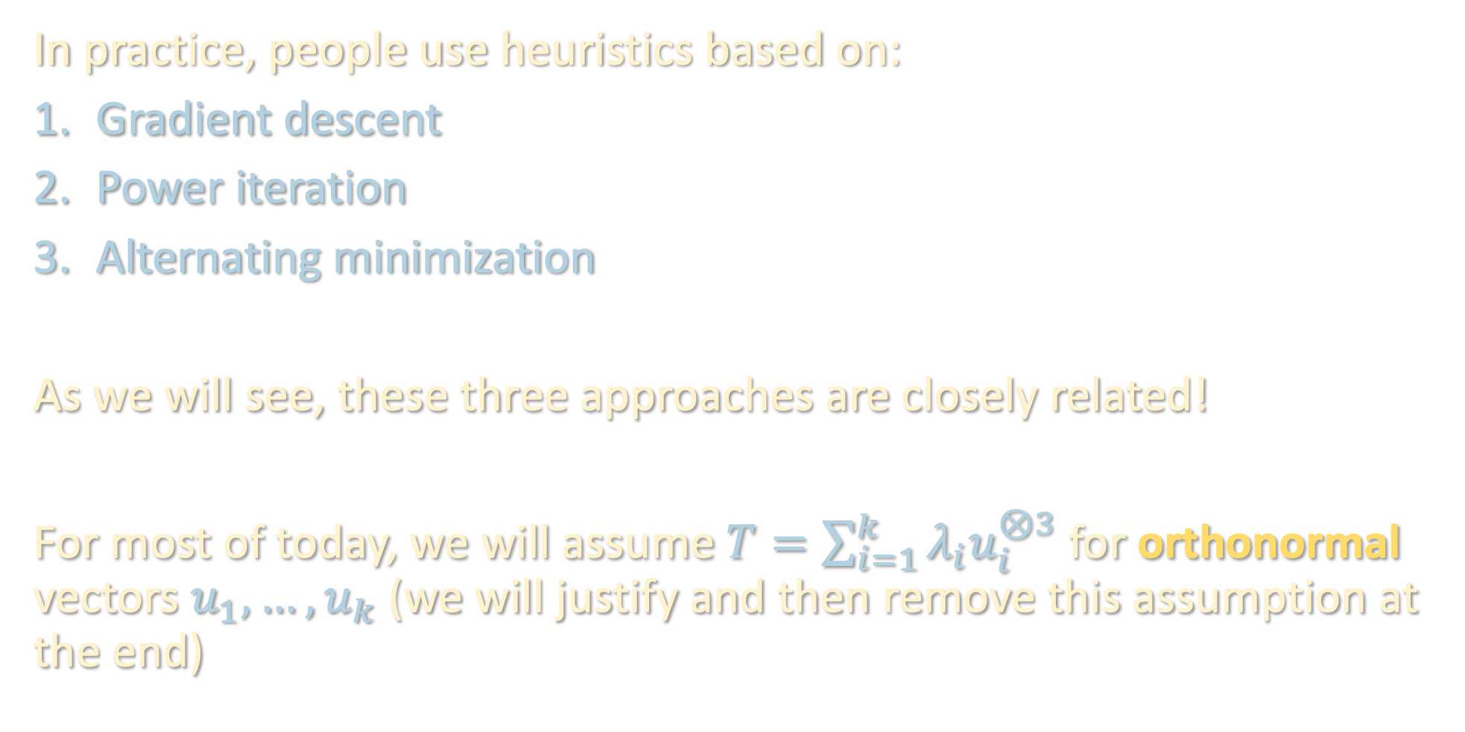
ITERATIVE ALGORITHMS
In practice, people use heuristics based on:
Gradient descent
Power iteration
Alternating minimization
As we will see, these three approaches are closely related!
For most of today, we will assume $T=\sum_{i=1}^{k}{λ_{i}u_{i}^{⊗3}}$ for orthonormal vectors $u_{1},…,u_{k}$ (we will justify and then remove this assumption at the end)

Slide 7
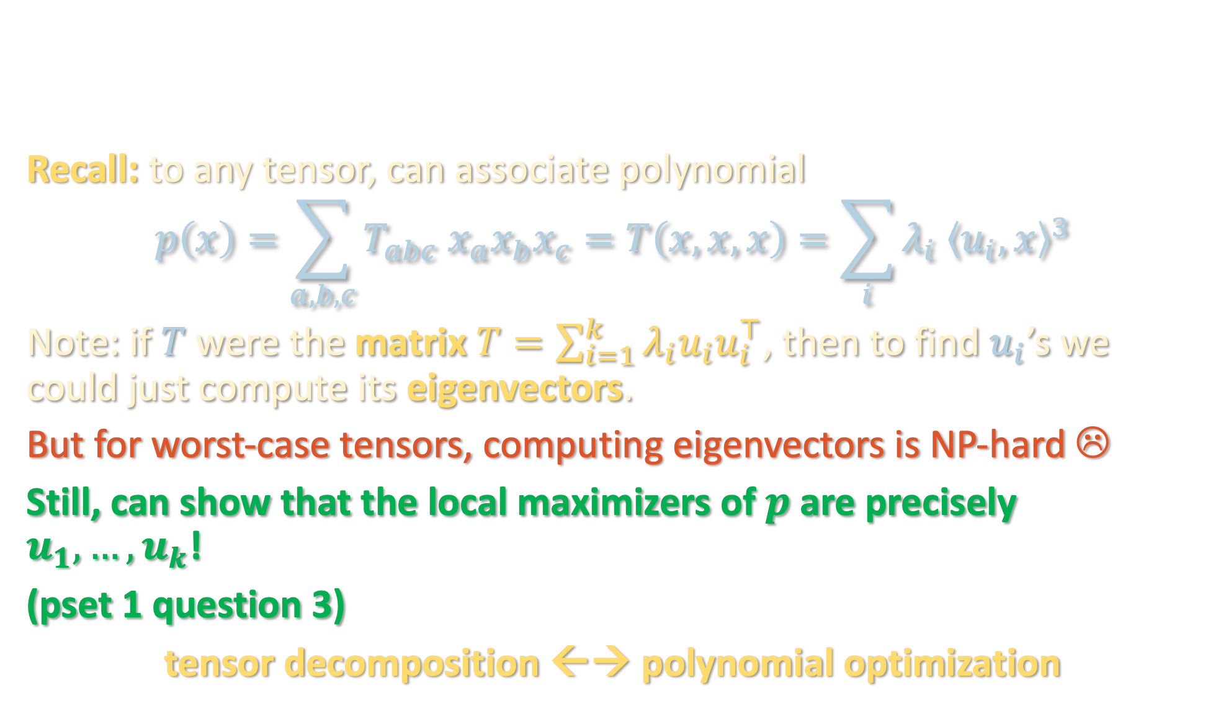
GRADIENT DESCENT
Recall: to any tensor, can associate polynomial
$$p\left(x\right)=\sum_{a,b,c}{T_{abc} x_{a}x_{b}x_{c}}=T\left(x,x,x\right)=\sum_{i}{λ_{i} {\left\langle u_{i},x\right\rangle }^{3}}$$
Note: if $T$ were the matrix $T=\sum_{i=1}^{k}{λ_{i}u_{i}u_{i}^{⊤}}$, then to find $u_{i}$’s we could just compute its eigenvectors.
But for worst-case tensors, computing eigenvectors is NP-hard ☹
Still, can show that the local maximizers of $p$ are precisely $u_{1},…,u_{k}$!
(pset 1 question 3)
tensor decomposition ←→ polynomial optimization

Slide 8

GRADIENT DESCENT
Optimization problem:
$$\max_{\left\|x\right\|=1}{p\left(x\right)}$$

Slide 9
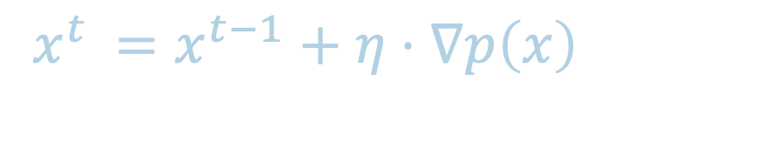
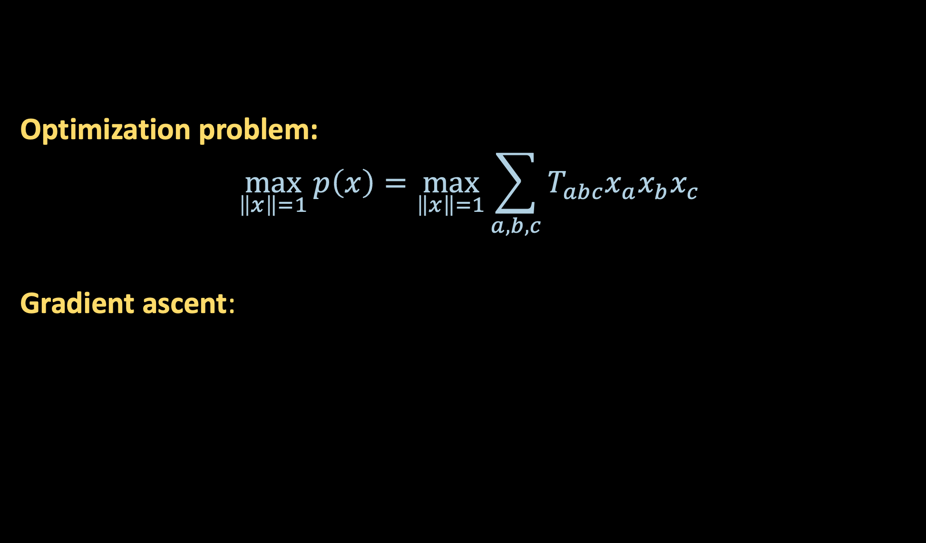
GRADIENT DESCENT
Optimization problem:
$$\max_{\left\|x\right\|=1}{p\left(x\right)}=\max_{\left\|x\right\|=1}{\sum_{a,b,c}{T_{abc}x_{a}x_{b}x_{c}}}$$
Gradient ascent:
$$x^{t}$$ | $$=x^{t−1}+η⋅∇p\left(x\right)$$

Slide 10
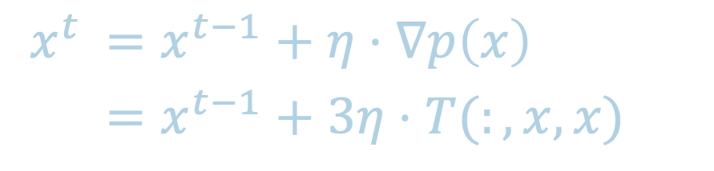
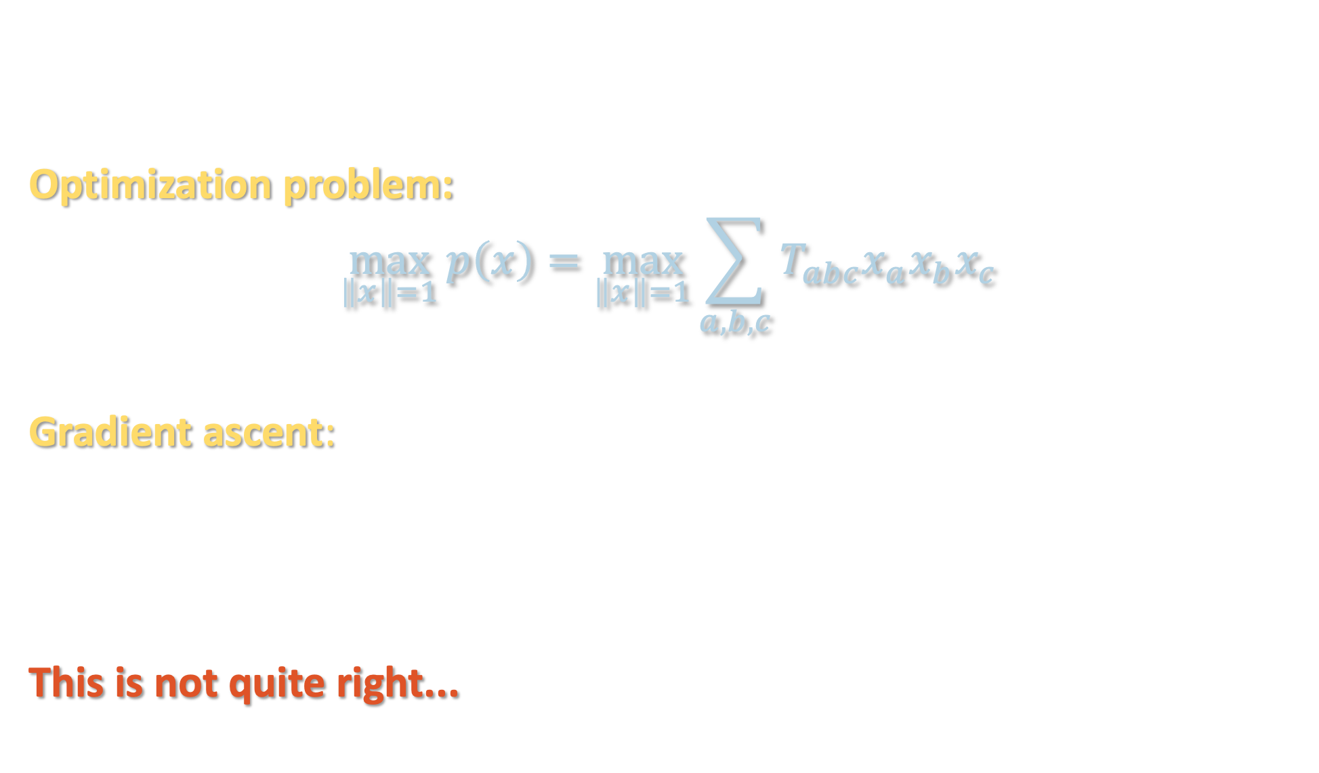
GRADIENT DESCENT
Optimization problem:
$$\max_{\left\|x\right\|=1}{p\left(x\right)}=\max_{\left\|x\right\|=1}{\sum_{a,b,c}{T_{abc}x_{a}x_{b}x_{c}}}$$
Gradient ascent:
This is not quite right...
$$x^{t}$$ | $$=x^{t−1}+η⋅∇p\left(x\right)$$
 | $$=x^{t−1}+3η⋅T(:,x,x)$$

Slide 11
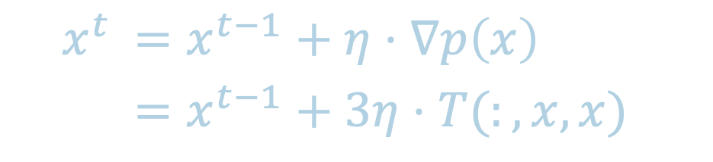
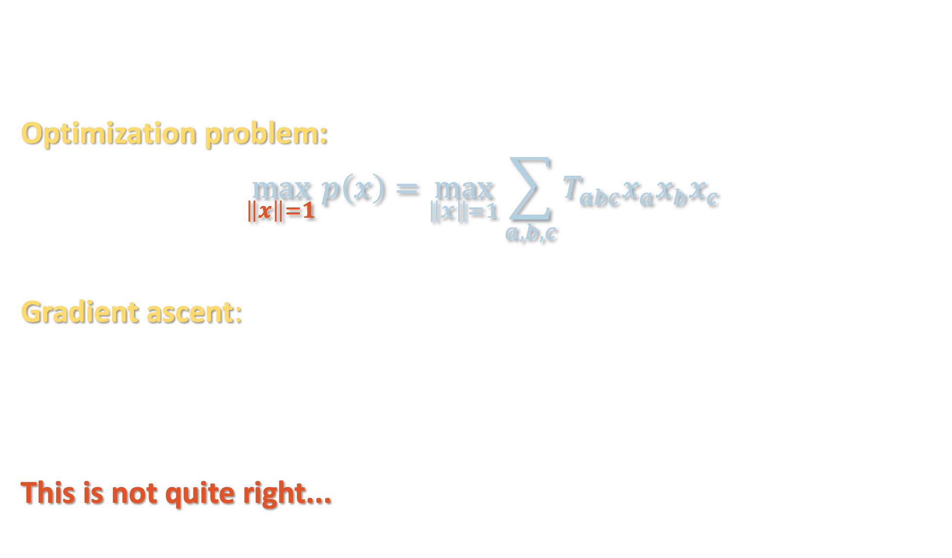
GRADIENT DESCENT
Optimization problem:
$$\max_{\left\|x\right\|=1}{p\left(x\right)}=\max_{\left\|x\right\|=1}{\sum_{a,b,c}{T_{abc}x_{a}x_{b}x_{c}}}$$
Gradient ascent:
This is not quite right...
$$x^{t}$$ | $$=x^{t−1}+η⋅∇p\left(x\right)$$
 | $$=x^{t−1}+3η⋅T(:,x,x)$$

Slide 12

(RIEMANNIAN) GRADIENT DESCENT
Need to ensure that our iterates always lie on the unit sphere
$$x^{t+1}=x^{t}+3η⋅T(:,x^{t},x^{t})$$

Slide 13

(RIEMANNIAN) GRADIENT DESCENT
Need to ensure that our iterates always lie on the unit sphere
$$x^{t+1}=proj\left(x^{t}+3η⋅T\left(:,x^{t},x^{t}\right)\right)$$

Slide 14
(RIEMANNIAN) GRADIENT DESCENT
Need to ensure that our iterates always lie on the unit sphere
$$x^{t+1}=proj\left(x^{t}+3η⋅T\left(:,x^{t},x^{t}\right)\right)$$

Slide 15
(RIEMANNIAN) GRADIENT DESCENT
Need to ensure that our iterates always lie on the unit sphere
$$x^{t+1}=proj\left(x^{t}+3η⋅T\left(:,x^{t},x^{t}\right)\right)$$

Slide 16
(RIEMANNIAN) GRADIENT DESCENT
Need to ensure that our iterates always lie on the unit sphere
$$x^{t+1}=proj\left(x^{t}+3η⋅T\left(:,x^{t},x^{t}\right)\right)$$

Slide 17
(RIEMANNIAN) GRADIENT DESCENT
Need to ensure that our iterates always lie on the unit sphere
$$x^{t+1}=proj\left(x^{t}+3η⋅T\left(:,x^{t},x^{t}\right)\right)$$
“tangent space”

Slide 18
(RIEMANNIAN) GRADIENT DESCENT
Need to ensure that our iterates always lie on the unit sphere
$$x^{t+1}=proj\left(x^{t}+3η⋅T\left(:,x^{t},x^{t}\right)\right)$$
all of the movement in this direction is “wasted” movement!
“tangent space”

Slide 19
(RIEMANNIAN) GRADIENT DESCENT
Need to ensure that our iterates always lie on the unit sphere
$$x^{t+1}=proj\left(x^{t}+3η⋅T\left(:,x^{t},x^{t}\right)\right)$$
all of the movement in this direction is “wasted” movement!
“tangent space”

Slide 20
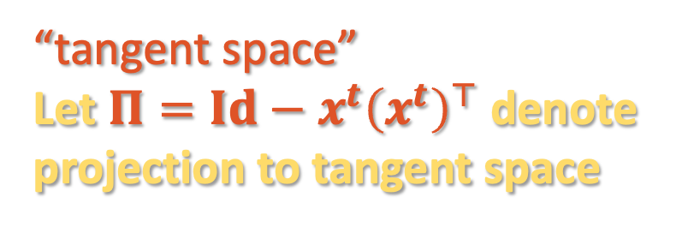
(RIEMANNIAN) GRADIENT DESCENT
Need to ensure that our iterates always lie on the unit sphere
$$x^{t+1}=proj\left(x^{t}+3η⋅T\left(:,x^{t},x^{t}\right)\right)$$
all of the movement in this direction is “wasted” movement!
“tangent space”
Let $Π=Id−x^{t}{\left(x^{t}\right)}^{⊤}$ denote
projection to tangent space

Slide 21

(RIEMANNIAN) GRADIENT DESCENT
Need to ensure that our iterates always lie on the unit sphere
$$x^{t+1}=proj\left(x^{t}+3η⋅T\left(:,x^{t},x^{t}\right)\right)$$
$$x^{t+1}=proj\left(x^{t}+3η⋅Π⋅T\left(:,x^{t},x^{t}\right)\right)$$

Slide 22

(RIEMANNIAN) GRADIENT DESCENT
Need to ensure that our iterates always lie on the unit sphere
$$x^{t+1}=proj\left(x^{t}+3η⋅T\left(:,x^{t},x^{t}\right)\right)$$
$$x^{t+1}=proj\left(x^{t}+3η⋅\left(Id−x^{t}{\left(x^{t}\right)}^{⊤}\right)⋅T\left(:,x^{t},x^{t}\right)\right)$$

Slide 23

(RIEMANNIAN) GRADIENT DESCENT
Need to ensure that our iterates always lie on the unit sphere
$$x^{t+1}=proj\left(x^{t}+3η⋅T\left(:,x^{t},x^{t}\right)\right)$$
$$x^{t+1}=proj\left(x^{t}+3η⋅\left[T\left(:,x^{t},x^{t}\right)−x^{t}⋅T\left(x^{t},x^{t},x^{t}\right)\right]\right)$$

Slide 24
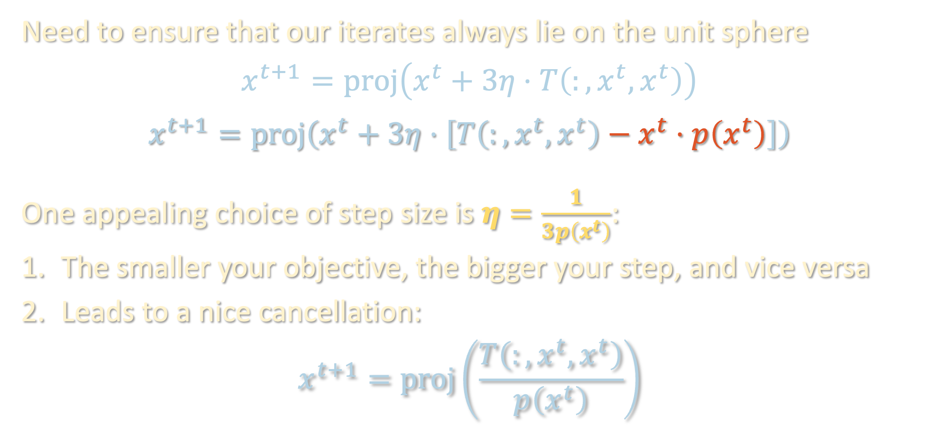
(RIEMANNIAN) GRADIENT DESCENT
Need to ensure that our iterates always lie on the unit sphere
$$x^{t+1}=proj\left(x^{t}+3η⋅T\left(:,x^{t},x^{t}\right)\right)$$
$$x^{t+1}=proj\left(x^{t}+3η⋅\left[T\left(:,x^{t},x^{t}\right)−x^{t}⋅p\left(x^{t}\right)\right]\right)$$
One appealing choice of step size is $η=\frac{1}{3p\left(x^{t}\right)}$:
The smaller your objective, the bigger your step, and vice versa
Leads to a nice cancellation:
$$x^{t+1}=proj\left(\frac{T\left(:,x^{t},x^{t}\right)}{p\left(x^{t}\right)}\right)$$

Slide 25

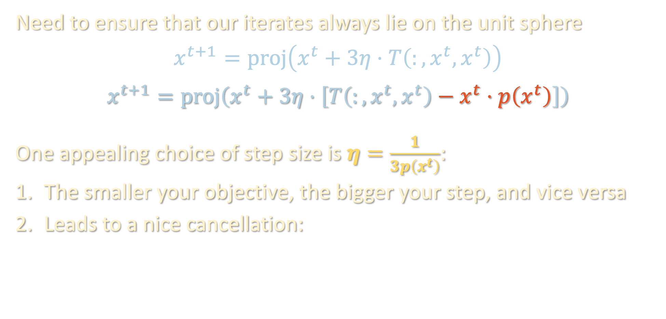
(RIEMANNIAN) GRADIENT DESCENT
Need to ensure that our iterates always lie on the unit sphere
$$x^{t+1}=proj\left(x^{t}+3η⋅T\left(:,x^{t},x^{t}\right)\right)$$
$$x^{t+1}=proj\left(x^{t}+3η⋅\left[T\left(:,x^{t},x^{t}\right)−x^{t}⋅p\left(x^{t}\right)\right]\right)$$
One appealing choice of step size is $η=\frac{1}{3p\left(x^{t}\right)}$:
The smaller your objective, the bigger your step, and vice versa
Leads to a nice cancellation:
$$x^{t+1}=proj\left(T\left(:,x^{t},x^{t}\right)\right)$$

Slide 26

TENSOR POWER METHOD
$$x^{t+1}=proj\left(T\left(:,x^{t},x^{t}\right)\right)$$
Tensor generalization of the classic power method for finding top eigenvector of a matrix

Slide 27
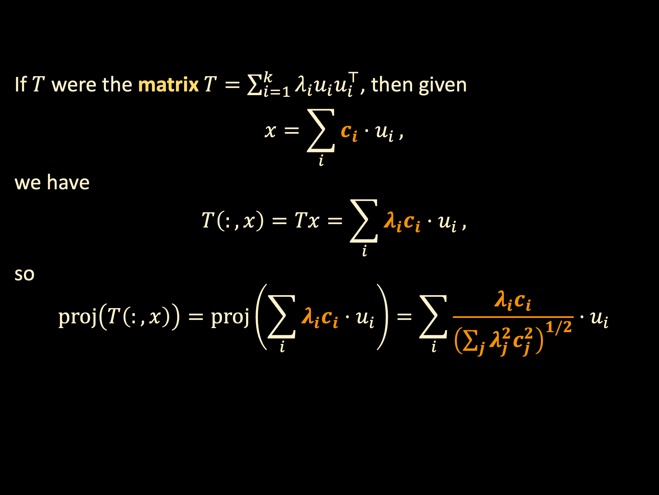
TENSOR POWER METHOD
If $T$ were the matrix $T=\sum_{i=1}^{k}{λ_{i}u_{i}u_{i}^{⊤}}$, then given
$$x=\sum_{i}{c_{i}⋅u_{i}},$$
we have
$$T\left(:,x\right)=Tx=\sum_{i}{λ_{i}c_{i}⋅u_{i}},$$
so
$$proj\left(T\left(:,x\right)\right)=proj\left(\sum_{i}{λ_{i}c_{i}⋅u_{i}}\right)=\sum_{i}{\frac{λ_{i}c_{i}}{{\left(\sum_{j}{λ_{j}^{2}c_{j}^{2}}\right)}^{1/2}}⋅u_{i}}$$

Slide 28
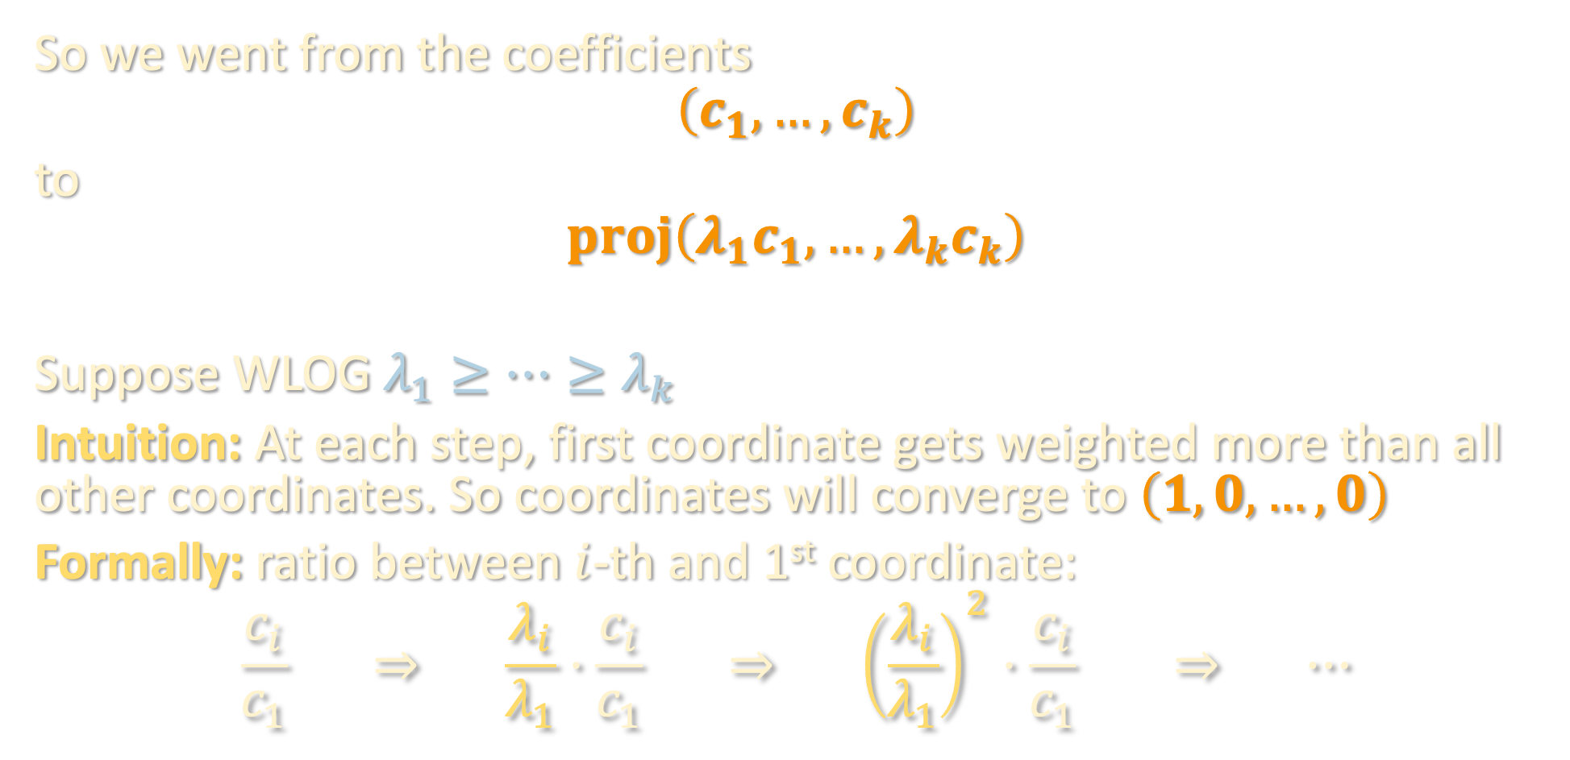
TENSOR POWER METHOD
So we went from the coefficients
$$\left(c_{1},…,c_{k}\right)$$
to
$$proj\left(λ_{1}c_{1},…,λ_{k}c_{k}\right)$$
Suppose WLOG $λ_{1}≥⋯≥λ_{k}$
Intuition: At each step, first coordinate gets weighted more than all other coordinates. So coordinates will converge to $\left(1,0,…,0\right)$
Formally: ratio between $i$-th and 1st coordinate:
$$\frac{c_{i}}{c_{1}} ⇒ \frac{λ_{i}}{λ_{1}}⋅\frac{c_{i}}{c_{1}} ⇒ {\left(\frac{λ_{i}}{λ_{1}}\right)}^{2}⋅\frac{c_{i}}{c_{1}} ⇒ ⋯$$
i.e., exponential (“linear”) convergence

Slide 29
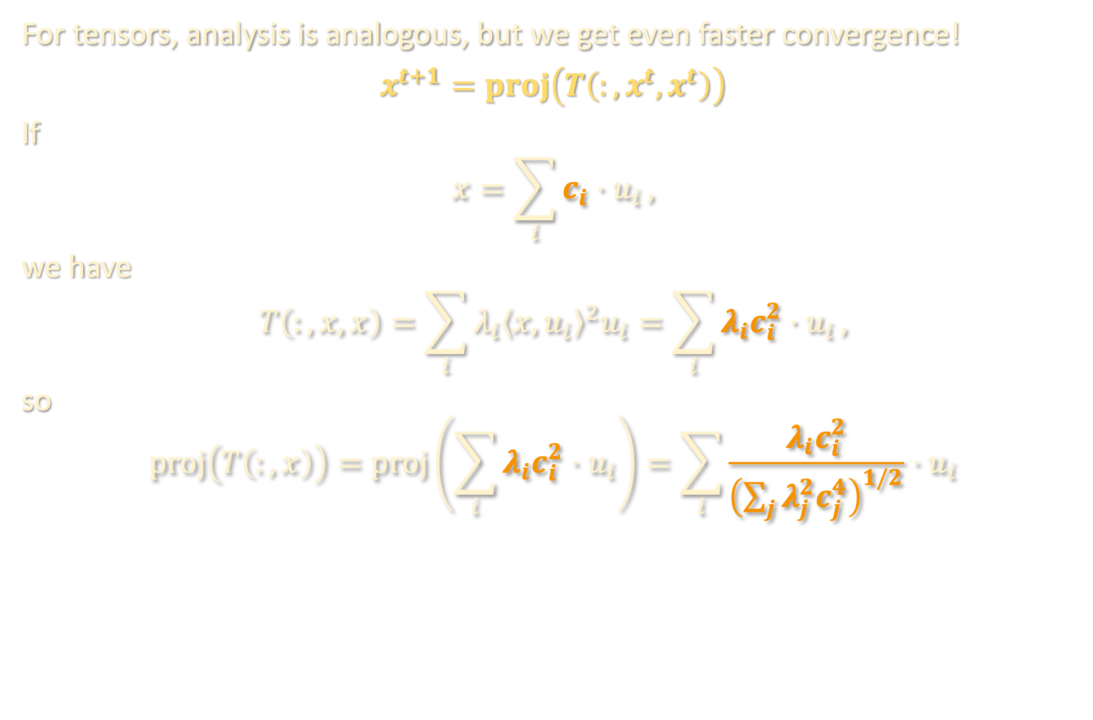
TENSOR POWER METHOD
For tensors, analysis is analogous, but we get even faster convergence!
$$x^{t+1}=proj\left(T\left(:,x^{t},x^{t}\right)\right)$$
If
$$x=\sum_{i}{c_{i}⋅u_{i}},$$
we have
$$T\left(:,x,x\right)=\sum_{i}{λ_{i}{\left\langle x,u_{i}\right\rangle }^{2}u_{i}}=\sum_{i}{λ_{i}c_{i}^{2}⋅u_{i}},$$
so
$$proj\left(T\left(:,x\right)\right)=proj\left(\sum_{i}{λ_{i}c_{i}^{2}⋅u_{i}}\right)=\sum_{i}{\frac{λ_{i}c_{i}^{2}}{{\left(\sum_{j}{λ_{j}^{2}c_{j}^{4}}\right)}^{1/2}}⋅u_{i}}$$

Slide 30

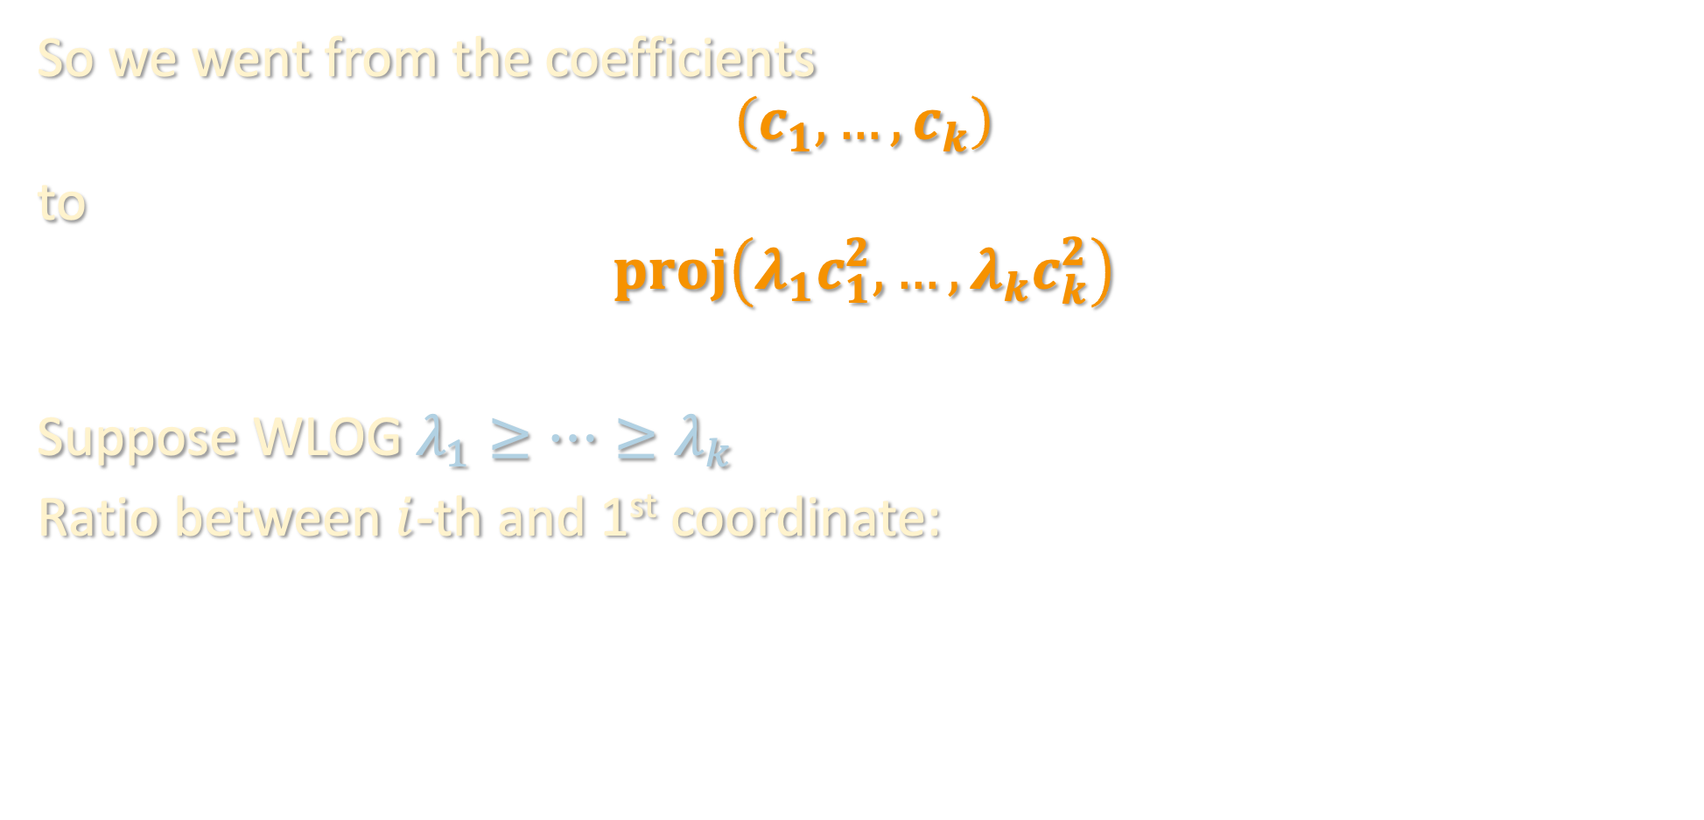
TENSOR POWER METHOD
So we went from the coefficients
$$\left(c_{1},…,c_{k}\right)$$
to
$$proj\left(λ_{1}c_{1}^{2},…,λ_{k}c_{k}^{2}\right)$$
Suppose WLOG $λ_{1}≥⋯≥λ_{k}$
Ratio between $i$-th and 1st coordinate:
$$\frac{c_{i}}{c_{1}} ⇒ \frac{λ_{i}c_{i }}{λ_{1}c_{1}}⋅\frac{c_{i}}{c_{1}}$$

Slide 31

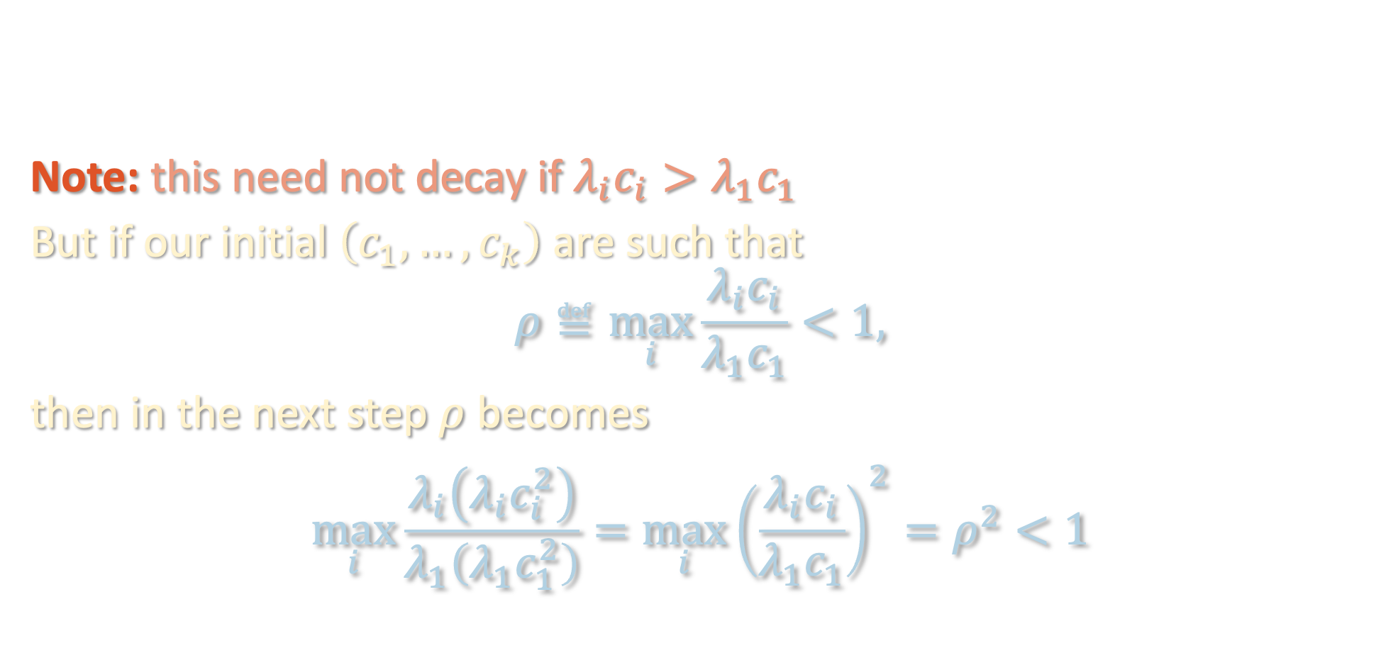
TENSOR POWER METHOD
Note: this need not decay if $λ_{i}c_{i}>λ_{1}c_{1}$
But if our initial $\left(c_{1},…,c_{k}\right)$ are such that
$$ρ≝\max_{i}{\frac{λ_{i}c_{i}}{λ_{1}c_{1}}}<1,$$
then in the next step $ρ$ becomes
$$\max_{i}{\frac{λ_{i}\left(λ_{i}c_{i}^{2}\right)}{λ_{1}\left(λ_{1}c_{1}^{2}\right)}}=\max_{i}{{\left(\frac{λ_{i}c_{i}}{λ_{1}c_{1}}\right)}^{2}}=ρ^{2}<1$$
$$\frac{c_{i}}{c_{1}} ⇒ \frac{λ_{i}c_{i }}{λ_{1}c_{1}}⋅\frac{c_{i}}{c_{1}}$$

Slide 32
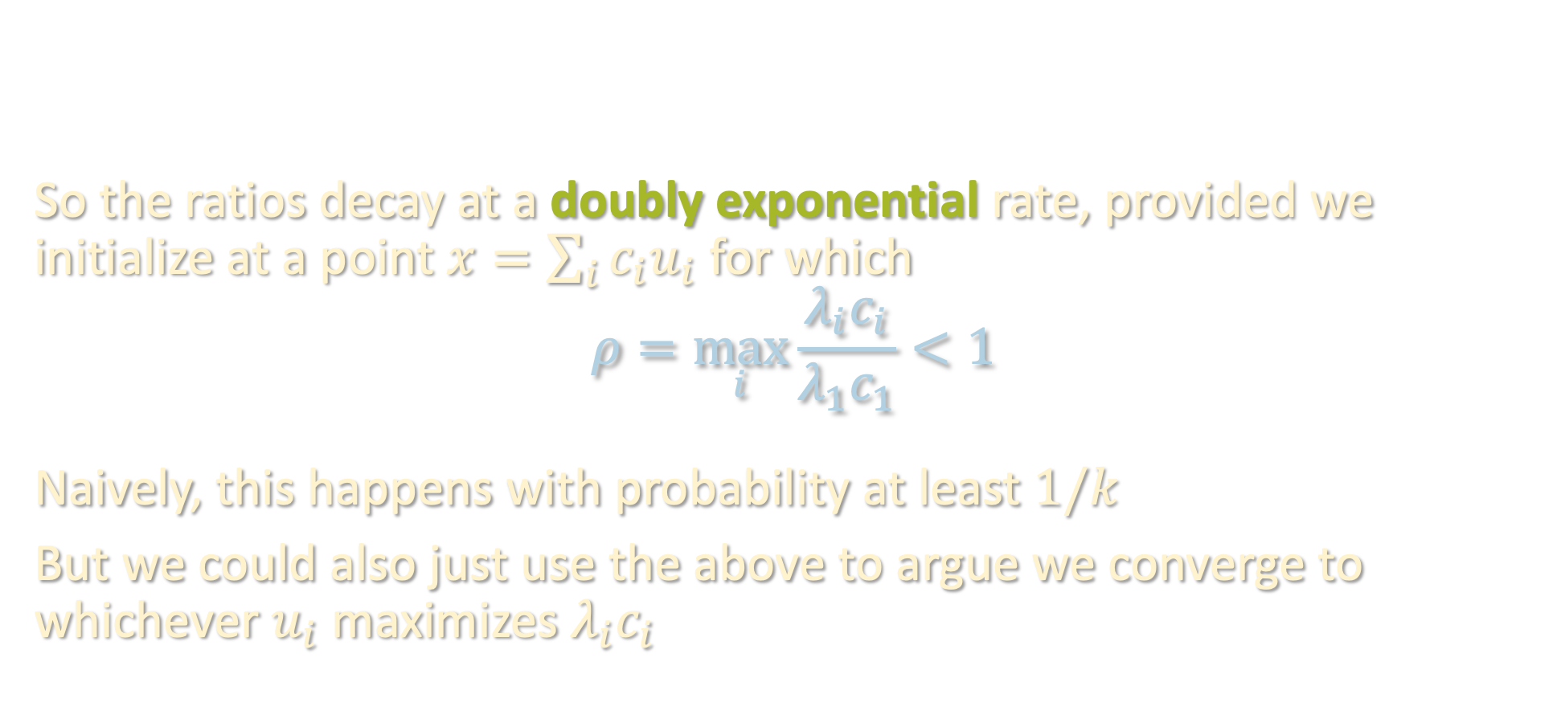
TENSOR POWER METHOD
So the ratios decay at a doubly exponential rate, provided we initialize at a point $x=\sum_{i}{c_{i}u_{i}}$ for which
$$ρ=\max_{i}{\frac{λ_{i}c_{i}}{λ_{1}c_{1}}}<1$$
Naively, this happens with probability at least $1/k$
But we could also just use the above to argue we converge to whichever $u_{i}$ maximizes $λ_{i}c_{i}$
$$\frac{c_{i}}{c_{1}} ⇒ ρ⋅\frac{c_{i}}{c_{1}} ⇒ ρ^{2}⋅\frac{c_{i}}{c_{1}} ⇒ ρ^{4}⋅\frac{c_{i}}{c_{1}} ⇒ ρ^{8}⋅\frac{c_{i}}{c_{1}}$$

Slide 33
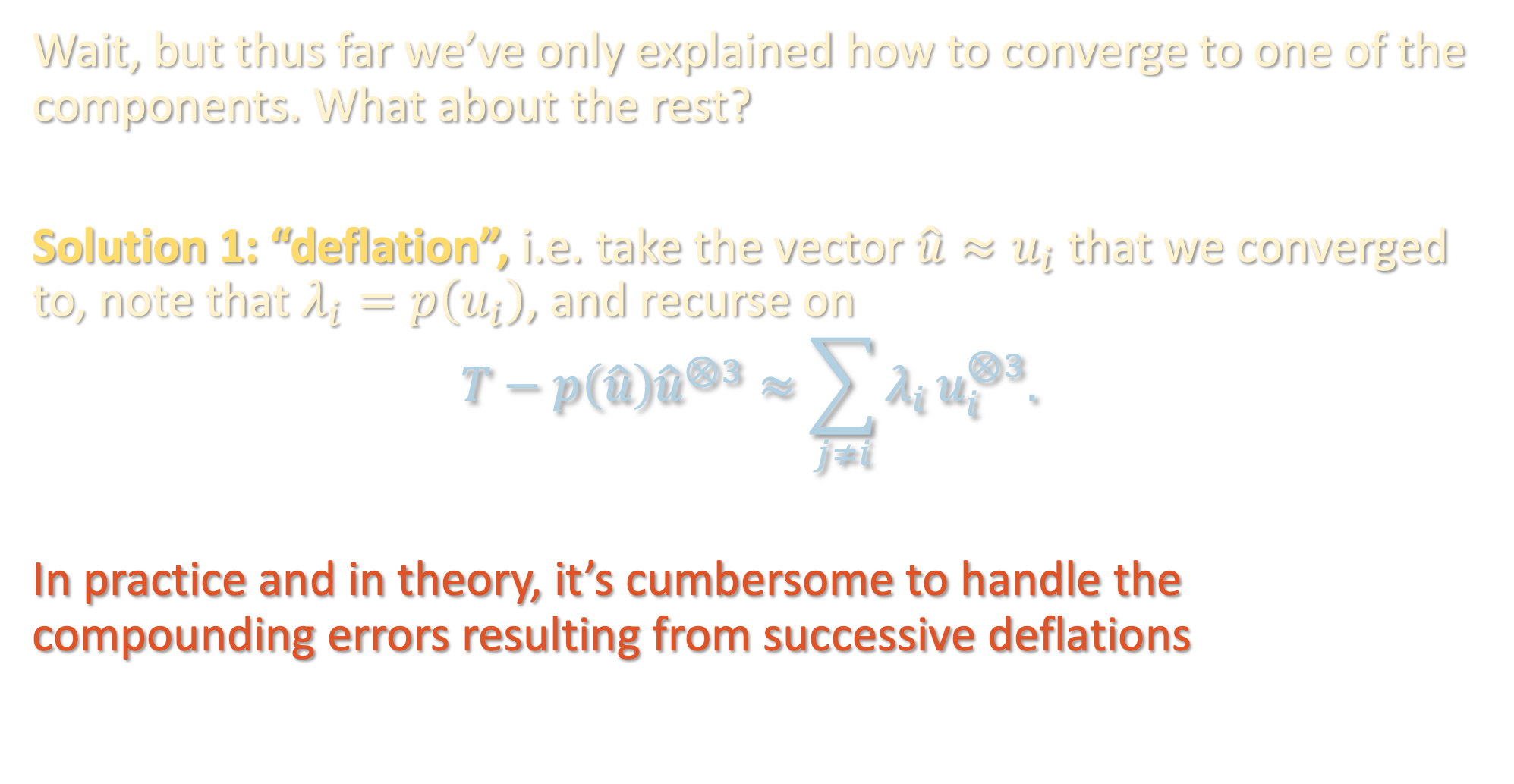
TENSOR POWER METHOD
Wait, but thus far we’ve only explained how to converge to one of the components. What about the rest?
Solution 1: “deflation”, i.e. take the vector $\hat{u}≈u_{i}$ that we converged to, note that $λ_{i}=p\left(u_{i}\right)$, and recurse on
$$T−p\left(\hat{u}\right){\hat{u}}^{⊗3}≈\sum_{j≠i}{λ_{i}}u_{i}^{⊗3}.$$
In practice and in theory, it’s cumbersome to handle the compounding errors resulting from successive deflations

Slide 34
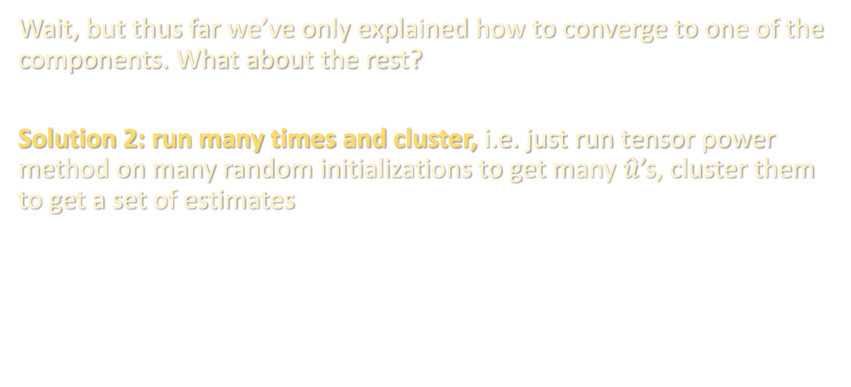
TENSOR POWER METHOD
Wait, but thus far we’ve only explained how to converge to one of the components. What about the rest?
Solution 2: run many times and cluster, i.e. just run tensor power method on many random initializations to get many $\hat{u}$’s, cluster them to get a set of estimates

Slide 35
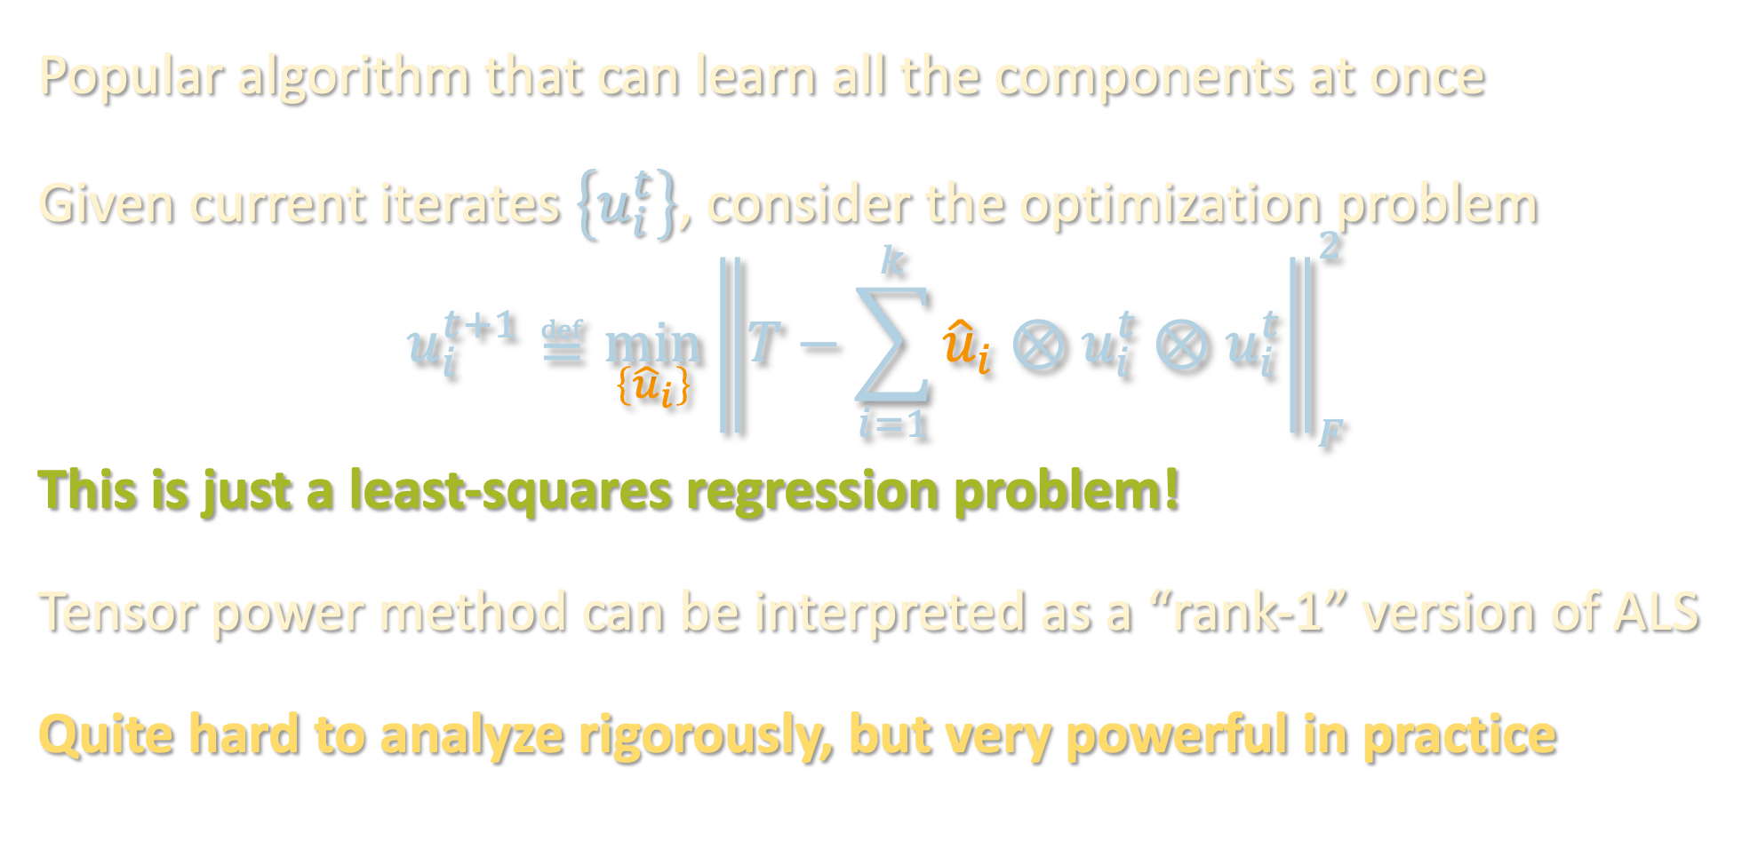
ALTERNATING LEAST SQUARES (ALS)
Popular algorithm that can learn all the components at once
Given current iterates $\left\{u_{i}^{t}\right\}$, consider the optimization problem
$$u_{i}^{t+1}≝\min_{\left\{{\hat{u}}_{i}\right\}}{{\left\|T−\sum_{i=1}^{k}{{\hat{u}}_{i}⊗u_{i}^{t}⊗u_{i}^{t}}\right\|}_{F}^{2}}$$
This is just a least-squares regression problem!
Tensor power method can be interpreted as a “rank-1” version of ALS
Quite hard to analyze rigorously, but very powerful in practice

Slide 36
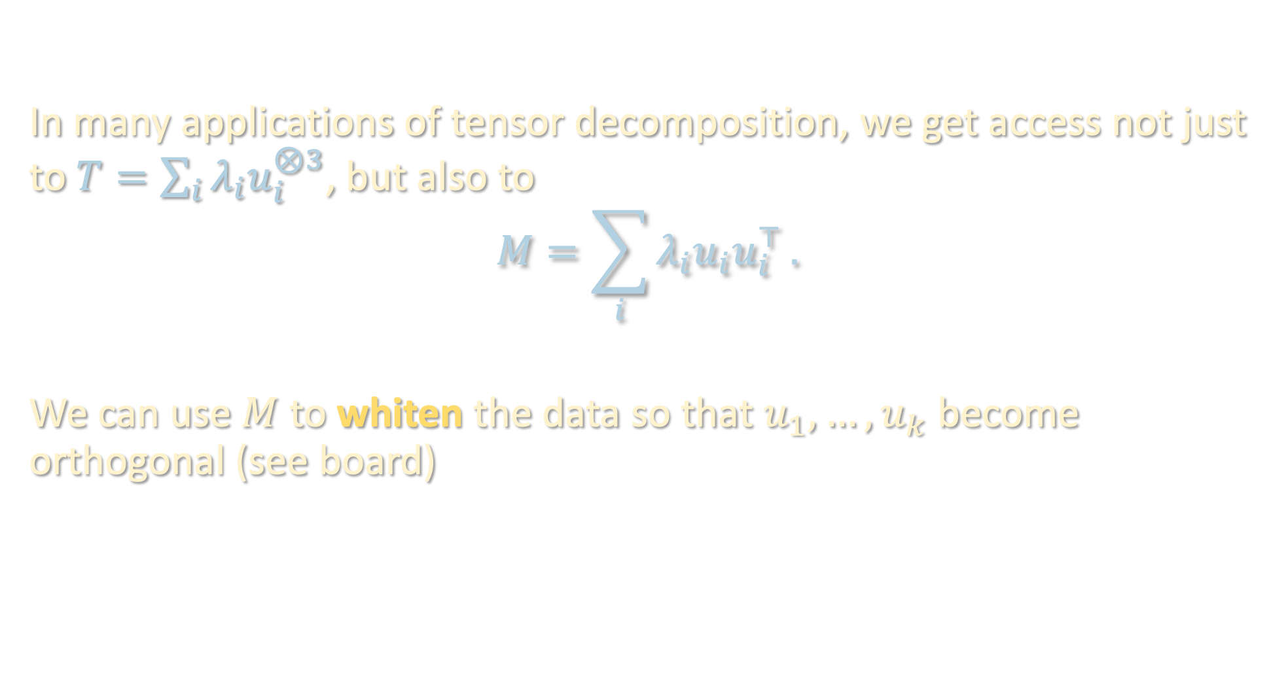
WHY IS ORTHOGONALITY REASONABLE?
In many applications of tensor decomposition, we get access not just to $T=\sum_{i}{λ_{i}u_{i}^{⊗3}}$, but also to
$$M=\sum_{i}{λ_{i}u_{i}u_{i}^{⊤}}.$$
We can use $M$ to whiten the data so that $u_{1},…,u_{k}$ become orthogonal (see board)

Slide 37
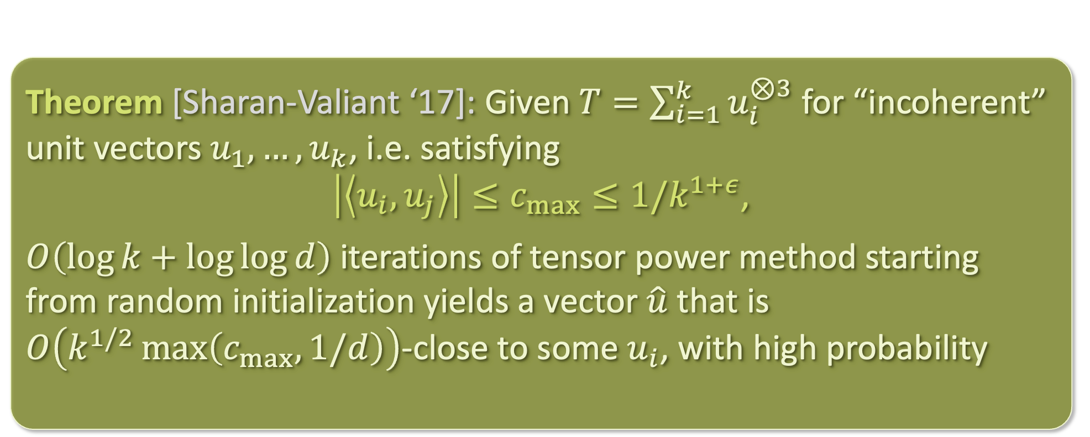

WHAT IF WE DON’T / CAN’T WHITEN?
When $u_{1},…,u_{k}$ are not orthogonal but merely linearly independent, analyzing these algorithms becomes much more challenging...
Theorem [Sharan-Valiant ‘17]: Given $T=\sum_{i=1}^{k}{u_{i}^{⊗3}}$ for “incoherent” unit vectors $u_{1},…,u_{k}$, i.e. satisfying
$\left|\left\langle u_{i},u_{j}\right\rangle \right|≤c_{max}≤1/k^{1+ε}$,
$O\left(\log{k}+\log{\log{d}}\right)$ iterations of tensor power method starting from random initialization yields a vector $\hat{u}$ that is $O\left(k^{1/2}\max\left(c_{max},1/d\right)\right)$-close to some $u_{i}$, with high probability

Slide 38
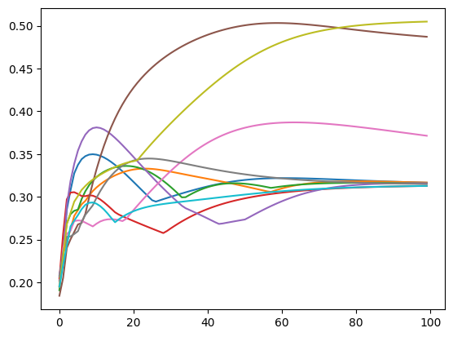
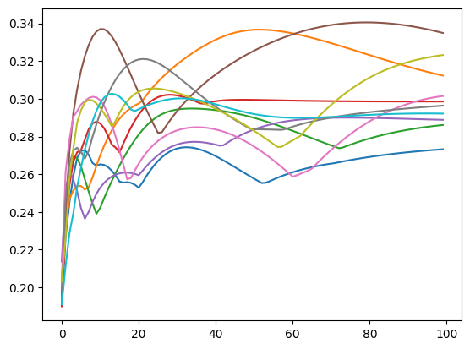
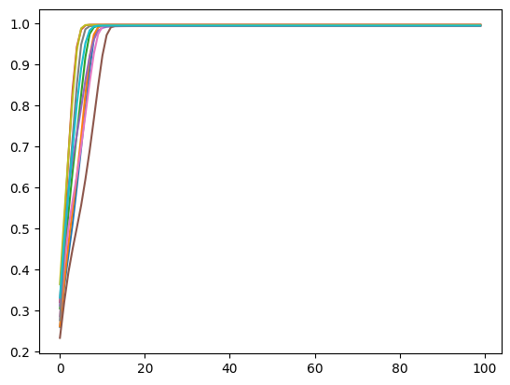
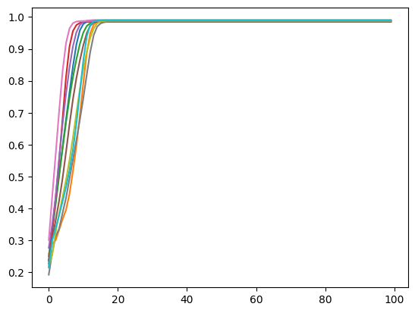
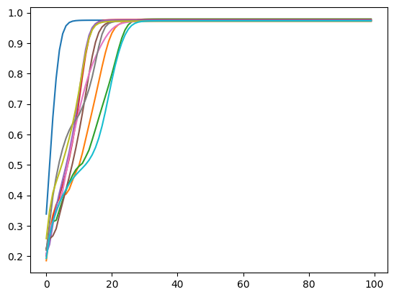
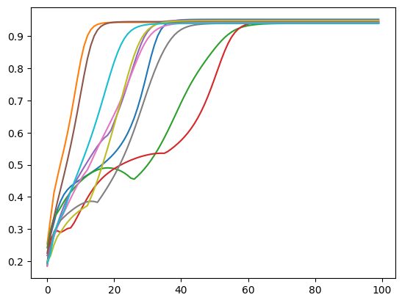
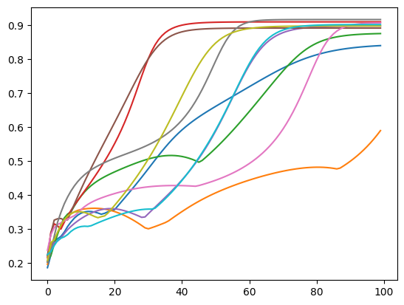
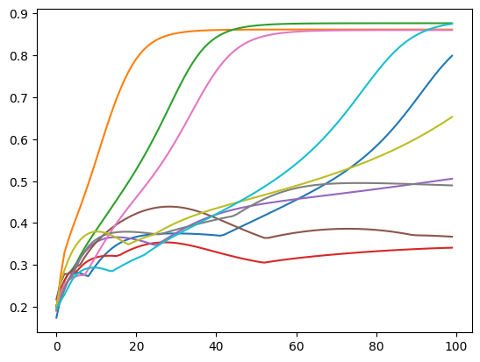
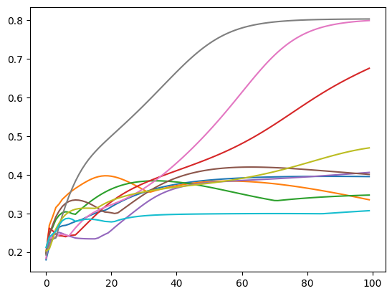










EMPIRICAL MYSTERIES
Not only do we not yet understand deep learning, we don’t even understand tensor power method!
$$k=400$$
$$k=1000$$
$$k=2000$$
$$k=4000$$
$$k=6000$$
$$k=8000$$
$$k=10000$$
$$k=12000$$
$$d=400$$
$$k=15000$$

Slide 39
EMPIRICAL MYSTERIES
Not only do we not yet understand deep learning, we don’t even understand tensor power method!
https://arxiv.org/pdf/2211.03827.pdf [Wu-Zhou ‘22]

Slide 40
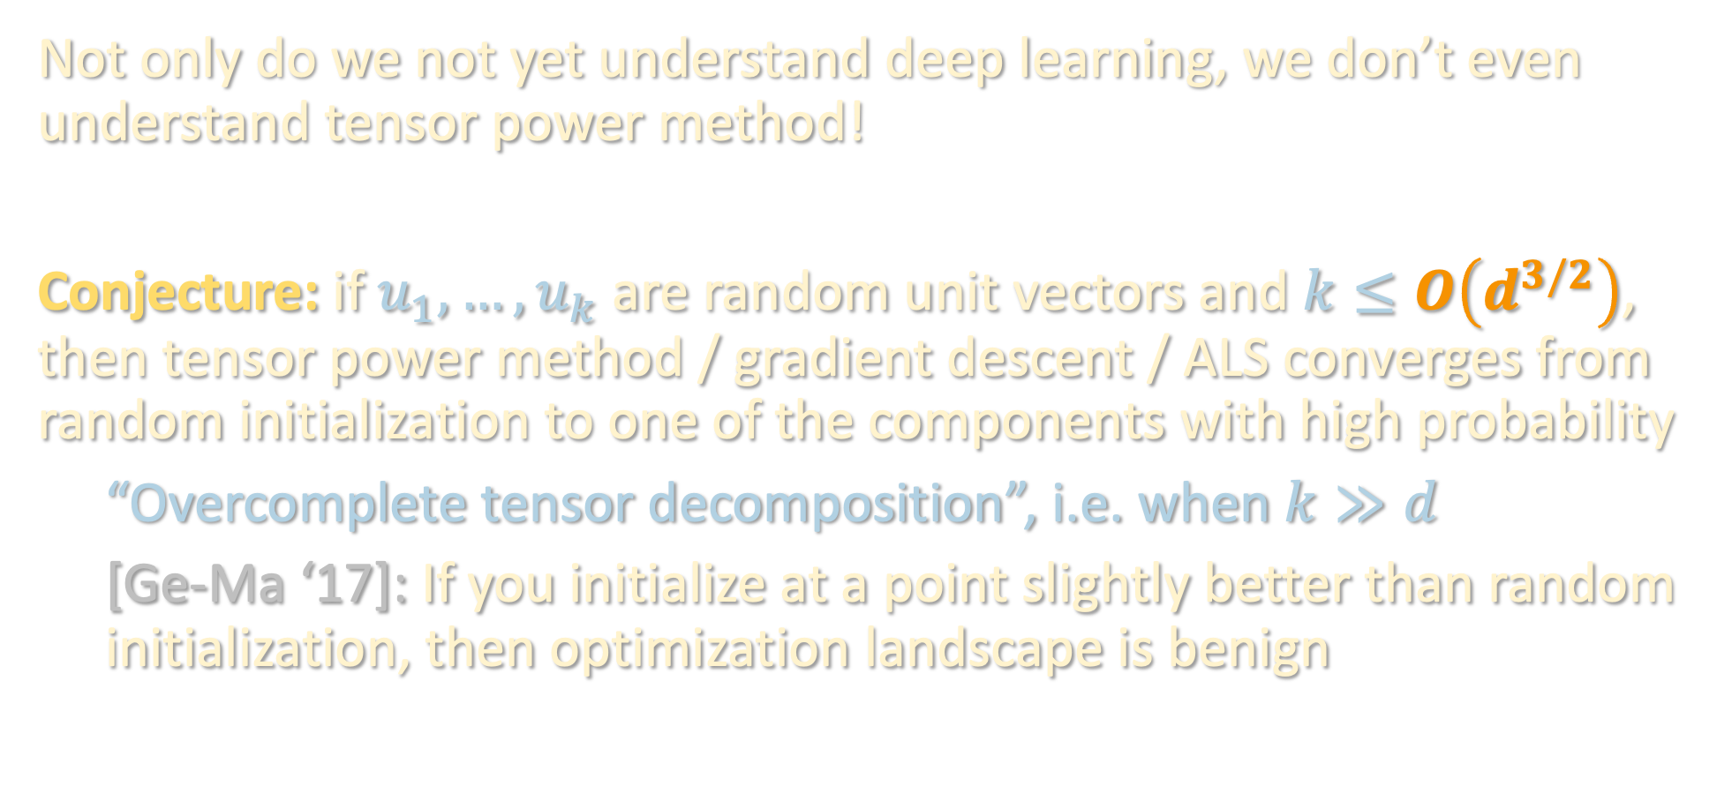
EMPIRICAL MYSTERIES
Not only do we not yet understand deep learning, we don’t even understand tensor power method!
Conjecture: if $u_{1},…,u_{k}$ are random unit vectors and $k≤O\left(d^{3/2}\right)$, then tensor power method / gradient descent / ALS converges from random initialization to one of the components with high probability
“Overcomplete tensor decomposition”, i.e. when $k≫d$
[Ge-Ma ‘17]: If you initialize at a point slightly better than random initialization, then optimization landscape is benign

Slide 41
TAKEAWAYS
Jennrich’s algorithm not great in practice (runtime, robustness)
Empirically, several popular iterative approaches (gradient descent, tensor power method, and ALS) are much more powerful and closely related, but much harder to analyze
We proved tensor power method works when the components are sufficiently “incoherent”, but theory is still very far from fully explaining its empirical behavior
Next lecture: provable overcomplete tensor decomposition by going beyond worst-case analysis

