Slide 1

CS 224: ALGORITHMS FOR DATA SCIENCE
LECTURE 24 (12/4)
Tensor decomposition
Sum-of-squares
Robustness
Supervised learning
Computational complexity
Statistical physics
Generative modeling
DIFFUSION MODELS

Slide 2
Primer on diffusion models
Discretization analysis
Course recap

Slide 3
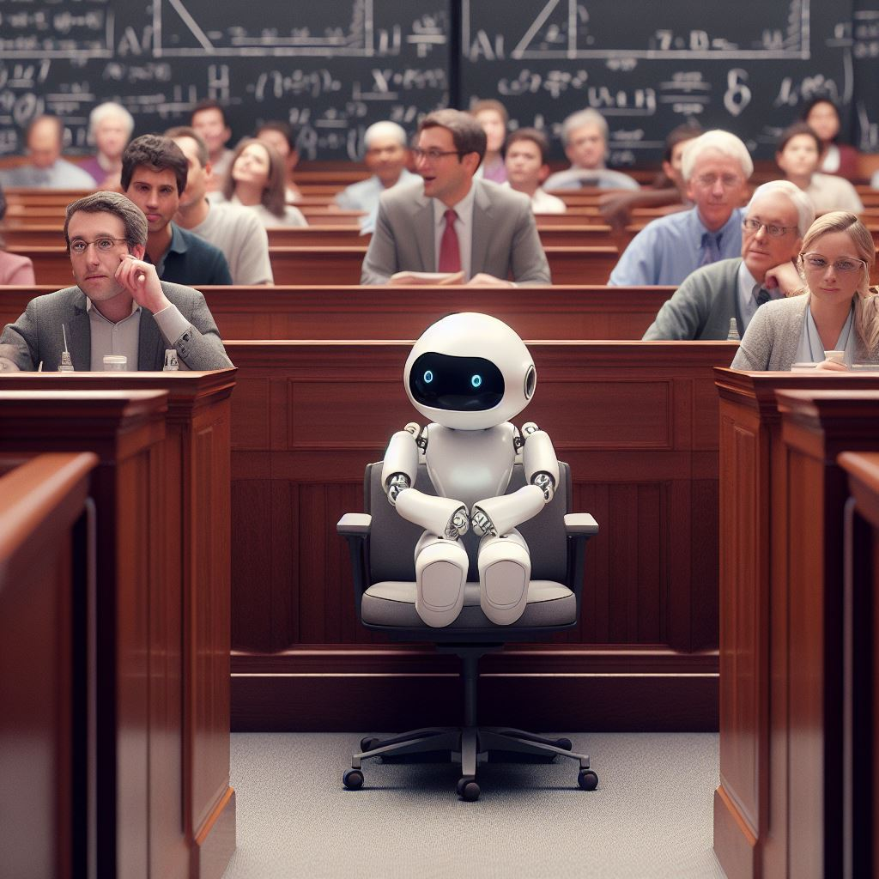


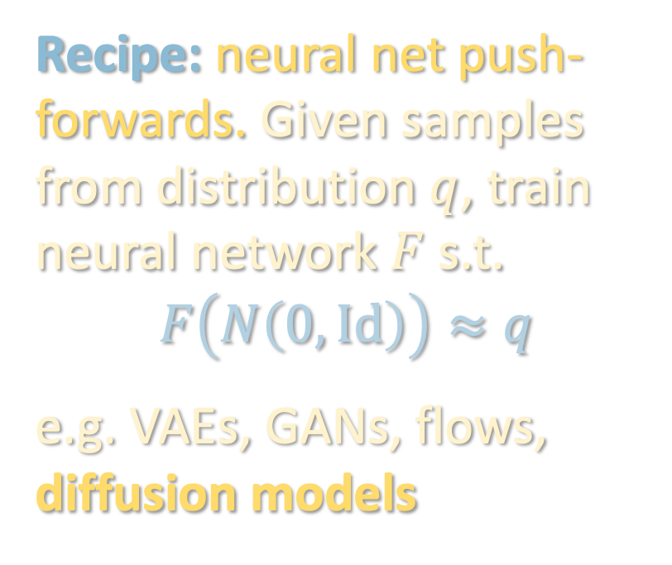
DEEP GENERATIVE MODELS
Powerful framework for learning real-world, high-dimensional distributions from data
Recipe: neural net push-forwards. Given samples from distribution $q$, train neural network $F$ s.t.
$$F\left(N\left(0,Id\right)\right)≈q$$
e.g. VAEs, GANs, flows, diffusion models

Slide 4
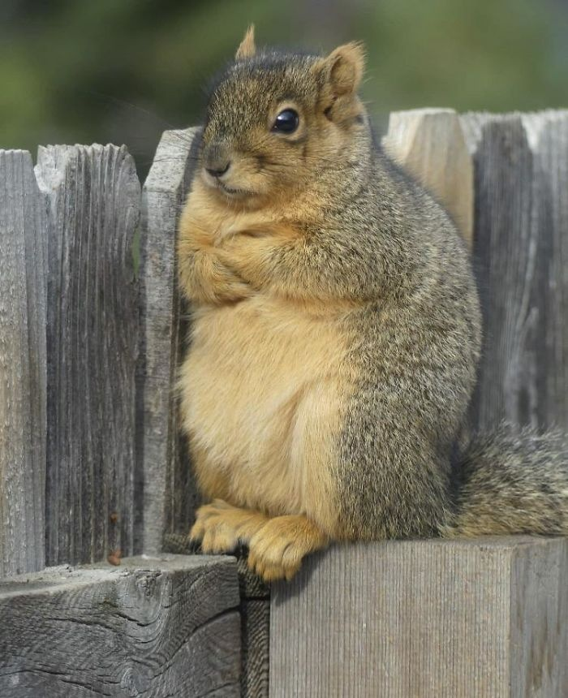
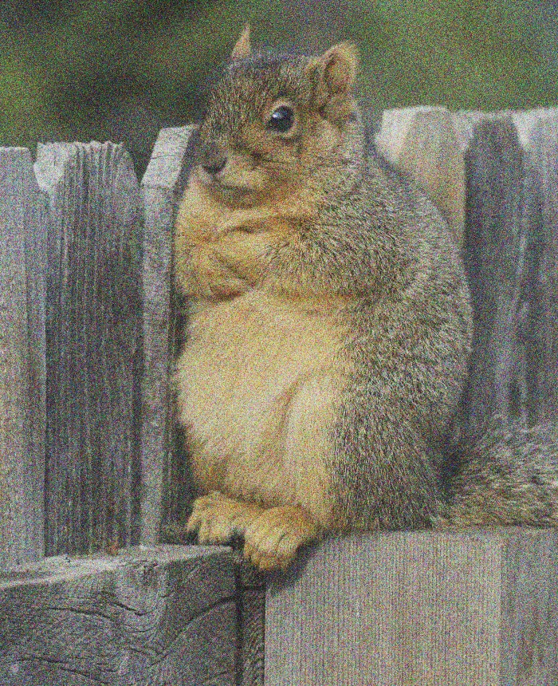
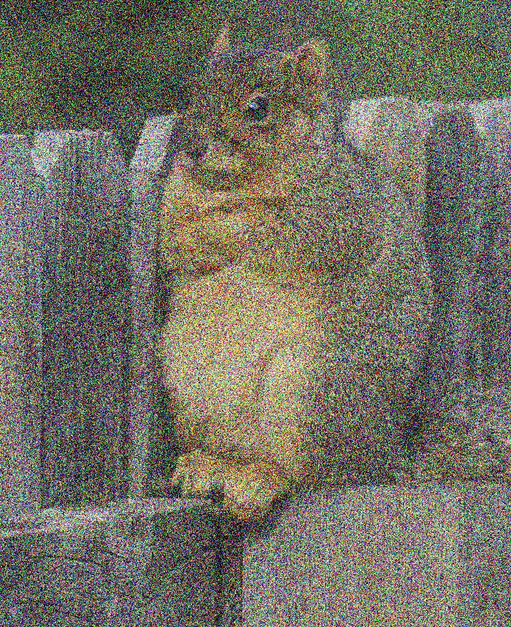
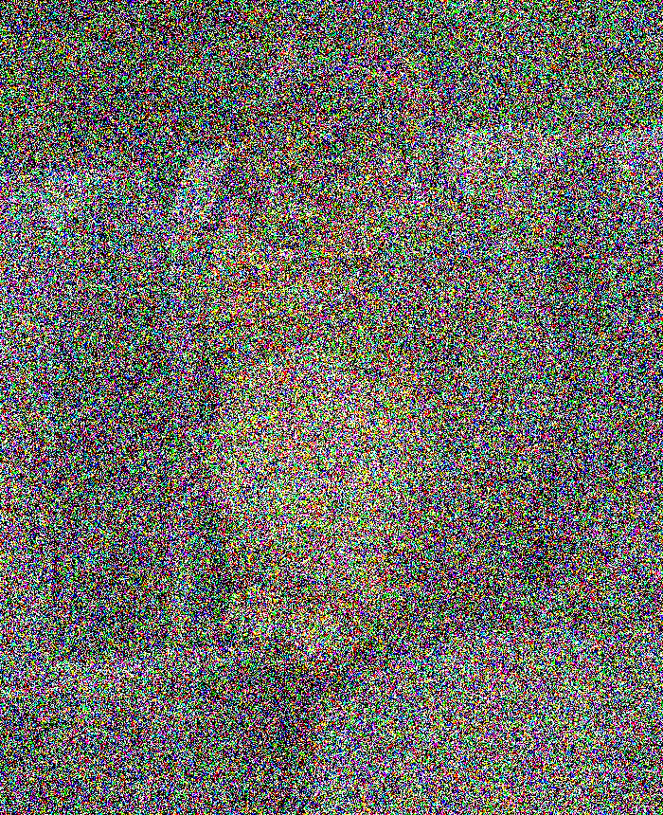

DIFFUSION MODELS
Forward process
$$t=0$$
$$t=∞$$
$$X_{t}=e^{−t}⋅X_{0}+\sqrt{1−e^{−2t}}⋅γ$$
$$dX_{t}=−X_{t}+\sqrt{2}dB_{t}$$
$X_{0}∼q$ (data distribution)
$$N\left(0,Id\right)$$

Slide 5
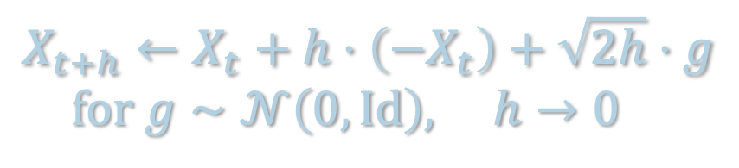
DIFFUSION MODELS
$$X_{t+h}←X_{t}+h⋅\left(−X_{t}\right)+\sqrt{2h}⋅g$$
$for g∼𝒩\left(0,Id\right), h→0$
$$q_{0}=q$$
$$q_{t}$$
Forward process
$$t=0$$
$$t=∞$$
$$dX_{t}=−X_{t} dt+\sqrt{2} dB_{t}$$
$X_{0}∼q$ (data distribution)

Slide 6
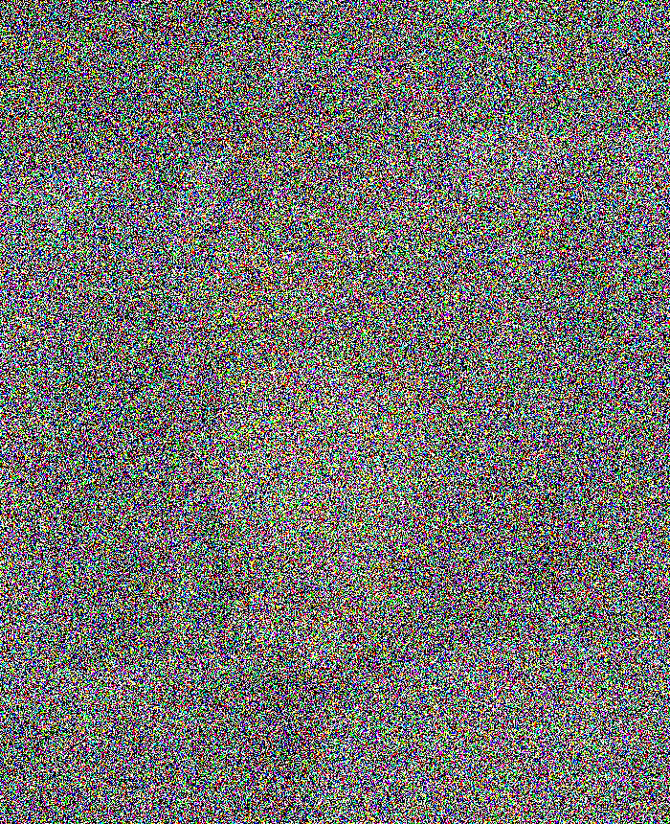
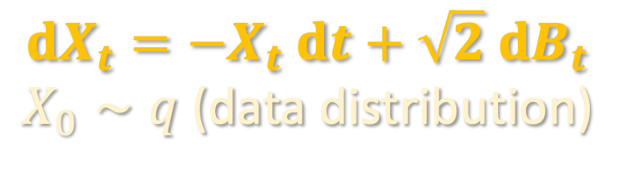
DIFFUSION MODELS
$$q_{0}=q$$
$$q_{t}$$
Forward process
$$t=0$$
$$t=T$$
$$dX_{t}=−X_{t} dt+\sqrt{2} dB_{t}$$
$X_{0}∼q$ (data distribution)
in practice, can only run for finite time

Slide 7
DIFFUSION MODELS
(a few slides later, we will prove why running this reverses the forward process)
$$q_{T}$$
$$q_{T−t}$$
$$q_{0}=q$$
Reverse process
$$t=0$$
$$t=T$$
$$dX_{t}^{←}=\left\{X_{t}^{←}+2∇ ln q_{T−t}\left(X_{t}^{←}\right)\right\} dt+\sqrt{2} dB_{t}$$
$X_{0}^{←}∼q_{T}$ (forward process at time $T$)

Slide 8

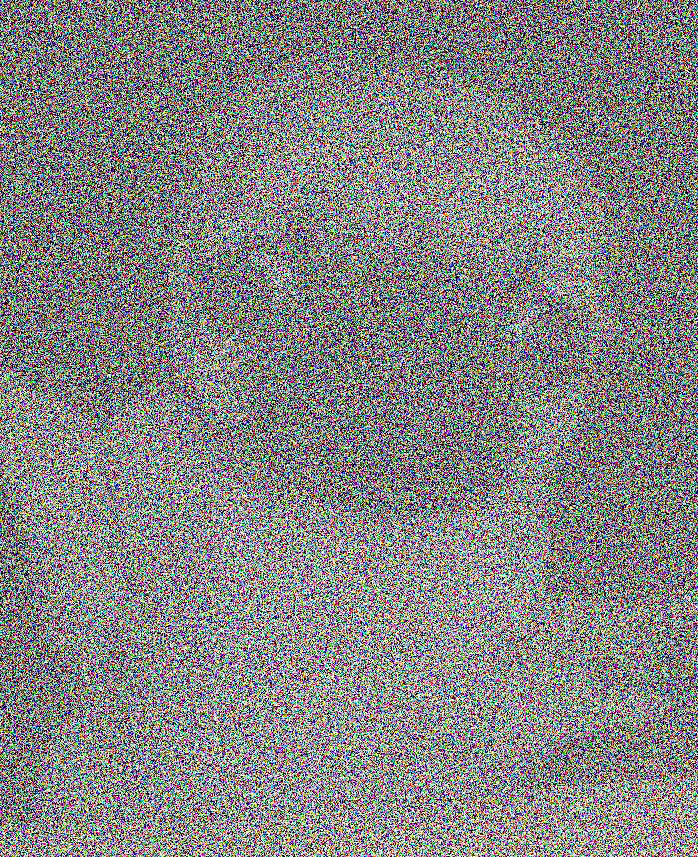
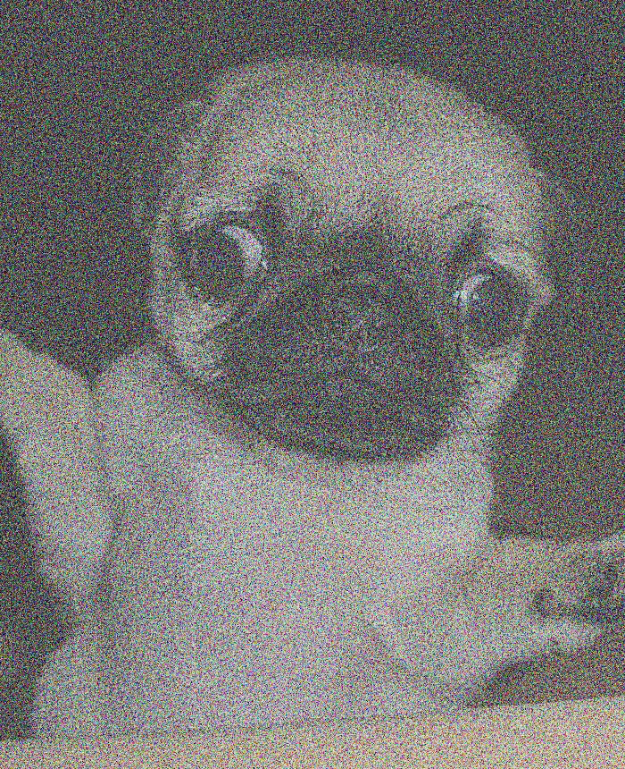
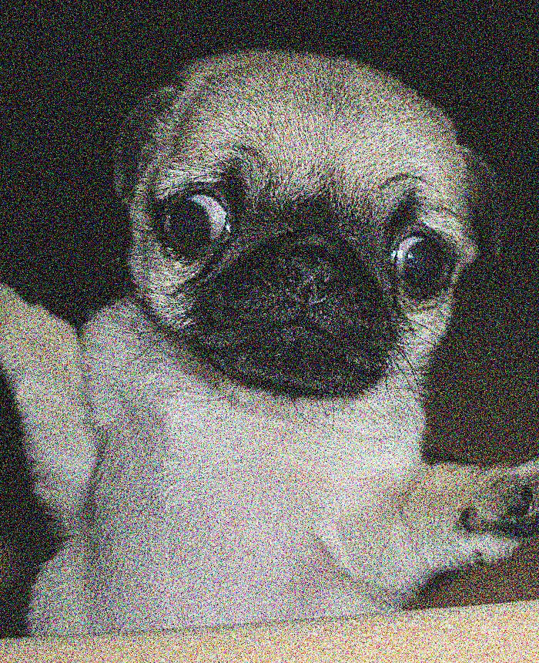
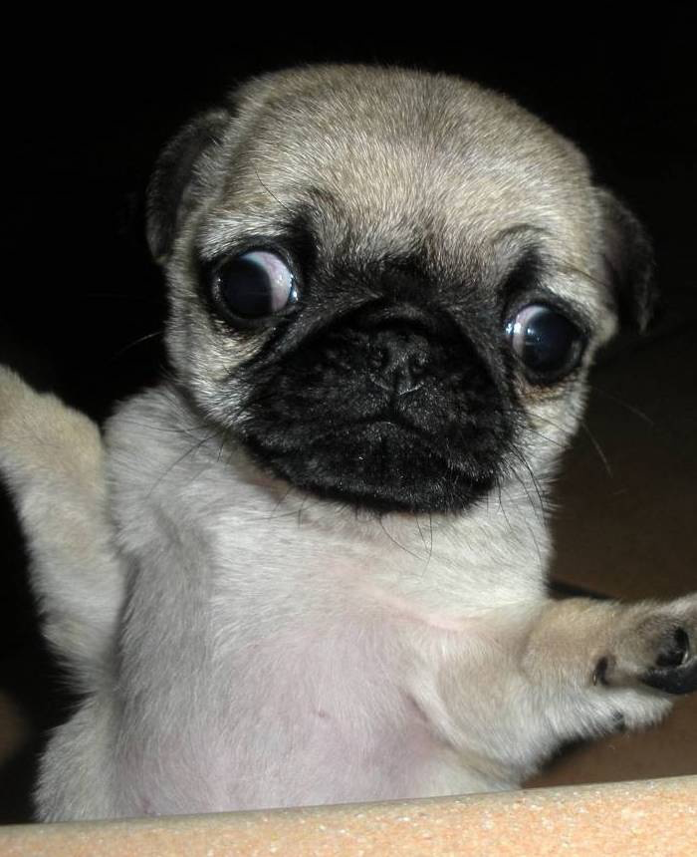
DIFFUSION MODELS
Sources of error:
Initialize at Gaussian instead of $q_{T}$
To sample fresh images, run reverse process w/ Gaussian initialization
initialize at pure Gaussian
$$t=0$$
$$t=T$$
$$dX_{t}^{←}=\left\{X_{t}^{←}+2∇ ln q_{T−t}\left(X_{t}^{←}\right)\right\} dt+\sqrt{2} dB_{t}$$
$X_{0}^{←}∼q_{T}$ (forward process at time $T$)

Slide 9
DIFFUSION MODELS
Sources of error:
Initialize at Gaussian instead of $q_{T}$
To sample fresh images, run reverse process w/ Gaussian initialization
initialize at pure Gaussian
$$t=0$$
$$t=T$$
“score function”
we don’t have access to this!
$$dX_{t}^{←}=\left\{X_{t}^{←}+2∇ ln q_{T−t}\left(X_{t}^{←}\right)\right\} dt+\sqrt{2} dB_{t}$$
$X_{0}^{←}∼q_{T}$ (forward process at time $T$)

Slide 10
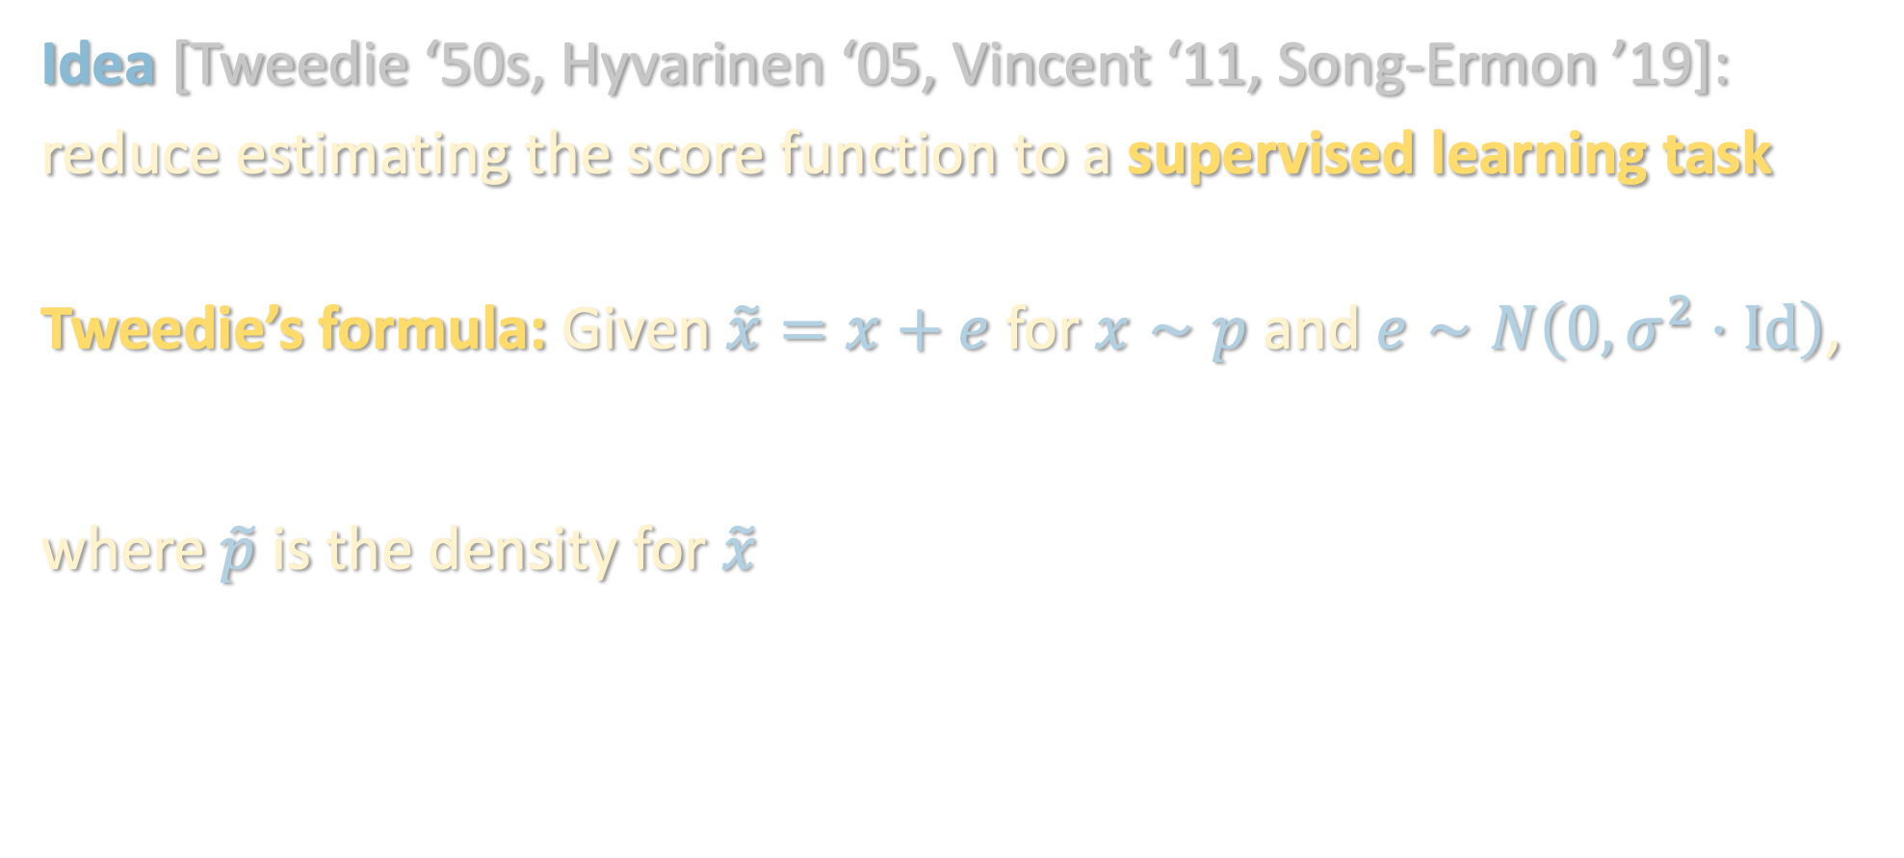

SCORE MATCHING
Sources of error:
Initialize at Gaussian instead of $q_{T}$
Idea [Tweedie ‘50s, Hyvarinen ‘05, Vincent ‘11, Song-Ermon ’19]:
reduce estimating the score function to a supervised learning task
Tweedie’s formula: Given $\tilde{x}=x+e$ for $x∼p$ and $e∼N\left(0,σ^{2}⋅Id\right)$,
$$𝔼\left[x | \tilde{x}\right]=\tilde{x}+σ^{2}⋅∇ ln \tilde{p}\left(\tilde{x}\right)$$
where $\tilde{p}$ is the density for $\tilde{x}$
$$𝔼\left[x | \tilde{x}\right]=\tilde{x}+σ^{2}⋅∇ ln \tilde{p}\left(\tilde{x}\right)$$
Score function: Bayes-optimal estimate for noise (up to scaling)

Slide 11

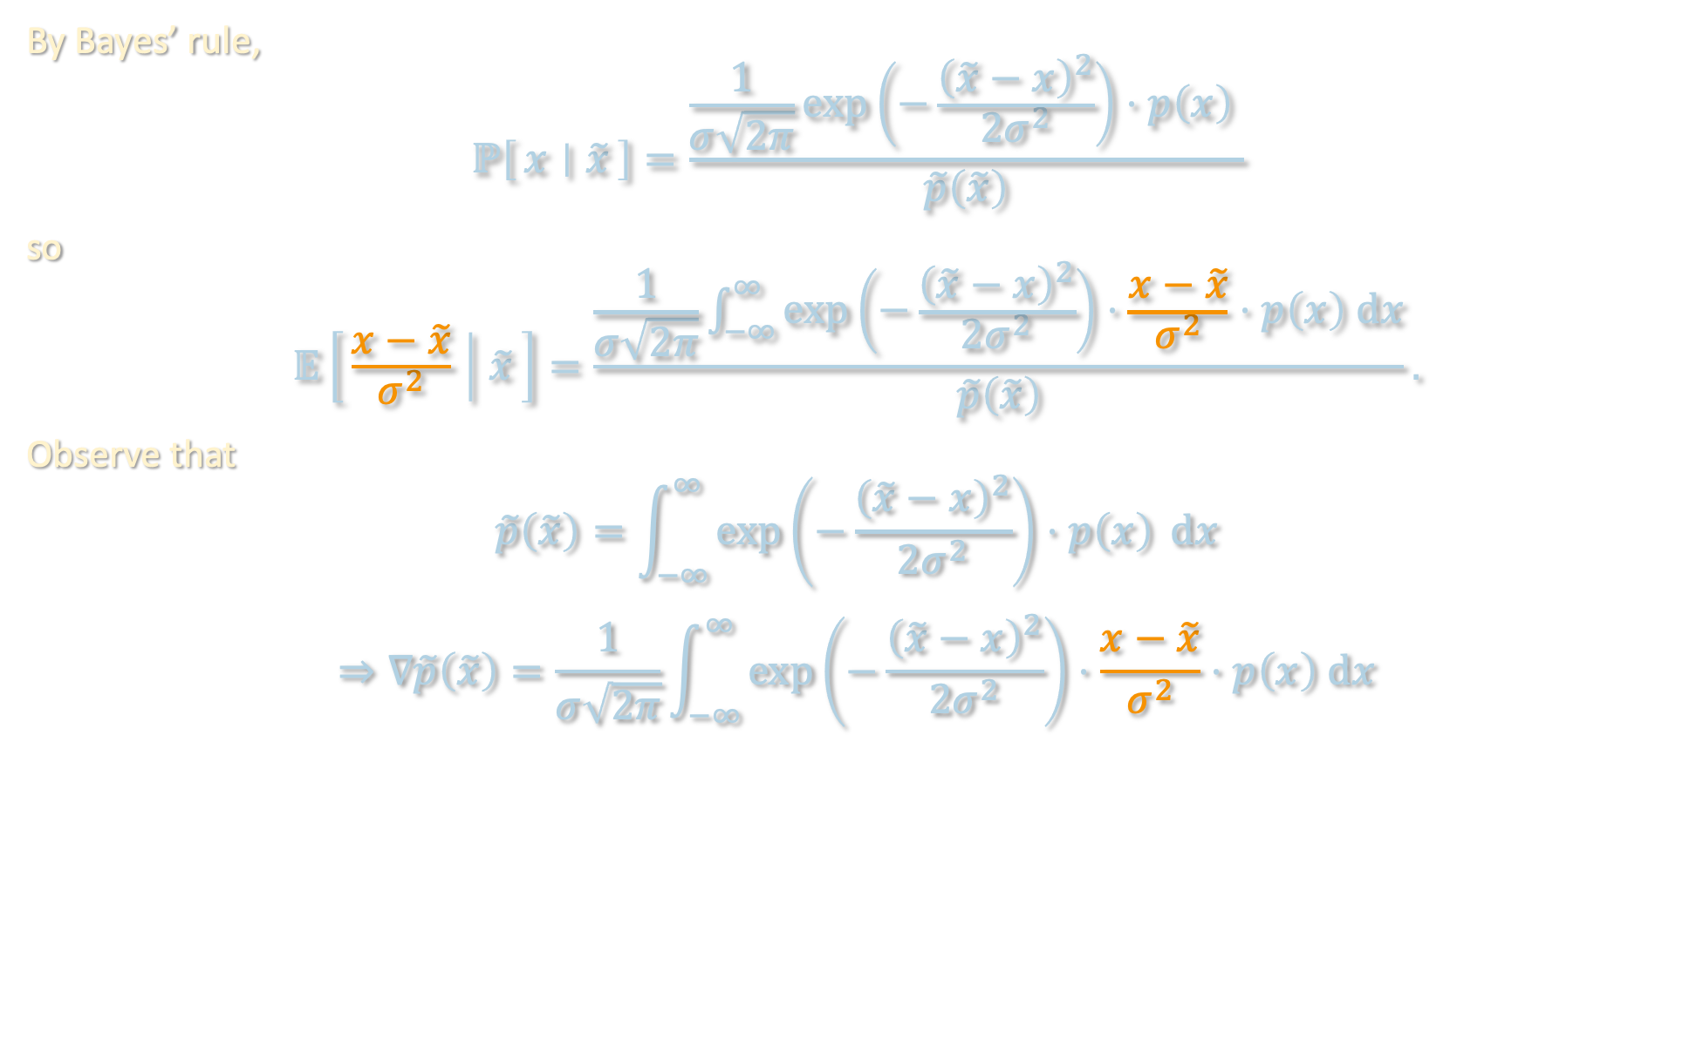
PROOF OF TWEEDIE’S FORMULA
$$𝔼\left[x | \tilde{x}\right]=\tilde{x}+σ^{2}⋅∇ ln \tilde{p}\left(\tilde{x}\right)$$
By Bayes’ rule,
$$ℙ\left[x ∣ \tilde{x}\right]=\frac{\frac{1}{σ\sqrt{2π}}\exp\left(−\frac{{\left(\tilde{x}−x\right)}^{2}}{2σ^{2}}\right)⋅p\left(x\right) }{\tilde{p}\left(\tilde{x}\right)}$$
so
$$𝔼\left[\frac{x−\tilde{x}}{σ^{2}} ∣ \tilde{x}\right]=\frac{\frac{1}{σ\sqrt{2π}}\int_{−∞}^{∞}{\exp\left(−\frac{{\left(\tilde{x}−x\right)}^{2}}{2σ^{2}}\right)⋅\frac{x−\tilde{x}}{σ^{2}}⋅p\left(x\right) dx}}{\tilde{p}\left(\tilde{x}\right)}.$$
Observe that
$$\tilde{p}\left(\tilde{x}\right)=\int_{−∞}^{∞}{\exp\left(−\frac{{\left(\tilde{x}−x\right)}^{2}}{2σ^{2}}\right)⋅p\left(x\right) }dx$$
$$⇒∇\tilde{p}\left(\tilde{x}\right)=\frac{1}{σ\sqrt{2π}}\int_{−∞}^{∞}{\exp\left(−\frac{{\left(\tilde{x}−x\right)}^{2}}{2σ^{2}}\right)⋅\frac{x−\tilde{x}}{σ^{2}}⋅p\left(x\right) dx}$$

Slide 12
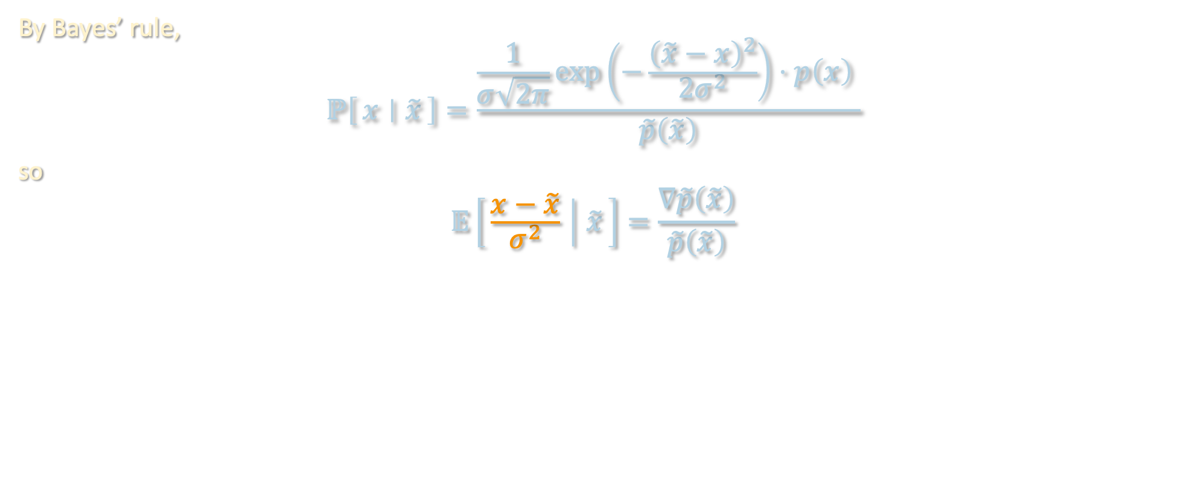

PROOF OF TWEEDIE’S FORMULA
$$𝔼\left[x | \tilde{x}\right]=\tilde{x}+σ^{2}⋅∇ ln \tilde{p}\left(\tilde{x}\right)$$
By Bayes’ rule,
$$ℙ\left[x ∣ \tilde{x}\right]=\frac{\frac{1}{σ\sqrt{2π}}\exp\left(−\frac{{\left(\tilde{x}−x\right)}^{2}}{2σ^{2}}\right)⋅p\left(x\right) }{\tilde{p}\left(\tilde{x}\right)}$$
so
$$𝔼\left[\frac{x−\tilde{x}}{σ^{2}} ∣ \tilde{x}\right]=\frac{∇\tilde{p}\left(\tilde{x}\right)}{\tilde{p}\left(\tilde{x}\right)}$$
$$=∇\ln{\tilde{p}\left(\tilde{x}\right)}$$

Slide 13
SCORE MATCHING
Sources of error:
Initialize at Gaussian instead of $q_{T}$
Idea [Tweedie ‘50s, Hyvarinen ‘05, Vincent ‘11, Song-Ermon ’19]:
reduce estimating the score function to a supervised learning task
Tweedie’s formula: Given $\tilde{x}=x+e$ for $x∼p$ and $e∼N\left(0,σ^{2}⋅Id\right)$,
$$𝔼\left[x | \tilde{x}\right]=\tilde{x}+σ^{2}⋅∇ ln \tilde{p}\left(\tilde{x}\right)$$
where $\tilde{p}$ is the density for $\tilde{x}$
$$𝔼\left[x | \tilde{x}\right]=\tilde{x}+σ^{2}⋅∇ ln \tilde{p}\left(\tilde{x}\right)$$
Score function: Bayes-optimal estimate for noise (up to scaling)

Slide 14
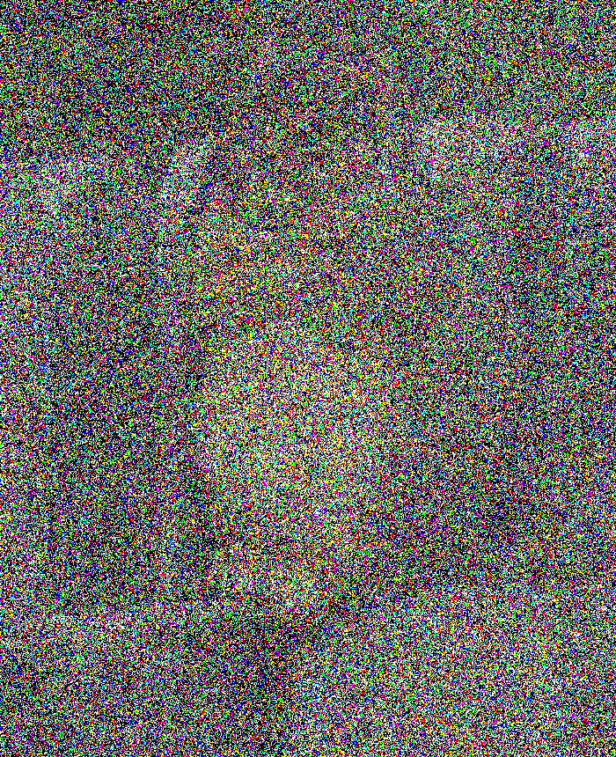
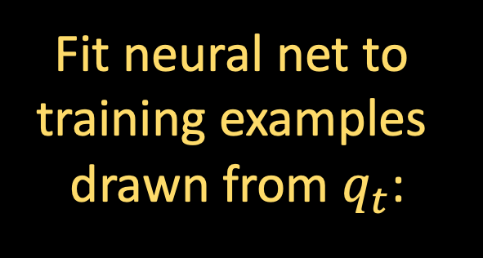

SCORE MATCHING
Sources of error:
Initialize at Gaussian instead of $q_{T}$
Idea [Tweedie ‘50s, Hyvarinen ‘05, Vincent ‘11, Song-Ermon ’19]:
reduce estimating the score function to a supervised learning task
Supervised task: given noisy image $X_{t}$, predict noise $γ$ that was added
Fit neural net to
training examples
drawn from $q_{t}$:

Slide 15

SCORE MATCHING
Sources of error:
Initialize at Gaussian instead of $q_{T}$
Score estimation error
Still far from rigorously understanding why neural nets can solve such supervised tasks well... We will just take on faith that they can
Assumption: For all $t$, have access to score estimate $s_{t}\left(⋅\right)$ satisfying
$$𝔼_{q_{t}}\left[{\left\|s_{t}\left(X_{t}\right)−∇\ln{q_{t}\left(X_{t}\right)}\right\|}^{2}\right]≤ε_{sc}^{2}$$
Fit neural net to
training examples
drawn from $q_{t}$:

Slide 16
DIFFUSION MODELS
Sources of error:
Initialize at Gaussian instead of $q_{T}$
Score estimation error
Reverse process (in practice)
initialize at pure Gaussian
$$t=0$$
$$t=T$$
$$dX_{t}^{←}=\left\{X_{t}^{←}+2∇ ln q_{T−t}\left(X_{t}^{←}\right)\right\} dt+\sqrt{2} dB_{t}$$
$X_{0}^{←}∼q_{T}$ (forward process at time $T$)

Slide 17
DIFFUSION MODELS
Sources of error:
Initialize at Gaussian instead of $q_{T}$
Score estimation error
Reverse process (in practice)
initialize at pure Gaussian
$$t=0$$
$$t=T$$
can’t run in continuous time, need to discretize
$$dX_{t}^{←}=\left\{X_{t}^{←}+2s_{T−t}\left(X_{t}^{←}\right)\right\} dt+\sqrt{2} dB_{t}$$
$X_{0}^{←}∼q_{T}$ (forward process at time $T$)

Slide 18
DIFFUSION MODELS
Sources of error:
Initialize at Gaussian instead of $q_{T}$
Score estimation error
Reverse process (in practice)
initialize at pure Gaussian
$$t=h, 2h, 3h, …$$
$$t=0$$
$$t=T$$
can’t run in continuous time, need to discretize
$$dX_{t}^{←}=\left\{X_{t}^{←}+2s_{T−t}\left(X_{t}^{←}\right)\right\} dt+\sqrt{2} dB_{t}$$
$X_{0}^{←}∼q_{T}$ (forward process at time $T$)

Slide 19
DIFFUSION MODELS
Sources of error:
Initialize at Gaussian instead of $q_{T}$
Score estimation error
Discretization error
Reverse process (in practice)
initialize at pure Gaussian
$$t=h, 2h, 3h, …$$
$$t=0$$
$$t=T$$
$$dX_{t}^{←}=\left\{X_{t}^{←}+2s_{T−kh}\left(X_{kh}^{←}\right)\right\} dt+\sqrt{2} dB_{t}$$
$X_{0}^{←}∼q_{T}$ (forward process at time $T$)
Linear SDE, so we can solve exactly
$$k=⌊t/h⌋$$

Slide 20

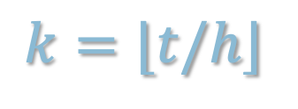


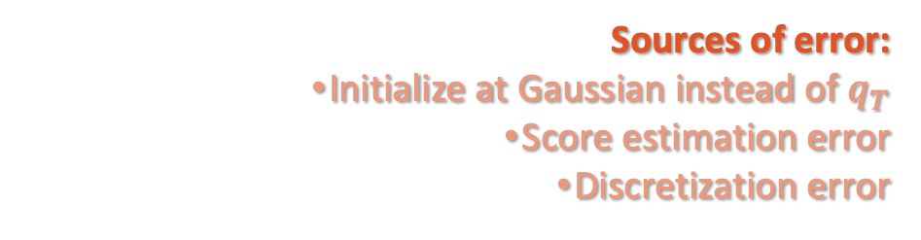
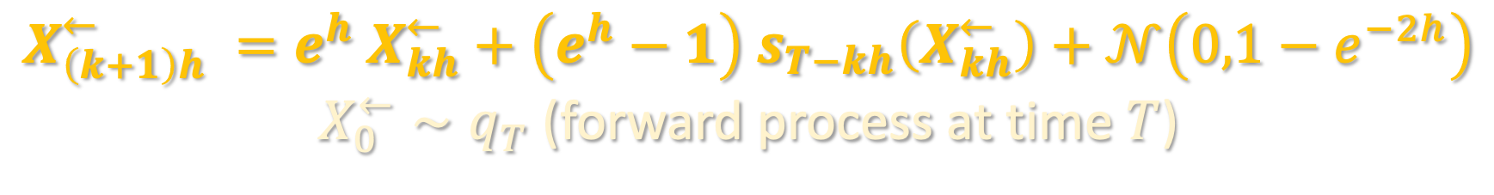
DIFFUSION MODELS
Sources of error:
Initialize at Gaussian instead of $q_{T}$
Score estimation error
Discretization error
Reverse process (in practice)
initialize at pure Gaussian
$$t=h, 2h, 3h, …$$
$$t=0$$
$$t=T$$
$$X_{\left(k+1\right)h}^{←} =e^{h} X_{kh}^{←}+\left(e^{h}−1\right) s_{T−kh}\left(X_{kh}^{←}\right)+𝒩\left(0,1−e^{−2h}\right)$$
$X_{0}^{←}∼q_{T}$ (forward process at time $T$)
$$k=⌊t/h⌋$$

Slide 21
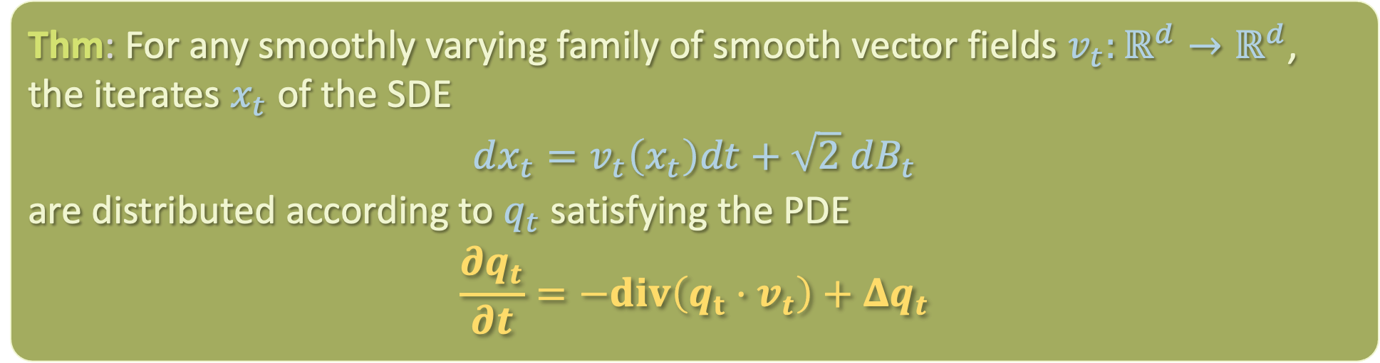

JUSTIFICATION FOR THE REVERSE SDE
The evolution of the probability distribution $q_{t}$ is given by a PDE in the space of probability distributions, the Fokker-Planck equation
Proof: see board
Can then check that Fokker-Planck equations for forward and reverse processes are time-reversals of each other
Thm: For any smoothly varying family of smooth vector fields $v_{t}:ℝ^{d}→ℝ^{d}$, the iterates $x_{t}$ of the SDE
$$dx_{t}=v_{t}\left(x_{t}\right)dt+\sqrt{2} dB_{t}$$
are distributed according to $q_{t}$ satisfying the PDE
$$\frac{∂q_{t}}{∂t}=−div\left(q_{t}⋅v_{t}\right)+Δq_{t}$$

Slide 22
Primer on diffusion models
Discretization analysis
Course recap

Slide 23
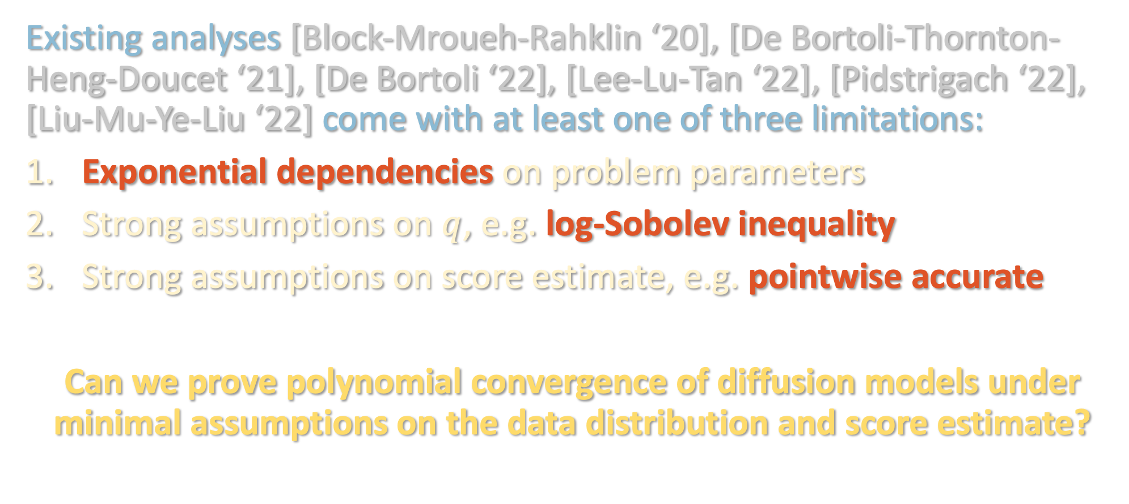
PRIOR WORK
Existing analyses [Block-Mroueh-Rahklin ‘20], [De Bortoli-Thornton-Heng-Doucet ‘21], [De Bortoli ‘22], [Lee-Lu-Tan ‘22], [Pidstrigach ‘22], [Liu-Mu-Ye-Liu ‘22] come with at least one of three limitations:
Exponential dependencies on problem parameters
Strong assumptions on $q$, e.g. log-Sobolev inequality
Strong assumptions on score estimate, e.g. pointwise accurate
Can we prove polynomial convergence of diffusion models under minimal assumptions on the data distribution and score estimate?

Slide 24
ASSUMPTIONS
($L^{2}$-accurate score estimate): For all $t=0,h,2h,…,T$, the score estimate $s_{t}\left(⋅\right)$ satisfies
$$𝔼_{q_{t}}\left[{\left\|s_{t}\left(X_{t}\right)−∇\ln{q_{t}\left(X_{t}\right)}\right\|}^{2}\right]≤ε_{sc}^{2}$$
(Smoothness): For all $t≥0$, $∇\ln{q_{t}}\left(⋅\right)$ is $L$-Lipschitz
(Bounded second moment): $𝔪_{2}^{2}≔𝔼_{q}\left[{\left\|x\right\|}^{2}\right]<∞$
II is standard and necessary to get TV convergence
III is significantly weaker than what is needed in prior work (e.g. distribution does not have to be approximately log-concave)

Slide 25
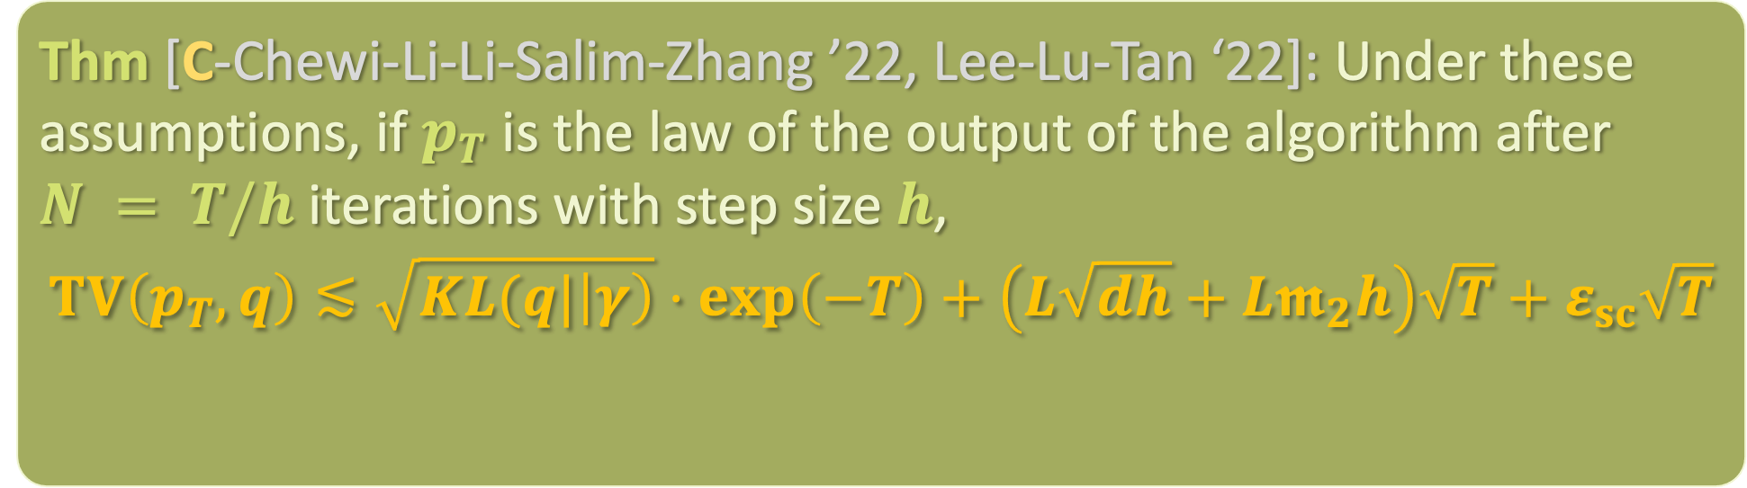
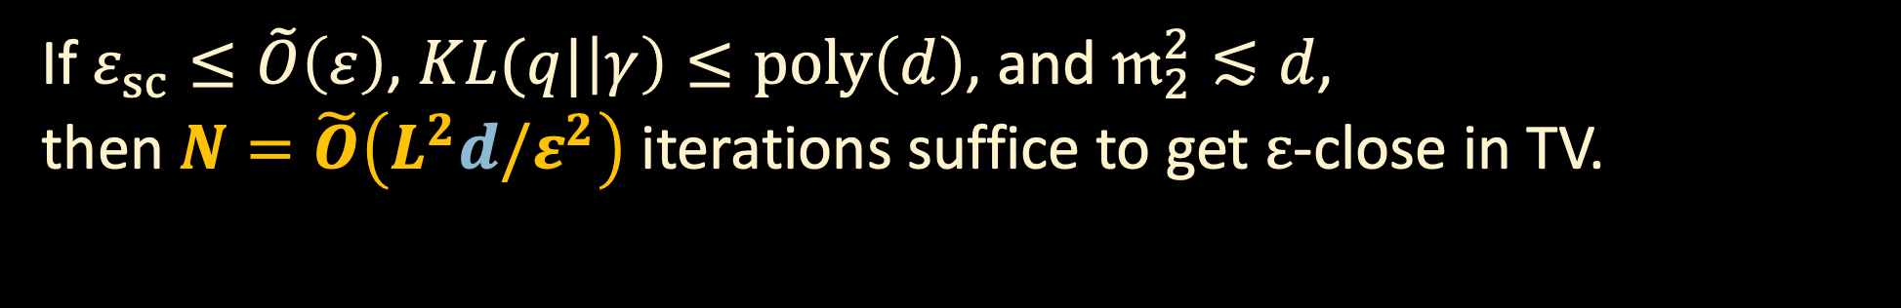
CONVERGENCE GUARANTEE
Thm [C-Chewi-Li-Li-Salim-Zhang ’22, Lee-Lu-Tan ‘22]: Under these assumptions, if $p_{T}$ is the law of the output of the algorithm after $N = T/h$ iterations with step size $h$,
$$TV\left(p_{T},q\right)≲\sqrt{KL(q|\left|γ\right)}⋅\exp\left(−T\right)+\left(L\sqrt{dh}+L𝖒_{2}h\right)\sqrt{T}+ε_{sc}\sqrt{T}$$
error from initializing at $γ$ instead of $q_{T}$
discretization error
score error
If $ε_{sc}≤\tilde{O}\left(ε\right)$, $KL(q|\left|γ\right)≤poly\left(d\right)$, and $𝔪_{2}^{2}≲d$,
then $N=\tilde{O}\left(L^{2}d/ε^{2}\right)$ iterations suffice to get $ε$-close in TV.

Slide 26
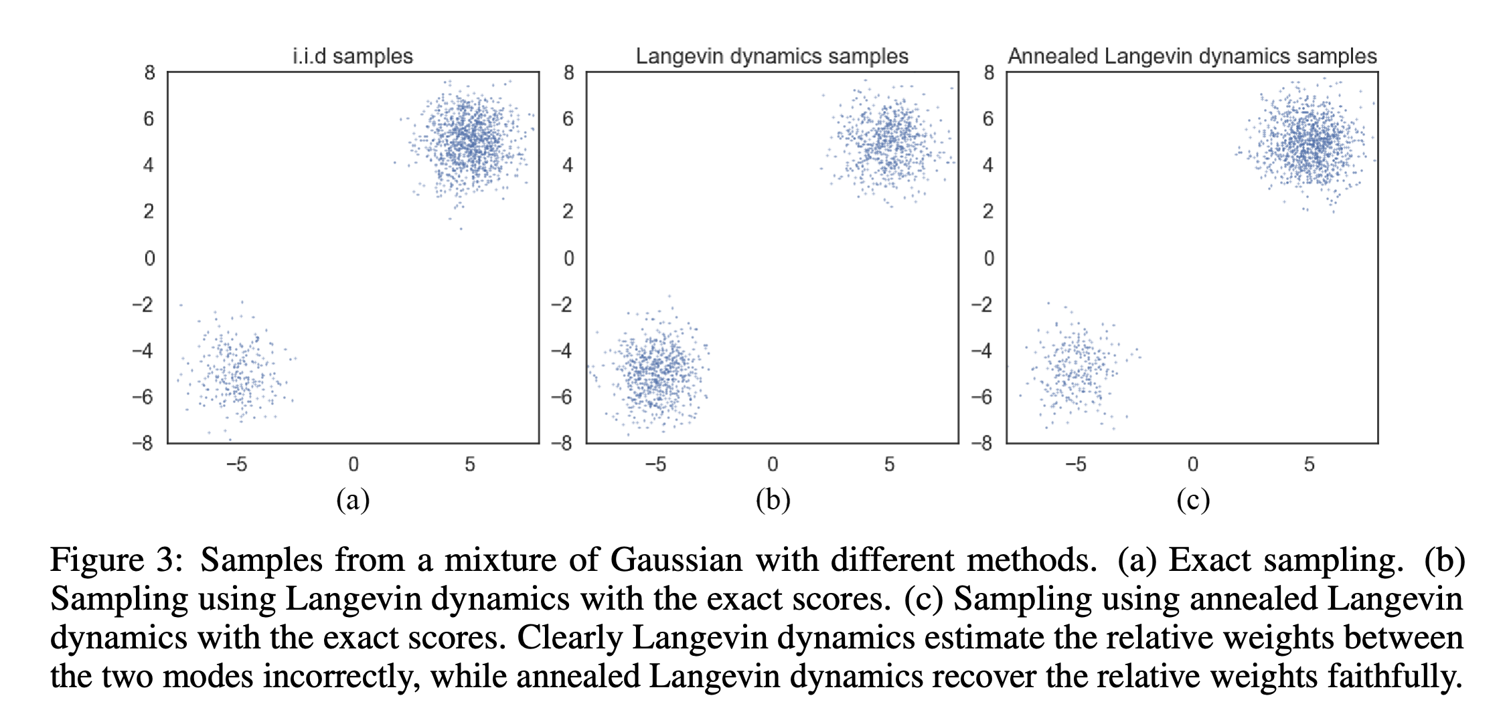

COMPARISON TO LANGEVIN MCMC
Langevin dynamics
$$dY_{t}=−∇\ln{q}\left(Y_{t}\right)+\sqrt{2h} dB_{t}$$
As $t→∞$, distribution over $Y_{t}$ converges to the stationary distribution $q$
Issue: Langevin may take long time to mix for multimodal distributions
Intuition: by accessing the score at many noise scales, diffusion models can pass freely between the different modes of the distribution
[Song-Ermon ’19]

Slide 27
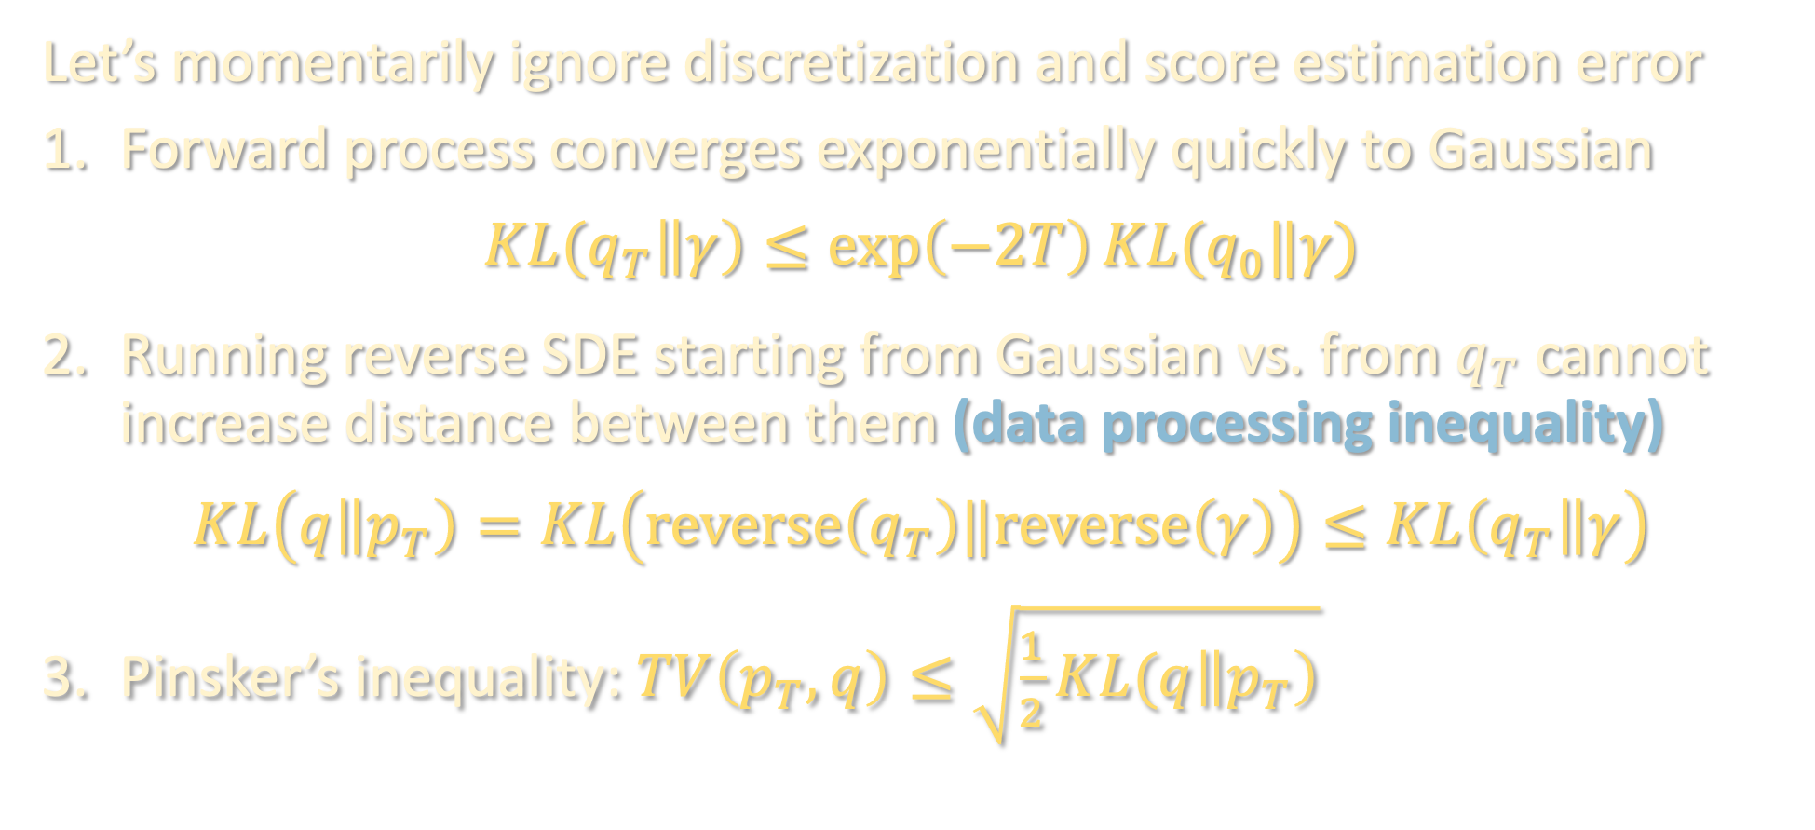
CONTINUOUS-TIME ARGUMENT
$q$: data distribution
$q_{t}$: forward process at time $t$
$p_{t}$: reverse process at time $t$
$$q_{0}=q,p_{0}=γ, p_{T}=alg. output$$
Let’s momentarily ignore discretization and score estimation error
Forward process converges exponentially quickly to Gaussian
$$KL(q_{T}\left\|γ\right)≤\exp\left(−2T\right)KL(q_{0}‖γ)$$
Running reverse SDE starting from Gaussian vs. from $q_{T}$ cannot increase distance between them (data processing inequality)
$$KL\left(q\left\|p_{T}\right)=KL\left(reverse\left(q_{T}\right)‖reverse\left(γ\right)\right)≤KL\left(q_{T}\right\|γ\right)$$
Pinsker’s inequality: $TV\left(p_{T},q\right)≤\sqrt{\frac{1}{2}KL(q\left\|p_{T}\right)}$

Slide 28

DISCRETIZATION ARGUMENT
Consider the ideal reverse process (continuous, perfect score) and algorithm (discrete, estimated score), with both now initialized at $q_{T}$
To control the distance between these processes, we use Girsanov’s theorem, a powerful tool for bounding distance between laws of processes driven by the same Brownian motion
Intuition: distribution over last iterate of reverse process is hard to characterize, but distribution over trajectory just given by a bunch of Gaussian samples

Slide 29

DISCRETIZATION ARGUMENT
Consider the ideal reverse process (continuous, perfect score) and algorithm (discrete, estimated score), with both now initialized at $q_{T}$
To control the distance between these processes, we use Girsanov’s theorem, a powerful tool for bounding distance between laws of processes driven by the same Brownian motion
Intuition: distribution over last iterate of reverse process is hard to characterize, but distribution over trajectory just given by a bunch of Gaussian samples

Slide 30
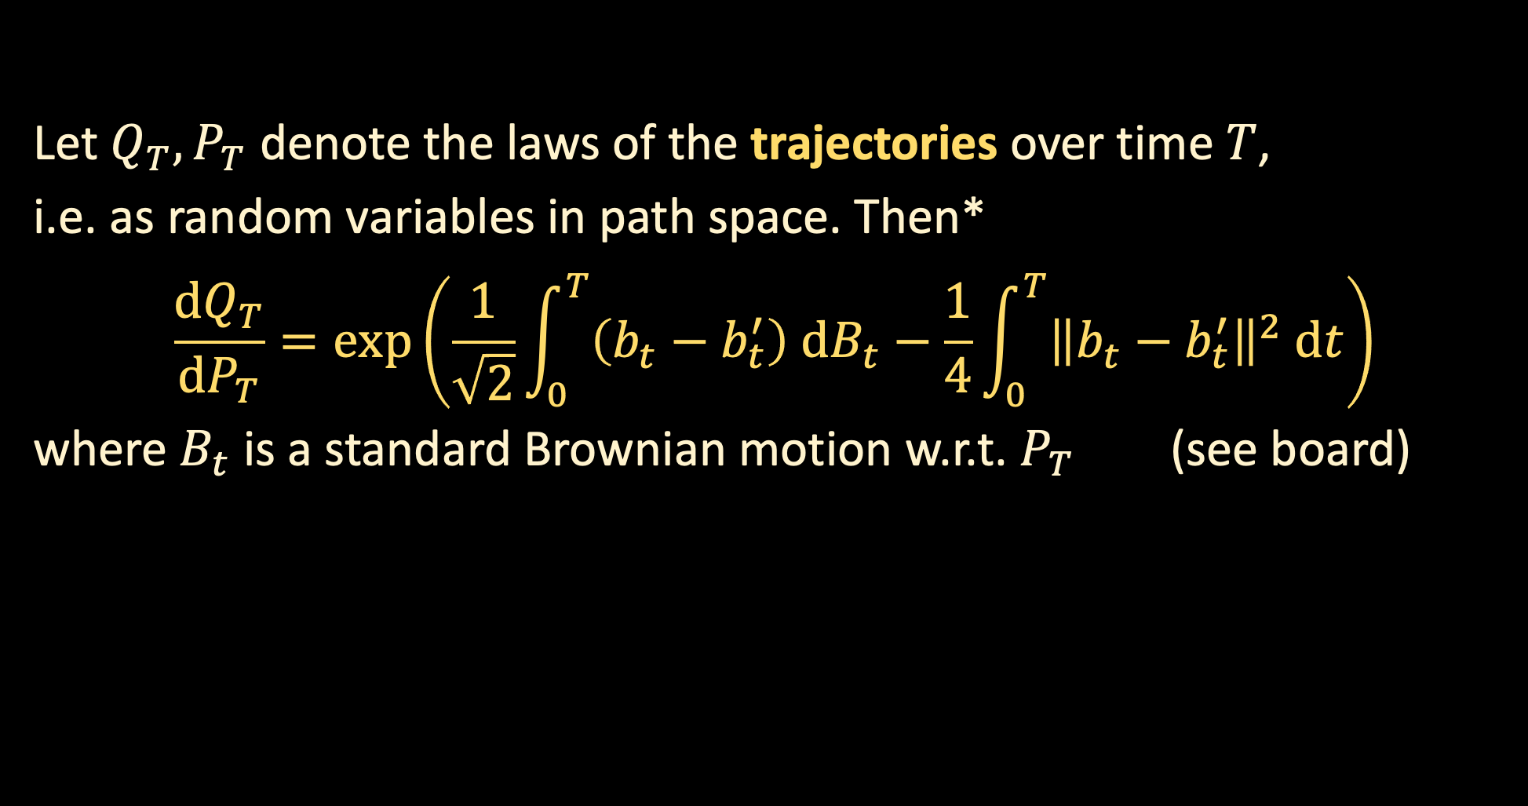

DISCRETIZATION ARGUMENT
Consider the SDE’s
$$dX_{t}=b_{t} dt+\sqrt{2} dB_{t}$$
$$dX_{t}=b_{t}^{′} dt+\sqrt{2} dB_{t}$$
with the same initial distribution.
Let $Q_{T}, P_{T}$ denote the laws of the trajectories over time $T$,
i.e. as random variables in path space. Then*
$$\frac{dQ_{T}}{dP_{T}}=\exp\left(\frac{1}{\sqrt{2}}\int_{0}^{T}{\left(b_{t}−b_{t}^{′}\right) dB_{t}}−\frac{1}{4}\int_{0}^{T}{{\left\|b_{t}−b_{t}^{′}\right\|}^{2} dt}\right)$$
where $B_{t}$ is a standard Brownian motion w.r.t. $P_{T}$ (see board)

Slide 31
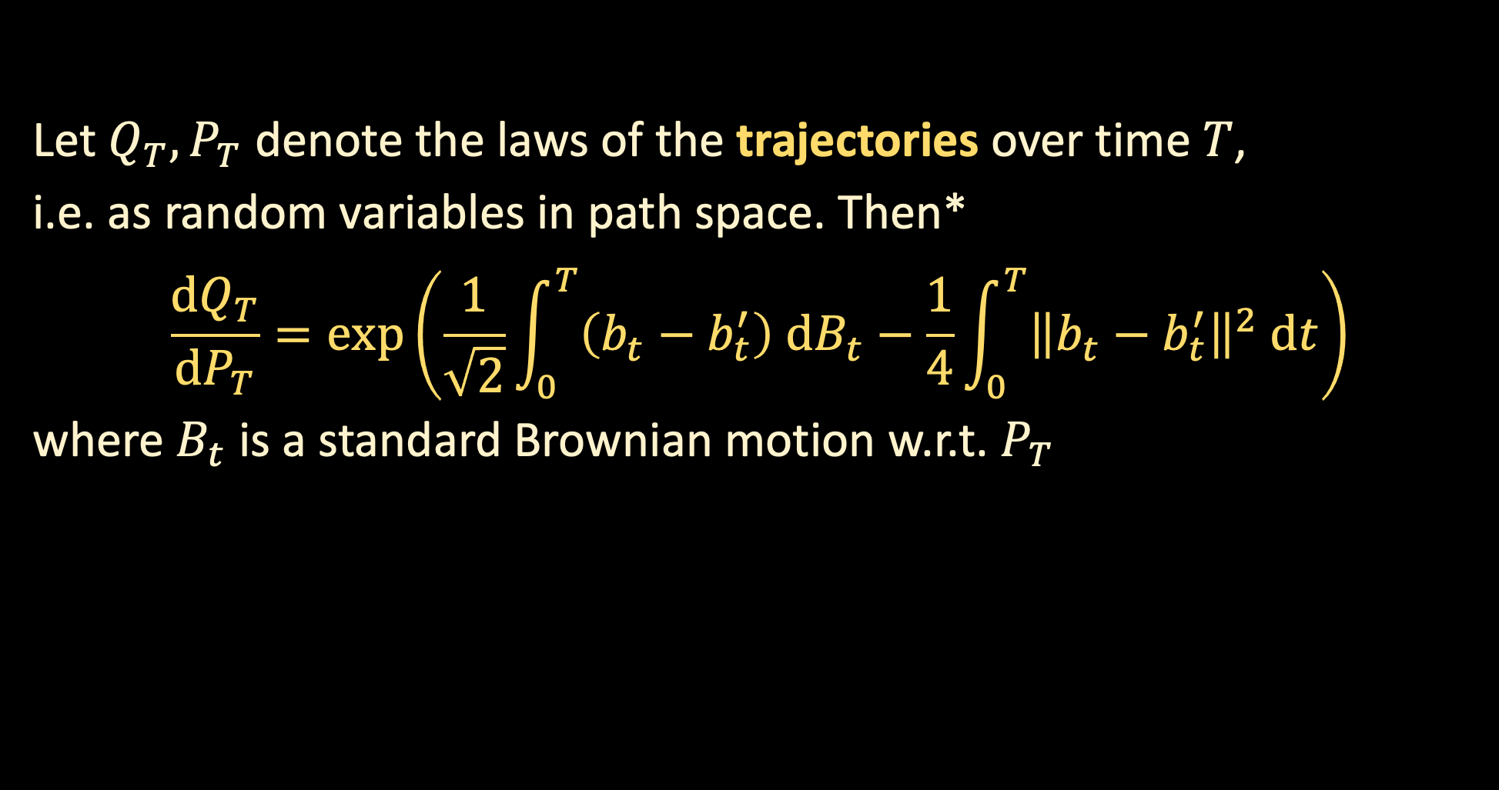

DISCRETIZATION ARGUMENT
Consider the SDE’s
$$dX_{t}=\left\{X_{t}+2∇\ln{q_{T−t}\left(X_{t}\right)}\right\} dt+\sqrt{2} dB_{t}$$
$$dX_{t}=\left\{X_{t}+2s_{T−kh}\left(X_{kh}\right)\right\} dt+\sqrt{2} dB_{t}$$
both initialized at $q_{T}$.
Let $Q_{T}, P_{T}$ denote the laws of the trajectories over time $T$,
i.e. as random variables in path space. Then*
$$\frac{dQ_{T}}{dP_{T}}=\exp\left(\frac{1}{\sqrt{2}}\int_{0}^{T}{\left(b_{t}−b_{t}^{′}\right) dB_{t}}−\frac{1}{4}\int_{0}^{T}{{\left\|b_{t}−b_{t}^{′}\right\|}^{2} dt}\right)$$
where $B_{t}$ is a standard Brownian motion w.r.t. $P_{T}$

Slide 32

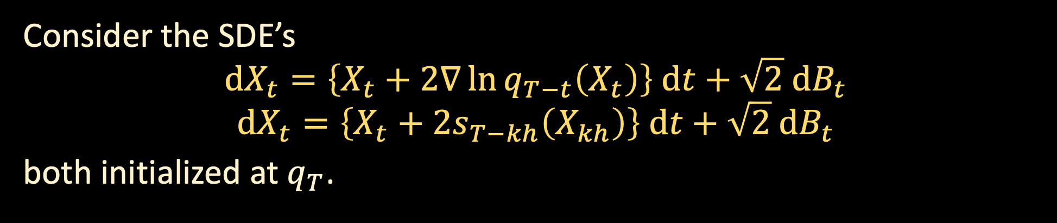
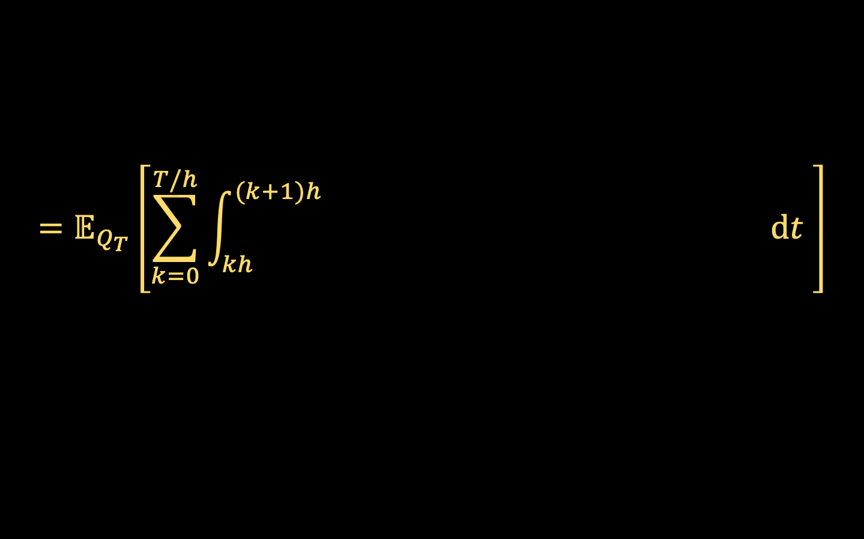


DISCRETIZATION ARGUMENT
Consider the SDE’s
$$dX_{t}=\left\{X_{t}+2∇\ln{q_{T−t}\left(X_{t}\right)}\right\} dt+\sqrt{2} dB_{t}$$
$$dX_{t}=\left\{X_{t}+2s_{T−kh}\left(X_{kh}\right)\right\} dt+\sqrt{2} dB_{t}$$
both initialized at $q_{T}$.
$$≥KL\left(ideal process‖algorithm\right)$$
Let $Q_{T}, P_{T}$ denote the laws of the trajectories over time $T$,
$KL(Q_{T}\left\|P_{T}\right)=𝔼_{Q_{T}}\left[\ln{\frac{dQ_{T}}{dP_{T}}}\right]$
$$=𝔼_{Q_{T}}\left[\sum_{k=0}^{T/h}{\int_{kh}^{(k+1)h}{{\left\|∇\ln{q_{T−t}(X_{t})}−s_{T−kh}\left(X_{k}\right)\right\|}^{2} dt }}\right]$$
$${\left\|∇\ln{q_{T−t}(X_{t})}−s_{T−kh}\left(X_{kh}\right)\right\|}^{2}$$

Slide 33
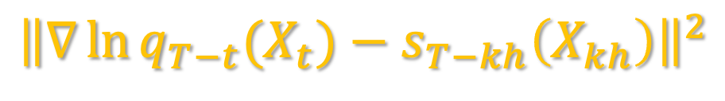
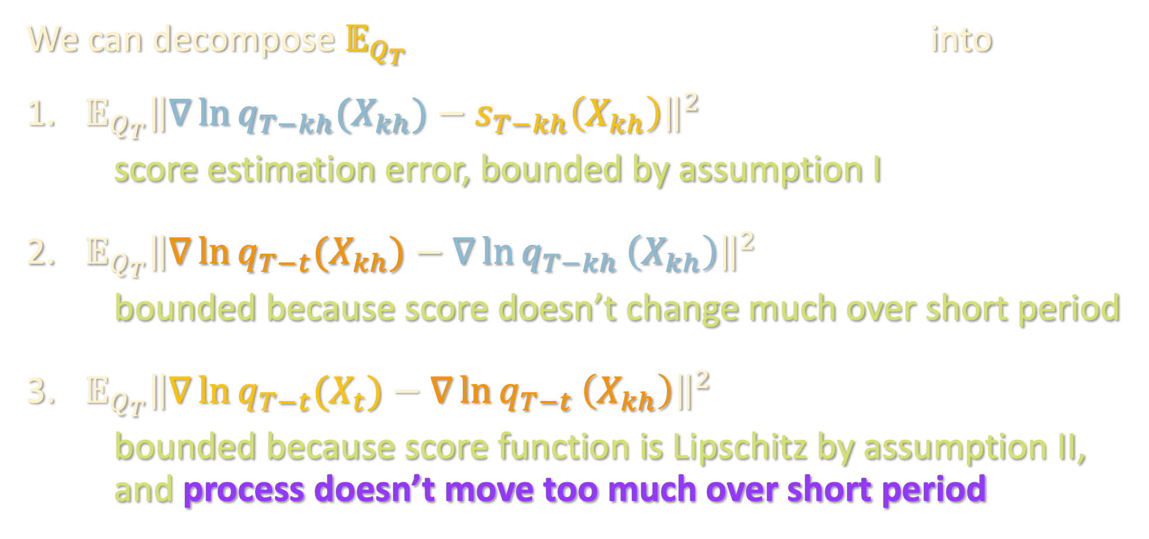
DISCRETIZATION ARGUMENT
$${\left\|∇\ln{q_{T−t}(X_{t})}−s_{T−kh}\left(X_{kh}\right)\right\|}^{2}$$
We can decompose $𝔼_{Q_{T}}$ into
${𝔼_{Q_{T}}\left\|∇\ln{q_{T−kh}(X_{kh})}−s_{T−kh}\left(X_{kh}\right)\right\|}^{2}$
score estimation error, bounded by assumption I
${𝔼_{Q_{T}}\left\|∇\ln{q_{T−t}(X_{kh})}−∇\ln{q_{T−kh}}\left(X_{kh}\right)\right\|}^{2}$
bounded because score doesn’t change much over short period
${𝔼_{Q_{T}}\left\|∇\ln{q_{T−t}(X_{t})}−∇\ln{q_{T−t}}\left(X_{kh}\right)\right\|}^{2}$
bounded because score function is Lipschitz by assumption II, and process doesn’t move too much over short period

Slide 34


DISCRETIZATION ARGUMENT
Example calculation bounding movement over short period of time
See board for how to bound the first two terms
$$𝔼 {\left\|X_{t+h}−X_{t}\right\|}^{2}$$ | $$=𝔼 {\left\|\int_{t}^{t+h}{\left\{X_{r}+2∇\ln{q_{T−r}\left(X_{r}\right)}\right\} dr}+\sqrt{2} \left(B_{t+h}−B_{t}\right)\right\|}^{2}$$
 | $$≲h\int_{t}^{t+h}{𝔼 {\left\|X_{r}\right\|}^{2} dr}+h\int_{t}^{t+h}{𝔼 {\left\|∇\ln{q_{T−r }\left(X_{r}\right)}\right\|}^{2}}dr+𝔼 {\left\|B_{t+h}−B_{t}\right\|}^{2}$$
$$O(dh)$$

Slide 35
PROVABLE SCORE ESTIMATION
Known settings where score estimation is provably possible:
[El Alaoui-Montanari-Sellke, FOCS ’22]: AMP + diffusion model → state-of-the-art guarantees for sampling from spin glasses (“random Ising model”)
[Montanari-Wu ‘22]: AMP + diffusion model → posterior sampler for Z2 synchronization
Optimal algorithms for Bayesian inference
+ diffusion models
= state of the art samplers (even in theory!)

Slide 36
PROVABLE SCORE ESTIMATION
Known settings where score estimation is provably possible:
[El Alaoui-Montanari-Sellke, FOCS ’22]: AMP + diffusion model → state-of-the-art guarantees for sampling from spin glasses (“random Ising model”)
[Montanari-Wu ‘22]: AMP + diffusion model → posterior sampler for Z2 synchronization
[Shah-C-Klivans, NeurIPS ‘23]: gradient descent on score matching objective + diffusion model → new algorithm for learning Gaussian mixtures

Slide 37
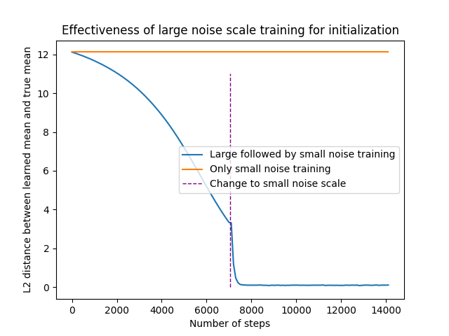
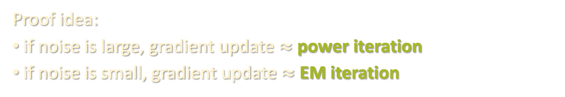
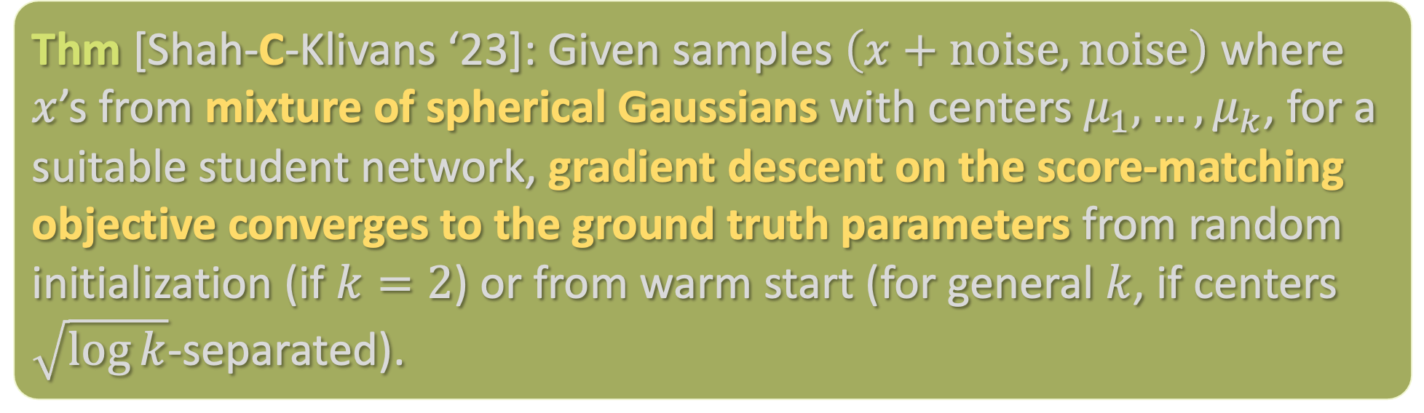
PROVABLE SCORE ESTIMATION
Thm [Shah-C-Klivans ‘23]: Given samples $\left(x+noise,noise\right)$ where $x$’s from mixture of spherical Gaussians with centers $μ_{1},…,μ_{k}$, for a suitable student network, gradient descent on the score-matching objective converges to the ground truth parameters from random initialization (if $k=2$) or from warm start (for general $k$, if centers $\sqrt{\log{k}}$-separated).
Proof idea:
if noise is large, gradient update $≈$ power iteration
if noise is small, gradient update $≈$ EM iteration

Slide 38
Primer on diffusion models
Discretization analysis
Parting thoughts

Slide 39
BEYOND CS 224
Differential privacy (Vadhan, Dwork, Neel): https://privacytools.seas.harvard.edu/classes
Algorithmic fairness (CS 226r, Dwork)
More on deep learning (CS 229br, Barak)
Online / reinforcement learning (CS 184, Janson & Kakade)
More on optimization (AM 121, Y. Chen; ENG-SCI 257, Yang)
Economics and ML (CS 236r, Y. Chen)
Causal inference (https://datascience.harvard.edu/programs/causal-inference/)
Control theory (AM 232, Li)
Sampling / MCMC (CS 291, Sellke)

Slide 40
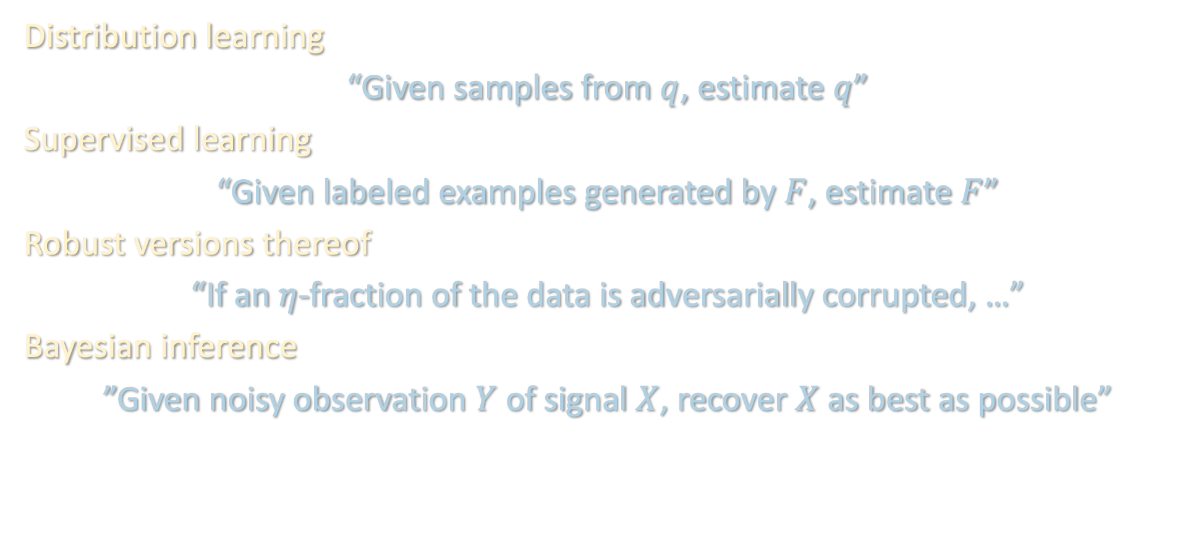
LOOKING BACK: ALGORITHMIC QUESTIONS
Distribution learning
“Given samples from $q$, estimate $q$”
Supervised learning
“Given labeled examples generated by $F$, estimate $F$”
Robust versions thereof
“If an $η$-fraction of the data is adversarially corrupted, …”
Bayesian inference
”Given noisy observation $Y$ of signal $X$, recover $X$ as best as possible”

Slide 41
LOOKING BACK: UPPER BOUNDS
”Moment”/polynomial-based methods
  Polynomial regression: what linearized neural networks are implicitly doing
  Tensor decomposition
  Sum-of-squares: “programming language”, useful for exploiting moments of data distribution in principled way
  ”Optimal” in the sense that they often saturate CSQ / SQ lower bounds
  …but not the end of the story (e.g. filtered PCA)

Slide 42
LOOKING BACK: UPPER BOUNDS
Most things in life are some form of nonconvex optimization
  Practitioner’s method of choice, often hard to analyze in theory
  Many algos in class are implicitly performing nonconvex optimization:
    Tensor power method
    Belief propagation
    Filtering in robust statistics
  Conversely, gradient descent sometimes secretly mimics “theory” algos:
    NTK is just doing kernel regression
    SGD for learning single index models is just finding nontrivial Hermite coefficient
    Score estimation for learning mixtures of Gaussians is doing power method / EM
  Asymptotic methods (mean-field, state evolution) for getting sharp predictions

Slide 43
LOOKING BACK: LOWER BOUNDS
Traditional reduction-based hardness is hard to prove because we want to preserve the “average-case” nature of the instance
Two exceptions seen in class: cryptographic reductions
  Daniely-Vardi lifting
  CLWE (continuous learning with errors)
In lieu of reductions, in ML theory we often try prove failure of families of popular / conjecturally optimal algorithms
  “Easier” because there are standard “recipes”, e.g. statistical query dimension, statistical dimension
  Recipes often based on failure of specific algorithms (e.g. method of moments / random projections), suggesting these techniques are “optimal”
  Statistical query (SQ) and correlational statistical query (CSQ) algorithms (CS style)
  Failure of belief propagation / AMP (physics style)

Slide 44
LOOKING BACK: MODELING
We largely focused on the “realizable” / “student-teacher” setting
  Self-contained testbed over which we know for certain that algorithms in practice succeed – we just don’t know why and, for the time being, just want to find some algorithm that we can prove succeeds
Beyond worst case: problem instances in practice are not fully adversarial
  Smoothed analysis: model this by considering adversarial instances that have been slightly perturbed by noise
  Robustness
  Can be subtle picking right corruption model: RCN -> Massart -> agnostic
  Modeling data as adversarially corrupted can be useful even in the absence of an adversary (e.g. fairness, semirandom noise, etc.)

Slide 45
LOOKING AHEAD: MODELING
Today we saw a glimpse of another approach: oracle reductions
  Instead of trying to fully understand a deep learning system (e.g. diffusion models), break it into modular parts (e.g. score estimation + sampling) and prove one component works well assuming the other works somewhat well
  In lieu of “end-to-end” guarantees, can we obtain other nontrivial reductions between different learning tasks?
  (as usual, need to be careful how the reductions transform the relevant input distributions)

Slide 46
LOOKING AHEAD
  This area is still incredibly young, and this course may look very different in 5-10 years
  As theorists, we are unbelievably fortunate to be living in a time where the practice of machine learning is constantly offering tantalizing mathematical mysteries waiting to be understood rigorously
  I hope many of you will contribute to understanding these mysteries!

