Slide 1

CS 224: ALGORITHMS FOR DATA SCIENCE
LECTURE 0 (8/26)
INTRODUCTION
https://sitanchen.com/cs224-f23.html

Slide 2
Logistics
Philosophy
Vignette

Slide 3
TEACHING STAFF
Instructor: Sitan Chen
sitan@seas.harvard.edu
Teaching Fellows:
David Brewster
dbrewster@g.harvard.edu
Depen Morwani
dmorwani@g.harvard.edu
Rosie Zhao
rosiezhao@g.harvard.edu
Office Hours:
SEC 3.325, Thursdays 4-5
Weekly office hour:
SEC 2.330, Mondays 11-12
(check course page for updates)
Pset office hour:
Held the week of pset deadline
http://whenisgood.net/f4fdbbh
Fill out time prefs by 9/8

Slide 4
COURSEWORK
0%: pset 0
40%: 4 psets, roughly once / 2 weeks
30%: course project
15%: class participation
15%: scribing

Slide 5
PARTICIPATION
Participation = engagement during lectures and in discussions on Ed
Please stop me and ask questions during lectures!
If you’re confused about something / can’t read my handwriting, odds are you’re not the only one

Slide 6
SCRIBING
Signup sheet will be posted end of today on course webpage
  Sign up for 1 slot by 9/8
  First come first serve
  Link to official scribing template and instructions will also be posted

Slide 7
FINAL PROJECT
Three options
  Original research
  Expository survey
  Technical blog post series
List of (optional) suggested topics/readings will be posted in the first few weeks of semester
Timing:
  Last pset will be due ~end of October
  Submit project idea by first week of November (details to follow)
Group projects (of up to 4) strongly encouraged, esp. for options 1+3

Slide 8
Logistics
Philosophy
Vignette

Slide 9
THIS COURSE
We will focus on algorithms with provable guarantees

Slide 10
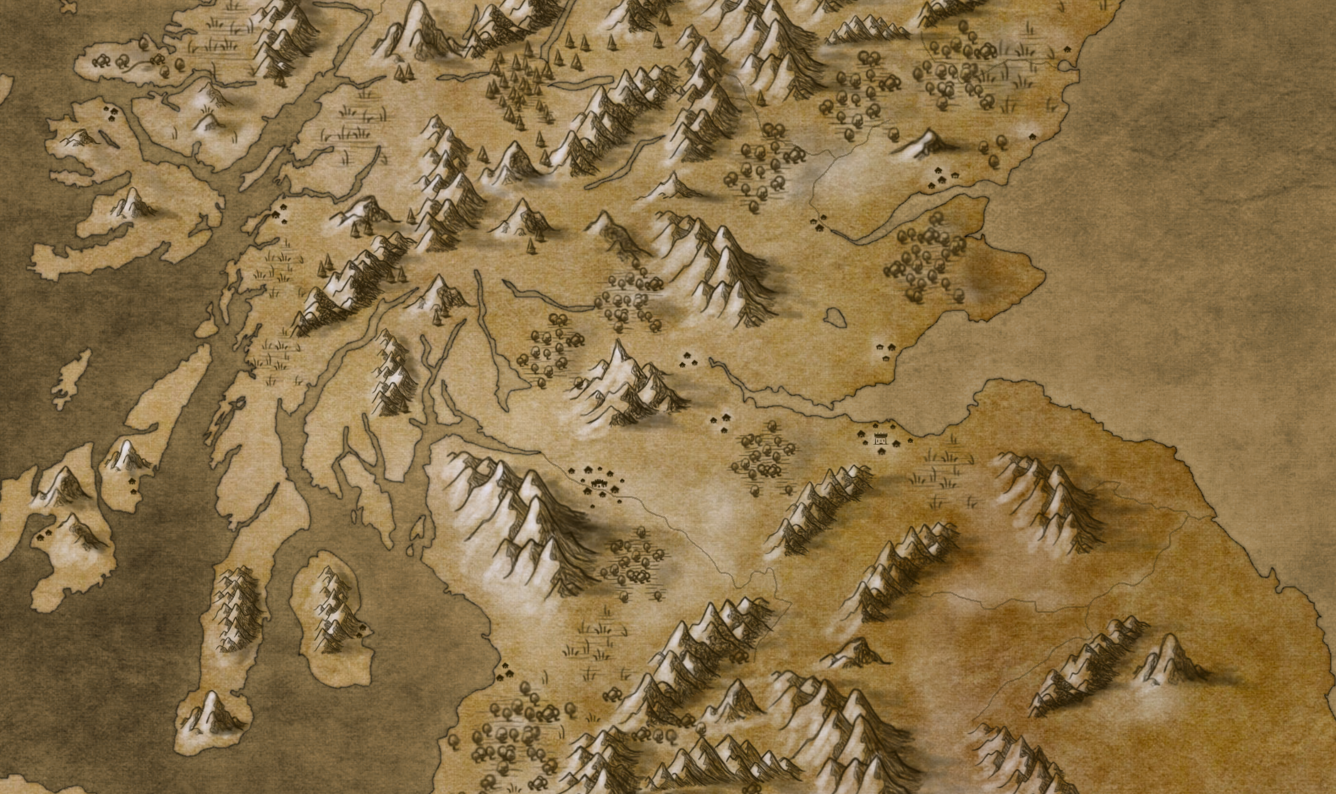
THIS COURSE
We will focus on algorithms with provable guarantees
What does it mean to “think algorithmically” in data science?
counting/
sampling
hashing
graph coloring
minimum spanning tree
sorting
convex optimization
lp’s/sdp’s
traveling salesman
matrix multiplication
primality testing
polynomial factorization
graph isomorphism
shortest
paths
satisfiability
graph cuts
network
flows
lattice problems
parity
games
dynamic
programming
integer factorization

Slide 11
THIS COURSE
We will focus on algorithms with provable guarantees
What does it mean to “think algorithmically” in data science?
graphical models
quantum learning
clustering/ mixture models
tensor methods
dimensionality reduction
nonconvex optimization
first/second-order methods
generative modeling
neural networks
robustness
multi-index models
strategic behavior
algorithmic fairness
agnostic learning
matrix completion
sparse recovery
online learning
private learning
dictionary learning
reinforcement learning

Slide 12
THIS COURSE
We will focus on algorithms with provable guarantees
What does it mean to “think algorithmically” in data science?

Slide 13

THIS COURSE
We will focus on algorithms with provable guarantees
What does it mean to “think algorithmically” in data science?

Slide 14
THIS COURSE
We will focus on algorithms with provable guarantees
What does it mean to “think algorithmically” in data science?
$$\left(x_{1}∨{\overline{x}}_{2}∨x_{7}\right)∧\left(x_{2}∨{\overline{x}}_{4}∨x_{5}\right)∧⋯∧\left({\overline{x}}_{3}∨x_{6}∨x_{1}\right)$$

Slide 15
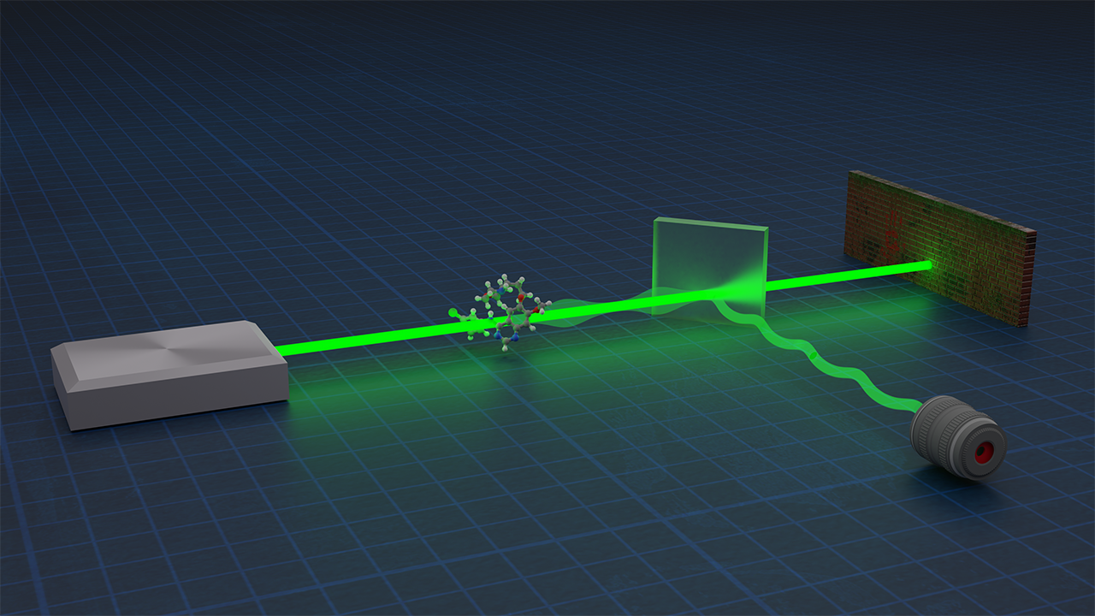
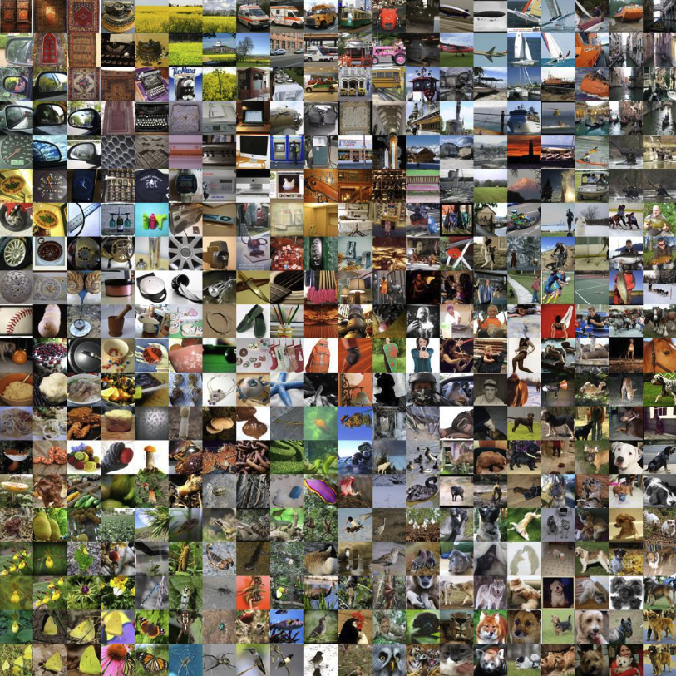

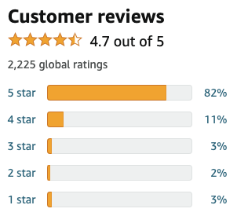
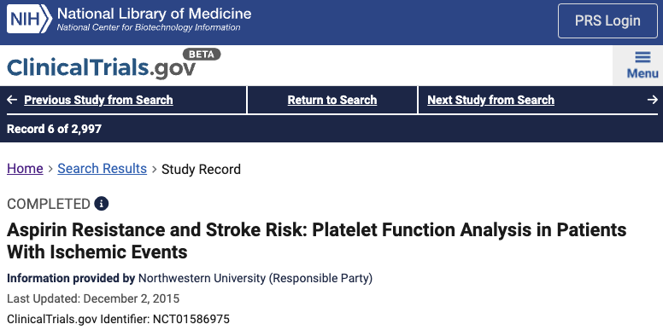
THIS COURSE
We will focus on algorithms with provable guarantees
What does it mean to “think algorithmically” in data science?

Slide 16
THIS COURSE
We will focus on algorithms with provable guarantees
What does it mean to “think algorithmically” in data science?
Pitfalls abound....
counting/
sampling
hashing
graph coloring
minimum spanning tree
sorting
convex optimization
lp’s/sdp’s
traveling salesman
matrix multiplication
primality testing
polynomial factorization
graph isomorphism
shortest
paths
satisfiability
graph cuts
network
flows
lattice problems
parity
games
dynamic
programming
integer factorization

Slide 17

THIS COURSE
We will focus on algorithms with provable guarantees
What does it mean to “think algorithmically” in data science?
Pitfalls abound....
counting/
sampling
hashing
graph coloring
minimum spanning tree
sorting
convex optimization
lp’s/sdp’s
traveling salesman
matrix multiplication
primality testing
polynomial factorization
graph isomorphism
shortest
paths
satisfiability
graph cuts
network
flows
lattice problems
parity
games
dynamic
programming
integer factorization

Slide 18
THIS COURSE
We will focus on algorithms with provable guarantees
What does it mean to “think algorithmically” in data science?
Pitfalls abound....
graphical models
quantum learning
clustering/ mixture models
tensor methods
dimensionality reduction
nonconvex optimization
first/second-order methods
generative modeling
neural networks
robustness
multi-index models
strategic behavior
algorithmic fairness
agnostic learning
matrix completion
sparse recovery
online learning
private learning
dictionary learning
reinforcement learning

Slide 19
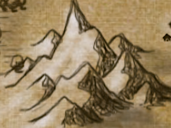
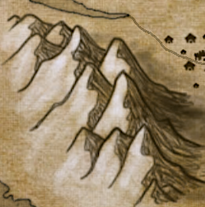
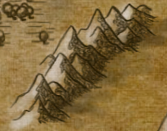




THIS COURSE
We will focus on algorithms with provable guarantees
What does it mean to “think algorithmically” in data science?
Pitfalls abound....
graphical models
Most problems, if not posed carefully, are NP-hard
Big gap b/t what’s possible in practice and what we can prove theorems about
quantum learning
clustering/ mixture models
tensor methods
dimensionality reduction
nonconvex optimization
first/second-order methods
generative modeling
neural networks
robustness
multi-index models
strategic behavior
algorithmic fairness
agnostic learning
matrix completion
sparse recovery
online learning
private learning
dictionary learning
reinforcement learning

Slide 20
THIS COURSE
We will focus on algorithms with provable guarantees
What does it mean to “think algorithmically” in data science?
Pitfalls abound....
Three modes of thinking you will learn:
  Proving upper bounds (designing + rigorously analyzing algorithms)
  Proving lower bounds (impossibility results)
  Modeling (formulating algorithmic questions that are mathematically tractable and practically meaningful)

Slide 21

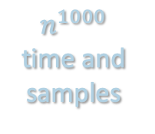
1. PROVING UPPER BOUNDS
Disclaimer: goal not necessarily to invent or analyze algorithms meant for immediate practical deployment
Goals:
Find signatures of tractability: identify properties of data-generating process that algorithms can “latch onto”
Map the frontier: identify tasks on the edge of being provably possible (popular algorithms in practice often don’t suffice)
Develop frameworks: meta-algorithms that could become practically useful heuristics
$n^{1000}$ time and samples
optimal sample complexity, near-linear runtime, parallelizable

Slide 22
2. PROVING LOWER BOUNDS
Goals:
Identify baselines so we’re not chasing after impossible performance guarantees
Diagnose when model is too general: if we can construct instances which are intractable, then the model may need to be refined
Clarify source of hardness:
  Statistical --- not enough information, impossible regardless of computational resources
  Computational --- enough data, but no efficient algorithm

Slide 23
3. MODELING
Goals:
Rigorously define what algorithms in practice are actually accomplishing
Articulate properties of real-world data that make ML tractable
Stress test existing models to make sure our algorithms are not “overfitting” to artificial assumptions
strength of
algorithmic
guarantees
generality of model

Slide 24
THIS COURSE
We will focus on algorithms with provable guarantees
What does it mean to “think algorithmically” in data science?
Pitfalls abound....
Three modes of thinking you will learn:
  Proving upper bounds
  Proving lower bounds
  Modeling
Algorithmic lens on data science transferrable to other domains (not just about understanding why ML works)

Slide 25
THIS COURSE
We will focus on algorithms with provable guarantees
What does it mean to “think algorithmically” in data science?
Pitfalls abound....
Three modes of thinking you will learn:
  Proving upper bounds
  Proving lower bounds
  Modeling
Algorithmic lens on data science transferrable to other domains (not just about understanding why ML works)

Slide 26
Logistics
Philosophy
Vignette

Slide 27
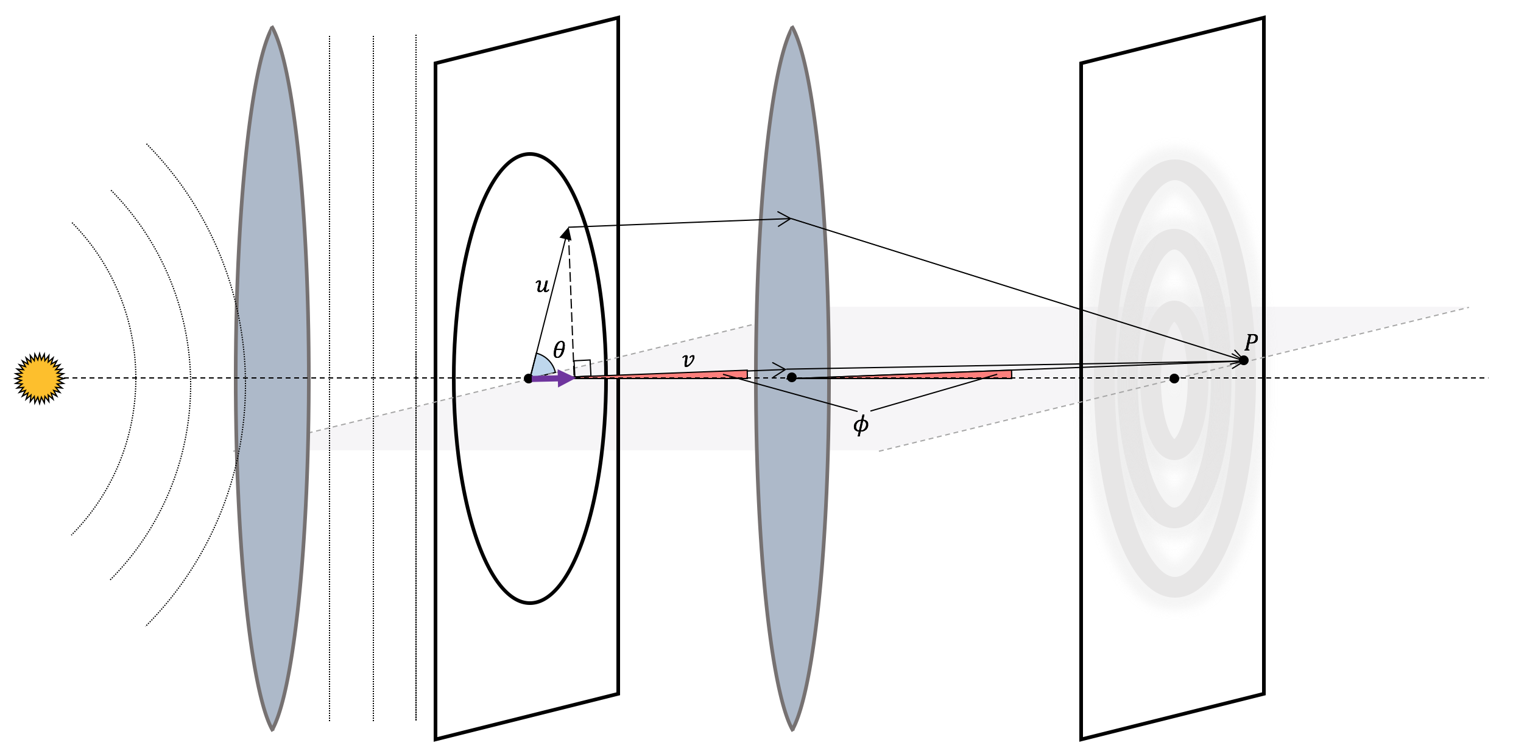
DIFFRACTION BASICS
Lens 1
Lens 2
Airy disk
Point source of light
Imaging plane
Circular aperture

Slide 28
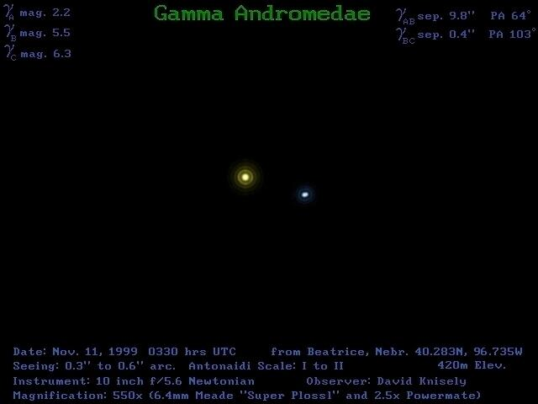
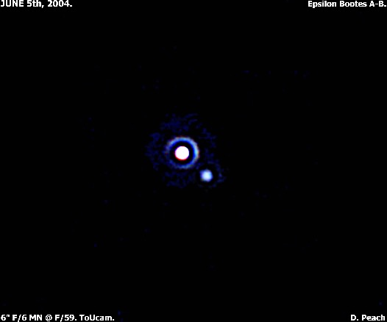
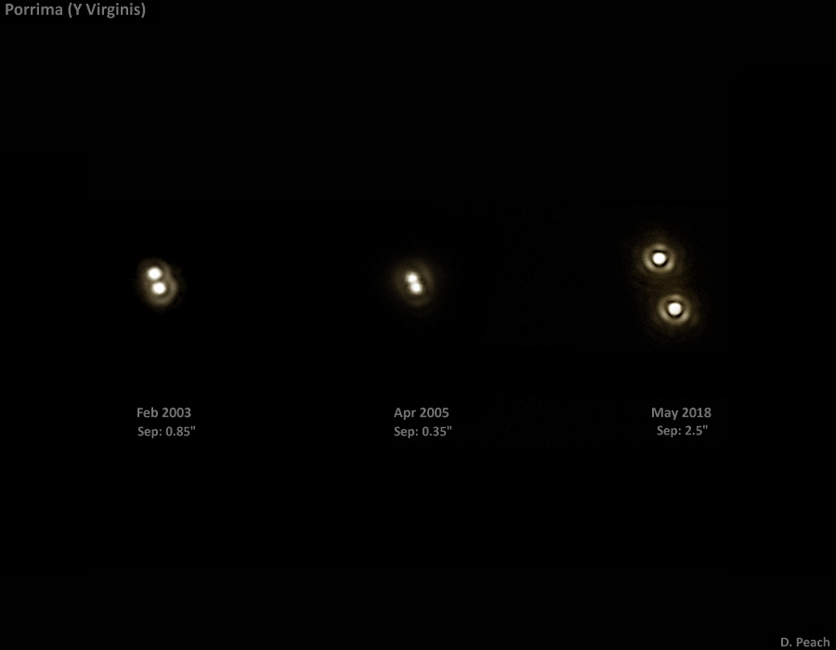
DIFFRACTION BASICS

Slide 29
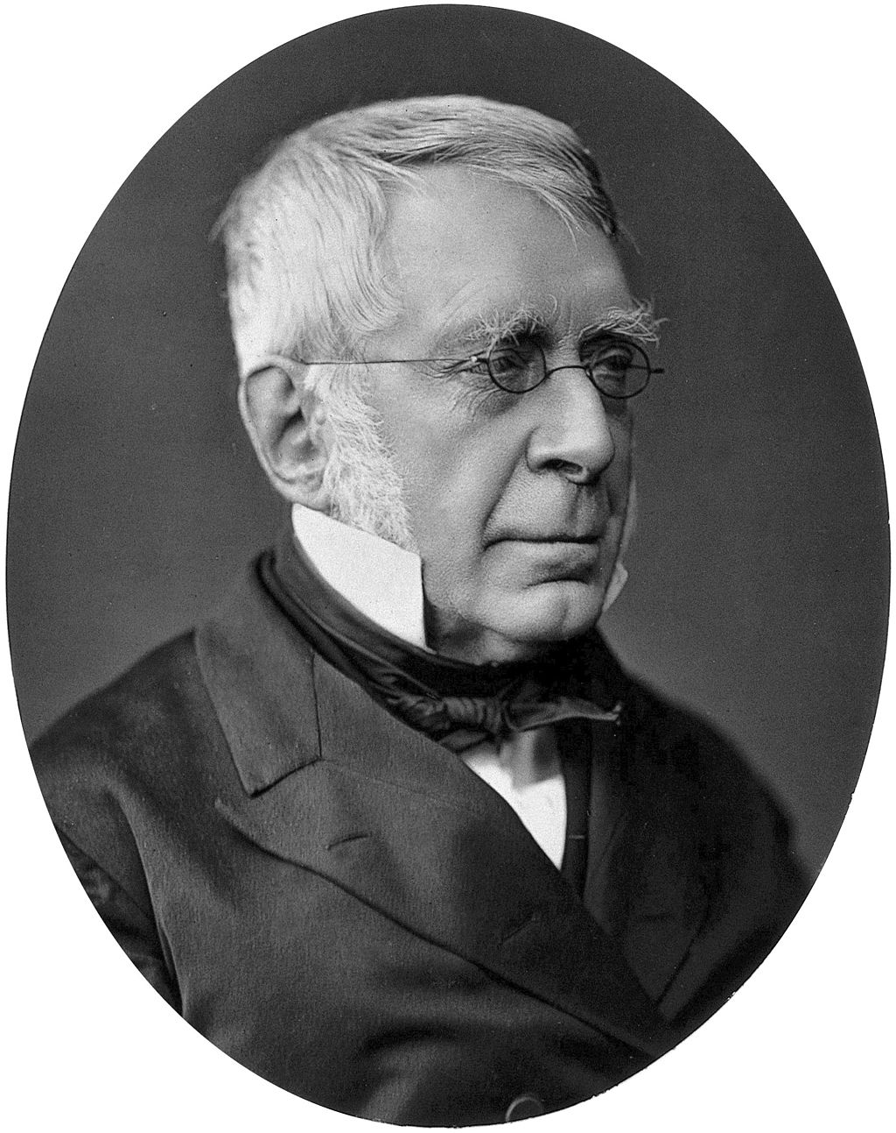
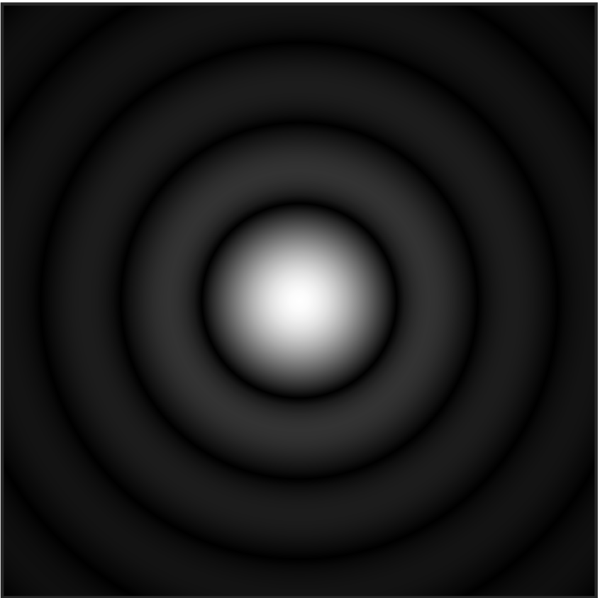

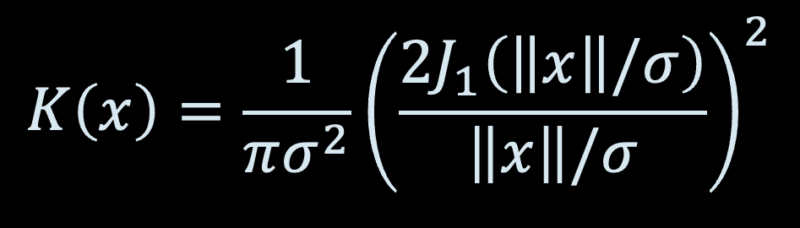
AIRY DISKS
Bessel function
The Airy point spread function is given by
Can be interpreted as the infinitesimal probability of a photon striking the point $x$ on the observation plane
i.e. probability density function for some distribution $q$ over $ℝ^{2}$
$$K\left(x\right)=\frac{1}{πσ^{2}}{\left(\frac{2J_{1}\left(\left\|x\right\|/σ\right)}{\left\|x\right\|/σ}\right)}^{2}$$
Sir George Biddell Airy
(1835-1881)
spread parameter, quantifies level of “blur”

Slide 30
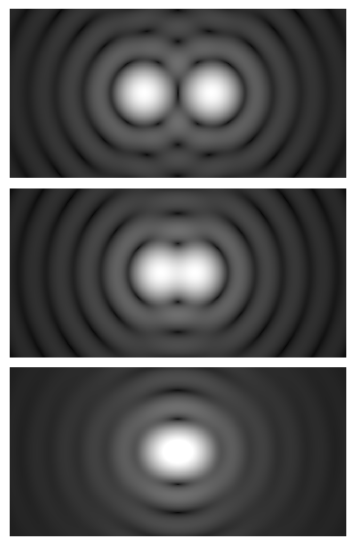
“THE” DIFFRACTION LIMIT
For >150 years, widely believed that diffraction imposes fundamental limit to resolution
Conventional wisdom: If two Airy disks are too close, the blur makes it impossible to distinguish them
How close exactly?

Slide 31
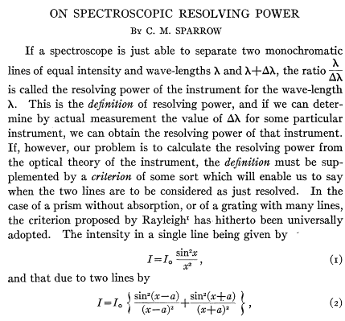
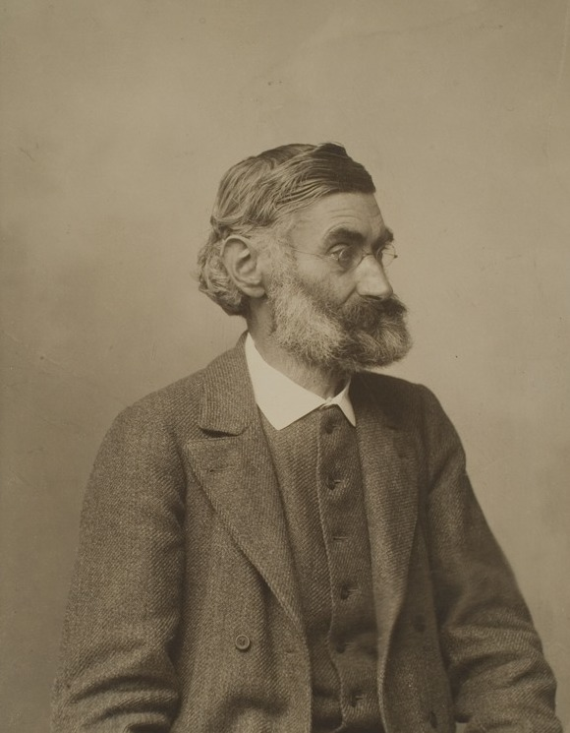
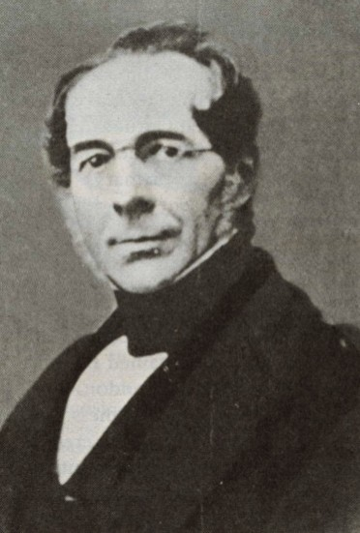
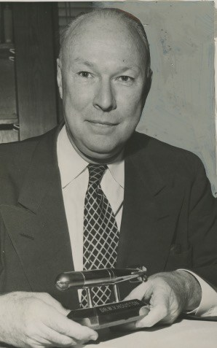
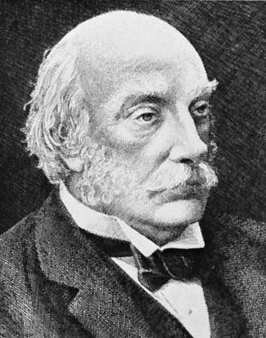
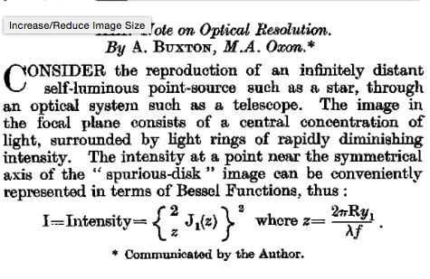
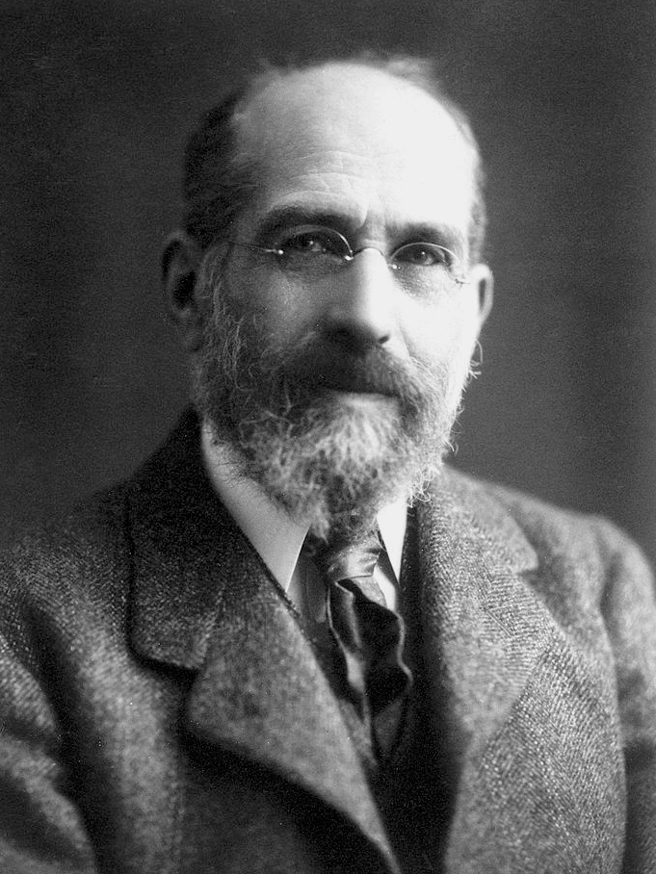

“THE” DIFFRACTION LIMIT
Sparrow
Abbe
Dawes
Houston
Rayleigh
Buxton
Schuster
0.94
1
1.02
1.03
1.22
1.46
2.44
pairwise separation ($×πσ$)

Slide 32

“THE” DIFFRACTION LIMIT
Sparrow
Abbe
Dawes
Houston
Rayleigh
Buxton
Schuster
0.94
1
1.02
1.03
1.22
1.46
2.44
pairwise separation ($×πσ$)
”Rayleigh criterion”: Resolution becomes impossible as soon as the center of one disk touches the first ring of another
$$≈1.22πσ$$

Slide 33
“THE” DIFFRACTION LIMIT
Sparrow
Abbe
Dawes
Houston
Rayleigh
Buxton
Schuster
0.94
1
1.02
1.03
1.22
1.46
2.44
pairwise separation ($×πσ$)
Which (if any) of these criteria is the correct one?

Slide 34
A PERSISTENT DEBATE
Lord Rayleigh’s justification for his criterion in 1879:
“This rule is convenient on account of its simplicity and it is sufficiently accurate in view of the necessary uncertainty as to what exactly is meant by resolution”
Carroll Mason Sparrow’s justification for their criterion in 1918:
“It is obvious that the undulation condition should set an upper limit to the resolving power ... My own observations on this point have been checked by a number of friends and colleagues.”

Slide 35
A PERSISTENT DEBATE
Pushback from Richard Feynman:
“...it seems a little pedantic to put such precision into the resolving power formula. This is because Rayleigh’s criterion is a rough idea in the first place. It tells you where it begins to get very hard to tell whether the image was made by one or by two stars. Actually, if sufficiently careful measurements of the exact intensity distribution over the diffracted image spot can be made, the fact that two sources make the spot can be proved even (below the Abbe limit).”

Slide 36
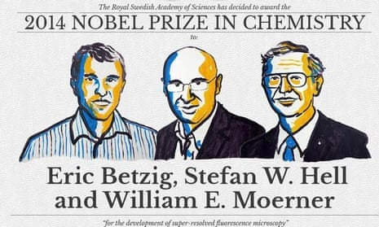
A PERSISTENT DEBATE
Yet the considerable empirical evidence points towards there being a limit to what we can resolve with classical optical systems
Can we put the diffraction limit on rigorous footing?
Awarded for the development of super-resolved fluorescence microscopy to surpass this limit!

Slide 37
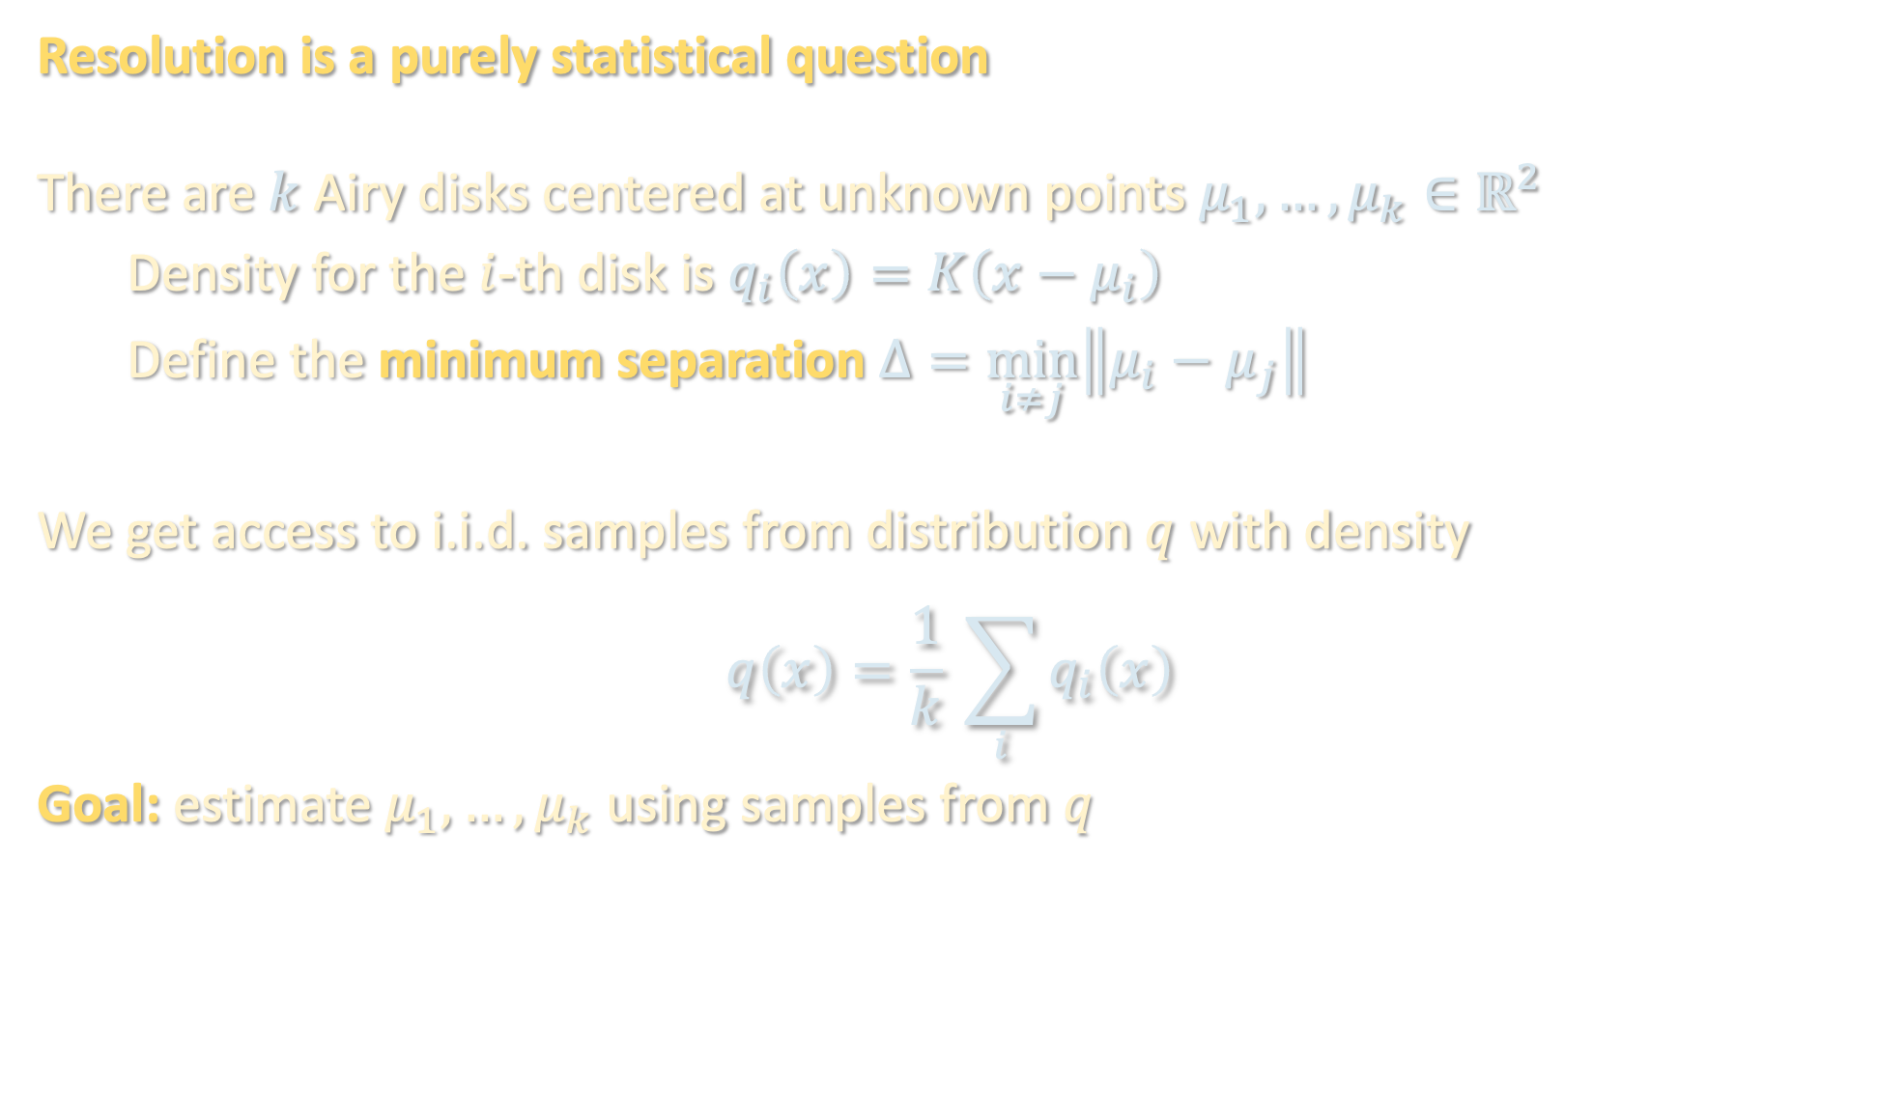
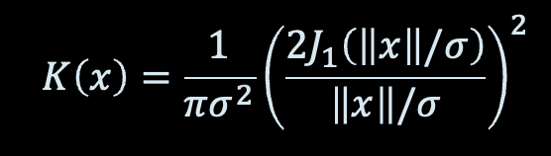
MIXTURE MODEL LEARNING
$$K\left(x\right)=\frac{1}{πσ^{2}}{\left(\frac{2J_{1}\left(\left\|x\right\|/σ\right)}{\left\|x\right\|/σ}\right)}^{2}$$
Resolution is a purely statistical question
There are $k$ Airy disks centered at unknown points $μ_{1},…,μ_{k}∈ℝ^{2}$
Density for the $i$-th disk is $q_{i}\left(x\right)=K\left(x−μ_{i}\right)$
Define the minimum separation $Δ=\min_{i≠j}\left\|μ_{i}−μ_{j}\right\|$
We get access to i.i.d. samples from distribution $q$ with density
$$q\left(x\right)=\frac{1}{k} \sum_{i}{q_{i}\left(x\right)}$$
Goal: estimate $μ_{1},…,μ_{k}$ using samples from $q$
[“Mixture model”]

Slide 38
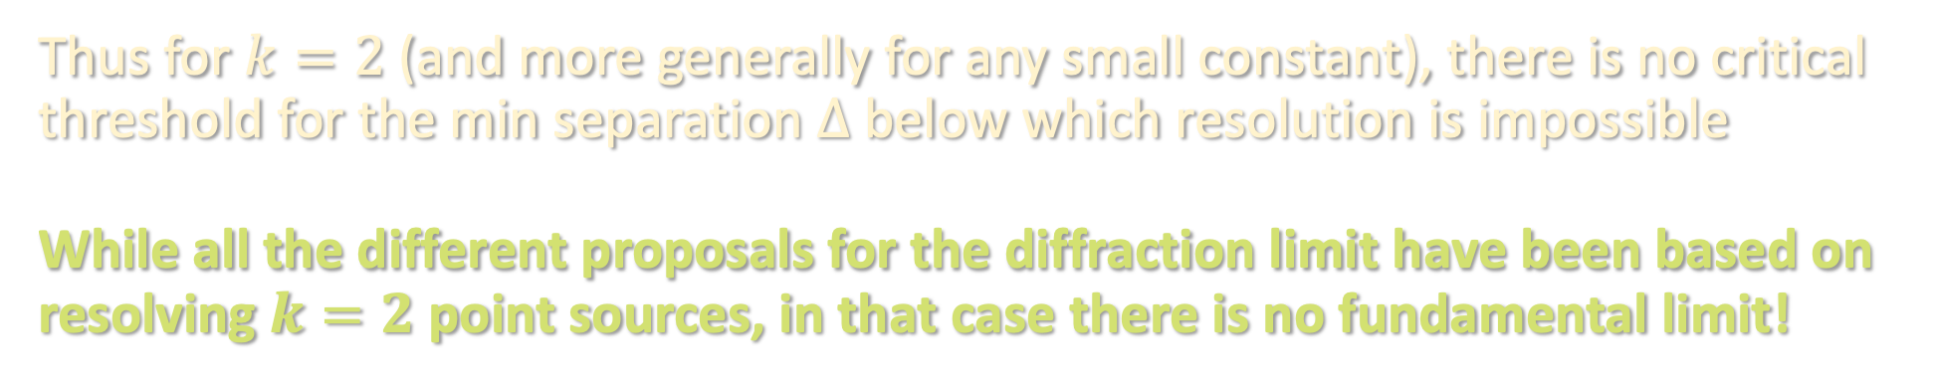
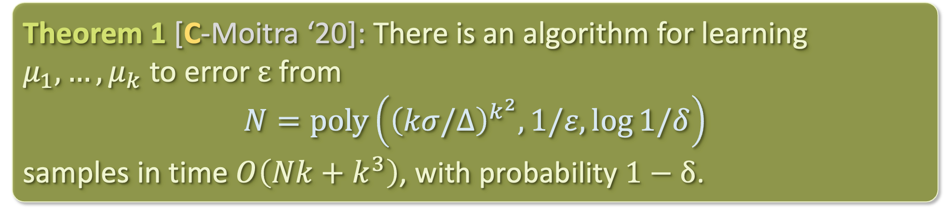
RESULTS
SC and Ankur Moitra. "Algorithmic foundations for the diffraction limit." Proceedings of the 53rd Annual ACM SIGACT Symposium on Theory of Computing (STOC). 2021.
Theorem 1 [C-Moitra ‘20]: There is an algorithm for learning $μ_{1},…,μ_{k}$ to error $ε$ from
$$N=poly\left({\left(kσ/Δ\right)}^{k^{2}},1/ε,\log{1/δ}\right)$$
samples in time $O\left(Nk+k^{3}\right)$, with probability $1−δ$.
Thus for $k=2$ (and more generally for any small constant), there is no critical threshold for the min separation $Δ$ below which resolution is impossible
While all the different proposals for the diffraction limit have been based on resolving $k=2$ point sources, in that case there is no fundamental limit!

Slide 39
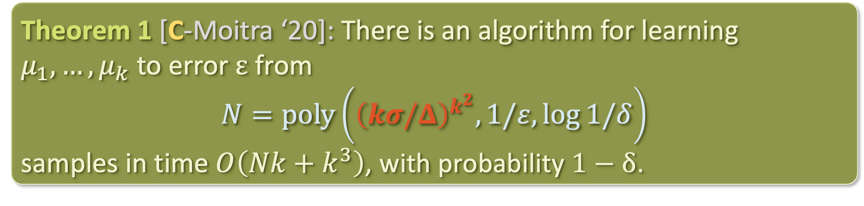
RESULTS
Theorem 1 [C-Moitra ‘20]: There is an algorithm for learning $μ_{1},…,μ_{k}$ to error $ε$ from
$$N=poly\left({\left(kσ/Δ\right)}^{k^{2}},1/ε,\log{1/δ}\right)$$
samples in time $O\left(Nk+k^{3}\right)$, with probability $1−δ$.
Thus for $k=2$ (and more generally for any small constant), there is no critical threshold for the min separation $Δ$ below which resolution is impossible
While all the different proposals for the diffraction limit have been based on resolving $k=2$ point sources, in that case there is no fundamental limit!

Slide 40
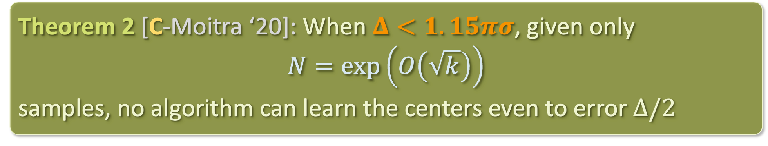
RESULTS
Theorem 2 [C-Moitra ‘20]: When $Δ<1.15πσ$, given only
$$N=\exp\left(O\left(\sqrt{k}\right)\right)$$
samples, no algorithm can learn the centers even to error $Δ/2$
i.e. diffraction does impose a fundamental limitation on resolution vis-à-vis an exponential blowup in sample complexity with respect to # disks

Slide 41
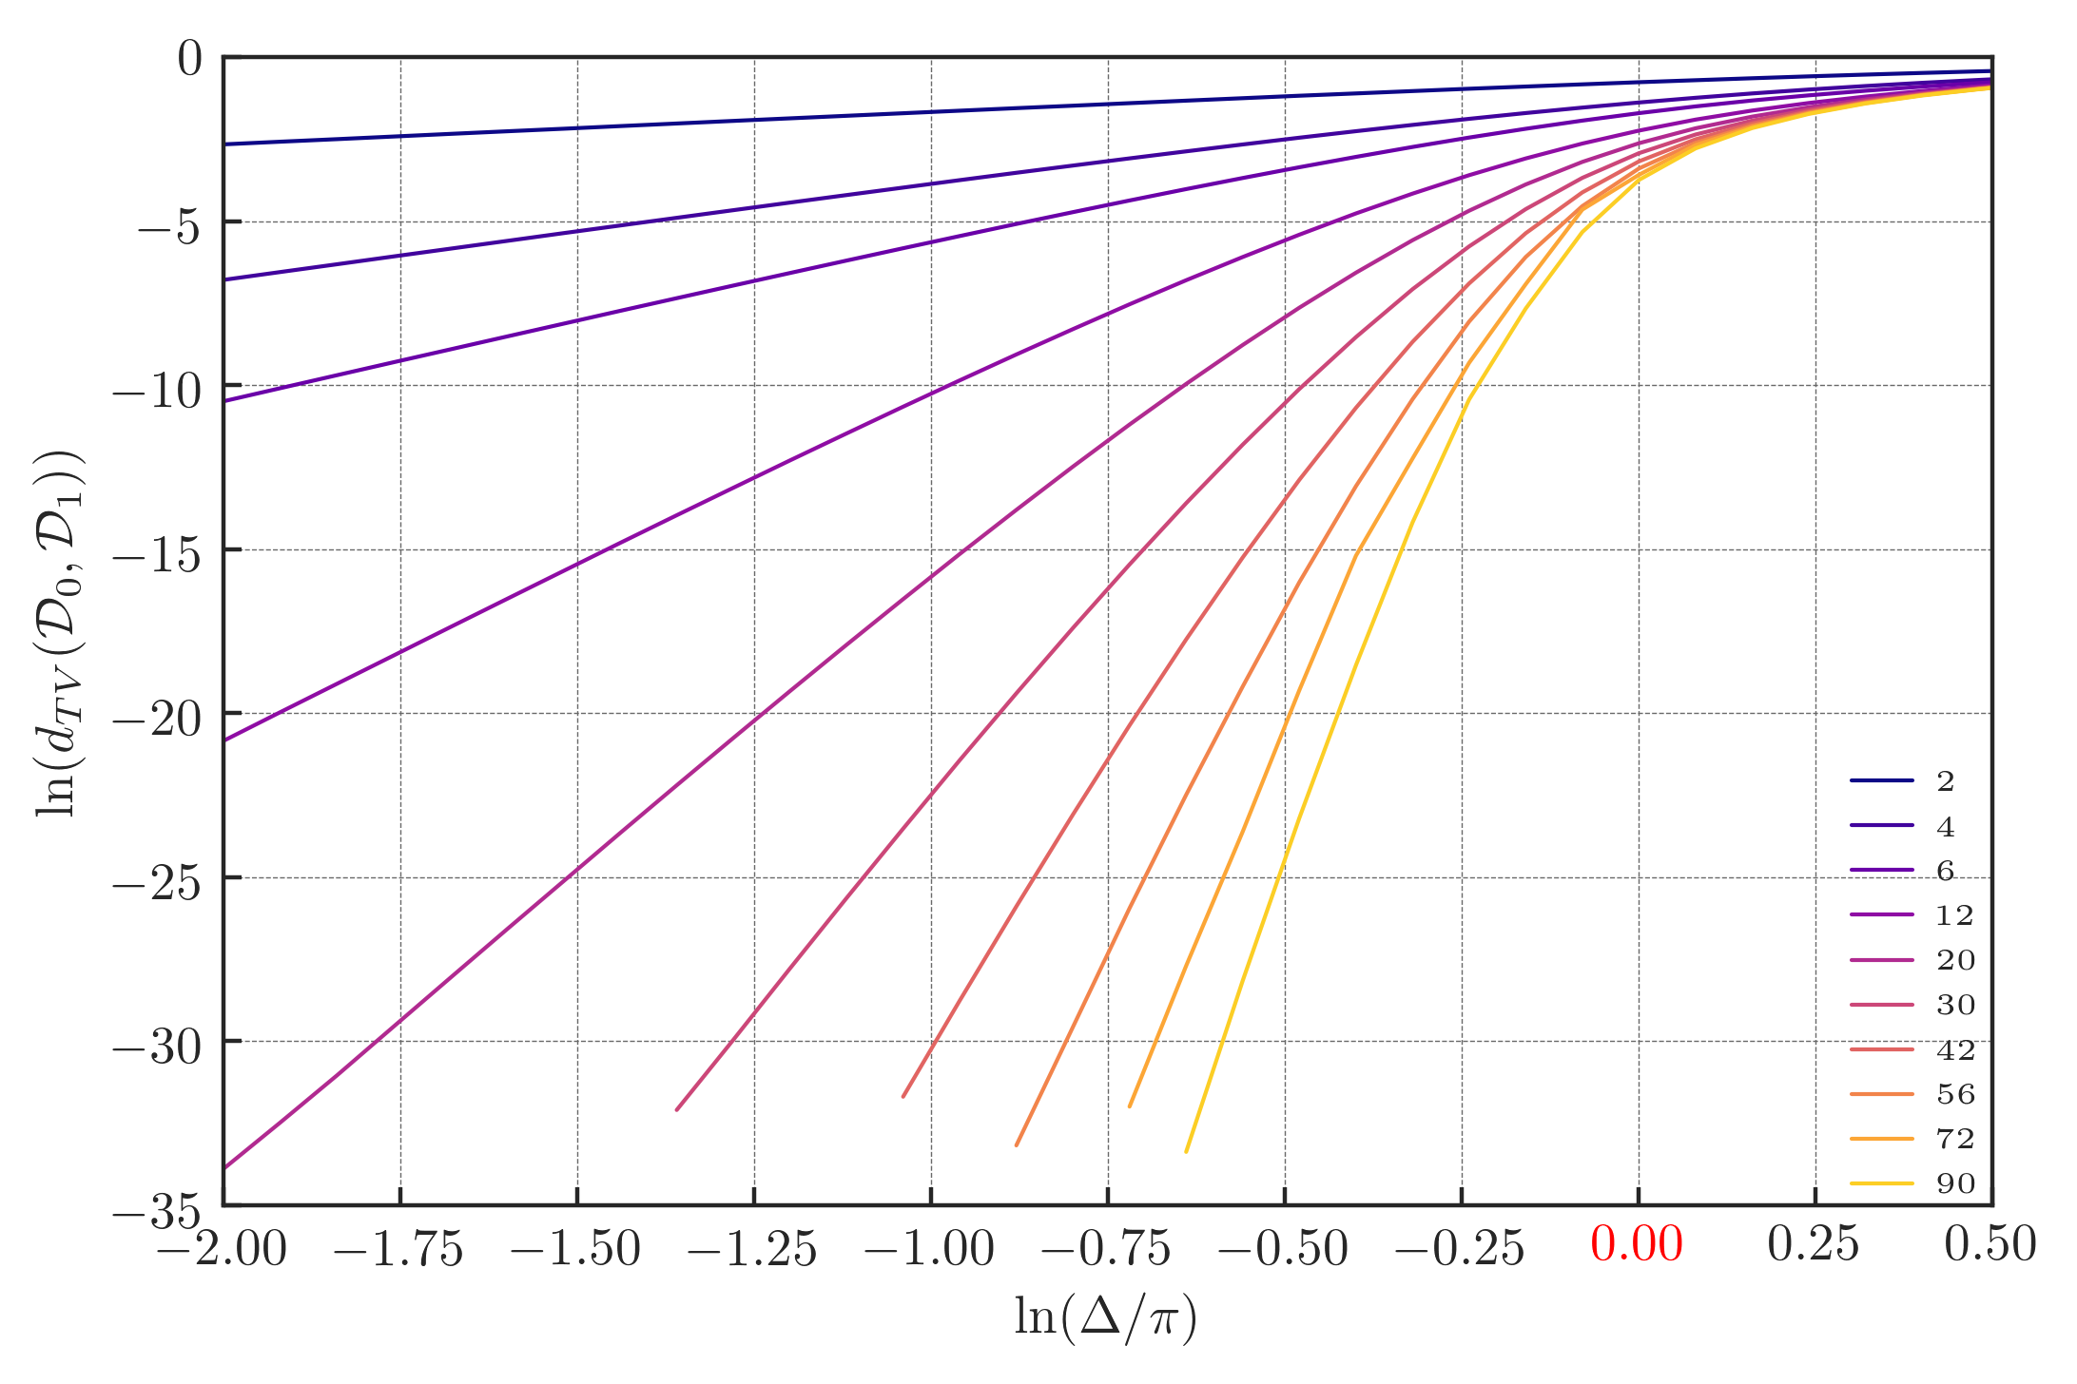
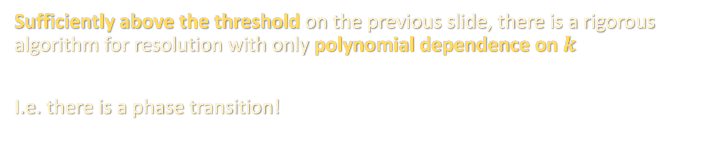
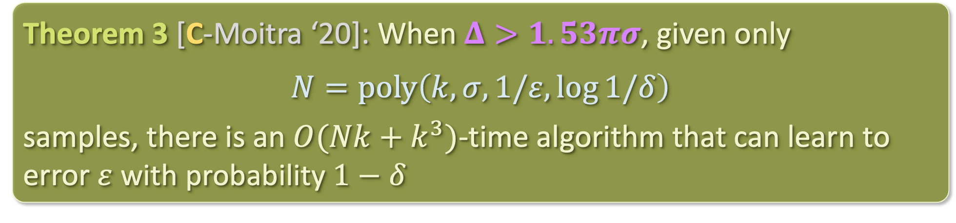
RESULTS
Theorem 3 [C-Moitra ‘20]: When $Δ>1.53πσ$, given only
$$N=poly\left(k,σ,1/ε,\log{1/δ}\right)$$
samples, there is an $O(Nk+k^{3})$-time algorithm that can learn to error $ε$ with probability $1−δ$
Sufficiently above the threshold on the previous slide, there is a rigorous algorithm for resolution with only polynomial dependence on $k$
I.e. there is a phase transition!
In 1-D, we know the precise threshold ($Δ=πσ$), the Abbe limit

Slide 42
INTERPRETATION
Vindicates opposing views on the diffraction limit:
In domains where there are few close-by sources (e.g. astronomy), it is possible to resolve below the diffraction limit
In domains where there are many close-by sources (e.g. microscopy), diffraction imposes fundamental limit on resolution

Slide 43
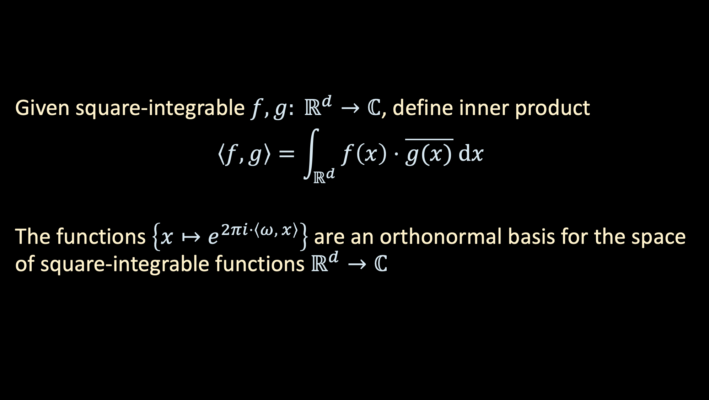
FOURIER ANALYSIS PRIMER
Given square-integrable $f,g: ℝ^{d}→ℂ$, define inner product
$$\left\langle f,g\right\rangle =\int_{ℝ^{d}}{ f\left(x\right)⋅\overline{g(x)} dx}$$
The functions $\left\{x↦e^{2πi⋅\left\langle ω, x\right\rangle }\right\}$ are an orthonormal basis for the space of square-integrable functions $ℝ^{d}→ℂ$

Slide 44
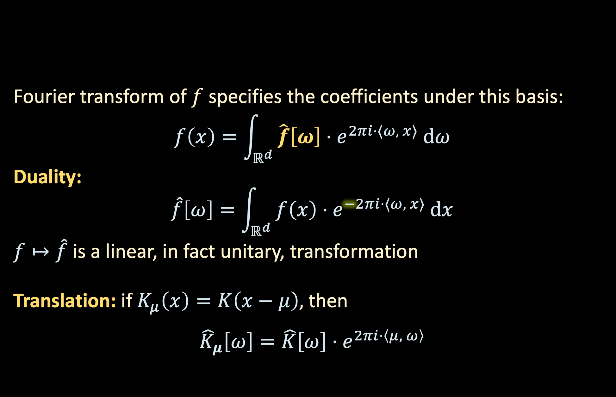
FOURIER ANALYSIS PRIMER
Fourier transform of $f$ specifies the coefficients under this basis:
$$f\left(x\right)=\int_{ℝ^{d}}{ \hat{f}\left[ω\right]⋅e^{2πi⋅⟨ω, x⟩} dω}$$
Duality:
$$\hat{f}\left[ω\right]=\int_{ℝ^{d}}{ f\left(x\right)⋅e^{−2πi⋅⟨ω, x⟩} dx}$$
$f↦\hat{f}$ is a linear, in fact unitary, transformation
Translation: if $K_{μ}\left(x\right)=K\left(x−μ\right),$ then
$${\hat{K}}_{μ}\left[ω\right]=\hat{K}\left[ω\right]⋅e^{2πi⋅\left\langle μ, ω\right\rangle }$$

Slide 45
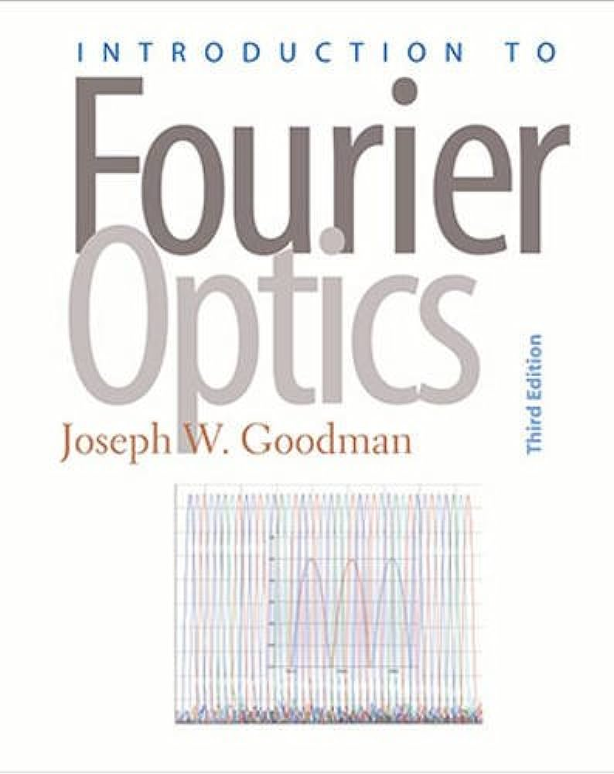
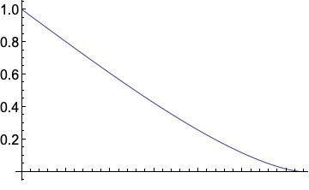


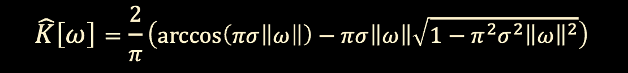
FOURIER ANALYSIS PRIMER
Why do we care?
  Airy disk comes from Fourier analysis
    $\hat{K}$ is the convolution of a disk (the aperture) with itself
  Gives an easy way to deconvolve (see board)
  $$\hat{K}\left[ω\right]=\frac{2}{π}\left(\arccos\left(πσ\left\|ω\right\|\right)−πσ\left\|ω\right\|\sqrt{1−π^{2}σ^{2}{\left\|ω\right\|}^{2}}\right)$$
Fourier transform becomes zero beyond $1/σπ$
$$ω$$

Slide 46
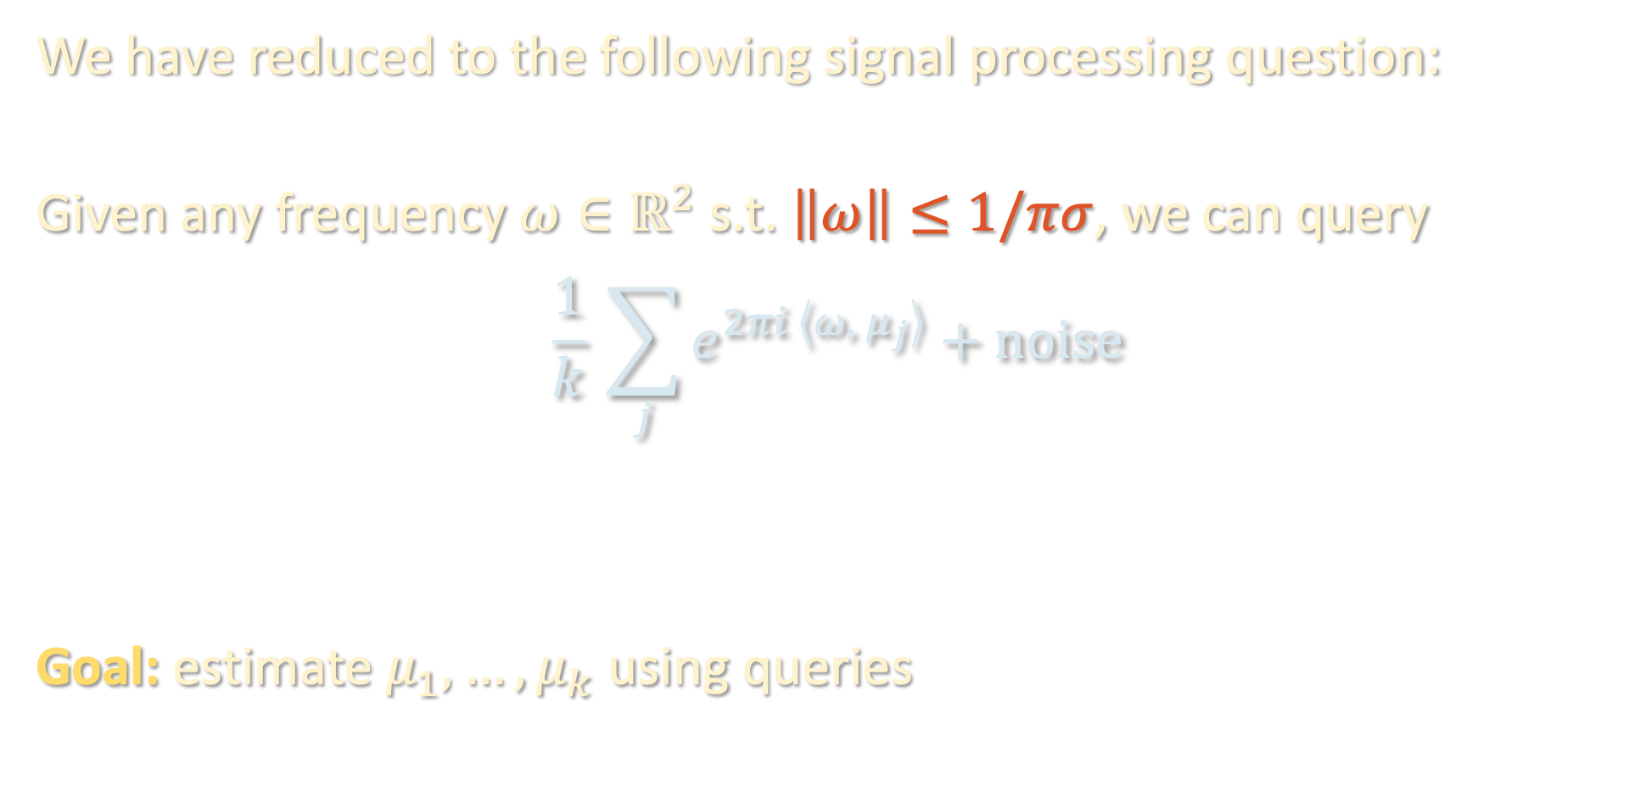
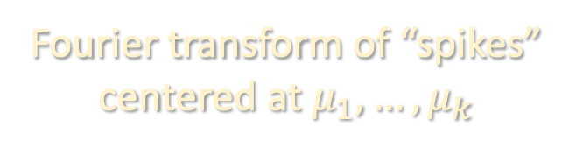
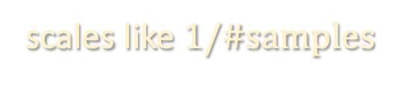
ESTIMATING SPIKES
We have reduced to the following signal processing question:
Given any frequency $ω∈ℝ^{2}$ s.t. $\left\|ω\right\|≤1/πσ$, we can query
$$\frac{1}{k} \sum_{j}{e^{2πi \left\langle ω, μ_{j}\right\rangle }}+noise$$
Goal: estimate $μ_{1},…,μ_{k}$ using queries
scales like $1/\#samples$
Fourier transform of “spikes”
centered at $μ_{1},…,μ_{k}$

Slide 47
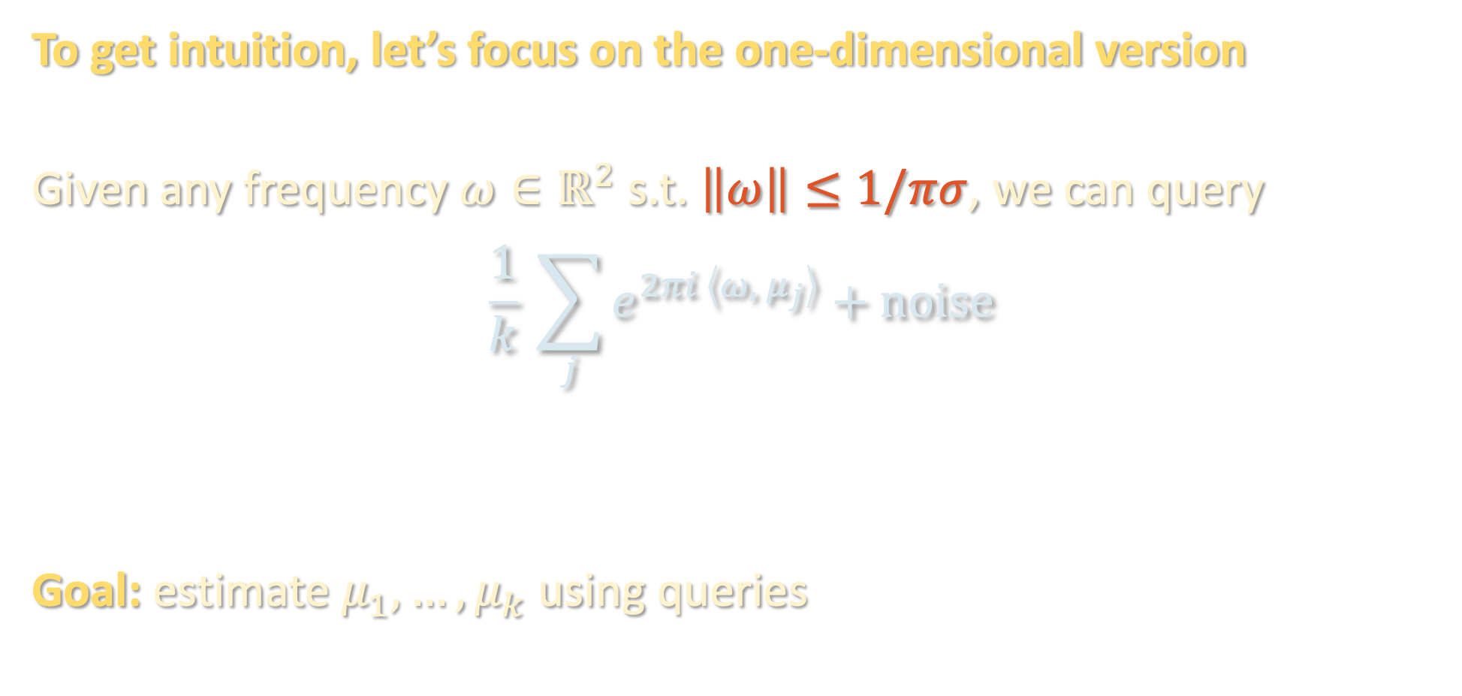

ESTIMATING SPIKES: 1-D VERSION
To get intuition, let’s focus on the one-dimensional version
Given any frequency $ω∈ℝ^{2}$ s.t. $\left\|ω\right\|≤1/πσ$, we can query
$$\frac{1}{k} \sum_{j}{e^{2πi \left\langle ω, μ_{j}\right\rangle }}+noise$$
Goal: estimate $μ_{1},…,μ_{k}$ using queries
$$ℝ$$

Slide 48
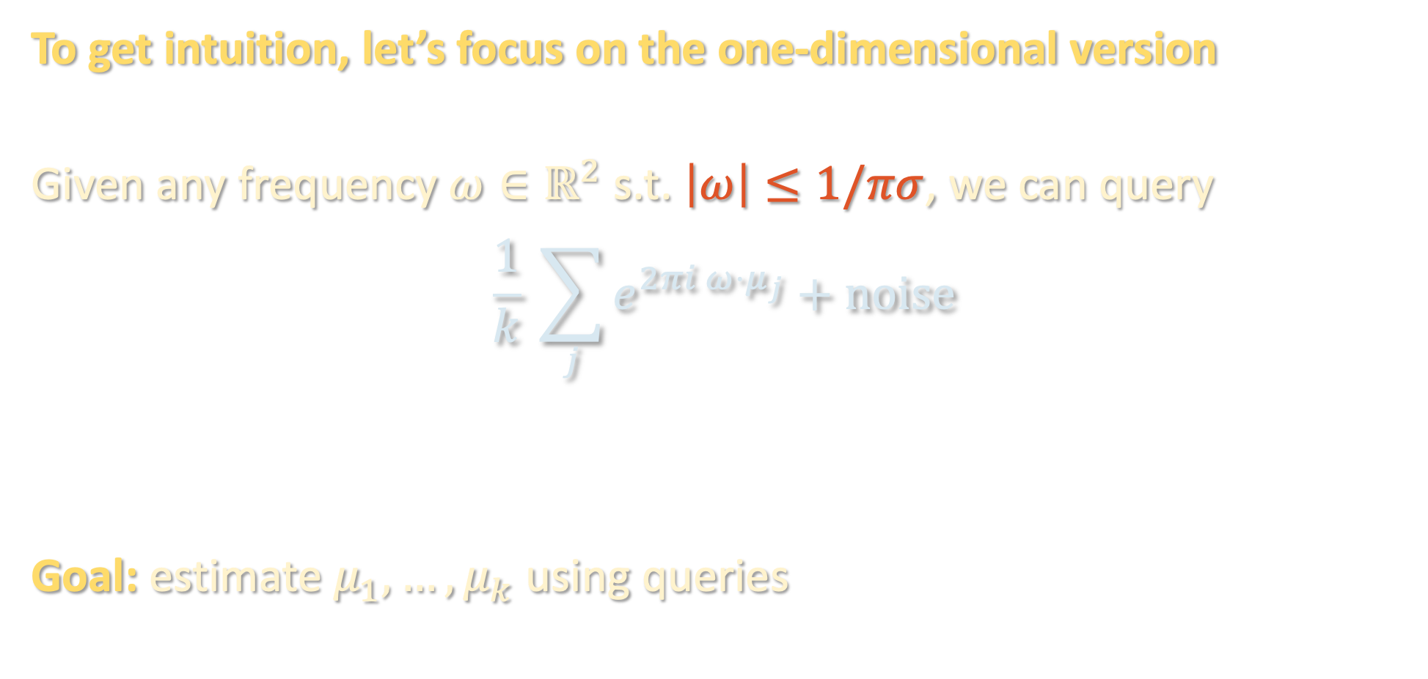
ESTIMATING SPIKES: 1-D VERSION
To get intuition, let’s focus on the one-dimensional version
Given any frequency $ω∈ℝ^{2}$ s.t. $\left|ω\right|≤1/πσ$, we can query
$$\frac{1}{k} \sum_{j}{e^{2πi ω⋅μ_{j}}}+noise$$
Goal: estimate $μ_{1},…,μ_{k}$ using queries
$$ℝ$$

Slide 49
MATRIX PENCIL METHOD
(see board)

Slide 50
GENERALIZING TO TWO DIMENSIONS
Next lecture: tensor decomposition

Slide 51
RECAP
Sparrow
Abbe
Dawes
Houston
Rayleigh
Buxton
Schuster
0.94
1
1.02
1.03
1.22
1.46
2.44
A physical phenomenon, the diffraction limit, can be understood as a statistical one, namely a phase transition in sample complexity
Algorithmic lens on data science broadly useful (i.e. not just about understanding machine learning)
Sometimes, different fields are secretly studying the same thing

Slide 52
LOOKING AHEAD
 | Modeling | Upper bounds | Lower bounds
Tensors |  | ✓
Sum-of-squares |  | ✓
Robustness | ✓ | ✓
Supervised learning | ✓ | ✓ | ✓
Hardness of learning |  |  | ✓
Statistical physics / inference | ✓ | ✓ | ✓
Generative modeling | ✓ | ✓

