Slide 1
CS 224: ALGORITHMS FOR DATA SCIENCE LECTURE 19 (11/13)
Tensor decomposition
Sum-of-squares
Robustness
Supervised learning
Computational complexity
Statistical physics
Generative modeling
CRYPTOGRAPHIC REDUCTIONS AND LEARNING

Slide 2
Early connections to cryptography
(pseudorandom functions, public-key crypto, agnostic noise)
Crypto lower bound for learning MLPs over Gaussians
(Goldreich’s PRG, Daniely-Vardi lifting)
Other results and outlook
(Continuous LWE, complexity recap)
Disclaimer: I’m not a cryptographer, take Prof. Barak’s CS 127 if you want to learn the crypto fundamentals for real!

Slide 3
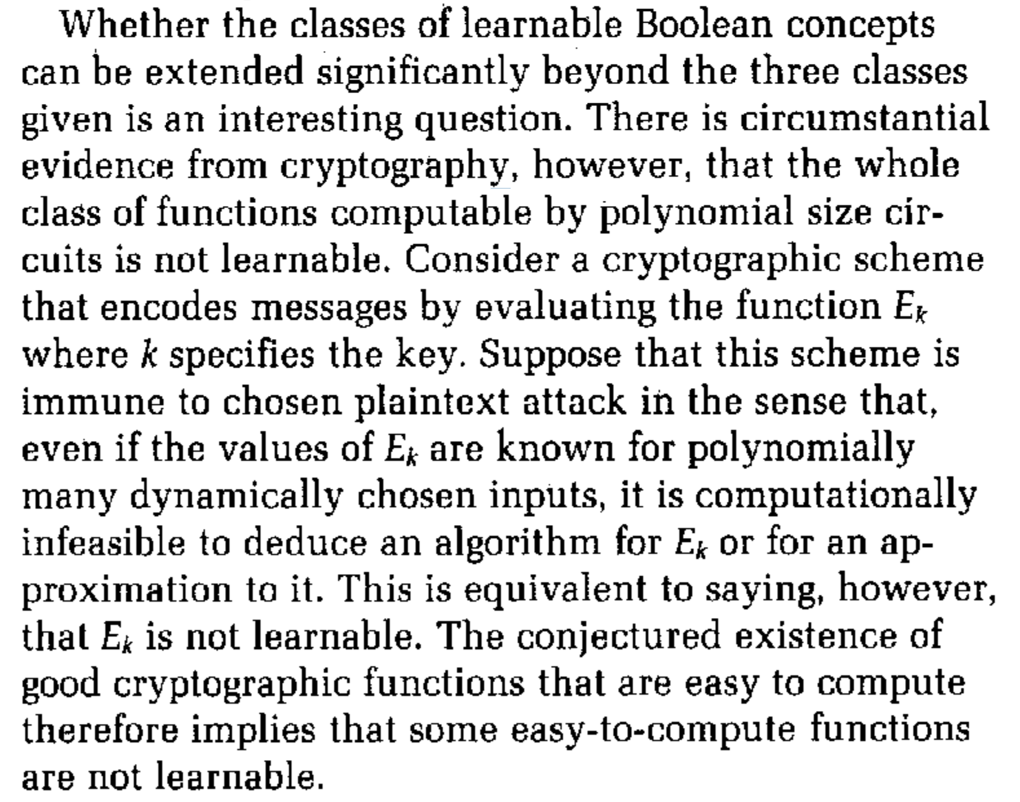
CRYPTOGRAPHY AND LEARNING
From Valiant’s “A theory for the learnable”

Slide 4
PSEUDORANDOM FUNCTION FAMILIES (PRF)
Roughly, a pseudorandom function family (PRF) is a family $𝔉$ of $2^{n}$ functions ${\left\{0,1\right\}}^{n}→{\left\{0,1\right\}}^{n}$ which “fools” any polynomial-time adversary in the following sense:
$f$ is promised to come from one of two scenarios:
(Random) $f$ sampled uniformly from set of all Boolean functions
(Pseudorandom) $f$ is sampled from the PRF $𝔉$
The adversary can query $f$ polynomially many times at arbitrary inputs and must distinguish with nontrivial advantage which scenario we are in

Slide 5
PRFS FROM ONE-WAY FUNCTIONS
A one-way function (OWF) is a function ${f:\left\{0,1\right\}}^{n}→{\left\{0,1\right\}}^{m}$ which is efficiently computable but hard to invert, i.e. given $y=f\left(x\right)$ for a random $x$, it is computationally hard to find $x′$ such that $f\left(x^{′}\right)=y$
“minimal” assumption necessary for cryptography to be possible
Thm [Goldreich-Goldwasser-Micali ‘84]: Pseudorandom function families exist if one-way functions exist.
Corollary [Valiant ‘84]: Poly-sized circuits are hard to PAC learn, even given the ability to query them at arbitrary inputs (“learning from membership queries”)

Slide 6
PRFS FROM ONE-WAY FUNCTIONS
Corollary [Valiant ‘84]: Poly-sized circuits are hard to PAC learn, even given the ability to query them at arbitrary inputs (“learning from membership queries”)
Proof: a polynomial-time PAC learning algorithm would yield a polynomial-time adversary for distinguishing whether the underlying function is truly random or from a PRF
Pros:
Assumption is very mild
Learner is very powerful
Cons:
worst-case lower bound
class of functions too powerful

Slide 7
PUBLIC-KEY ENCRYPTION
Stronger assumption, but hardness for weaker classes of functions
Three algorithms: gen, enc, and dec
gen($1^{n}$): outputs public key Pk and secret key Sk
enc(Pk,m): (randomly) encrypts $m∈\left\{0,1\right\}$ into $poly\left(n\right)$ bits under Pk
dec(Sk,c): decrypts a ciphertext c under Pk
Correctness: $dec(Sk,enc(Pk,m)) = m$ with all but negl. failure probability
Security: can’t distinguish b/t encryption of 0 vs. 1, i.e. for all poly-time algs,
$$\left|\underset{Pk,Sk}{Pr}\left[A\left(Pk,enc\left(Pk\right)\right)=1\right]−\underset{Pk,Sk}{Pr}\left[A\left(Pk,enc\left(Pk\right)\right)=0\right]\right|≪\frac{1}{poly\left(n\right)}$$

Slide 8
PUBLIC-KEY ENCRYPTION (EXAMPLES)
Trapdoor function:
One-way function such that there exists efficient algorithm $I$ that takes as input $f\left(x\right)$ and a trapdoor string $t$ and outputs $x′$ for which $f\left(x\right)=f\left(x^{′}\right)$
Example: RSA
- $x↦x^{e} mod n$ for $n=pq$, $e$ relatively prime to $φ\left(n\right)=(p−1)(q−1)$
- trapdoor: $d≡e^{−1 }mod φ\left(n\right)$

Slide 9
PUBLIC-KEY ENCRYPTION (EXAMPLES)
Trapdoor function:
One-way function such that there exists efficient algorithm $I$ that takes as input $f\left(x\right)$ and a trapdoor string $t$ and outputs $x′$ for which $f\left(x\right)=f\left(x^{′}\right)$
gen($1^{n}$): Pk is trapdoor function $f$, secret key Sk is trapdoor $t$
enc(Pk,m): encrypts a message $m$ by mapping through $f$
dec(Sk,c): decrypts a ciphertext c by inverting using $t$
Note: doesn’t quite work, need to define e.g. “hard core predicates”

Slide 10
PUBLIC-KEY ENCRYPTION + HARDNESS OF LEARNING
Lemma [Kearns-Valiant ‘94]: Given a public-key cryptosystem (gen, enc, dec), if there is a function class $𝒞$ that contains all the decryption functions $dec\left(Sk,⋅\right)$ for all choices of key, then if $𝒞$ is distribution-free PAC-learnable in polynomial time, then there is a polynomial-time distinguisher between encryptions of 0 and 1.
Proof: train on examples generated via
Pick either m = 0 or m = 1 w.p. ½
Generate labeled example $\left(enc\left(Pk,m\right),m\right)$
A PAC learning algorithm would return a good approximation for the decryption function and thus violate security assumption

Slide 11
PUBLIC-KEY ENCRYPTION + HARDNESS OF LEARNING
Examples of hardness results proved using this observation:
[Kearns-Valiant ‘94]: poly-sized Boolean formulas, deterministic finite automata of poly size, poly-sized threshold circuits with constant depth
[Klivans-Sherstov ‘06]: intersections of poly many halfspaces, poly-size depth-2 circuits with majority gates, depth-3 poly-size arithmetic circuits
[Applebaum-Barak-Wigderson ‘09]: Boolean functions that only depend on $\log\left(n\right)$ variables in the input (juntas)
Drawback: input distribution is unnatural (distribution over encryptions)

Slide 12
DISTRIBUTION-SPECIFIC HARDNESS: NOISE HELPS
For learning problems where there is label noise, e.g. agnostic learning, relatively easy to prove hardness even when the input distribution is a known “nice” distribution like $Unif\left({\left\{±1\right\}}^{n}\right)$
Recall learning parity with noise:
$η>0$, random $S⊆\left[d\right]$, given dataset $\left(x_{1},y_{1}\right),…,\left(x_{N},y_{N}\right)$ as follows:
$$x\sim {\left\{±1\right\}}^{d}, y=\left\{\begin{aligned}x_{S} w.p. 1−η \\ −x_{S} otherwise\end{aligned}\right.$$
LPN and in particular its larger finite field size variant, “Learning with Errors” (LWE), forms the basis of various post-quantum cryptosystems
(more on this at the end)

Slide 13
DISTRIBUTION-SPECIFIC HARDNESS: NOISE HELPS
For learning problems where there is label noise, e.g. agnostic learning, relatively easy to prove hardness even when the input distribution is a known “nice” distribution like $Unif\left({\left\{±1\right\}}^{n}\right)$
Proof idea: majority function correlates with the parity function nontrivially, so if one could approximately learn the former, one could distinguish noisy parity dataset from purely random labels
(see notes for details)
Lemma [Kalai-Klivans-Mansour-Servedio ‘06]: A polynomial-time algorithm for agnostically learning halfspaces over the uniform distribution implies a polynomial-time algorithm for learning parity with noise.

Slide 14
TAKEAWAYS SO FAR
Typically in the past, cryptographic assumptions have been great for proving lower bounds for learning worst-case functions either over worst-case input distributions, or over benign input distribution but with label noise
Additionally, the settings are all discrete in nature!
Rest of lecture:
- Cryptographic lower bound for learning neural networks over Gaussian inputs
Briefly at the end:
- Cryptographic lower bound for learning mixtures of Gaussians

Slide 15
Early connections to cryptography
(pseudorandom functions, public-key crypto, agnostic noise)
Crypto lower bound for learning MLPs over Gaussians
(Goldreich’s PRG, Daniely-Vardi lifting)
Other results and outlook
(Continuous LWE, complexity recap)

Slide 16
CRYPTO HARDNESS FOR MLPS
Lemma [Daniely-Vardi ‘20]: Assuming security of Goldreich’s pseudorandom generator, MLP’s of depth three are hard to learn under Gaussian inputs.
Cryptographic hardness for learning a real-valued function over a ”nice distribution” without label noise!
Unlike the CSQ lower bound we saw previously, this hardness result pertains to arbitrary polynomial-time computation, though the class of functions is more complex– depth 3 vs depth 2
(see board)

Slide 17
SUBSEQUENT WORK
[C-Gollakota-Klivans-Meka ‘22]: Daniely-Vardi’s lifting can be refined to get rid of outer activation, and can be extended to give both full SQ lower bounds and lower bounds in the membership query model
[Daniely-Srebro-Vardi ‘23]: Modification of the reduction shows that even in the smoothed complexity setting, depth-4 MLPs are hard to learn over Gaussian inputs

Slide 18
Early connections to cryptography
(pseudorandom functions, public-key crypto, agnostic noise)
Crypto lower bound for learning MLPs over Gaussians
(Goldreich’s PRG, Daniely-Vardi lifting)
Other results and outlook
(Continuous LWE, complexity recap)

Slide 19
OTHER RECENT CRYPTO LOWER BOUNDS
Lemma [Bruna-Regev-Song-Tang ‘21]: Under the assumption that there are no polynomial-time quantum algorithms for certain (worst-case) lattice problems, learning mixtures of Gaussians is hard
Key insight: if one takes the parallel pancakes instance but with equally spaced components, looks like solving noisy linear equations “mod 1”
This is the continuous analogue of solving noisy linear equations over finite fields (“learning with errors (LWE)”), which is known to be hard under the same assumption
[Gupte-Vafa-Vaikuntanathan ‘22]: direct reduction from LWE
Subsequent applications to hardness of learning halfspaces, e.g. [Tiegel ‘23]

Slide 20
COMPLEXITY RECAP
Strong connections between cryptography / average-case complexity and ML theory, but practically relevant reductions tricky because the former are typically discrete and either correspond to unnatural input distributions or require agnostic noise to simulate
Bulk of work on lower bounds has been in restricted models like SQ (surprisingly robust, main exception is Gaussian elimination)
hardness is based on engineering instances with structural features that preclude certain algorithms. convenient by virtue of recipes
E.g. parity <-> low-degree approximation, Gaussian mixtures <-> moment methods / dimensionality reduction
These instances show (surprisingly!) that not only do those algorithms fail, but any algorithm will fail

Slide 21
COMPLEXITY RECAP
Lower bounds are a powerful way of introspecting about modeling choices
e.g. once upon a time distribution-free agnostic learning was a great target to shoot for, but turned out to be too good to be true
Realizing a model is too general often requires requires taking a computational, rather than a statistical, lens
Even seemingly benign settings (continuous functions, Gaussian inputs, smoothed MLP weights) can be computationally hard!

Slide 22
THE FINAL STRETCH…
sum-of-squares
optimization
physics, inference, and sampling
robust statistics
tensors
supervised
learning
computational complexity

