Slide 1

CS 224: ALGORITHMS FOR DATA SCIENCE
LECTURE 18 (11/6)
Tensor decomposition
Sum-of-squares
Robustness
Supervised learning
Computational complexity
Statistical physics
Generative modeling
SQ LOWER BOUNDS (REECIPES + APPLICATIONS)

Slide 2

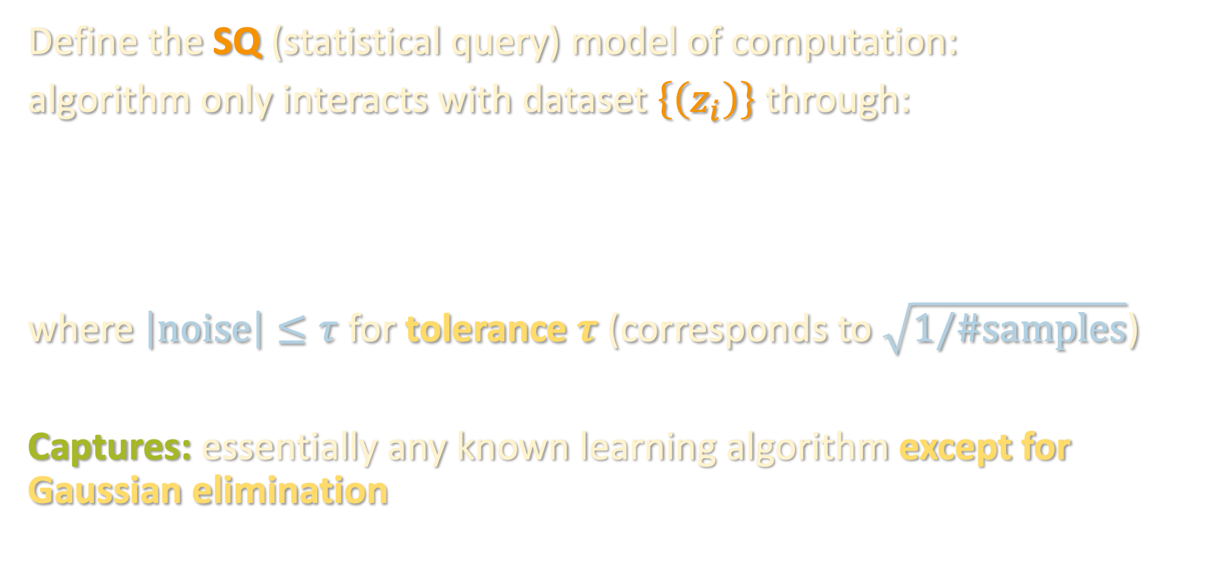
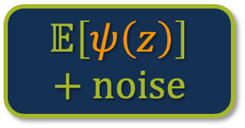

TODAY: STATISTICAL QUERY
Define the SQ (statistical query) model of computation:
algorithm only interacts with dataset $\left\{\left(z_{i}\right)\right\}$ through:
where $\left|noise\right|≤τ$ for tolerance $τ$ (corresponds to $\sqrt{1/\#samples}$)
Captures: essentially any known learning algorithm except for Gaussian elimination
$$𝔼\left[ψ\left(z\right)\right]+noise$$
$$ψ:ℝ^{m}→ℝ$$

Slide 3
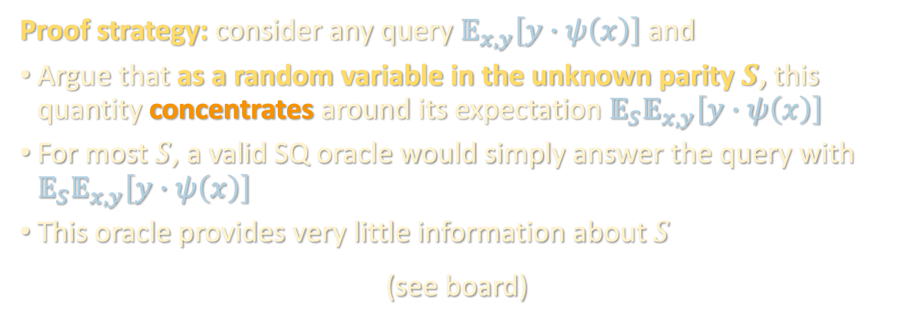
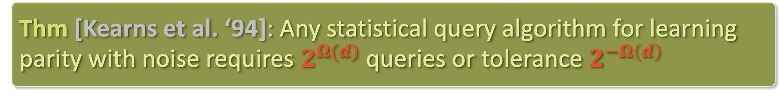
SQ LOWER BOUND FOR NOISY PARITY
Thm [Kearns et al. ‘94]: Any statistical query algorithm for learning parity with noise requires $2^{Ω(d)}$ queries or tolerance $2^{−Ω\left(d\right)}$
Proof strategy: consider any query $𝔼_{x,y}\left[y∙ψ\left(x\right)\right]$ and
Argue that as a random variable in the unknown parity $S$, this quantity concentrates around its expectation $𝔼_{S}𝔼_{x,y}\left[y∙ψ\left(x\right)\right]$
For most $S$, a valid SQ oracle would simply answer the query with $𝔼_{S}𝔼_{x,y}\left[y∙ψ\left(x\right)\right]$
This oracle provides very little information about $S$
(see board)

Slide 4
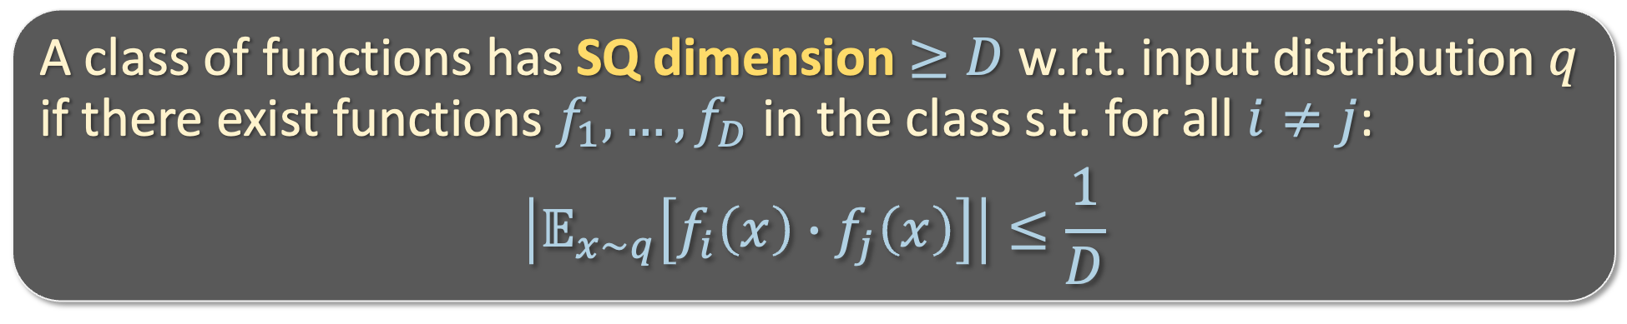
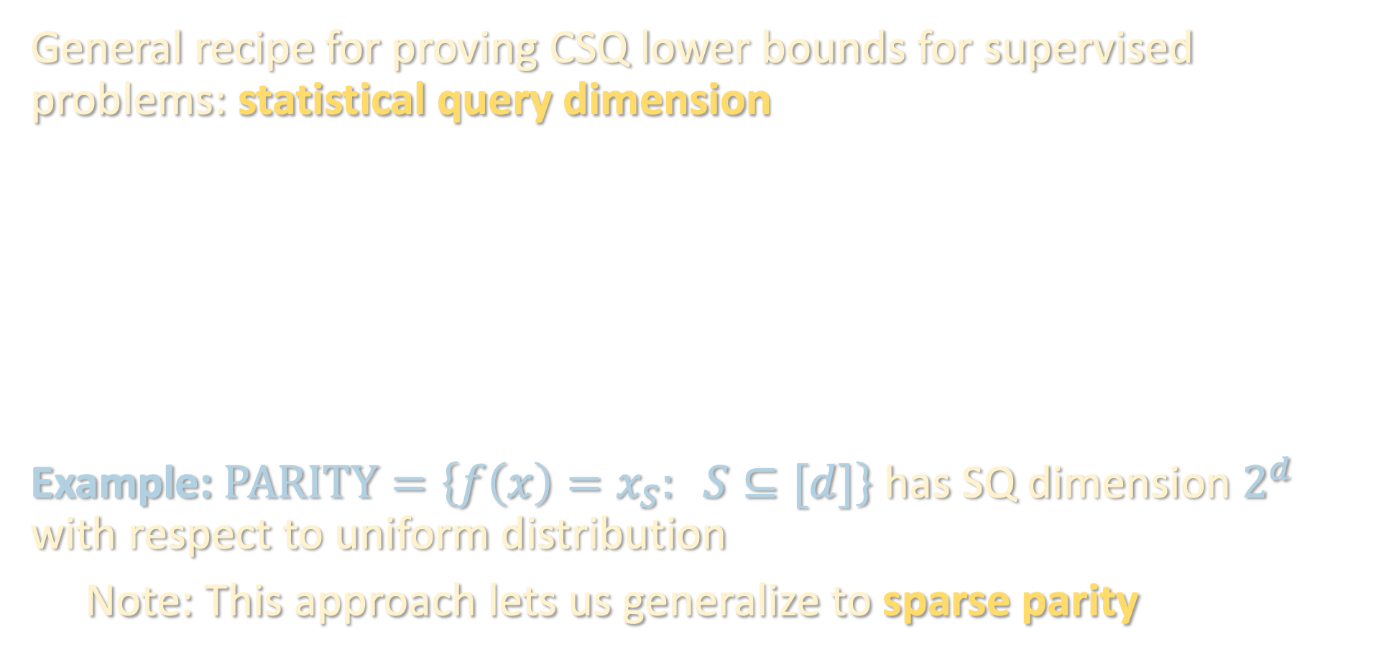
STATISTICAL QUERY DIMENSION
General recipe for proving CSQ lower bounds for supervised problems: statistical query dimension
Example: $PARITY=\left\{f\left(x\right)=x_{S}: S⊆[d]\right\}$ has SQ dimension $2^{d}$ with respect to uniform distribution
Note: This approach lets us generalize to sparse parity
A class of functions has SQ dimension $≥D$ w.r.t. input distribution $q$ if there exist functions $f_{1},…,f_{D}$ in the class s.t. for all $i≠j$:
$$\left|𝔼_{x\sim q}\left[f_{i}\left(x\right)∙f_{j}\left(x\right)\right]\right|≤\frac{1}{D}$$

Slide 5

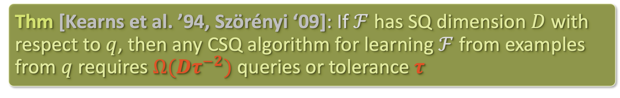
STATISTICAL QUERY DIMENSION
Thm [Kearns et al. ’94, Szörényi ‘09]: If $ℱ$ has SQ dimension $D$ with respect to $q$, then any CSQ algorithm for learning $ℱ$ from examples from $q$ requires $Ω(Dτ^{−2})$ queries or tolerance $τ$
E.g. take $τ=\sqrt[3]{1/D}$. If $D$ super-polynomially large, the SQ lower bound qualitatively implies that you either need super-polynomial #queries or super-polynomial #samples (inverse tolerance)

Slide 6
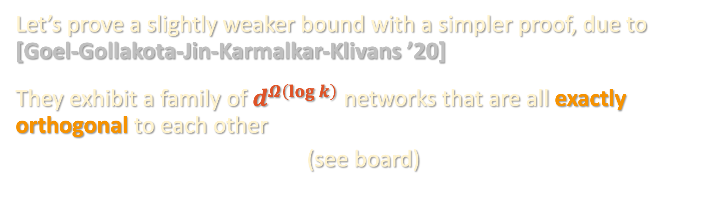
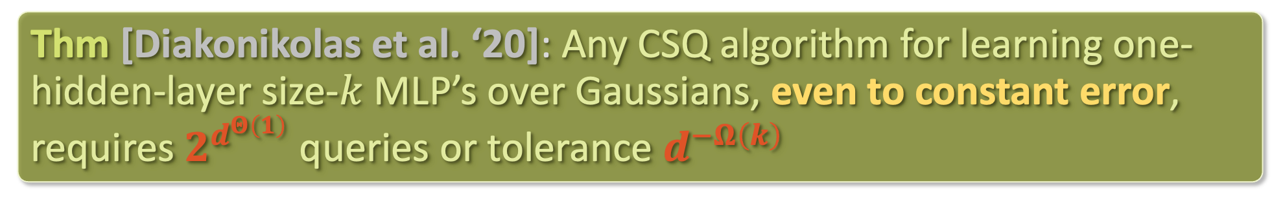
SQ LOWER BOUND FOR MLPS
Thm [Diakonikolas et al. ‘20]: Any CSQ algorithm for learning one-hidden-layer size-$k$ MLP’s over Gaussians, even to constant error, requires $2^{d^{Θ\left(1\right)}}$ queries or tolerance $d^{−Ω\left(k\right)}$
Let’s prove a slightly weaker bound with a simpler proof, due to [Goel-Gollakota-Jin-Karmalkar-Klivans ’20]
They exhibit a family of $d^{Ω\left(log k\right)}$ networks that are all exactly orthogonal to each other
(see board)

Slide 7
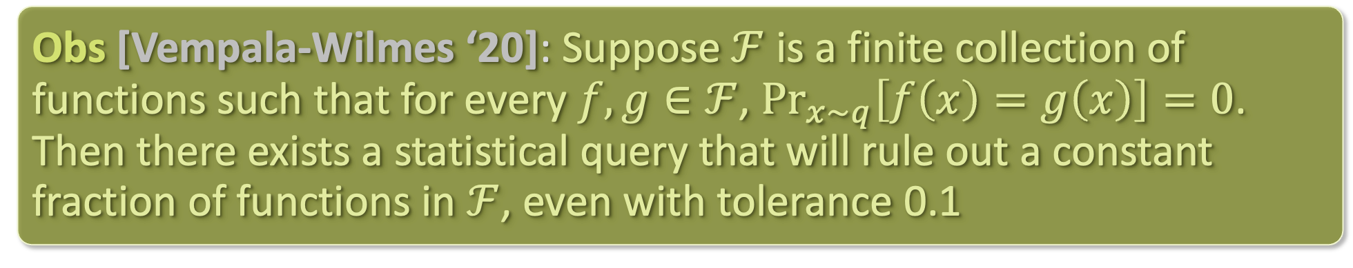




WHAT ABOUT SQ FOR REAL-VALUED FUNCTIONS?
(Full) SQ lower bounds for supervised learning of real-valued functions are rare / hard to show. Reason: quirk of the SQ model ☹
Proof: find $φ\left(x,y\right)$ such that $φ\left(x,f(x)\right)=v_{f}$ (well-defined because $\operatorname{Pr}\left[f\left(x\right)=g\left(x\right)\right]=0$ for all $f,g∈ℱ$).
Answer to $φ\left(x,f(x)\right)$ rules out all $g∈ℱ$ such that $\left|v_{f}−v_{g}\right|>0.1$
Obs [Vempala-Wilmes ‘20]: Suppose $ℱ$ is a finite collection of functions such that for every $f,g∈ℱ$, $\underset{x\sim q}{Pr}\left[f\left(x\right)=g\left(x\right)\right]=0$. Then there exists a statistical query that will rule out a constant fraction of functions in $ℱ$, even with tolerance 0.1
$$v_{f_{1}}$$
$$v_{f_{2}}$$
$$v_{f_{3}}$$
$$⋯$$
0
1

Slide 8
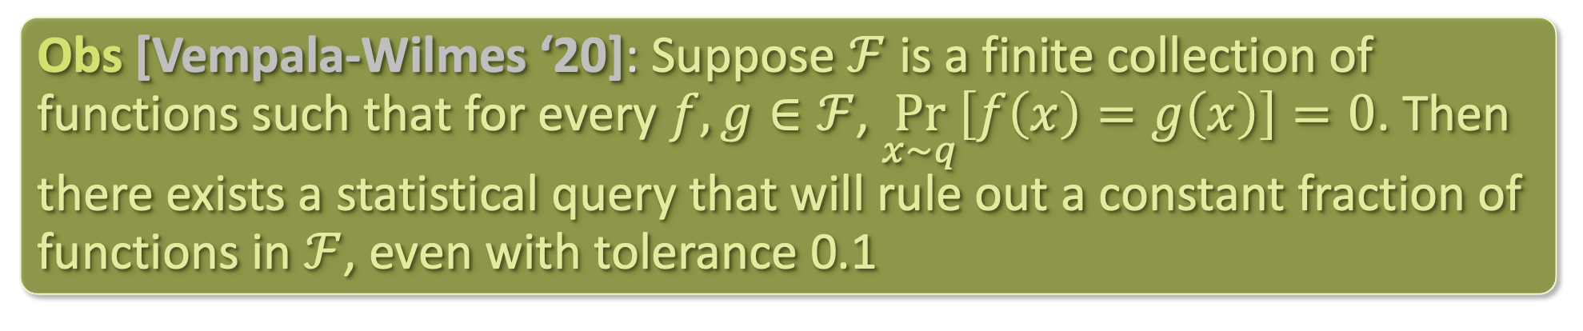
WHAT ABOUT SQ FOR REAL-VALUED FUNCTIONS?
(Full) SQ lower bounds for supervised learning of real-valued functions are rare / hard to show. Reason: quirk of the SQ model ☹
When functions are real-valued but take on Boolean values a non-vanishing fraction of the time, then this does not apply ☺
[C-Gollakota-Klivans-Meka ‘22]: Full SQ lower bounds for learning (real-valued) MLPs over Gaussian inputs (next time)
Obs [Vempala-Wilmes ‘20]: Suppose $ℱ$ is a finite collection of functions such that for every $f,g∈ℱ$, $\underset{x\sim q}{Pr}\left[f\left(x\right)=g\left(x\right)\right]=0$. Then there exists a statistical query that will rule out a constant fraction of functions in $ℱ$, even with tolerance 0.1

Slide 9
Statistical query lower bounds for supervised problems
Statistical query lower bounds for unsupervised problems

Slide 10
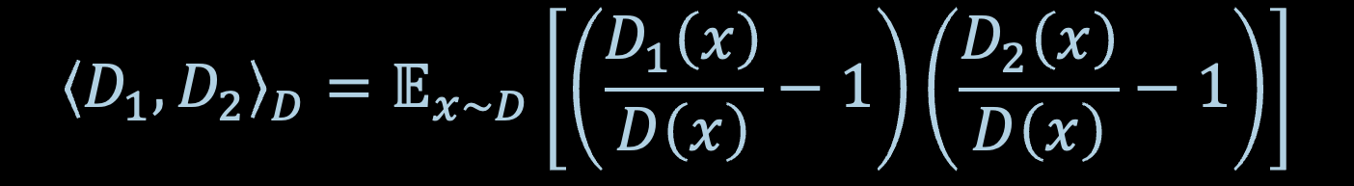
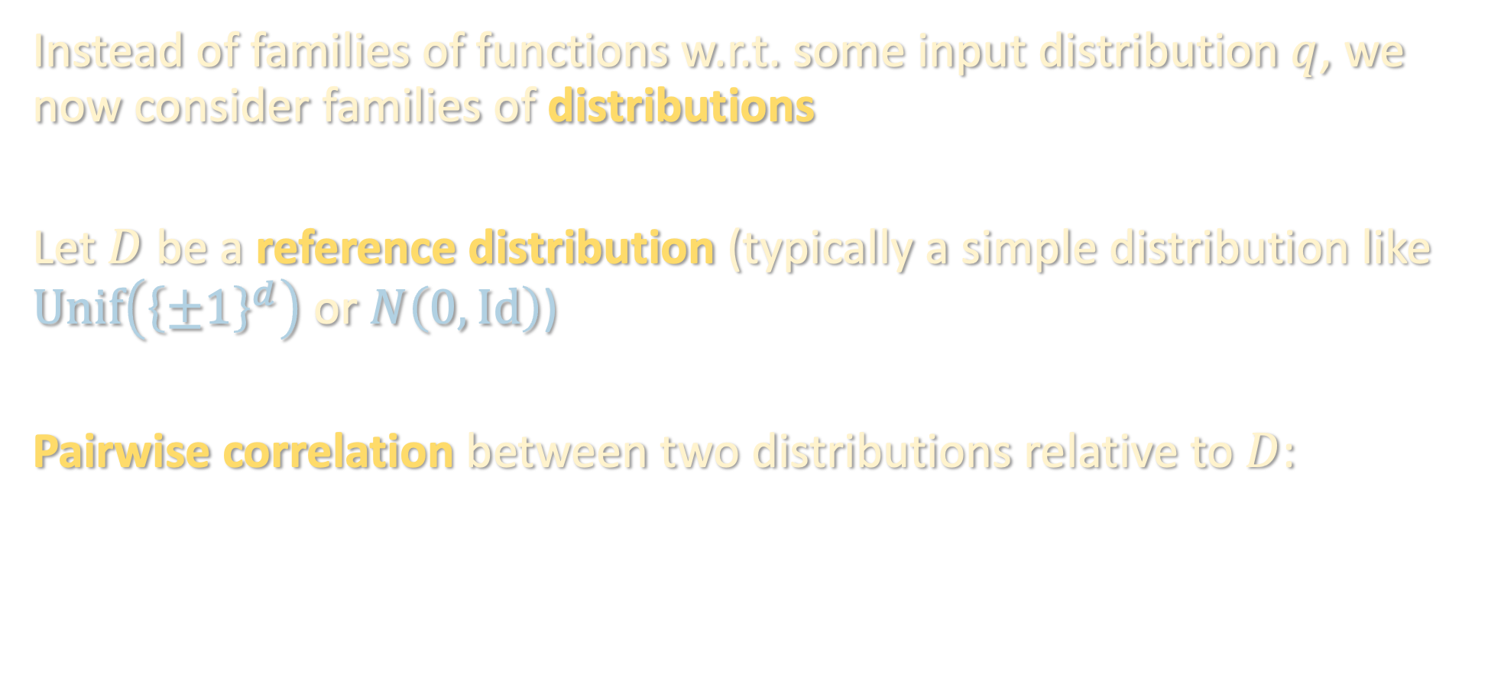
SQ LOWER BOUNDS FOR UNSUPERVISED PROBLEMS
Instead of families of functions w.r.t. some input distribution $q$, we now consider families of distributions
Let $D$ be a reference distribution (typically a simple distribution like $Unif\left({\left\{±1\right\}}^{d}\right)$ or $N\left(0,Id\right)$)
Pairwise correlation between two distributions relative to $D$:
$${\left\langle D_{1},D_{2}\right\rangle }_{D}=𝔼_{x\sim D}\left[\left(\frac{D_{1}\left(x\right)}{D\left(x\right)}−1\right)\left(\frac{D_{2}\left(x\right)}{D\left(x\right)}−1\right)\right]$$

Slide 11
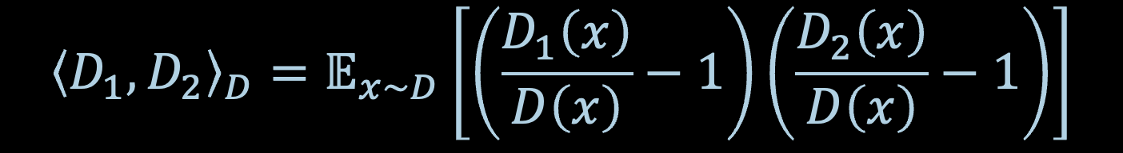
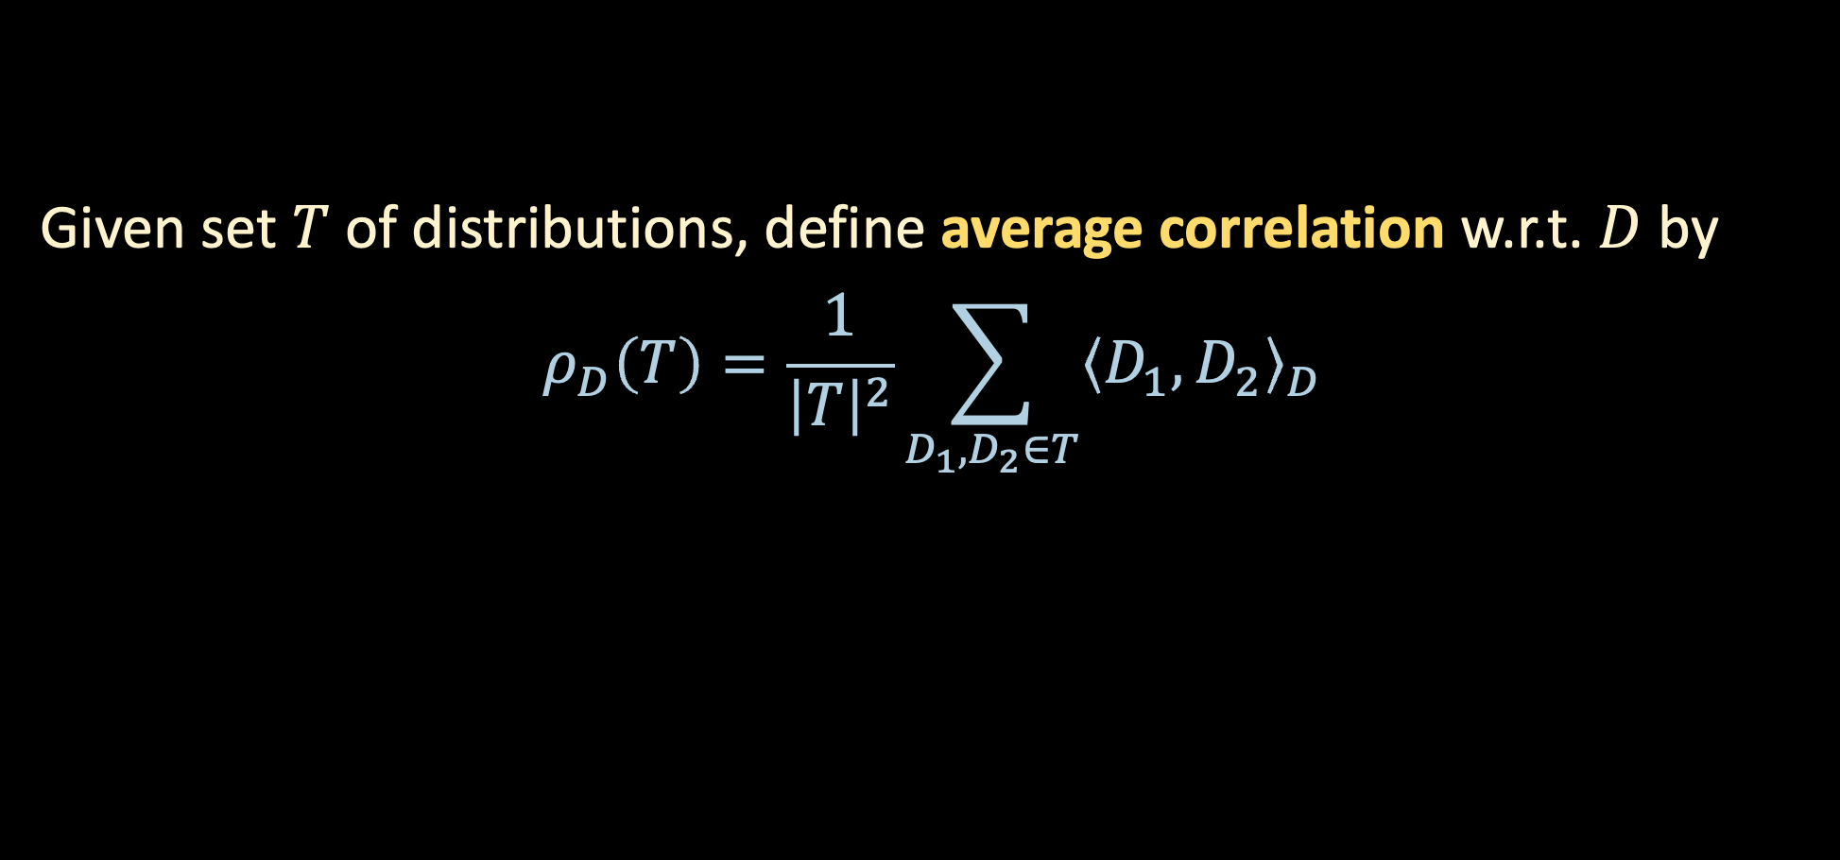
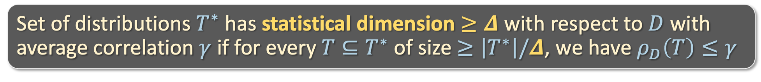
SQ LOWER BOUNDS FOR UNSUPERVISED PROBLEMS
$${\left\langle D_{1},D_{2}\right\rangle }_{D}=𝔼_{x\sim D}\left[\left(\frac{D_{1}\left(x\right)}{D\left(x\right)}−1\right)\left(\frac{D_{2}\left(x\right)}{D\left(x\right)}−1\right)\right]$$
Given set $T$ of distributions, define average correlation w.r.t. $D$ by
$$ρ_{D}\left(T\right)=\frac{1}{{\left|T\right|}^{2}}\sum_{D_{1},D_{2}∈T}{{\left\langle D_{1},D_{2}\right\rangle }_{D}}$$
Set of distributions $T^{∗}$ has statistical dimension $≥Δ$ with respect to $D$ with average correlation $γ$ if for every $T⊆T^{∗}$ of size $≥\left|T^{∗}\right|/Δ$, we have $ρ_{D}\left(T\right)≤γ$

Slide 12
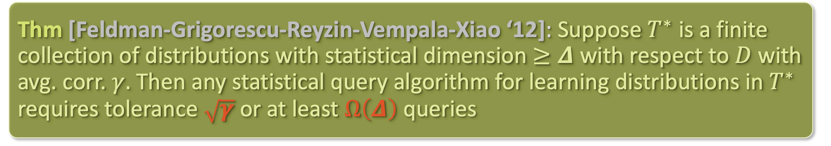
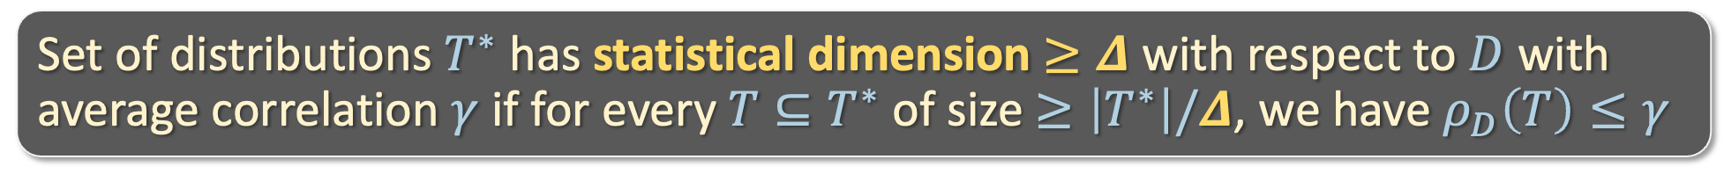
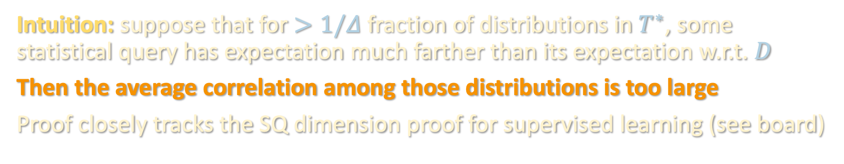
SQ LOWER BOUNDS FOR UNSUPERVISED PROBLEMS
Set of distributions $T^{∗}$ has statistical dimension $≥Δ$ with respect to $D$ with average correlation $γ$ if for every $T⊆T^{∗}$ of size $≥\left|T^{∗}\right|/Δ$, we have $ρ_{D}\left(T\right)≤γ$
Thm [Feldman-Grigorescu-Reyzin-Vempala-Xiao ‘12]: Suppose $T^{∗}$ is a finite collection of distributions with statistical dimension $≥Δ$ with respect to $D$ with avg. corr. $γ.$ Then any statistical query algorithm for learning distributions in $T^{∗}$ requires tolerance $\sqrt{γ}$ or at least $Ω\left(Δ\right)$ queries
Intuition: suppose that for $>1/Δ$ fraction of distributions in $T^{∗}$, some statistical query has expectation much farther than its expectation w.r.t. $D$
Then the average correlation among those distributions is too large
Proof closely tracks the SQ dimension proof for supervised learning (see board)

Slide 13
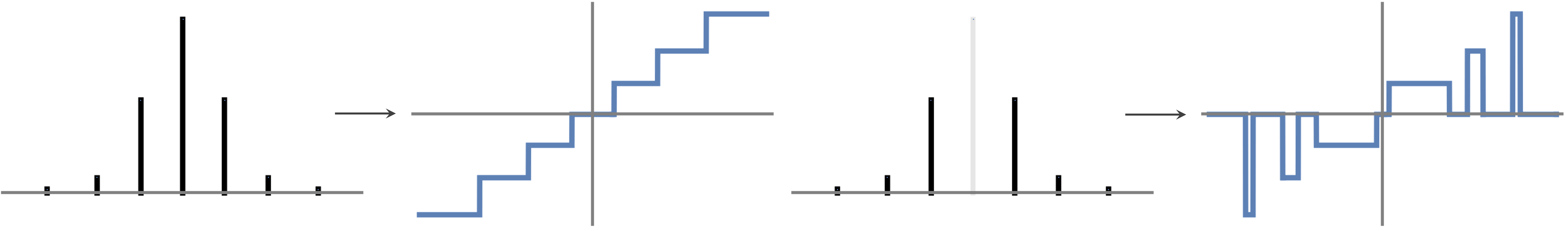

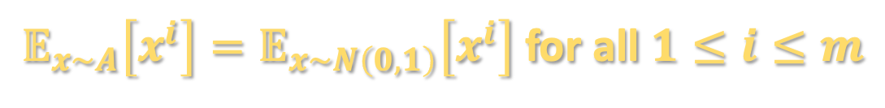


HOW TO LOWER BOUND STATISTICAL DIMENSION
Say we wanted to show an SQ lower bound for mixtures of Gaussians
Goal: design set of Gaussian mixtures which mostly have tiny pairwise correlation with each other relative to $N\left(0,Id\right)$
How to get tiny pairwise correlation?
Idea: “moment matching”
$$v$$
$$P_{v}$$
$𝔼_{x\sim A}\left[x^{i}\right]=𝔼_{x\sim N\left(0,1\right)}\left[x^{i}\right]$ for all $1≤i≤m$
“parallel pancakes”

Slide 14
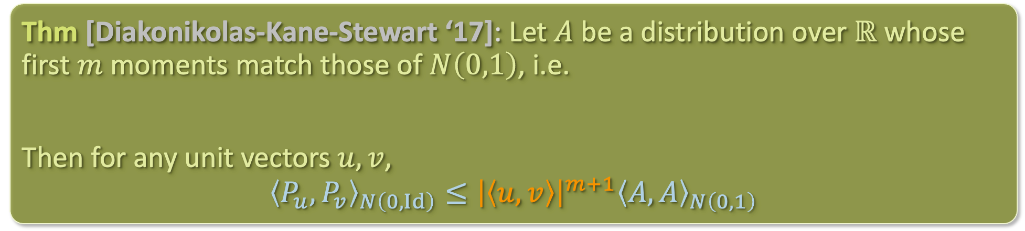
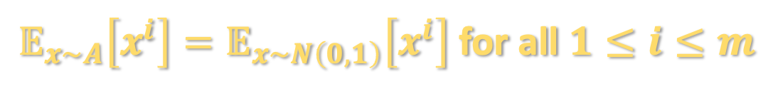
HOW TO LOWER BOUND STATISTICAL DIMENSION
Say we wanted to show an SQ lower bound for mixtures of Gaussians
Goal: design set of Gaussian mixtures which mostly have tiny pairwise correlation with each other relative to $N\left(0,Id\right)$
How to get tiny pairwise correlation?
Idea: “moment matching”
Thm [Diakonikolas-Kane-Stewart ‘17]: Let $A$ be a distribution over $ℝ$ whose first $m$ moments match those of $N\left(0,1\right)$, i.e.
$𝔼_{x\sim A}\left[x^{i}\right]=𝔼_{x\sim N\left(0,1\right)}\left[x^{i}\right]$ for all $1≤i≤m$
Then for any unit vectors $u,v$,
$${\left\langle P_{u},P_{v}\right\rangle }_{N\left(0,Id\right)}≤{\left|\left\langle u,v\right\rangle \right|}^{m+1}{\left\langle A,A\right\rangle }_{N\left(0,1\right)}$$
$𝔼_{x\sim A}\left[x^{i}\right]=𝔼_{x\sim N\left(0,1\right)}\left[x^{i}\right]$ for all $1≤i≤m$

Slide 15
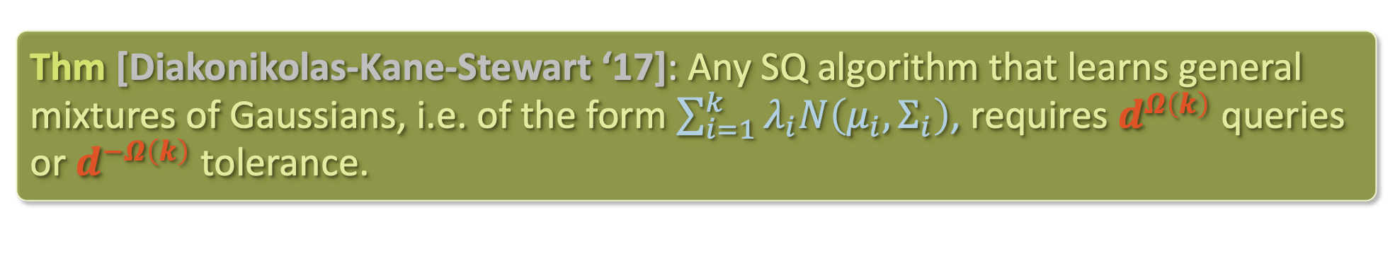
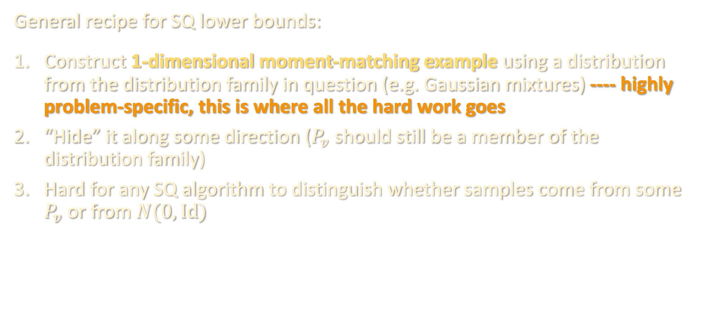
HOW TO LOWER BOUND STATISTICAL DIMENSION
General recipe for SQ lower bounds:
Construct 1-dimensional moment-matching example using a distribution from the distribution family in question (e.g. Gaussian mixtures) ---- highly problem-specific, this is where all the hard work goes
“Hide” it along some direction ($P_{v}$ should still be a member of the distribution family)
Hard for any SQ algorithm to distinguish whether samples come from some $P_{v}$ or from $N(0,Id)$
Thm [Diakonikolas-Kane-Stewart ‘17]: Any SQ algorithm that learns general mixtures of Gaussians, i.e. of the form $\sum_{i=1}^{k}{λ_{i}N\left(μ_{i},Σ_{i}\right)}$, requires $d^{Ω\left(k\right)}$ queries or $d^{−Ω\left(k\right)}$ tolerance.

Slide 16
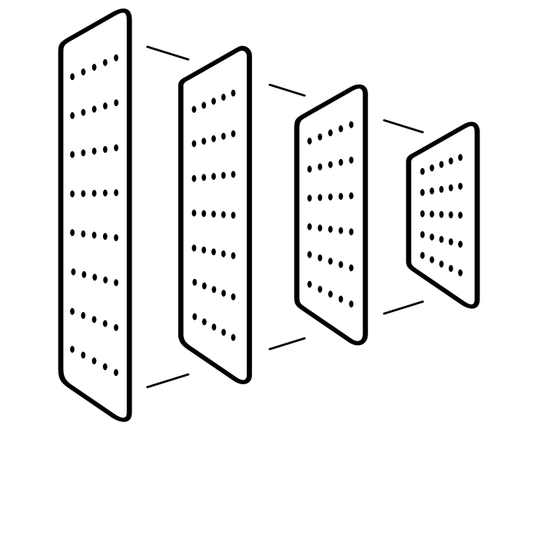


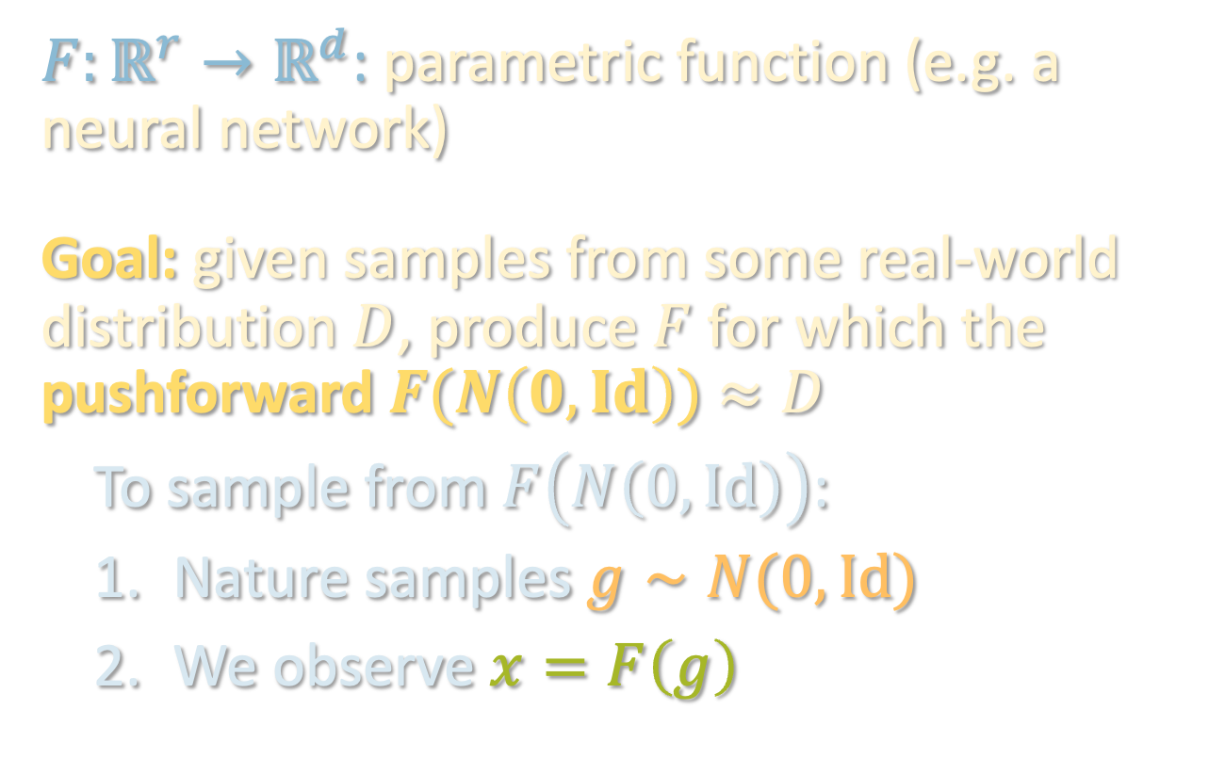

LEARNING GENERATIVE MODELS
$$x$$
$F:ℝ^{r}→ℝ^{d}$: parametric function (e.g. a neural network)
Goal: given samples from some real-world distribution $D$, produce $F$ for which the pushforward $F(N\left(0,Id\right))$ $≈D$
To sample from $F\left(N\left(0,Id\right)\right)$:
Nature samples $g∼N(0,Id)$
We observe $x=F\left(g\right)$
$$g$$
$$F$$

Slide 17

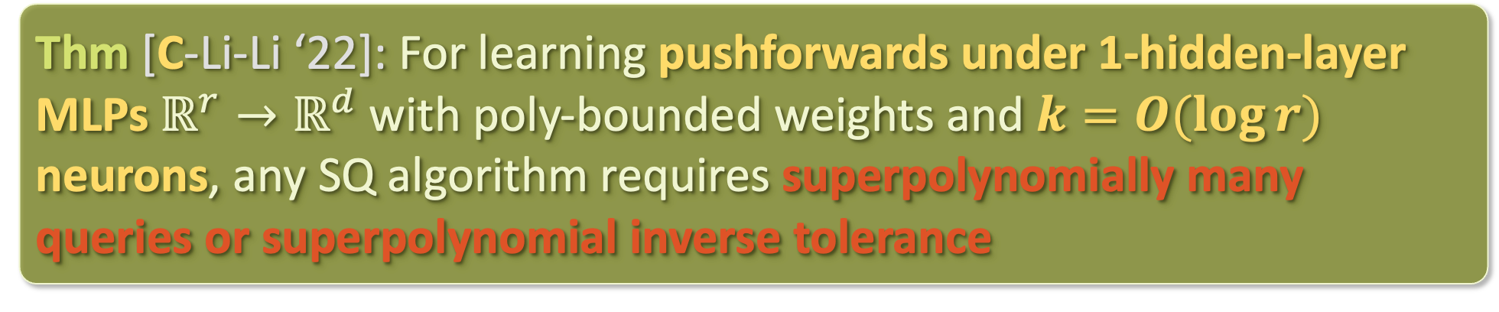


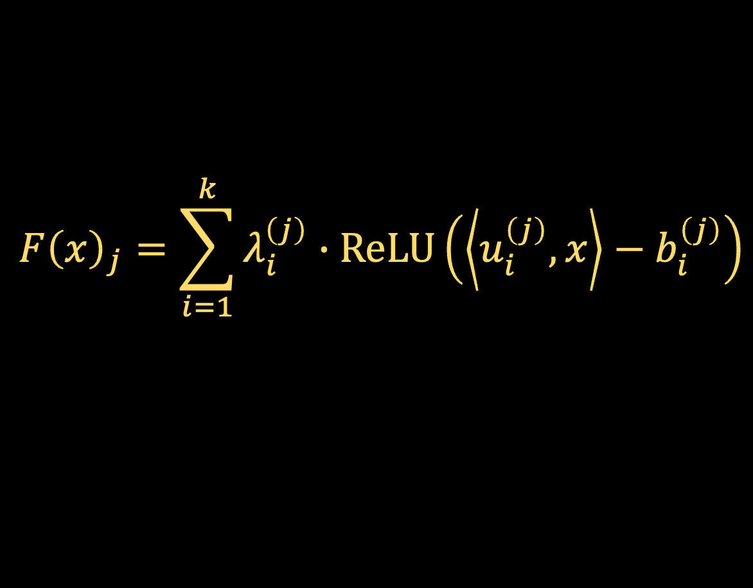
LEARNING GENERATIVE MODELS
$r$: input dimension
$d$: output dimension
$$x$$
$$F{\left(x\right)}_{j}=\sum_{i=1}^{k}{λ_{i}^{\left(j\right)}∙ReLU\left(\left\langle u_{i}^{\left(j\right)},x\right\rangle −b_{i}^{\left(j\right)}\right)}$$
$$g$$
“world’s simplest generative model”
$$F$$
Thm [C-Li-Li ‘22]: For learning pushforwards under 1-hidden-layer MLPs $ℝ^{r}→ℝ^{d}$ with poly-bounded weights and $k=O(\log{r})$ neurons, any SQ algorithm requires superpolynomially many queries or superpolynomial inverse tolerance
Notes:
under any reasonable distance, e.g. TV or wasserstein

Slide 18
PROOF SKETCH
Key technical ingredient: construct 1D pushforward $D=f(N\left(0,1\right))$ which matches all low-order moments with $N\left(0,1\right)$
Can then construct a high-dimensional pushforward which is $D$ along $v$ and Gaussian along all directions orthogonal to $v$
$$F^{∗}\left(g\right)=U⋅(f\left(g_{1}\right),g_{2},…,g_{r})$$

Slide 19
PROOF SKETCH
Key technical ingredient: construct 1D pushforward $D=f(N\left(0,1\right))$ which matches all low-order moments with $N\left(0,1\right)$
In 1D, 2-layer networks $≡$ piecewise linear functions
Main issue: the slopes are infinite... to implement this with a ReLU network, we’d need infinitely large weights! ☹

Slide 20
PROOF SKETCH
Key technical ingredient: construct 1D pushforward $D=f(N\left(0,1\right))$ which matches all low-order moments with $N\left(0,1\right)$
In 1D, 2-layer networks $≡$ piecewise linear functions
Main issue: the slopes are infinite... to implement this with a ReLU network, we’d need infinitely large weights! ☹

Slide 21
PROOF SKETCH
Key technical ingredient: construct 1D pushforward $D=f(N\left(0,1\right))$ which matches all low-order moments with $N\left(0,1\right)$
In 1D, 2-layer networks $≡$ piecewise linear functions
Main issue: the slopes are infinite... to implement this with a ReLU network, we’d need infinitely large weights! ☹

Slide 22
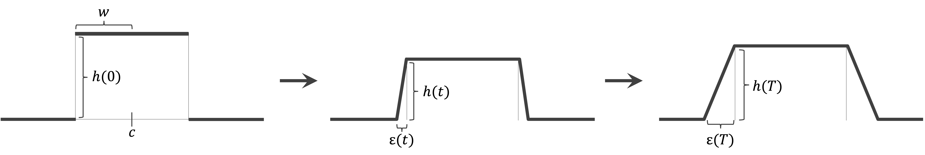
PROOF SKETCH
Idea: perturb the slopes of the function along a certain ODE
- maintains the moments of the pushforward
- gradually decreases weights needed to implement function
To ensure bases of the bumps don’t collide, can only run ODE for small amount of time, but enough to get poly-bounded slopes

Slide 23
NEXT TIME
For the last lecture on complexity, we will explore reduction-based lower bounds and dive deeper into the connection between computational complexity of learning and cryptography

