Slide 1

CS 224: ALGORITHMS FOR DATA SCIENCE
LECTURE 14 (10/25)
Tensor decomposition
Sum-of-squares
Robustness
Supervised learning
Computational complexity
Statistical physics
Generative modeling
FILTERED PCA

Slide 2
ANNOUNCEMENTS
Pset 4 (last one) posted Monday night
Office hours over Zoom this Thursday (out of town) --- email me for Zoom link if planning to attend
EE seminar on Thursday (JB Lasserre – CNRS, co-inventor of SoS)
SEC LL2.224 at 10am
SEC 2.118 at 4pm

Slide 3
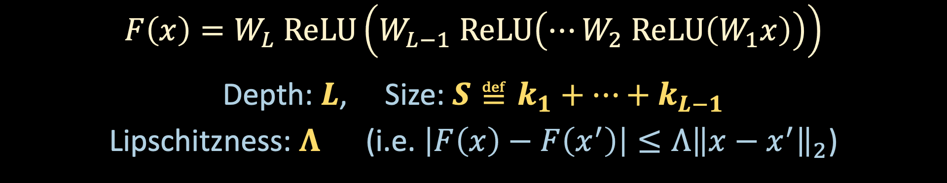
MULTI-LAYER PERCEPTRONS
$$x$$
$$W_{1}^{T}$$
$$W_{L−1}^{T}$$
$$W_{L}^{T}$$
$$W_{2}^{T}$$
…
$$ReLU$$
$$ReLU$$
$$ReLU$$
$$y$$
$$1×k_{L−1}$$
$$k_{L−1}×k_{L−2}$$
$$k_{2}×k_{1}$$
$$k_{1}×d$$
$$F\left(x\right)=W_{L} ReLU\left(W_{L−1} ReLU\left(⋯W_{2} ReLU\left(W_{1}x\right)\right)\right)$$
Depth: $L$, Size: $S≝k_{1}+⋯+k_{L−1}$
Lipschitzness: $Λ$ (i.e. $\left|F\left(x\right)−F\left(x^{′}\right)\right|≤Λ{\left\|x−x^{′}\right\|}_{2}$)

Slide 4
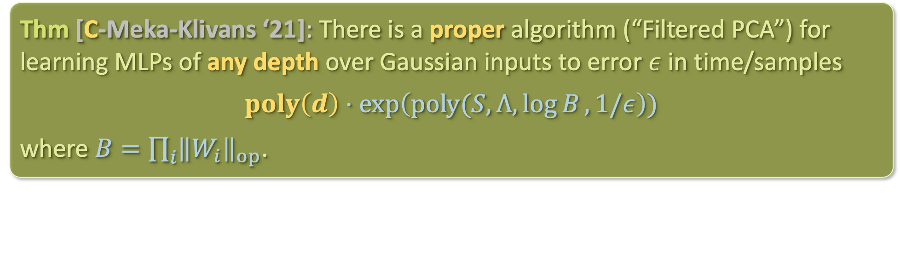
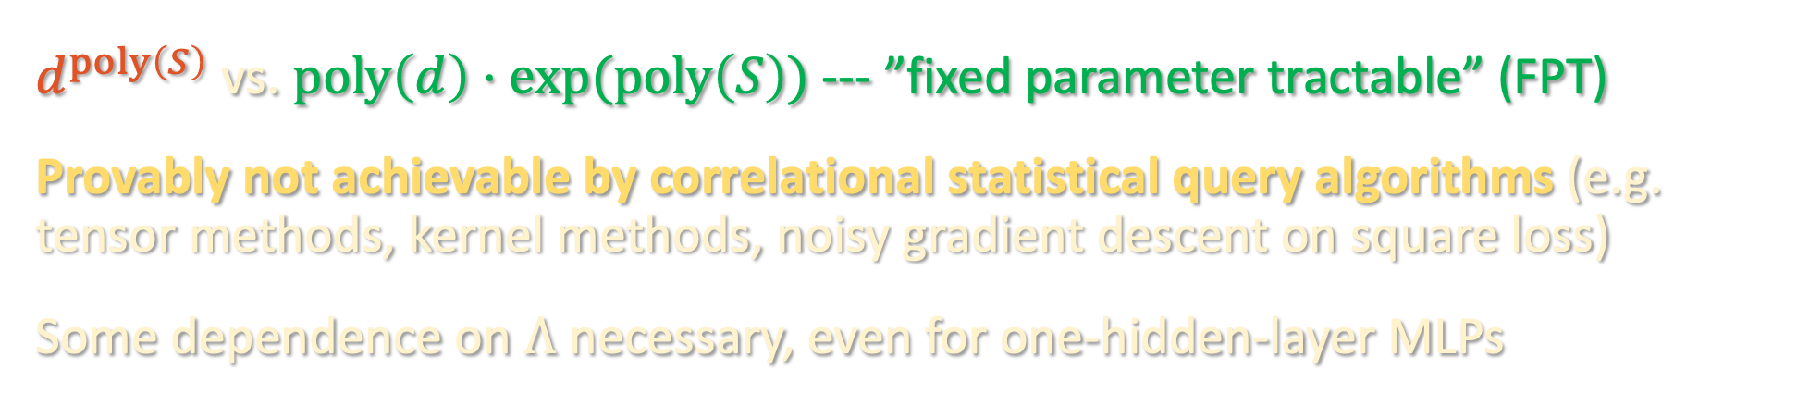
BEYOND CSQ: FILTERED PCA
Thm [C-Meka-Klivans ‘21]: There is a proper algorithm (“Filtered PCA”) for learning MLPs of any depth over Gaussian inputs to error $ε$ in time/samples
$$poly\left(d\right)⋅\exp\left(poly(S,Λ,\log{B},1/ε\right))$$
where $B=\prod_{i}{{\left\|W_{i}\right\|}_{op}}$.
$d^{poly\left(S\right)}$ vs. $poly\left(d\right)⋅exp⁡(poly\left(S\right))$ --- ”fixed parameter tractable” (FPT)
Provably not achievable by correlational statistical query algorithms (e.g. tensor methods, kernel methods, noisy gradient descent on square loss)
Some dependence on $Λ$ necessary, even for one-hidden-layer MLPs

Slide 5
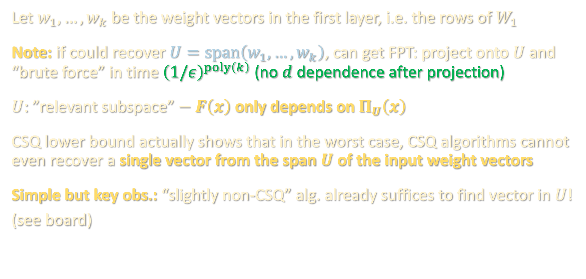
WARMUP: FINDING A RELEVANT DIRECTION
Let $w_{1},…,w_{k}$ be the weight vectors in the first layer, i.e. the rows of $W_{1}$
Note: if could recover $U=span\left(w_{1},…,w_{k}\right)$, can get FPT: project onto $U$ and “brute force” in time ${\left(1/ε\right)}^{poly\left(k\right)}$ (no $d$ dependence after projection)
$U$: ”relevant subspace” $− F\left(x\right)$ only depends on $Π_{U}\left(x\right)$
CSQ lower bound actually shows that in the worst case, CSQ algorithms cannot even recover a single vector from the span $U$ of the input weight vectors
Simple but key obs.: “slightly non-CSQ” alg. already suffices to find vector in $U$!
(see board)

Slide 6
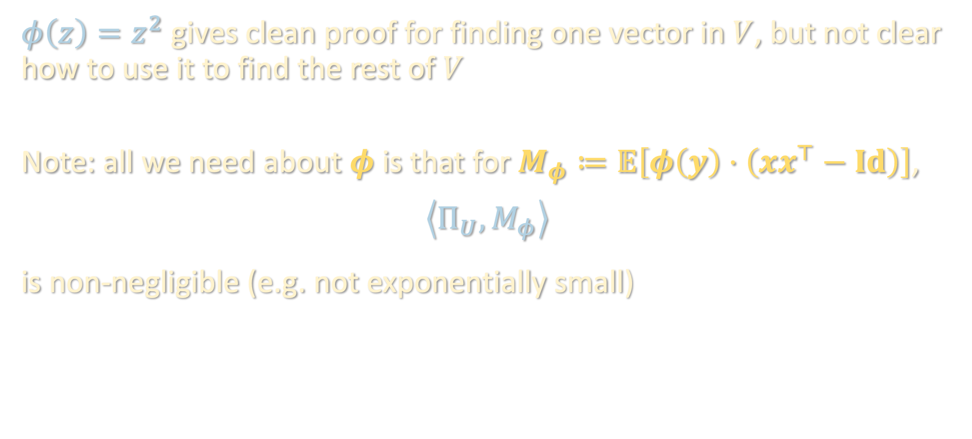
A DIFFERENT FILTER FUNCTION
$φ\left(z\right)=z^{2}$ gives clean proof for finding one vector in $V$, but not clear how to use it to find the rest of $V$
Note: all we need about $φ$ is that for $M_{φ}≔𝔼\left[φ\left(y\right)⋅\left(xx^{⊤}−Id\right)\right]$,
$$\left\langle Π_{U},M_{φ}\right\rangle$$
is non-negligible (e.g. not exponentially small)

Slide 7
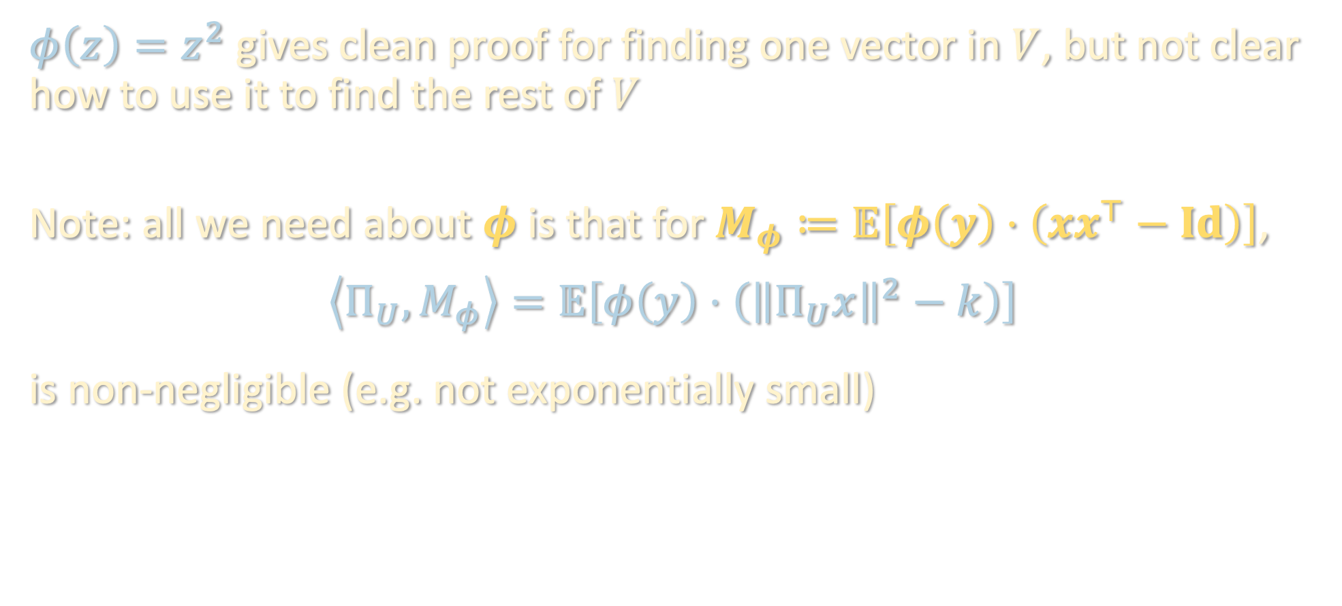
A DIFFERENT FILTER FUNCTION
$φ\left(z\right)=z^{2}$ gives clean proof for finding one vector in $V$, but not clear how to use it to find the rest of $V$
Note: all we need about $φ$ is that for $M_{φ}≔𝔼\left[φ\left(y\right)⋅\left(xx^{⊤}−Id\right)\right]$,
$$\left\langle Π_{U},M_{φ}\right\rangle =𝔼\left[φ\left(y\right)⋅\left({\left\|Π_{U}x\right\|}^{2}−k\right)\right]$$
is non-negligible (e.g. not exponentially small)

Slide 8

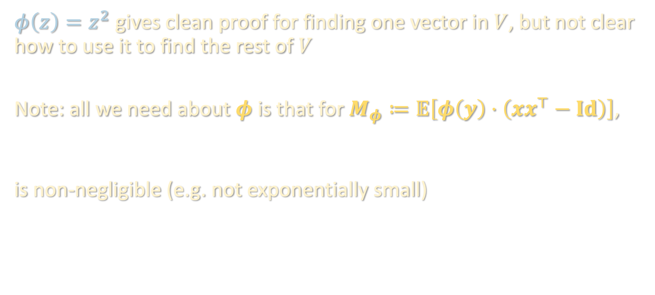
A DIFFERENT FILTER FUNCTION
$φ\left(z\right)=z^{2}$ gives clean proof for finding one vector in $V$, but not clear how to use it to find the rest of $V$
Note: all we need about $φ$ is that for $M_{φ}≔𝔼\left[φ\left(y\right)⋅\left(xx^{⊤}−Id\right)\right]$,
$$\left\langle Π_{V},M_{φ}\right\rangle =𝔼\left[φ\left(y\right)⋅\left({\left\|Π_{V}x\right\|}^{2}−k\right)\right]$$
is non-negligible (e.g. not exponentially small)
$$\left\langle Π_{U},M_{φ}\right\rangle =𝔼\left[φ\left(y\right)⋅\left({\left\|Π_{U}x\right\|}^{2}−k\right)\right]$$

Slide 9

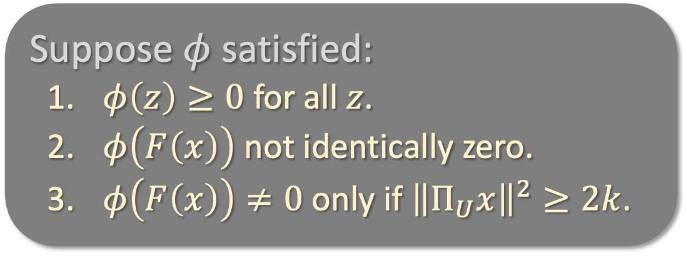



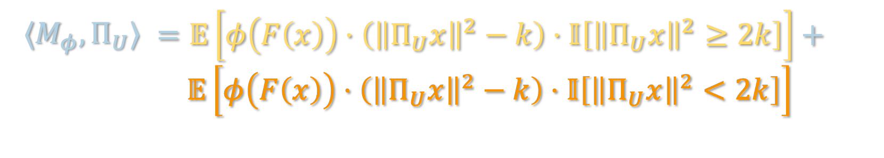
A DIFFERENT FILTER FUNCTION
$$\left\langle Π_{U},M_{φ}\right\rangle =𝔼\left[φ\left(y\right)⋅\left({\left\|Π_{U}x\right\|}^{2}−k\right)\right]$$
$$φ\left(F\left(x\right)\right)$$
Suppose $φ$ satisfied:
  $φ\left(z\right)≥0$ for all $z$.
  $φ\left(F\left(x\right)\right)$ not identically zero.
  $φ\left(F\left(x\right)\right)≠0$ only if ${\left\|Π_{U}x\right\|}^{2}≥2k$.
$${\left\|Π_{U}x\right\|}^{2}$$
$$2k$$
$⟨M_{φ},Π_{U}⟩$ | $$=𝔼\left[φ\left(F\left(x\right)\right)⋅\left({\left\|Π_{U}x\right\|}^{2}−k\right)⋅𝕀\left[{\left\|Π_{U}x\right\|}^{2}≥2k\right]\right]+$$ $$𝔼\left[φ\left(F\left(x\right)\right)⋅\left({\left\|Π_{U}x\right\|}^{2}−k\right)⋅𝕀\left[{\left\|Π_{U}x\right\|}^{2}<2k\right]\right]$$
Then:

Slide 10
A DIFFERENT FILTER FUNCTION
$$\left\langle Π_{U},M_{φ}\right\rangle =𝔼\left[φ\left(y\right)⋅\left({\left\|Π_{U}x\right\|}^{2}−k\right)\right]$$
$$φ\left(F\left(x\right)\right)$$
Suppose $φ$ satisfied:
  $φ\left(z\right)≥0$ for all $z$.
  $φ\left(F\left(x\right)\right)$ not identically zero.
  $φ\left(F\left(x\right)\right)≠0$ only if ${\left\|Π_{U}x\right\|}^{2}≥2k$.
$${\left\|Π_{U}x\right\|}^{2}$$
$$2k$$
$⟨M_{φ},Π_{U}⟩$ | $$=𝔼\left[φ\left(F\left(x\right)\right)⋅\left({\left\|Π_{U}x\right\|}^{2}−k\right)⋅𝕀\left[{\left\|Π_{U}x\right\|}^{2}≥2k\right]\right]$$
Then:

Slide 11
A DIFFERENT FILTER FUNCTION
$$\left\langle Π_{U},M_{φ}\right\rangle =𝔼\left[φ\left(y\right)⋅\left({\left\|Π_{U}x\right\|}^{2}−k\right)\right]$$
$$φ\left(F\left(x\right)\right)$$
Suppose $φ$ satisfied:
  $φ\left(z\right)≥0$ for all $z$.
  $φ\left(F\left(x\right)\right)$ not identically zero.
  $φ\left(F\left(x\right)\right)≠0$ only if ${\left\|Π_{U}x\right\|}^{2}≥2k$.
$${\left\|Π_{U}x\right\|}^{2}$$
$$2k$$
$⟨M_{φ},Π_{U}⟩$ | $$≥𝔼\left[φ\left(F\left(x\right)\right)⋅k⋅𝕀\left[{\left\|Π_{U}x\right\|}^{2}≥2k\right]\right]>0$$
Then:
so top eigenvector of $M$ would lie in relevant subspace $U$.

Slide 12
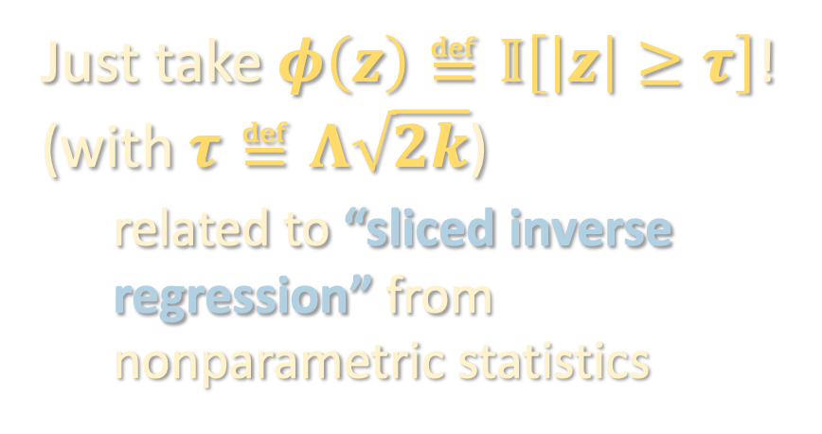




A DIFFERENT FILTER FUNCTION
Suppose $φ$ satisfied:
  $φ\left(z\right)≥0$ for all $z$.
  $φ\left(F\left(x\right)\right)$ not identically zero.
  $φ\left(F\left(x\right)\right)≠0$ only if ${\left\|Π_{U}x\right\|}^{2}≥2k$.
Just take $φ\left(z\right)≝𝕀\left[\left|z\right|≥τ\right]$!
(with $τ≝Λ\sqrt{2k}$)
related to “sliced inverse regression” from nonparametric statistics
$$φ\left(F\left(x\right)\right)$$
$${\left\|Π_{U}x\right\|}^{2}$$
$$2k$$

Slide 13
A DIFFERENT FILTER FUNCTION
Suppose $φ$ satisfied:
  $φ\left(z\right)≥0$ for all $z$.
  $φ\left(F\left(x\right)\right)$ not identically zero.
  $φ\left(F\left(x\right)\right)≠0$ only if ${\left\|Π_{U}x\right\|}^{2}≥2k$.
Just take $φ\left(z\right)≝𝕀\left[\left|z\right|≥τ\right]$!
(with $τ≝Λ\sqrt{2k}$)
related to “sliced inverse regression” from nonparametric statistics
$$φ\left(F\left(x\right)\right)$$
$\left\langle M_{φ},Π_{U}\right\rangle$ | $$≥k⋅𝔼\left[φ\left(F\left(x\right)\right)⋅𝕀\left[{\left\|Π_{U}x\right\|}^{2}≥2k\right]\right]$$
$${\left\|Π_{U}x\right\|}^{2}$$
$$2k$$

Slide 14
A DIFFERENT FILTER FUNCTION
Suppose $φ$ satisfied:
  $φ\left(z\right)≥0$ for all $z$.
  $φ\left(F\left(x\right)\right)$ not identically zero.
  $φ\left(F\left(x\right)\right)≠0$ only if ${\left\|Π_{U}x\right\|}^{2}≥2k$.
Just take $φ\left(z\right)≝𝕀\left[\left|z\right|≥τ\right]$!
(with $τ≝Λ\sqrt{2k}$)
related to “sliced inverse regression” from nonparametric statistics
$$φ\left(F\left(x\right)\right)$$
$\left\langle M_{φ},Π_{U}\right\rangle$ | $$≥k⋅𝔼\left[𝕀\left[\left|F\left(x\right)\right|≥τ\right]\right]$$
$${\left\|Π_{U}x\right\|}^{2}$$
$$2k$$

Slide 15

A DIFFERENT FILTER FUNCTION
Suppose $φ$ satisfied:
  $φ\left(z\right)≥0$ for all $z$.
  $φ\left(F\left(x\right)\right)$ not identically zero.
  $φ\left(F\left(x\right)\right)≠0$ only if ${\left\|Π_{U}x\right\|}^{2}≥2k$.
Just take $φ\left(z\right)≝𝕀\left[\left|z\right|≥τ\right]$!
(with $τ≝Λ\sqrt{2k}$)
related to “sliced inverse regression” from nonparametric statistics
$$φ\left(F\left(x\right)\right)$$
$$\left\{x:{\left\|Π_{U}x\right\|}^{2}<2k\right\}$$
$\left\langle M_{φ},Π_{U}\right\rangle$ | $$≥k⋅ℙ\left[\left|F\left(x\right)\right|≥τ\right]$$
$${\left\|Π_{U}x\right\|}^{2}$$
$$2k$$

Slide 16
A DIFFERENT FILTER FUNCTION
Suppose $φ$ satisfied:
  $φ\left(z\right)≥0$ for all $z$.
  $φ\left(F\left(x\right)\right)$ not identically zero.
  $φ\left(F\left(x\right)\right)≠0$ only if ${\left\|Π_{U}x\right\|}^{2}≥2k$.
Just take $φ\left(z\right)≝𝕀\left[\left|z\right|≥τ\right]$!
(with $τ≝Λ\sqrt{2k}$)
related to “sliced inverse regression” from nonparametric statistics
$$φ\left(F\left(x\right)\right)$$
$\left\langle M_{φ},Π_{U}\right\rangle$ | $$≥k⋅ℙ\left[\left|F\left(x\right)\right|≥τ\right]$$
$${\left\|Π_{U}x\right\|}^{2}$$
$$2k$$

Slide 17




A DIFFERENT FILTER FUNCTION
Just take $φ\left(z\right)≝𝕀\left[\left|z\right|≥τ\right]$!
(with $τ≝Λ\sqrt{2k}$)
$φ\left(F\left(x\right)\right)≠0$ only if ${\left\|Π_{U}x\right\|}^{2}≥2k$.
If ${\left\|Π_{U}x\right\|}^{2}<2k$, then $|F\left(x\right)|<Λ\sqrt{2k}$:
so Property 3 holds.
$$\left|F\left(x\right)\right|=\left|F\left(Π_{U}x\right)\right|$$
$≤\left|F\left(0\right)\right|+Λ\left\|Π_{U}x\right\|$
$<Λ\sqrt{2k}$

Slide 18

A DIFFERENT FILTER FUNCTION
Just take $φ\left(z\right)≝𝕀\left[\left|z\right|≥τ\right]$!
(with $τ≝Λ\sqrt{2k}$)
$φ\left(F\left(x\right)\right)$ not identically zero.

Slide 19

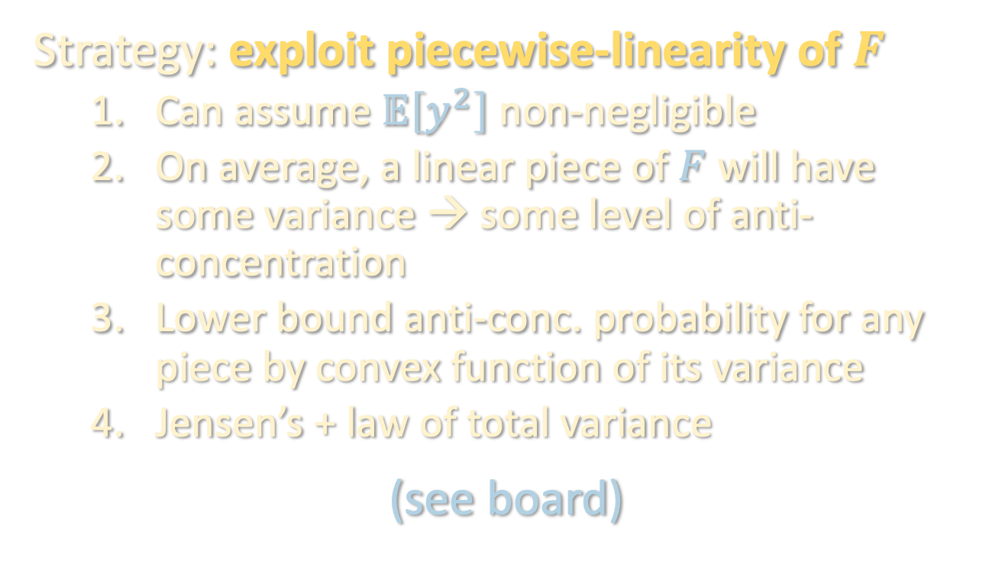
A DIFFERENT FILTER FUNCTION
Just take $φ\left(z\right)≝𝕀\left[\left|z\right|≥τ\right]$!
(with $τ≝Λ\sqrt{2k}$)
$ℙ\left[\left|F\left(x\right)\right|≥τ\right]$ is large.
Strategy: exploit piecewise-linearity of $F$
  Can assume $𝔼\left[y^{2}\right]$ non-negligible
  On average, a linear piece of $F$ will have some variance → some level of anti-concentration
  Lower bound anti-conc. probability for any piece by convex function of its variance
  Jensen’s + law of total variance
  (see board)

Slide 20
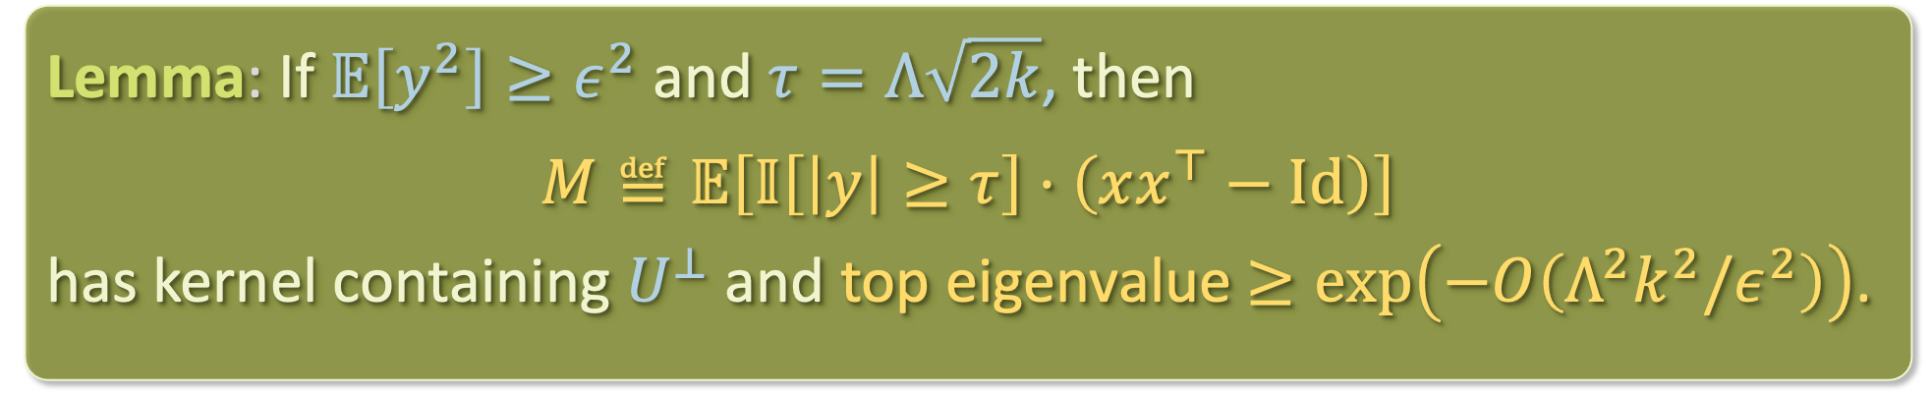

FINDING A RELEVANT FUNCTION
Lemma: If $𝔼\left[y^{2}\right]≥ε^{2}$ and $τ=Λ\sqrt{2k}$, then
$$M≝𝔼\left[𝕀\left[\left|y\right|≥τ\right]⋅\left(xx^{⊤}−Id\right)\right]$$
has kernel containing $U^{⊥}$ and top eigenvalue $≥\exp\left(−O\left(Λ^{2}k^{2}/ε^{2}\right)\right)$.
If we form an empirical estimate of $M$ from enough samples and take its top eigenvector, will be close to relevant subspace $U$
The full spectrum of $M$ need not reveal the full subspace $U$…
How do we learn the rest of the relevant subspace?

Slide 21

FINDING ANOTHER RELEVANT DIRECTION
Given $v∈U$, how do we find another vector $v^{′}∈U ∖span\left(v\right)$?
$$𝔼\left[𝕀\left[\left|y\right|≥τ\right]⋅\left(xx^{⊤}−Id\right)\right]$$

Slide 22

FINDING ANOTHER RELEVANT DIRECTION
Given $v∈U$, how do we find another vector $v^{′}∈U ∖span\left(v\right)$?
$$Π_{v}^{⊥}⋅𝔼\left[𝕀\left[\left|y\right|≥τ\right]⋅\left(xx^{⊤}−Id\right)\right]⋅Π_{v}^{⊥}$$

Slide 23

FINDING ANOTHER RELEVANT DIRECTION
Given $v∈U$, how do we find another vector $v^{′}∈U ∖span\left(v\right)$?
$$Π_{v}^{⊥}⋅𝔼\left[𝕀\left[\left|y\right|≥τ\right]⋅\left(xx^{⊤}−Id\right)\right]⋅Π_{v}^{⊥}$$

Slide 24

FINDING ANOTHER RELEVANT DIRECTION
Given $v∈U$, how do we find another vector $v^{′}∈U ∖span\left(v\right)$?
$$M^{′}≝Π_{v}^{⊥}⋅𝔼\left[𝕀\left[\left|y−F\left(Π_{v}x\right)\right|≥τ\right]⋅\left(xx^{⊤}−Id\right)\right]⋅Π_{v}^{⊥}$$
For now, pretend we have access to this

Slide 25
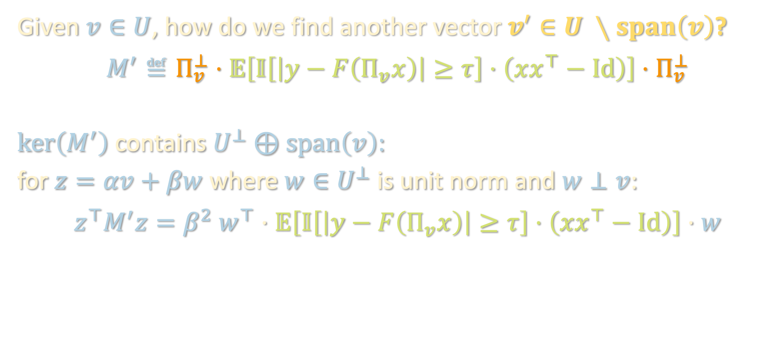
FINDING ANOTHER RELEVANT DIRECTION
Given $v∈U$, how do we find another vector $v^{′}∈U ∖span\left(v\right)$?
$$M^{′}≝Π_{v}^{⊥}⋅𝔼\left[𝕀\left[\left|y−F\left(Π_{v}x\right)\right|≥τ\right]⋅\left(xx^{⊤}−Id\right)\right]⋅Π_{v}^{⊥}$$
$ker\left(M^{′}\right)$ contains $U^{⊥}⊕span\left(v\right)$:
for $z=αv+βw$ where $w∈U^{⊥}$ is unit norm and $w⊥v$:
$$z^{⊤}M^{′}z=β^{2} w^{⊤}⋅𝔼\left[𝕀\left[\left|y−F\left(Π_{v}x\right)\right|≥τ\right]⋅\left(xx^{⊤}−Id\right)\right]⋅w$$

Slide 26


FINDING ANOTHER RELEVANT DIRECTION
Given $v∈U$, how do we find another vector $v^{′}∈U ∖span\left(v\right)$?
$$M^{′}≝Π_{v}^{⊥}⋅𝔼\left[𝕀\left[\left|y−F\left(Π_{v}x\right)\right|≥τ\right]⋅\left(xx^{⊤}−Id\right)\right]⋅Π_{v}^{⊥}$$
$ker\left(M^{′}\right)$ contains $U^{⊥}⊕span\left(v\right)$:
for $z=αv+βw$ where $w∈U^{⊥}$ is unit norm and $w⊥v$:
$$z^{⊤}M^{′}z=β^{2} w^{⊤}⋅𝔼\left[𝕀\left[\left|y−F\left(Π_{v}x\right)\right|≥τ\right]⋅\left(xx^{⊤}−Id\right)\right]⋅w$$
$$=β^{2} 𝔼\left[𝕀\left[\left|y−F\left(Π_{v}x\right)\right|≥τ\right]⋅\left({\left\langle w,x\right\rangle }^{2}−1\right)\right]$$
depends on $U⊕v$
depends on $w$ (orthogonal to $U⊕v$)

Slide 27
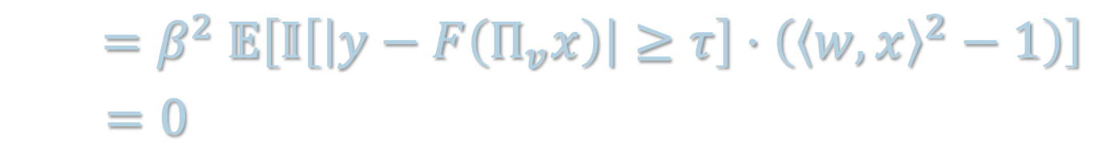
FINDING ANOTHER RELEVANT DIRECTION
Given $v∈U$, how do we find another vector $v^{′}∈U ∖span\left(v\right)$?
$$M^{′}≝Π_{v}^{⊥}⋅𝔼\left[𝕀\left[\left|y−F\left(Π_{v}x\right)\right|≥τ\right]⋅\left(xx^{⊤}−Id\right)\right]⋅Π_{v}^{⊥}$$
$ker\left(M^{′}\right)$ contains $U^{⊥}⊕span\left(v\right)$:
for $z=αv+βw$ where $w∈U^{⊥}$ is unit norm and $w⊥v$:
$$z^{⊤}M^{′}z=β^{2} w^{⊤}⋅𝔼\left[𝕀\left[\left|y−F\left(Π_{v}x\right)\right|≥τ\right]⋅\left(xx^{⊤}−Id\right)\right]⋅w$$
$$=β^{2} 𝔼\left[𝕀\left[\left|y−F\left(Π_{v}x\right)\right|≥τ\right]⋅\left({\left\langle w,x\right\rangle }^{2}−1\right)\right]$$
$$=0$$

Slide 28
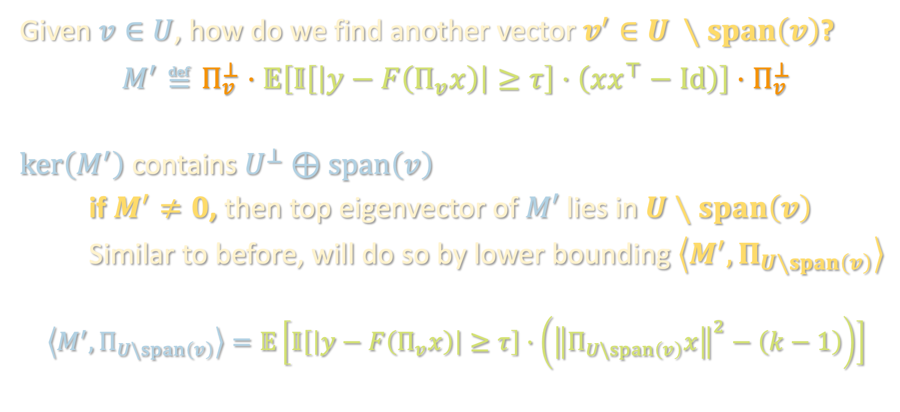
FINDING ANOTHER RELEVANT DIRECTION
Given $v∈U$, how do we find another vector $v^{′}∈U ∖span\left(v\right)$?
$$M^{′}≝Π_{v}^{⊥}⋅𝔼\left[𝕀\left[\left|y−F\left(Π_{v}x\right)\right|≥τ\right]⋅\left(xx^{⊤}−Id\right)\right]⋅Π_{v}^{⊥}$$
$ker\left(M^{′}\right)$ contains $U^{⊥}⊕span\left(v\right)$
if $M^{′}≠0$, then top eigenvector of $M′$ lies in $U∖span\left(v\right)$
Similar to before, will do so by lower bounding $\left\langle M^{′},Π_{U∖span\left(v\right)}\right\rangle$
$$\left\langle M^{′},Π_{U\backslash span\left(v\right)}\right\rangle =𝔼\left[𝕀\left[\left|y−F\left(Π_{v}x\right)\right|≥τ\right]⋅\left({\left\|Π_{U\backslash span\left(v\right)}x\right\|}^{2}−\left(k−1\right)\right)\right]$$

Slide 29


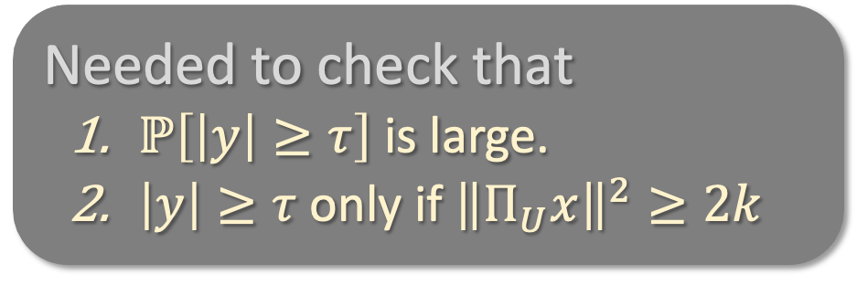




FINDING ANOTHER RELEVANT DIRECTION
Previously…
$$\left\langle M,Π_{U}\right\rangle =𝔼\left[𝕀\left[\left|y\right|≥τ\right]⋅\left({\left\|Π_{U}x\right\|}^{2}−k\right)\right]$$
Needed to check that
  $ℙ\left[\left|y\right|≥τ\right]$ is large.
  $\left|y\right|≥τ$only if ${\left\|Π_{U}x\right\|}^{2}≥2k$
$$𝕀\left[\left|y\right|≥τ\right]$$
$${\left\|Π_{U}x\right\|}^{2}$$
$$2k$$
Then:
so top eigenvector of $M$ would lie in $U$.
$⟨M,Π_{U}⟩$ | $$≥k⋅ℙ\left[\left|y\right|≥τ\right]>0$$

Slide 30

FINDING ANOTHER RELEVANT DIRECTION
$$\left\langle M′,Π_{U\backslash span\left(v\right)}\right\rangle =𝔼\left[𝕀\left[\left|y−F\left(Π_{v}x\right)\right|≥τ\right]⋅\left({\left\|Π_{U\backslash span\left(v\right)}x\right\|}^{2}−(k−1)\right)\right]$$
Needed to check that
  $ℙ\left[\left|y\right|≥τ\right]$ is large.
  $\left|y\right|≥τ$only if ${\left\|Π_{U}x\right\|}^{2}≥2k$
$$𝕀\left[\left|y\right|≥τ\right]$$
$${\left\|Π_{U}x\right\|}^{2}$$
$$2k$$
Then:
so top eigenvector of $M$ would lie in $U$.
$⟨M,Π_{U}⟩$ | $$≥k⋅ℙ\left[\left|y\right|≥τ\right]>0$$

Slide 31
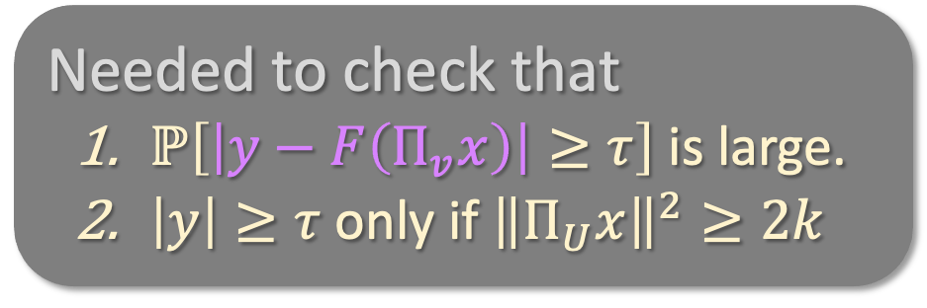
FINDING ANOTHER RELEVANT DIRECTION
$$\left\langle M′,Π_{U\backslash span\left(v\right)}\right\rangle =𝔼\left[𝕀\left[\left|y−F\left(Π_{v}x\right)\right|≥τ\right]⋅\left({\left\|Π_{U\backslash span\left(v\right)}x\right\|}^{2}−(k−1)\right)\right]$$
Needed to check that
  $ℙ\left[\left|y−F\left(Π_{v}x\right)\right|≥τ\right]$ is large.
  $\left|y\right|≥τ$only if ${\left\|Π_{U}x\right\|}^{2}≥2k$
$$𝕀\left[\left|y\right|≥τ\right]$$
$${\left\|Π_{U}x\right\|}^{2}$$
$$2k$$
Then:
so top eigenvector of $M$ would lie in $U$.
$⟨M,Π_{U}⟩$ | $$≥k⋅ℙ\left[\left|y\right|≥τ\right]>0$$

Slide 32
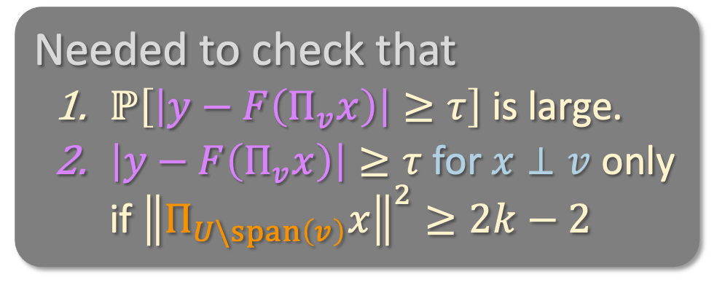
FINDING ANOTHER RELEVANT DIRECTION
$$\left\langle M′,Π_{U\backslash span\left(v\right)}\right\rangle =𝔼\left[𝕀\left[\left|y−F\left(Π_{v}x\right)\right|≥τ\right]⋅\left({\left\|Π_{U\backslash span\left(v\right)}x\right\|}^{2}−(k−1)\right)\right]$$
Needed to check that
  $ℙ\left[\left|y−F\left(Π_{v}x\right)\right|≥τ\right]$ is large.
  $\left|y−F\left(Π_{v}x\right)\right|≥τ$ for $x⊥v$ only if ${\left\|Π_{U\backslash span\left(v\right)}x\right\|}^{2}≥2k−2$
$$𝕀\left[\left|y\right|≥τ\right]$$
$${\left\|Π_{U}x\right\|}^{2}$$
$$2k$$
Then:
so top eigenvector of $M$ would lie in $U$.
$⟨M,Π_{U}⟩$ | $$≥k⋅ℙ\left[\left|y\right|≥τ\right]>0$$

Slide 33



FINDING ANOTHER RELEVANT DIRECTION
$$\left\langle M′,Π_{U\backslash span\left(v\right)}\right\rangle =𝔼\left[𝕀\left[\left|y−F\left(Π_{v}x\right)\right|≥τ\right]⋅\left({\left\|Π_{U\backslash span\left(v\right)}x\right\|}^{2}−(k−1)\right)\right]$$
Needed to check that
  $ℙ\left[\left|y−F\left(Π_{v}x\right)\right|≥τ\right]$ is large.
  $\left|y−F\left(Π_{v}x\right)\right|≥τ$ for $x⊥v$ only if ${\left\|Π_{U\backslash span\left(v\right)}x\right\|}^{2}≥2k−2$
$$𝕀\left[\left|y−F\left(Π_{v}x\right)\right|≥τ\right]$$
$${\left\|Π_{U\backslash span\left(v\right)}x\right\|}^{2}$$
$$2k−2$$
Then:
so top eigenvector of $M$ would lie in $U$.
$⟨M,Π_{U}⟩$ | $$≥k⋅ℙ\left[\left|y\right|≥τ\right]>0$$

Slide 34

FINDING ANOTHER RELEVANT DIRECTION
$$\left\langle M′,Π_{U\backslash span\left(v\right)}\right\rangle =𝔼\left[𝕀\left[\left|y−F\left(Π_{v}x\right)\right|≥τ\right]⋅\left({\left\|Π_{U\backslash span\left(v\right)}x\right\|}^{2}−(k−1)\right)\right]$$
Needed to check that
  $ℙ\left[\left|y−F\left(Π_{v}x\right)\right|≥τ\right]$ is large.
  $\left|y−F\left(Π_{v}x\right)\right|≥τ$ for $x⊥v$ only if ${\left\|Π_{U\backslash span\left(v\right)}x\right\|}^{2}≥2k−2$
$$𝕀\left[\left|y−F\left(Π_{v}x\right)\right|≥τ\right]$$
$${\left\|Π_{U\backslash span\left(v\right)}x\right\|}^{2}$$
$$2k−2$$
Then:
so top eigenvector of $M$ would lie in $U$.
$⟨M,Π_{U\backslash span\left(v\right)}⟩$ | $$≥k⋅ℙ\left[\left|y\right|≥τ\right]>0$$

Slide 35
FINDING ANOTHER RELEVANT DIRECTION
$$\left\langle M′,Π_{U\backslash span\left(v\right)}\right\rangle =𝔼\left[𝕀\left[\left|y−F\left(Π_{v}x\right)\right|≥τ\right]⋅\left({\left\|Π_{U\backslash span\left(v\right)}x\right\|}^{2}−(k−1)\right)\right]$$
Needed to check that
  $ℙ\left[\left|y−F\left(Π_{v}x\right)\right|≥τ\right]$ is large.
  $\left|y−F\left(Π_{v}x\right)\right|≥τ$ for $x⊥v$ only if ${\left\|Π_{U\backslash span\left(v\right)}x\right\|}^{2}≥2k−2$
$$𝕀\left[\left|y−F\left(Π_{v}x\right)\right|≥τ\right]$$
$${\left\|Π_{U\backslash span\left(v\right)}x\right\|}^{2}$$
$$2k−2$$
Then:
so top eigenvector of $M$ would lie in $U$.
$⟨M,Π_{U\backslash span\left(v\right)}⟩$ | $$≥\left(k−1\right)⋅ℙ\left[\left|y−F\left(Π_{v}x\right)\right|≥τ\right]>0$$

Slide 36

FINDING ANOTHER RELEVANT DIRECTION
$$\left\langle M′,Π_{U\backslash span\left(v\right)}\right\rangle =𝔼\left[𝕀\left[\left|y−F\left(Π_{v}x\right)\right|≥τ\right]⋅\left({\left\|Π_{U\backslash span\left(v\right)}x\right\|}^{2}−(k−1)\right)\right]$$
Needed to check that
  $ℙ\left[\left|y−F\left(Π_{v}x\right)\right|≥τ\right]$ is large.
  $\left|y−F\left(Π_{v}x\right)\right|≥τ$ for $x⊥v$ only if ${\left\|Π_{U\backslash span\left(v\right)}x\right\|}^{2}≥2k−2$
$$𝕀\left[\left|y−F\left(Π_{v}x\right)\right|≥τ\right]$$
$${\left\|Π_{U\backslash span\left(v\right)}x\right\|}^{2}$$
$$2k−2$$
Then:
so top eigenvector of $M′$ would lie in $U\backslash span\left(v\right)$.
$⟨M,Π_{U\backslash span\left(v\right)}⟩$ | $$≥\left(k−1\right)⋅ℙ\left[\left|y−F\left(Π_{v}x\right)\right|≥τ\right]>0$$

Slide 37


FINDING ANOTHER RELEVANT DIRECTION
  2. $\left|y−F\left(Π_{v}x\right)\right|≥τ$ for $x⊥v$ only if ${\left\|Π_{U\backslash span\left(v\right)}x\right\|}^{2}≥2k−2$
Take any $x⊥v$
If ${\left\|Π_{U\backslash span\left(v\right)}x\right\|}^{2}<2k−2$, then $|F(x)−F\left(Π_{v}x\right)|<Λ\sqrt{2k−2}$:
$$\left|F\left(x\right)−F\left(Π_{v}x\right)\right|=\left|F\left(Π_{U}x\right)−F(Π_{v}x)\right|$$

Slide 38

FINDING ANOTHER RELEVANT DIRECTION
  2. $\left|y−F\left(Π_{v}x\right)\right|≥τ$ for $x⊥v$ only if ${\left\|Π_{U\backslash span\left(v\right)}x\right\|}^{2}≥2k−2$
Take any $x⊥v$
If ${\left\|Π_{U\backslash span\left(v\right)}x\right\|}^{2}<2k−2$, then $|F(x)−F\left(Π_{v}x\right)|<Λ\sqrt{2k−2}$:
$$\left|F\left(x\right)−F\left(Π_{v}x\right)\right|=\left|F\left(Π_{U}x\right)−F(Π_{v}x)\right|$$
$≤Λ \left\|Π_{U\backslash span\left(v\right)}x\right\|$

Slide 39
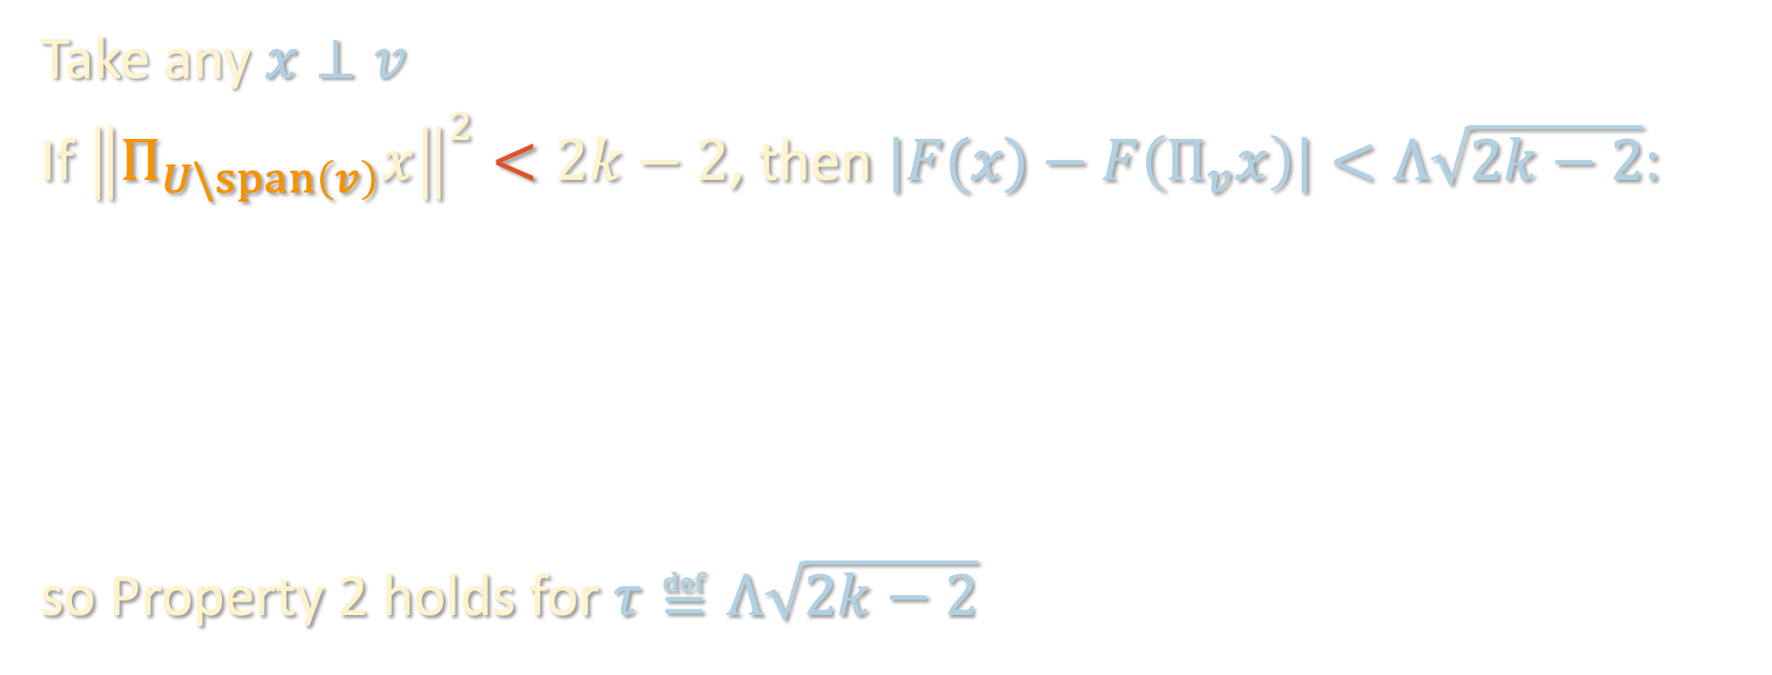
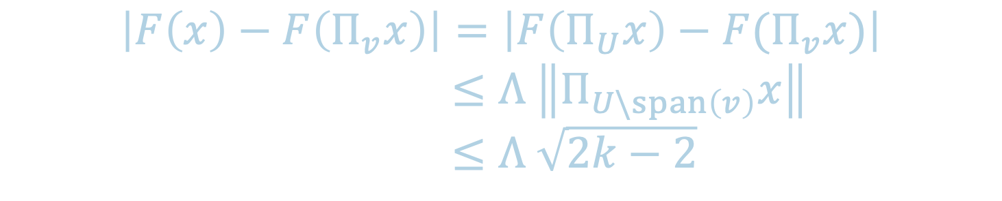
FINDING ANOTHER RELEVANT DIRECTION
  2. $\left|y−F\left(Π_{v}x\right)\right|≥τ$ for $x⊥v$ only if ${\left\|Π_{U\backslash span\left(v\right)}x\right\|}^{2}≥2k−2$
Take any $x⊥v$
If ${\left\|Π_{U\backslash span\left(v\right)}x\right\|}^{2}<2k−2$, then $|F(x)−F\left(Π_{v}x\right)|<Λ\sqrt{2k−2}$:
so Property 2 holds for $τ≝Λ\sqrt{2k−2}$
$$\left|F\left(x\right)−F\left(Π_{v}x\right)\right|=\left|F\left(Π_{U}x\right)−F(Π_{v}x)\right|$$
$≤Λ \left\|Π_{U\backslash span\left(v\right)}x\right\|$
$≤Λ \sqrt{2k−2}$

Slide 40

FINDING ANOTHER RELEVANT DIRECTION
  1. $ℙ\left[\left|y−F\left(Π_{v}x\right)\right|≥τ\right]$ is large (anti-concentration of $F\left(x\right)−F\left(Π_{v}x\right)$)
If $𝔼\left[{\left(y−F\left(Π_{v}x\right)\right)}^{2}\right]$ large:
  Because $F\left(x\right)−F\left(Π_{v}x\right)$ is piecewise-linear, we can apply anti-concentration argument from earlier.
If $𝔼\left[{\left(y−F\left(Π_{v}x\right)\right)}^{2}\right]$ small:
  $F\left(Π_{v}x\right)$ already achieves low test loss, so we’re done!

Slide 41
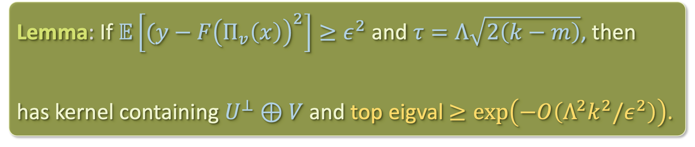

FINDING ANOTHER RELEVANT DIRECTION
Say we’ve found orthogonal vectors $v_{1},…,v_{m}∈U$ so far. Let $V$ denote their span.
If we form an empirical estimate of $M′$ from enough samples and take its top eigenvector, we recover a new direction in $U$.
Lemma: If $𝔼\left[{(y−F\left(Π_{v}\left(x\right)\right)}^{2}\right]≥ε^{2}$ and $τ=Λ\sqrt{2\left(k−m\right)}$, then
$$M^{′}≝Π_{V}^{⊥}⋅𝔼\left[𝕀\left[\left|y−F\left(Π_{V}x\right)\right|≥τ\right]⋅\left(xx^{⊤}−Id\right)\right]⋅Π_{V}^{⊥}$$
has kernel containing $U^{⊥}⊕V$ and top eigval $≥\exp\left(−O\left(Λ^{2}k^{2}/ε^{2}\right)\right)$.
$$M^{′}≝Π_{V}^{⊥}⋅𝔼\left[𝕀\left[\left|y−F\left(Π_{V}x\right)\right|≥τ\right]⋅\left(xx^{⊤}−Id\right)\right]⋅Π_{V}^{⊥}$$

Slide 42
CHICKEN AND EGG PROBLEM?
$$M^{′}≝Π_{V}^{⊥}⋅𝔼\left[𝕀\left[\left|y−F\left(Π_{V}x\right)\right|≥τ\right]⋅\left(xx^{⊤}−Id\right)\right]⋅Π_{V}^{⊥}$$

Slide 43
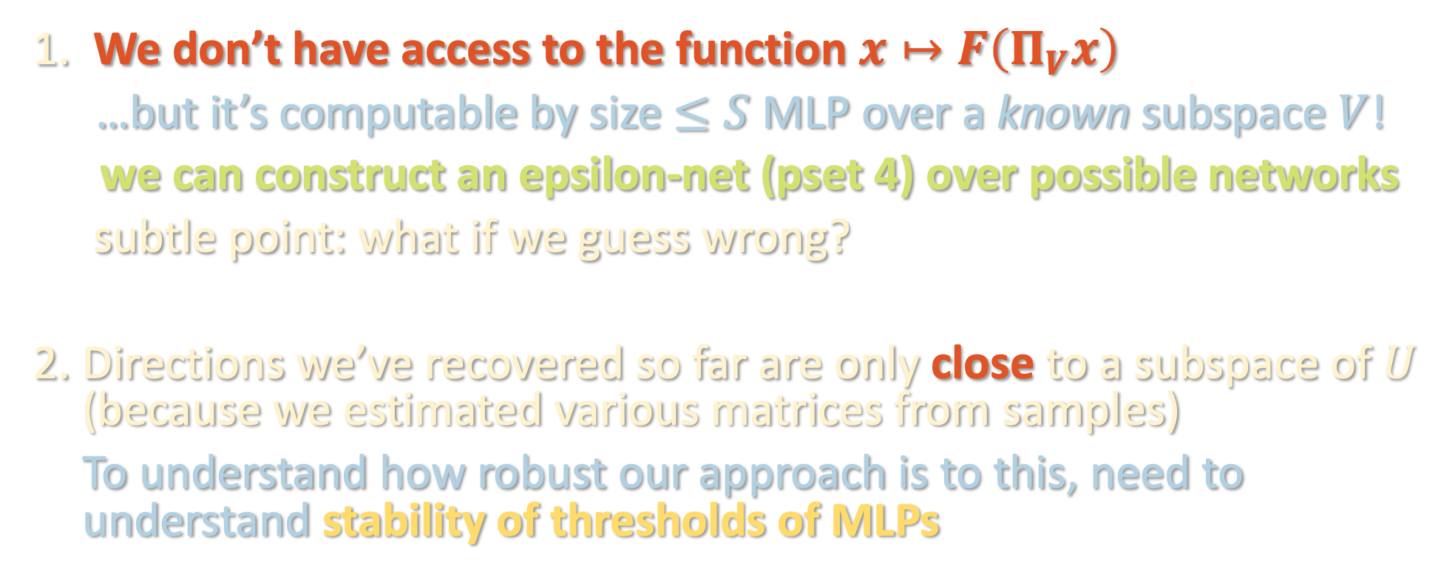
CHICKEN AND EGG PROBLEM?
$$M^{′}≝Π_{V}^{⊥}⋅𝔼\left[𝕀\left[\left|y−F\left(Π_{V}x\right)\right|≥τ\right]⋅\left(xx^{⊤}−Id\right)\right]⋅Π_{V}^{⊥}$$
We don’t have access to the function $x↦F\left(Π_{V}x\right)$
…but it’s computable by size $≤S$ MLP over a known subspace $V$!
we can construct an epsilon-net (pset 4) over possible networks
subtle point: what if we guess wrong?
Directions we’ve recovered so far are only close to a subspace of $U$ (because we estimated various matrices from samples)
To understand how robust our approach is to this, need to understand stability of thresholds of MLPs

Slide 44
KEY STABILITY RESULT

Slide 45
KEY STABILITY RESULT

Slide 46
KEY STABILITY RESULT
Want to bound the (Gaussian volume of this area of disagreement.

Slide 47

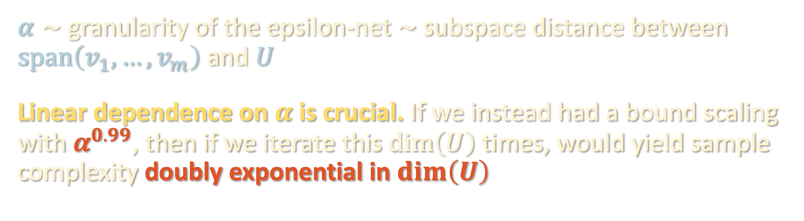

KEY STABILITY RESULT
$$\prod_{i}{{\left\|W_{i}\right\|}_{op}}≤B$$
Lemma: For depth-$L$ MLPs $F$ and $F′$ with the same architecture and whose weight matrices are $α$-close in operator norm,
$$ℙ\left[\left|F\left(x\right)\right|>τ and \left|F^{′}\left(x\right)\right|≤τ\right]≤2^{O\left(S\right)}Bα/τ$$
$α∼$granularity of the epsilon-net $∼$ subspace distance between $span\left(v_{1},…,v_{m}\right)$ and $U$
Linear dependence on $α$ is crucial. If we instead had a bound scaling with $α^{0.99}$, then if we iterate this $\dim\left(U\right)$ times, would yield sample complexity doubly exponential in $\dim\left(U\right)$

Slide 48








KEY STABILITY RESULT – DEPTH REDUCTION
Theorem [Ovchinnikov ‘03]: Any continuous piecewise-linear function $F$ can be written as a depth-2 max-min formula.
$max$
……
$min$
$$min$$
$$min$$
…………
$$⟨u_{1},x⟩$$
$$⟨u_{2},x⟩$$
$$⟨u_{N},x⟩$$

Slide 49

















KEY STABILITY RESULT – PROOF SKETCH
Lemma: For depth-$L$ MLPs $F$ and $F′$ with the same architecture and whose weight matrices are $α$-close in operator norm,
$$ℙ\left[\left|F\left(x\right)\right|>τ and \left|F^{′}\left(x\right)\right|≤τ\right]≤2^{O\left(S\right)}Bα/τ$$
Consider max-min formulas $Φ, Φ′$ for $F, F′$
$max$
$$Φ$$
……
$min$
$$min$$
$$min$$
…………
$$⟨u_{1},x⟩$$
$$⟨u_{2},x⟩$$
$$⟨u_{N},x⟩$$
$max$
$$Φ′$$
……
$min$
$$min$$
$$min$$
…………
$$⟨w_{1},x⟩$$
$$⟨w_{2},x⟩$$
$$⟨w_{N},x⟩$$

Slide 50





KEY STABILITY RESULT – PROOF SKETCH
Lemma: For depth-$L$ MLPs $F$ and $F′$ with the same architecture and whose weight matrices are $α$-close in operator norm,
$$ℙ\left[\left|F\left(x\right)\right|>τ and \left|F^{′}\left(x\right)\right|≤τ\right]≤2^{O\left(S\right)}Bα/τ$$
Consider max-min formulas $Φ, Φ′$ for $F, F′$
MLPS have same architecture → $Φ,Φ′$ have same clause structure
$max$
$$Φ$$
……
$min$
$$min$$
$$min$$
…………
$$⟨u_{1},x⟩$$
$$⟨u_{2},x⟩$$
$$⟨u_{N},x⟩$$
$max$
$$Φ′$$
……
$min$
$$min$$
$$min$$
…………
$$⟨w_{1},x⟩$$
$$⟨w_{2},x⟩$$
$$⟨w_{N},x⟩$$

Slide 51
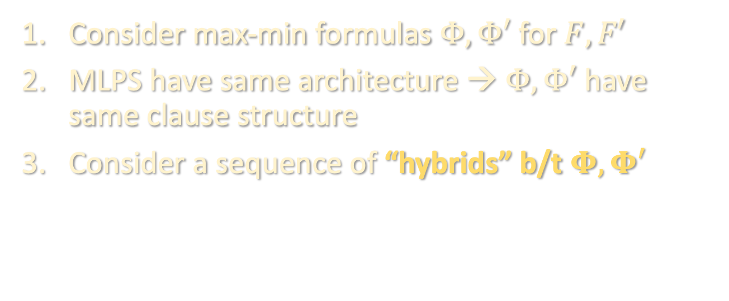
KEY STABILITY RESULT – PROOF SKETCH
Lemma: For depth-$L$ MLPs $F$ and $F′$ with the same architecture and whose weight matrices are $α$-close in operator norm,
$$ℙ\left[\left|F\left(x\right)\right|>τ and \left|F^{′}\left(x\right)\right|≤τ\right]≤2^{O\left(S\right)}Bα/τ$$
Consider max-min formulas $Φ, Φ′$ for $F, F′$
MLPS have same architecture → $Φ,Φ′$ have same clause structure
Consider a sequence of “hybrids” b/t $Φ, Φ′$
$max$
$$Φ$$
……
$min$
$$min$$
$$min$$
…………
$$⟨u_{1},x⟩$$
$$⟨u_{2},x⟩$$
$$⟨u_{N},x⟩$$
$max$
$$Φ′$$
……
$min$
$$min$$
$$min$$
…………
$$⟨w_{1},x⟩$$
$$⟨w_{2},x⟩$$
$$⟨w_{N},x⟩$$

Slide 52


KEY STABILITY RESULT – PROOF SKETCH
Lemma: For depth-$L$ MLPs $F$ and $F′$ with the same architecture and whose weight matrices are $α$-close in operator norm,
$$ℙ\left[\left|F\left(x\right)\right|>τ and \left|F^{′}\left(x\right)\right|≤τ\right]≤2^{O\left(S\right)}Bα/τ$$
Consider max-min formulas $Φ, Φ′$ for $F, F′$
MLPS have same architecture → $Φ,Φ′$ have same clause structure
Consider a sequence of “hybrids” b/t $Φ, Φ′$
$max$
$$Φ^{\left(1\right)}$$
……
$min$
$$min$$
$$min$$
…………
$$⟨w_{1},x⟩$$
$$⟨u_{2},x⟩$$
$$⟨u_{N},x⟩$$
$max$
$$Φ′$$
……
$min$
$$min$$
$$min$$
…………
$$⟨w_{1},x⟩$$
$$⟨w_{2},x⟩$$
$$⟨w_{N},x⟩$$

Slide 53


KEY STABILITY RESULT – PROOF SKETCH
Lemma: For depth-$L$ MLPs $F$ and $F′$ with the same architecture and whose weight matrices are $α$-close in operator norm,
$$ℙ\left[\left|F\left(x\right)\right|>τ and \left|F^{′}\left(x\right)\right|≤τ\right]≤2^{O\left(S\right)}Bα/τ$$
Consider max-min formulas $Φ, Φ′$ for $F, F′$
MLPS have same architecture → $Φ,Φ′$ have same clause structure
Consider a sequence of “hybrids” b/t $Φ, Φ′$
$max$
$$Φ^{\left(2\right)}$$
……
$min$
$$min$$
$$min$$
…………
$$⟨w_{1},x⟩$$
$$⟨w_{2},x⟩$$
$$⟨u_{N},x⟩$$
$max$
$$Φ′$$
……
$min$
$$min$$
$$min$$
…………
$$⟨w_{1},x⟩$$
$$⟨w_{2},x⟩$$
$$⟨w_{N},x⟩$$

Slide 54


KEY STABILITY RESULT – PROOF SKETCH
Lemma: For depth-$L$ MLPs $F$ and $F′$ with the same architecture and whose weight matrices are $α$-close in operator norm,
$$ℙ\left[\left|F\left(x\right)\right|>τ and \left|F^{′}\left(x\right)\right|≤τ\right]≤2^{O\left(S\right)}Bα/τ$$
Consider max-min formulas $Φ, Φ′$ for $F, F′$
MLPS have same architecture → $Φ,Φ′$ have same clause structure
Consider a sequence of “hybrids” b/t $Φ, Φ′$
$max$
$$Φ^{\left(N\right)}$$
……
$min$
$$min$$
$$min$$
…………
$$⟨w_{1},x⟩$$
$$⟨w_{2},x⟩$$
$$⟨u_{N},x⟩$$
$max$
$$Φ′$$
……
$min$
$$min$$
$$min$$
…………
$$⟨w_{1},x⟩$$
$$⟨w_{2},x⟩$$
$$⟨w_{N},x⟩$$

Slide 55

KEY STABILITY RESULT – PROOF SKETCH
Lemma: For depth-$L$ MLPs $F$ and $F′$ with the same architecture and whose weight matrices are $α$-close in operator norm,
$$ℙ\left[\left|F\left(x\right)\right|>τ and \left|F^{′}\left(x\right)\right|≤τ\right]≤2^{O\left(S\right)}Bα/τ$$
Consider max-min formulas $Φ, Φ′$ for $F, F′$
MLPS have same architecture → $Φ,Φ′$ have same clause structure
Consider a sequence of “hybrids” b/t $Φ, Φ′$
$max$
$$Φ^{′}=Φ^{\left(N\right)}$$
……
$min$
$$min$$
$$min$$
…………
$$⟨w_{1},x⟩$$
$$⟨w_{2},x⟩$$
$$⟨u_{N},x⟩$$
$max$
$$Φ′$$
……
$min$
$$min$$
$$min$$
…………
$$⟨w_{1},x⟩$$
$$⟨w_{2},x⟩$$
$$⟨w_{N},x⟩$$

Slide 56
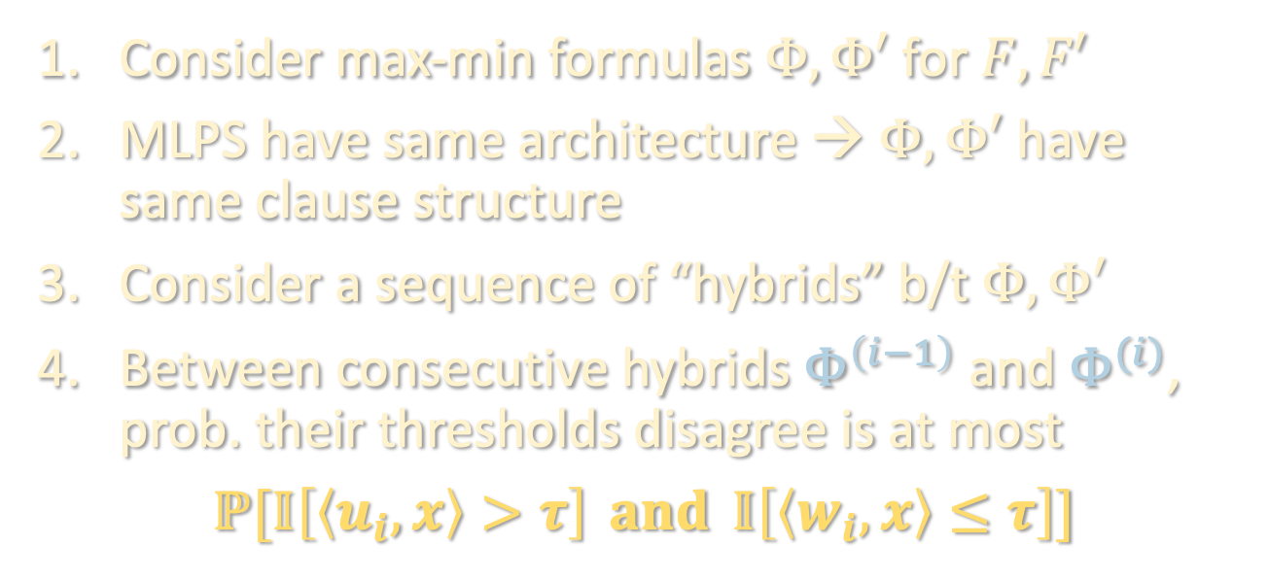
KEY STABILITY RESULT – PROOF SKETCH
Lemma: For depth-$L$ MLPs $F$ and $F′$ with the same architecture and whose weight matrices are $α$-close in operator norm,
$$ℙ\left[\left|F\left(x\right)\right|>τ and \left|F^{′}\left(x\right)\right|≤τ\right]≤2^{O\left(S\right)}Bα/τ$$
Consider max-min formulas $Φ, Φ′$ for $F, F′$
MLPS have same architecture → $Φ,Φ′$ have same clause structure
Consider a sequence of “hybrids” b/t $Φ, Φ′$
Between consecutive hybrids $Φ^{\left(i−1\right)}$ and $Φ^{(i)}$, prob. their thresholds disagree is at most
$$ℙ[𝕀\left[\left\langle u_{i},x\right\rangle >τ\right] and 𝕀\left[\left\langle w_{i},x\right\rangle ≤τ\right]]$$
$max$
$$Φ^{′}=Φ^{\left(N\right)}$$
……
$min$
$$min$$
$$min$$
…………
$$⟨w_{1},x⟩$$
$$⟨w_{2},x⟩$$
$$⟨u_{N},x⟩$$
$max$
$$Φ′$$
……
$min$
$$min$$
$$min$$
…………
$$⟨w_{1},x⟩$$
$$⟨w_{2},x⟩$$
$$⟨w_{N},x⟩$$

Slide 57
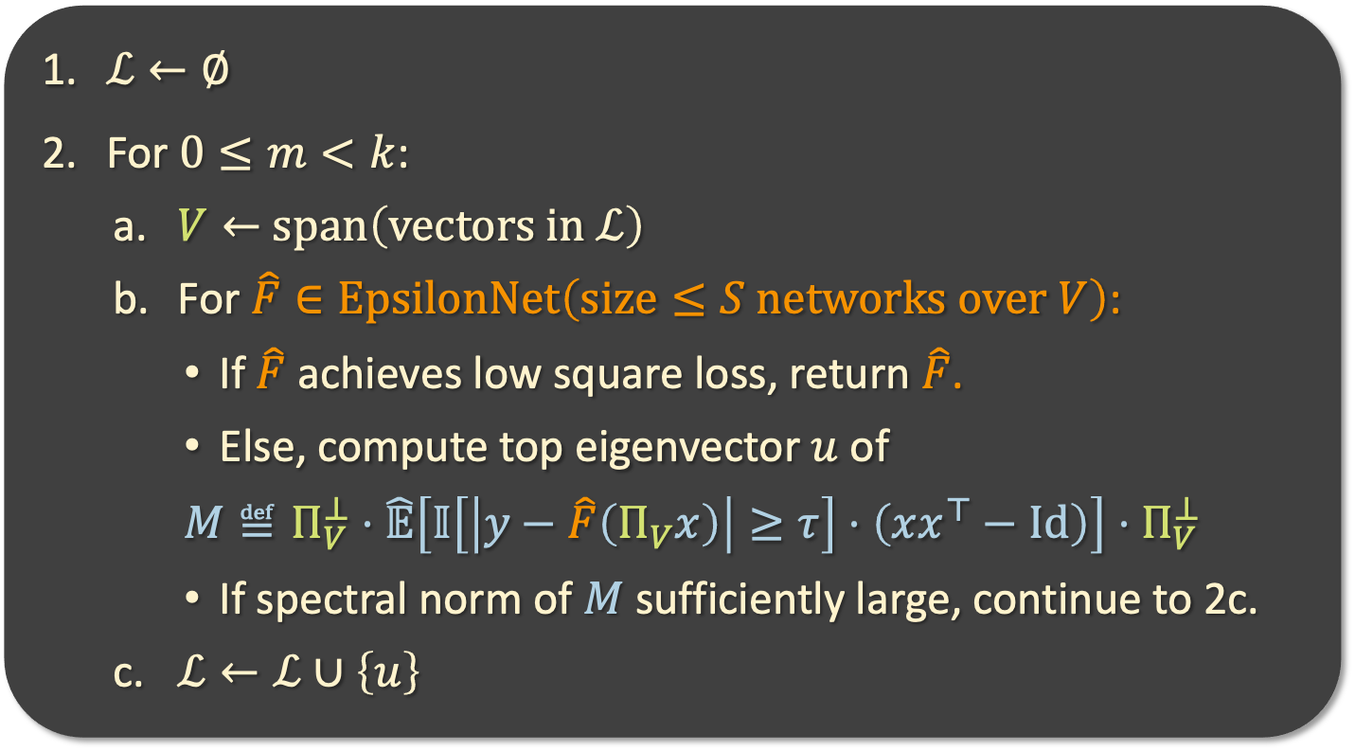
THE ALGORITHM
Filtered PCA
$ℒ←∅$
For $0≤m<k$:
  $V←$ $span\left(vectors in ℒ\right)$
  For $\hat{F}∈EpsilonNet\left(size≤S networks over V\right)$:
    If $\hat{F}$ achieves low square loss, return $\hat{F}$.
    Else, compute top eigenvector $u$ of
    $M≝Π_{V}^{⊥}⋅\hat{𝔼}\left[𝕀\left[\left|y−\hat{F}\left(Π_{V}x\right)\right|≥τ\right]⋅\left(xx^{⊤}−Id\right)\right]⋅Π_{V}^{⊥}$
    If spectral norm of $M$ sufficiently large, continue to 2c.
  $ℒ←ℒ∪\left\{u\right\}$

Slide 58
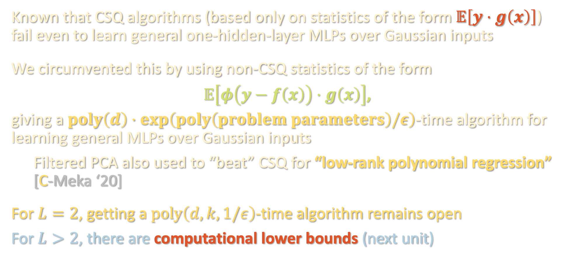
TAKEAWAYS
Known that CSQ algorithms (based only on statistics of the form $𝔼\left[y⋅g\left(x\right)\right]$) fail even to learn general one-hidden-layer MLPs over Gaussian inputs
We circumvented this by using non-CSQ statistics of the form
$𝔼\left[φ\left(y−f\left(x\right)\right)⋅g\left(x\right)\right]$,
giving a $poly\left(d\right)⋅\exp\left(poly\left(problem parameters\right)/ε\right)$-time algorithm for learning general MLPs over Gaussian inputs
Filtered PCA also used to “beat” CSQ for “low-rank polynomial regression” [C-Meka ‘20]
For $L=2$, getting a $poly\left(d,k,1/ε\right)$-time algorithm remains open
For $L>2$, there are computational lower bounds (next unit)

Slide 59
NEXT TIME
What can we actually prove about gradient descent?
Two regimes where we can say something:
Neural tangent kernel
Mean-field

