Slide 1

CS 224: ALGORITHMS FOR DATA SCIENCE
LECTURE 13 (10/23)
Tensor decomposition
Sum-of-squares
Robustness
Supervised learning
Computational complexity
Statistical physics
Generative modeling
PAC LEARNING CONTINUED, LEARNING MLPS

Slide 2
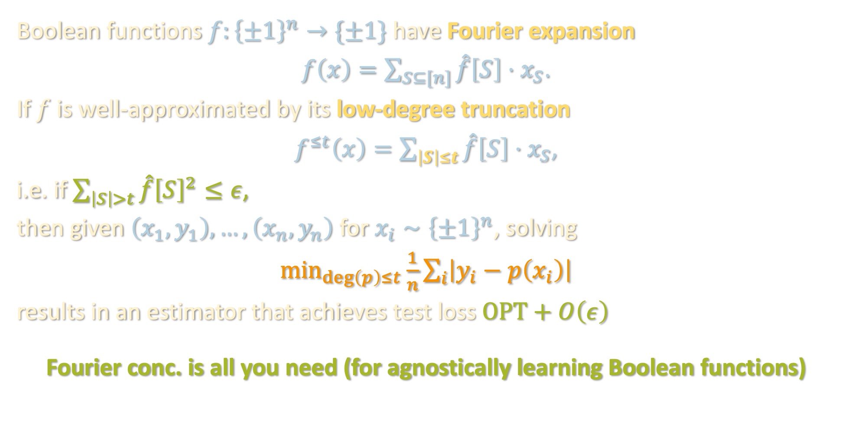
RECAP OF LAST TIME
Boolean functions $f:{\left\{±1\right\}}^{n}→\{±1\}$ have Fourier expansion
$f\left(x\right)=\sum_{S⊆[n]}{\hat{f}\left[S\right]⋅x_{S}}$.
If $f$ is well-approximated by its low-degree truncation
$f^{≤t}\left(x\right)=\sum_{\left|S\right|≤t}{\hat{f}\left[S\right]⋅x_{S}}$,
i.e. if $\sum_{\left|S\right|>t}{\hat{f}{\left[S\right]}^{2}}≤ε$,
then given $\left(x_{1},y_{1}\right),…,\left(x_{n},y_{n}\right)$ for $x_{i}∼{\left\{±1\right\}}^{n}$, solving
$\min_{\deg\left(p\right)≤t}{\frac{1}{n}\sum_{i}{\left|y_{i}−p\left(x_{i}\right)\right|}}$
results in an estimator that achieves test loss $OPT+O\left(ε\right)$
Fourier conc. is all you need (for agnostically learning Boolean functions)
“L1 polynomial regression”

Slide 3
Noise sensitivity and Fourier concentration
One-hidden-layer MLPs: C. Elegans of ML theory
Hermite polynomials, low-degree approximation
Tensor methods (again)
Lower bounds
Algorithm/warmup for next lecture

Slide 4
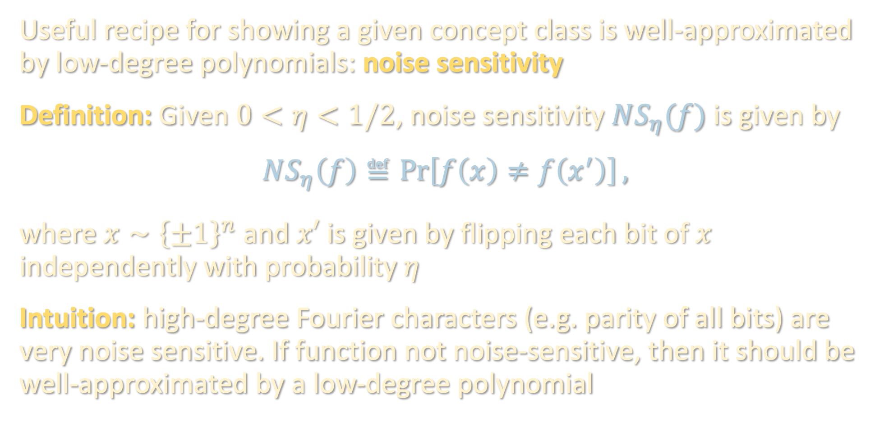
NOISE-STABLE FUNCTIONS ARE LEARNABLE
Useful recipe for showing a given concept class is well-approximated by low-degree polynomials: noise sensitivity
Definition: Given $0<η<1/2$, noise sensitivity $NS_{η}(f)$ is given by
$$NS_{η}\left(f\right)≝\operatorname{Pr}\left[f\left(x\right)≠f\left(x^{′}\right)\right],$$
where $x∼{\left\{±1\right\}}^{n}$ and $x′$ is given by flipping each bit of $x$ independently with probability $η$
Intuition: high-degree Fourier characters (e.g. parity of all bits) are very noise sensitive. If function not noise-sensitive, then it should be well-approximated by a low-degree polynomial

Slide 5


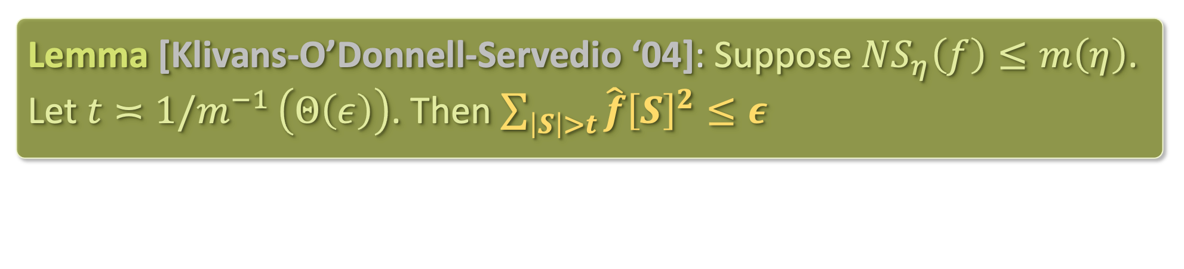





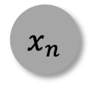




NOISE-STABLE FUNCTIONS ARE LEARNABLE
Lemma [Klivans-O’Donnell-Servedio ‘04]: Suppose $NS_{η}\left(f\right)≤m\left(η\right)$. Let $t≍1/m^{−1 }\left(Θ\left(ε\right)\right)$. Then $\sum_{\left|S\right|>t}{\hat{f}{\left[S\right]}^{2}}≤ε$
Application [Klivans-O’Donnell-Servedio ‘04]: any function of $k$ halfspaces satisfies $NS_{η}\left(f\right)≲k\sqrt{η}$, can be learned in time $n^{O\left(k^{2}/ε^{2}\right)}$
Proofs: see board
$$h$$
sgn
sgn
sgn
$$⋯$$
sgn
$v_{1}$
$v_{2}$
$v_{3}$
$v_{k}$
$$⋅⋅⋅⋅⋅⋅⋅$$
$$x_{1}$$
$$x_{2}$$
$$x_{3}$$
$$x_{n}$$

Slide 6
Noise sensitivity and Fourier concentration
One-hidden-layer MLPs: C. Elegans of ML theory
Hermite polynomials, low-degree approximation
Tensor methods (again)
Lower bounds
Algorithm/warmup for next lecture

Slide 7


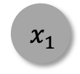

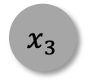





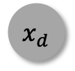

REAL-VALUED INPUT/OUTPUT
Let us now turn to PAC-learning functions $ℝ^{d}→$ $ℝ$
$$h$$
sgn
sgn
sgn
$$⋯$$
sgn
$v_{1}$
$v_{2}$
$v_{3}$
$v_{k}$
$$⋅⋅⋅⋅⋅⋅⋅$$
$${ x}_{1}$$
$$x_{2}$$
$$x_{3}$$
$$x_{d}$$

Slide 8
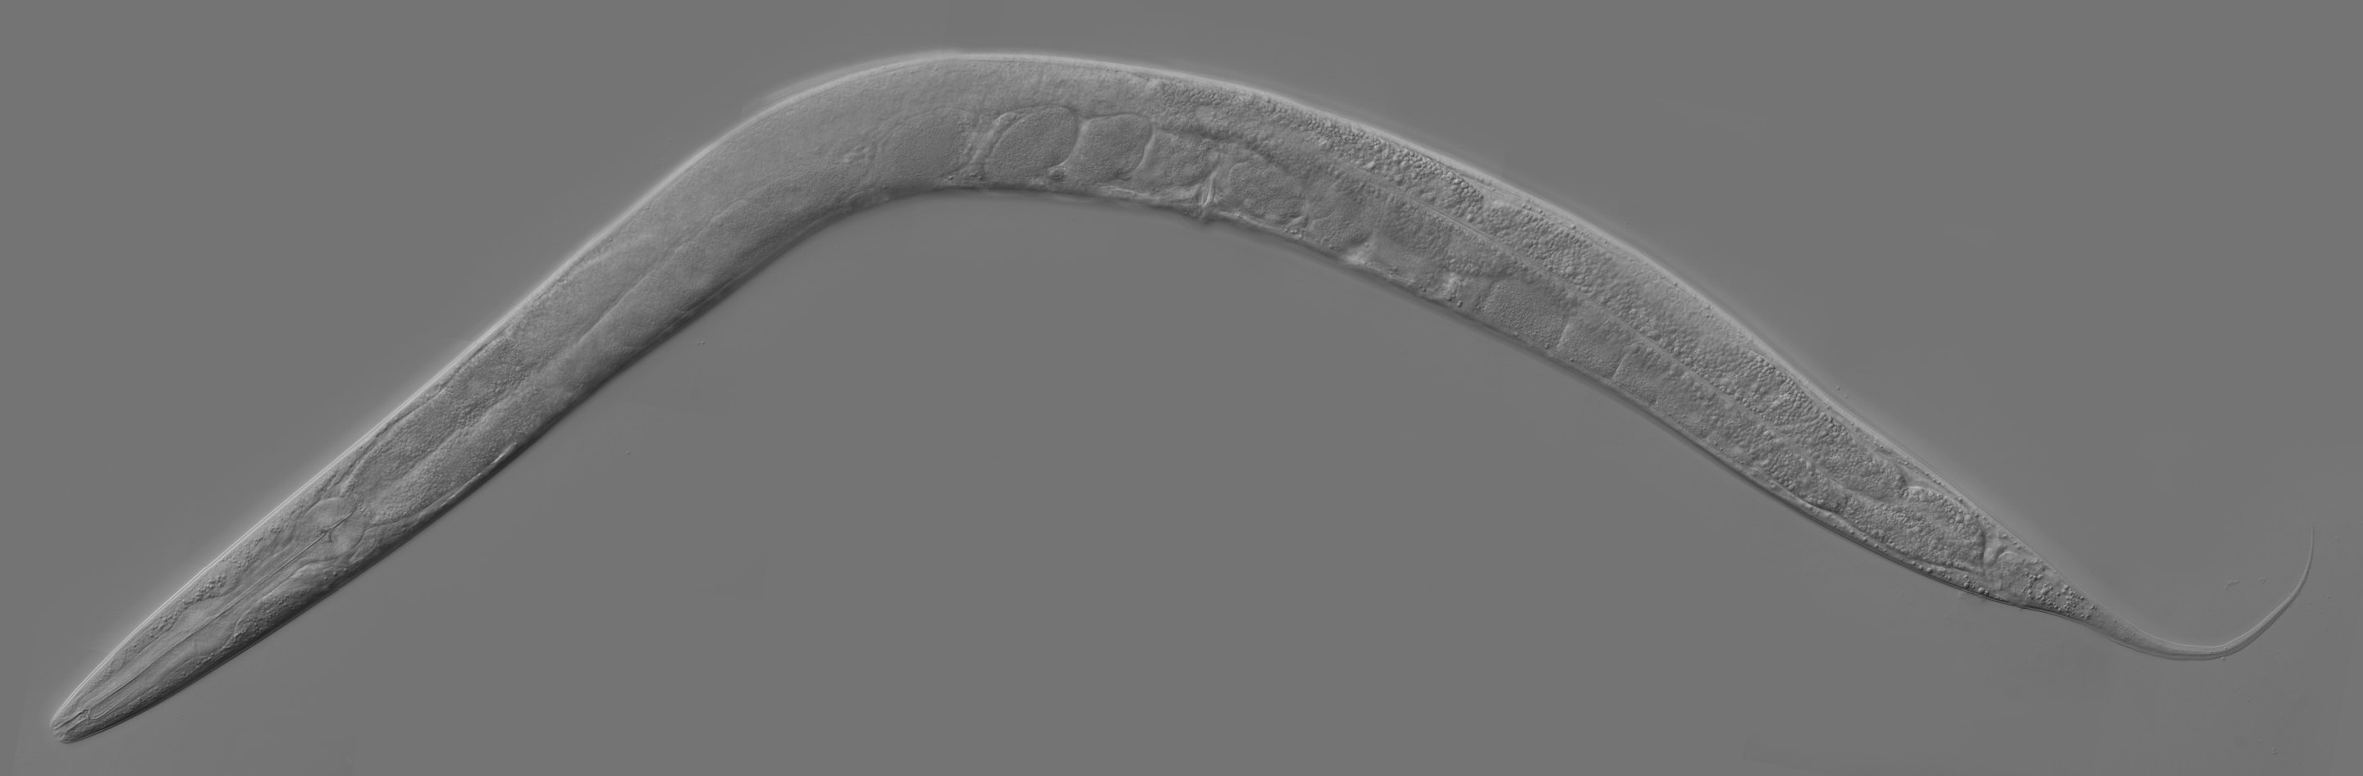
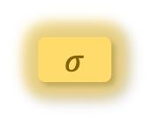



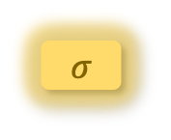

REAL-VALUED INPUT/OUTPUT
Let us now turn to PAC-learning functions $ℝ^{d}→$ $ℝ$
“Model organism”: one-hidden-layer multilayer perceptron (MLP)
$$linear$$
$σ$
$σ$
$σ$
$$⋯$$
$σ$
$v_{1}$
$v_{2}$
$v_{3}$
$v_{k}$
$$⋅⋅⋅⋅⋅⋅⋅$$
$${ x}_{1}$$
$$x_{2}$$
$$x_{3}$$
$$x_{d}$$

Slide 9
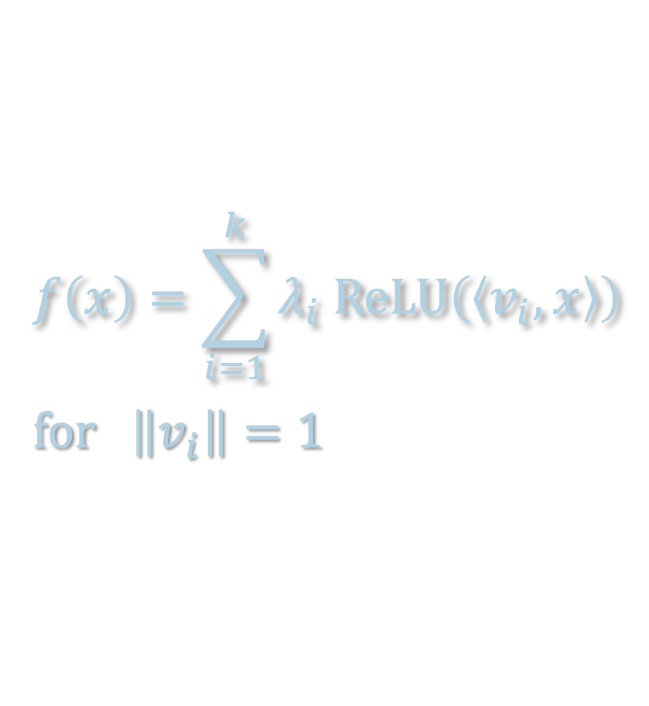
REAL-VALUED INPUT/OUTPUT
Let us now turn to PAC-learning functions $ℝ^{d}→$ $ℝ$
“Model organism”: one-hidden-layer multilayer perceptron (MLP)
$$f\left(x\right)=\sum_{i=1}^{k}{λ_{i} ReLU\left(\left\langle v_{i},x\right\rangle \right)}$$
$for \left\|v_{i}\right\|=1$

Slide 10
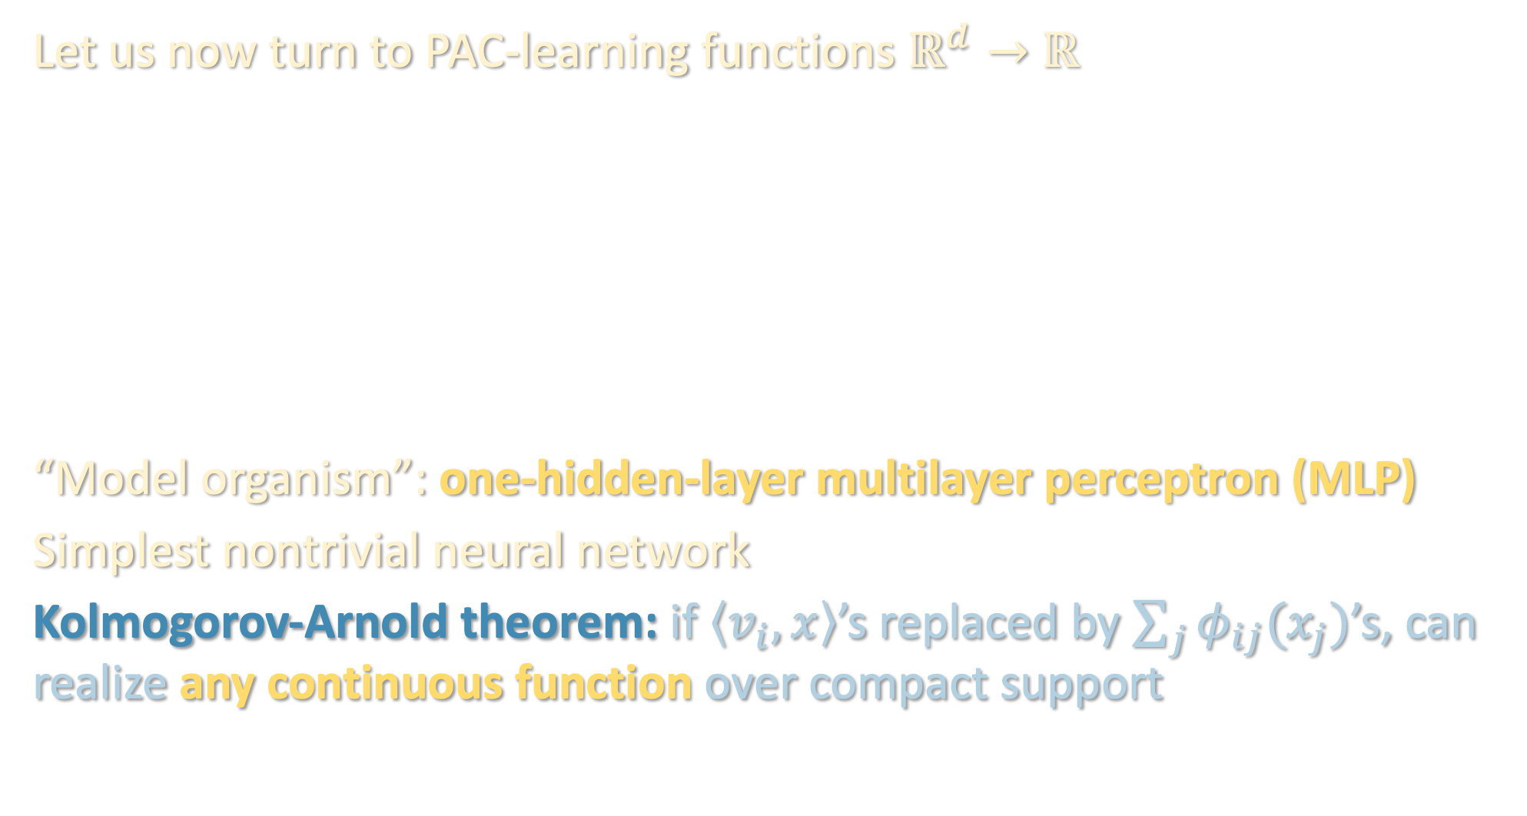
REAL-VALUED INPUT/OUTPUT
Let us now turn to PAC-learning functions $ℝ^{d}→$ $ℝ$
“Model organism”: one-hidden-layer multilayer perceptron (MLP)
Simplest nontrivial neural network
Kolmogorov-Arnold theorem: if $\left\langle v_{i},x\right\rangle$’s replaced by $\sum_{j}{φ_{ij}(x_{j})}$’s, can realize any continuous function over compact support
$$f\left(x\right)=\sum_{i=1}^{k}{λ_{i} ReLU\left(\left\langle v_{i},x\right\rangle \right)}$$
$for \left\|v_{i}\right\|=1$

Slide 11
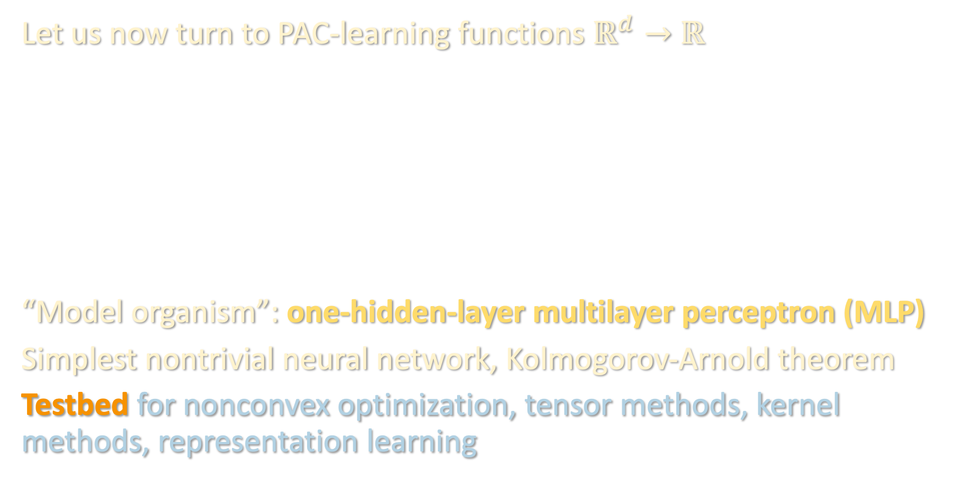
REAL-VALUED INPUT/OUTPUT
Let us now turn to PAC-learning functions $ℝ^{d}→$ $ℝ$
“Model organism”: one-hidden-layer multilayer perceptron (MLP)
Simplest nontrivial neural network, Kolmogorov-Arnold theorem
Testbed for nonconvex optimization, tensor methods, kernel methods, representation learning
$$f\left(x\right)=\sum_{i=1}^{k}{λ_{i} ReLU\left(\left\langle v_{i},x\right\rangle \right)}$$
$for \left\|v_{i}\right\|=1$

Slide 12
Noise sensitivity and Fourier concentration
One-hidden-layer MLPs: C. Elegans of ML theory
Hermite polynomials, low-degree approximation
Tensor methods (again)
Lower bounds
Algorithm/warmup for next lecture

Slide 13
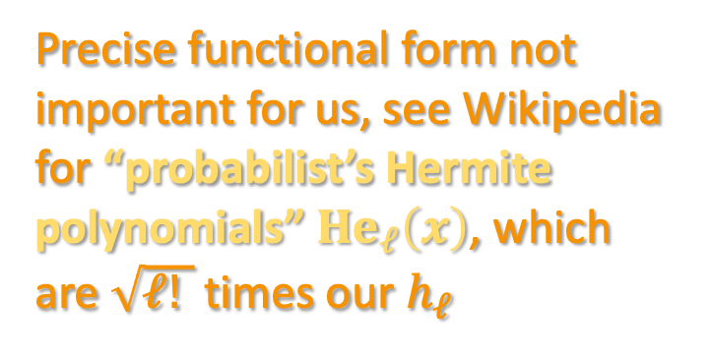
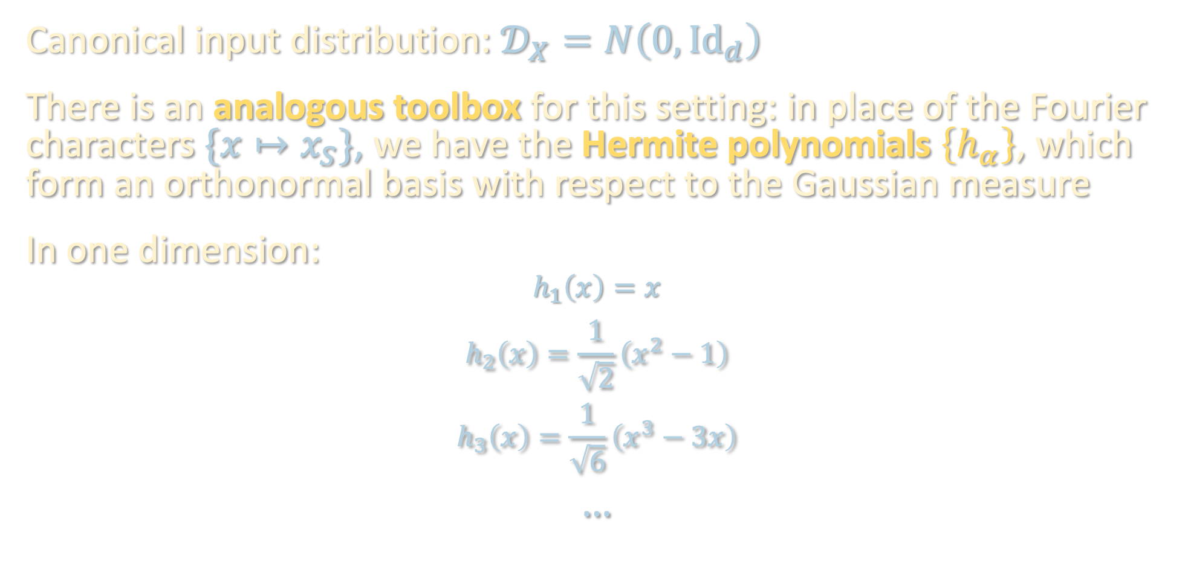
GAUSSIAN INPUTS
Canonical input distribution: $𝒟_{X}=N\left(0,{Id}_{d}\right)$
There is an analogous toolbox for this setting: in place of the Fourier characters $\{x↦x_{S}\}$, we have the Hermite polynomials $\left\{h_{α}\right\}$, which form an orthonormal basis with respect to the Gaussian measure
In one dimension:
$$h_{1}\left(x\right)=x$$
$$h_{2}\left(x\right)=\frac{1}{\sqrt{2}}\left(x^{2}−1\right)$$
$$h_{3}\left(x\right)=\frac{1}{\sqrt{6}}\left(x^{3}−3x\right)$$
…
Precise functional form not important for us, see Wikipedia for “probabilist’s Hermite polynomials” $He_{ℓ}\left(x\right)$, which are $\sqrt{ℓ! }$ times our $h_{ℓ}$

Slide 14
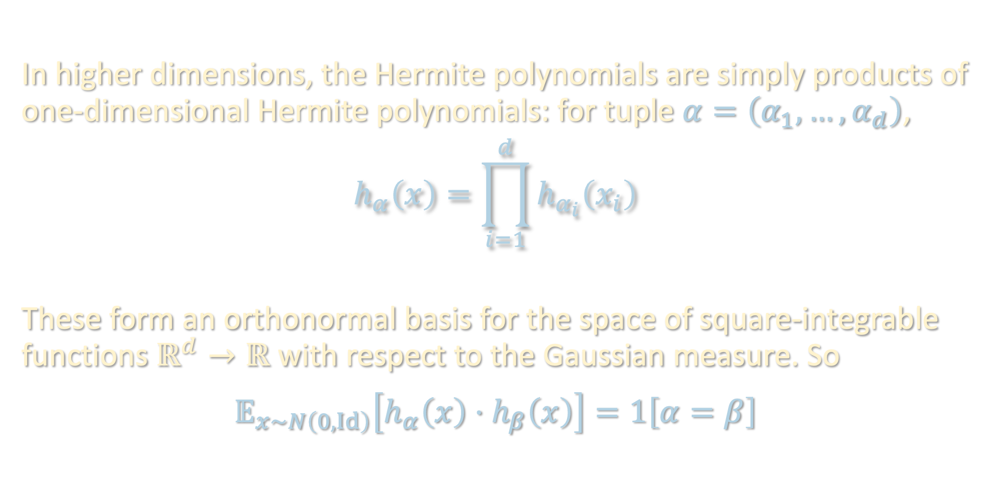
HERMITE POLYNOMIALS
In higher dimensions, the Hermite polynomials are simply products of one-dimensional Hermite polynomials: for tuple $α=\left(α_{1},…,α_{d}\right)$,
$$h_{α}\left(x\right)=\prod_{i=1}^{d}{h_{α_{i}}\left(x_{i}\right)}$$
These form an orthonormal basis for the space of square-integrable functions $ℝ^{d}→ℝ$ with respect to the Gaussian measure. So
$$𝔼_{x∼N\left(0,Id\right)}\left[h_{α}\left(x\right)⋅h_{β}\left(x\right)\right]=1\left[α=β\right]$$

Slide 15
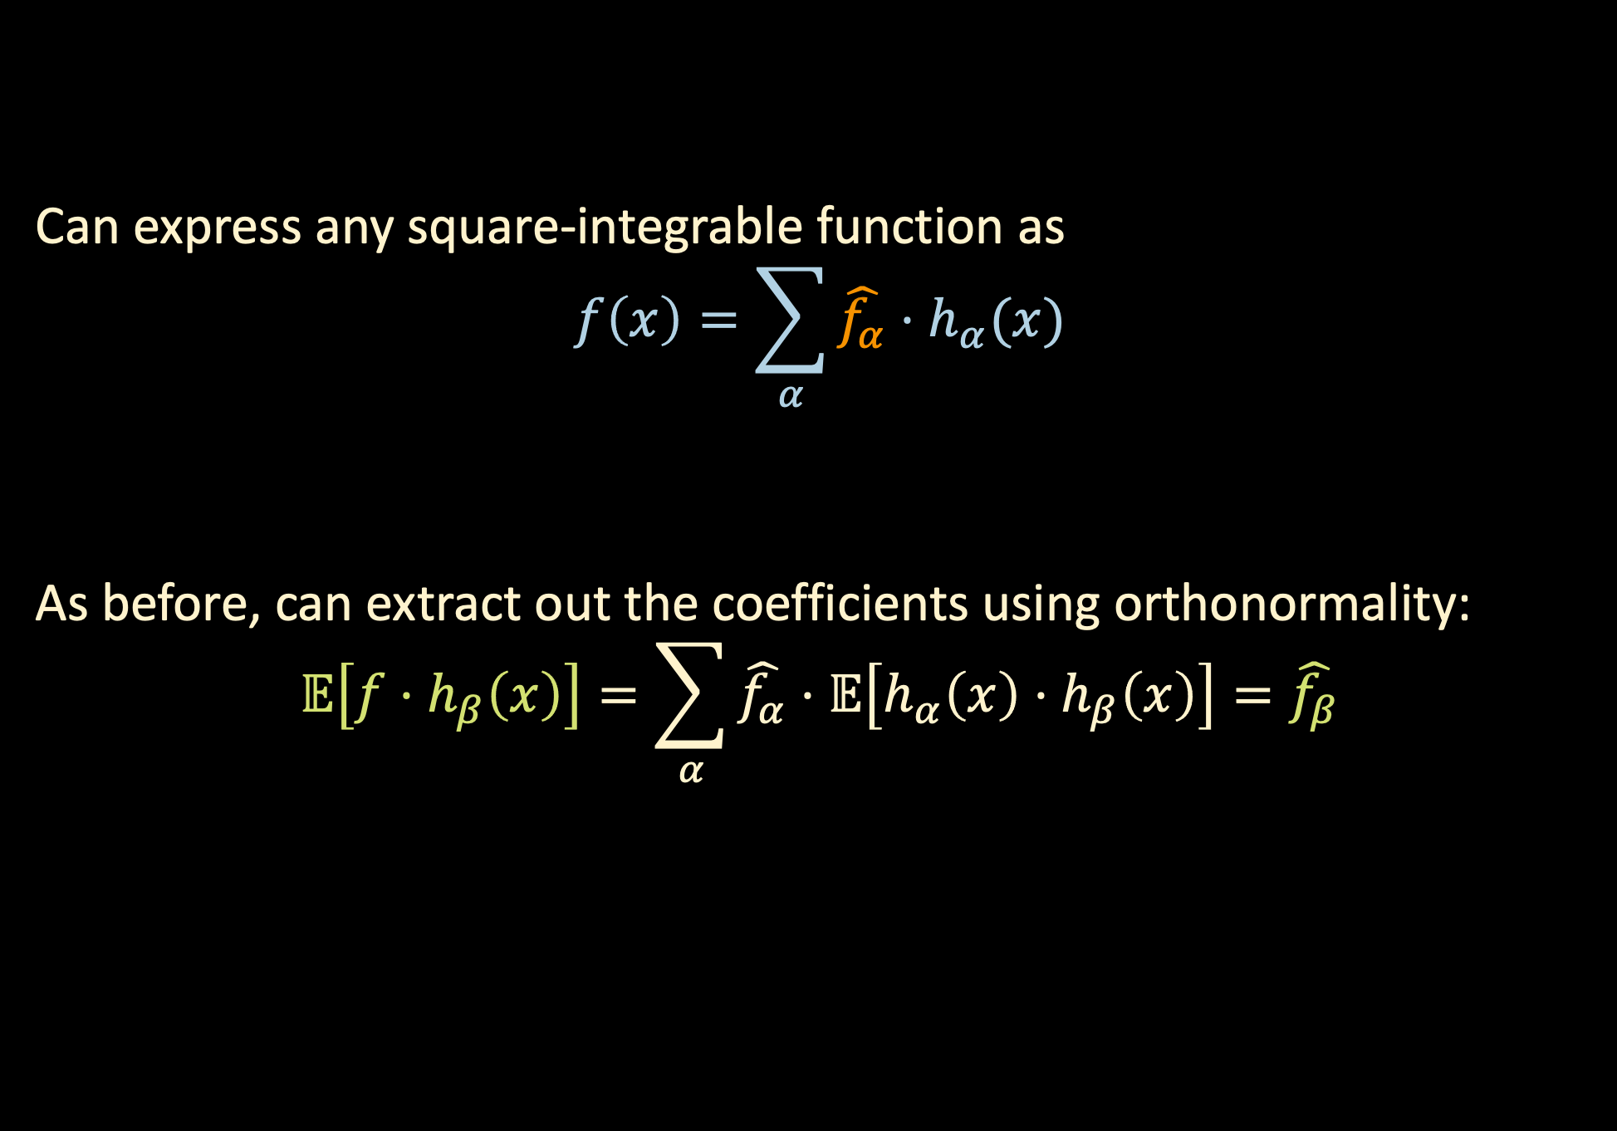
HERMITE POLYNOMIALS
Can express any square-integrable function as
$$f\left(x\right)=\sum_{α}{\hat{f_{α}}⋅h_{α}(x)}$$
As before, can extract out the coefficients using orthonormality:
$$𝔼\left[f⋅h_{β}\left(x\right)\right]=\sum_{α}{\hat{f_{α}}}⋅𝔼\left[h_{α}\left(x\right)⋅h_{β}\left(x\right)\right]=\hat{f_{β}}$$
Hermite coefficient
As before, can estimate empirically using training data

Slide 16
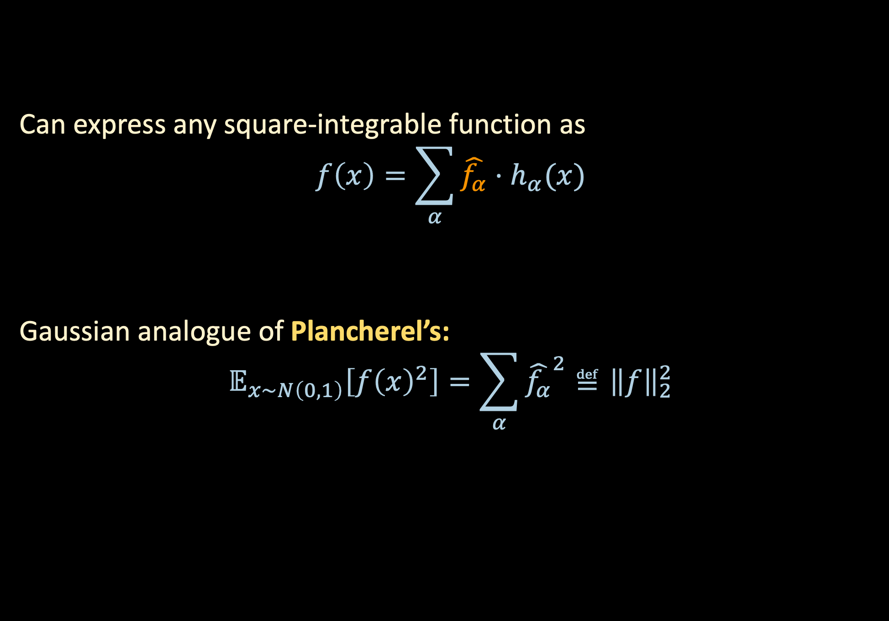
HERMITE POLYNOMIALS
Can express any square-integrable function as
$$f\left(x\right)=\sum_{α}{\hat{f_{α}}⋅h_{α}(x)}$$
Gaussian analogue of Plancherel’s:
$$𝔼_{x∼N\left(0,1\right)}\left[f{\left(x\right)}^{2}\right]=\sum_{α}{{\hat{f_{α}}}^{2}}≝{\left\|f\right\|}_{2}^{2}$$
Hermite coefficient

Slide 17

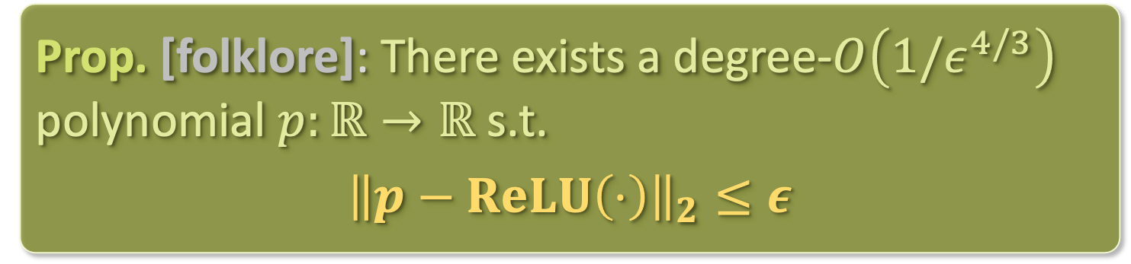


LOW-DEGREE APPROXIMATION
There are analogous notions of low-degree approximation in the Gaussian setting
Prop. [folklore]: There exists a degree-$O\left(1/ε^{4/3}\right)$ polynomial $p:ℝ→ℝ$ s.t.
$${\left\|p−ReLU\left(⋅\right)\right\|}_{2}≤ε$$
$${\hat{ReLU}}_{ℓ}^{2}$$
$$∼1/ℓ^{5/2}$$
Degree $ℓ$

Slide 18
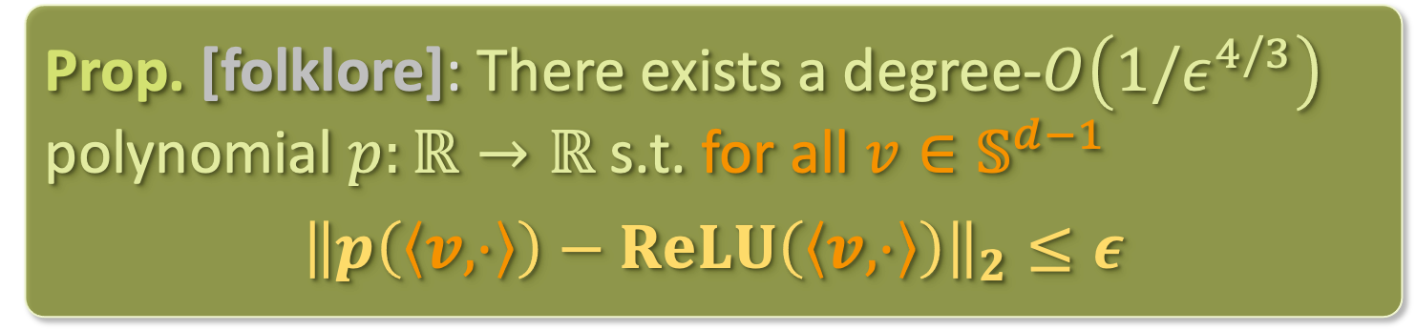
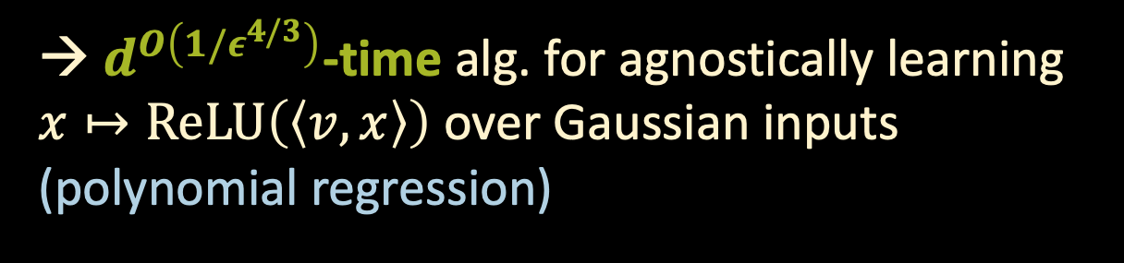
LOW-DEGREE APPROXIMATION
There are analogous notions of low-degree approximation in the Gaussian setting
Prop. [folklore]: There exists a degree-$O\left(1/ε^{4/3}\right)$ polynomial $p:ℝ→ℝ$ s.t. for all $v∈𝕊^{d−1}$
$${\left\|p\left(\left\langle v,⋅\right\rangle \right)−ReLU\left(\left\langle v,⋅\right\rangle \right)\right\|}_{2}≤ε$$
$${\hat{ReLU}}_{ℓ}^{2}$$
→ $d^{O\left(1/ε^{4/3}\right)}$-time alg. for agnostically learning $x↦ReLU\left(\left\langle v,x\right\rangle \right)$ over Gaussian inputs
(polynomial regression)
$$∼1/ℓ^{5/2}$$
Degree $ℓ$

Slide 19
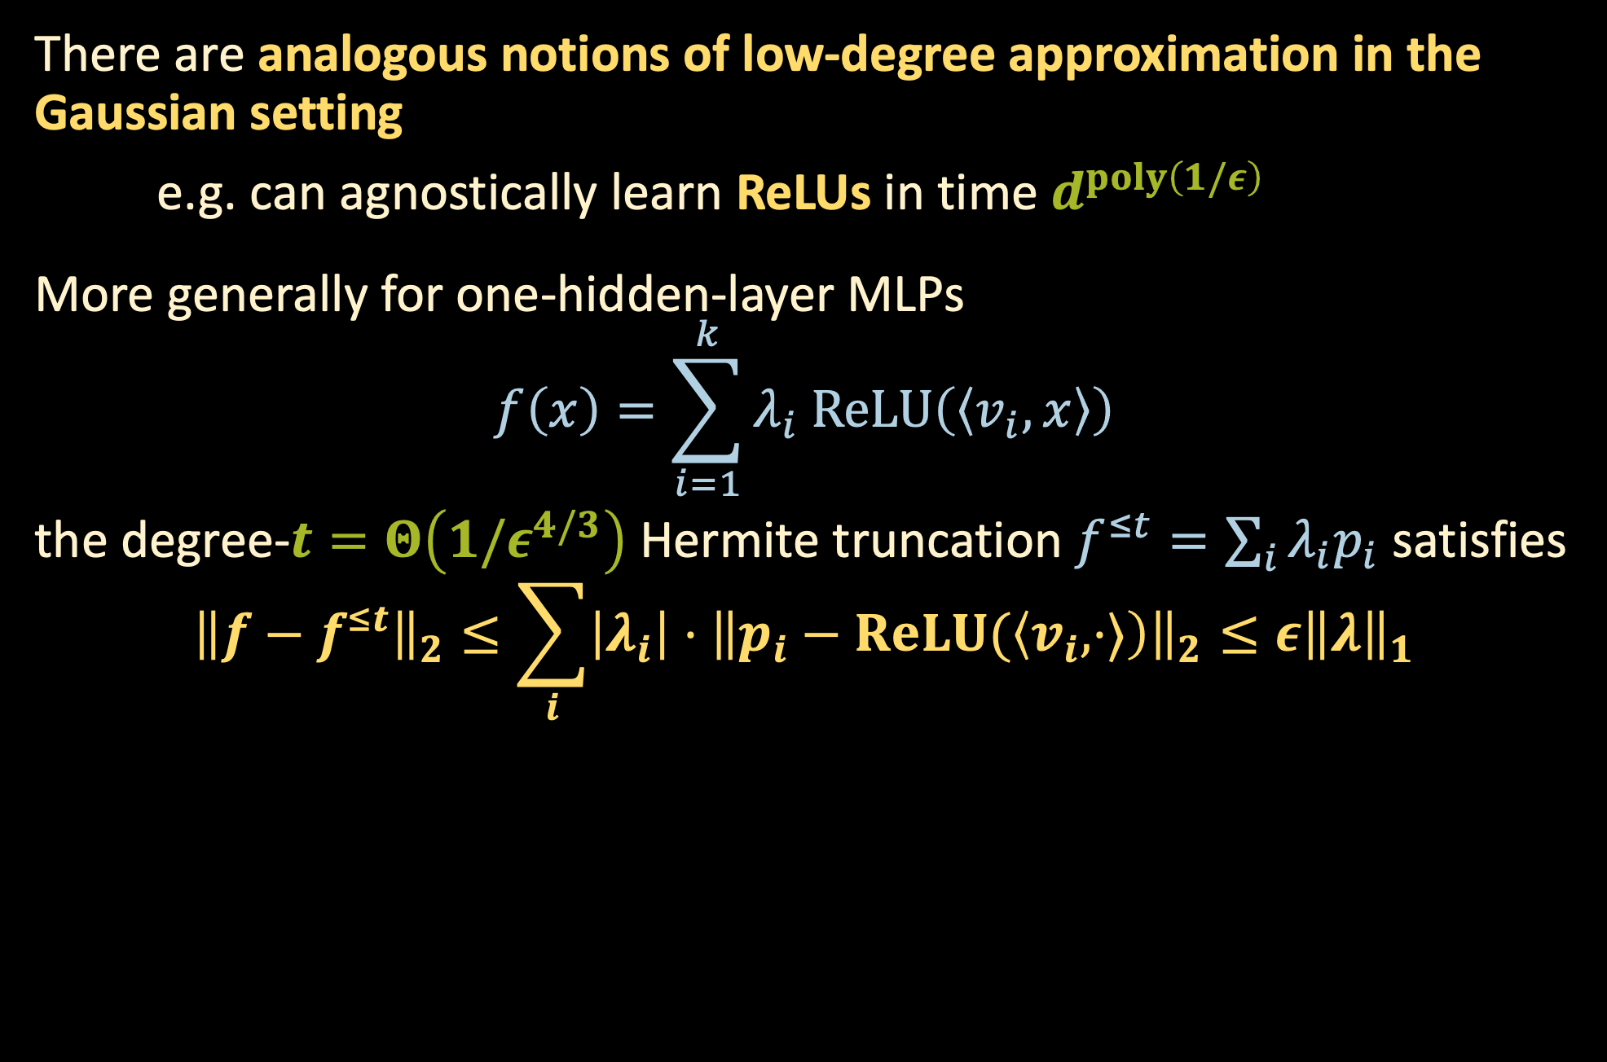
LOW-DEGREE APPROXIMATION
There are analogous notions of low-degree approximation in the Gaussian setting
e.g. can agnostically learn ReLUs in time $d^{poly\left(1/ε\right)}$
More generally for one-hidden-layer MLPs
$$f\left(x\right)=\sum_{i=1}^{k}{λ_{i} ReLU\left(\left\langle v_{i},x\right\rangle \right)}$$
the degree-$t=Θ\left(1/ε^{4/3}\right)$ Hermite truncation $f^{≤t}=\sum_{i}{λ_{i}p_{i}}$ satisfies
$${\left\|f−f^{≤t}\right\|}_{2}≤\sum_{i}{\left|λ_{i}\right|⋅{\left\|p_{i}−ReLU(\left\langle v_{i},⋅⟩\right)\right\|}_{2}}≤ε{\left\|λ\right\|}_{1}$$

Slide 20
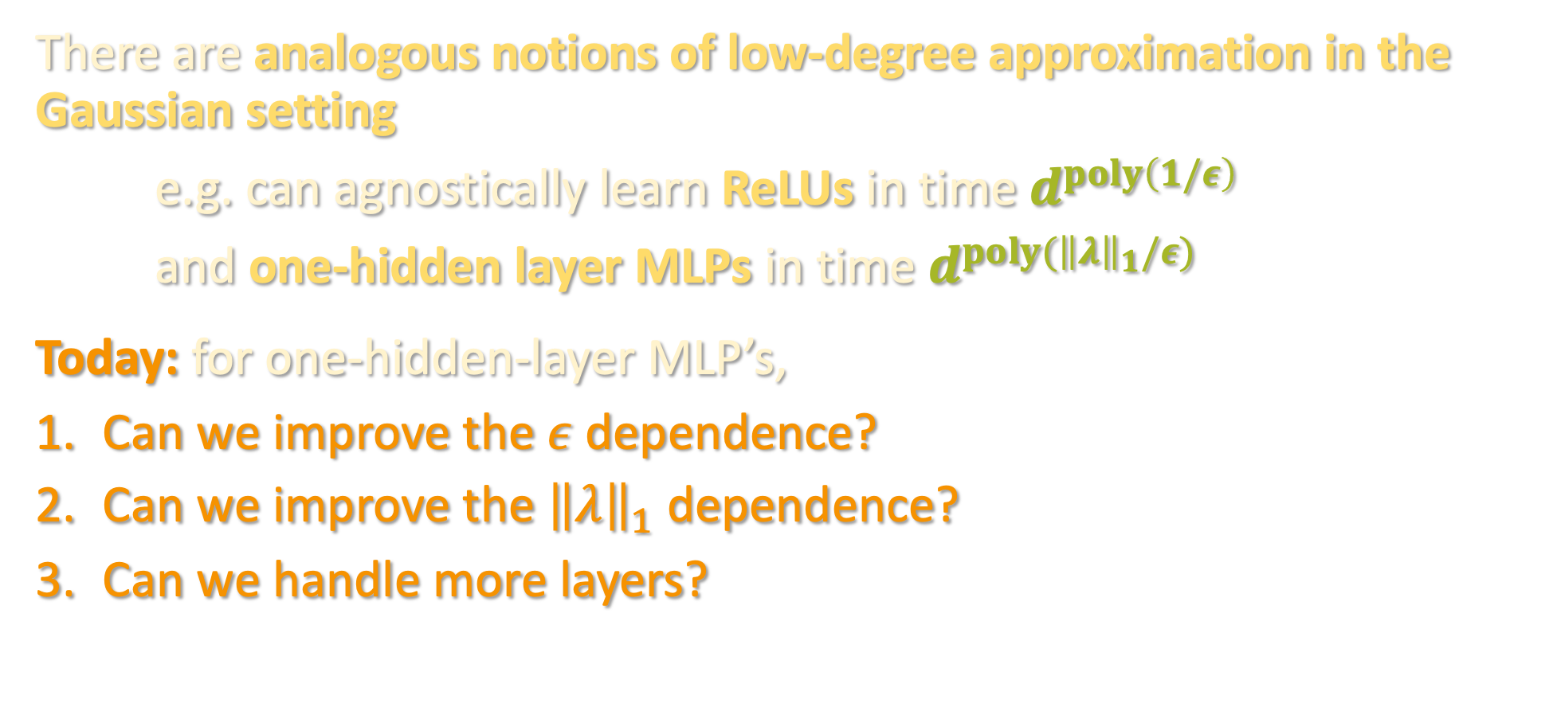
LOW-DEGREE APPROXIMATION
There are analogous notions of low-degree approximation in the Gaussian setting
e.g. can agnostically learn ReLUs in time $d^{poly\left(1/ε\right)}$
and one-hidden layer MLPs in time $d^{poly({\left\|λ\right\|}_{1}/ε)}$
Today: for one-hidden-layer MLP’s,
Can we improve the $ε$ dependence?
Can we improve the ${\left\|λ\right\|}_{1}$ dependence?
Can we handle more layers?

Slide 21
Noise sensitivity and Fourier concentration
One-hidden-layer MLPs: C. Elegans of ML theory
Hermite polynomials, low-degree approximation
Tensor methods (again)
Lower bounds
Algorithm/warmup for next lecture

Slide 22

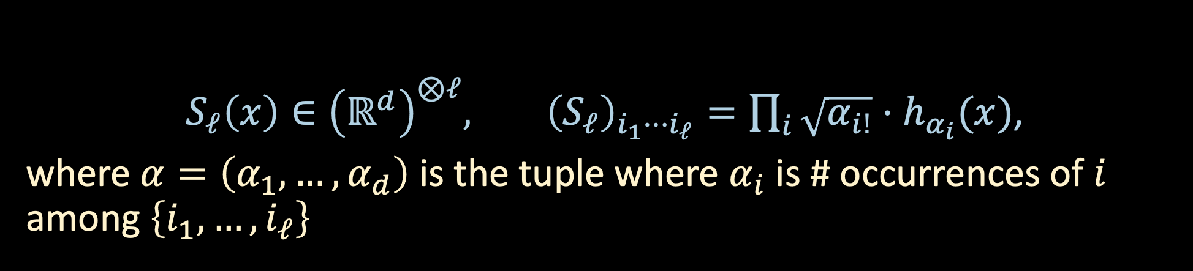

TENSOR METHODS
For “non-degenerate” one-hidden-layer MLPs, can use tensor decomp.
Starting point: organize Hermite polynomials into a tensor, sometimes called the (higher-order) score function (of the Gaussian):
$S_{ℓ}\left(x\right)∈{\left(ℝ^{d}\right)}^{⊗ℓ}, {\left(S_{ℓ}\right)}_{i_{1}⋯i_{ℓ}}=\prod_{i}{\sqrt{α_{i!}}}⋅h_{α_{i}}(x)$,
where $α=\left(α_{1},…,α_{d}\right)$ is the tuple where $α_{i}$ is # occurrences of $i$ among $\left\{i_{1},…,i_{ℓ}\right\}$
$S_{1}\left(x\right)=x$
$S_{2}\left(x\right)=xx^{⊤}−Id$
$S_{3}\left(x\right)=x^{⊗3}−x⊗_{3}Id$
$$⋮$$
$$h_{1}\left(x\right)=x$$
$$h_{2}\left(x\right)=\left(x^{2}−1\right)/\sqrt{2}$$
$$h_{3}\left(x\right)=\left(x^{3}−3x\right)/\sqrt{6}$$
$$⋮$$

Slide 23

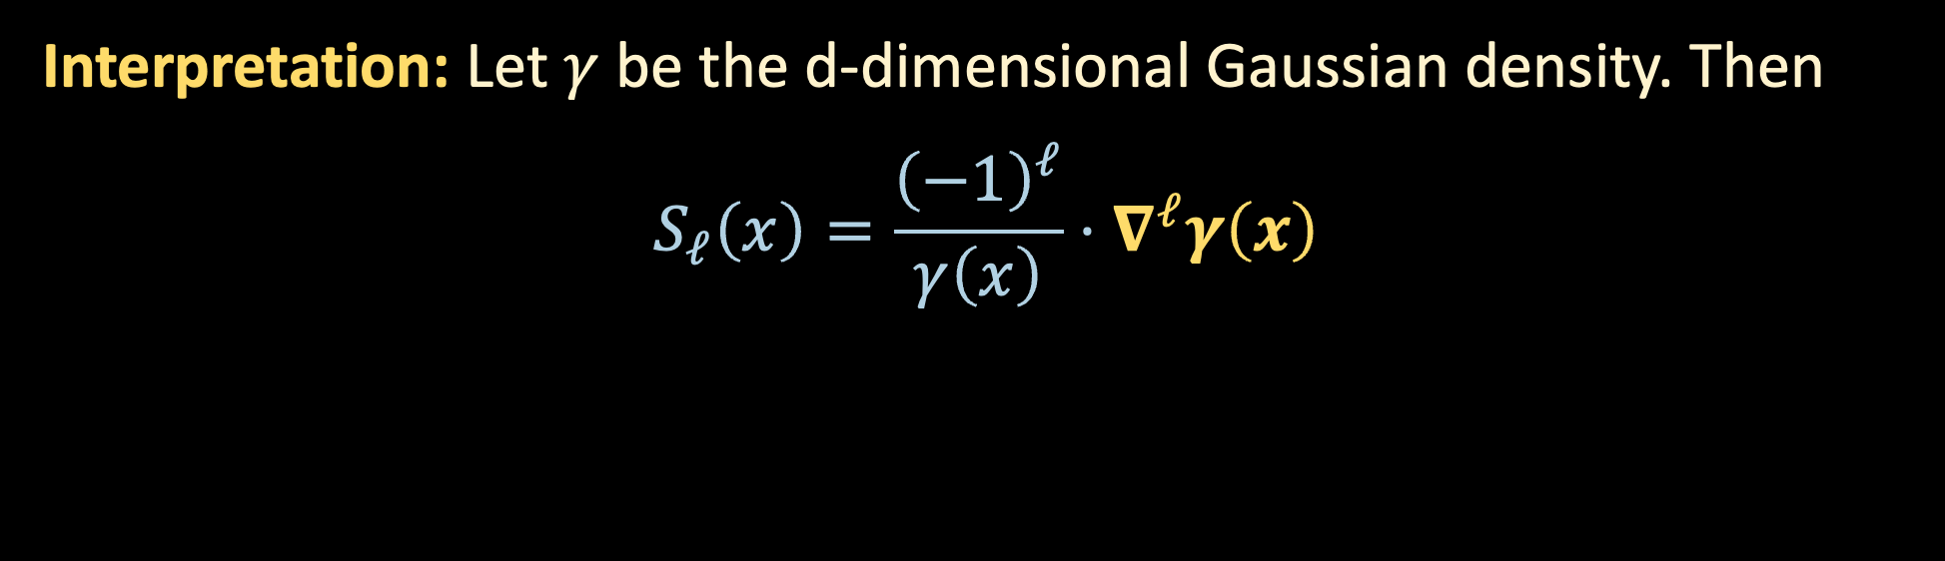

TENSOR METHODS
$S_{ℓ}\left(x\right)∈{\left(ℝ^{d}\right)}^{⊗ℓ}, {\left(S_{ℓ}\right)}_{i_{1}⋯i_{ℓ}}=\prod_{i}{\sqrt{α_{i!}}}⋅h_{α_{i}}(x)$,
where $α=\left(α_{1},…,α_{d}\right)$ is the tuple where $α_{i}$ is # occurrences of $i$ among $\left\{i_{1},…,i_{ℓ}\right\}$
Interpretation: Let $γ$ be the d-dimensional Gaussian density. Then
$$S_{ℓ}\left(x\right)=\frac{{\left(−1\right)}^{ℓ}}{γ\left(x\right)}⋅∇^{ℓ}γ\left(x\right)$$
$ℓ$-th derivative tensor

Slide 24

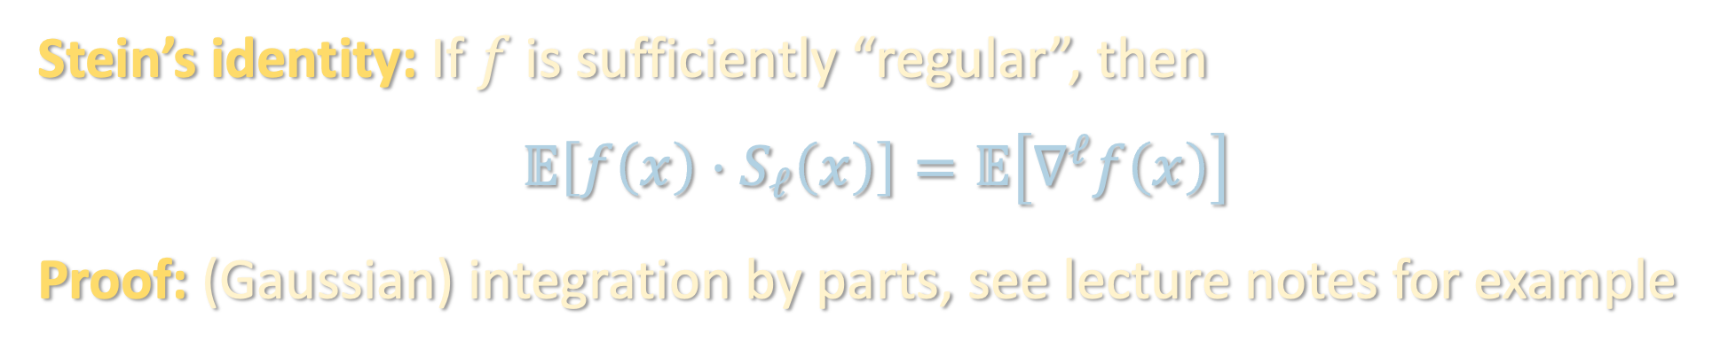
TENSOR METHODS
$S_{ℓ}\left(x\right)∈{\left(ℝ^{d}\right)}^{⊗ℓ}, {\left(S_{ℓ}\right)}_{i_{1}⋯i_{ℓ}}=\prod_{i}{\sqrt{α_{i!}}}⋅h_{α_{i}}(x)$,
where $α=\left(α_{1},…,α_{d}\right)$ is the tuple where $α_{i}$ is # occurrences of $i$ among $\left\{i_{1},…,i_{ℓ}\right\}$
Stein’s identity: If $f$ is sufficiently “regular”, then
$$𝔼\left[f\left(x\right)⋅S_{ℓ}\left(x\right)\right]=𝔼\left[∇^{ℓ}f\left(x\right)\right]$$
Proof: (Gaussian) integration by parts, see lecture notes for example

Slide 25
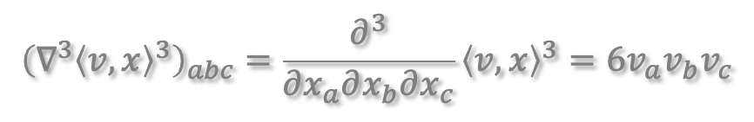
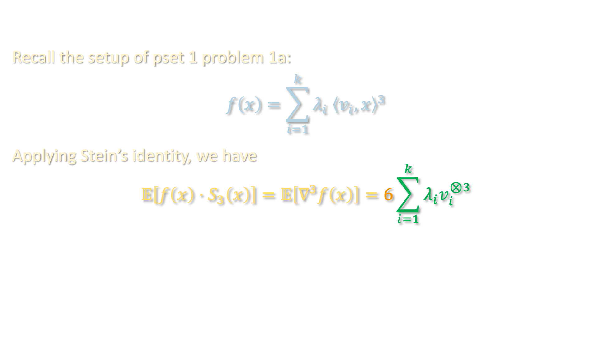
TENSOR METHODS – BLAST FROM THE PAST
Recall the setup of pset 1 problem 1a:
$$f\left(x\right)=\sum_{i=1}^{k}{λ_{i} {\left\langle v_{i},x\right\rangle }^{3}}$$
Applying Stein’s identity, we have
$$𝔼\left[f\left(x\right)⋅S_{3}\left(x\right)\right]=𝔼\left[∇^{3}f\left(x\right)\right]=6\sum_{i=1}^{k}{λ_{i}v_{i}^{⊗3}}$$
$${\left(∇^{3}{\left\langle v,x\right\rangle }^{3}\right)}_{abc}=\frac{∂^{3}}{∂x_{a}∂x_{b}∂x_{c}}{\left\langle v,x\right\rangle }^{3}=6v_{a}v_{b}v_{c}$$

Slide 26
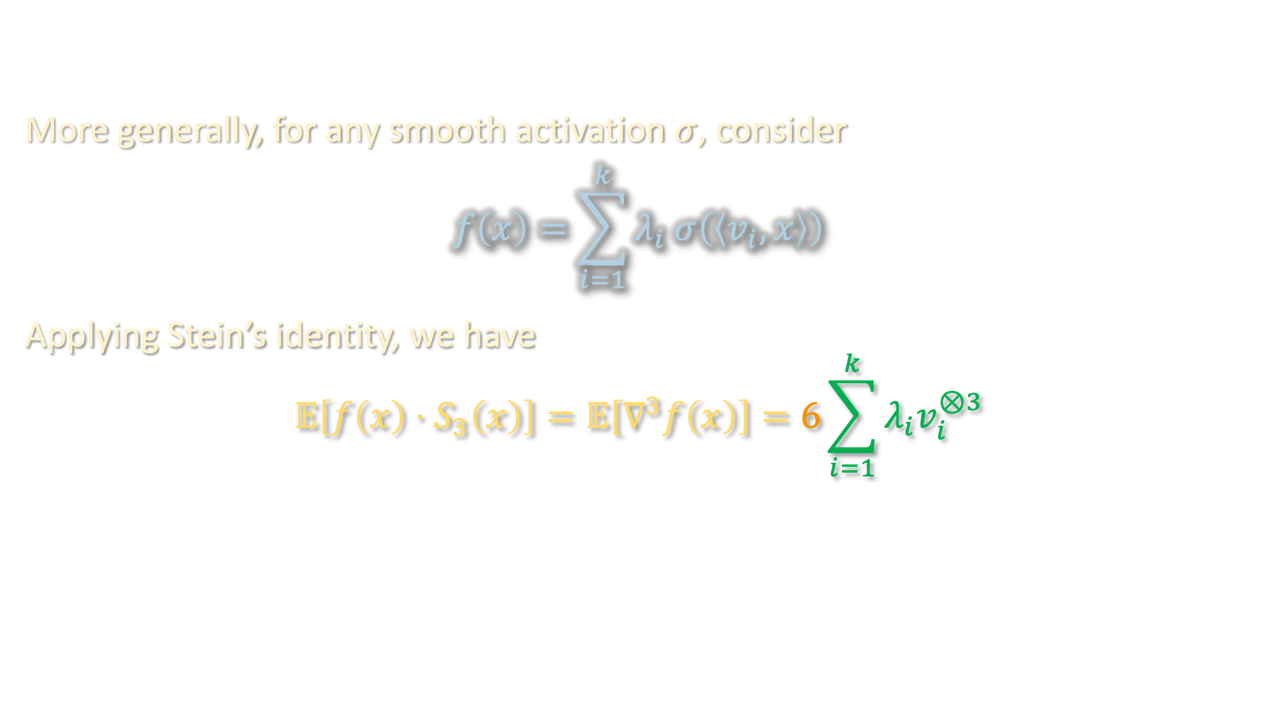
TENSOR METHODS – BLAST FROM THE PAST
More generally, for any smooth activation $σ$, consider
$$f\left(x\right)=\sum_{i=1}^{k}{λ_{i} σ\left(\left\langle v_{i},x\right\rangle \right)}$$
Applying Stein’s identity, we have
$$𝔼\left[f\left(x\right)⋅S_{3}\left(x\right)\right]=𝔼\left[∇^{3}f\left(x\right)\right]=6\sum_{i=1}^{k}{λ_{i}v_{i}^{⊗3}}$$

Slide 27
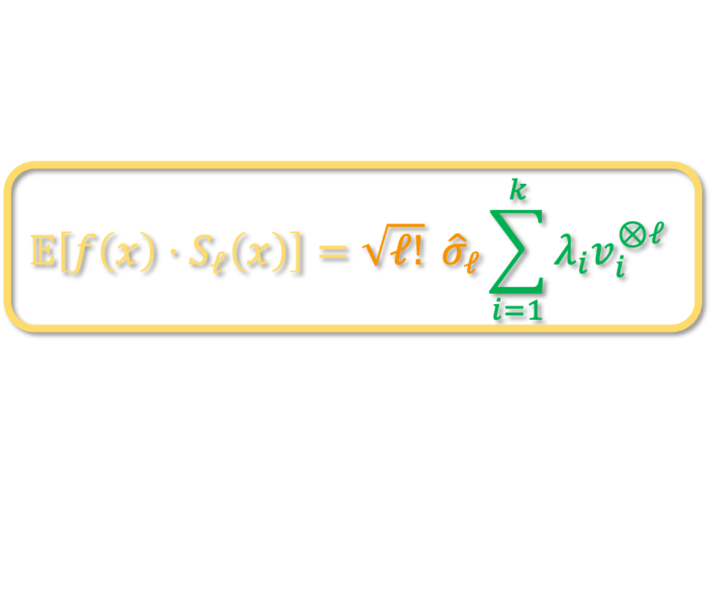
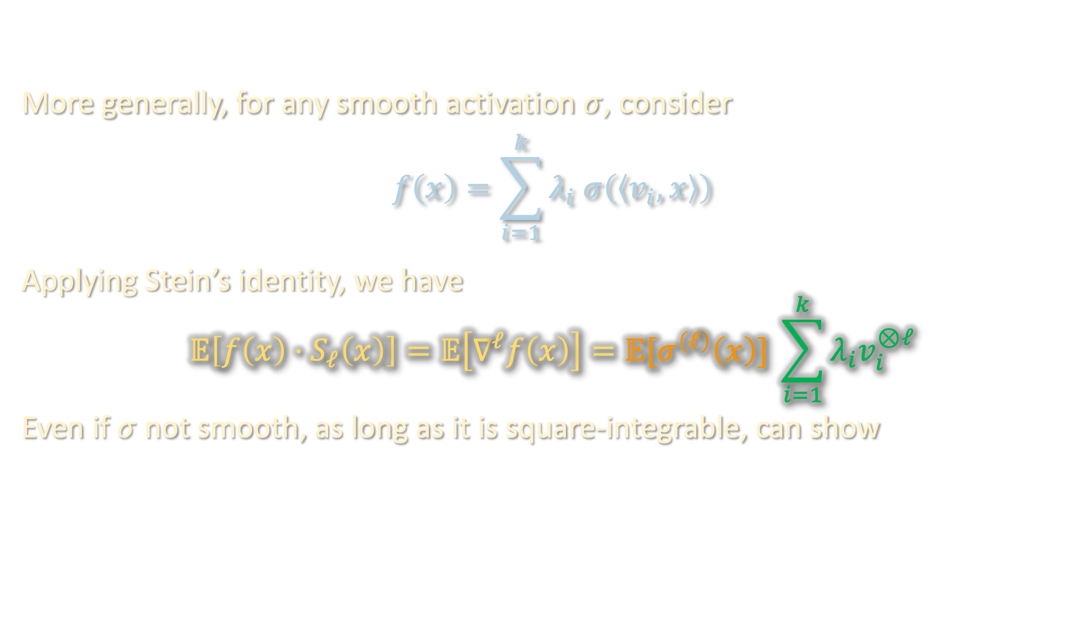
TENSOR METHODS – BLAST FROM THE PAST
More generally, for any smooth activation $σ$, consider
$$f\left(x\right)=\sum_{i=1}^{k}{λ_{i} σ\left(\left\langle v_{i},x\right\rangle \right)}$$
Applying Stein’s identity, we have
$$𝔼\left[f\left(x\right)⋅S_{ℓ}\left(x\right)\right]=𝔼\left[∇^{ℓ}f\left(x\right)\right]=𝔼[σ^{\left(ℓ\right)}\left(x\right)] \sum_{i=1}^{k}{λ_{i}v_{i}^{⊗ℓ}}$$
Even if $σ$ not smooth, as long as it is square-integrable, can show
$$𝔼\left[f\left(x\right)⋅S_{ℓ}\left(x\right)\right]=\sqrt{ℓ!} {\hat{σ}}_{ℓ}\sum_{i=1}^{k}{λ_{i}v_{i}^{⊗ℓ}}$$

Slide 28
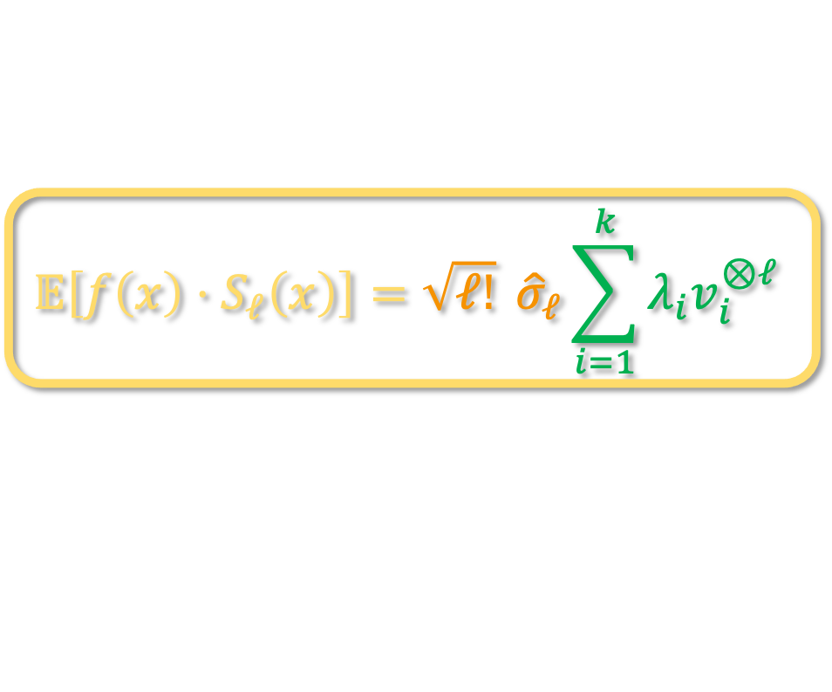
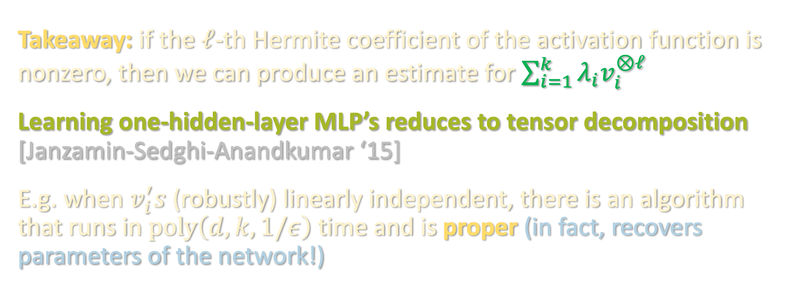
TENSOR METHODS – BLAST FROM THE PAST
$$𝔼\left[f\left(x\right)⋅S_{ℓ}\left(x\right)\right]=\sqrt{ℓ!} {\hat{σ}}_{ℓ}\sum_{i=1}^{k}{λ_{i}v_{i}^{⊗ℓ}}$$
Takeaway: if the $ℓ$-th Hermite coefficient of the activation function is nonzero, then we can produce an estimate for $\sum_{i=1}^{k}{λ_{i}v_{i}^{⊗ℓ}}$
Learning one-hidden-layer MLP’s reduces to tensor decomposition [Janzamin-Sedghi-Anandkumar ‘15]
E.g. when $v_{i}^{′}s$ (robustly) linearly independent, there is an algorithm that runs in $poly\left(d,k,1/ε\right)$ time and is proper (in fact, recovers parameters of the network!)

Slide 29
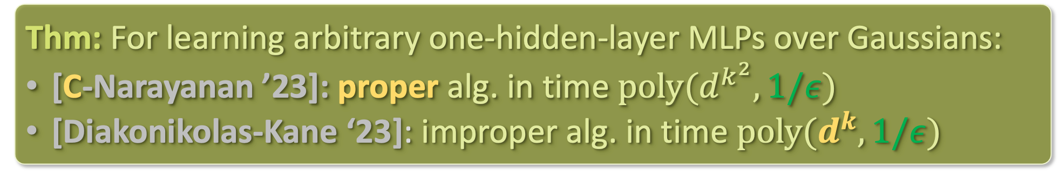
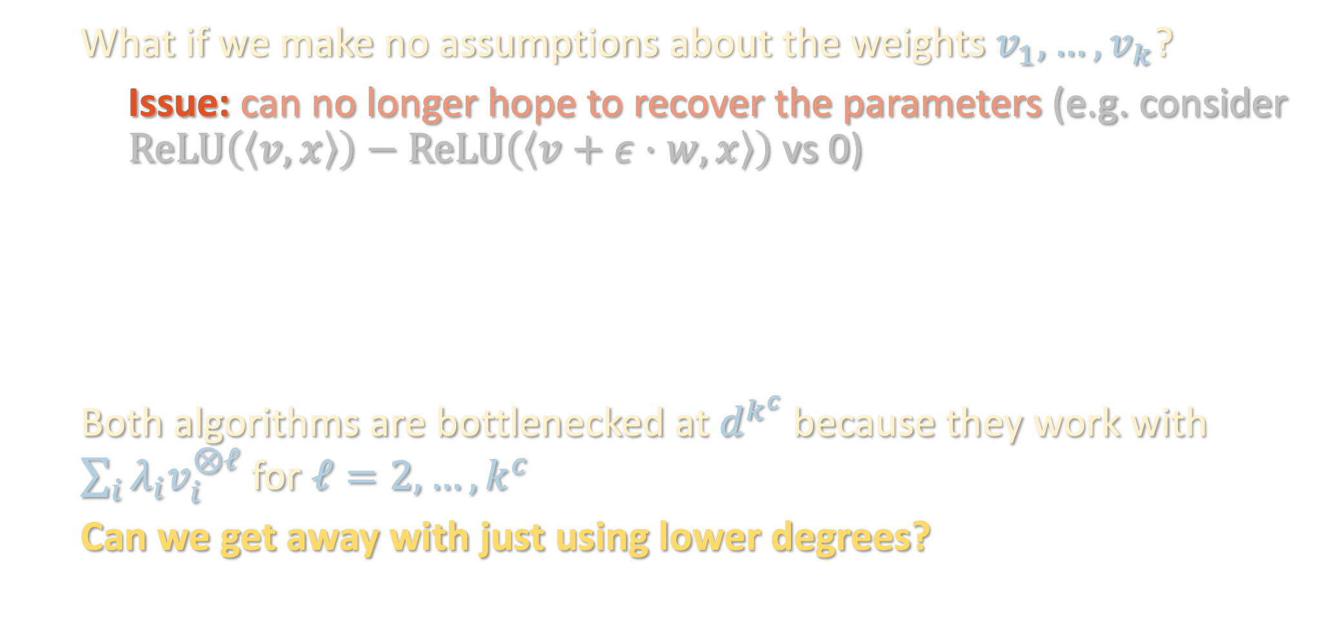
BEYOND LINEARLY INDEPENDENT WEIGHTS
What if we make no assumptions about the weights $v_{1},…,v_{k}$?
Issue: can no longer hope to recover the parameters (e.g. consider $ReLU\left(\left\langle v,x\right\rangle \right)−ReLU\left(\left\langle v+ε⋅w,x\right\rangle \right)$ vs 0)
Both algorithms are bottlenecked at $d^{k^{c}}$ because they work with $\sum_{i}{λ_{i}v_{i}^{⊗ℓ}}$ for $ℓ=2,…, k^{c}$
Can we get away with just using lower degrees?
Thm: For learning arbitrary one-hidden-layer MLPs over Gaussians:
[C-Narayanan ’23]: proper alg. in time $poly(d^{k^{2}},1/ε)$
[Diakonikolas-Kane ‘23]: improper alg. in time $poly(d^{k},1/ε)$

Slide 30
Noise sensitivity and Fourier concentration
One-hidden-layer MLPs: C. Elegans of ML theory
Hermite polynomials, low-degree approximation
Tensor methods (again)
Lower bounds
Algorithm/warmup for next lecture

Slide 31
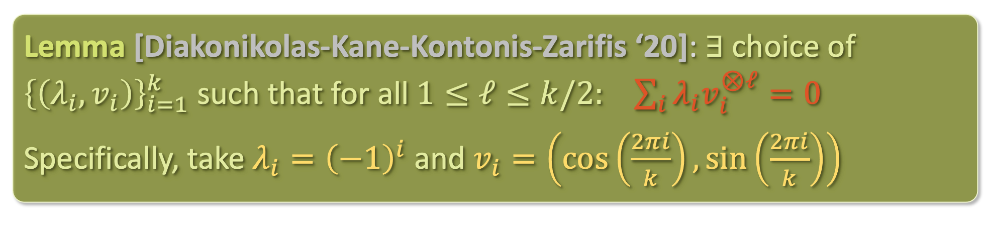
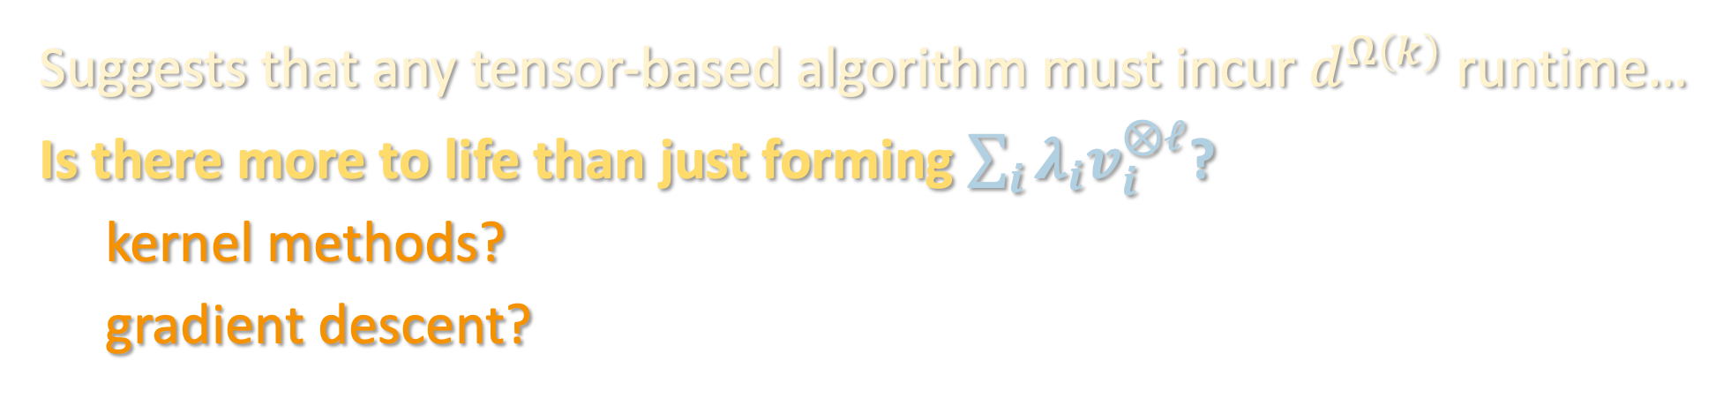
OBSTRUCTION FOR TENSOR METHODS
Lemma [Diakonikolas-Kane-Kontonis-Zarifis ‘20]: $∃$choice of ${\left\{\left(λ_{i},v_{i}\right)\right\}}_{i=1}^{k}$ such that for all $1≤ℓ≤k/2:$ $\sum_{i}{λ_{i}v_{i}^{⊗ℓ}}=0$
Specifically, take $λ_{i}={\left(−1\right)}^{i}$ and $v_{i}=\left(\cos\left(\frac{2πi}{k}\right),\sin\left(\frac{2πi}{k}\right)\right)$
Suggests that any tensor-based algorithm must incur $d^{Ω\left(k\right)}$ runtime…
Is there more to life than just forming $\sum_{i}{λ_{i}v_{i}^{⊗ℓ}}$?
kernel methods?
gradient descent?

Slide 32
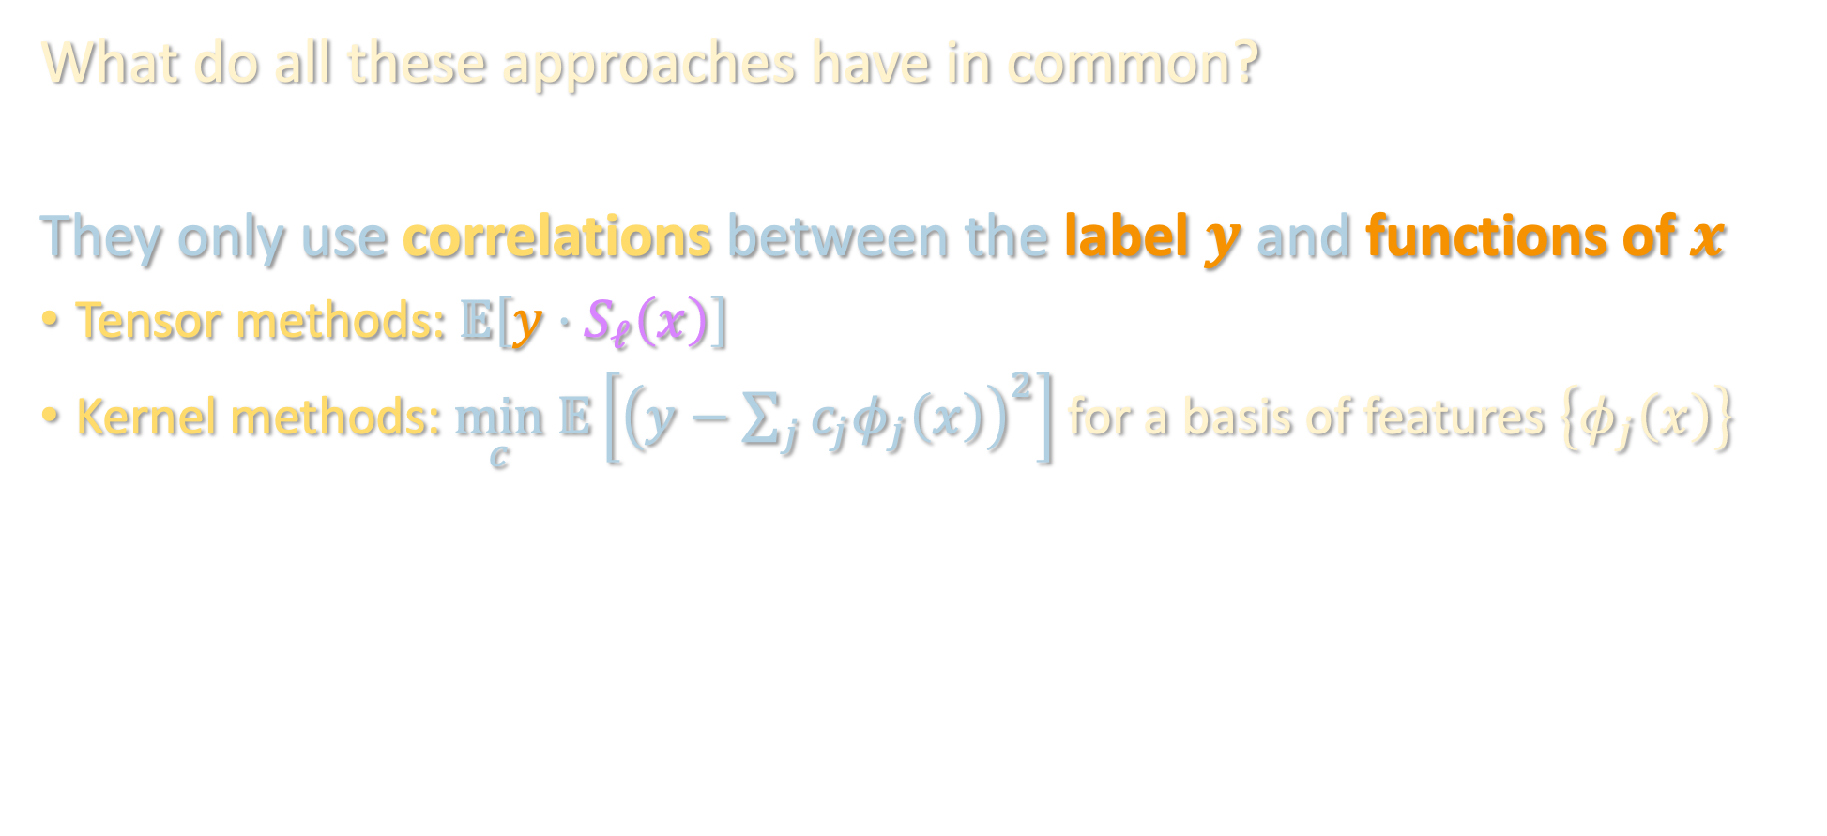
OBSTRUCTION FOR “CORRELATIONAL” METHODS
What do all these approaches have in common?
They only use correlations between the label $y$ and functions of $x$
Tensor methods: $𝔼\left[y⋅S_{ℓ}\left(x\right)\right]$
Kernel methods: $\min_{c} 𝔼\left[{\left(y−\sum_{j}{c_{j}φ_{j}\left(x\right)}\right)}^{2}\right]$ for a basis of features $\left\{φ_{j}\left(x\right)\right\}$

Slide 33
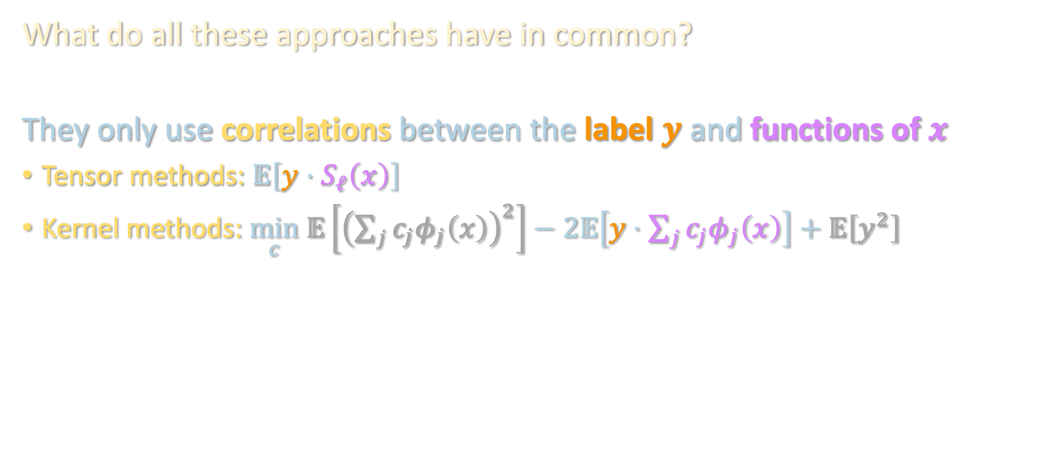
OBSTRUCTION FOR “CORRELATIONAL” METHODS
What do all these approaches have in common?
They only use correlations between the label $y$ and functions of $x$
Tensor methods: $𝔼\left[y⋅S_{ℓ}\left(x\right)\right]$
Kernel methods: $\min_{c} 𝔼\left[{\left(\sum_{j}{c_{j}φ_{j}\left(x\right)}\right)}^{2}\right]−2𝔼\left[y⋅\sum_{j}{c_{j}φ_{j}\left(x\right)}\right]+𝔼\left[y^{2}\right]$

Slide 34
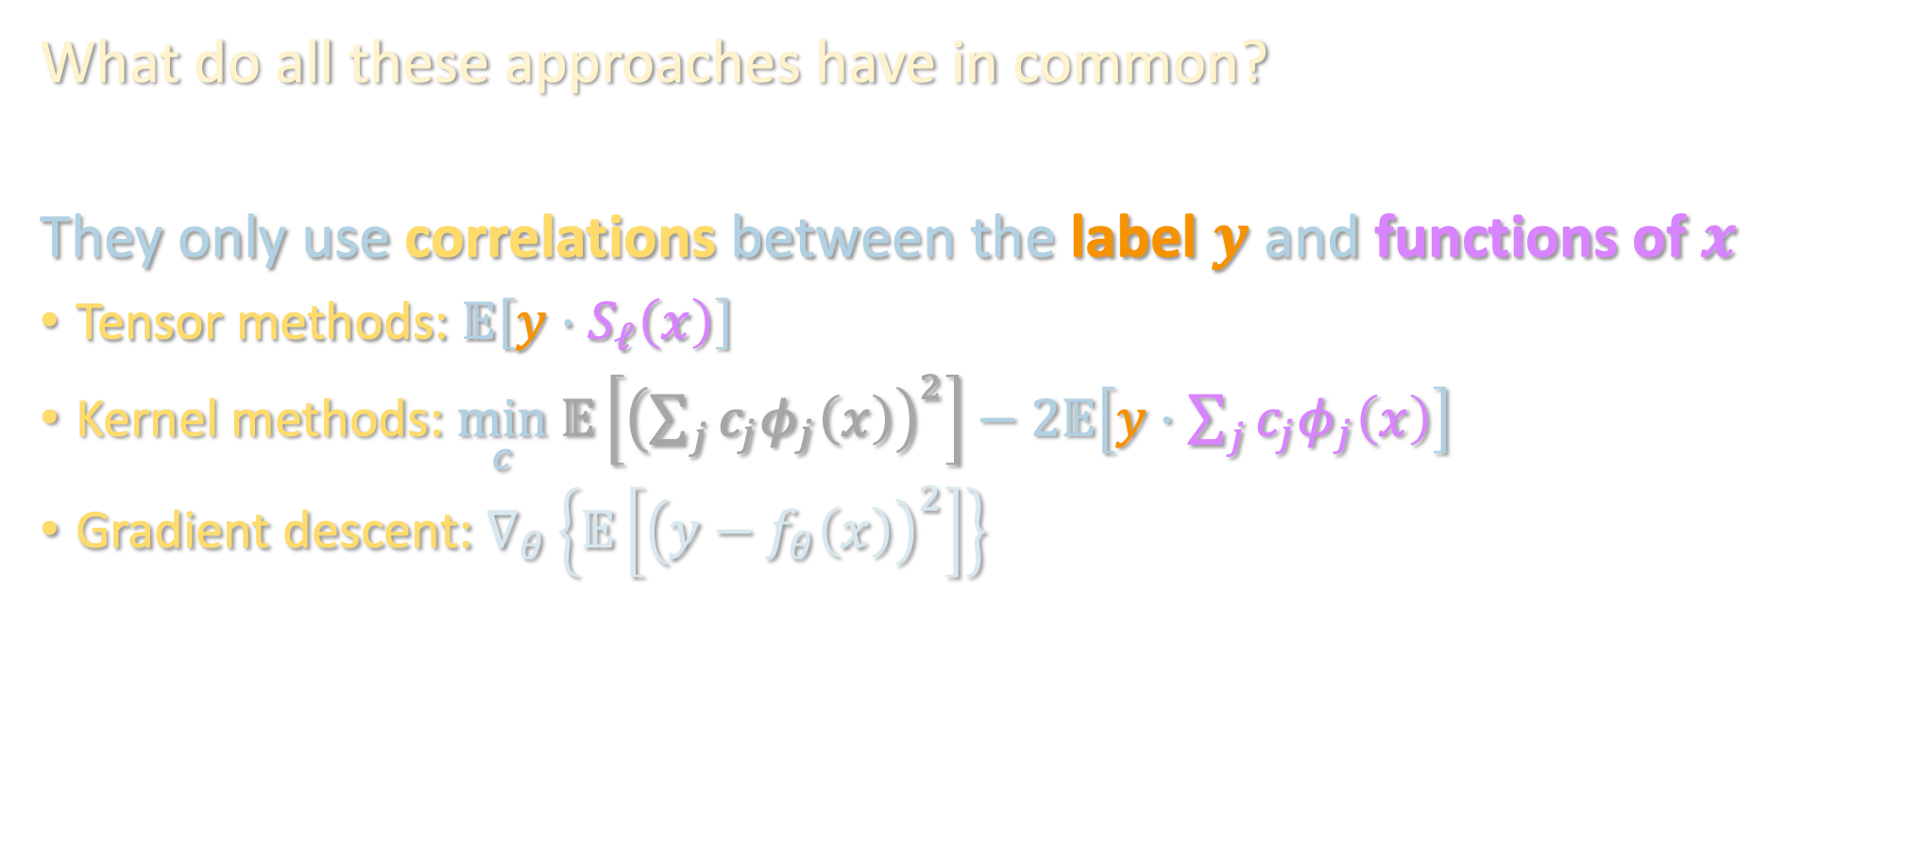
OBSTRUCTION FOR “CORRELATIONAL” METHODS
What do all these approaches have in common?
They only use correlations between the label $y$ and functions of $x$
Tensor methods: $𝔼\left[y⋅S_{ℓ}\left(x\right)\right]$
Kernel methods: $\min_{c} 𝔼\left[{\left(\sum_{j}{c_{j}φ_{j}\left(x\right)}\right)}^{2}\right]−2𝔼\left[y⋅\sum_{j}{c_{j}φ_{j}\left(x\right)}\right]$
Gradient descent: $∇_{θ}\left\{𝔼\left[{\left(y−f_{θ}\left(x\right)\right)}^{2}\right]\right\}$

Slide 35
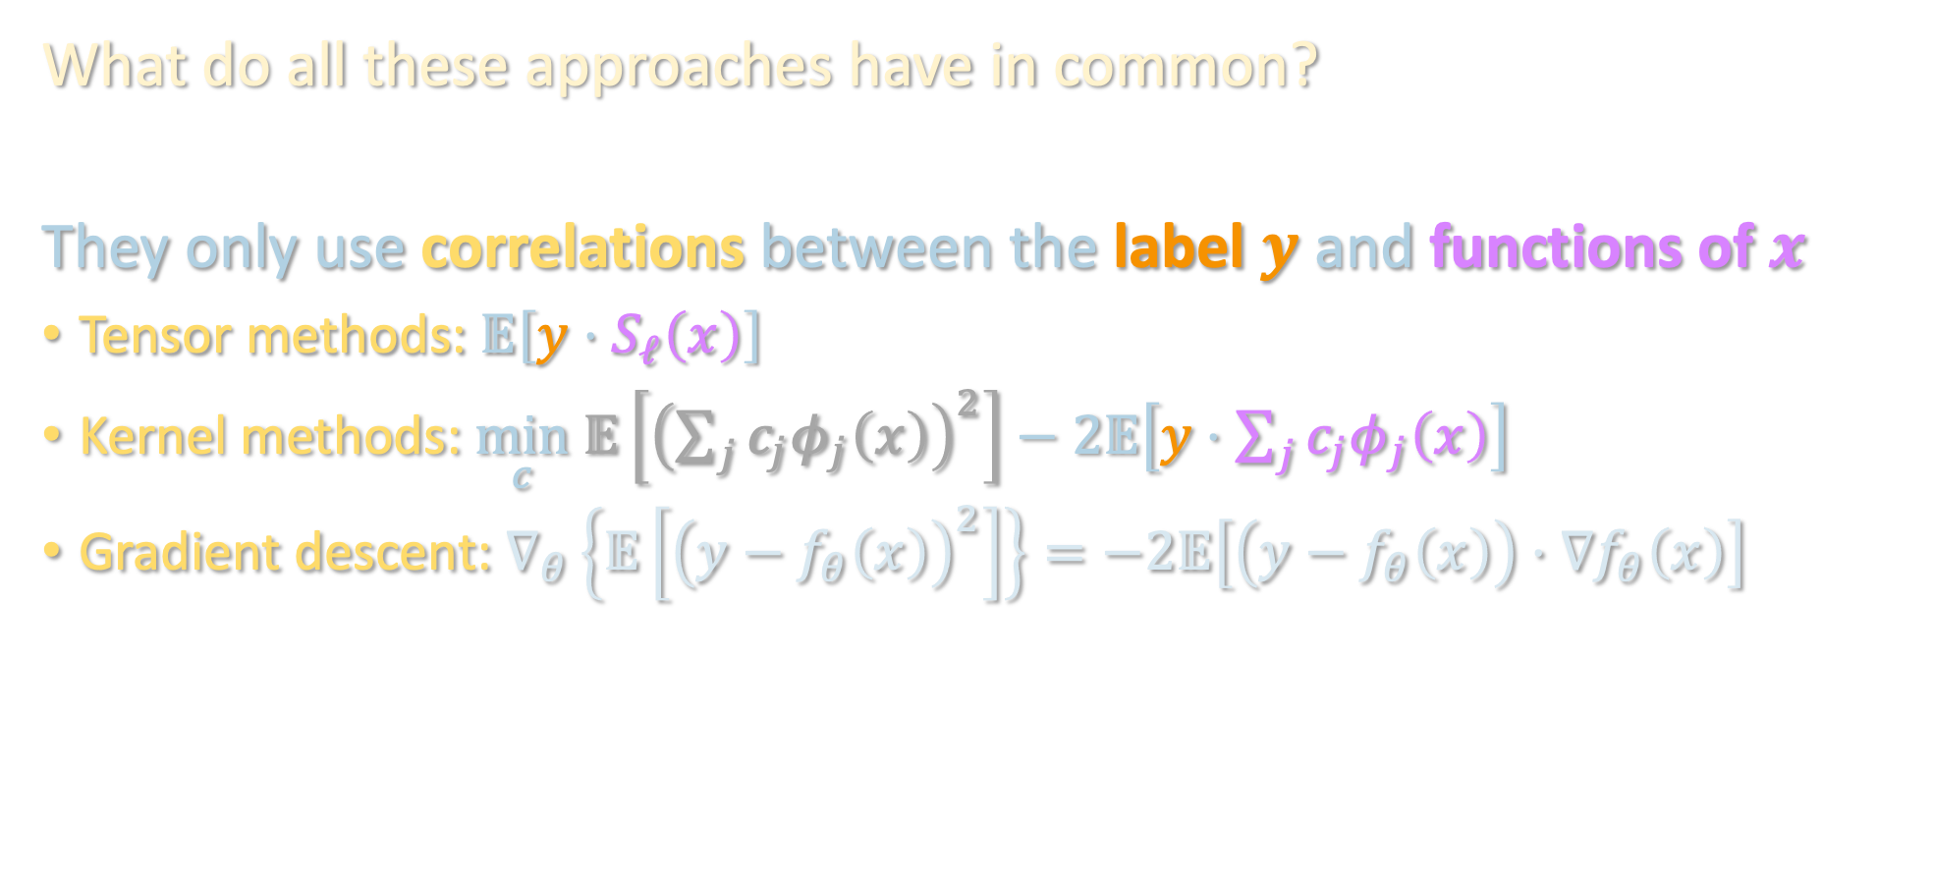
OBSTRUCTION FOR “CORRELATIONAL” METHODS
What do all these approaches have in common?
They only use correlations between the label $y$ and functions of $x$
Tensor methods: $𝔼\left[y⋅S_{ℓ}\left(x\right)\right]$
Kernel methods: $\min_{c} 𝔼\left[{\left(\sum_{j}{c_{j}φ_{j}\left(x\right)}\right)}^{2}\right]−2𝔼\left[y⋅\sum_{j}{c_{j}φ_{j}\left(x\right)}\right]$
Gradient descent: $∇_{θ}\left\{𝔼\left[{\left(y−f_{θ}\left(x\right)\right)}^{2}\right]\right\}=−2𝔼\left[\left(y−f_{θ}\left(x\right)\right)⋅∇f_{θ}\left(x\right)\right]$

Slide 36
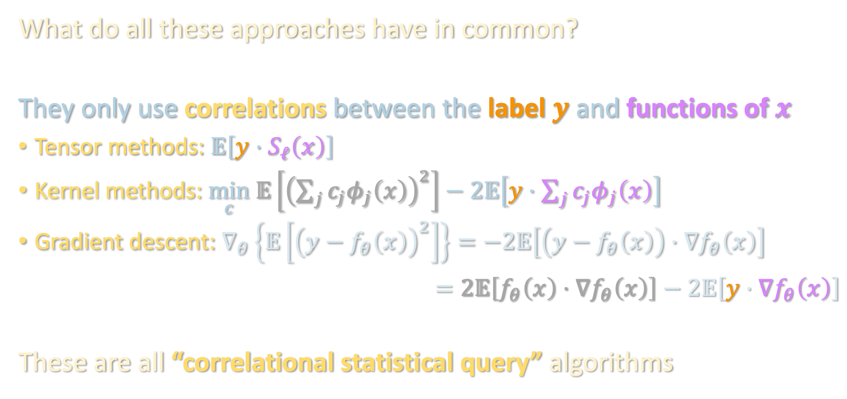
OBSTRUCTION FOR “CORRELATIONAL” METHODS
What do all these approaches have in common?
They only use correlations between the label $y$ and functions of $x$
Tensor methods: $𝔼\left[y⋅S_{ℓ}\left(x\right)\right]$
Kernel methods: $\min_{c} 𝔼\left[{\left(\sum_{j}{c_{j}φ_{j}\left(x\right)}\right)}^{2}\right]−2𝔼\left[y⋅\sum_{j}{c_{j}φ_{j}\left(x\right)}\right]$
Gradient descent: $∇_{θ}\left\{𝔼\left[{\left(y−f_{θ}\left(x\right)\right)}^{2}\right]\right\}=−2𝔼\left[\left(y−f_{θ}\left(x\right)\right)⋅∇f_{θ}\left(x\right)\right]$
$$=2𝔼\left[f_{θ}\left(x\right)⋅∇f_{θ}\left(x\right)\right]−2𝔼\left[y⋅∇f_{θ}\left(x\right)\right]$$
These are all “correlational statistical query” algorithms

Slide 37





OBSTRUCTION FOR “CORRELATIONAL” METHODS
Correlational statistical query (CSQ) model: algorithm only interacts with the dataset through queries of the form
where $\left|noise\right|≤τ$ for tolerance $τ$ (corresponds to $\sqrt{1/\#samples}$)
Proof: computational complexity unit next week
Strong evidence that tensor/kernel/gradient methods can’t beat $d^{k}$
$$𝔼\left[y⋅ψ\left(x\right)\right]+noise$$
$$ψ:ℝ^{d}→ℝ$$
Thm [Diakonikolas et al. ‘20]: In CSQ, learning one-hidden-layer MLP’s over Gaussians, even to constant error, requires $2^{d^{Θ\left(1\right)}}$ queries or tolerance $d^{−Ω\left(k\right)}$

Slide 38

TAKING STOCK
Recall our guiding questions:
For one-hidden-layer MLP’s, low-degree approx got $d^{poly({\left\|λ\right\|}_{1}/ε)}$
Can we improve the $ε$ dependence?
Can we improve the ${\left\|λ\right\|}_{1}$ dependence?

Slide 39

TAKING STOCK
Recall our guiding questions:
For one-hidden-layer MLP’s, low-degree approx got $d^{poly({\left\|λ\right\|}_{1}/ε)}$
Can we improve the $ε$ dependence?
Can we improve the ${\left\|λ\right\|}_{1}$ dependence?
Next, we will see how to improve on 2 by going beyond CSQ. In the process, will also answer:
Can we handle more layers?

Slide 40
Noise sensitivity and Fourier concentration
One-hidden-layer MLPs: C. Elegans of ML theory
Hermite polynomials, low-degree approximation
Tensor methods (again)
Lower bounds
Algorithm/warmup for next lecture

Slide 41














BEYOND ONE HIDDEN LAYER
$$x$$
$$W_{1}^{T}$$
$$W_{L−1}^{T}$$
$$W_{L}^{T}$$
$$W_{2}^{T}$$
…
$$ReLU$$
$$ReLU$$
$$ReLU$$
$$y$$
$$1×k_{L−1}$$
$$k_{L−1}×k_{L−2}$$
$$k_{2}×k_{1}$$
$$k_{1}×d$$
$$f\left(x\right)=W_{L} ReLU\left(W_{L−1} ReLU\left(⋯W_{2} ReLU\left(W_{1}x\right)\right)\right)$$
Depth: $L$, Size: $S≝k_{1}+⋯+k_{L−1}$
Lipschitzness: $Λ$ (i.e. $\left|f\left(x\right)−f\left(x^{′}\right)\right|≤Λ{\left\|x−x^{′}\right\|}_{2}$)

Slide 42


BEYOND CSQ: FILTERED PCA
Thm [C-Meka-Klivans ‘21]: There is a proper algorithm (“Filtered PCA”) for learning MLPs of any depth over Gaussian inputs to error $ε$ in time/samples
$$poly\left(d\right)⋅\exp\left(poly(S,Λ,\log{B},1/ε\right))$$
where $B=\prod_{i}{{\left\|W_{i}\right\|}_{op}}$.
$d^{poly\left(S\right)}$ vs. $poly\left(d\right)⋅exp⁡(poly\left(S\right))$ --- ”fixed parameter tractable” (FPT)
First ex. of neural net class that is learnable, but provably not by noisy GD
Caveat: $ε$ back in the exponent…
Remains open how to get $poly\left(d,S,1/ε\right)$, even for one-hidden-layer MLPs’ (!)
In the complexity unit, will also see some new barriers at higher depth

Slide 43


BEYOND CSQ: FILTERED PCA
Let’s focus on one-hidden-layer MLPs for now:
Note: if could recover $V=span\left(v_{1},…,v_{k}\right)$, can get FPT: project onto $V$ and “brute force” in time ${\left(1/ε\right)}^{poly\left(k\right)}$ (no $d$ dependence after projection)
CSQ lower bound actually shows that in the worst case, CSQ algorithms cannot even recover a single vector from the span $V$ of the input weight vectors
Warmup obs.: a “slightly non-CSQ” alg. already suffices to find vector in $V$!
(see board)
$$f\left(x\right)=\sum_{i=1}^{k}{λ_{i} ReLU\left(\left\langle v_{i},x\right\rangle \right)}$$

