Slide 1

CS 224: ALGORITHMS FOR DATA SCIENCE
LECTURE 12 (10/18)
Tensor decomposition
Sum-of-squares
Robustness
Supervised learning
Computational complexity
Statistical physics
Generative modeling
PAC LEARNING BASICS, FOURIER ANALYSIS

Slide 2
ANNOUNCEMENTS
My office hour: Thursday 3-4pm to accommodate pset office hour
Talk in the TOC seminar (Ankur Moitra – MIT) today on a sum-of-squares algorithm for learning linear dynamical systems:
SEC 3.301 at 3:45pm today

Slide 3
PAC learning – motivation and problem setup
Boolean functions and Fourier analysis
Extensions to agnostic / general distributions

Slide 4

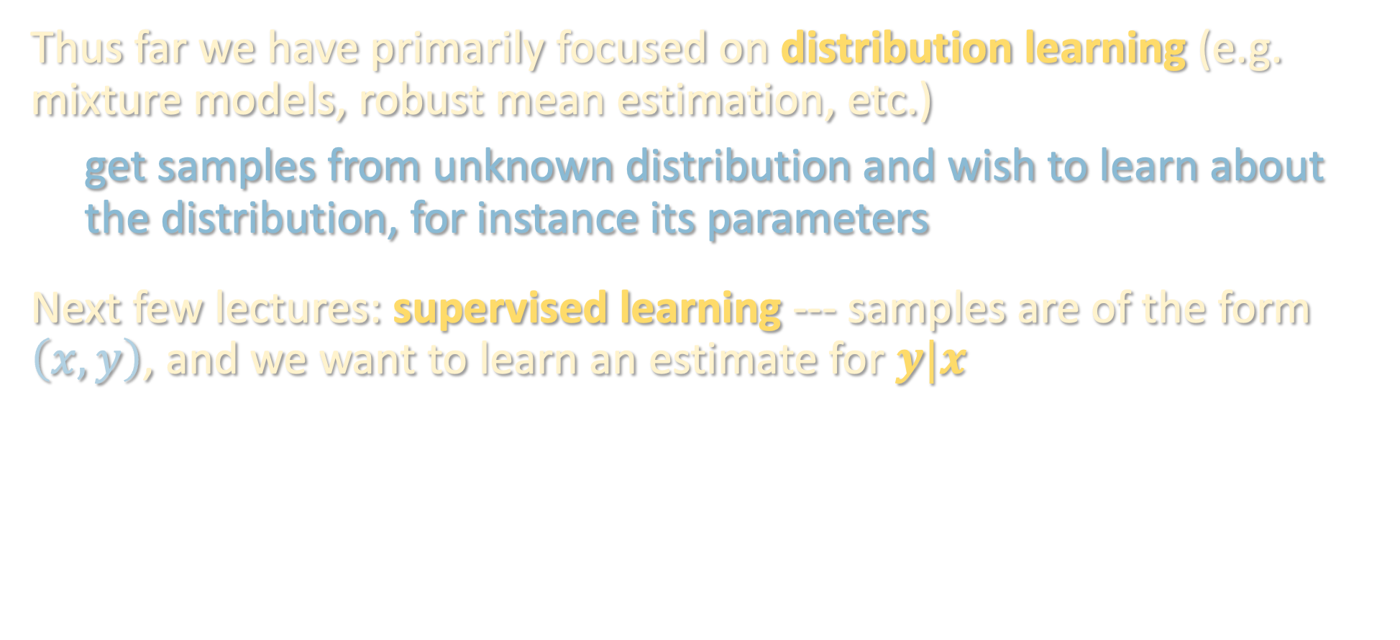
SUPERVISED LEARNING
Thus far we have primarily focused on distribution learning (e.g. mixture models, robust mean estimation, etc.)
get samples from unknown distribution and wish to learn about the distribution, for instance its parameters
Next few lectures: supervised learning --- samples are of the form $\left(x,y\right)$, and we want to learn an estimate for $y|x$
Cat
-----
Dog

Slide 5
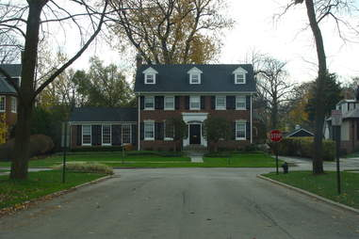
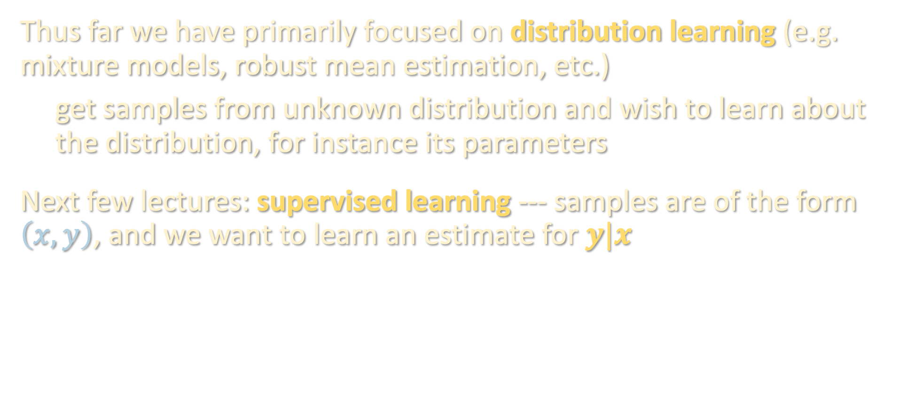
SUPERVISED LEARNING
Thus far we have primarily focused on distribution learning (e.g. mixture models, robust mean estimation, etc.)
get samples from unknown distribution and wish to learn about the distribution, for instance its parameters
Next few lectures: supervised learning --- samples are of the form $\left(x,y\right)$, and we want to learn an estimate for $y|x$
$1,477,600
{ms_sub_class: 60, lot_frontage: 65, lot_area: 8450, overall_qual: 7, overall_cond: 5, age: 37, bsm_fin_sf: 706, gr_liv_area: 1710, bedrooms_abv_gr: 3, garage_area: 548, ...}

Slide 6
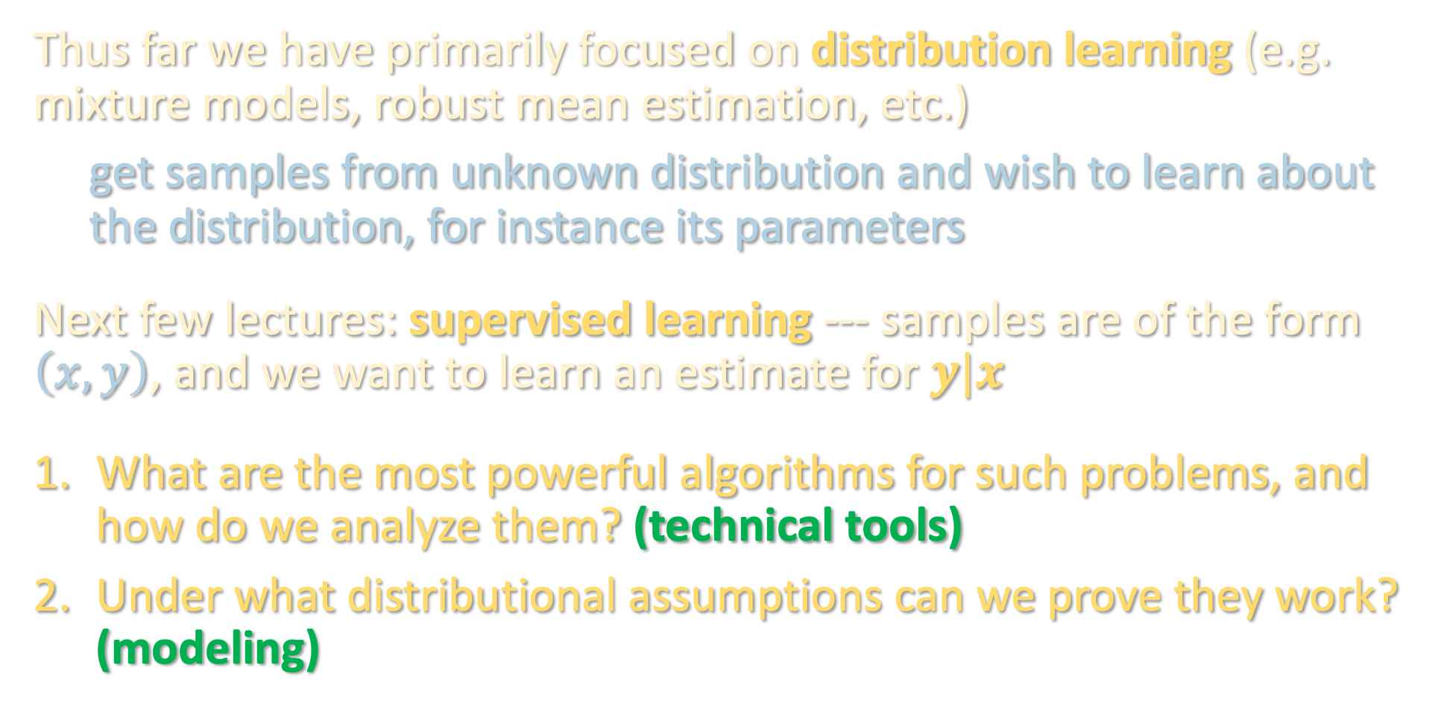
SUPERVISED LEARNING
Thus far we have primarily focused on distribution learning (e.g. mixture models, robust mean estimation, etc.)
get samples from unknown distribution and wish to learn about the distribution, for instance its parameters
Next few lectures: supervised learning --- samples are of the form $\left(x,y\right)$, and we want to learn an estimate for $y|x$
What are the most powerful algorithms for such problems, and how do we analyze them? (technical tools)
Under what distributional assumptions can we prove they work? (modeling)

Slide 7
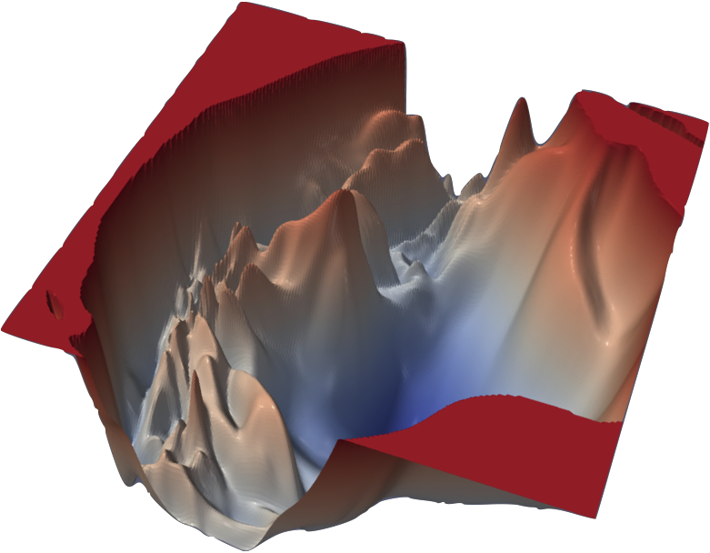
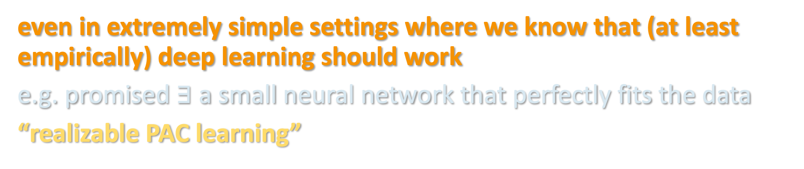
SUPERVISED LEARNING
Algorithm of choice in practice: “deep learning” - run SGD to optimize a deep neural network to fit training examples. Still mostly a mystery why this works except in very specialized settings...
Before we can understand why this works so well, should first understand why any polynomial-time algorithm could work
even in extremely simple settings where we know that (at least empirically) deep learning should work
e.g. promised $∃$ a small neural network that perfectly fits the data
“realizable PAC learning”

Slide 8
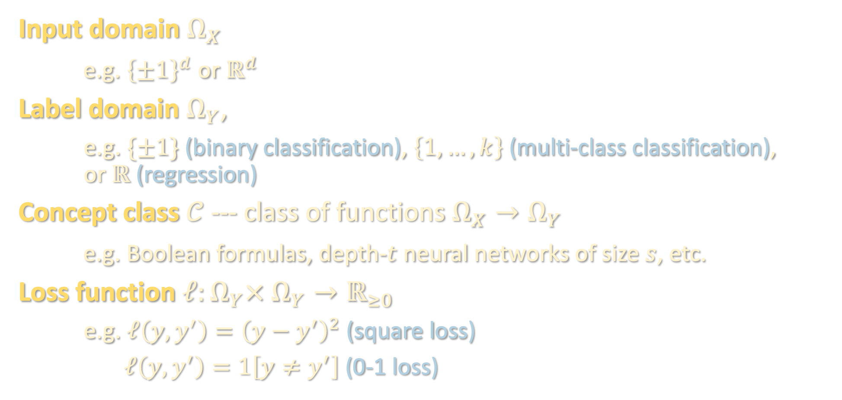
PROBABLY APPROXIMATELY CORRECT (PAC) LEARNING
[Valiant ‘84]
Input domain $Ω_{X}$
e.g. ${\left\{±1\right\}}^{d}$ or $ℝ^{d}$
Label domain $Ω_{Y}$,
e.g. $\{±1\}$ (binary classification), $\left\{1,…,k\right\}$ (multi-class classification), or $ℝ$ (regression)
Concept class $𝒞$ --- class of functions $Ω_{X}→Ω_{Y}$
e.g. Boolean formulas, depth-$t$ neural networks of size $s$, etc.
Loss function $ℓ:Ω_{Y}× Ω_{Y}→ℝ_{≥0}$
e.g. $ℓ\left(y,y^{′}\right)={\left(y−y^{′}\right)}^{2}$ (square loss)
$ℓ\left(y,y^{′}\right)=1\left[y≠y^{′}\right]$ (0-1 loss)

Slide 9
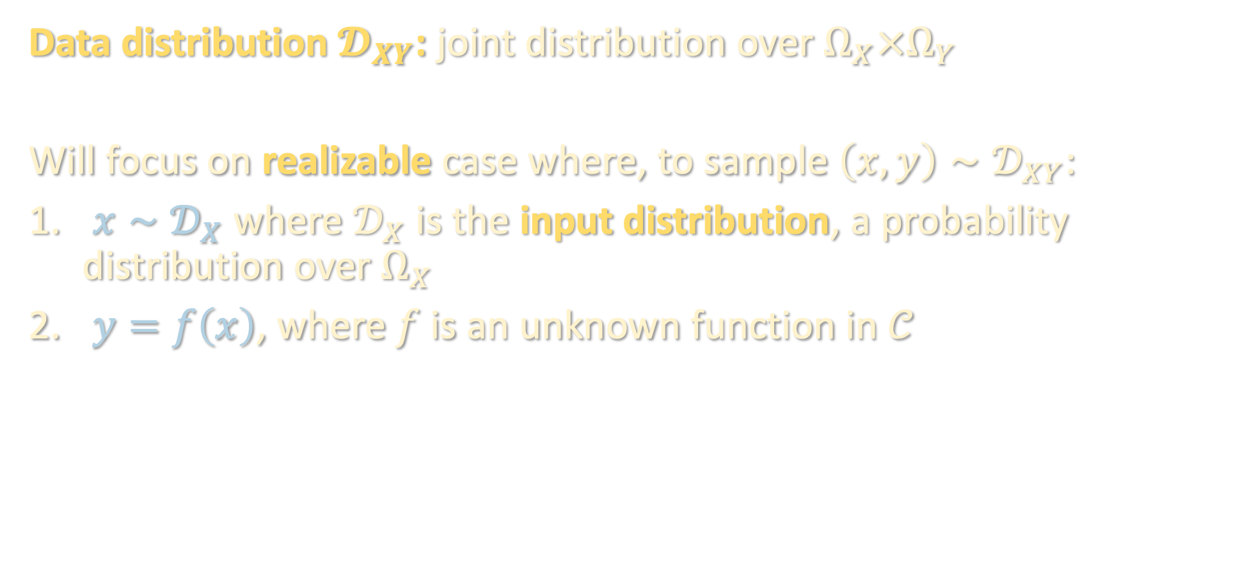
PROBABLY APPROXIMATELY CORRECT (PAC) LEARNING
Data distribution $𝓓_{XY}$: joint distribution over $Ω_{X}×Ω_{Y}$
Will focus on realizable case where, to sample $\left(x,y\right)∼𝒟_{XY}$:
$x∼𝒟_{X}$ where $𝒟_{X}$ is the input distribution, a probability distribution over $Ω_{X}$
$y=f\left(x\right)$, where $f$ is an unknown function in $𝒞$

Slide 10
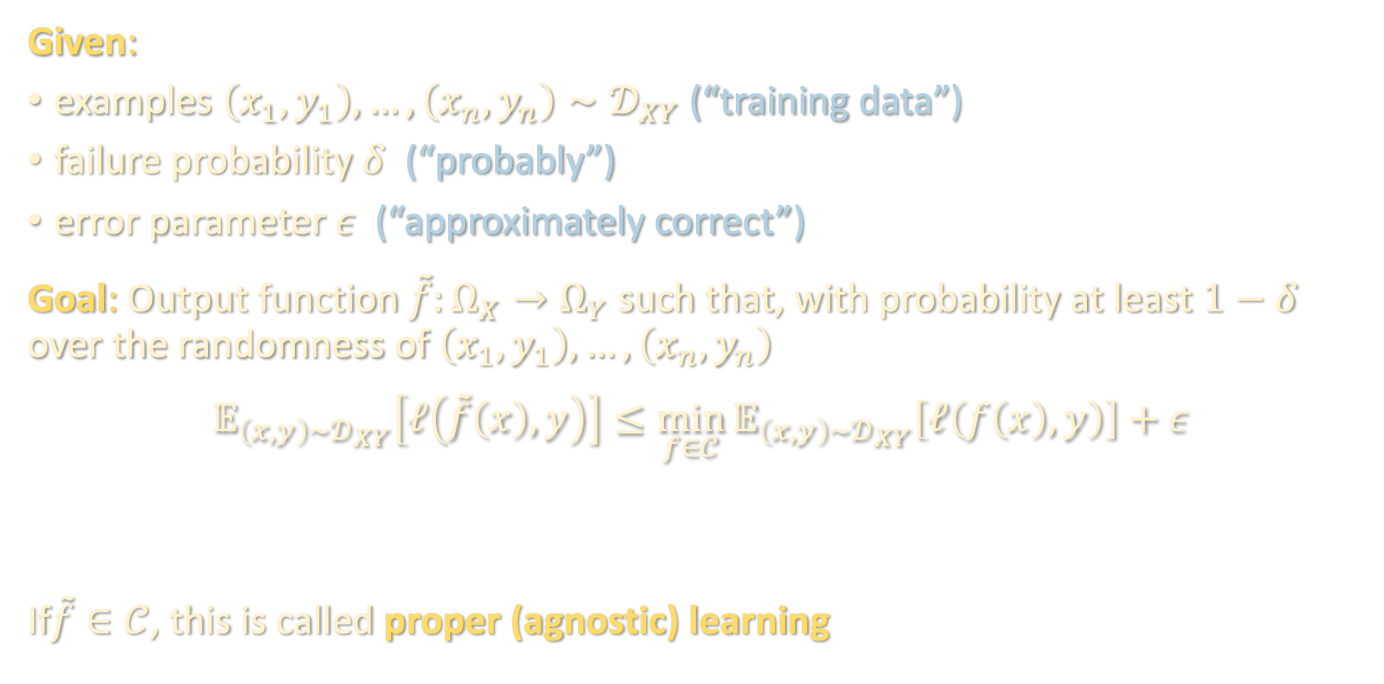
PROBABLY APPROXIMATELY CORRECT (PAC) LEARNING
Given:
examples $\left(x_{1},y_{1}\right),…,\left(x_{n},y_{n}\right)∼𝒟_{XY}$ (“training data”)
failure probability $δ$ (“probably”)
error parameter $ε$ (“approximately correct”)
Goal: Output function $\tilde{f}:Ω_{X}→Ω_{Y}$ such that, with probability at least $1−δ$ over the randomness of $\left(x_{1},y_{1}\right),…,\left(x_{n},y_{n}\right)$
$$𝔼_{\left(x,y\right)∼𝒟_{XY}}\left[ℓ\left(\tilde{f}\left(x\right),y\right)\right]≤\min_{f∈𝒞}{𝔼_{\left(x,y\right)∼𝒟_{XY}}\left[ℓ\left(f\left(x\right),y\right)\right]}+ε$$
If$\tilde{f}∈𝒞$, this is called proper (agnostic) learning
test loss
OPT
(in realizable case, OPT = 0)

Slide 11
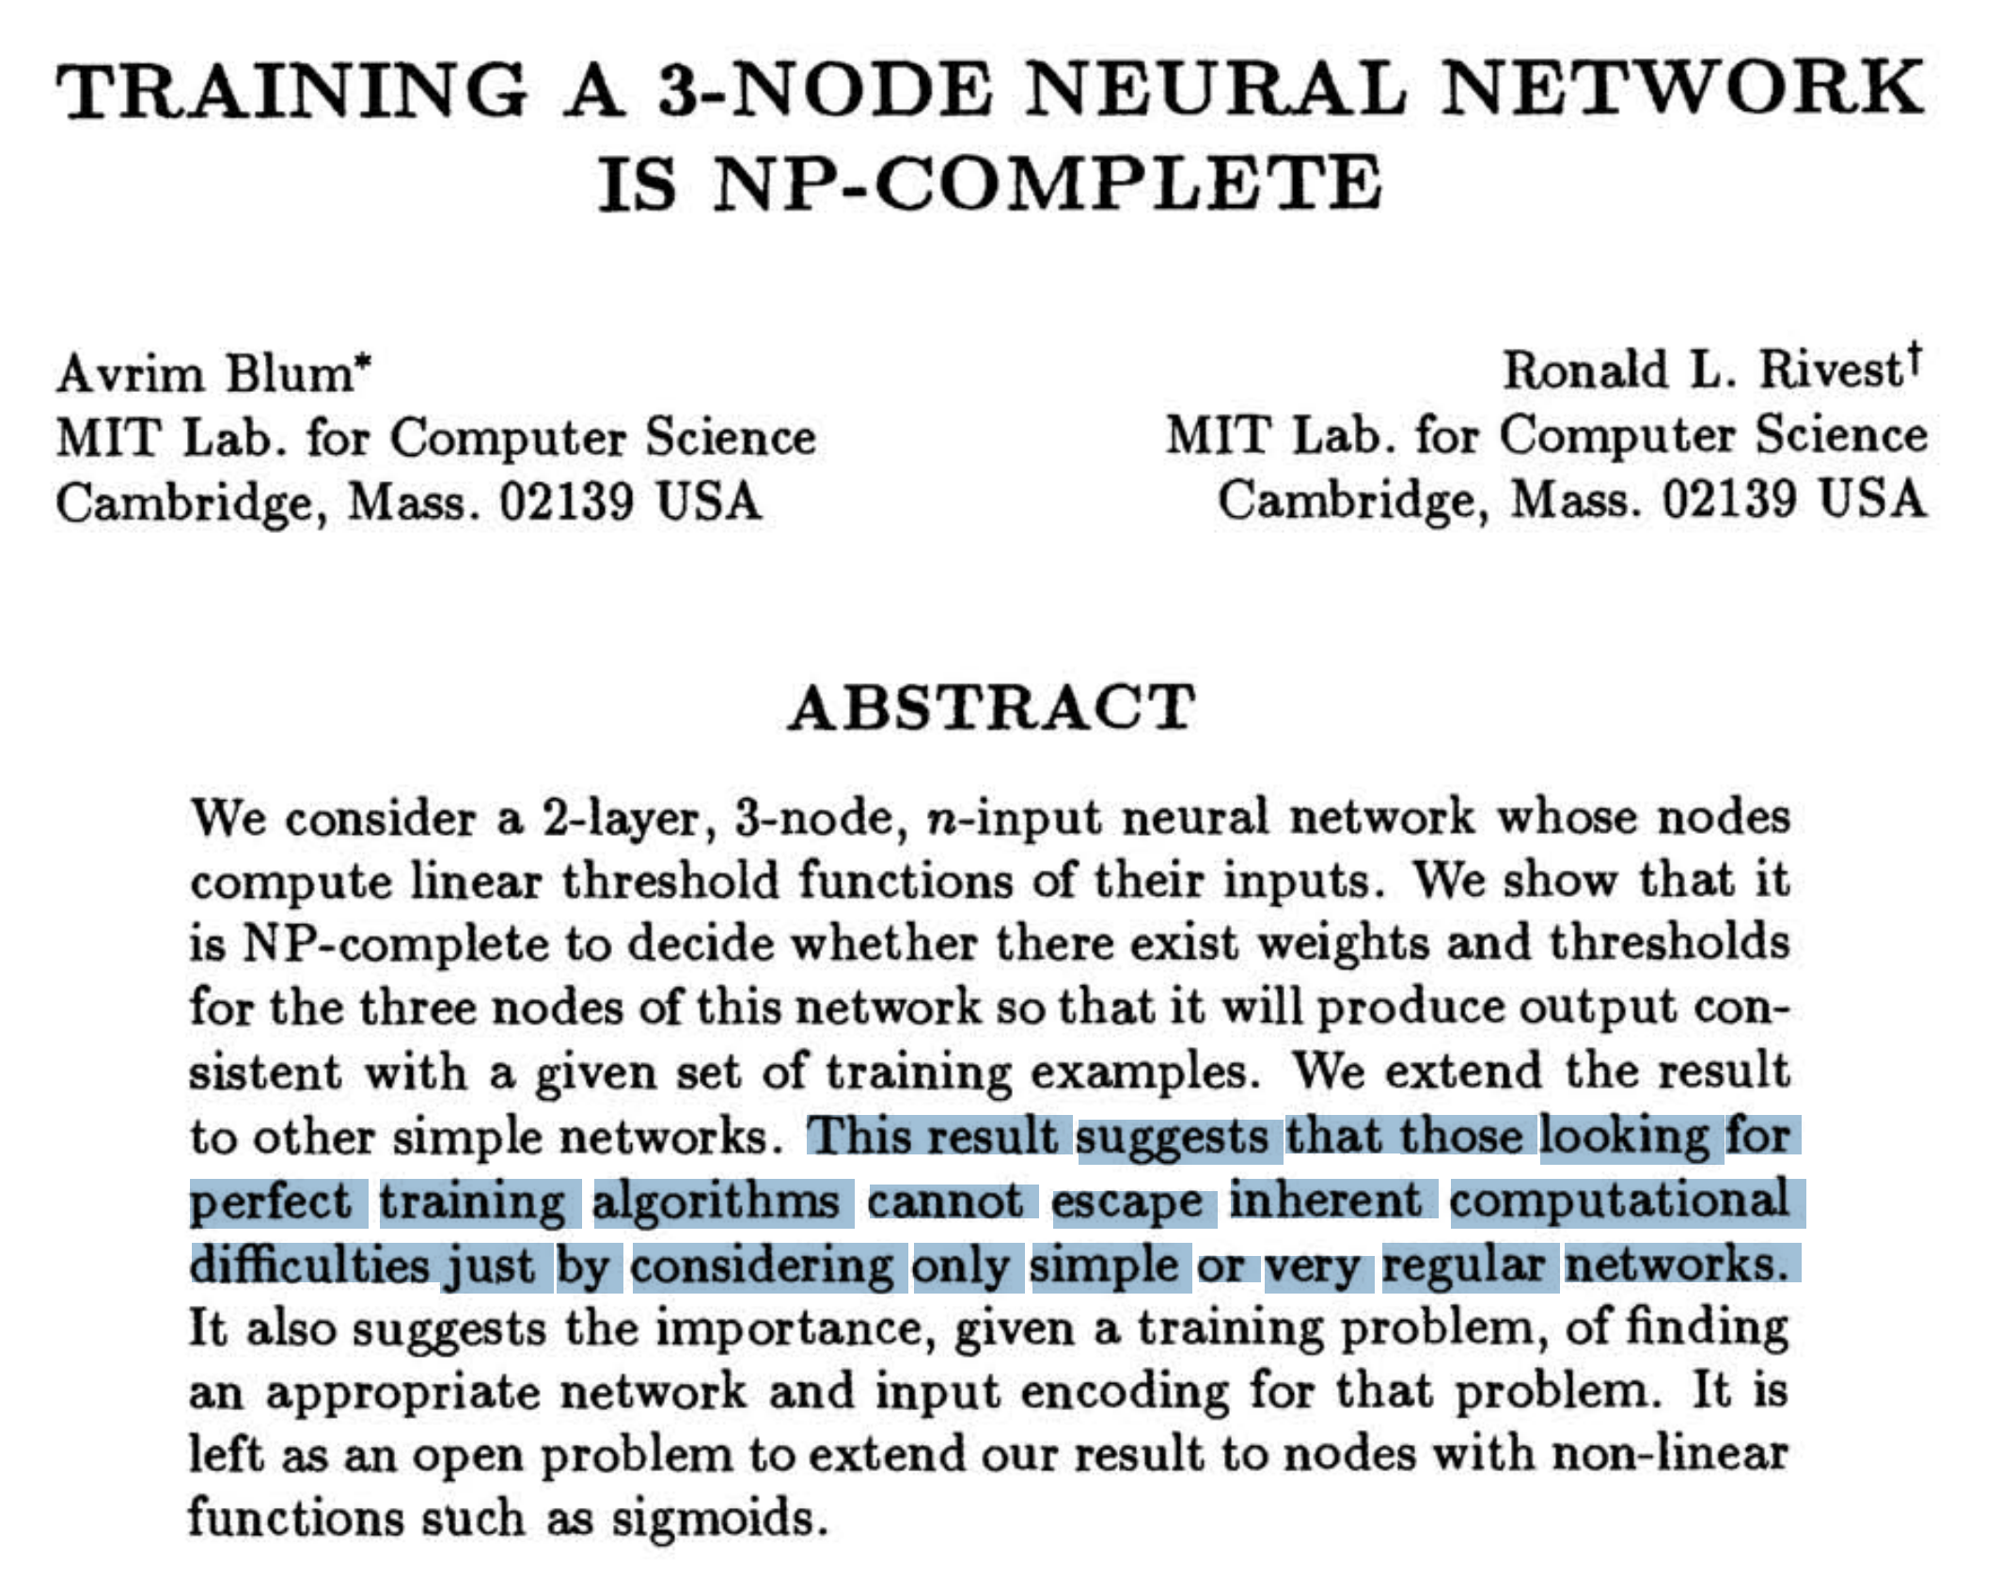

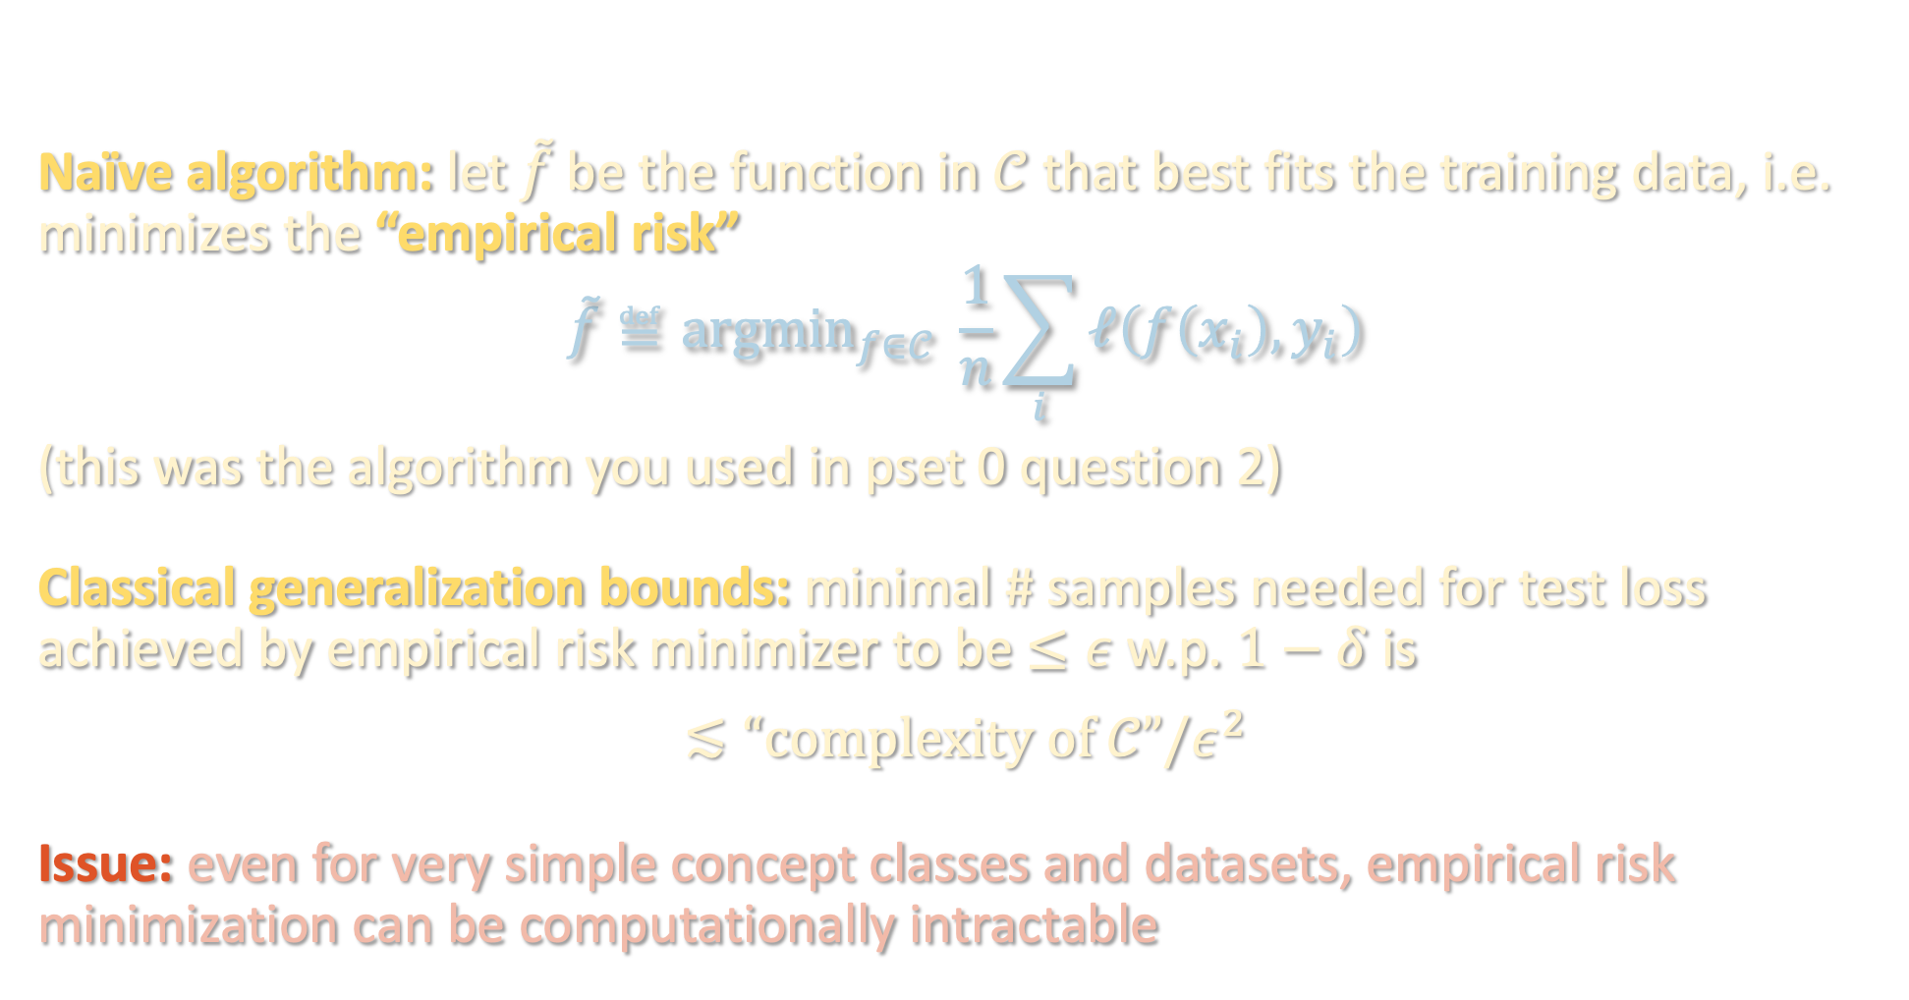
EMPIRICAL RISK MINIMIZATION
Naïve algorithm: let $\tilde{f}$ be the function in $𝒞$ that best fits the training data, i.e. minimizes the “empirical risk”
$$\tilde{f}≝{argmin}_{f∈𝒞} \frac{1}{n}\sum_{i}{ℓ\left(f\left(x_{i}\right),y_{i}\right)}$$
(this was the algorithm you used in pset 0 question 2)
Classical generalization bounds: minimal # samples needed for test loss achieved by empirical risk minimizer to be $≤ε$ w.p. $1−δ$ is
$$≲“complexity of 𝒞”/ε^{2}$$
Issue: even for very simple concept classes and datasets, empirical risk minimization can be computationally intractable
$\log{|𝒞|}$
Rademacher complexity
VC dimension
Covering number
Fat-shattering number
….

Slide 12

EFFICIENT ALGORITHMS
Here we will focus on provably correct algorithms for PAC learning that run in polynomial time
Distribution-free with Massart noise
Known
Truth?
generality of
distributional
assumption
Gaussian/
uniform over ${\left\{±1\right\}}^{n}$
*
Halfspaces
Neural networks
expressivity of function class

Slide 13
PAC learning – motivation and problem setup
Boolean functions and Fourier analysis
Extensions to agnostic / general distributions

Slide 14
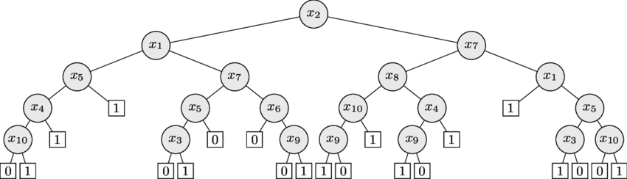
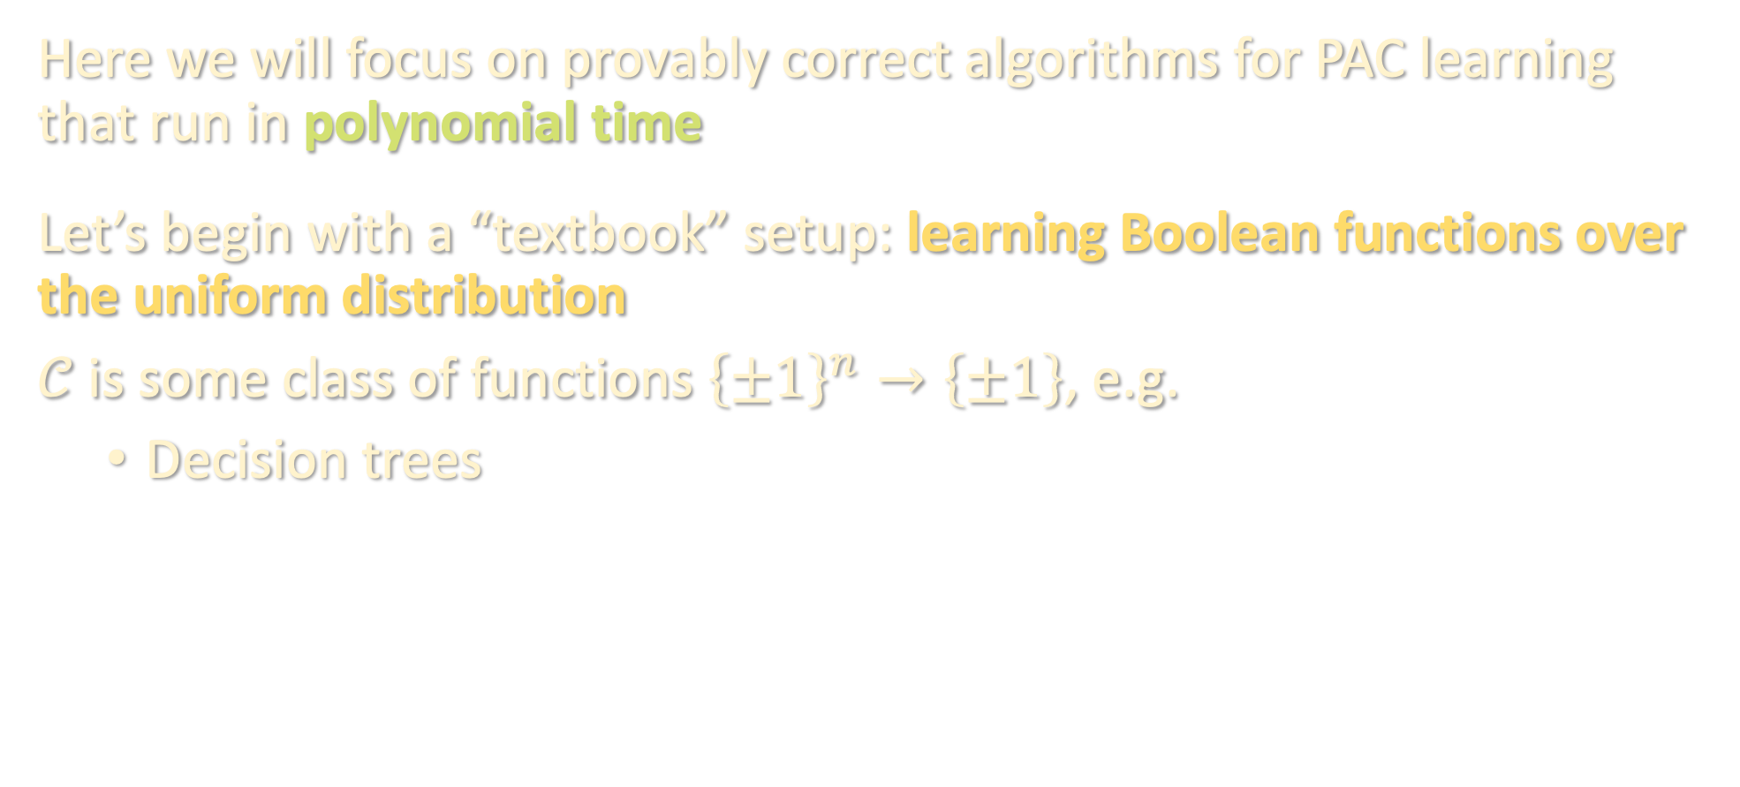
EFFICIENT ALGORITHMS
Here we will focus on provably correct algorithms for PAC learning that run in polynomial time
Let’s begin with a “textbook” setup: learning Boolean functions over the uniform distribution
$𝒞$ is some class of functions ${\left\{±1\right\}}^{n}→\left\{±1\right\}$, e.g.
Decision trees

Slide 15
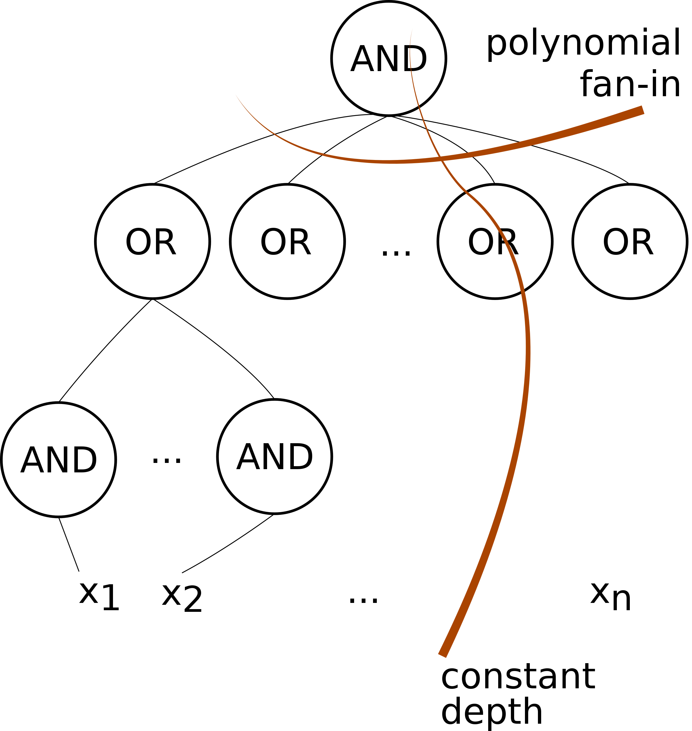
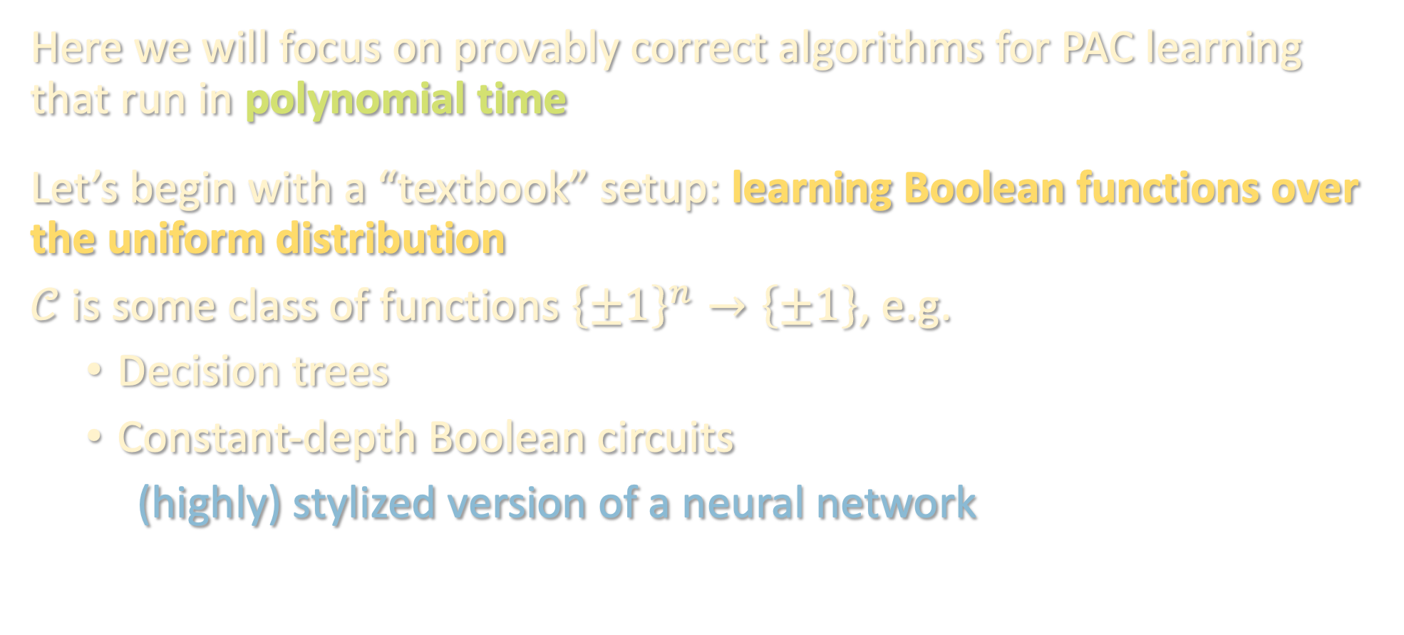
EFFICIENT ALGORITHMS
Here we will focus on provably correct algorithms for PAC learning that run in polynomial time
Let’s begin with a “textbook” setup: learning Boolean functions over the uniform distribution
$𝒞$ is some class of functions ${\left\{±1\right\}}^{n}→\left\{±1\right\}$, e.g.
Decision trees
Constant-depth Boolean circuits
(highly) stylized version of a neural network

Slide 16
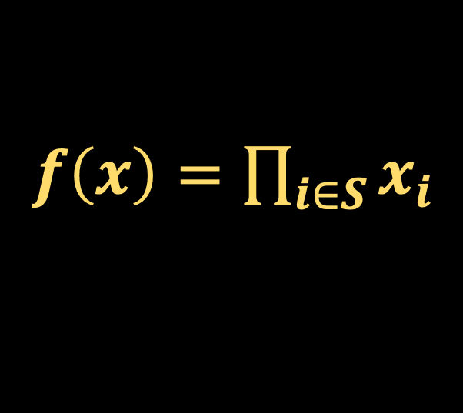
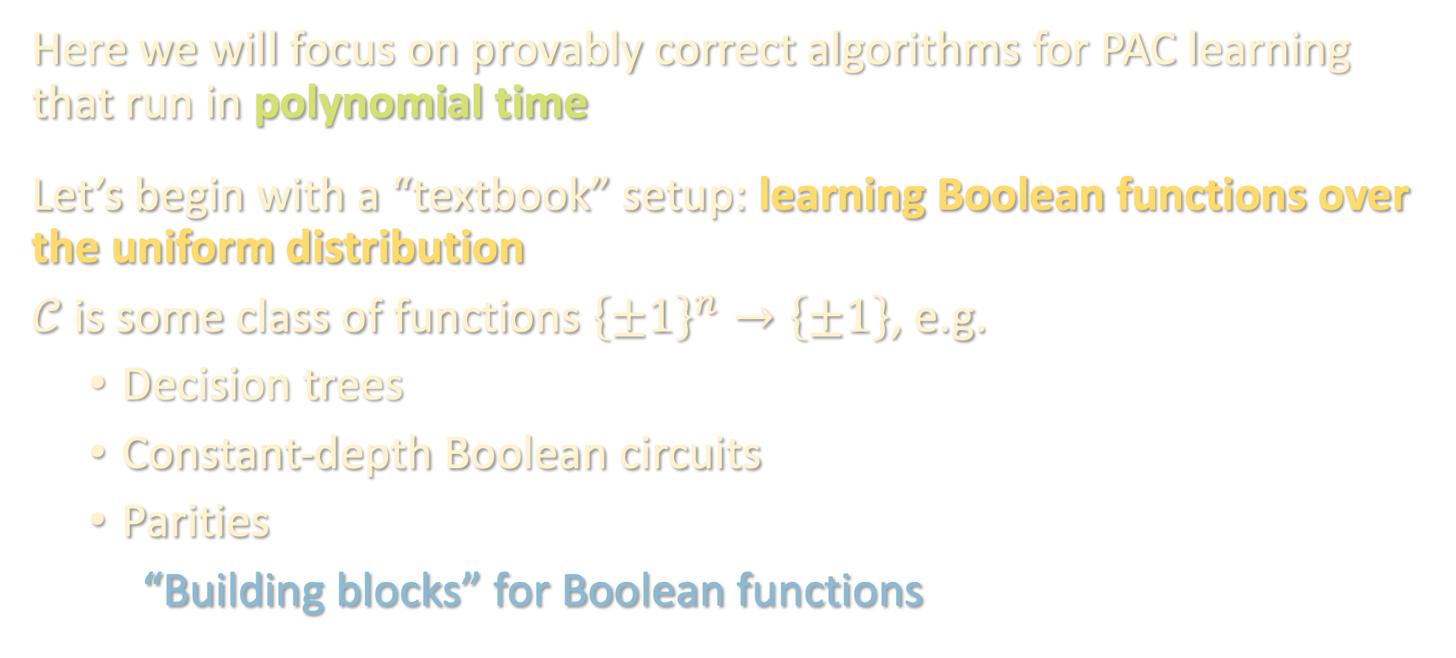
EFFICIENT ALGORITHMS
Here we will focus on provably correct algorithms for PAC learning that run in polynomial time
Let’s begin with a “textbook” setup: learning Boolean functions over the uniform distribution
$𝒞$ is some class of functions ${\left\{±1\right\}}^{n}→\left\{±1\right\}$, e.g.
Decision trees
Constant-depth Boolean circuits
Parities
“Building blocks” for Boolean functions
$f\left(x\right)=\prod_{i∈S}{x_{i}}$

Slide 17
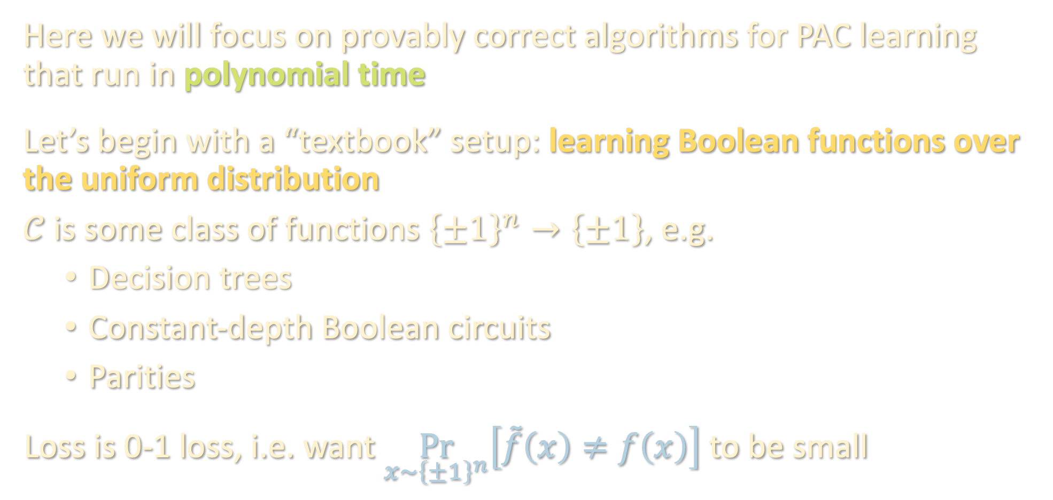
EFFICIENT ALGORITHMS
Here we will focus on provably correct algorithms for PAC learning that run in polynomial time
Let’s begin with a “textbook” setup: learning Boolean functions over the uniform distribution
$𝒞$ is some class of functions ${\left\{±1\right\}}^{n}→\left\{±1\right\}$, e.g.
Decision trees
Constant-depth Boolean circuits
Parities
Loss is 0-1 loss, i.e. want $\underset{x∼{\left\{±1\right\}}^{n}}{Pr}\left[\tilde{f}\left(x\right)≠f\left(x\right)\right]$ to be small

Slide 18
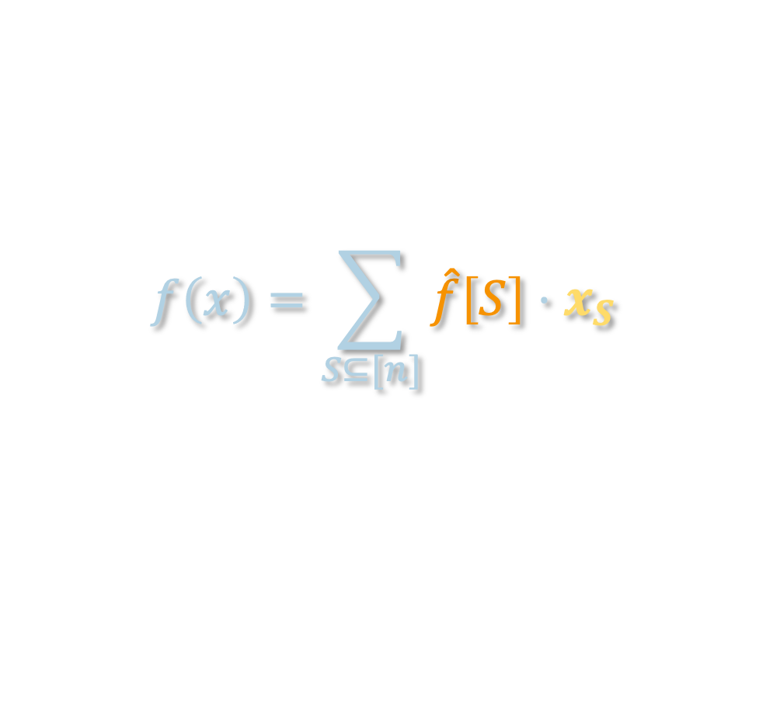
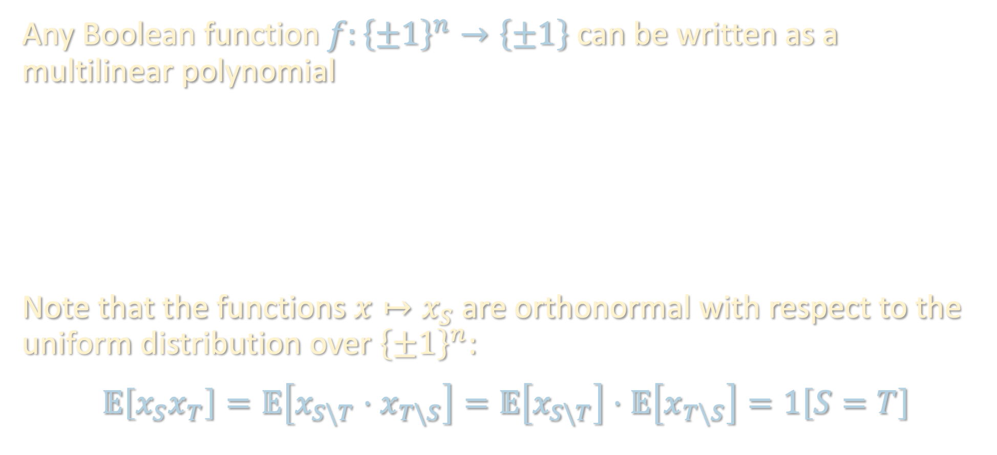

FOURIER ANALYSIS OF BOOLEAN FUNCTIONS
Any Boolean function $f:{\left\{±1\right\}}^{n}→\left\{±1\right\}$ can be written as a multilinear polynomial
$$f\left(x\right)=\sum_{S⊆[n]}{\hat{f}\left[S\right]⋅x_{S}}$$
Note that the functions $x↦x_{S}$ are orthonormal with respect to the uniform distribution over ${\left\{±1\right\}}^{n}$:
$$𝔼\left[x_{S}x_{T}\right]=𝔼\left[x_{S\backslash T}⋅x_{T\backslash S}\right]=𝔼\left[x_{S\backslash T}\right]⋅𝔼\left[x_{T\backslash S}\right]=1\left[S=T\right]$$
$$f\left(x\right)=\sum_{S⊆[n]}{\hat{f}\left[S\right]⋅x_{S}}$$
Parity / Fourier character / basis function
Fourier coefficient
Example: $f\left[∅\right]=𝔼\left[f\right]$

Slide 19

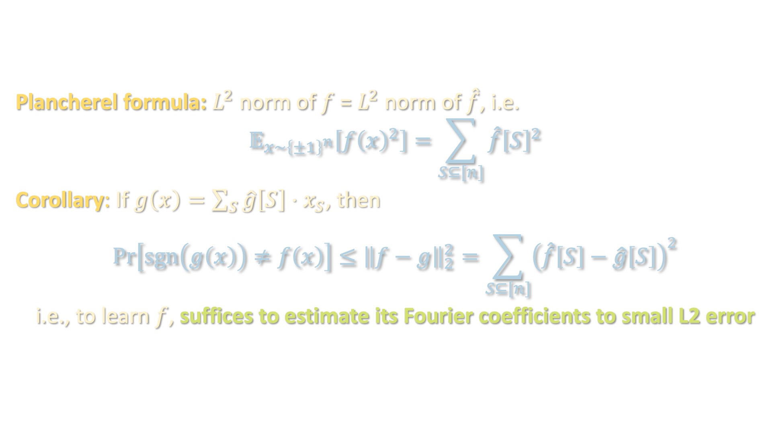

FOURIER ANALYSIS OF BOOLEAN FUNCTIONS
Plancherel formula: $L^{2}$ norm of $f$ = $L^{2}$ norm of $\hat{f}$, i.e.
$$𝔼_{x∼{\left\{±1\right\}}^{n}}\left[f{\left(x\right)}^{2}\right]=\sum_{S⊆[n]}{\hat{f}{\left[S\right]}^{2}}$$
Corollary: If $g\left(x\right)=\sum_{S}{\hat{g}\left[S\right]⋅x_{S}}$, then
$$\operatorname{Pr}\left[\operatorname{sgn}\left(g\left(x\right)\right)≠f\left(x\right)\right]≤{\left\|f−g\right\|}_{2}^{2}=\sum_{S⊆[n]}{{\left(\hat{f}\left[S\right]−\hat{g}\left[S\right]\right)}^{2}}$$
i.e., to learn $f$, suffices to estimate its Fourier coefficients to small L2 error
$$f\left(x\right)=\sum_{S⊆[n]}{\hat{f}\left[S\right]⋅x_{S}}$$
We denote this by ${\left\|f\right\|}_{2}^{2}$

Slide 20
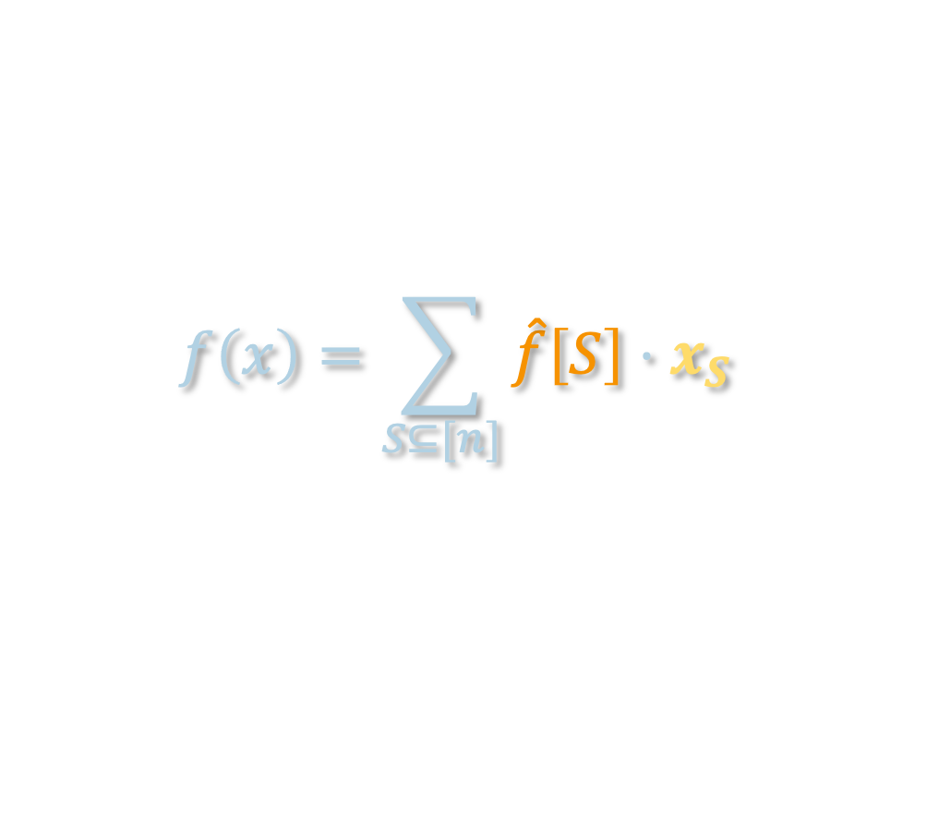
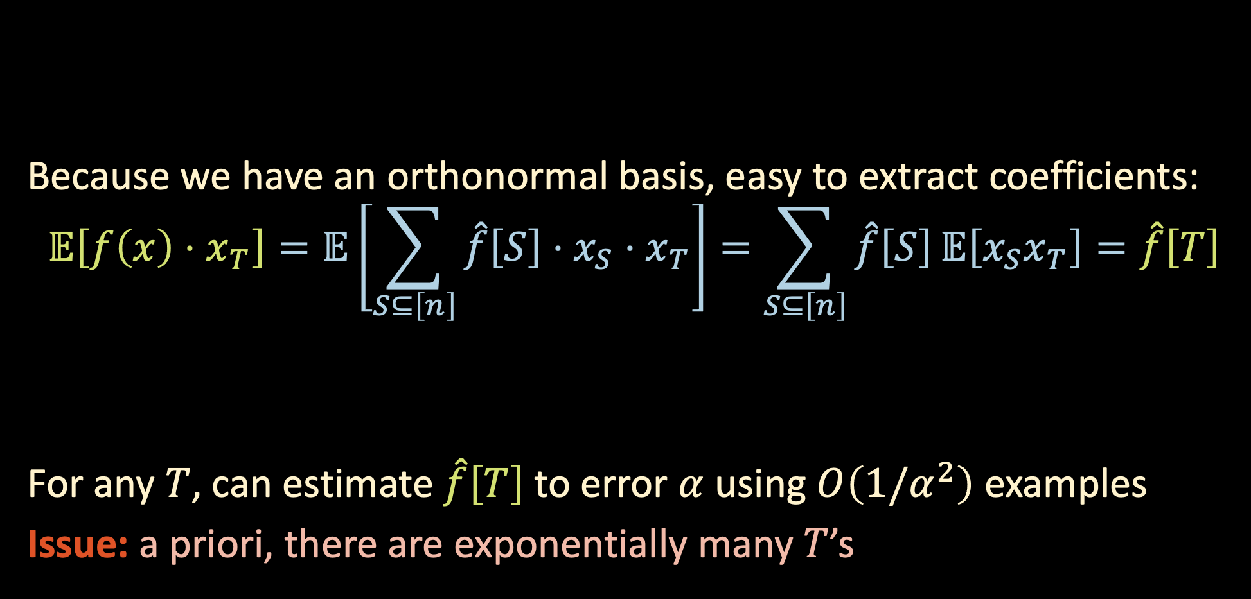
FOURIER ANALYSIS OF BOOLEAN FUNCTIONS
$$f\left(x\right)=\sum_{S⊆[n]}{\hat{f}\left[S\right]⋅x_{S}}$$
Because we have an orthonormal basis, easy to extract coefficients:
$$𝔼\left[f\left(x\right)⋅x_{T}\right]=𝔼\left[\sum_{S⊆\left[n\right]}{\hat{f}\left[S\right]⋅x_{S}}⋅x_{T}\right]=\sum_{S⊆\left[n\right]}{\hat{f}\left[S\right]}𝔼\left[x_{S}x_{T}\right]=\hat{f}\left[T\right]$$
For any $T$, can estimate $\hat{f}\left[T\right]$to error $α$ using $O\left(1/α^{2}\right)$ examples
Issue: a priori, there are exponentially many $T$’s
We can estimate this empirically using our training data!

Slide 21
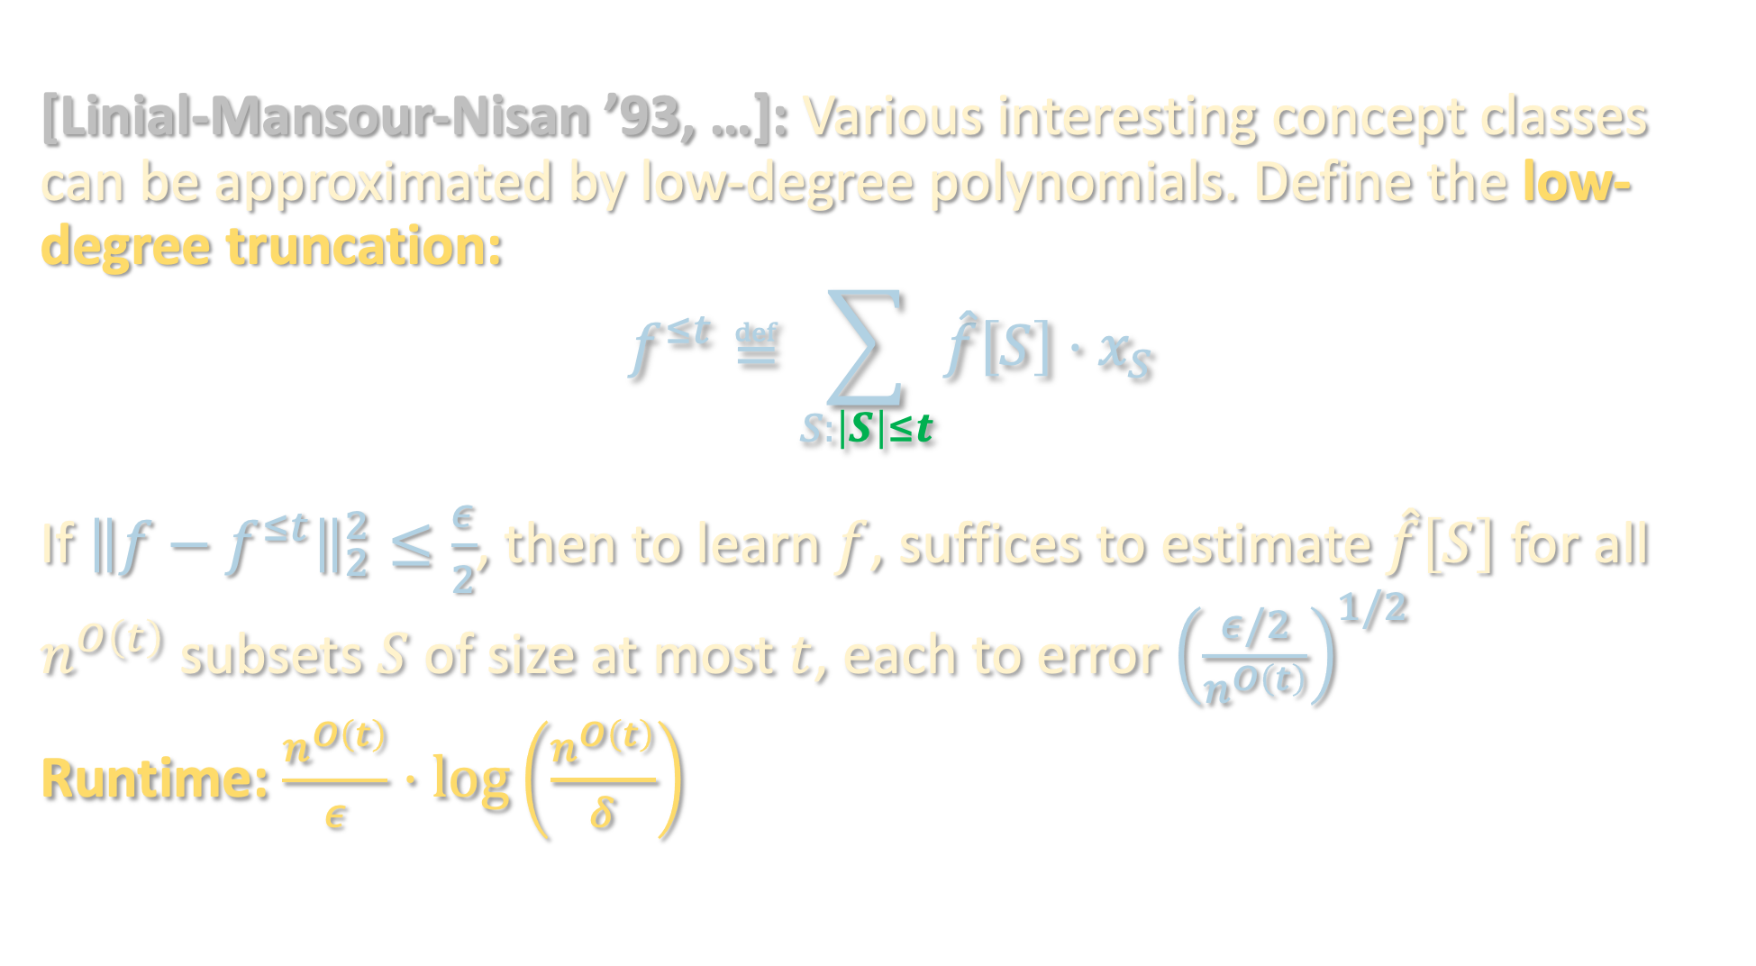
LOW-DEGREE ALGORITHM
[Linial-Mansour-Nisan ’93, …]: Various interesting concept classes can be approximated by low-degree polynomials. Define the low-degree truncation:
$$f^{≤t}≝\sum_{S:\left|S\right|≤t}{\hat{f}\left[S\right]⋅x_{S}}$$
If ${\left\|f−f^{≤t}\right\|}_{2}^{2}≤\frac{ε}{2}$, then to learn $f$, suffices to estimate $\hat{f}\left[S\right]$ for all $n^{O\left(t\right)}$ subsets $S$ of size at most $t$, each to error ${\left(\frac{ε/2}{n^{O\left(t\right)}}\right)}^{1/2}$
Runtime: $\frac{n^{O\left(t\right)}}{ε}⋅\log\left(\frac{n^{O\left(t\right)}}{δ}\right)$

Slide 22
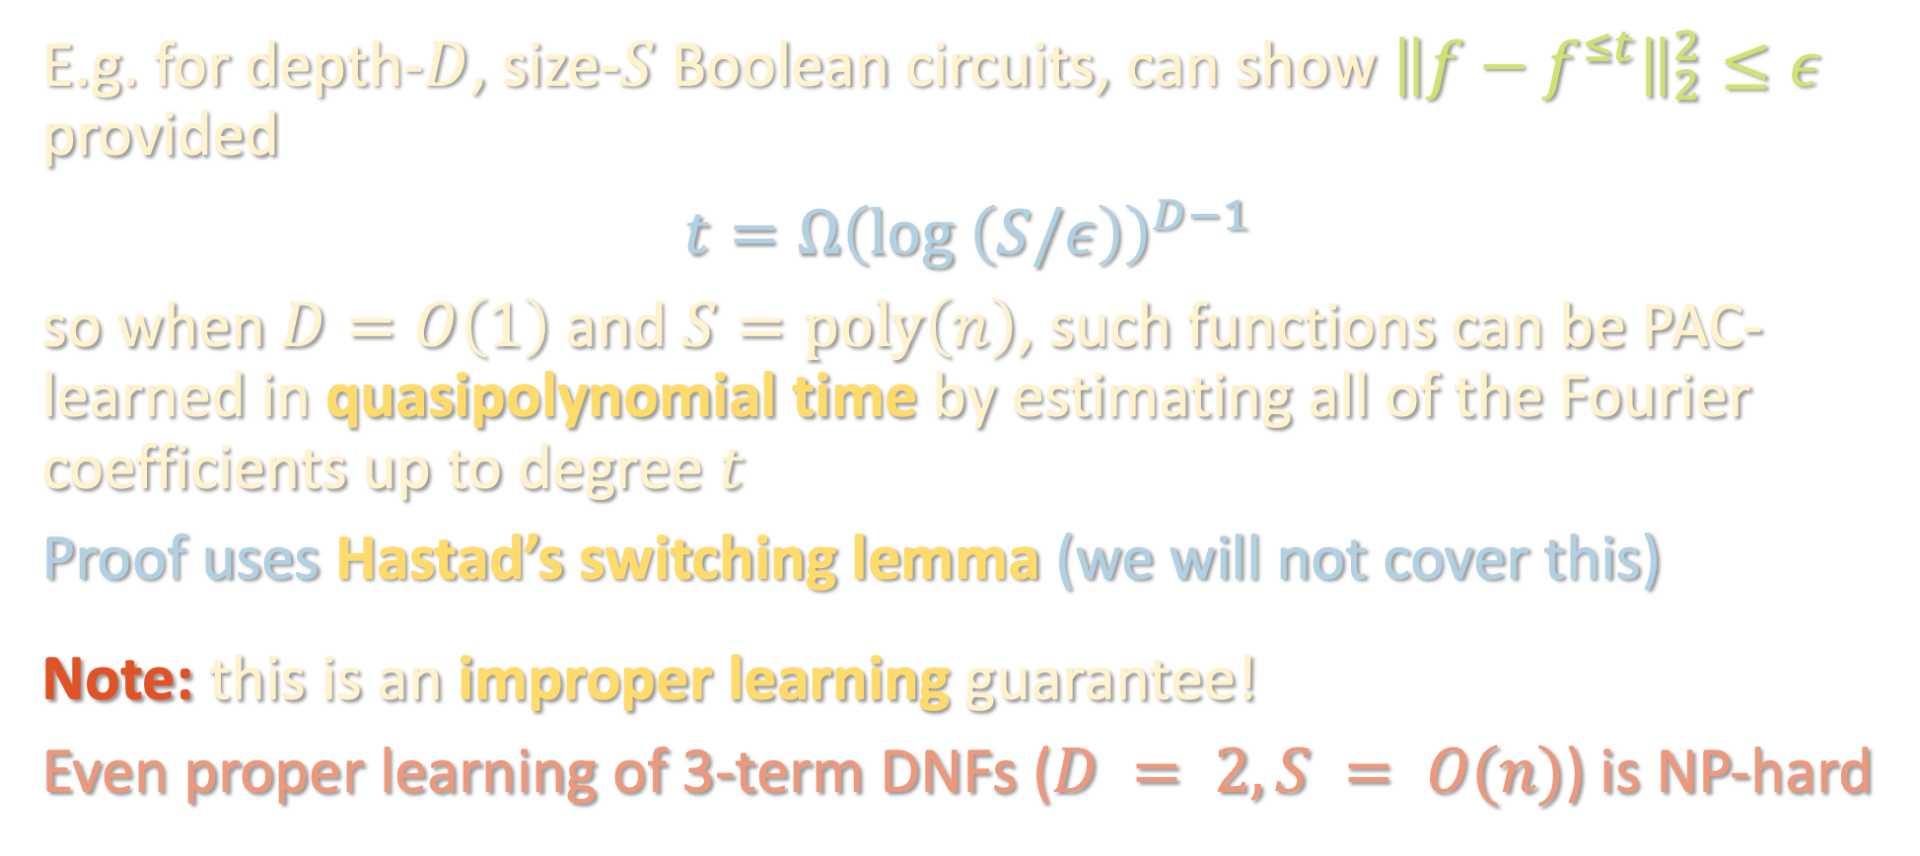
LOW-DEGREE ALGORITHM
E.g. for depth-$D$, size-$S$ Boolean circuits, can show ${\left\|f−f^{≤t}\right\|}_{2}^{2}≤ε$ provided
$$t=Ω{\left(\log\left(S/ε\right)\right)}^{D−1 }$$
so when $D=O\left(1\right)$ and $S=poly\left(n\right)$, such functions can be PAC-learned in quasipolynomial time by estimating all of the Fourier coefficients up to degree $t$
Proof uses Hastad’s switching lemma (we will not cover this)
Note: this is an improper learning guarantee!
Even proper learning of 3-term DNFs ($D = 2, S = O(n)$) is NP-hard

Slide 23
PAC learning – motivation and problem setup
Boolean functions and Fourier analysis
Extensions to agnostic / general distributions

Slide 24


REMARK ON AGNOSTIC LEARNING
Low-degree algorithm also provides guarantees in agnostic setting:
$\min_{g:\deg\left(g\right)≤t}{𝔼\left[{\left(g\left(x\right)−y\right)}^{2}\right]}$ | $$≤𝔼\left[{\left(f^{≤t}\left(x\right)−y\right)}^{2}\right]$$
 | $$=𝔼\left[{\left(\left(f^{≤t}\left(x\right)−f\left(x\right)\right)+\left(f\left(x\right)−y\right)\right)}^{2}\right]$$
 | $$≤2 𝔼\left[{\left(f^{≤t}\left(x\right)−f\left(x\right)\right)}^{2}\right]+2 𝔼\left[{\left(f\left(x\right)−y\right)}^{2}\right]$$
 | $$≤O\left(ε\right)+8\operatorname{Pr}\left[f\left(x\right)≠y\right]$$
 | $$=O\left(ε\right)+8 OPT$$
The low-degree algorithm is finding (an approximation to) the best low-degree approximation to the label. Optimal $g$ can be found with polynomial regression

Slide 25


REMARK ON AGNOSTIC LEARNING
Low-degree algorithm also provides guarantees in agnostic setting:
Note that $Pr\left[\operatorname{sgn}\left(g\left(x\right)\right)≠y\right]≤𝔼\left[{\left(g\left(x\right)−y\right)}^{2}\right]$, so low-degree algorithm achieves constant-factor approximation to OPT
Solving $\min_{g:\deg\left(g\right)≤t}{𝔼\left[\left|g\left(x\right)−y\right|\right]}$ and taking $\operatorname{sgn}\left(g\left(x\right)−s\right)$ for optimal $s$ upgrades this to $OPT+O\left(ε\right)$ “for free” [Kalai-Klivans-Mansour-Servedio ‘06] “L1 polynomial regression”
$\min_{g:\deg\left(g\right)≤t}{𝔼\left[{\left(g\left(x\right)−y\right)}^{2}\right]}$ | $$≤𝔼\left[{\left(f^{≤t}\left(x\right)−y\right)}^{2}\right]$$
 | $$=𝔼\left[{\left(\left(f^{≤t}\left(x\right)−f\left(x\right)\right)+\left(f\left(x\right)−y\right)\right)}^{2}\right]$$
 | $$≤2 𝔼\left[{\left(f^{≤t}\left(x\right)−f\left(x\right)\right)}^{2}\right]+2 𝔼\left[{\left(f\left(x\right)−y\right)}^{2}\right]$$
 | $$≤O\left(ε\right)+8\operatorname{Pr}\left[f\left(x\right)≠y\right]$$
 | $$=O\left(ε\right)+8 OPT$$

Slide 26

REMARK ON AGNOSTIC LEARNING
Low-degree algorithm also provides guarantees in agnostic setting:
$\min_{g:\deg\left(g\right)≤t}{𝔼\left[{\left(g\left(x\right)−y\right)}^{2}\right]}$ | $$≤𝔼\left[{\left(f^{≤t}\left(x\right)−y\right)}^{2}\right]$$
 | $$=𝔼\left[{\left(\left(f^{≤t}\left(x\right)−f\left(x\right)\right)+\left(f\left(x\right)−y\right)\right)}^{2}\right]$$
 | $$≤2 𝔼\left[{\left(f^{≤t}\left(x\right)−f\left(x\right)\right)}^{2}\right]+2 𝔼\left[{\left(f\left(x\right)−y\right)}^{2}\right]$$
 | $$≤O\left(ε\right)+8\operatorname{Pr}\left[f\left(x\right)≠y\right]$$
 | $$=O\left(ε\right)+8 OPT$$

Slide 27

REMARK ON AGNOSTIC LEARNING
Low-degree algorithm also provides guarantees in agnostic setting:
$\min_{g:\deg\left(g\right)≤t}{𝔼\left[{\left(g\left(x\right)−y\right)}^{2}\right]}$ | $$≤𝔼\left[{\left(f^{≤t}\left(x\right)−y\right)}^{2}\right]$$
 | $$=𝔼\left[{\left(\left(f^{≤t}\left(x\right)−f\left(x\right)\right)+\left(f\left(x\right)−y\right)\right)}^{2}\right]$$
 | $$≤2 𝔼\left[{\left(f^{≤t}\left(x\right)−f\left(x\right)\right)}^{2}\right]+2 𝔼\left[{\left(f\left(x\right)−y\right)}^{2}\right]$$
 | $$≤O\left(ε\right)+8\operatorname{Pr}\left[f\left(x\right)≠y\right]$$
 | $$=O\left(ε\right)+8 OPT$$

Slide 28

REMARK ON AGNOSTIC LEARNING
Low-degree algorithm also provides guarantees in agnostic setting:
$\min_{g:\deg\left(g\right)≤t}{𝔼\left[{\left(g\left(x\right)−y\right)}^{2}\right]}$ | $$≤𝔼\left[{\left(f^{≤t}\left(x\right)−y\right)}^{2}\right]$$
 | $$=𝔼\left[{\left(\left(f^{≤t}\left(x\right)−f\left(x\right)\right)+\left(f\left(x\right)−y\right)\right)}^{2}\right]$$
 | $$≤2 𝔼\left[{\left(f^{≤t}\left(x\right)−f\left(x\right)\right)}^{2}\right]+2 𝔼\left[{\left(f\left(x\right)−y\right)}^{2}\right]$$
 | $$≤O\left(ε\right)+8\operatorname{Pr}\left[f\left(x\right)≠y\right]$$
 | $$=O\left(ε\right)+8 OPT$$

Slide 29
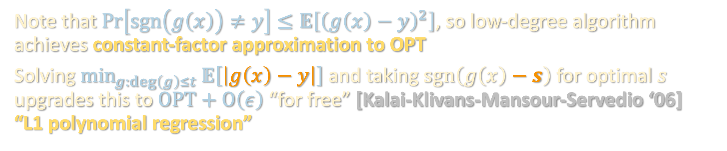

REMARK ON AGNOSTIC LEARNING
Low-degree algorithm also provides guarantees in agnostic setting:
$\min_{g:\deg\left(g\right)≤t}{𝔼\left[{\left(g\left(x\right)−y\right)}^{2}\right]}$ | $$≤𝔼\left[{\left(f^{≤t}\left(x\right)−y\right)}^{2}\right]$$
 | $$=𝔼\left[{\left(\left(f^{≤t}\left(x\right)−f\left(x\right)\right)+\left(f\left(x\right)−y\right)\right)}^{2}\right]$$
 | $$≤2 𝔼\left[{\left(f^{≤t}\left(x\right)−f\left(x\right)\right)}^{2}\right]+2 𝔼\left[{\left(f\left(x\right)−y\right)}^{2}\right]$$
 | $$≤O\left(ε\right)+8\operatorname{Pr}\left[f\left(x\right)≠y\right]$$
 | $$=O\left(ε\right)+8 OPT$$
Note that $Pr\left[\operatorname{sgn}\left(g\left(x\right)\right)≠y\right]≤𝔼\left[{\left(g\left(x\right)−y\right)}^{2}\right]$, so low-degree algorithm achieves constant-factor approximation to OPT
Solving $\min_{g:\deg\left(g\right)≤t}{𝔼\left[\left|g\left(x\right)−y\right|\right]}$ and taking $\operatorname{sgn}\left(g\left(x\right)−s\right)$ for optimal $s$ upgrades this to $OPT+O\left(ε\right)$ “for free” [Kalai-Klivans-Mansour-Servedio ‘06] “L1 polynomial regression”

Slide 30

REMARK ON AGNOSTIC LEARNING
Low-degree algorithm also provides guarantees in agnostic setting:
Note that $Pr\left[\operatorname{sgn}\left(g\left(x\right)\right)≠y\right]≤𝔼\left[{\left(g\left(x\right)−y\right)}^{2}\right]$, so low-degree algorithm achieves constant-factor approximation to OPT
Solving $\min_{g:\deg\left(g\right)≤t}{𝔼\left[\left|g\left(x\right)−y\right|\right]}$ and taking $\operatorname{sgn}\left(g\left(x\right)−s\right)$ for optimal $s$ upgrades this to $OPT+O\left(ε\right)$ “for free” [Kalai-Klivans-Mansour-Servedio ‘06] “L1 polynomial regression”
Takeaway: functions which are well-approximated by low-degree polynomials can be learned even in the challenging agnostic learning setting!

Slide 31
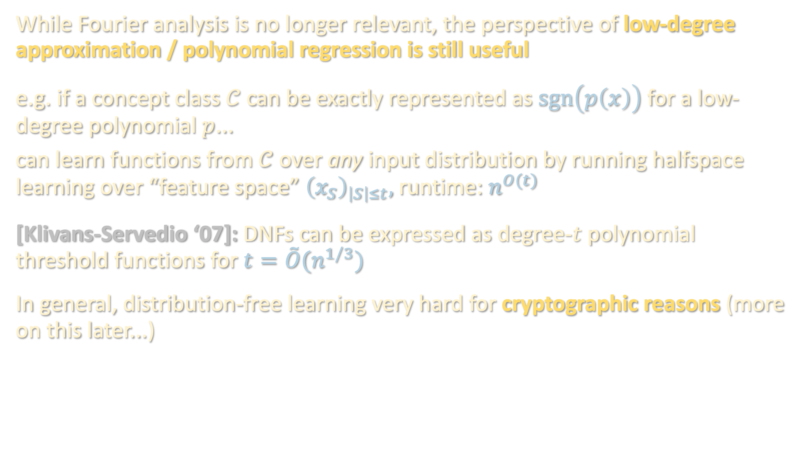
BEYOND THE UNIFORM DISTRIBUTION
While Fourier analysis is no longer relevant, the perspective of low-degree approximation / polynomial regression is still useful
e.g. if a concept class $𝒞$ can be exactly represented as $\operatorname{sgn}\left(p\left(x\right)\right)$ for a low-degree polynomial $p$...
can learn functions from $𝒞$ over any input distribution by running halfspace learning over “feature space” ${\left(x_{S}\right)}_{\left|S\right|≤t},$runtime: $n^{O(t)}$
[Klivans-Servedio ‘07]: DNFs can be expressed as degree-$t$ polynomial threshold functions for $t=\tilde{O}(n^{1/3})$
In general, distribution-free learning very hard for cryptographic reasons (more on this later...)

